Slide 1

SuperStore
Amra Fetić
CREATED
MiD BOOTCAMP PROJECT

Slide 2



AGENDA
What is the overall sales trend over time?
Which shipping mode is most commonly used, and does it correlate with higher sales?
BONUS SALES PREDICTION
Is there a correlation between the segment of customers and the amount of sales?
BONUS SALES PREDICTION
What are the top-selling products and categories?
How do sales vary across different regions or countries?

Slide 3
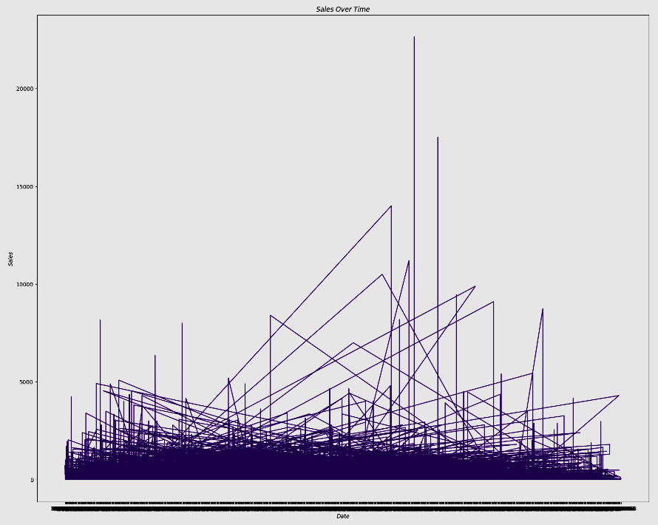
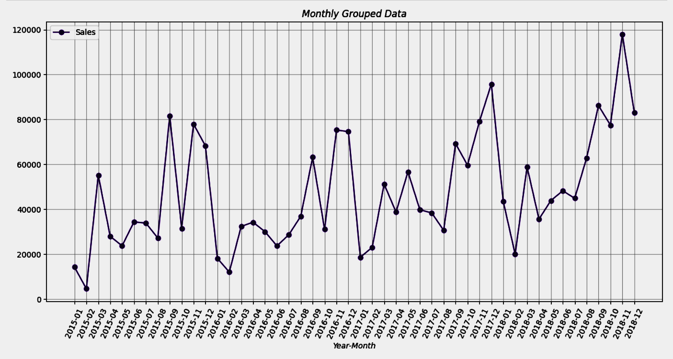
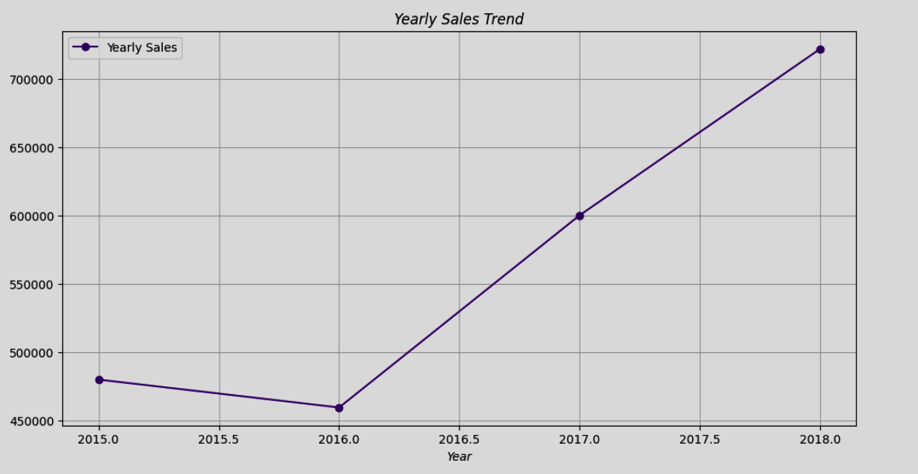
What is the overall sales trend over time?
Daily ,
Monthly or
Yearly?

Slide 4
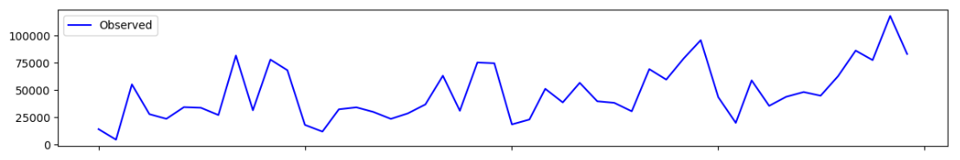
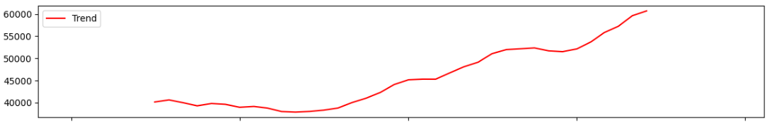
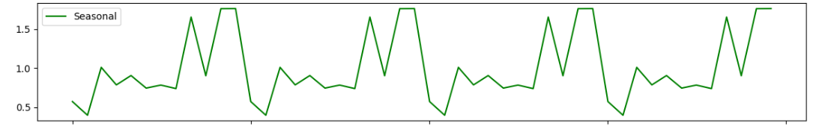
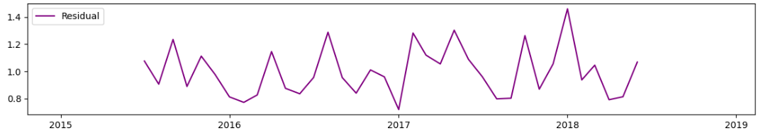

Slide 5
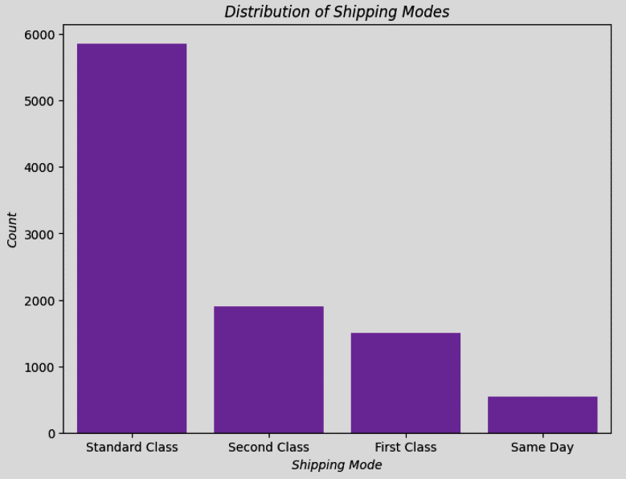

Which shipping mode is most commonly used, and does it correlate with higher sales?

Slide 6
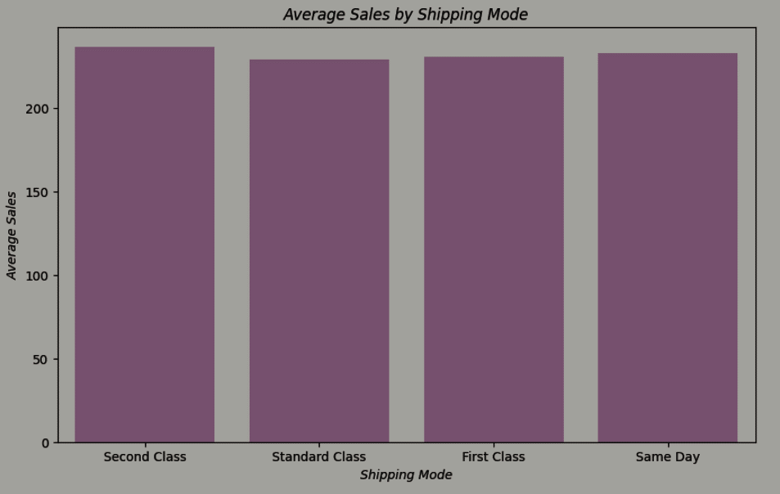

What about Average Sales ?
Ship mode | Average sales (mean)
First Class Same Day Second Class Standard Class | 230.228 232.749 236.547 228.84

Slide 7
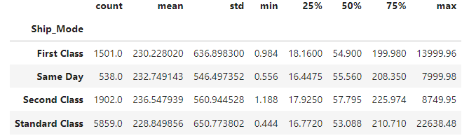
T-test: t-statistic = -0.13, p-value = 0.8929
Notes:
For the ship_mode 'First Class'sale values vary widely, with a high standard deviation.
'Same Day' - shipping is similar to 'First Class', the sales values show variability.
'Second Class'- sales values also have variability.
'Standard Class' - This shipping mode has the highest count of data points,sales values have a wide range, as indicated by the standard deviation

Slide 8
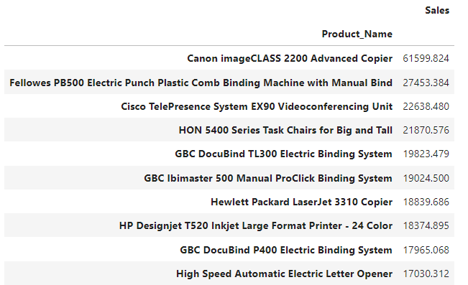

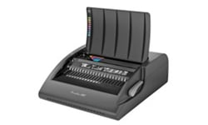
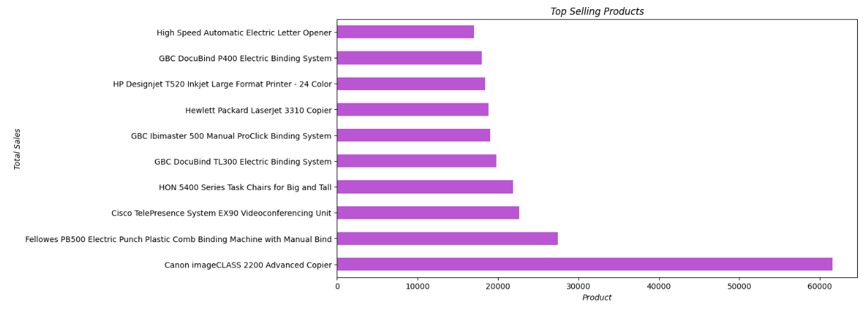

What are the top-selling products and categories?

Slide 9
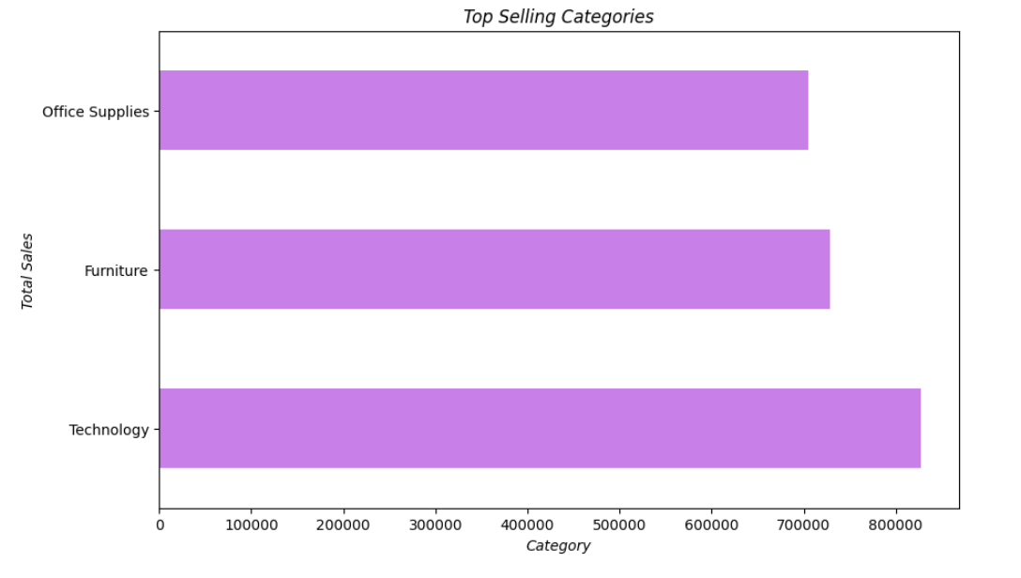
What are the top-selling products and categories?
Category | Sales
Technology | 827455.8730
Furniture | 728658.5757
Office Supplies | 705422.3340

Slide 10
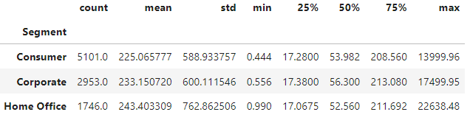
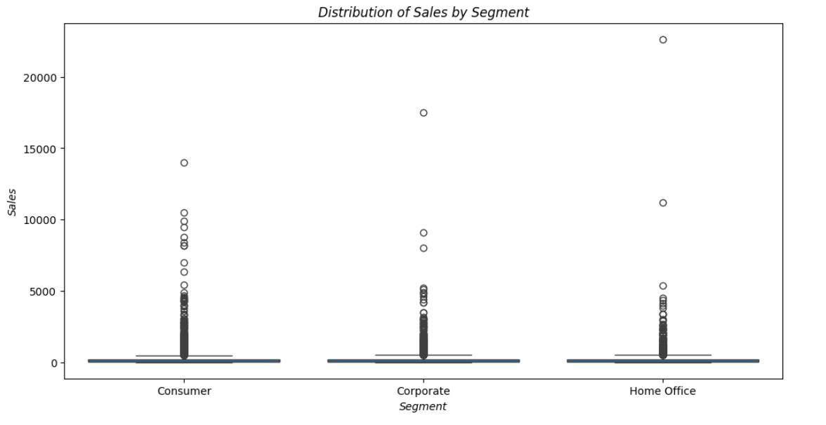
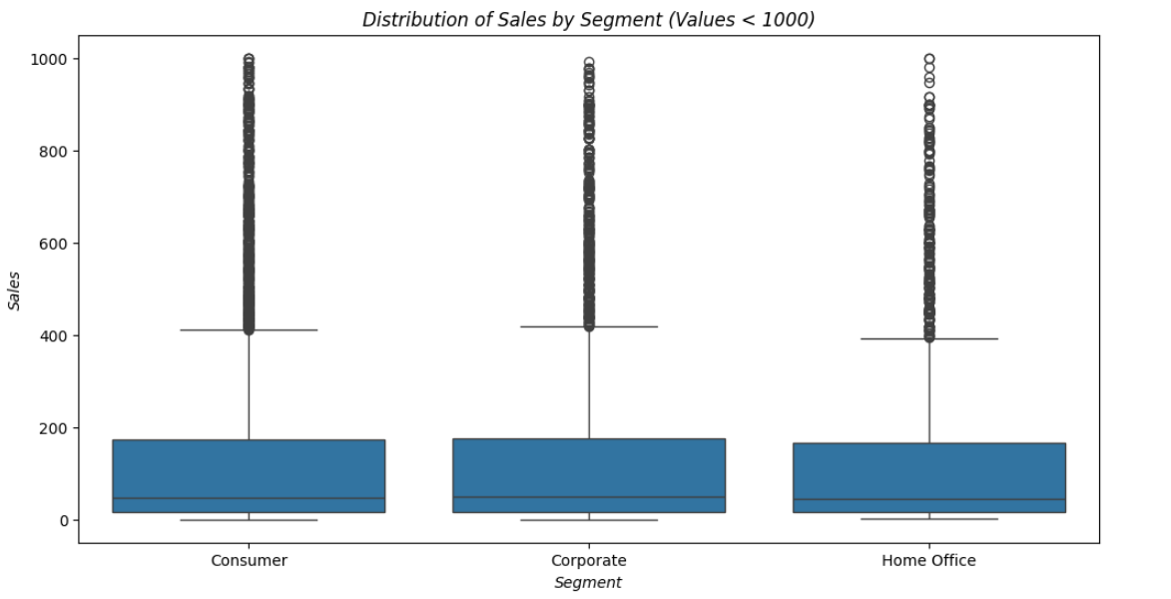
Is there a correlation between the segment of customers and the amount of sales?
ANOVA F-statistic: 0.59
P-value: 0.5558
Notes:
The p-value associated with the F-statistic is 0.5558. This p-value is compared to a significance level (commonly 0.05) to determine whether the observed differences are statistically significant.
A higher p-value (in this case, greater than 0.05) suggests that you do not have enough evidence to reject the null hypothesis. The null hypothesis typically states that there are no significant differences between the group means.
Interpretation:
With an F-statistic of 0.59 and a p-value of 0.5558, you may not have enough evidence to reject the null hypothesis. This suggests that, based on the provided sales data, there may not be statistically significant differences in average sales values between the three segments.

Slide 11
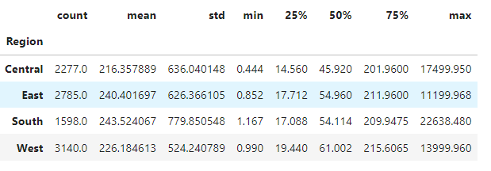
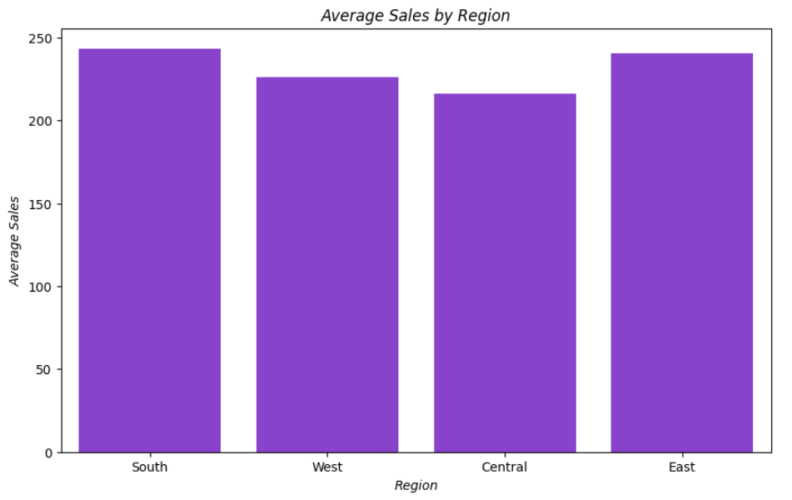
How do sales vary across different regions or countries?
Reject the null hypothesis
ANOVA F-statistic: 0.90
P-value: 0.4416
Notes:
This means that, statistically, there is not enough evidence to conclude that there are significant differences in mean sales values among the regions

Slide 12
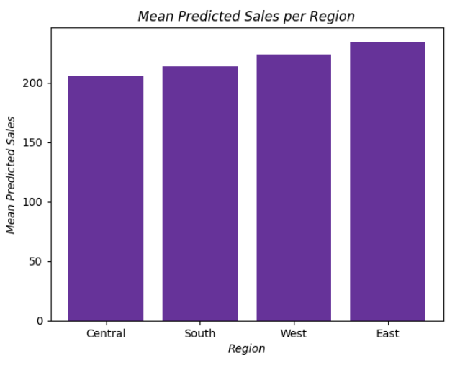
Predictive analysis to forecast future sales
Region | Predicted Sales
Central | 206.03
East | 234.58
South | 213.53
West | 223.61
Mean Squared Error: 670942.0782053045
Notes:
In summary, a Mean Squared Error of 670942.0782053045 indicates the average squared difference between observed and predicted sales values.

Slide 13
THANK YOU

