Slide 1
QA-SFiA Project 1
By Amran Uddin

Slide 2
Project Requirements
CRUD Functioning Website
Using Python Flask
Deployed by Jenkins
Have a relational database with at least two tables

Slide 3
My Solution
Have a game movie review website
Have 4 tables with two tables paired up with another table and one table from each pair connecting to a fifth user table.

Slide 4
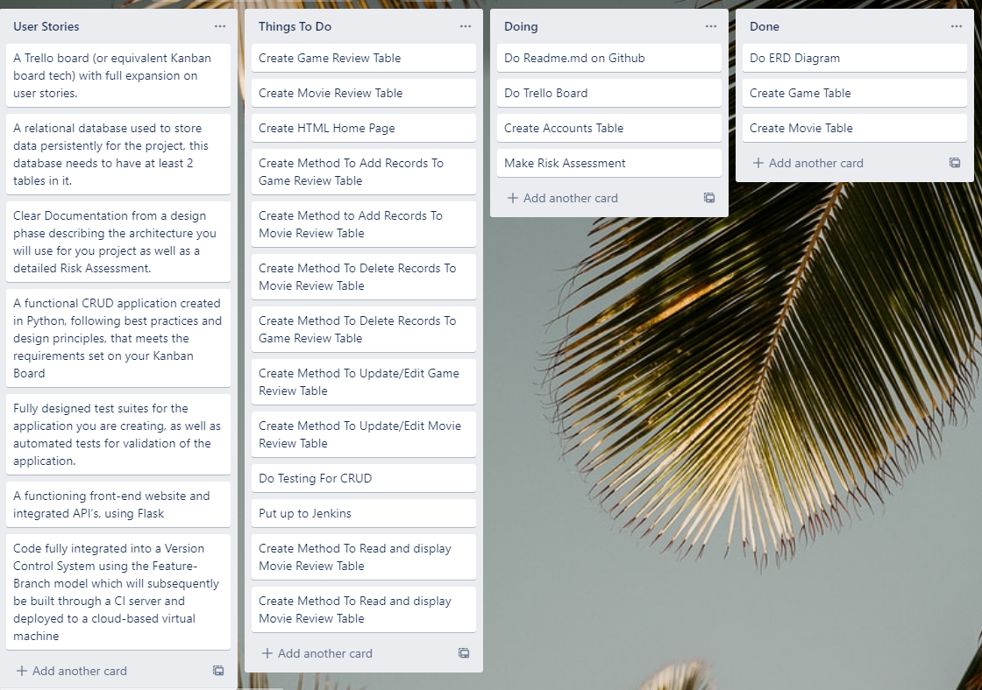
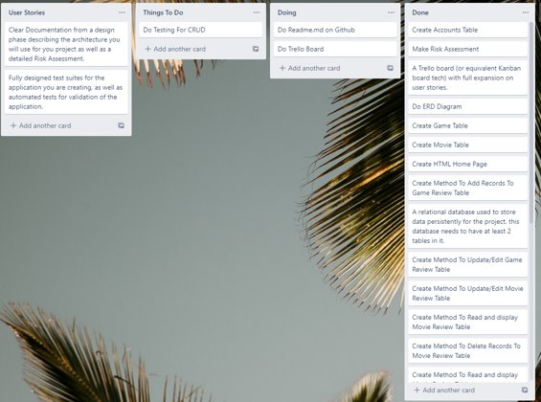
Agile
Trello Before
Trello After
I used a Trello board for planning. For time management and making sure, I also set myself goals. For example on week 1&2 we were doing sql so I made sure to finish that by the end of week 2. On week 3 we were working Flask so I made sure crud functionality was working by end of week 3.

Slide 5
Risk Assessment
Risk Assessment | Risk Factor | Mitigating | New Risk Factor
Corrupted Files | 8/10 | Online Version Control | 3/10
Deleted Files | 6/10 | Online Version Control | 1/10
Losing Git Password | 9/10 | Have Email Recovery | 2/10
Falling Sick | 9/10 | Maintain Health/Visiting Doc/Sanitizing/Isolating | 7/10
Data of Site Leaked | 3/10 | Hashing/Storing Sensitive Information In Secure Locations | 1/10
Forgetting Code | 7/10 | Good Commenting | 5/10
Bad Time Management | 6/10 | Trello Board | 4/10
Running out of money | 3/10 | Pausing VM and Database instance when not in use | 2/10
Getting Hacked | 7/10 | Strong password | 4/10

Slide 6
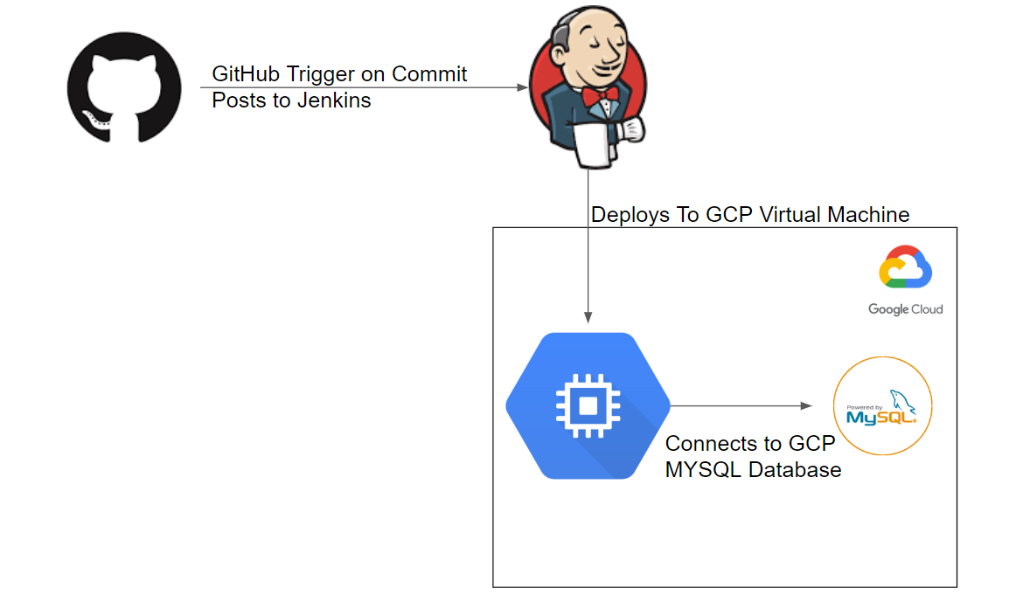

Deployment
Program will be coded in vscode using python-flask and version controlled on GitHub. When changes are made a trigger will cause Jenkins to build the program with the latest version. This will be ran on a GCP Virtual Machine which will be connected to a GCP MYSQL database.

Slide 7
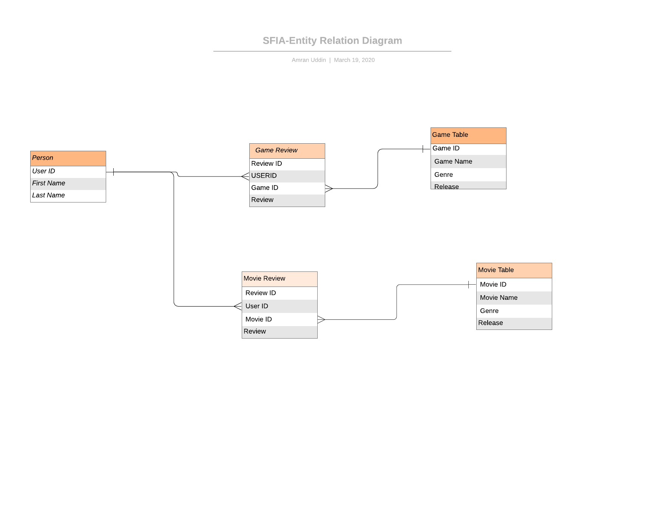
Entity Relation Diagram
I have created 4 tables excluding the user table. The four tables are paired up with one of each pair being connected to the accounts table, meeting the requirements for the relational database.

Slide 8
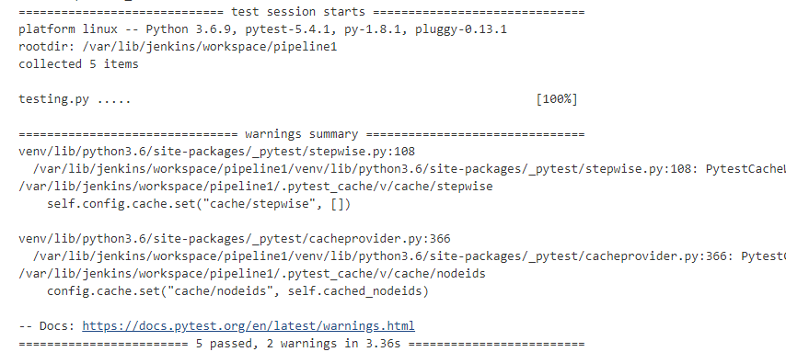
Testing
Using Pytest

Slide 9
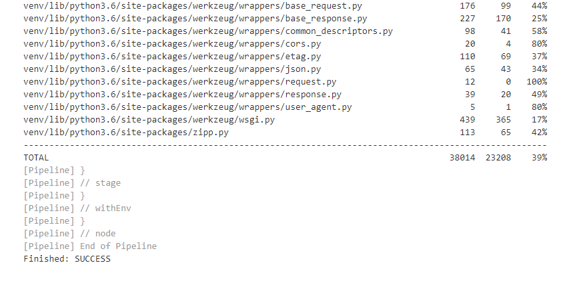
Testing
Using coverage

Slide 10
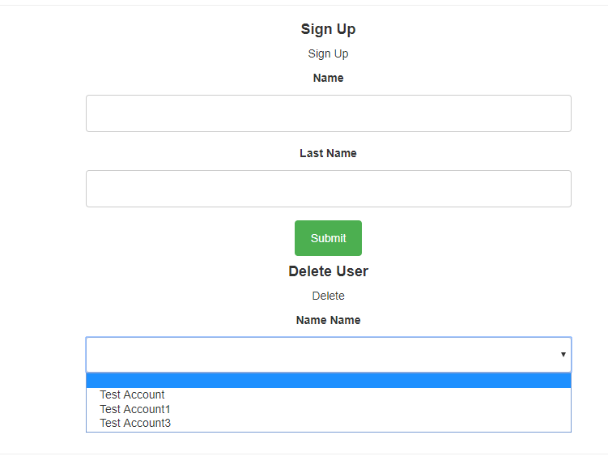
Website – CRD – CREATE READ DELETE
On Sign Up you can add your First and Last Name this will add your user to the accounts table
On Delete you can pick from one of the accounts to delete, this will delete their review and take their name from the accounts table for future review taking.

Slide 11
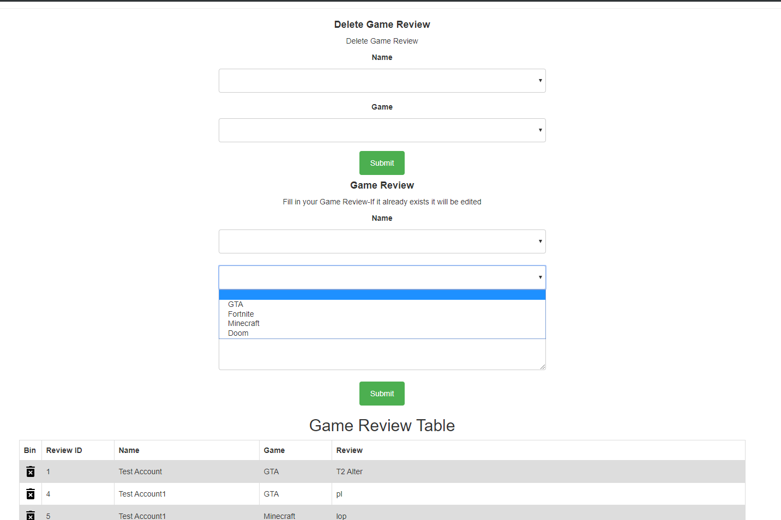
Website-CRUD-CREATE READ UPDATE DELETE
For Delete Game Review, you pick your name and the game of the review you want to delete.
For the second form you pick the name of the user that wants to review, pick the game you want to review and write a review with less than 200 characters.
If a review already exists with that user and game the review will be edited with the new review
You can also delete just by clicking the bin icon to delete a review as well

Slide 12
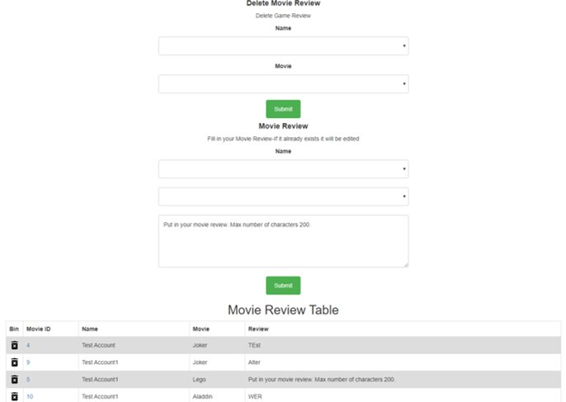
Website-CRUD-CREATE READ UPDATE DELETE
For Delete Movie Review, you pick your name and the movie of the review you want to delete.
For the second form you pick the name of the user that wants to review, pick the movie you want to review and write a review with less than 200 characters.
If a review already exists with that user and movie the review will be edited with the new review
You can also delete just by clicking the bin icon to delete a review as well

Slide 13
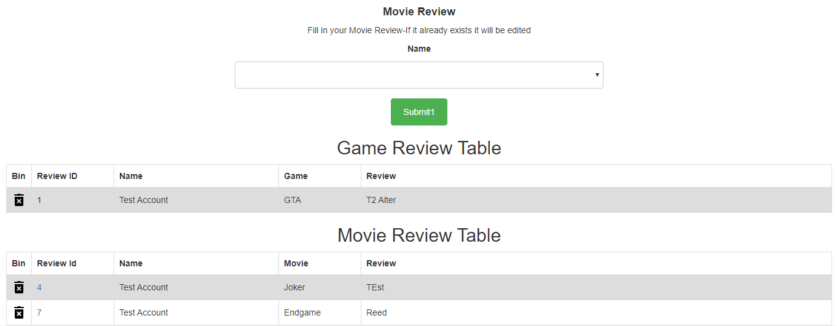
Website-RD-READ DELETE
Select the user you want to view reviews for click submit and records will be displayed in the table
You can delete from the bin icon for the review you want to delete.

Slide 14
Retrospective
4 tables excluding the user table with two pairs of relation
Good use of Jenkins, making it build on new GitHub version of the app
Good Time Management
Easy to use graphical interface
What went well
What could be better
A login feature
Selenium Testing
Add more games and movies for user to review
Write code in a way that is more easier to test

