Slide 1
DIO
(DIGITAL INPUT OUTPUT)

Slide 2
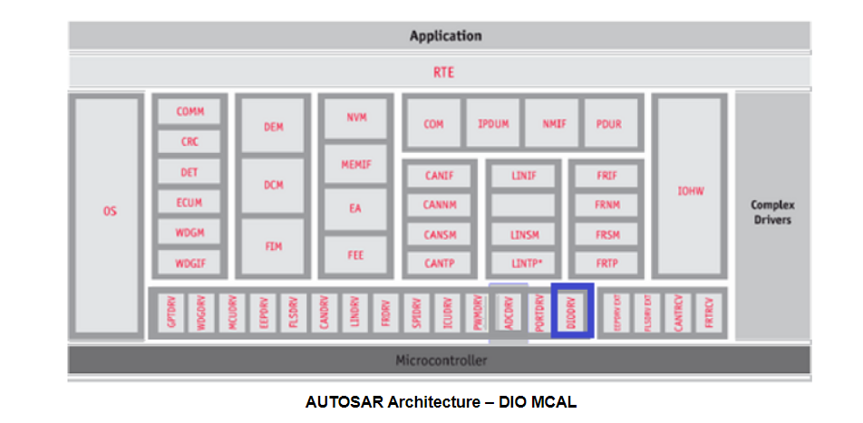
Dio Overview: The DIO driver is a part of the microcontroller (peripheral) Driver module which is a part of the Basic Software. The figure below shows the position of the DIO driver in the AUTOSAR Architecture.

Slide 3
The DIO driver provides an interface to external peripherals by abstracting the input and output pins on the microcontroller device.
The DIO pins are general purpose in nature. TDA4x have multiple DIO driver instances.
TDA4x can support up to 11 instances. These instances are generally associated with specific domain, e.g. wakeup, main domains.
Refer the device specific data Manual for operating voltages and current sourcing capabilities 2.

Slide 4
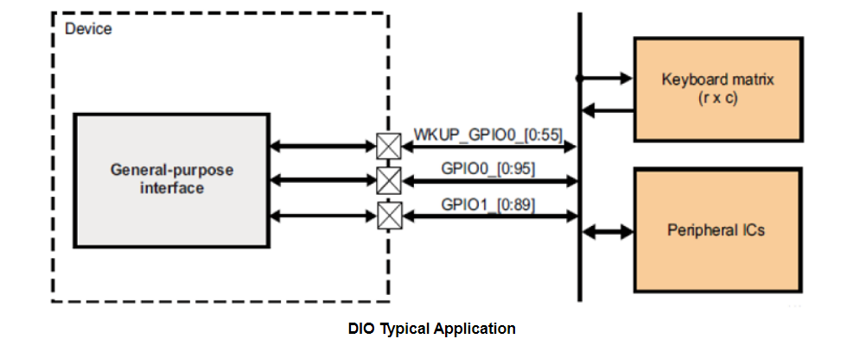

Slide 5
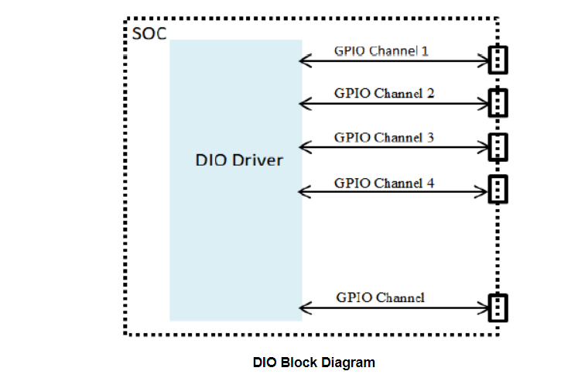
Design Description: The DIO driver provides an interface to the external connections.

Slide 6
Dependencies
Depends on MCAL Port module.
The DIO module does not provide APIs for overall configuration and initialization of the port structure which is used in the DIO module. The initialization and configuration will be done by other entities. The DIO module adapts its configuration and usage to the microcontroller and ECU.
Many ports and port pins are assigned by the PORT Driver Module to various functionalities for example
General purpose I/O (GPIO / Dio)
SPI
ADC
PWM, etc...

Slide 7
DIO Channel, Port And Channel Group
A DIO channel represents a single general-purpose digital input/output pin.
A DIO Port is a grouping of several DIO channels by hardware (typically controlled by one hardware register).
A DIO Channel Group consists of several adjoining DIO channels represented by a logical group. A DIO channel group belongs to one DIO port as illustrated below

Slide 8
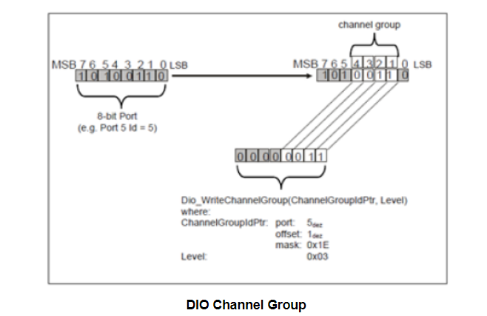

Slide 9
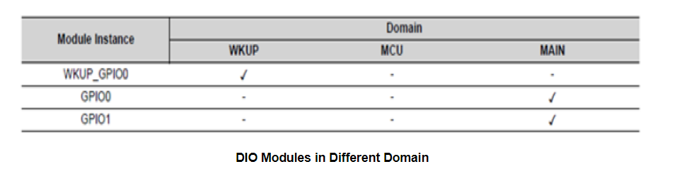
The allocation of DIO instances is dependent on the variant of the device being used. In general, channels/pins can be configured as input or output. Each DIO instance supports 9 banks of 16 DIO pins each. There are in total 3 instances, one in wakeup domain and two in the main domain.

Slide 10
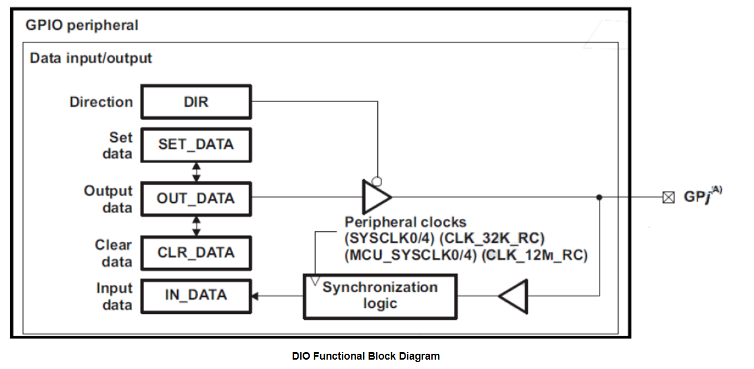
Input/Output Functionality
The DIO peripheral provides the main functionality of input and output. Each pin can be configured independently as input or output with the help of the GPIO direction registers

Slide 11
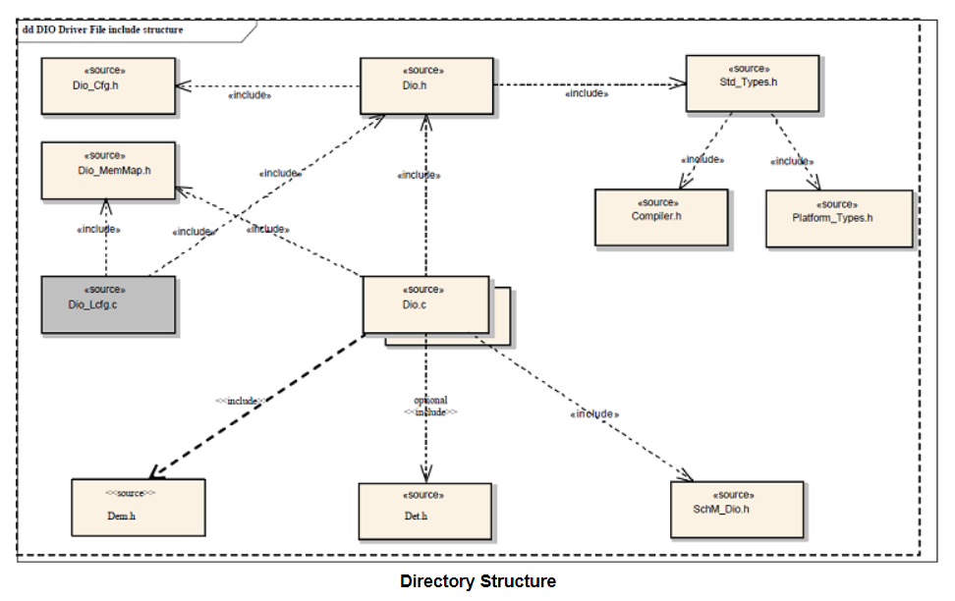
Directory Structure The below diagram shows the overall files structure for the DIO driver. The Dio.c and Dio.h are the 2 files that contain the DIO driver's APIs.

Slide 12
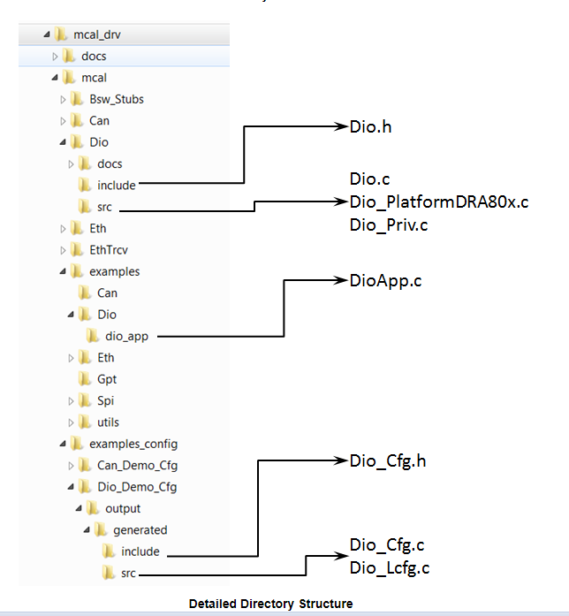

Slide 13
Driver Implemented by
Dio.h : Shall implement the interface provided by the driver
Dio.c, Dio_Priv.h : Shall implement the driver functionality
Example Application
Dio_Cfg.h and Dio_Cfg.c: Shall implement the generated configuration for pre-compile variant
Dio_Cfg.h and Dio_Lcfg.c: Shall implement the generated configuration for link-time variant
DioApp.c: Shall implement the example application that demonstrates the use of the driver

