Slide 1
AUTOMATIC PUBLIC LIGHTNING SYSTEM
CSE7101- Capstone Project
Review-2
Batch Number:CSE_60
Under the Supervision of,
Mr. Tanveer Ahmed
Assistant Professor
School of Computer Science and Engineering
Presidency University
Roll Number | Student Name
20221CCS0005 20231CCS3005 20231CCS3006 | AMREEN J BHAVANA A AALIYA ZAINA
Name of the Program: Capstone Project
Name of the HoD: Dr. Anandaraj
Name of the Program Project Coordinator: Ms Priyanka Niranjan
Name of the School Project Coordinators: Dr. Sampath A K , Dr. Geetha A

Slide 2
Abstract
An energy-efficient automated public lighting system is proposed using ESP-NOW — a low-power, low-latency, peer-to-peer wireless protocol supported by ESP32 microcontrollers. The system uses distributed sensor nodes (Ambient light) mounted on street poles to detect time and ambient luminance. Nodes communicate locally using ESP-NOW to coordinate switching and dimming of lights, while a gateway node aggregates status and relays logs to a cloud server over Wi-Fi for monitoring and analytics. The design reduces energy consumption by dimming lights during low-activity periods and turning them to full brightness on demand, improves response time compared to cloud-dependent systems, and keeps costs low by using off-the-shelf ESP32 hardware.

Slide 3
Literature Survey
Smart street lighting: research on time-based and environment-aware control strategies for public lights to reduce energy consumption.
ESP-NOW applications: studies and prototypes showing ESP-NOW’s suitability for low-latency local meshes and sensor/actuator coordination.
Sensing techniques: LDR/TSL2591 for ambient light, and ultrasonic/radar sensors for vehicle detection.
Centralized vs. distributed control: comparisons showing distributed local decision-making lowers latency and reliance on cloud connectivity.
Power management & dimming: strategies (PWM, LED drivers, adaptive dimming profiles) and evaluation of energy savings.

Slide 4
Objectives
Design a low-cost, low-latency public lighting control system using ESP32 devices and ESP-NOW.
Implement local, autonomous decision-making at each pole (ambient light based).
Achieve at least 50% energy savings relative to always-on lighting through dimming and on-demand brightening.
Enable a gateway for remote monitoring, logging, and OTA updates.
Ensure reliability and safety (fail-safe: lights default to safe brightness on communication failure).
Demonstrate scalability across multiple poles with robust inter-node coordination.

Slide 5
Existing Methods and Drawbacks
Timer-based systems: Lights turn on/off at scheduled times.
Drawbacks: No adaptation to actual pedestrian/vehicle flow; wasted energy.
Photocell (LDR) control: Lights respond only to ambient light.
Drawbacks: Cannot adapt to occupancy or transient needs (e.g., dark but nobody present).
Centralized cloud control (Wi-Fi/GSM): Each lamp connects to cloud server for commands.
Drawbacks: Higher latency, dependency on internet connectivity, higher power consumption, higher data costs.
Drawbacks: Local decisions only; no coordination (e.g., sudden brightening across many poles when a vehicle moves).

Slide 6
Proposed Method & Feasibility
Proposed Method:
Local coordination: Nodes broadcast short ESP-NOW messages (motion detected, light level, node ID) to nearby nodes. When the time sensor detects the time, the detecting node requests nearby nodes to increase brightness preemptively (improve safety).
Feasibility:
Technical: ESP-NOW is supported on ESP32, supports low-latency, peer-to-peer messaging and low power.
Economic: ESP32 nodes and sensors are low cost(ESP32 < ₹335, sensors < ₹200).
Operational: Local decision making reduces dependence on internet.
Scalability: ESP-NOW supports many strategies.

Slide 7
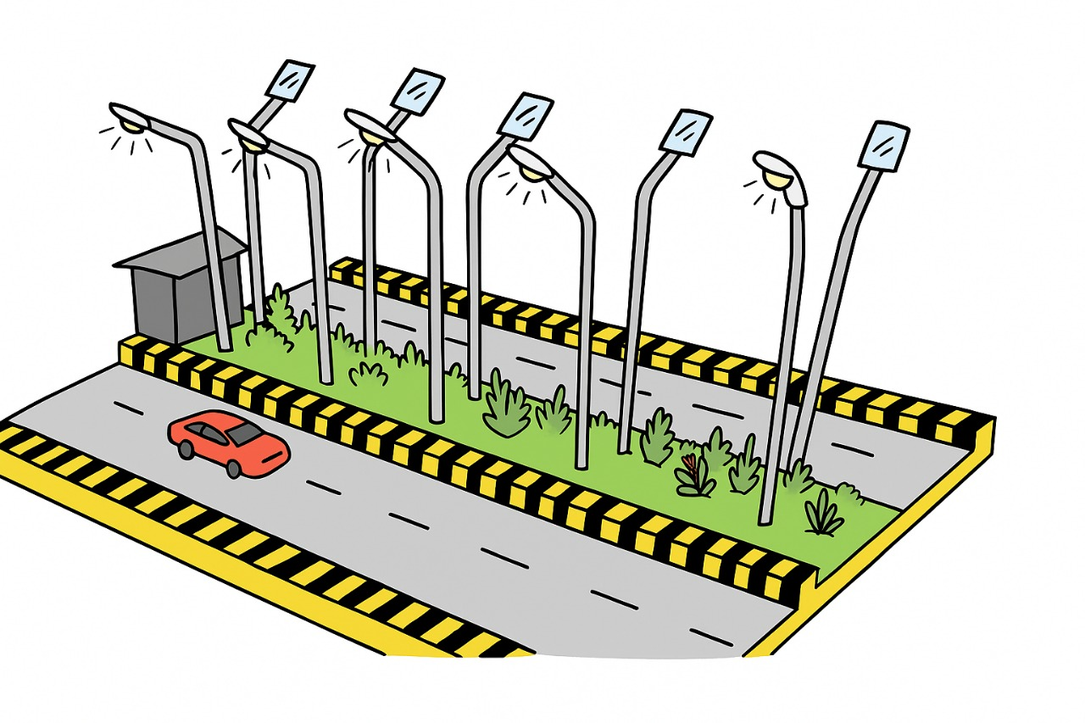
Architecture Diagram

Slide 8
Hardware & Software Requirements
Software Requirements
IDE: Arduino IDE
Libraries: ESP8266WiFi, ESP-NOW.
Protocol: ESP-NOW (for peer-to-peer communication)
Hardware Requirements
Item Specification
Microcontrollers ESP8266 (D1mini) ×6 units
Sensors Ambient Light Sensor ×1
Actuators 5V Single-Channel Relay Modules ×6
Lights LEDs (for simulation)
Power 5V Power Supply

Slide 9
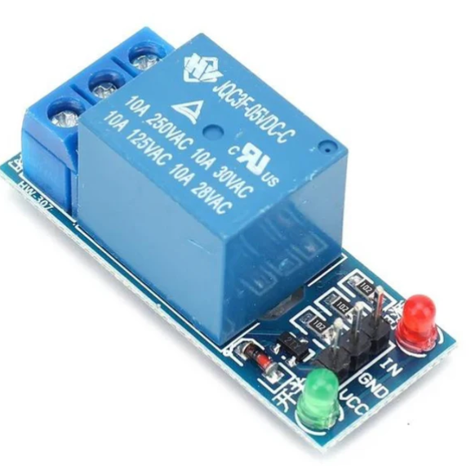
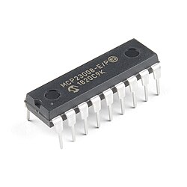
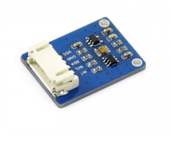
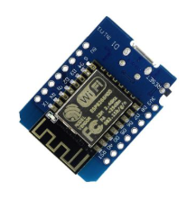
Components
5V Active Low Relay I2C [Inter-Integrated circuit] Ambient Light Sensor D1mini NodeMcu

Slide 10
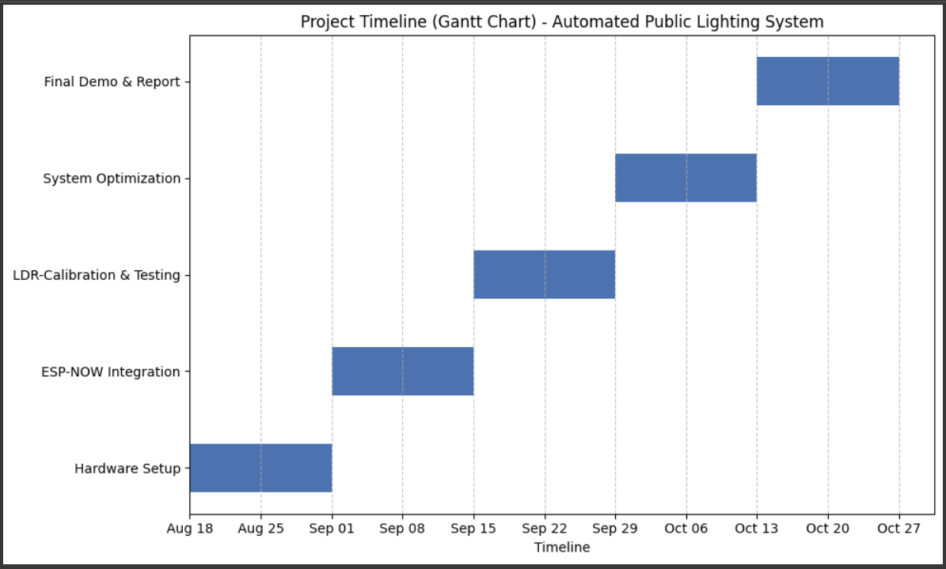
Timeline (Gantt Chart)

Slide 11
References
1. P. K. Sahoo et al., “IoT-Based Smart Lighting System for Energy Efficiency,” IEEE Access, vol. 9, pp. 112158–112173, 2021.
2. Espressif Systems, “ESP-NOW Protocol Documentation,” 2023. [Online]. Available: https://docs.espressif.com/projects/esp-idf/en/latest/esp32/api-reference/network/esp_now.html
3. A. Gupta, “Low-Cost Automation Using ESP8266,” Journal of Embedded Systems, vol. 7, no. 4, pp. 45–59, Dec. 2022.
4. https://www.mdpi.com/2673-4591/56/1/147
5. https://www.mdpi.com/2076-3417/9/16/3281

