Slide 1
AUTOMATED PUBLIC LIGHTNING SYSTEM USING ESP NOW PSCS_14
CSE7101- Capstone Project
Review-1
Batch Number: CSE_248
Under the Supervision of,
Mr. Tanveer Ahmed
Assistant Professor
Roll Number | Student Name
20221CCS0002 | AMREEN J
20231CCS3005 | BHAVANA A
20231CCS3006 | AALIYA ZAINA
Name of the Program: Computer Science and Engineering
Name of the HoD: Dr. Anandaraj
Name of the Program Project Coordinator: Ms Priyanka
Name of the School Project Coordinators: Dr. Sampath A K , Dr. Geetha A

Slide 2
Problem Statement Number: PSCS_17
Manual public lighting systems waste energy by operating on fixed schedules, ignoring ambient light conditions. Rural/remote areas lack adaptive solutions due to high costs and dependency on centralized networks.
Key Features
1. Energy inefficiency due to non-adaptive lighting schedules.
2. High deployment costs of IoT solutions requiring cloud infrastructure.
3. Lack of real-time responsiveness to environmental changes.

Slide 3
Content
Problem Statement
Objectives
Background and Related work for title Selection
Analysis of Problem Statement
Innovation or Novel Contributions
Git-hub Link
Timeline of the Project
References

Slide 4
Objectives
1. Design a low-cost, *offline* lighting system using ESP8266.
2. Implement *ESP-NOW* for decentralized master-slave communication.
3. Optimize energy usage via ambient light sensor.
4. Enable automatic light activation/deactivation without human intervention.

Slide 5
Analysis of Problem Statement
Technology Stack: Hardware: ESP8266 D1 mini, Light sensors, Relay modules, LEDs
Communication: ESP-NOW (for peer-to-peer data transfer)
Software: Arduino IDE, C/C++
Challenges:
Challenge Solution
Packet loss in ESP-NOW Use acknowledgment messages
LDR calibration Calibrate dynamically under different light levels
Power supply to relays Use external 5V source to avoid brownouts

Slide 6
Analysis of Problem Statement (contd...)
Software Requirements
IDE: Arduino IDE
Libraries: ESP8266WiFi, ESP-NOW, Adafruit_Sensor
Protocol: ESP-NOW (for peer-to-peer communication)
Hardware Requirements
Item Specification
Microcontrollers ESP8266 (NodeMCU) ×6 units
Sensors Ambient Light Sensor ×1
Actuators 5V Single-Channel Relay Modules ×6
Lights LEDs (for simulation)
Power 5V Power Supply

Slide 7
Analysis of Problem Statement
Challenges Identified:
Language barrier for rural users
Manual, time-consuming navigation
No job-matching intelligence
Opportunities:
Use AI to predict and serve user needs instantly
Increase adoption by making the system accessible to non-tech-savvy users
Expected Benefits:
Shorter query resolution time
Improved user engagement
Higher job placement success rates

Slide 8
Github Link
Github Link
https://github.com/Amreen-552/Automated-Public-Lighting-System-Capstone-2025-

Slide 9
Background & Related Work
Existing Solutions:
- Timer-based systems: Inflexible, ignore weather/seasonal changes.
- Cloud-IoT systems: Expensive, require stable internet (unsuitable for remote areas).
- Smart city projects: Centralized, high-cost (e.g., Philips Hue).
- Gap Identified:
No cost-effective, offline solution using peer-to-peer communication for public lighting.

Slide 10
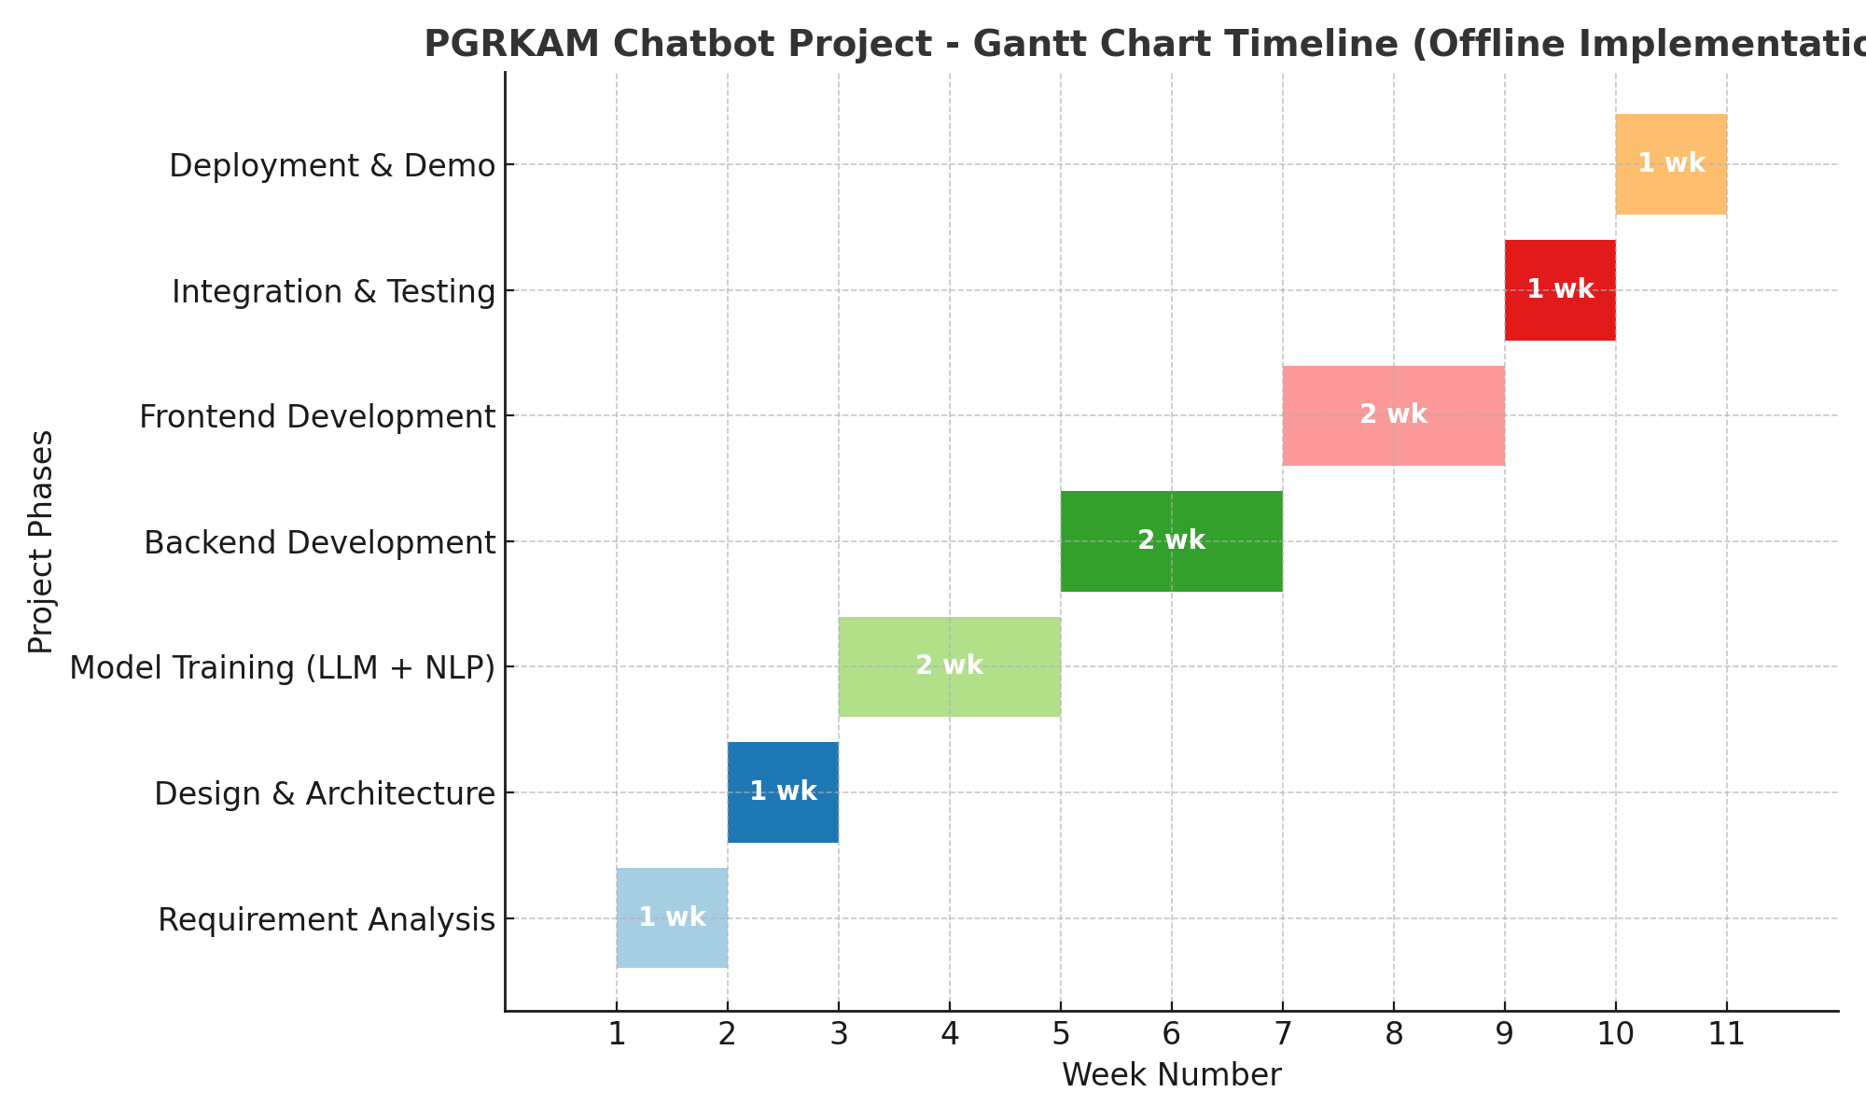
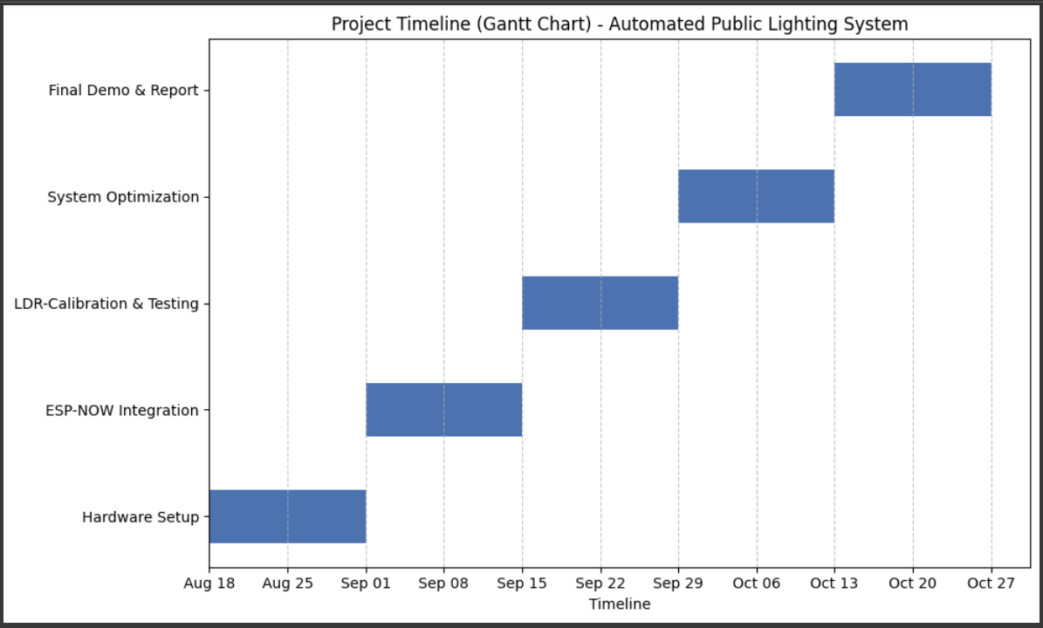
Timeline of the Project (Gantt Chart)

Slide 11
References (IEEE Paper format)
1. P. K. Sahoo et al., “IoT-Based Smart Lighting System for Energy Efficiency,” IEEE Access, vol. 9, pp. 112158–112173, 2021.
2. Espressif Systems, “ESP-NOW Protocol Documentation,” 2023. [Online]. Available: https://docs.espressif.com/projects/esp-idf/en/latest/esp32/api-reference/network/esp_now.html
3. A. Gupta, “Low-Cost Automation Using ESP8266,” Journal of Embedded Systems, vol. 7, no. 4, pp. 45–59, Dec. 2022.

Slide 12


