Slide 1
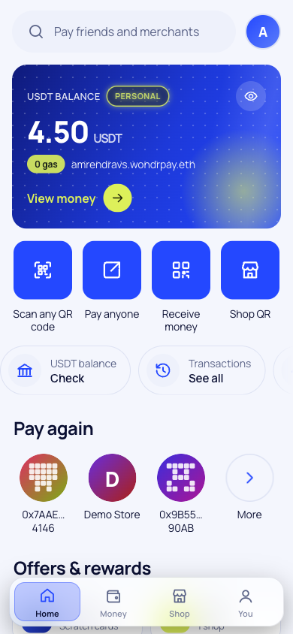
WondrPay
ETHGlobal Mumbai 2026 · Arkiv · Build on Arkiv
UPI for digital dollars. Scan, confirm with your fingerprint, paid in about a second. No gas, no seed phrase.
Live on testnet · wondrpay.vercel.app
Notes:
WondrPay, UPI for digital dollars. Money settles on Whitechain; every record around it lives on Arkiv. (Phone on WondrPay Transactions, read from Arkiv.)

Slide 2
Digital dollars still can't buy a cup of chai
20B
$129B
0
UPI payments in India every month, by scanning a QR
sent home to India every year, the most of any country
of those payments can be made with the dollars in a WhiteBIT account
NPCI, Aug 2025
World Bank, 2024
until WondrPay
Notes:
Three numbers. 20 billion: UPI payments in India every month, by scanning a QR. 129 billion: dollars sent home to India every year. Zero: the number of those you can pay with the dollars sitting in a WhiteBIT account. WondrPay fixes the zero. It's UPI for digital dollars.

Slide 3
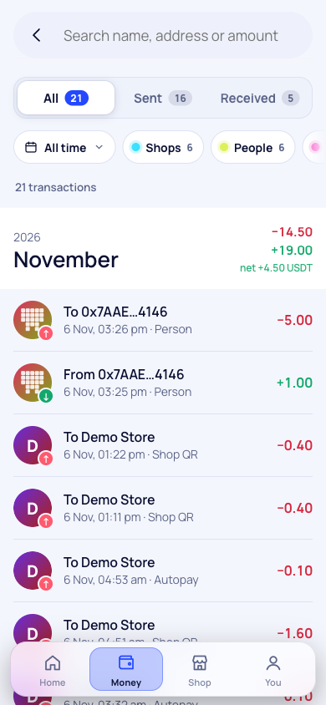



Three taps from QR to receipt
Scan
0 gas
The shop's QR shows its verified name and the exact amount before anything happens
Confirm
Your fingerprint or PIN signs this one payment. The key never leaves your phone
Paid in ~1 s
Settled in USDT on Whitechain with 0 gas for you, and a receipt saved on Arkiv
Notes:
(Laptop: Amaron checkout, tap Pay with WondrPay. Phone: scan the QR, confirm.) Scan, fingerprint, done. Paid in USDT on Whitechain, with zero WBT in my wallet. We pay the gas, so shoppers never see it. The store has its order, and I got a scratch card: cashback paid in WBT.

Slide 4








Everything is live on testnet today
Pay any shop QR
Pay by name
One real person
WBT cashback
Fingerprint, PIN or MetaMask
priya.wondrpay.eth on ENS
World ID, up to 5 wallets
Scratch cards, 1 to 5% back
Fair refunds
Subscriptions
Checkout SDK
Business portal
Only to the buyer, on Arkiv
Approve each, or Autopay
Any website, about 20 lines
API keys, links, roles, 11 currencies
Notes:
Also live on testnet: sending money to people with names like priya.wondrpay.eth, subscriptions that renew on their own, refund requests stored on Arkiv with World ID stopping fake claims, and a business portal that gave our demo store Amaron an API key, payment links, webhooks, team roles and prices in local currency in an afternoon.

Slide 5




How it fits together
Whitechain
USDT settlement and shop registry
Arkiv
Shopper's phone
WondrPay
Requests, receipts, directories, refunds
Holds the key and signs one exact order. Never pays gas
Checks the order, pays the gas and relays it. Writes the records
World ID
One human per name, shop and reward
ENS
Readable names like shop.wondrpay.eth
Notes:
(Backup, skip if short on time.) The phone holds the key and signs one exact order. Our relayer pays the gas and settles it on Whitechain. Arkiv holds the public records: requests, receipts, directories, refunds. World ID keeps it one human per name, shop and reward. ENS gives everyone a readable name.

Slide 6
Moving money still costs too much
$685B
sent home to developing countries every year
38%
of India's remittances come from the Gulf
Sources: World Bank Remittance Prices Worldwide; RBI remittances survey (FY24); card acquirer rates
Notes:
Money crossing borders is where payments are still broken: 685 billion dollars a year goes home to developing countries, and sending it costs about 6%. Cards cost shops 2 to 3%. A WondrPay shop pays 0.5%.

Slide 7



Where we start, and where we're going
Gulf → India
The Gulf sends 38% of India's remittances
Ukraine and Europe
Freelancers paid in USDT, cashing out via WhiteBIT
Dollar savers
Turkey, Nigeria, Argentina
1M
50k
verified people by year 3
shops by year 3
Notes:
We start where W Group is already strong: the Gulf to India, since the Gulf sends 38% of India's remittances; Ukraine and Europe, freelancers paid in USDT cashing out through WhiteBIT; and countries that save in dollars: Turkey, Nigeria, Argentina. Three-year goal: 1 million verified people, 50,000 shops, 1.5 billion dollars in shop payments and 3 billion sent home.

Slide 8

Why Arkiv, and not a private database
With Arkiv
With Postgres
Receipts are public: anyone matches them to a Whitechain tx
Receipts live in our DB; users ask us and trust us
A QR request expires in the data layer, on its deadline
Expiry is a cron job we could get wrong
The pay screen checks who wrote a request ($owner)
Trust whatever row our server returns
Shop and name directories any app can read
A closed user table
Notes:
Why not Postgres? Because with Arkiv, receipts are public records anyone can match to a Whitechain transaction without our API. A shop QR expires in the data layer itself. Provenance is part of verification: the pay screen trusts a request only if Arkiv says WondrPay wrote it and the shop's signature checks out on-chain. And shop and name directories are open to other apps.

Slide 9

17 entity types, one public data layer
Payments
People and shops
Subscriptions
request · receipt · paylink
person · merchant · worldclaim
plan · mandate · due
Refunds
Rewards
Business
refundevt · dispute
reward · offer
site · webhook · member · daily
Owner: every read uses .ownedBy(writer)
Expiry: minutes for a QR, ~6 months for a receipt
Indexed: history, dashboards and directories
Notes:
Seventeen entity types: payment requests, receipts and links; people, shops and World ID claims; subscription plans, mandates and dues; refund events and disputes; rewards and offers; and business sites, webhooks and team members. Each has an owner, indexed fields and an expiry that matches what it means: minutes for a QR, months for a receipt.

Slide 10



A QR that disappears exactly on time
Shop signs
Request written
4 checks
Paid
Expired
an order on its device
expiry = on-chain deadline (5 min)
owner, digest, shop signature, still valid
receipt + status flip in one batch
gone from Arkiv; contract rejects it
What we hit, and what would help most
An API reference for SDK 1.0.x
Filterable and sortable $createdAt
A Rabdi status page
Skip patches on expired entities in a batch
Notes:
Here's a QR's life. The shop signs an order; we write a request whose expiry equals the on-chain deadline. The payer's phone checks four things: owner, digest, shop signature, still valid. Payment writes the receipt and flips the request to paid in one batch. After the deadline the request is gone, and the contract rejects it too. Our top asks: an API reference for SDK 1.0, a filterable createdAt, and a status page.

Slide 11
Every $100 at a shop pays three ways
4¢
Whitechain gas, paid in WBT
23¢
Back to the shopper as WBT cashback
$0.50
23¢
WondrPay's margin
fee per $100
~$7M revenue a year by year 3
Shop margin, plus an exchange share, business plans and 3¢ per transfer after 10 free a month. Cards charge shops $2 to $3
Notes:
Every 100 dollars spent at a shop: the shop pays 50 cents, against 2 to 3% for cards. 4 cents is Whitechain's gas, 23 cents goes back to the shopper as cashback, 23 cents is ours. On top: a share of currency exchange, business plans, and 3 cents per transfer after ten free a month. About 7 million dollars a year of revenue by year three.

Slide 12
Proof it works, not traction
110
216
80
Whitechain transactions on our PaymentRouter
USDT transfers, all gas paid by WondrPay
payment receipts stored on Arkiv
17
16
19
shops, and 12 websites with API keys
subscriptions running on mandates
scratch cards, 9 of them winners
Testnet numbers from two days of building (6 Nov 2026): Whitechain Sepolia, Arkiv Rabdi, ENS Sepolia
Notes:
(Backup.) All of this is on testnet today: 110 transactions and 216 USDT transfers on our PaymentRouter, all gas paid by us; 80 receipts, 17 shops, 12 websites with API keys and 16 subscriptions on Arkiv. These are two days of building: proof the flows work, not traction.

Slide 13
Money on Whitechain, records on Arkiv
Receipts anyone can verify, QR codes that expire on time, refunds no one can edit.
What we'd love from you
1
An API reference that matches SDK 1.0.x
2
A filterable and sortable $createdAt
3
A status page and health endpoint for Rabdi
wondrpay.vercel.app · wondrpay-demo-store.vercel.app · github.com/AmrendraTheCoder/whitepay
Notes:
Payments on Whitechain, records on Arkiv: receipts anyone can verify, QR codes that expire on time, and refunds no one can edit. It's live on Rabdi today. Thank you.

