Slide 1
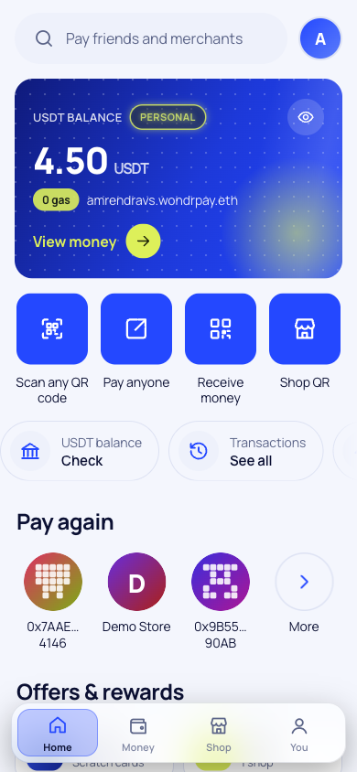
WondrPay
ETHGlobal Mumbai 2026 · Whitechain · Operate + Scale
UPI for digital dollars. Scan, confirm with your fingerprint, paid in about a second. No gas, no seed phrase.
Live on testnet · wondrpay.vercel.app
Notes:
WondrPay, UPI for digital dollars, built on Whitechain. (Open Amaron with one product in the bag; phone on the WondrPay home screen.)

Slide 2
Digital dollars still can't buy a cup of chai
20B
$129B
0
UPI payments in India every month, by scanning a QR
sent home to India every year, the most of any country
of those payments can be made with the dollars in a WhiteBIT account
NPCI, Aug 2025
World Bank, 2024
until WondrPay
Notes:
Three numbers. 20 billion: UPI payments in India every month, by scanning a QR. 129 billion: dollars sent home to India every year. Zero: the number of those you can pay with the dollars sitting in a WhiteBIT account. WondrPay fixes the zero. It's UPI for digital dollars.

Slide 3
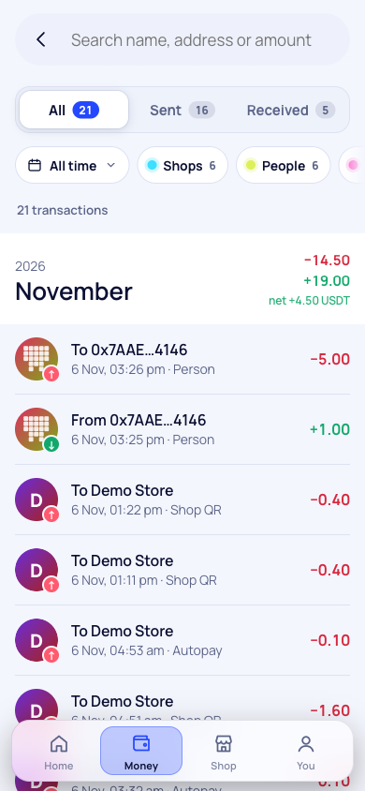



Three taps from QR to receipt
Scan
0 gas
The shop's QR shows its verified name and the exact amount before anything happens
Confirm
Your fingerprint or PIN signs this one payment. The key never leaves your phone
Paid in ~1 s
Settled in USDT on Whitechain with 0 gas for you, and a receipt saved on Arkiv
Notes:
(Laptop: Amaron checkout, tap Pay with WondrPay. Phone: scan the QR, confirm.) Scan, fingerprint, done. Paid in USDT on Whitechain, with zero WBT in my wallet. We pay the gas, so shoppers never see it. The store has its order, and I got a scratch card: cashback paid in WBT.

Slide 4








Everything is live on testnet today
Pay any shop QR
Pay by name
One real person
WBT cashback
Fingerprint, PIN or MetaMask
priya.wondrpay.eth on ENS
World ID, up to 5 wallets
Scratch cards, 1 to 5% back
Fair refunds
Subscriptions
Checkout SDK
Business portal
Only to the buyer, on Arkiv
Approve each, or Autopay
Any website, about 20 lines
API keys, links, roles, 11 currencies
Notes:
Also live on testnet: sending money to people with names like priya.wondrpay.eth, subscriptions that renew on their own, refund requests stored on Arkiv with World ID stopping fake claims, and a business portal that gave our demo store Amaron an API key, payment links, webhooks, team roles and prices in local currency in an afternoon.

Slide 5




How it fits together
Whitechain
USDT settlement and shop registry
Arkiv
Shopper's phone
WondrPay
Requests, receipts, directories, refunds
Holds the key and signs one exact order. Never pays gas
Checks the order, pays the gas and relays it. Writes the records
World ID
One human per name, shop and reward
ENS
Readable names like shop.wondrpay.eth
Notes:
(Backup, skip if short on time.) The phone holds the key and signs one exact order. Our relayer pays the gas and settles it on Whitechain. Arkiv holds the public records: requests, receipts, directories, refunds. World ID keeps it one human per name, shop and reward. ENS gives everyone a readable name.

Slide 6
Moving money still costs too much
$685B
sent home to developing countries every year
38%
of India's remittances come from the Gulf
Sources: World Bank Remittance Prices Worldwide; RBI remittances survey (FY24); card acquirer rates
Notes:
Money crossing borders is where payments are still broken: 685 billion dollars a year goes home to developing countries, and sending it costs about 6%. Cards cost shops 2 to 3%. A WondrPay shop pays 0.5%.

Slide 7



Where we start, and where we're going
Gulf → India
The Gulf sends 38% of India's remittances
Ukraine and Europe
Freelancers paid in USDT, cashing out via WhiteBIT
Dollar savers
Turkey, Nigeria, Argentina
1M
50k
verified people by year 3
shops by year 3
Notes:
We start where W Group is already strong: the Gulf to India, since the Gulf sends 38% of India's remittances; Ukraine and Europe, freelancers paid in USDT cashing out through WhiteBIT; and countries that save in dollars: Turkey, Nigeria, Argentina. Three-year goal: 1 million verified people, 50,000 shops, 1.5 billion dollars in shop payments and 3 billion sent home.

Slide 8
Why Whitechain wins: people pay every day
120M
$4.7M
Whitechain transactions a year at our year-3 goal
of WBT gas a year, at today's testnet prices
$80M
$2.6M
of USDT held on Whitechain by shops and wallets
of WBT handed to 1M people as cashback
People trade now and then. They pay daily. W Group brings 40M+ users; WondrPay gives them a reason to use Whitechain every day
Notes:
Whitechain's relaunch is about distribution: 40 million users across W Group. What a chain needs is a reason for them to come back every day. People trade now and then. They pay daily. At our three-year goal that's about 120 million Whitechain transactions a year, roughly 4.7 million dollars of WBT gas at today's testnet prices, around 80 million dollars of USDT held on Whitechain, and 2.6 million dollars of WBT handed to a million people as cashback.

Slide 9






Payments nobody notices: zero gas for the payer
Shopper signs
WondrPay relays
PaymentRouter settles
a USDT authorization for one exact order
and pays the WBT gas from shop fees
that order once, in about a second
Why the gas wallet can't be drained
One signature pays one exact order. Replays fail
A 5¢ minimum fee covers the gas of every payment
Limits per human, tied to World ID
Rate limits, and relaying pauses when gas spikes
Notes:
(Scale.) The payer never touches gas. They sign a USDT authorization for one exact order; our relayer submits it; the PaymentRouter settles that order once. Replays fail, the 5-cent minimum fee covers gas, limits are per human through World ID, and we pause relaying when gas spikes.

Slide 10


Any shop can join in an afternoon
The shop's server signs the price
<!-- one script tag -->
<script src="…/sdk/v1.4.0/checkout.js"
integrity="sha384-…"></script>
<!-- one button -->
<wondrpay-button
order-endpoint="/api/create-order"
payload='{"sku":"kurta"}'>
</wondrpay-button>
Refunds only to the payer, never above what they paid
Subscriptions with limits enforced on-chain
Orders dashboard, signed webhooks, CSV export
API keys, payment links, hosted checkout
Notes:
(Operate.) Any website adds checkout with one script tag and one button. The shop's server signs the price, webhooks are signed, refunds go only to the original payer and never above what they paid, and subscriptions have limits enforced on-chain.

Slide 11
Every $100 at a shop pays three ways
4¢
Whitechain gas, paid in WBT
23¢
Back to the shopper as WBT cashback
$0.50
23¢
WondrPay's margin
fee per $100
~$7M revenue a year by year 3
Shop margin, plus an exchange share, business plans and 3¢ per transfer after 10 free a month. Cards charge shops $2 to $3
Notes:
Every 100 dollars spent at a shop: the shop pays 50 cents, against 2 to 3% for cards. 4 cents is Whitechain's gas, 23 cents goes back to the shopper as cashback, 23 cents is ours. On top: a share of currency exchange, business plans, and 3 cents per transfer after ten free a month. About 7 million dollars a year of revenue by year three.

Slide 12
Proof it works, not traction
110
216
80
Whitechain transactions on our PaymentRouter
USDT transfers, all gas paid by WondrPay
payment receipts stored on Arkiv
17
16
19
shops, and 12 websites with API keys
subscriptions running on mandates
scratch cards, 9 of them winners
Testnet numbers from two days of building (6 Nov 2026): Whitechain Sepolia, Arkiv Rabdi, ENS Sepolia
Notes:
(Backup.) All of this is on testnet today: 110 transactions and 216 USDT transfers on our PaymentRouter, all gas paid by us; 80 receipts, 17 shops, 12 websites with API keys and 16 subscriptions on Arkiv. These are two days of building: proof the flows work, not traction.

Slide 13
Every payment pays three ways
We earn the fee, Whitechain earns the gas, shoppers earn WBT cashback.
What we'd love from you
1
WhiteBIT as the on/off-ramp partner, starting UAE → India
2
The Builder Program, to reach Whitechain mainnet
3
Co-marketing to W Group's 40M+ users
wondrpay.vercel.app · wondrpay-demo-store.vercel.app · github.com/AmrendraTheCoder/whitepay
Notes:
Every payment pays three ways: we earn the fee, Whitechain earns the gas, shoppers earn cashback. It's live today; Amaron just took a real payment. What we need: WhiteBIT as the ramp partner from UAE to India, the Builder Program for mainnet, and co-marketing to W Group users. Thank you.

