Slide 1
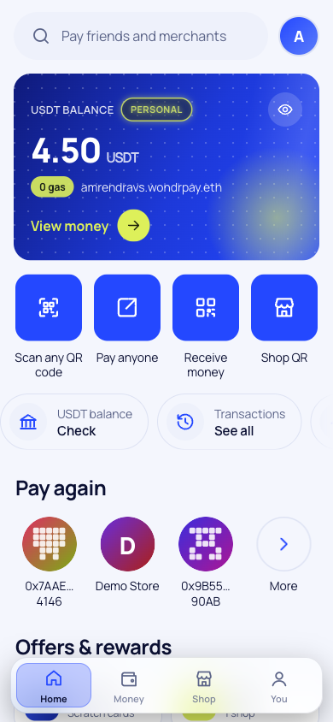
WondrPay
ETHGlobal Mumbai 2026 · World · Agent Pass + IDKit
UPI for digital dollars. Scan, confirm with your fingerprint, paid in about a second. No gas, no seed phrase.
Live on testnet · wondrpay.vercel.app
Notes:
WondrPay, UPI for digital dollars. Today I'll show where World ID sits in every payment we make fair. (Phone on WondrPay; World App ready.)

Slide 2
Digital dollars still can't buy a cup of chai
20B
$129B
0
UPI payments in India every month, by scanning a QR
sent home to India every year, the most of any country
of those payments can be made with the dollars in a WhiteBIT account
NPCI, Aug 2025
World Bank, 2024
until WondrPay
Notes:
Three numbers. 20 billion: UPI payments in India every month, by scanning a QR. 129 billion: dollars sent home to India every year. Zero: the number of those you can pay with the dollars sitting in a WhiteBIT account. WondrPay fixes the zero. It's UPI for digital dollars.

Slide 3
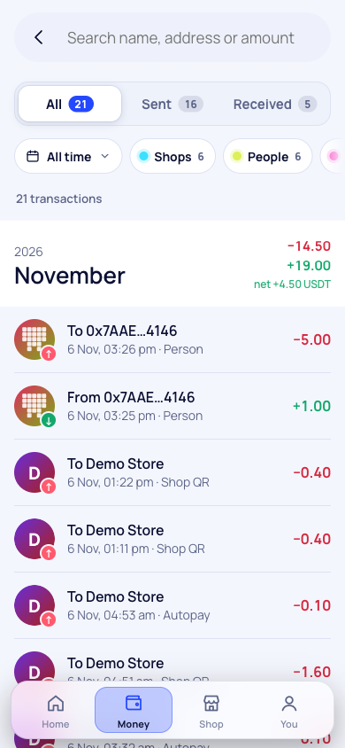



Three taps from QR to receipt
Scan
0 gas
The shop's QR shows its verified name and the exact amount before anything happens
Confirm
Your fingerprint or PIN signs this one payment. The key never leaves your phone
Paid in ~1 s
Settled in USDT on Whitechain with 0 gas for you, and a receipt saved on Arkiv
Notes:
(Laptop: Amaron checkout, tap Pay with WondrPay. Phone: scan the QR, confirm.) Scan, fingerprint, done. Paid in USDT on Whitechain, with zero WBT in my wallet. We pay the gas, so shoppers never see it. The store has its order, and I got a scratch card: cashback paid in WBT.

Slide 4








Everything is live on testnet today
Pay any shop QR
Pay by name
One real person
WBT cashback
Fingerprint, PIN or MetaMask
priya.wondrpay.eth on ENS
World ID, up to 5 wallets
Scratch cards, 1 to 5% back
Fair refunds
Subscriptions
Checkout SDK
Business portal
Only to the buyer, on Arkiv
Approve each, or Autopay
Any website, about 20 lines
API keys, links, roles, 11 currencies
Notes:
Also live on testnet: sending money to people with names like priya.wondrpay.eth, subscriptions that renew on their own, refund requests stored on Arkiv with World ID stopping fake claims, and a business portal that gave our demo store Amaron an API key, payment links, webhooks, team roles and prices in local currency in an afternoon.

Slide 5




How it fits together
Whitechain
USDT settlement and shop registry
Arkiv
Shopper's phone
WondrPay
Requests, receipts, directories, refunds
Holds the key and signs one exact order. Never pays gas
Checks the order, pays the gas and relays it. Writes the records
World ID
One human per name, shop and reward
ENS
Readable names like shop.wondrpay.eth
Notes:
(Backup, skip if short on time.) The phone holds the key and signs one exact order. Our relayer pays the gas and settles it on Whitechain. Arkiv holds the public records: requests, receipts, directories, refunds. World ID keeps it one human per name, shop and reward. ENS gives everyone a readable name.

Slide 6
Moving money still costs too much
$685B
sent home to developing countries every year
38%
of India's remittances come from the Gulf
Sources: World Bank Remittance Prices Worldwide; RBI remittances survey (FY24); card acquirer rates
Notes:
Money crossing borders is where payments are still broken: 685 billion dollars a year goes home to developing countries, and sending it costs about 6%. Cards cost shops 2 to 3%. A WondrPay shop pays 0.5%.

Slide 7



Where we start, and where we're going
Gulf → India
The Gulf sends 38% of India's remittances
Ukraine and Europe
Freelancers paid in USDT, cashing out via WhiteBIT
Dollar savers
Turkey, Nigeria, Argentina
1M
50k
verified people by year 3
shops by year 3
Notes:
We start where W Group is already strong: the Gulf to India, since the Gulf sends 38% of India's remittances; Ukraine and Europe, freelancers paid in USDT cashing out through WhiteBIT; and countries that save in dollars: Turkey, Nigeria, Argentina. Three-year goal: 1 million verified people, 50,000 shops, 1.5 billion dollars in shop payments and 3 billion sent home.

Slide 8

Five trust moments, one credential
Trust moment | World ID action | What it protects
Claim a name, you.wondrpay.eth | whitepay-name | One name per human
Verified-shop badge | whitepay-shop | A real person runs the shop
Payments over 100 USDT | whitepay-pay | A human approves big transfers
Refund request | whitepay-refund | No bot-made refund claims
Cashback claim | session proof | Bots can't farm rewards
Why Proof of Human: these are uniqueness questions, not identity questions. Passport or Selfie would ask for more than we need.
Notes:
Money apps have a uniqueness problem: one person can make a thousand wallets. We use World ID at five trust moments: claiming a name, verifying a shop, approving a payment over 100 USDT, requesting a refund, and claiming cashback. Each needs a unique human, not an identity, so Proof of Human is the minimum sufficient credential.

Slide 9




Verified on our backend, every single time
Request
World App
Backend verifies
Action runs
Our server signs the RP context
Proof bound to this wallet and action
Proof, signal and nullifier checked
Name issued, badge set, cashback paid
Cancelled, declined or replayed: nothing happens
No name is issued, the badge stays Unverified, cashback is not paid. The real World App reason is shown, and only the nullifier's hash is ever stored, on Arkiv
Notes:
Every proof is checked on our backend, never trusted from the browser. Our server signs the request context, World App returns a proof bound to this wallet and this exact action, we verify it, then the protected action runs. Cancel, decline or a replayed proof, and nothing happens: no name, no badge, no payout. We store only the nullifier's hash on Arkiv.

Slide 10


Bots can't farm WondrPay
Tested live
1 human
“Welcome bonus already used by this person on another wallet”
up to 5 linked wallets, with every limit counted per human
The one change we'd ask World for
Structured errors in World App instead of a bare “Failed”: unknown_action, environment_mismatch, already_verified_for_action, host_verification_timeout
50 wallets, one person: still 3 welcome wins and $5 a month in total
Notes:
That's what stops farming. One human can link up to five wallets, and limits count per human. A bot with fifty wallets still gets three welcome wins and five dollars a month in total. We tested it live: the second wallet was refused with 'Welcome bonus already used by this person on another wallet'. Our one ask for World: structured errors instead of a bare 'Failed'.

Slide 11
Every $100 at a shop pays three ways
4¢
Whitechain gas, paid in WBT
23¢
Back to the shopper as WBT cashback
$0.50
23¢
WondrPay's margin
fee per $100
~$7M revenue a year by year 3
Shop margin, plus an exchange share, business plans and 3¢ per transfer after 10 free a month. Cards charge shops $2 to $3
Notes:
Every 100 dollars spent at a shop: the shop pays 50 cents, against 2 to 3% for cards. 4 cents is Whitechain's gas, 23 cents goes back to the shopper as cashback, 23 cents is ours. On top: a share of currency exchange, business plans, and 3 cents per transfer after ten free a month. About 7 million dollars a year of revenue by year three.

Slide 12
Proof it works, not traction
110
216
80
Whitechain transactions on our PaymentRouter
USDT transfers, all gas paid by WondrPay
payment receipts stored on Arkiv
17
16
19
shops, and 12 websites with API keys
subscriptions running on mandates
scratch cards, 9 of them winners
Testnet numbers from two days of building (6 Nov 2026): Whitechain Sepolia, Arkiv Rabdi, ENS Sepolia
Notes:
(Backup.) All of this is on testnet today: 110 transactions and 216 USDT transfers on our PaymentRouter, all gas paid by us; 80 receipts, 17 shops, 12 websites with API keys and 16 subscriptions on Arkiv. These are two days of building: proof the flows work, not traction.

Slide 13
One person, one name, one reward
Proof of Human is what makes digital-dollar payments fair, without anyone sharing who they are.
What we'd love from you
1
Structured errors from World App (unknown action, environment mismatch, already verified)
2
A documented timeout for host verification
3
A clear pattern for repeat checks: session proofs vs unlimited actions
wondrpay.vercel.app · wondrpay-demo-store.vercel.app · github.com/AmrendraTheCoder/whitepay
Notes:
One person, one name, one reward. World ID is what makes digital-dollar payments fair without anyone sharing who they are. It's live on testnet; try it at wondrpay.vercel.app. Thank you.

