Slide 1
Final Project Report
Abuzer, Amresh, & Ava

Slide 2
01
THE PROBLEM & CONSTRAINTS

Slide 3
PERFORMANCE GOAL
By week 13, our robot reached all four targets in the specified order in under 3 minutes, without any collisions.
DESIGN CONSTRAINTS
3D Printing time constraints
Includes 3 ultrasonic sensors
2 ArUco Markers
Follows wiring color codes
Notes:
Talk about how WE met requirements– We used m2 and m1.6 nuts – printing meant no more than 2 hours and 50 min for each print at a time (usd 5 pro so not an issue)

Slide 4
02
CONCEPT DEVELOPMENT

Slide 5
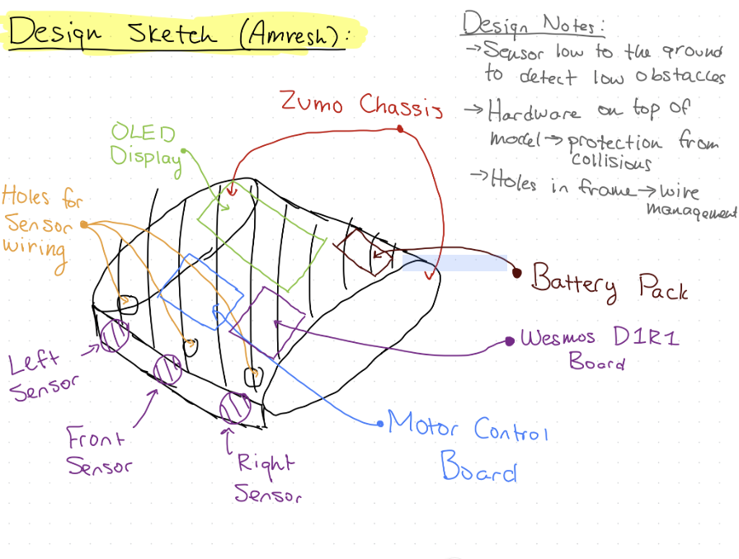
DESIGN CONCEPT #1
PROS
Wire management
Meets design dimension constraints
CONS
Elements not to scale; hard to replicate
Crowding of design elements
Parts aren’t secured
Notes:
Low to the ground

Slide 6
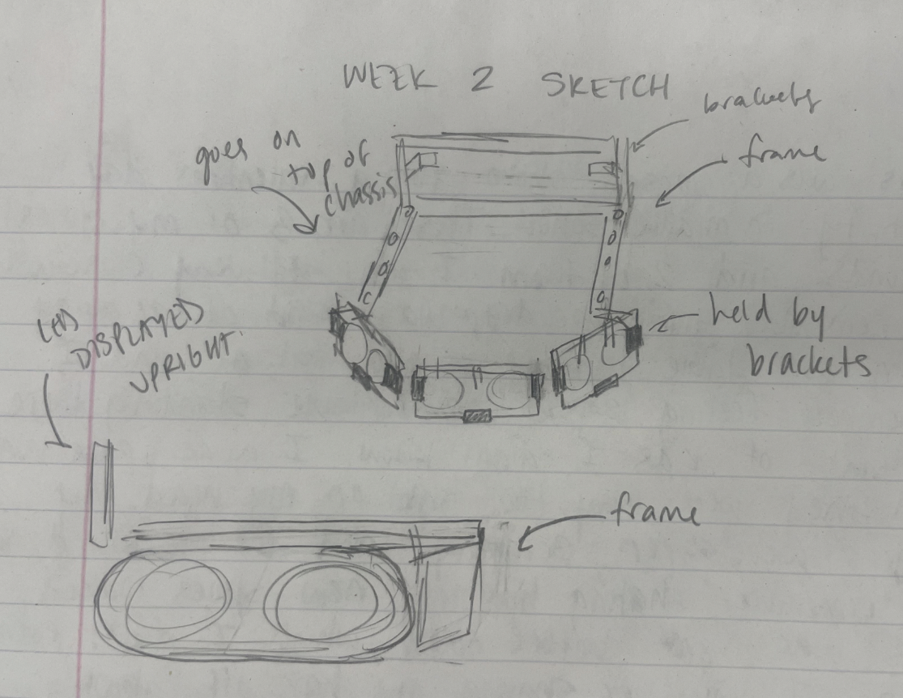
DESIGN CONCEPT #2
PROS
Sensors are secured
Room for components
OLED functionality addressed
CONS
Frame may be too fragile
Overhang = weight imbalance; impact on performance
Not all components addressed

Slide 7
03
FINAL DESIGN

Slide 8
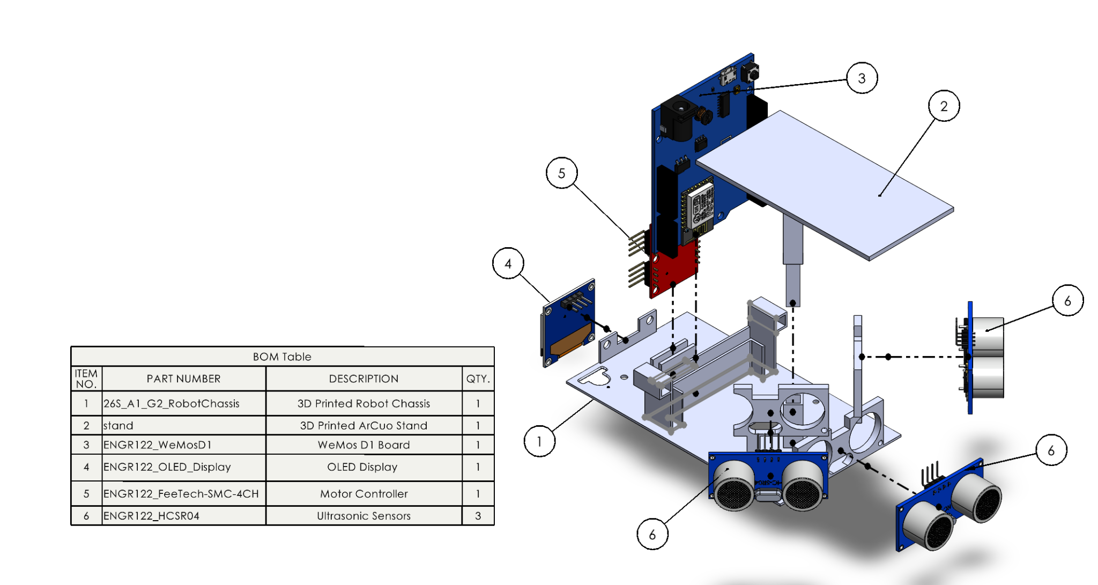
MECHANICAL DESIGN
Notes:
Wanted to avoid cold joints– opted for a lever style wire connector

Slide 9
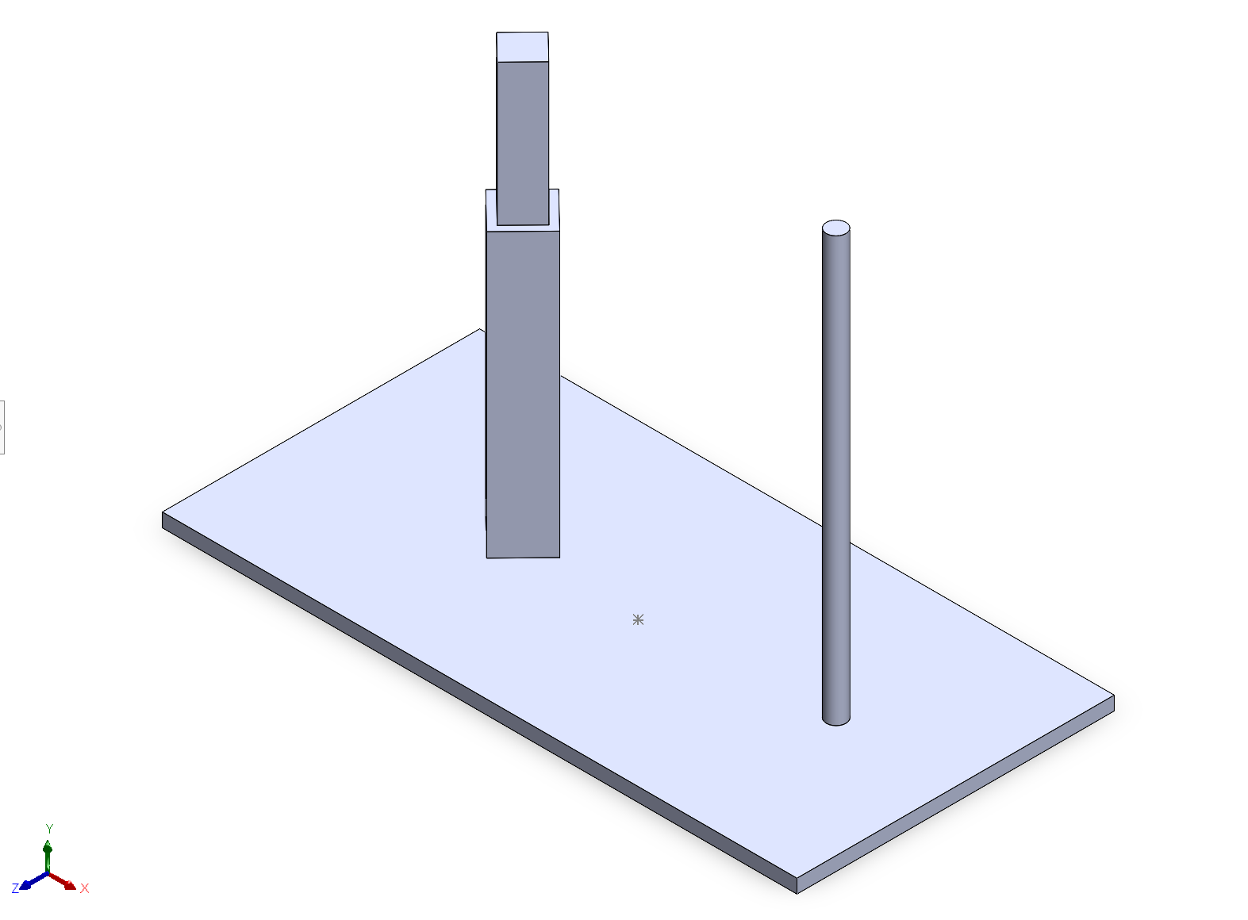
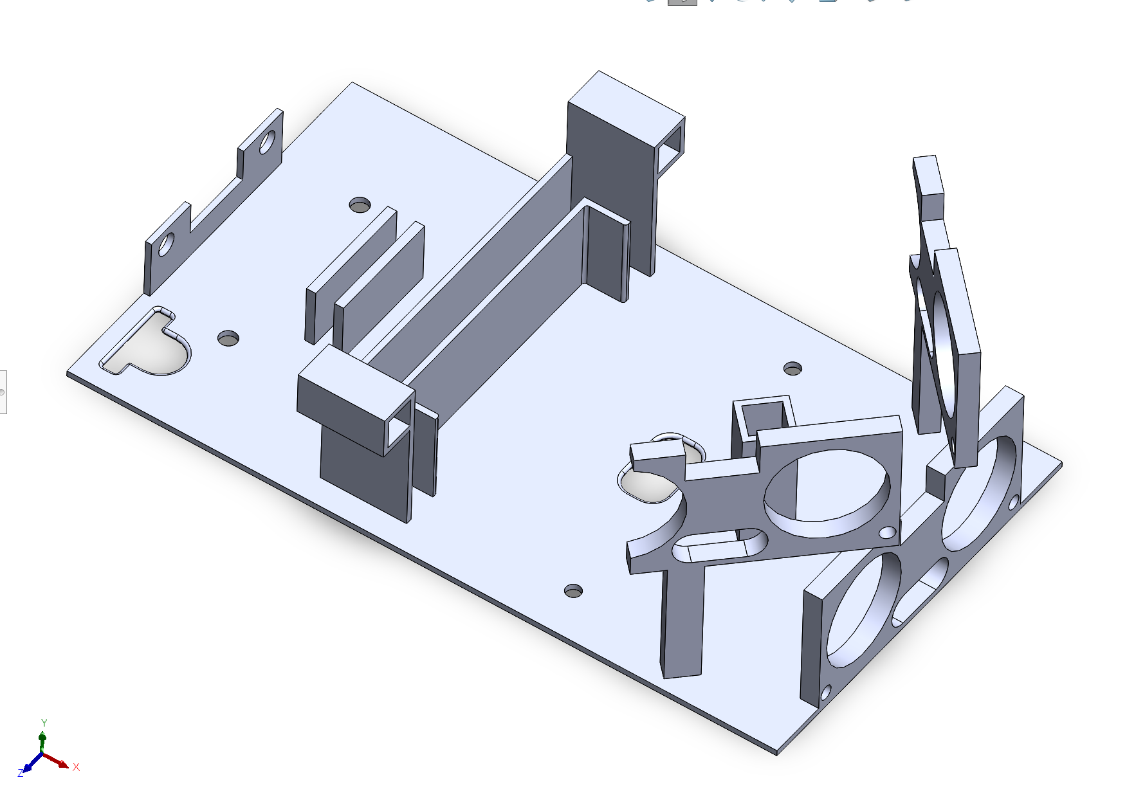
MECHANICAL DESIGN
Wire management
Prevents overheating

Slide 10
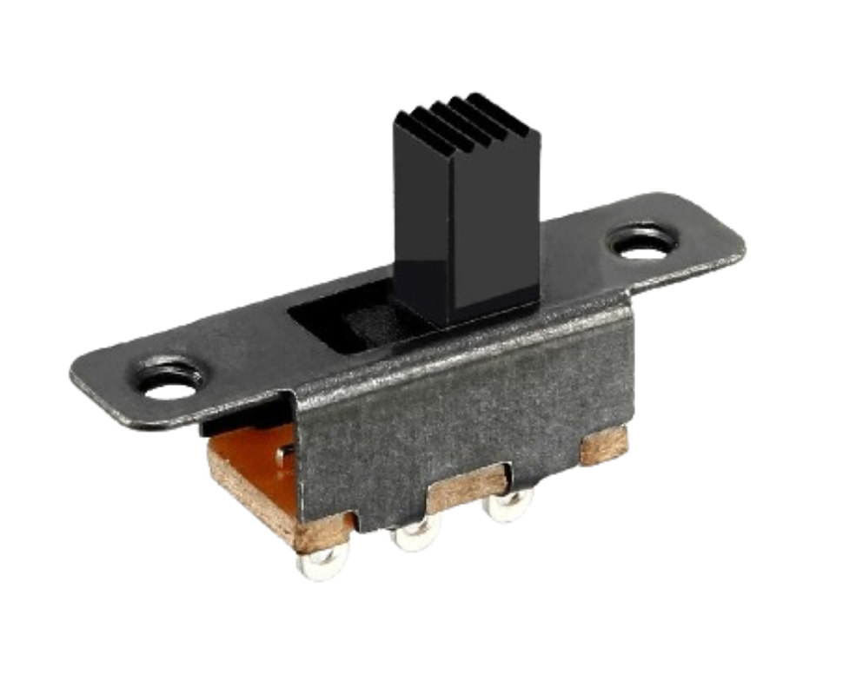
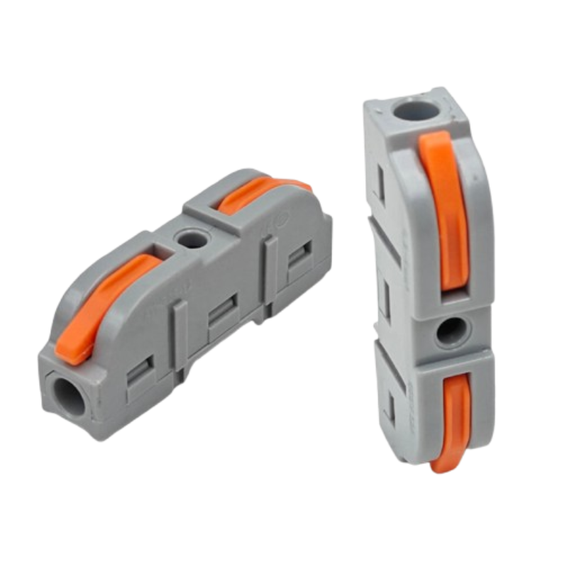
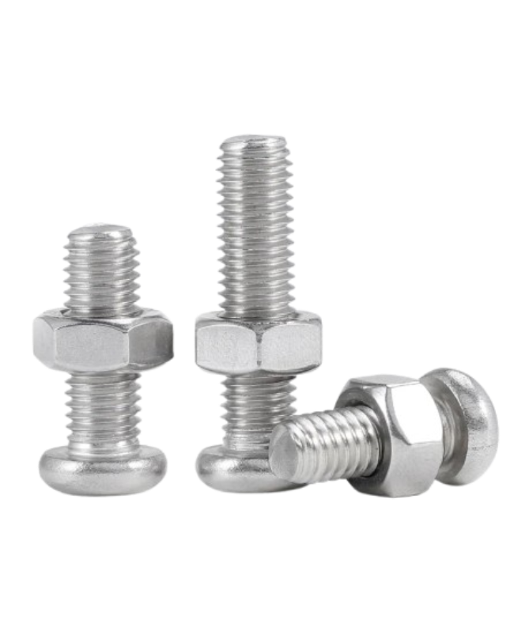
MECHANICAL DESIGN
SLIDE SWITCH
LEVER-STYLE WIRE CONNECTOR
M1.6 & M2 BOLTS AND HEX-NUTS

Slide 11
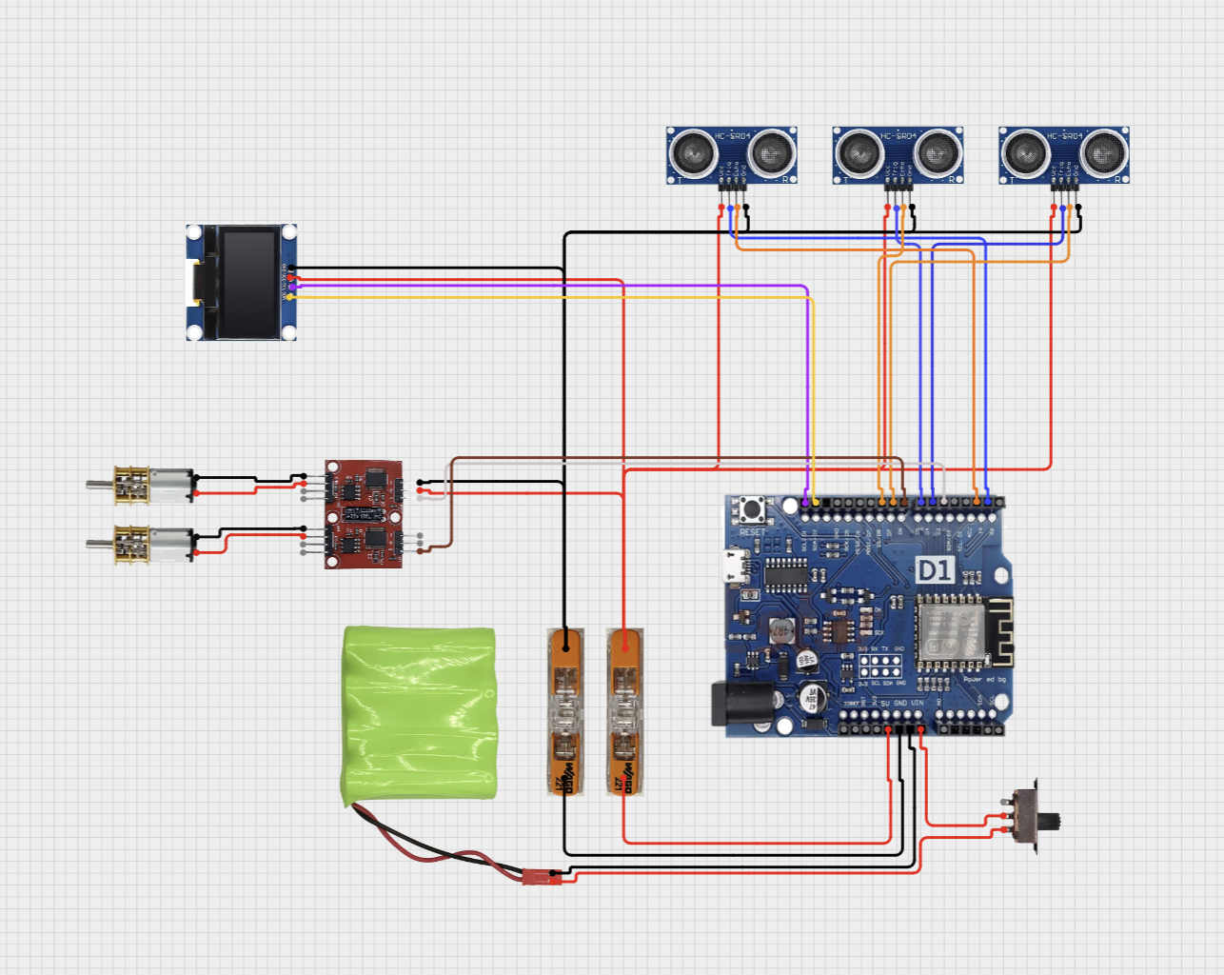
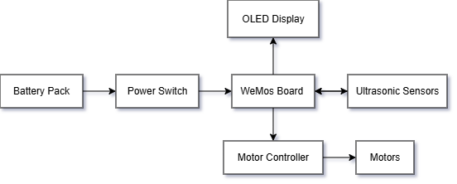
SYSTEM DESIGN: INPUT OUTPUT FLOW AND WIRING

Slide 12
04
SOFTWARE ALGORITHMS

Slide 13
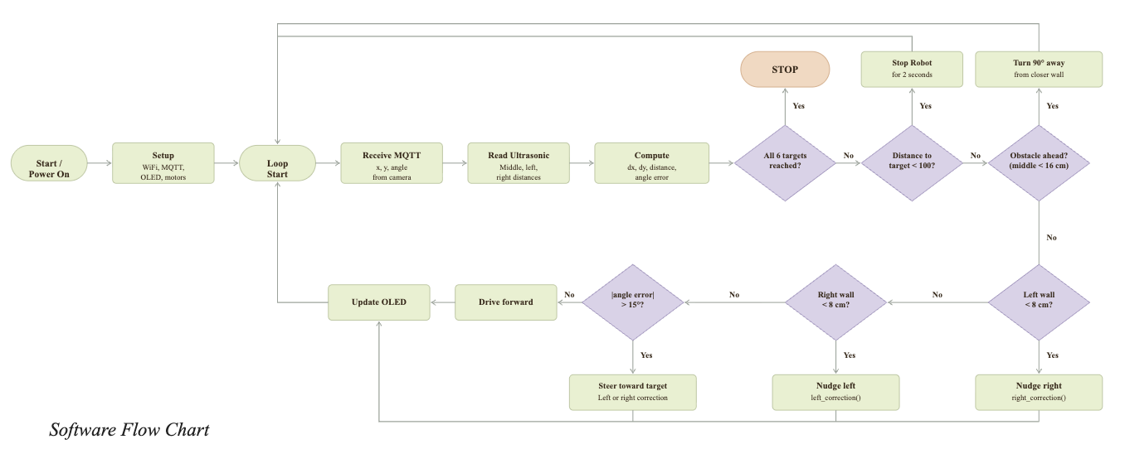
Software Flowchart

Slide 14
05
PROBLEMS & PROJECT MANAGEMENT

Slide 15
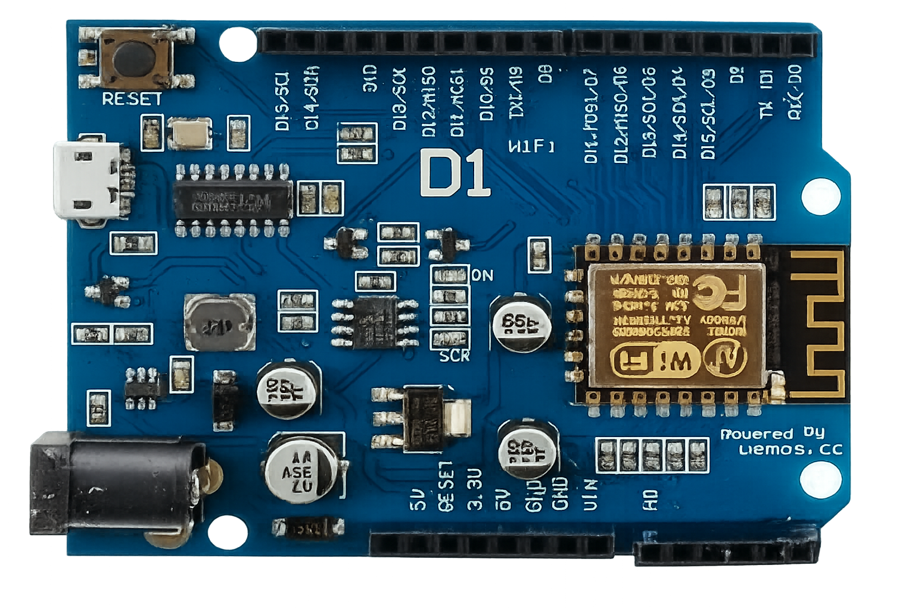
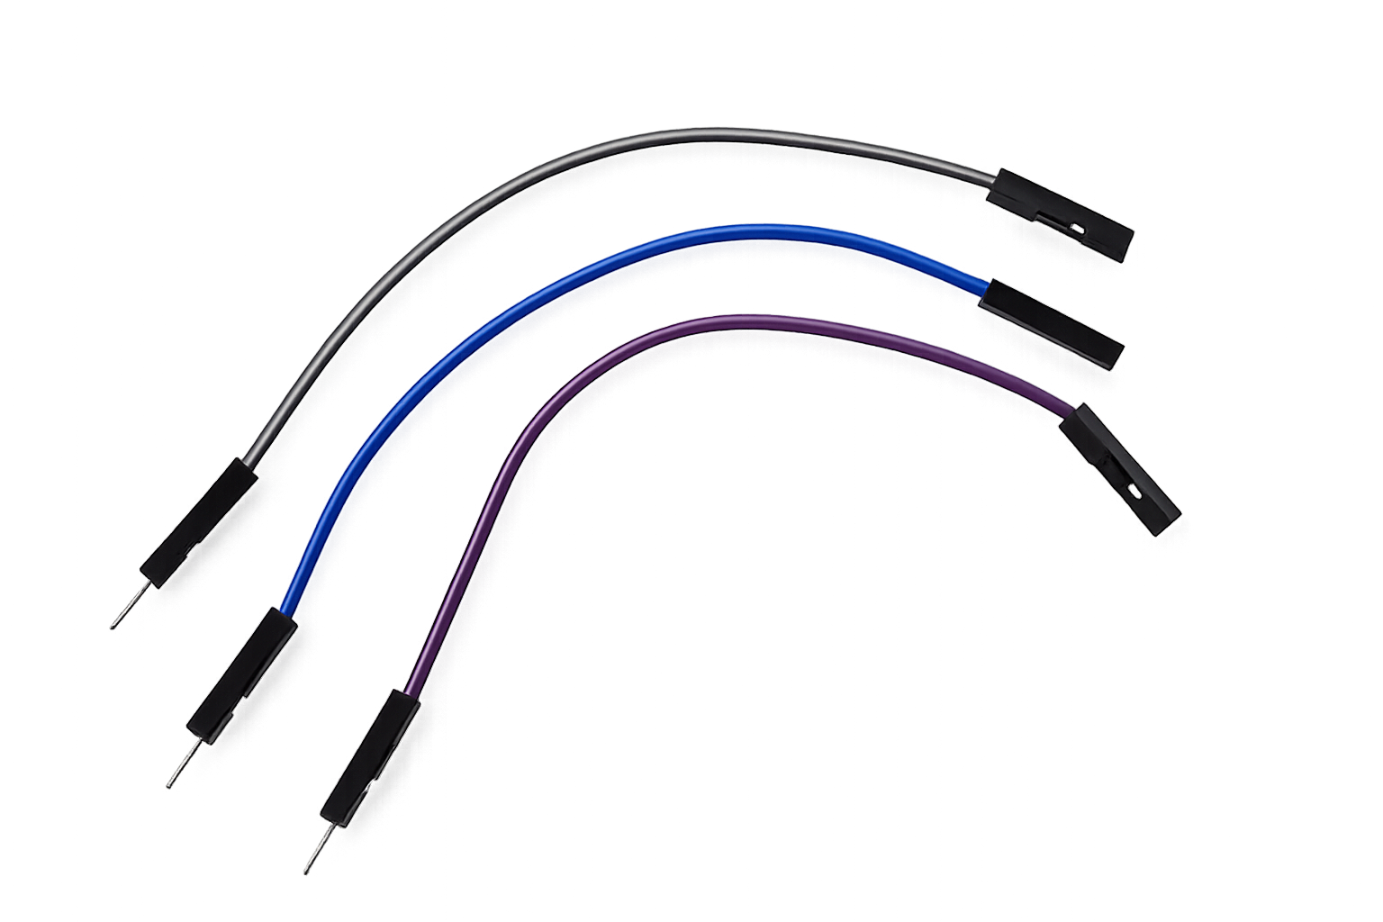
Setbacks/Problems:
Short circuited Arduino board
Faulty jumper wires
Faulty ultrasonic sensors

Slide 16
06
RESULTS OF WEEK 13 TESTING

Slide 17
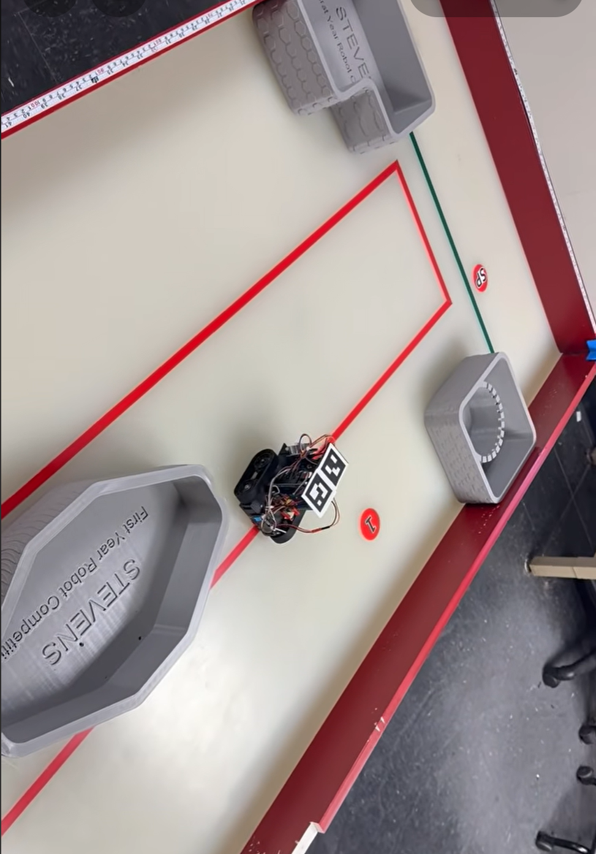
Accuracy:Reached all 4 targets successfully
Reliability: No collisions
Speed: 52 seconds
Integration:Utrasonic sensors, Motors, and OLED display fully functioned

Slide 18
CONCLUSION & RECOMMENDATIONS
07
• Autonomous navigation was successfully achieved.
• Mechanical, electrical, and software systems worked together.
• Future improvements: smoother turning, cleaner wiring, and improved aesthetics.

Slide 19
Thank You!

