Slide 1
SNN on FPGA
Srinithya Nagiri
Navateja Alla
Tanaya Kolankari

Slide 2
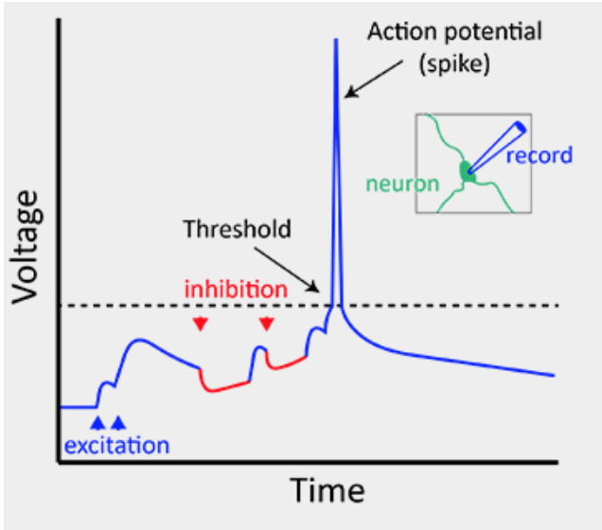
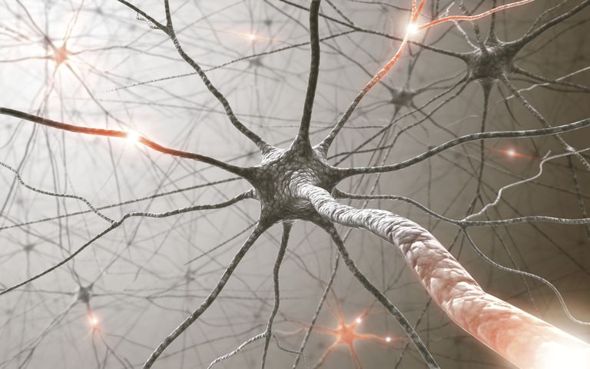
Spiking Neural Networks (SNN)
Mimic biological neural networks
Uses time information
Spike trains

Slide 3
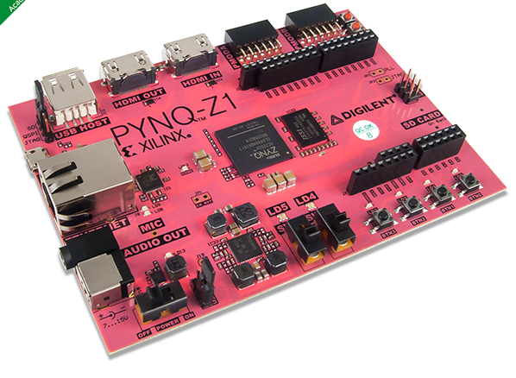
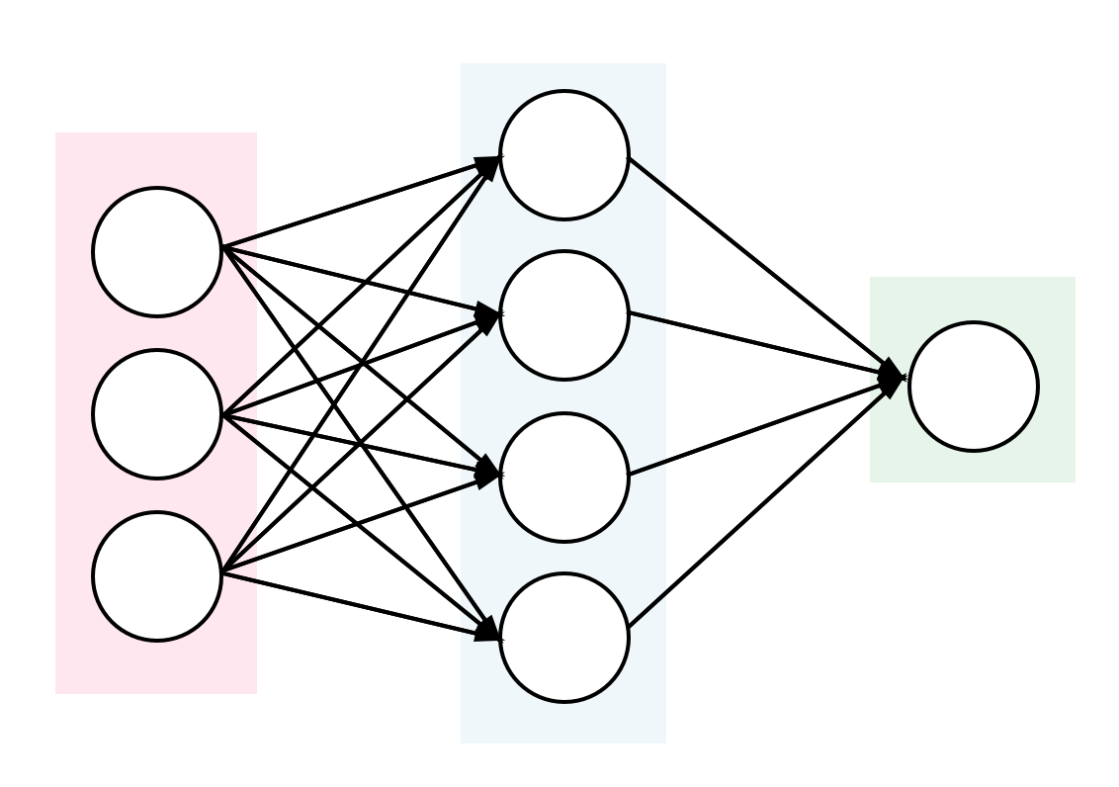
Why SNN on FPGA?
Individual neurons & different layers operate in parallel
Need multiply-accumulation & other matrix operations at each layer
Reconfigurable
Good cost to performance ratio
Power efficient

Slide 4
Goals
Choose an SNN, train and test it in SW
Identify computationally intensive blocks of SNN
Optimize the blocks on FPGA for
Latency of an order of milliseconds
Minimal power of around mW
Minimal resource utilization

