Slide 1
Design Space Exploration of Deep Neural Networks
CSCE 790
Yang ren, rui xin, Hassan Alamri

Slide 2
Introduction
Main Question: How the choice of DVFS affect inference time and energy consummations of Deep Neural Networks?
Main Goal: understand how the choice of hardware configurations in the deployment environment can influence runtime characteristics of DNNs.
Significance: Find the optimal choice of hardware configurations is important for performance improvement of DNNs

Slide 3
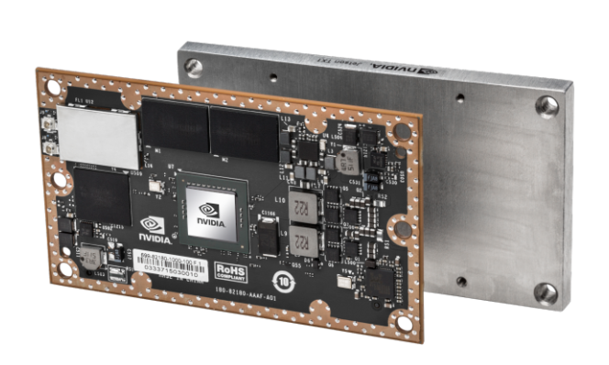
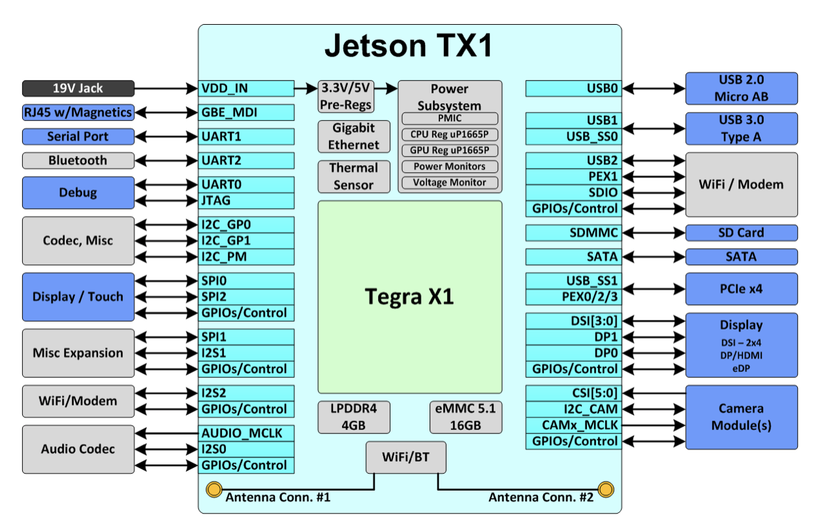
hardware platform SELECT – TX 1
Why TX 1: Useful for deploying computer vision and deep learning, Jetson TX1 runs Linux and provides 1TFLOPS of FP16 compute performance in 10 watts of power.
High efficiency of power architecture.

Slide 4
configuration space
For Hardware Platform:
---Number of GPU Devices; GPU Frequency; CPU Frequency; Number of CPU Core; EMC Frequency; Memory Fraction;
For Compiler-level:
---Tensorflow options : eg. allow memory growth and memory fraction per GPU
---LLVM and CUDA options ：Coming soon…

Slide 5
select specific DNN architectures
Resnet Architecture
With 50 layers
Pre-trained on Imagnet dataset
Backed by Tensorflow

Slide 6
decide the workload
Image eg. Cifar-10
Text
Time-series

Slide 7
How to do it
the control Variates method
---relationship between DVFS settings and inference time, power consumption
sampling strategy
---discrete the continuous variables such as CPU frequency

Slide 8
Power consumption implementation
APScheduler
File Read

Slide 9
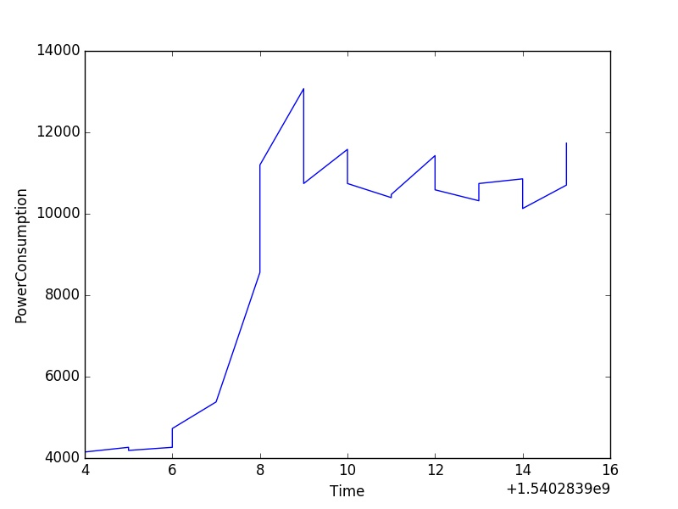
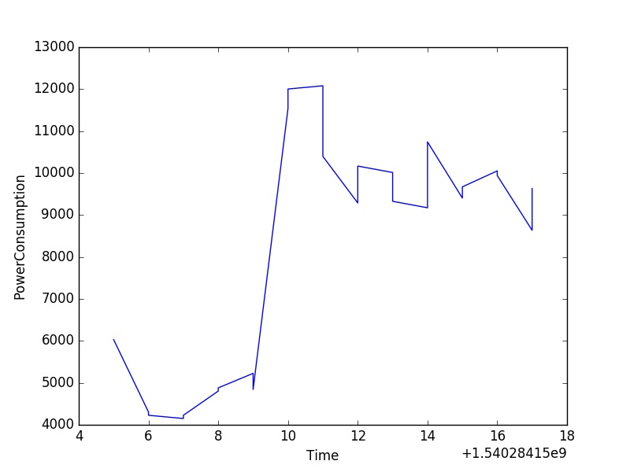
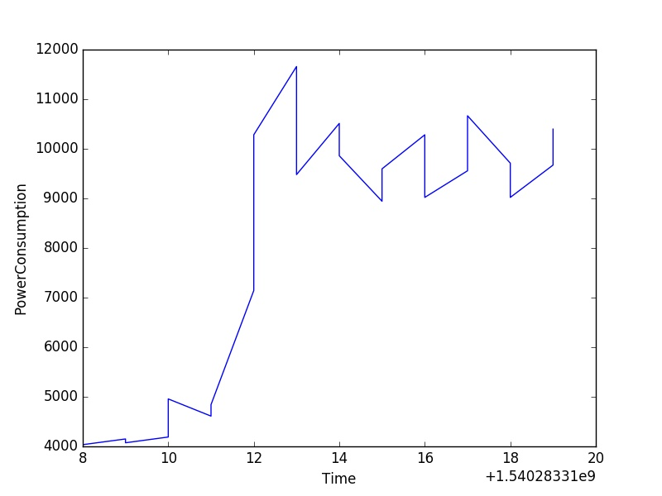
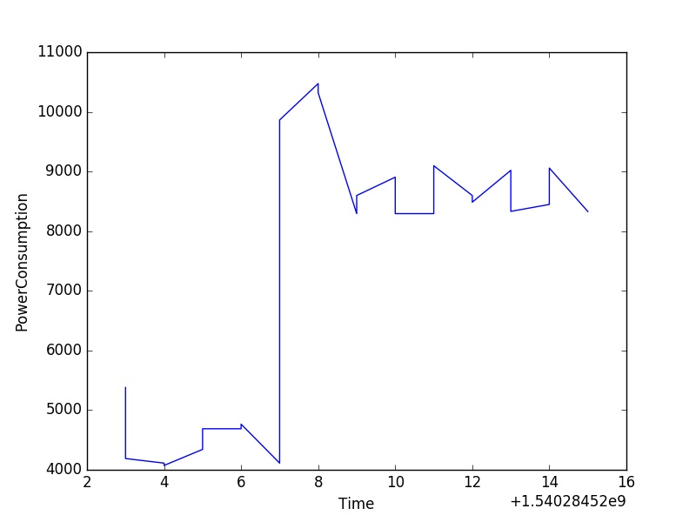
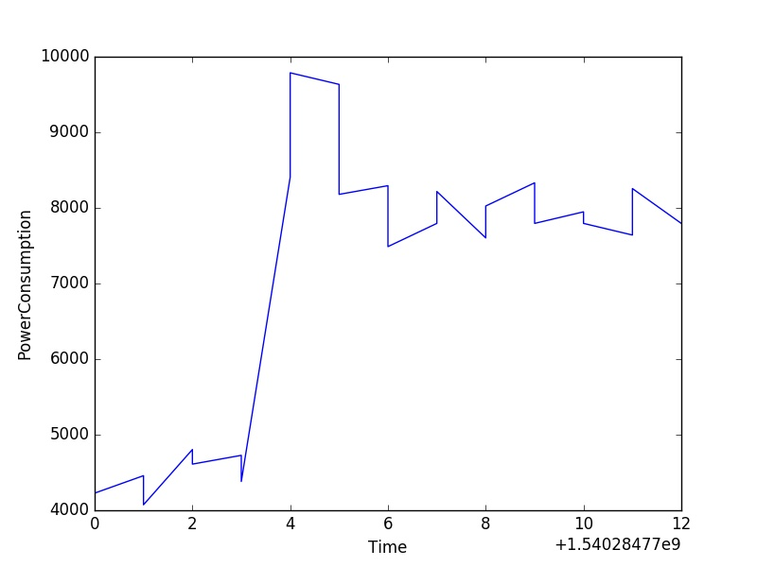
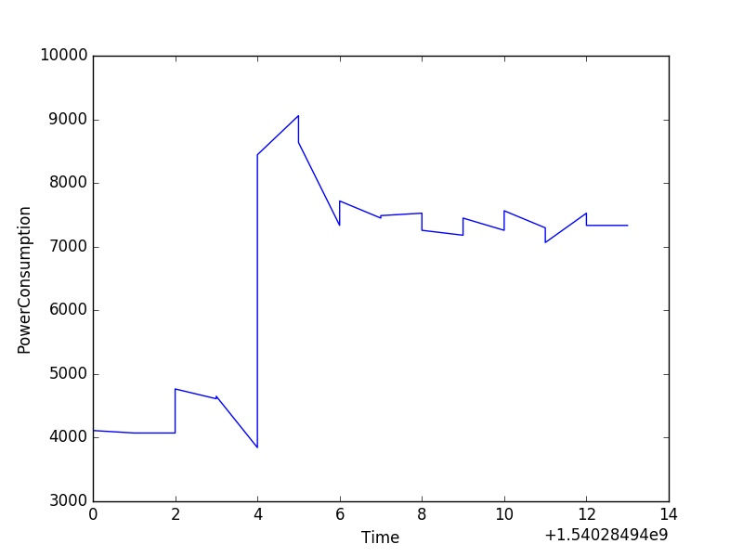
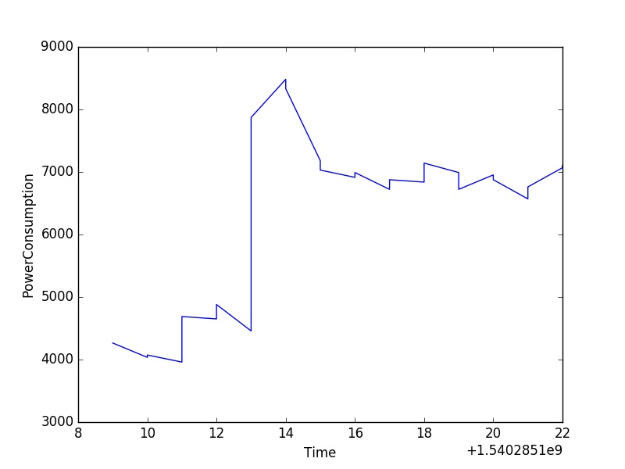
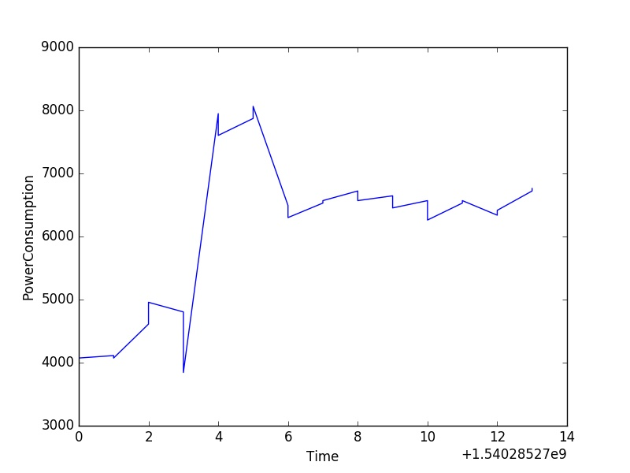
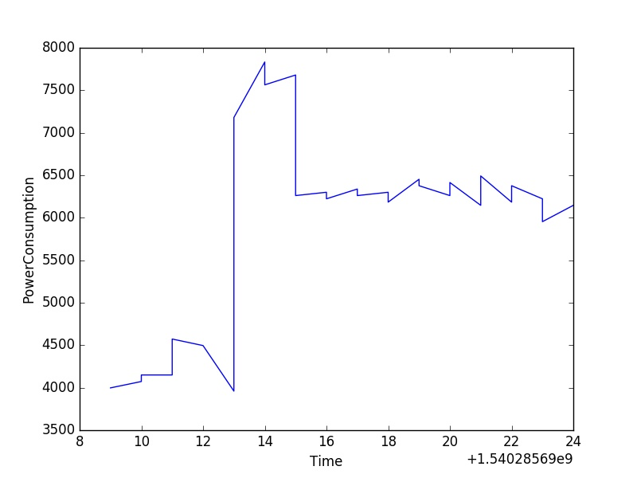
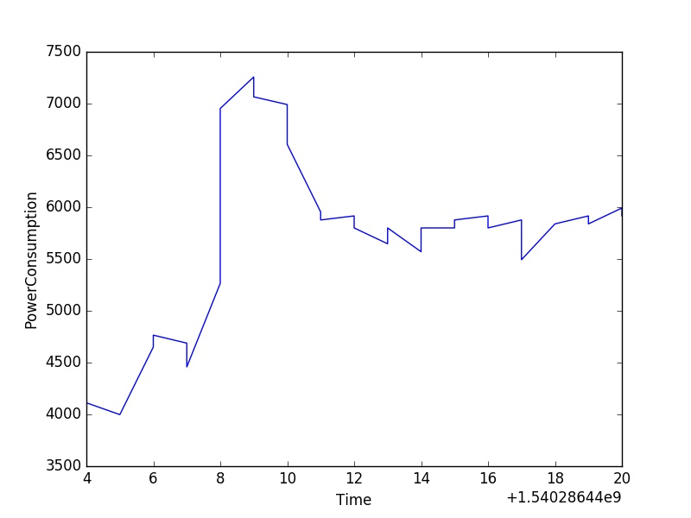
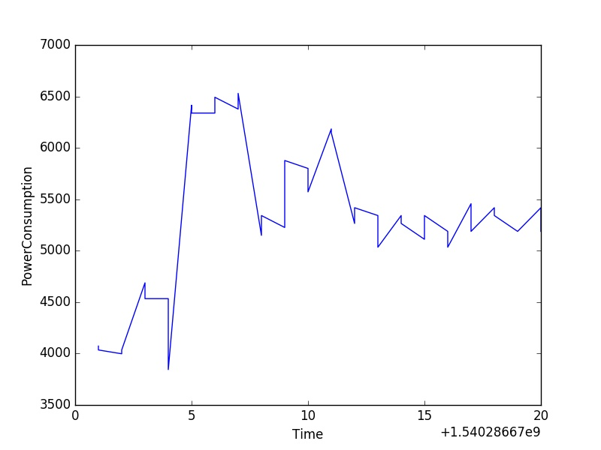
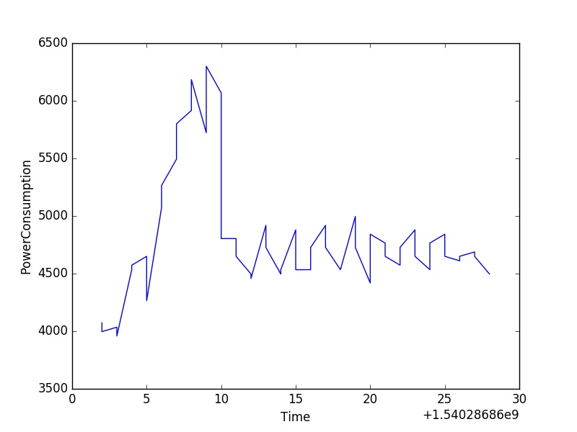
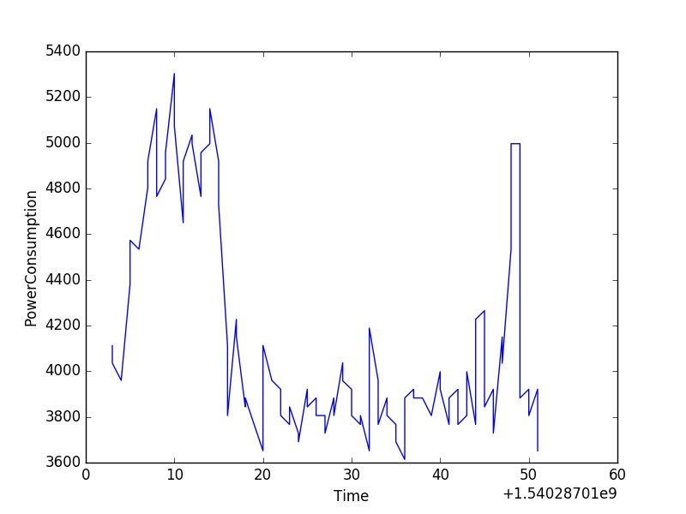
Experiment result

Slide 10
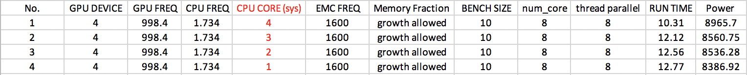
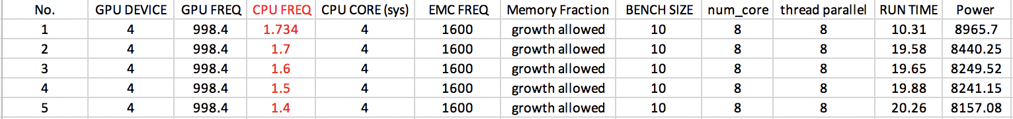
Experiment result

Slide 11
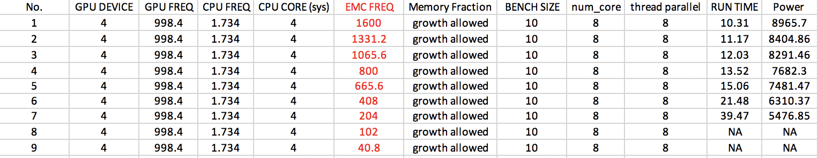
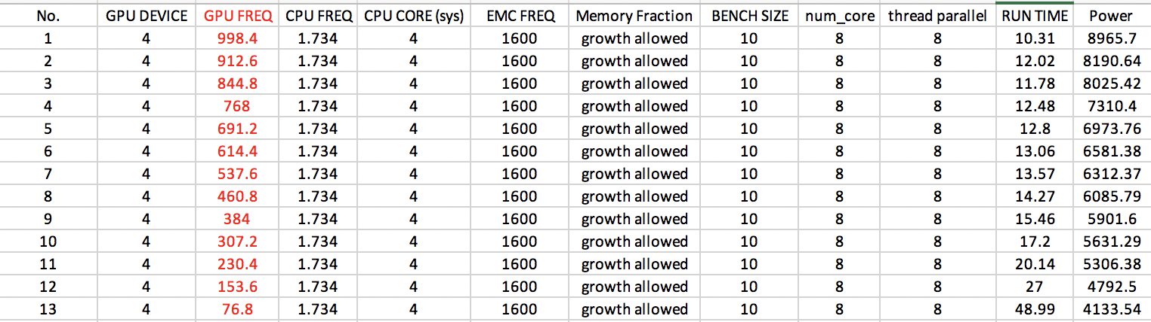
Experiment result
No. | GPU DEVICE | GPU FREQ | CPU FREQ | CPU CORE (sys) | EMC FREQ | Memory Fraction | BENCH SIZE | num_core | thread parallel | RUN TIME | Power
1 | 4 | 998.4 | 1.734 | 4 | 1600 | growth allowed | 10 | 8 | 8 | 10.31 | 8965.7
1 | 3 | 998.4 | 1.734 | 4 | 1600 | growth allowed | 10 | 8 | 8 | 10.41 | 8950.6
1 | 2 | 998.4 | 1.734 | 4 | 1600 | growth allowed | 10 | 8 | 8 | 10.29 | 8961.9
1 | 1 | 998.4 | 1.734 | 4 | 1600 | growth allowed | 10 | 8 | 8 | 10.26 | 8955.2

Slide 12
Experiment result

Slide 13
Experiment result

Slide 14
Experiment result

