Slide 1


RESHAPING THE
A
T
T
E
N
D
A
N
C
E
A
SYSTEM

Slide 2




Problem Statement
2. Ideas Implemented
3. Solution

Slide 3

Problem Statement
The problem that we are attempting to resolve is the automation of the method of recording attendance and reduction of proxy attendance.
Attendance acts as a suitable evaluation of a student's ability to remain dedicated and responsible towards their academics. Since most of the student's academic information is stored digitally it is efficient if the records of their attendance are recorded into the system directly instead of having to depend upon a pen and paper intermediate and having to insert it manually. By ensuring a secure means for the students to update their attendance using their personal devices with multi step verification we can conserve valuable time and also reduce false/proxy attendance.

Slide 4
Why is proxy attendance practiced by students?
Students want to avoid going to classes wanting to either studying at home or skip classes for unacademic reasons which is why they need to fake their attendance through proxy .
The attendance is taken manually by the professors in an institute. Some students try to alter the physical records through various means .
Challenges to automated attendance
Biometric scanner such as fingerprint scanners are expensive and difficult to set up and maintain.
In the midst of the global covid 19 pandemic biometric systems became unsuitable.

Slide 5


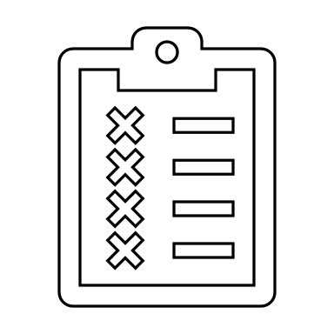
Problems of Proxy Attendance
Due to proxy attendance, a student gets an unfair advantage of being marked present in all the classes in which the student was absent.
When practiced in excess, it becomes a habit. This induces carelessness towards the academics and which may hamper their future.
When caught doing proxy for a friend, both the absentee and his/her friend are strictly punished.
It affects the decorum and discipline of an institution adversely.

Slide 6

Ideas implemented
The two basic ideas which support the basis of this project are
An individual must prove their identity as a student by providing appropriate credentials .
The student inputting the attendance must be present at the site of the class at the appropriate time slot .

Slide 7

Solution
How to ensure the identity of the student ?
The app we have developed will use the in-built fingerprint of the smart phones to verify the identity of the student . The student can input their attendance only if the fingerprint matches the original owner .
2. What if a student tries to fil their attendance without being In class ?
The app also has a feature of making use of GPS to access the location of the device and then checks whether the device is present within a certified radius of the class location . The attendance cannot be filled if the student is not within the class premises .

Slide 8

PROBLEM-SOLVING
Our Project was built in Android Studio Code using Java(valid for Android version greater than 6.0)
The App was built in Empty Activity Mode.
Our Project consists of three Main Activities – one for main Activity(where we linked the other two Activities)
From the two activities, one was for Biometric fingerprint scanner and other was for Location tracker using GPS.
If both of them are found true ("login successful" for the fingerprint scanner and "1" for GPS tracker), then Attendance will be successfully taken.
In this manner, Proxy attendance chances will be reduced producing very high accuracy rates.
The Attendance taken will be Linked with a database where the roll number of students are stored.
The database will be linked to a Calendar, so that Automatically, using our program attendance will be given to the students by only clicking two buttons.

Slide 9
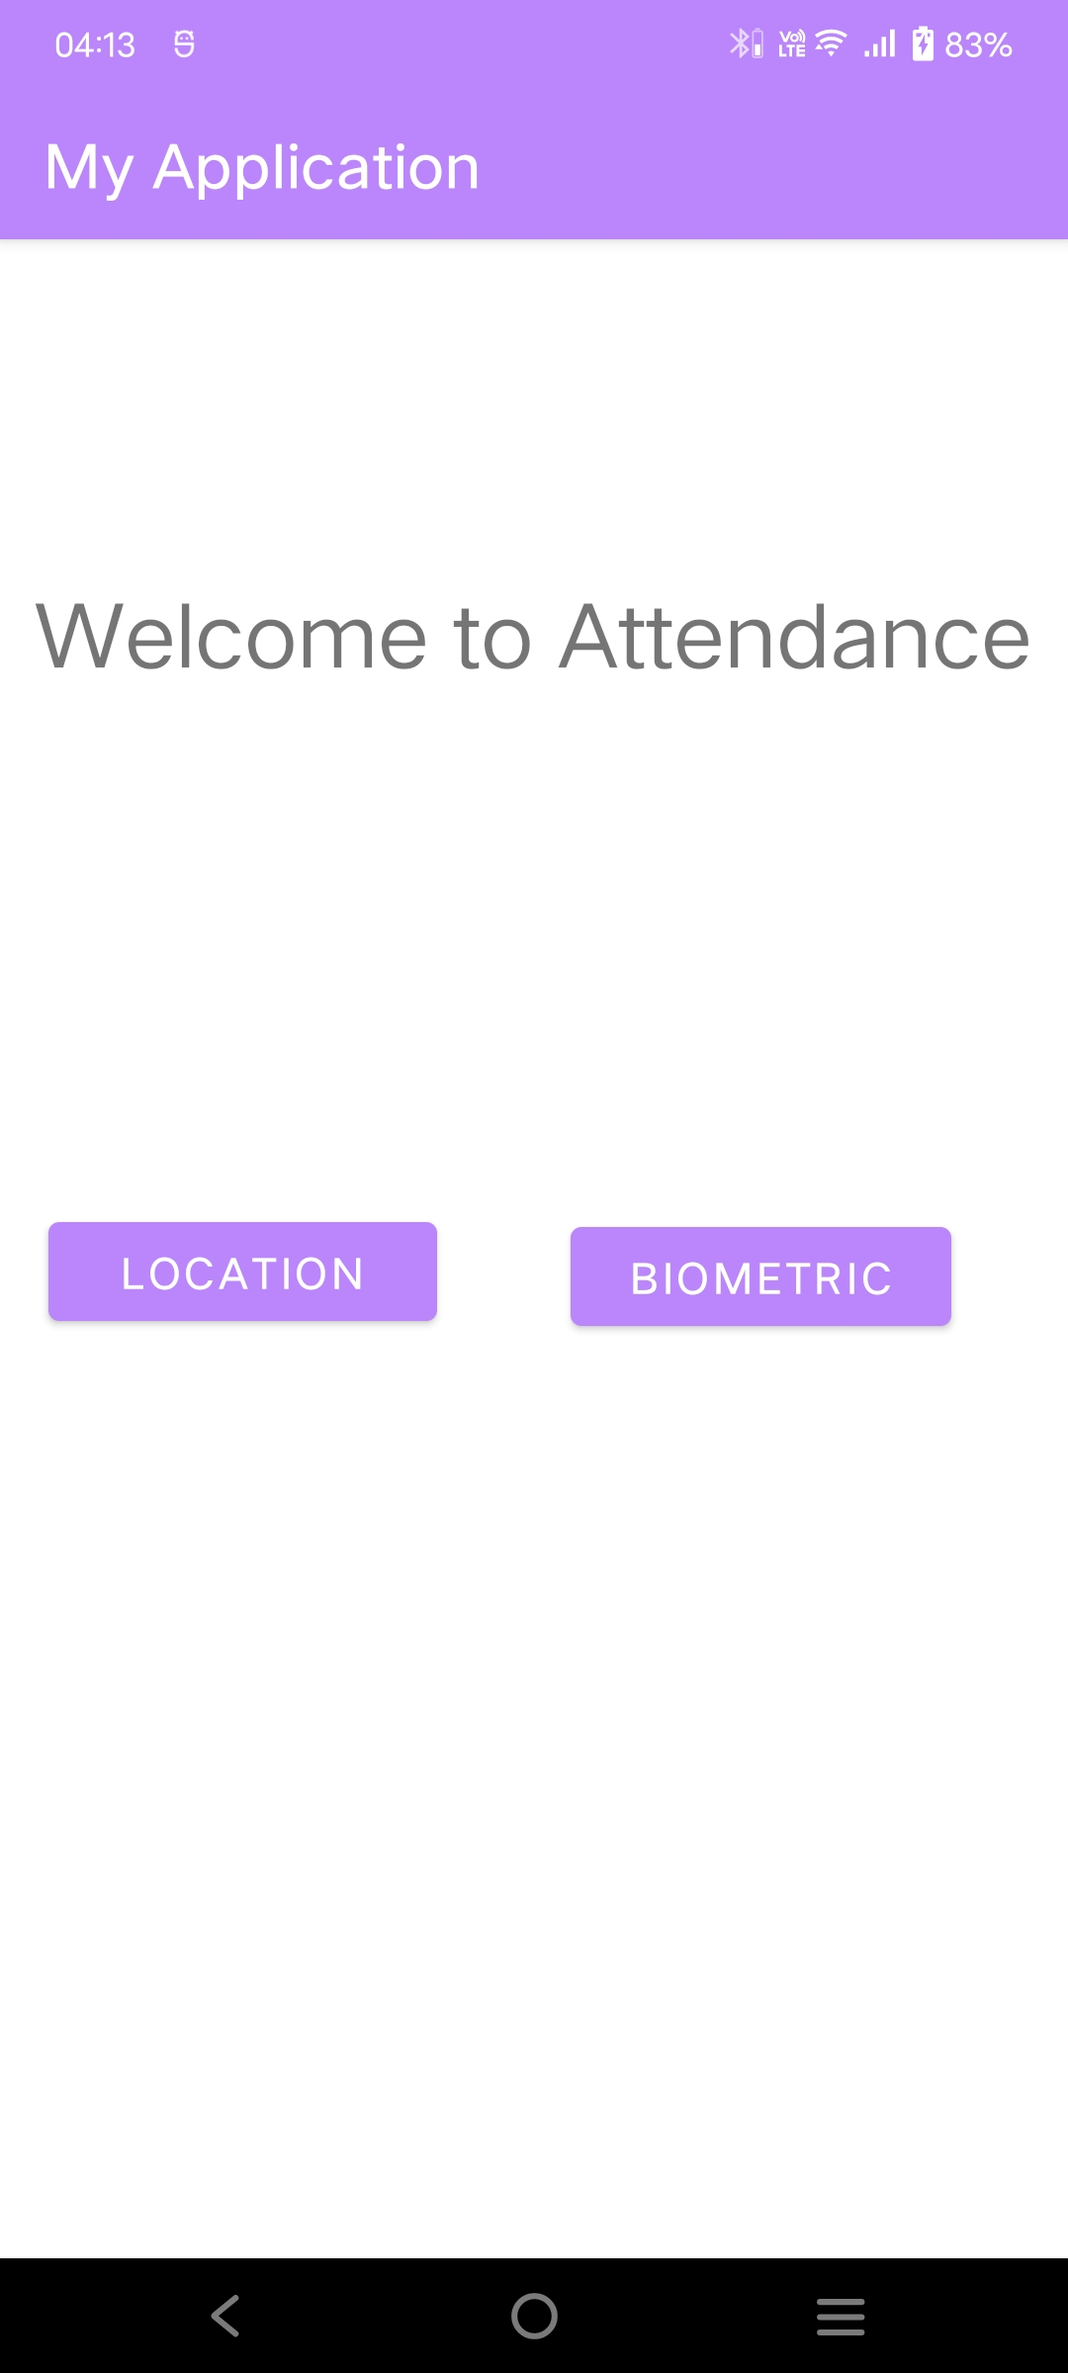
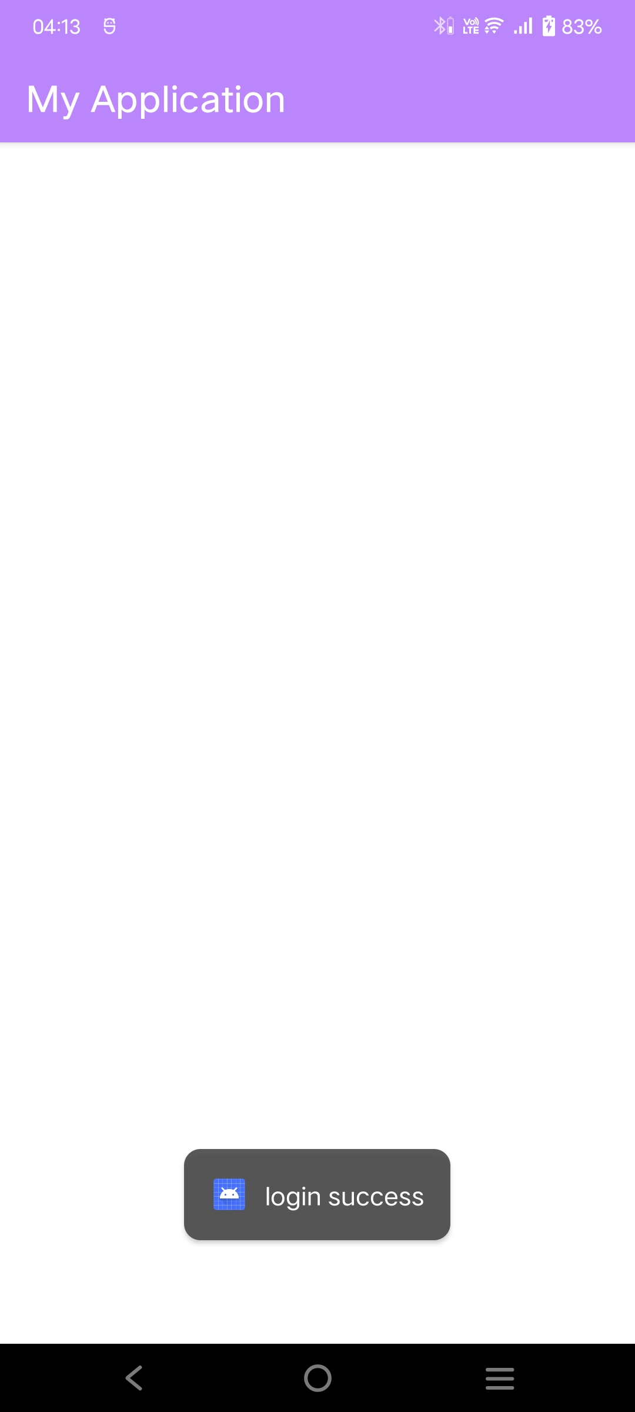
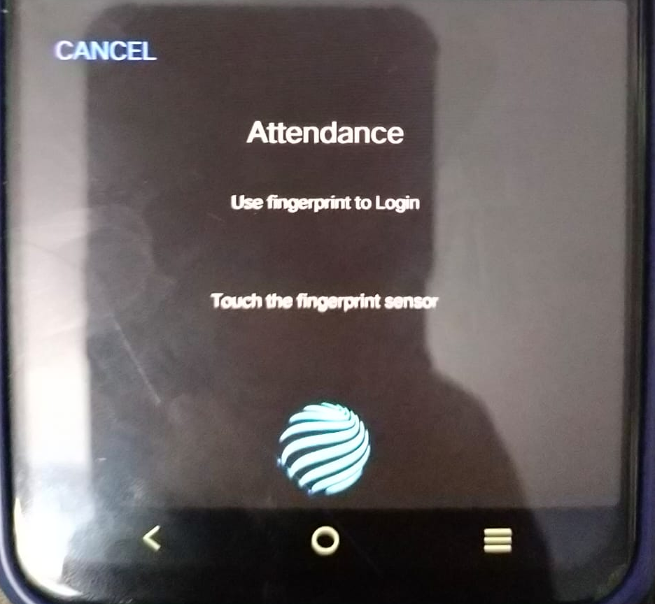
By clicking the 'BIOMETRIC' Button

Slide 10
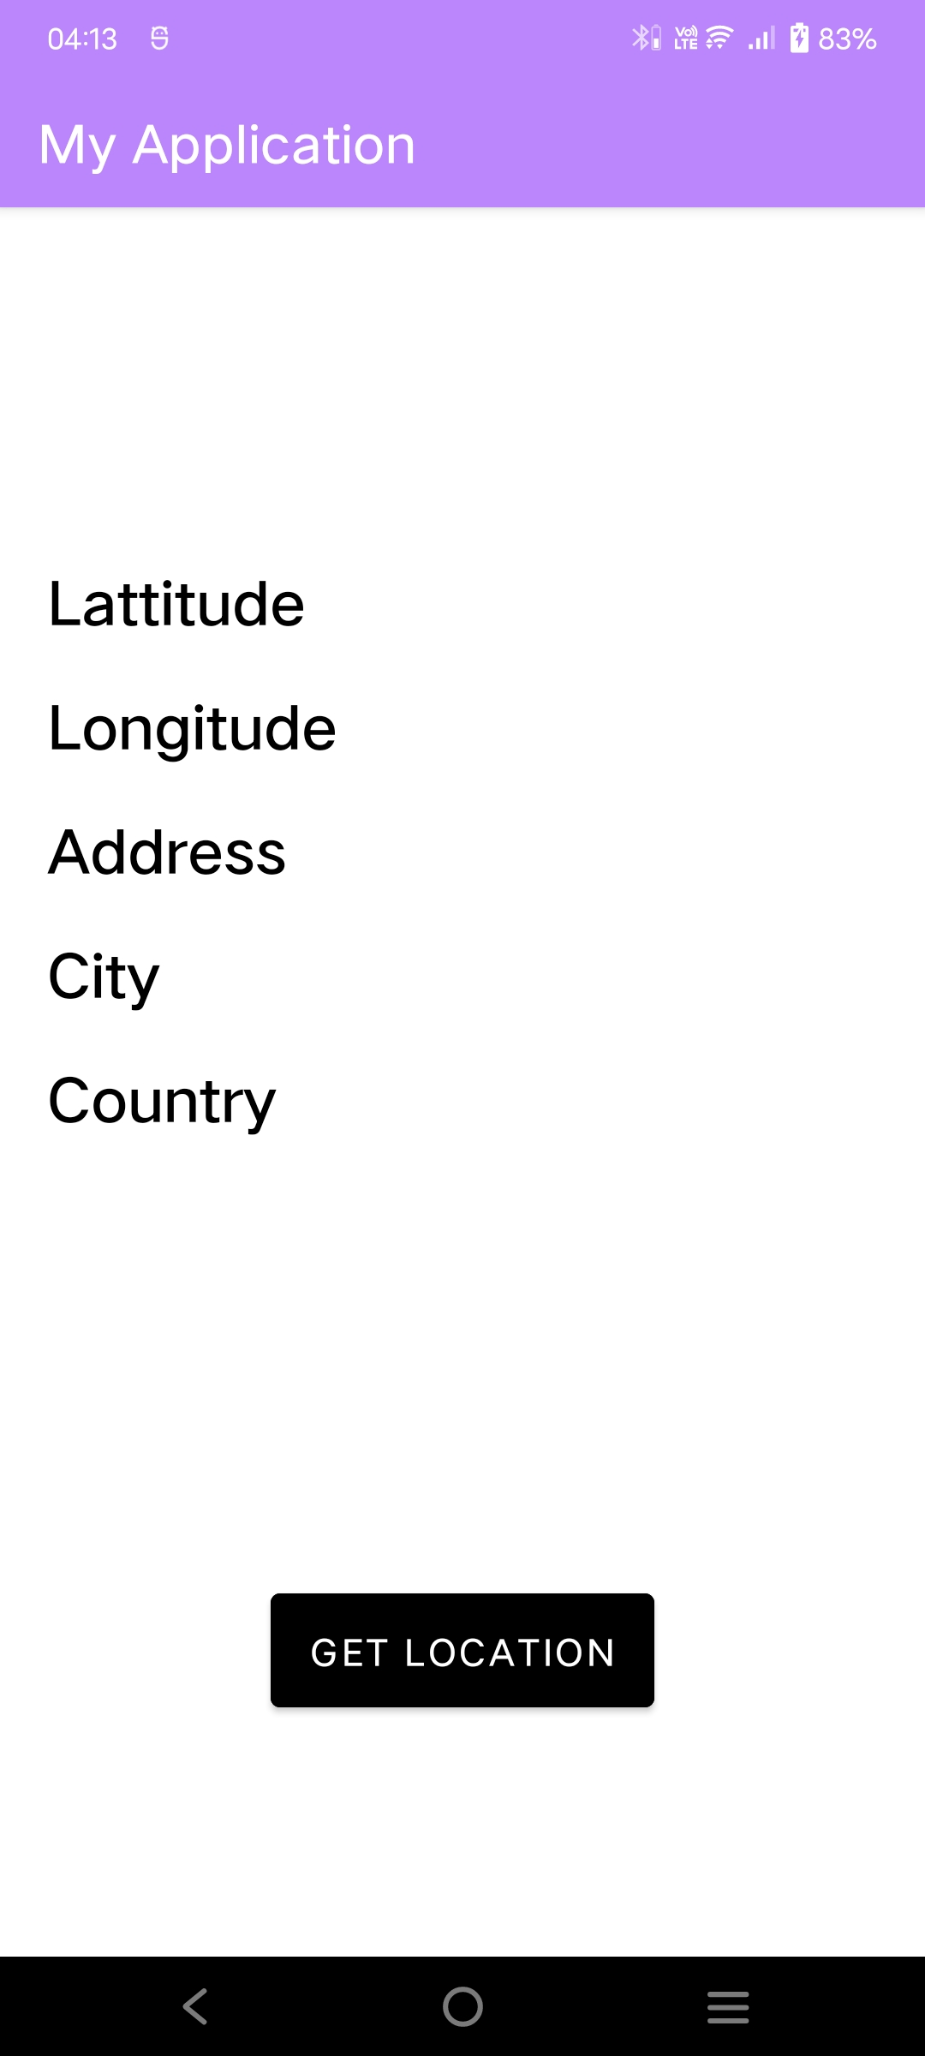
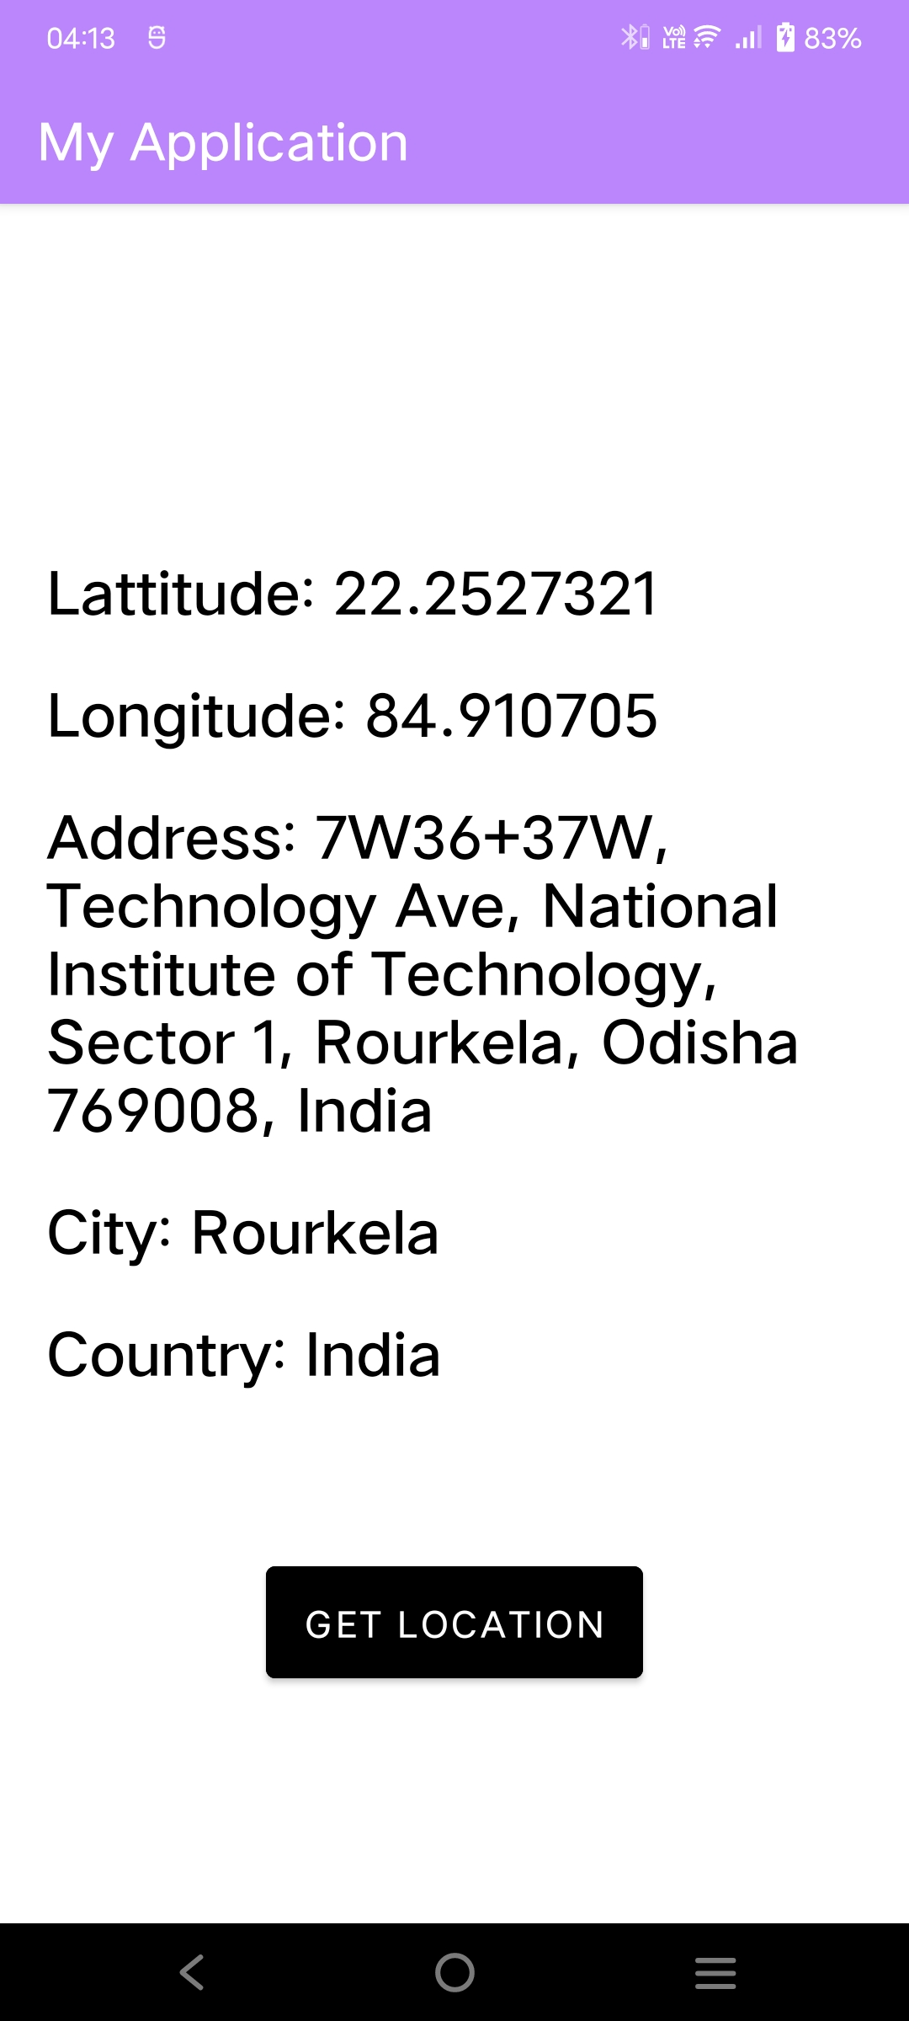
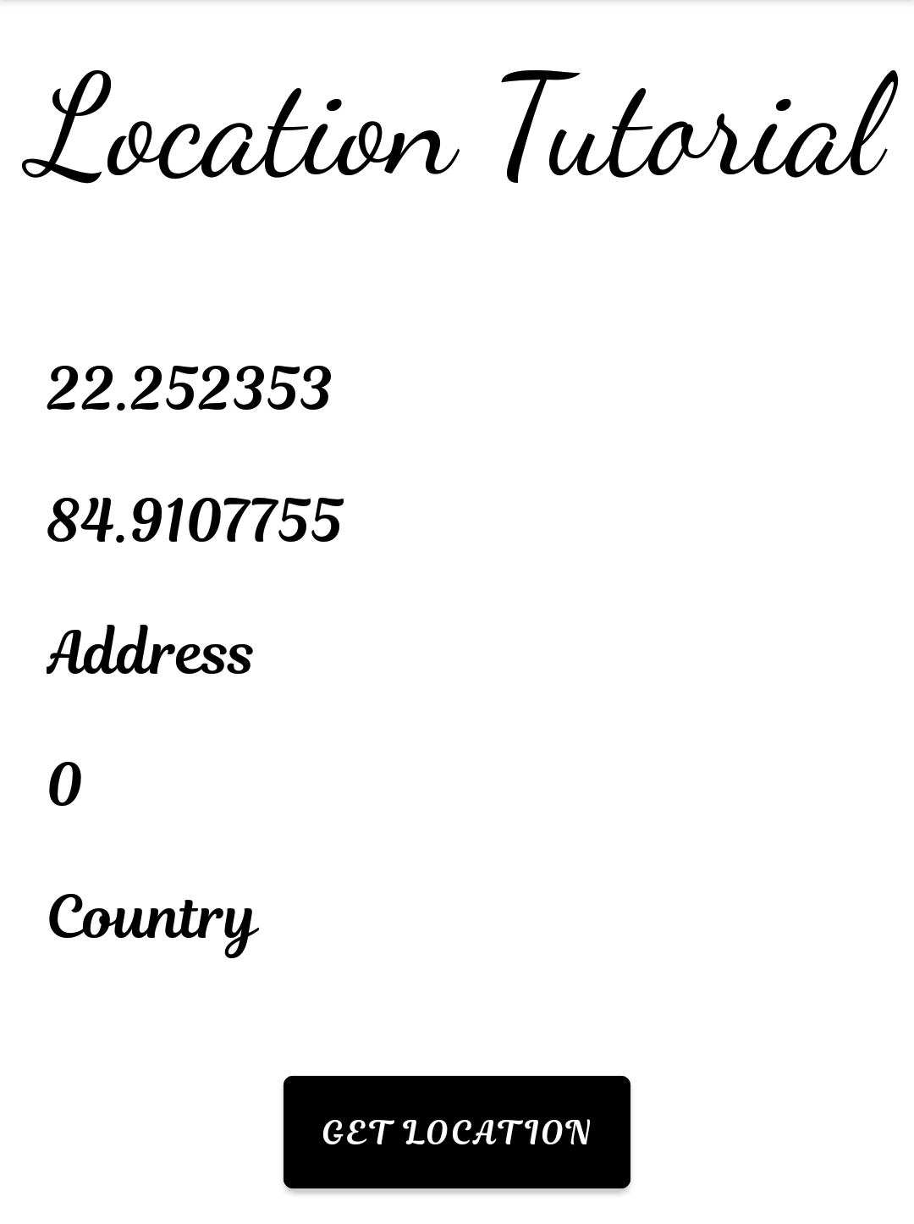


'0' means false
By Clicking The 'LOCATION' and 'GET LOCATION' button

Slide 11

OUR TEAM MEMBERS
SANJEEB DASH
PREETAM SUNDAR DAS
SUBRATA TRIPATHY
MRUTYUNJAYA SAHU
SPAMBYTES

Slide 12
Thank
You!

