Slide 1
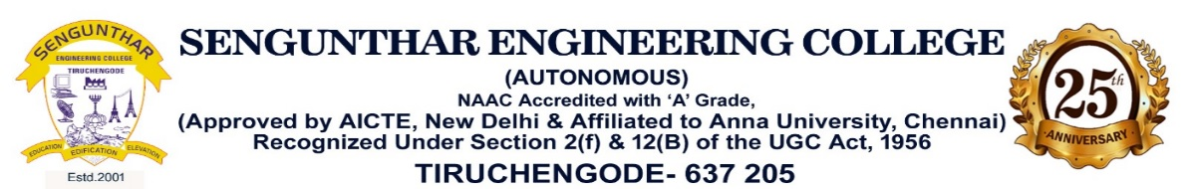
DEPARTMENT OF COMPUTER SCIENCE AND ENGINEERING
PROJECT WORK PHASE-II
TexVision AI: Intelligent Fabric Defect Detection and Quality Inspection System
PROJECT MEMBER:
AMRISH CM (61232312007)
GUIDED BY :
Mrs.S.HEMALATHA M.E.,

Slide 2
ABSTRACT
TexVision AI is an intelligent, AI-powered fabric defect detection and quality inspection system designed to improve textile manufacturing quality, reduce manual inspection efforts, and enhance production efficiency. Traditional fabric inspection methods rely on manual visual examination, which is time-consuming, inconsistent, and susceptible to human error. To overcome these challenges, TexVision AI adopts an advanced computer vision approach by continuously analyzing live camera feeds and fabric images for real-time defect detection and quality assessment.
The platform integrates state-of-the-art deep learning models, including YOLO-based object detection, to accurately identify and classify fabric defects such as holes, stains, weaving faults, misprints, and broken yarns. Supported by an enterprise architecture featuring an AI Service Manager, Dataset Manager, Model Manager, and real-time inspection pipeline, the system enables automated defect detection, inspection report generation, quality analytics, and model lifecycle management. This intelligent solution helps textile manufacturers achieve faster inspections, improved accuracy, reduced production waste, and consistent product quality while supporting future scalability for industrial automation and smart manufacturing.

Slide 3
OBJECTIVE
Develop an intelligent AI-powered fabric defect detection system that continuously monitors textile production using live camera feeds, image analysis, and real-time quality inspection.
Design and implement deep learning-based defect detection using YOLO models to accurately identify fabric defects, classify defect types, and evaluate quality with high precision.
Enable an integrated inspection workflow that automatically detects defects, generates inspection reports, stores defect history, and supports quality control decisions to improve production efficiency.
Replace traditional manual fabric inspection with an automated, AI-driven quality inspection platform that increases accuracy, reduces inspection time, minimizes human error, and enhances overall manufacturing productivity.

Slide 4
PROBLEM STATEMENT
The textile manufacturing industry produces large volumes of fabric that require continuous quality inspection to detect defects such as holes, stains, misprints, broken yarns, and weaving faults. Traditional inspection methods rely heavily on manual visual examination, which is time-consuming, labor-intensive, and prone to human error. This often results in inconsistent quality assessment, delayed defect detection, increased production waste, and higher operational costs.
Therefore, there is a need for an intelligent AI-powered fabric inspection system capable of performing real-time defect detection, automated quality assessment, defect classification, report generation, and production analytics. By leveraging advanced deep learning models and computer vision techniques, TexVision AI enables faster, more accurate, and consistent quality inspection, improving manufacturing efficiency and ensuring high-quality textile production.

Slide 5
INTRODUCTION
Modern textile industries produce large volumes of fabric that require continuous and accurate quality inspection to maintain production standards.
Traditional manual inspection methods are slow, labor-intensive, and prone to human errors, resulting in inconsistent quality and increased production waste.
TexVision AI uses YOLO-based deep learning and computer vision to detect, classify, and analyze fabric defects in real time from live camera feeds.
The system provides automated quality inspection, report generation, and production analytics through a local-first AI architecture, improving inspection accuracy, reducing waste, and enhancing manufacturing efficiency.

Slide 6
LITRATURE REVIEW
.
DeepLog: Anomaly Detection and Diagnosis from System Logs using Deep Learning
Min Du, Feifei Li, Guineng Zheng, Vivek Srikumar
School of Computing, University of Utah
Anomaly detection is a critical step towards building a secure and trustworthy system.
primary purpose of a system log is to record system states and Significant events at various critical points to help debug system failures and perform root cause analysis.
Such log data is universally available in nearly all computer systems.
Log data is an important and valuable resource for understanding system status and performance issues

Slide 7
LITRATURE REVIEW
.
YOLOv8: Real-Time Object Detection for Industrial Vision Applications
Ultralytics Research Team · Lionel Briand1
YOLOv8 is a state-of-the-art object detection model designed for high-speed and accurate real-time detection.
It provides excellent performance in detecting multiple object classes with low latency.
The model is widely adopted in industrial automation, manufacturing, and quality inspection systems.
Its accuracy and inference speed make it highly suitable for automated fabric defect detection in TexVision AI.

Slide 8
LITRATURE REVIEW
.
Automated Fabric Defect Detection Using Deep Learning and Computer Vision
Miguel De la Cruz Cabello a , Tiago Prince Sales b , Marcos R. Machado
a Department of Industrial Engineering and Business Information Systems, University of Twente
Deep learning and computer vision techniques have significantly improved automated fabric inspection.
Convolutional Neural Networks (CNNs) and YOLO models accurately identify defects such as holes, stains, and weaving faults.
Automated inspection reduces human error while improving production speed and quality consistency.
The study concludes that AI-based inspection systems provide higher accuracy and efficiency than traditional manual inspection methods.

Slide 9
EXISTING SYSTEM
Examples of Existing Systems:
Manual Fabric Inspection – Traditional visual inspection performed by human operators to identify defects during textile production.
Automated Optical Inspection (AOI) – Camera-based inspection systems that use predefined image processing techniques to detect basic fabric defects.
Conventional Machine Vision Systems – Rule-based image processing solutions that detect defects using fixed algorithms, offering limited adaptability to different fabric types.
Cloud-Based Quality Inspection Platforms – AI-enabled inspection systems that require cloud connectivity for image processing, model inference, and quality analytics, resulting in higher latency and dependency on internet availability.

Slide 10
PROPOSED SYSTEM
TexVision AI is an intelligent AI-powered fabric defect detection and quality inspection system designed to improve textile product quality and manufacturing efficiency.
It continuously captures and analyzes live camera feeds and fabric images to detect defects such as holes, stains, weaving faults, broken yarns, and misprints in real time.
The system uses YOLO-based deep learning models and computer vision techniques to accurately identify, classify, and evaluate fabric defects with high speed and precision.
It integrates a local-first enterprise architecture featuring the AI Service Manager, Dataset Manager, Model Manager, Camera Manager, and automated report generation, providing real-time quality analytics, inspection history, and efficient model management without depending on cloud services.

Slide 11
DISADVANTAGE OF EXISTING SYSTEM
Traditional manual fabric inspection is time-consuming, labor-intensive, and highly dependent on the operator's experience, leading to inconsistent results.
Conventional machine vision systems rely on fixed rules and image processing techniques, making them less effective in detecting complex or varying fabric defects.
Most existing systems lack real-time AI-based defect classification and quality analysis, resulting in delayed detection and increased production waste.
Cloud-dependent inspection solutions require internet connectivity, introduce processing delays, and provide limited flexibility for secure local industrial deployments.

Slide 12
ADVANTAGE OF PROPOSED SYSTEM
Provides real-time AI-powered fabric defect detection, enabling faster and more accurate inspection than traditional manual methods.
Uses YOLO-based deep learning models to automatically detect and classify multiple fabric defects with high precision.
Offers automated quality assessment, inspection report generation, and production analytics through an intelligent local-first architecture.
Improves product quality, reduces human errors and material waste, while increasing manufacturing efficiency and overall productivity.

Slide 13
SYSTEM REQUREMENTS
Hardware Requirements:
Processor: Intel i7 / Ryzen 7 or higher
RAM: Minimum 16 GB (32 GB recommended for AI models)
Storage: 512 GB SSD or higher
GPU (Optional but recommended): NVIDIA GPU for deep learning (CUDA support)
Camera: USB, RTSP, or IP Camera for Real-Time Fabric Inspection

Slide 14
SYSTEM REQUREMENTS
Software Requirements:
Operating System: Windows 10/11 (64-bit) or Linux
Frontend: Electron, React, TypeScript, Tailwind CSS
Backend: Python (FastAPI)
AI/ML Framework: PyTorch, YOLOv8, OpenCV
Database: SQLite (Local Database)
Development Tools: Visual Studio Code, Git, Node.js, Python 3.11+

Slide 15
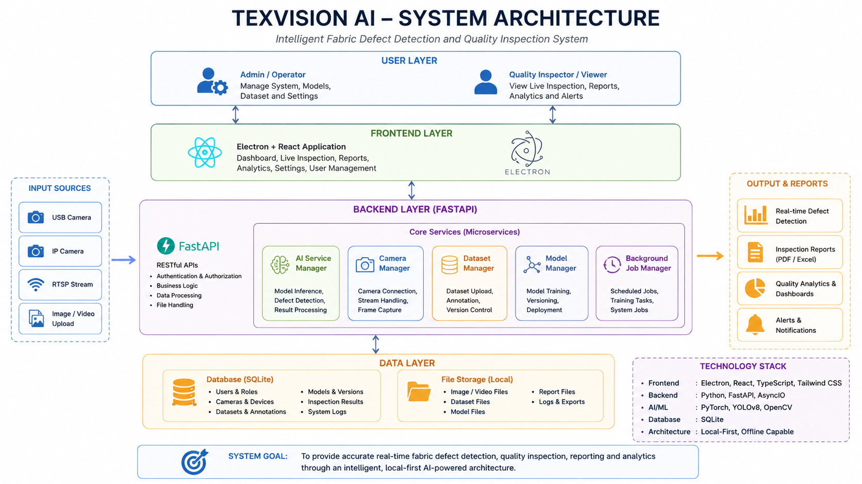
SYSTEM ARCHITECTURE

Slide 16
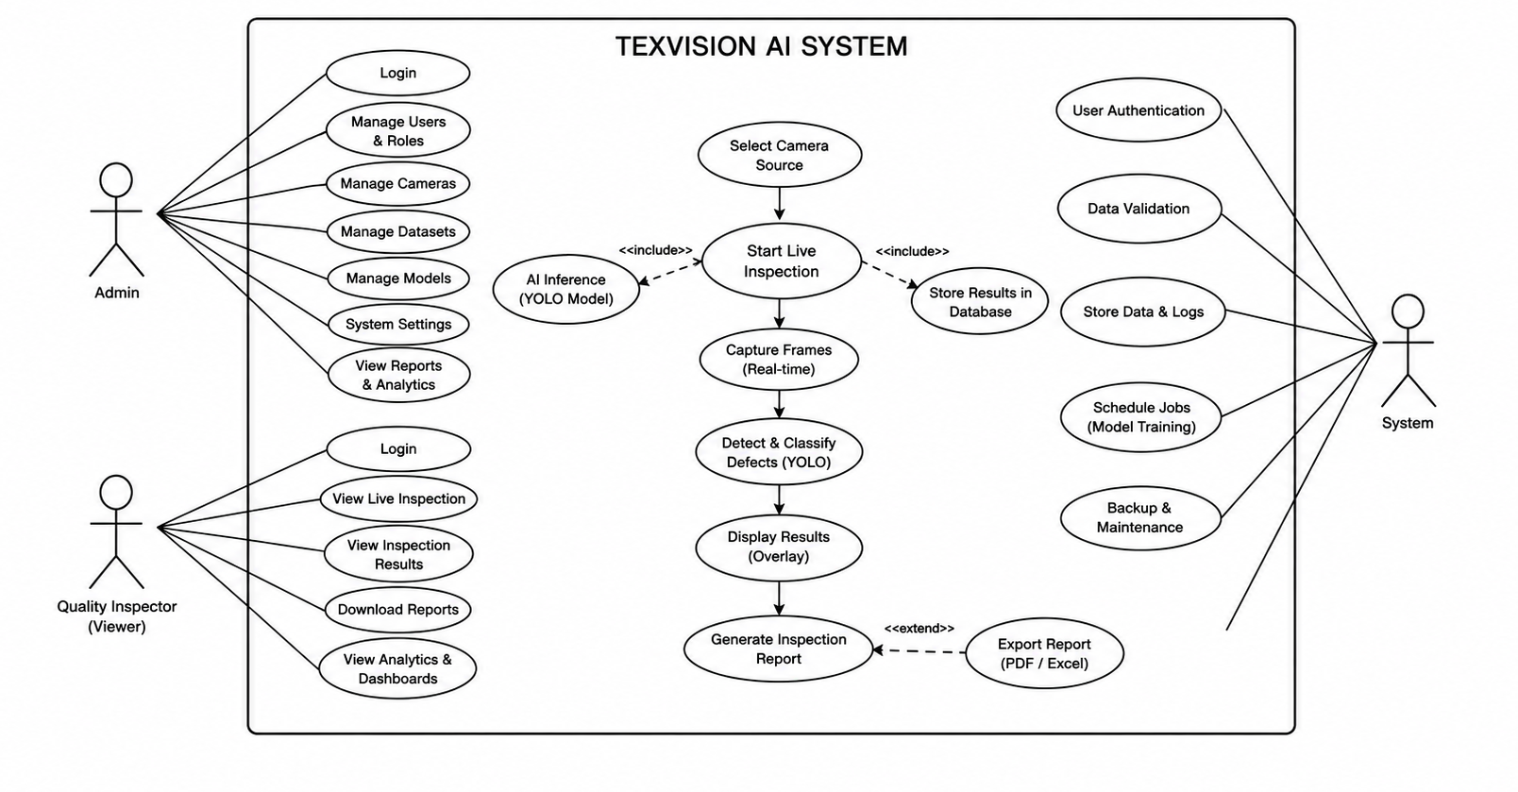
USE CASE DIAGRAM

Slide 17
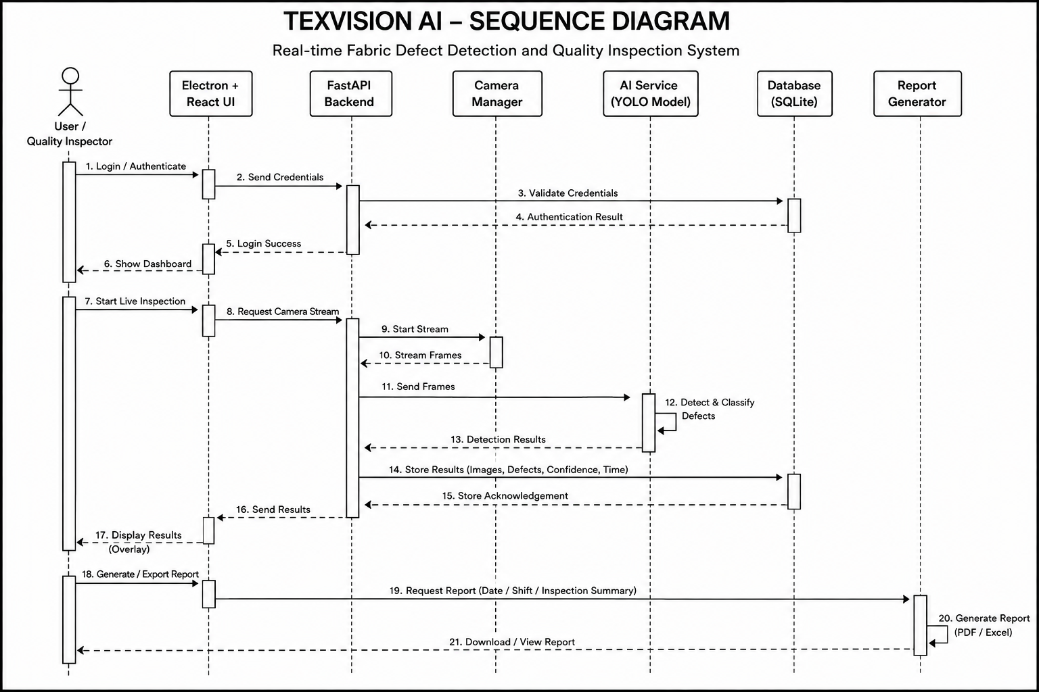
SEQUENCE DIAGRAM

Slide 18
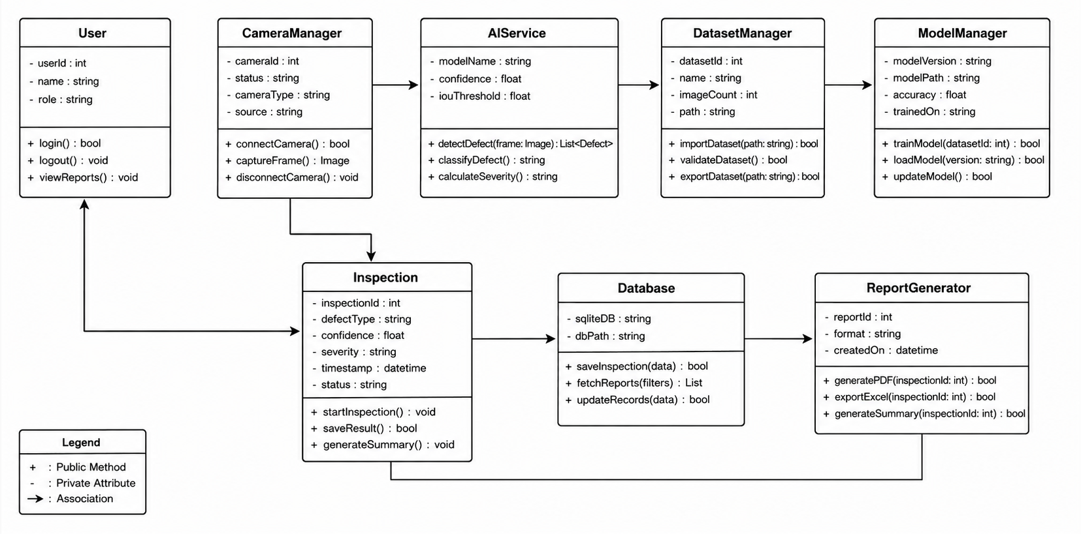
CLASS DIAGRAM

Slide 19
MODULES
AI Service Manager
Camera Manager
Dataset Manager
Model Manager
Inspection & Analytics Module
Report & Database Management

Slide 20
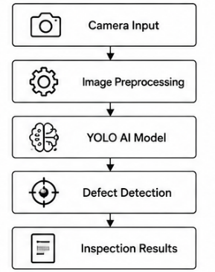
┘
1. AI Service Manager
Functions
Executes YOLO AI models for defect detection.
Processes captured fabric images in real time.
Classifies different types of fabric defects.
Calculates defect confidence and severity.
Sends inspection results to the application.

Slide 21
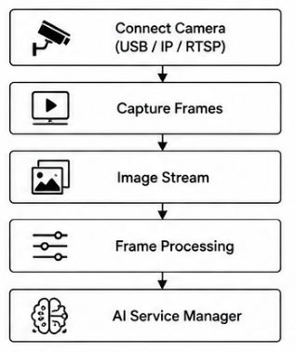
2. Camera Manager
Functions
Connects USB, RTSP, and IP cameras.
Captures live fabric images continuously.
Manages multiple camera streams.
Performs camera calibration.
Sends image frames to the AI engine.

Slide 22
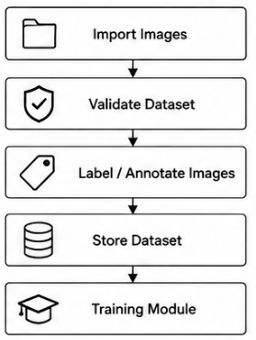
3. Dataset Manager
Functions
Imports fabric image datasets.
Validates dataset quality.
Stores annotations and labels.
Organizes dataset versions.
Supplies datasets for AI training.

Slide 23
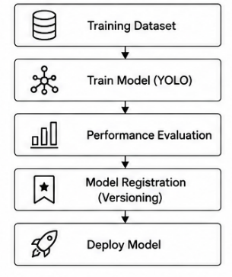
4. Model Manager
Functions
Trains YOLO models.
Maintains multiple model versions.
Evaluates model performance.
Deploys the best-performing model.
Updates AI models when required.

Slide 24
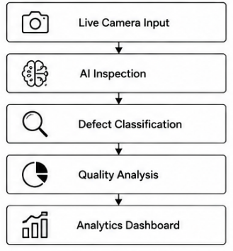
5 . Inspection & Analytics Module
Functions
Detects fabric defects instantly.
Classifies defect categories.
Calculates quality metrics.
Displays live inspection results.
Generates production analytics.

Slide 25
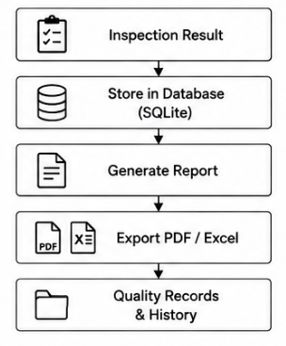
6. Report & Database Management
Functions
Stores inspection records.
Maintains defect history.
Generates PDF reports.
Exports Excel reports.
Supports quality tracking.

Slide 26
REFERENCE
Jocher, G., et al. - YOLOv8: Ultralytics Object Detection Model. Ultralytics Documentation, 2023.
Redmon, J., Divvala, S., Girshick, R., & Farhadi, A. - You Only Look Once: Unified, Real-Time Object Detection. IEEE Conference on Computer Vision and Pattern Recognition (CVPR), 2016.
He, K., Zhang, X., Ren, S., & Sun, J. - Deep Residual Learning for Image Recognition. IEEE CVPR, 2016.
Simonyan, K., & Zisserman, A. - Very Deep Convolutional Networks for Large-Scale Image Recognition. International Conference on Learning Representations (ICLR), 2015.
Ultralytics Research Team. - Ultralytics YOLO Documentation. Ultralytics Documentation, 2024.

Slide 27
THANK YOU
“Transforming Traditional Fabric Inspection into Intelligent Quality Assurance”
“Detect. Analyze. Ensure Quality.”

