Slide 1
Research Attachment Program
Color Band Detection using Verilog
By : Amrish S

Slide 2
Topics to be Discussed
Introduction
Image Processing
Verilog
Quartus Prime
Neural Network
Cyclone IV E
Advantages of Colour detection in Verilog
Sample Code
Output
Conclusion

Slide 3
Introduction
What is Image Processing?
Briefly define image processing as the manipulation and analysis of digital images to enhance, analyze, or obtain information from them.Highlight its applications in various fields like computer vision, medical imaging, robotics, and security systems.
Why Verilog for Image Processing?
Introduce Verilog as a hardware description language (HDL) used to design and implement digital circuits.
Hardware acceleration:
Verilog allows efficient implementation of image processing algorithms on dedicated hardware, leading to faster processing compared to software solutions.
Parallelism:
Verilog can exploit the inherent parallelism of image data for high-throughput processing.
Low-level control:
Verilog provides direct access to hardware resources like memory and processors, enabling fine-grained control over image processing pipelines.

Slide 4
Verilog
Verilog is a hardware description language (HDL) used to design and implement digital circuits and systems. It's like a programming language, but instead of writing code for software, you write code that describes the behavior and structure of electronic circuits
Modeling: Verilog allows you to model the functionality of digital circuits at different levels of abstraction, from simple logic gates to complex processors and memories.
Applications: Verilog is widely used in various fields such as:Digital logic design: designing integrated circuits (ICs), FPGAs (Field-Programmable Gate Arrays), and ASICs (Application-Specific Integrated Circuits).
Digital signal processing: implementing algorithms for tasks like filtering, compression, and modulation.
Verification: simulating and testing the behavior of digital circuits before fabrication

Slide 5
Quartus Prime
Intel Quartus Prime is a programmable logic device design software produced by Intel. It enables analysis and synthesis of HDL designs, allowing developers to compile their designs, perform timing analysis, examine RTL diagrams, simulate a design’s reaction to different stimuli, and configure the target device.
Features: Quartus Prime software includes features like Platform Designer, SoCEDS, DSP Builder, and an external memory interface toolkit. It also supports the generation of JAM/STAPL files for JTAG in-circuit device programmers.
Editions: Quartus Prime is available in three editions: Lite, Standard, and Pro. The Lite Edition is free and supports a limited number of FPGA devices. The Standard Edition requires a license and supports an extensive number of FPGA devices. The Pro Edition supports only the latest FPGA devices.
Design Flow: Quartus Prime supports a variety of design flows, including partial reconfiguration, block-based design, and incremental optimization.
Applications: Quartus Prime has wide-ranging applications in FPGA, CPLD, and SoC designs. It provides a fast path to convert your concept into reality and supports many third-party tools for synthesis, static timing analysis, board-level simulation, signal integrity analysis, and formal verification

Slide 6
Neural Network
Image Recognition: Neural networks, especially Convolutional Neural Networks (CNNs), have revolutionized the field of computer vision by enabling machines to recognize and analyze images.
Object Detection: Neural networks are capable of identifying and detecting objects within an image, which is a crucial application of image processing.
Image Segmentation: Neural networks can convert an image into a collection of regions of pixels represented by a mask or a labelled image, a process known as image segmentation.
Image Generation: Neural networks can generate new images based on certain criteria or characteristics, learning from a large dataset of images.
Hardware Implementation: The implementation of these image processing techniques using hardware description languages like Verilog can lead to the development of efficient and high-performance hardware solutions

Slide 7
Cyclone IV E
Overview: The Cyclone IV E board is a high-performance FPGA board developed by Intel. It uses the Cyclone IV E FPGA, which is designed for efficient implementation of complex algorithms and systems.
Features: The Cyclone IV E FPGA supports a wide range of logic elements, digital signal processing blocks, embedded memory, and user I/O count. The specific features vary depending on the model.
Design: The Cyclone IV E board is compact and simple, operating on a 3.3V single power supply.
Applications: The Cyclone IV E board is commonly used for designing digital systems, making it suitable for a variety of applications, including image processing, security, and robotics.
Variants: The Cyclone IV E FPGA is available in several variants, each offering different numbers of logic elements, digital signal processing blocks, embedded memory, and user I/O count1.

Slide 8
Advantages of Colour Detection in Verilog
Faster processing: Verilog is a hardware description language that can be used to design and implement digital circuits. By using verilog, colour detection can be performed at the hardware level, which is faster than software-based methods.
Lower power consumption: Hardware-based colour detection can also reduce the power consumption of the system, as it does not require a CPU or an operating system to run the algorithm.
Customizable design: Verilog allows the designer to create custom modules and components that can suit the specific needs and requirements of the colour detection application. For example, one can adjust the resolution, accuracy, and speed of the colour detection algorithm by modifying the verilog code.
Reusable code: Verilog code can be reused for different colour detection applications, as long as the input and output formats are compatible. This can save time and effort for the designer, as well as increase the reliability and consistency of the code.
Easy testing and debugging: Verilog code can be easily tested and debugged using simulation tools and logic analyzers. These tools can help the designer to verify the functionality and performance of the colour detection algorithm, as well as identify and fix any errors or bugs.

Slide 9
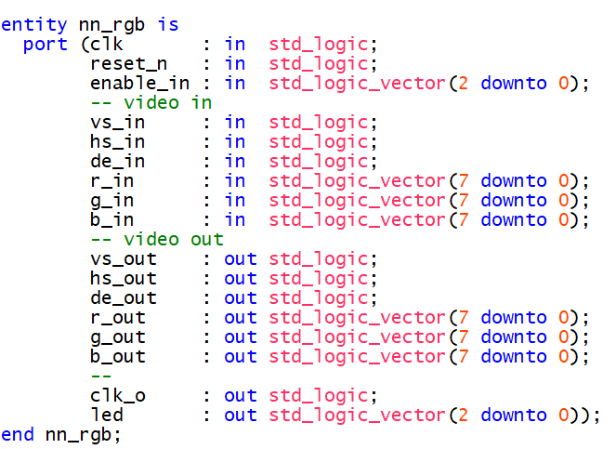
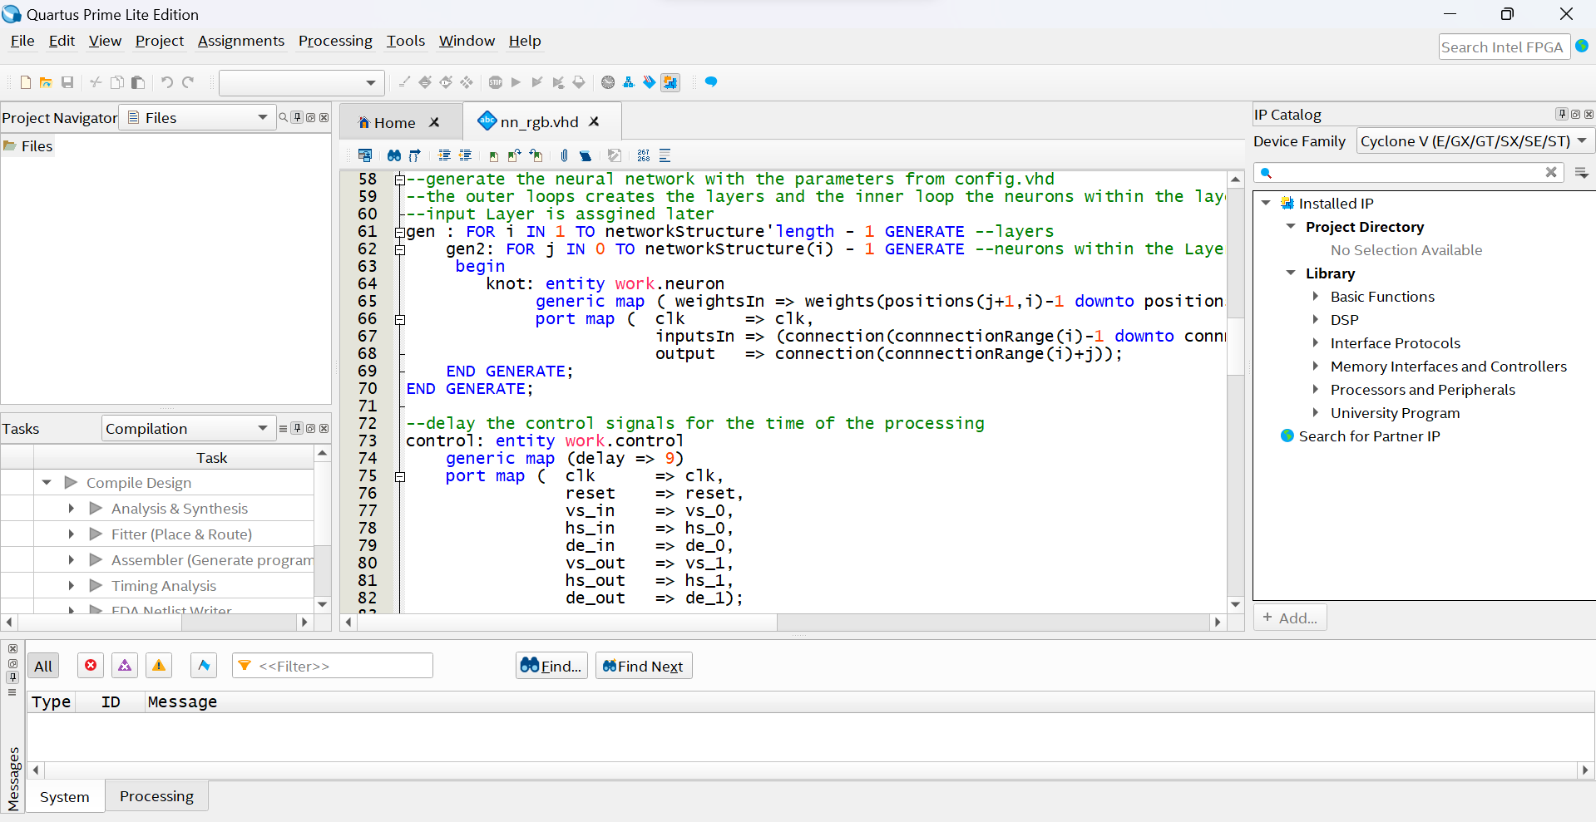
Sample Codes

Slide 10

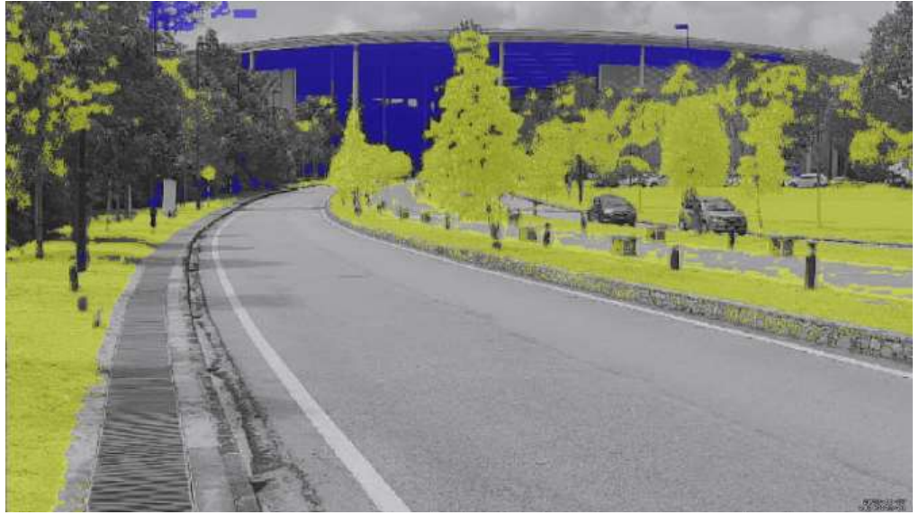
Output

Slide 11
Conclusion
Verilog is a powerful tool for designing and implementing hardware architectures for image processing tasks, such as color detection, edge detection, and feature extraction.Image processing in Verilog offers advantages such as efficiency, speed, flexibility, and reusability, making it suitable for real-time and cost-effective applications.Image processing in Verilog also faces challenges such as complexity, resource constraints, latency, and portability, requiring careful optimization and adaptation of algorithms and architectures.Image processing in Verilog has significant implications for various fields, such as medical imaging, security, and robotics, where accurate and fast image analysis and decision-making are essential.

Slide 12
Thank You

