Slide 1



Database Scalability

Slide 2

What we will learn today ?
1. Recap
2. Database Replication Models
3. 2 Phase Commit
4. CAP

Slide 3

1. Recap

Slide 4
1. Recap: Database Replication
Slave Shard 0
Flight id-4, 8
iOS
xyz.com
Server 1
Load Balancer
Master Shard-0
Flight id-4, 8
Slave Shard 0
Flight id-4, 8
xyz.com
Server 2
iOS
Master Shard-1
Flight id-1,5,9
Slave Shard 1
Flight id-1,5,9
Load Balancer
Load Balancer
xyz.com
Server 3
Slave Shard 1
Flight id-1,5,9
iOS
xyz.com
Server 4
Master
Shard-2
Flight id-2,6,10
Slave Shard 2
Flight id-2,6,10
Load Balancer
iOS
Slave Shard 2
Flight id-2,6,10
xyz.com
Server 5
Slave Shard 3
Flight id-3,7
Master
Shard 3
Flight id-3,7
iOS
Load Balancer
Slave Shard 3
Flight id-3,7

Slide 5
1. Recap: Database Replication
1. Now that we have 3 dB replicas for each Shard what happens if we update one shard Replica ?
2. How do we make sure that updates are consistent across shard replicas ?
3. How do we make sure read/write operations are in sync across all the 3 shard Replicas ?
4. How do the dB replicas communicate among themselves ?
5. We have few dB replication models(Master-Slave, Master-Master) to to fix this problem.

Slide 6
2. Database Replication Models

Slide 7
2. Database Replication Models
1. Single Primary Replication Model(Master-Slave)
2. Multi Primary Replication Model(Master-Master)

Slide 8
2.1 Single Primary Replication Model
1. This model helps in distributing the read request loads across dBs.
2. In this model we have two types of dBs- A Primary dB(Master) and Secondary dBs(Slave).
3.Primary dB(Master):We can perform read/write operation on ths dB.
4. Secondary dBs(Slaves): We can perform ONLY read operation on this dB.
Master dB
Slave dB A
Slave dB B

Slide 9
2.1 Single Primary Replication Model
Every Read request can be redirected to any of the 3 dB Replica.
We use a load balancer to distribute read request load evenly.
Master dB
Slave dB A
Slave dB B
Read
Read
Read

Slide 10
2.1 Single Primary Replication Model
What happens if a write to master(Primary) dB is made ?
Master dB
Slave dB A
Slave dB B
Write

Slide 11
2.1 Single Primary Replication Model
Master(Primary) dB performs a sync/async update to its slaves via dB links using a commit protocol.
Update via dB link
Update via dB link
Master dB
Slave dB A
Slave dB B
Write
Read
Read

Slide 12
2.1 Concerns with Single Primary Replication Model
1. We might run into race condition: If we write some data into primary(master) dB and then try to read data from a secondary(slave) dB before the primary(master) dB updates its changes to the secondary(slave) dB.
2. This is a good model for a news website where Reads > Writes.
3. If the primary(master) dB fails, we cant write to the dB. SPOF.
4. How do we distribute the write requests across dBs ? (write heavy)

Slide 13
2.2 Multi Primary Replication Model
1. This model helps in distributing the read+write request loads across dB servers.
2. We have multiple primary(master) dB to read from and write to the dBs.
Master dB A
Master dB B
Master dB C

Slide 14
2.2 Multi Primary Replication Model
Every Read request can be redirected to any of the 3 dB Replica.
We use a load balancer to distribute read request load evenly.
Master dB A
Master dB B
Master dB C
Read
Read
Read

Slide 15
2.2 Multi Primary Replication Model
Every Write request can be redirected to any of the 3 dB Replica.
We use a load balancer to distribute write request load evenly.
Master dB A
Master dB B
Master dB C
Write
Write
Write

Slide 16
2.2 Multi Primary Replication Model
Master(Primary) dB performs a sync/async update other Master via dB links using a commit protocol.
Update via dB link
Update via dB link
Update via dB link
Master dB A
Master dB B
Master dB C
Write
Write
Write

Slide 17
2.2 Concerns with Multi Primary Replication Model
1. We might run into Primary Key Conflict: If we create a new row into each of two primary(master) dBs A and B having the same primary key, and then an update happens between A and B to sync data.
Update via dB link
Master dB A
PK= 10
Master dB B
PK = 10
Write
Write

Slide 18
2.2 Concerns with Multi Primary Replication Model
1. What happens when two Master dBs A and C try to update the same row in Master dB B ? Conflict
Update via dB link
Update via dB link
Master dB A
PK = 15, duration(120)
Master dB B
PK = 15
Master dB C
PK = 15, duration(150)
Write
Write

Slide 19
3. 2-Phase Commit Protocol

Slide 20
3. 2-Phase Commit Protocol
1. Generally a dB transaction on a single dB server follows either of two semantics to maintain its data Consistency:
ACID = Atomicity + Consistency + Isolation + Durability(SQL dBs)
BASE = Basically Available + Soft State + Eventual Consistency(NoSql dbs like Key-Value store, document store, wide-Column store, graph dB)
2. How do we maintain ACID/BASE property in case of distributed dB servers ?

Slide 21
3. 2-Phase Commit Protocol
This is a distributed atomic(all-or-nothing) commit protocol to achieve agreement(consensus) across dB replicas during a commit process.
2. It has two phases:
Commit Request Phase(Voting phase)
Commit Phase
3. Lets see how it works with a running example of a banking dB

Slide 22

3. 2-Phase Commit Protocol: Defining roles and assumptions
1. We define a Transaction Coordinator TC(either a separate dB node or an existing one): Master dB
2. We define participants of the commit process: 1 Master, 2 Slaves.
3. We assume there exists a Write-Ahead-log at each dB server.
4. Also we assume dB server don’t crash forever and during a dB server crash the Write-Ahead-log is NOT lost/corrupted.
Master dB
TC
Slave dB A
participant
Slave dB B
participant

Slide 23
3. 2-Phase Commit Protocol
Let’s say we want to perform a withdraw transaction onto a banking dB(SQL) Customer Table which has a Master-Slave Replication Model.
2. We have the following withdraw transaction T:
withdraw_money(Customer, amount) {
Begin_Transaction();
if (Customer.balance – amount >= 0) {
Customer.balance = Customer.balance – amount;
Commit_Transaction();
} else {
Abort_Transaction();
}

Slide 24
3. 2-Phase Commit Protocol
1. Client(App Server) sends a “withdraw_money“ request to Master dB(Transaction Coordinator)
C → TC: Go!
Client
Withdraw Money
Go!
Master
TC
Slave A
participant
Slave B
participant

Slide 25
3. 2-Phase Commit: Voting Phase
2. Master(TC) sends a “prepare!” message to Slave A and Slave B.
TC→A: “prepare!”
TC→B: “prepare!”
Client
Master
TC
prepare!
prepare!
Slave A
participant
Slave B
participant

Slide 26
3. 2-Phase Commit: Voting Phase
3. Slave A and Slave B executes the transaction T upto before commit_transaction() and sends “yes” or a “No” to TC.
A → TC: yes!
B → TC: yes!
Client
Master
TC
Yes!
Yes!
Slave A
participant
Slave B
participant

Slide 27
3. 2-Phase Commit: Commit Phase
4. TC sends a commit message if both A and B say “yes”. TC sends an abort message if either says “No”. Slave A and Slave B commit on receipt of “commit”.
TC → A: commit!
TC → B: commit!
Client
Master
TC
commit!
commit!
Slave A
participant
Slave B
participant

Slide 28
3. 2-Phase Commit: Commit Phase
5. TC commits and sends “Okay” or “Failed” to the client.
TC → C: Okay!
Client
Okay!
Master
TC
Slave A
participant
Slave B
participant

Slide 29
3. 2-Phase Commit: Atomic Commit Rule
1. If one dB commits, no dB aborts.
2. If one dB aborts, no dB commits.
So no dB can commit until all the dBs agree together to commit.

Slide 30

3. Timeouts in Atomic Commit
1. Let’s say TC(Master) is waiting for a “yes” or “no” from A and B during Voting Phase ? TC hasn’t sent any commit message yet so can safely abort after timeout.
Client
I am waiting for my slaves to respond Yes/No☹
Master
TC
Yes/No ?
Yes/No ?
Slave A
participant
Slave B
participant

Slide 31
3. Timeouts in Atomic Commit
2. Let’s say in Commit Phase, A and B is waiting for “commit” or “Abort” message from TC. How long should A and B wait ?
Client
Master
TC
Commit/Abort ?
My master is not responding. Should I commit ?
My master is not responding. Should I abort ?
Slave A
participant
Slave B
participant

Slide 32
3. 2-Phase Commit: Termination Protocol
1. Let’s say Slave A and Slave B are waiting for “Commit” or ”Abort” message from TC(Master) in Commit Phase.
2. Let’s assume Slave B had voted “Yes” in Voting Phase.
3. Slave B sends a message to Slave A asking for its status:
B→A: Status?
Master
TC
Commit/Abort ?
I had voted “Yes”. Let me ask the status of A
Slave A
participant
Status ?
Slave B
participant

Slide 33
3. 2-Phase Commit: Termination Protocol
Four Cases arise, Case 1:
A→ B: No Reply. B continues to wait for TC
Client
Master
TC
Commit/Abort ?
No Reply from A. I ll have to wait for my master. Huh!!
Slave A
participant
No Reply
Slave B
participant

Slide 34
3. 2-Phase Commit: Termination Protocol
Case 2: A→ B : I got “commit”/”Abort” message from Master(TC).
B agrees with the Master’s(TC) decision.
Client
Master
TC
I got commit/Abort from TC. I am on it.
Commit/Abort
A got commit/Abort from TC. I ll also do the same.
Slave A
participant
Commit/Abort
Slave B
participant

Slide 35
3. 2-Phase Commit: Termination Protocol
Case 3: A→ B : I haven’t voted yet or voted a “No”. So TC can’t have decided to “Commit”.
Both A and B abort.
Client
Master
TC
I dint vote/voted No, So I am aborting.!
Commit/Abort ?
I had voted “Yes” but I am aborting too.
Slave A
participant
Not Voted/Voted No
Slave B
participant

Slide 36
3. 2-Phase Commit: Termination Protocol
Case 4: A→ B : I have voted “Yes”.
Both A and B must wait for TC. TC decides to “Commit” if both “Yes” received. TC “aborts” if timed-out.
Master
TC
I had voted Yes. I am waiting for my master.
Commit/Abort ?
I had voted “Yes” and A also voted “Yes”. I am waiting for TC.
Slave A
participant
Voted Yes
Slave B
participant

Slide 37
3. 2-Phase Commit: Handling Crash/Reboot
1. What happens if Master(TC) crashes just after sending “Commit” in Commit Phase ?
2. What happens if Slave A or Slave B crashes just after sending “yes” during Voting Phase ?
3. All the dB nodes use their “Write-Ahead-log”(on disk) to record their state before crash/Reboot.
4. When every node reboots and is reachable, it follows recovery Protocol to perform commit/Abort.

Slide 38
3. 2-Phase Commit: Recovery Protocol
1. Master(TC) reboots and finds no “Commit” record on disk. It aborts.
TC: I did not send any commit message before so I am aborting.
2. A and B reboots and doesn’t find “Yes” record on disk, It aborts.
A/B: I dint vote “Yes” so TC could’nt have committed.
3. A and B reboots and and finds “Yes” record on disk, it executes termination protocol.

Slide 39
3. Network Failure between dB Nodes
How does a dB system behave in case of network failure between their nodes ?
dB Replica A
Network Failure
dB Replica B

Slide 40
4. CAP Theorem

Slide 41
4. CAP Theorem
It says that it is IMPOSSSIBLE for a distributed dB system to achieve all the three Consistency, Availability and Partition Tolerance. We can pick only two of them.
Consistency: Every dB read request receives the value of most recent write or an error.
Availability: Every dB request receives a non-error response. There is no guarantee that the response contains the most recent writes(uptime = 99.99% of total time of service).
Partition Tolerance: The dB system continues to operate even if any number of messages are dropped/delayed by network between dB nodes.

Slide 42
4. Consistency Patterns
Weak Consistency: After a write, reads may or may or may not see it. E.g – App Engine: memcache, VoIP, live online vid, Realtime multiplayer game
Eventual Consistency: After a write, reads will eventually see it, mail, Search Engine, Indexing, DNS, Amazon S3
Strong Consistency: After a write, reads WILL see it, App Engine: Data Store, File System, RDBMS, Azure Tables.

Slide 43
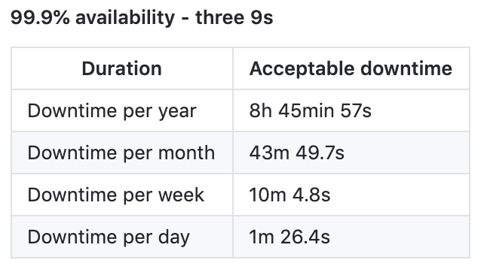
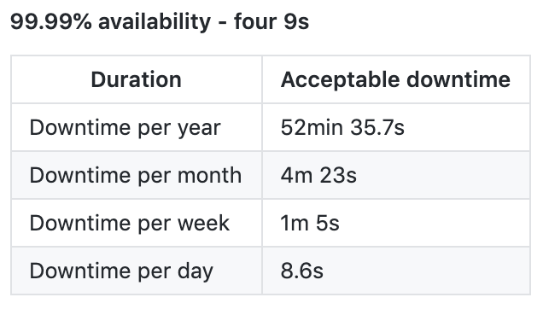
4. Availability Numbers
Availability is the Uptime of a system as a percentage of total time of service. It is measured in number of 9s.

Slide 44
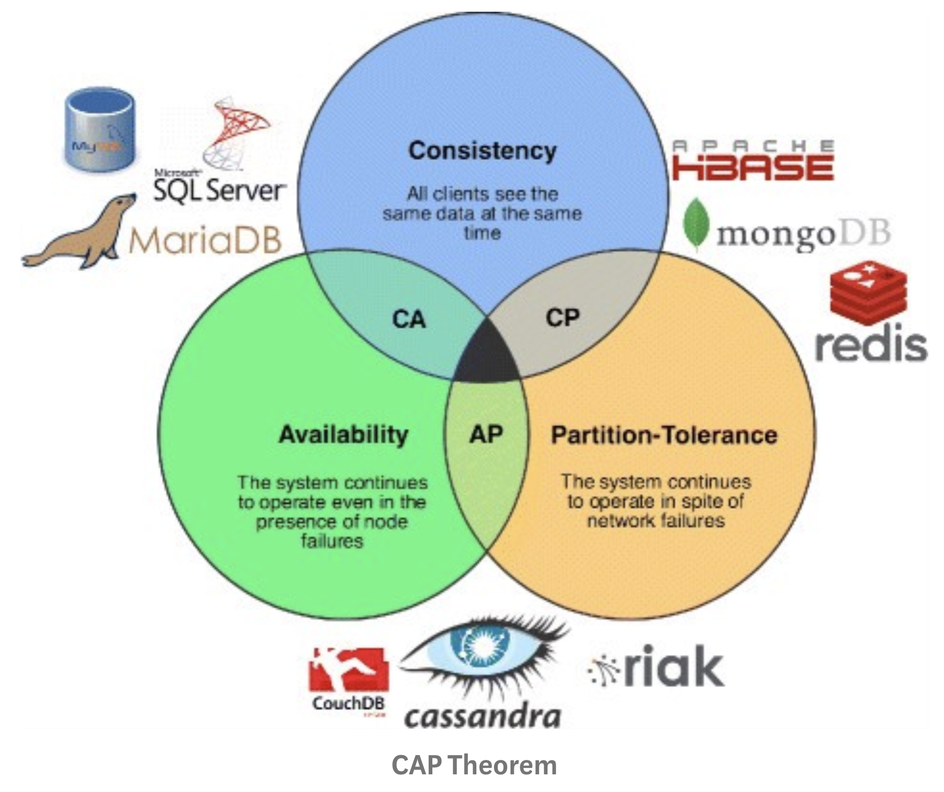

Slide 45
4. CAP Theorem: CA
A write transaction happening at dB Replica A will be updated to dB Replica B and vice versa. Both replica maintain consistent copies of data at any point of time. So every read receives most recent write.
Also dB A and B is up(available) for read/Write 99.99% of total time. So this provides CA.
dB Replica A
Flight ID- 4
Sync/Async Update
dB Replica B
Flight ID- 4
Read
Write
Read
Write

Slide 46
4. CAP Theorem: CP[SQL dBs]
Lets say the network connecting Replica A and B goes down and dBs get partitioned. Now both dBs stop serving Write requests as network failure is detected. The system is not available but maintains consistent copies of data in Replica A and B.
dB Replica A
Flight ID- 4
Network Failure
dB Replica B
Flight ID- 4
Read
Read

Slide 47
4. CAP Theorem: AP[NoSQL dBs]
Lets say the network connecting Replica A and B goes down and dBs get partitioned. Both dB Replicas are running fine.
Now a write transaction happening at A/B can no longer reach dB B/A resepectively. So both dB A and B end up maintaining inconsistent copies of data. But it continues to serve(Available) in a disconnected env.
dB Replica A
Flight ID- 4
Network Failure
dB Replica B
Flight ID- 4
Read
Write
Read
Write

Slide 48
4. AP and Eventual Consistency
The idea is the dB system will become consistent over time after network failure is fixed.
We allow dB read/Write requests on both dB Replicas even after network failure.
dB Replica A
Flight ID- 4
Network Failure
dB Replica B
Flight ID- 4
Read
Write
Read
Write

Slide 49
4. AP and Eventual Consistency
Both dB Replica A and B maintains a Merkle Tree which has the latest Write Transactions.
Lets say 4 write transactions A, B, C, D occurred on dB A during network Failure.
Each dB Replica maintains a Merkle Tree of write transactions.

Slide 50
4. Merkle Tree
We hash the transaction from leaf up to the root of tree at each dB.
Now we perform Tree Traversal(O(N)) and do data sync between dBs as network is up.
H[H(H(A), H(B)), H(H(C), H(D))]
H(H(A), H(B))
H(H(C), H(D))
H(A)
H(B)
H(C)
H(D)
Transaction A
Transaction B
Transaction C
Transaction D

Slide 51

Stay Tuned for Next session on:
Caching and CDN

