Slide 1
Text Generation using RNN
Group No:08
Project Guide:
Dr.Aditya Nigam
Dr.Arnav Bhavsar
TA Mentors:
Daksh Sir
Team Members:
Tulika
Eswer
Krishna
Amrit

Slide 2

Text Generation using RNN
Text Generation using CNN
Text Generation using RNN
Char Generation using LSTM
Word Level Text Generation using LSTM
Text Generation using Transformers/GPT2
Text Generation Conversational AI Chatbot
Text Generation Speech to Text using Transformers
Notebook: Summary of all work done.
https://colab.research.google.com/drive/1V5XunAN-L6asfTmVNQD_5_-RrSeZ9m2l?usp=sharing

Slide 3
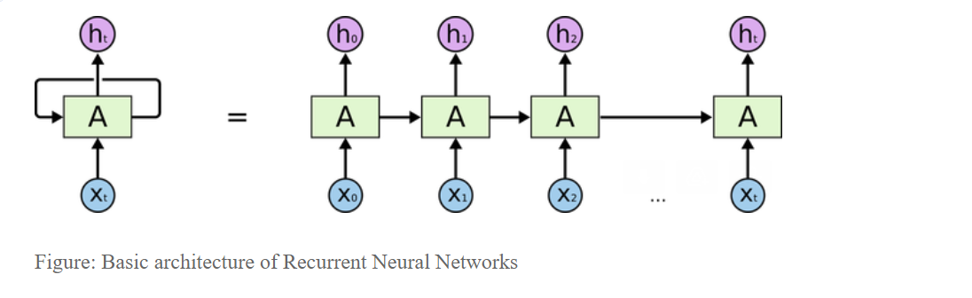
Text Generation Using RNN
Architecture:
RNN:

Slide 4
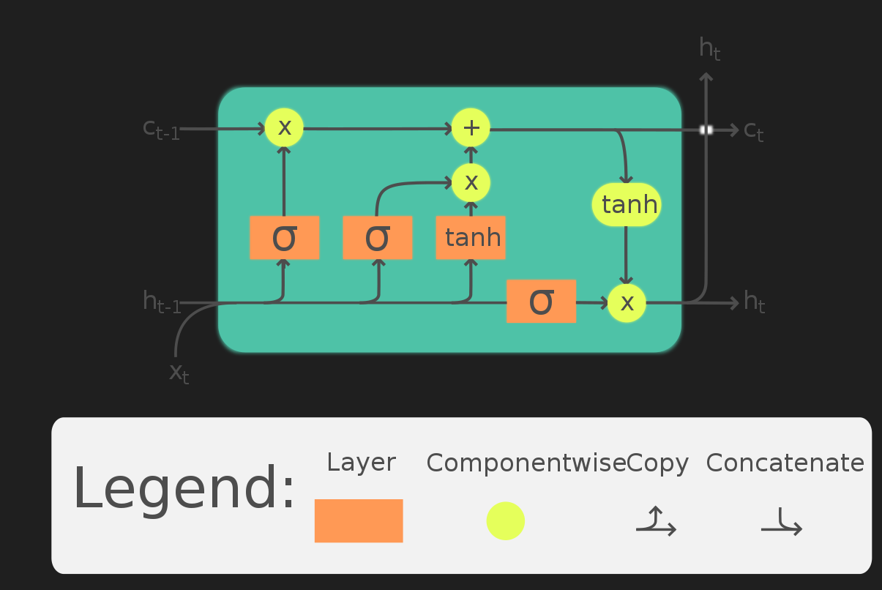
Text Generation Using RNN
Architecture:
LSTM:

Slide 5
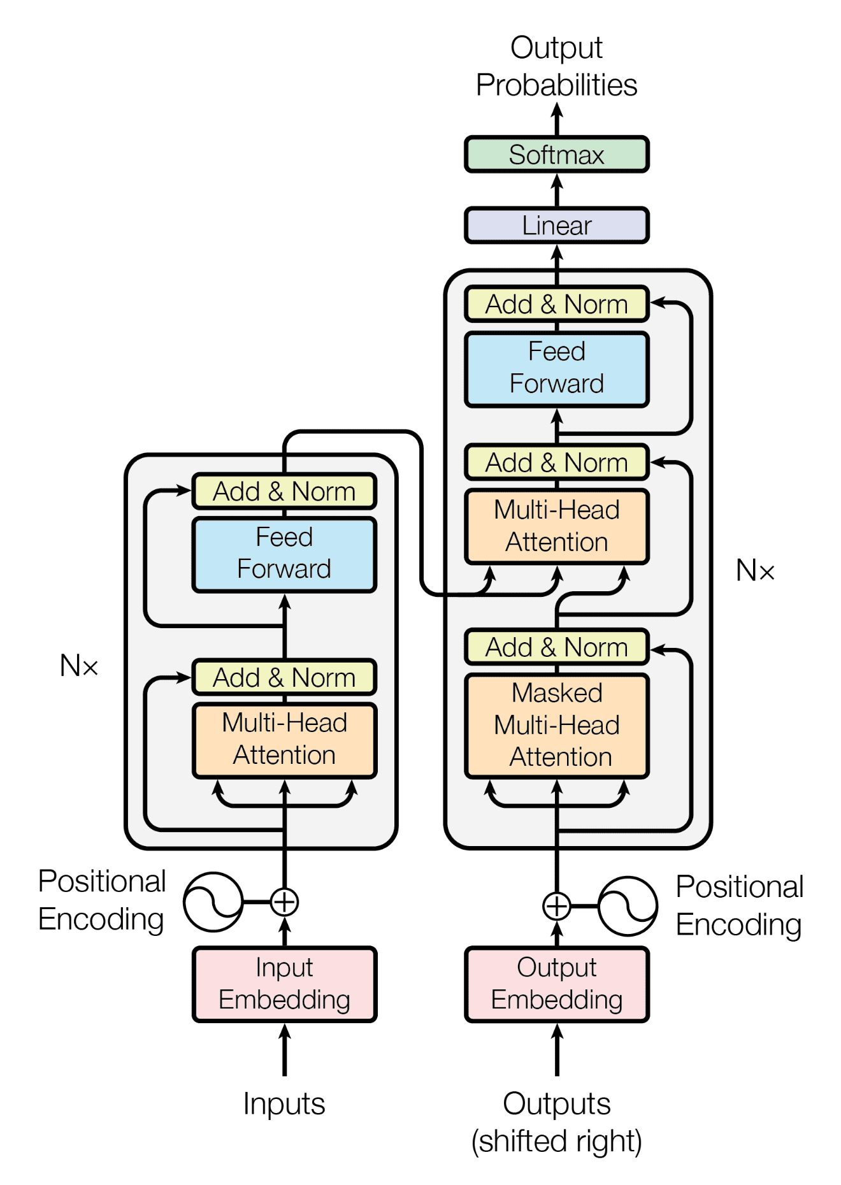
Text Generation Using RNN
Paper: (Attention is all you need)
https://arxiv.org/abs/1706.03762?context=cs
Architecture:
Transformers:

Slide 6
1. Text Generation Using RNN
Text generation: is a subfield of natural language processing (NLP). It leverages knowledge in computational linguistics and artificial intelligence to automatically generate natural language texts, which can satisfy certain communicative requirements.
Why RNN isn’t practical for text generation?
RNN has a big problem of vanishing and exploding gradients. Hence RNN can’t hold longer sequential information and in the text-generation task, we particularly need a model that can memorize a long sequence of data. For this purpose LSTM came into the picture.

Slide 7
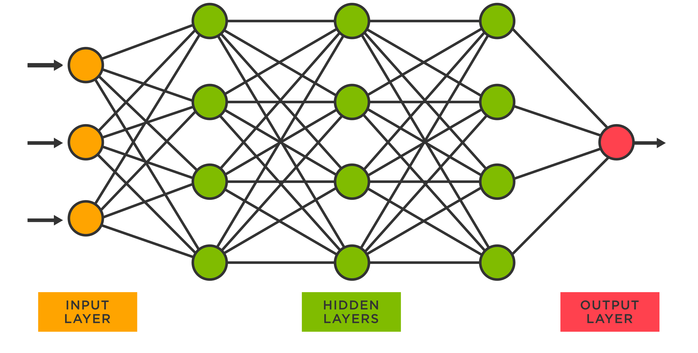
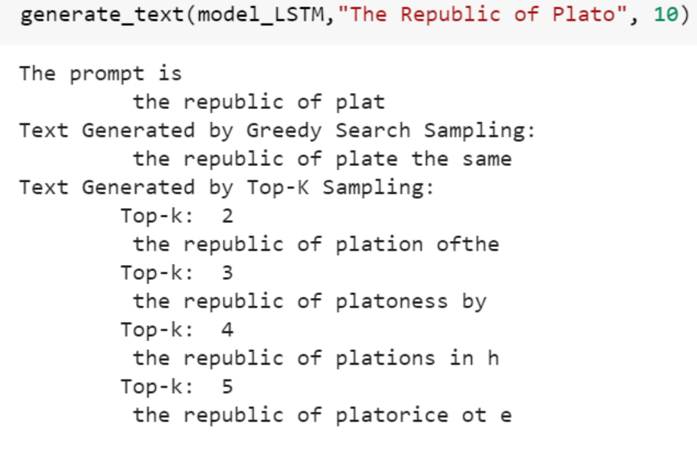
2. Char generation using LSTM
Result:
Notebook:
https://colab.research.google.com/drive/1ZUIpy9wfRHgQ-aNNUeO3UN6YZqc62vKb?usp=sharing#scrollTo=Mej1sm7Utlyi
Probablities over word/char set
Input

Slide 8
Char generation using LSTM
Steps:
Created data pipeline for word/char level text generation
Convert: text into seq of characters
Remove: unwanted characterd such as punctuations,html tags,white spaces
Generate: input (X) and output (y) pairs as token sequences.
Concatenate input (x) and output (y) into train data
Train language model:
Defined our LSTM model
Generating text with an LSTM network

Slide 9
Text generation using LSTM
What is a word level text generation?
A language model can be trained to generate text word-by-word.
In this case, each of the input and output tokens is made of word tokens.
In training, we supply a sequence of words as input (x) and a target word (next word to complete the input) as output (y)
After training, the language model learns to generate a conditional probability distribution over the vocabulary of words according to the given input sequence.

Slide 10
Text generation using LSTM
Notebook:https://colab.research.google.com/drive/1TLObm8g3IZRZS8uXdKKMSmt-kxUUc1Rb#scrollTo=tJyp6b7y4cOb

Slide 11
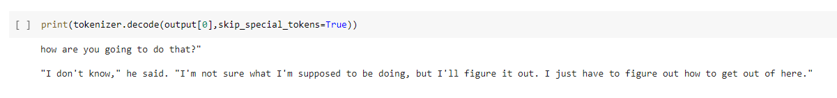
Word level text generation using transformer (gpt2)
Notebook:
https://colab.research.google.com/drive/1KI5gv6z2uCXgWAmcjwW2xpfefYpPNnMH?usp=sharing#scrollTo=TiMKEskSUKhq Result:

Slide 12
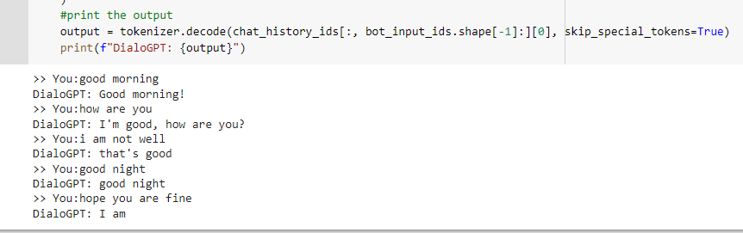
Text Generation using AI Chatbot
Notebook: https://colab.research.google.com/drive/1C97i1gR1GHgVixpk2SjUCOkWmNaFisK7#scrollTo=CP16AuMohjtc Result:

Slide 13
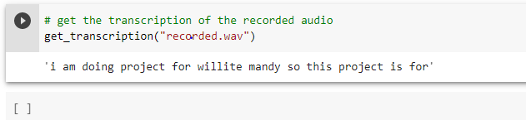
Text generation: Speech Recognition using transformers in python
Notebook: https://colab.research.google.com/drive/17vfkTbIF5uPF8A08Ed--EjCmI_9jg93I#scrollTo=OVAyy93UvU7S Result:

Slide 14

Thanks

