Slide 1
APS Project
Study and implement Pairing heap, Fibonacci heap and Binomial heap and compare them
Team Members
1.Amrit Sahai (2019201009)
2.Anvesh Bakwad (2019201030)

Slide 2


What is Heap?
Why we require Heap?
A Heap is a special Tree-based data structure in which the tree is a complete binary
tree.
Generally, Heaps can be of two types:
    Max Heap
    Min Heap
To implement priority queues.

Slide 3
Types Of Heaps
1. Binary Heap
2. Binomial Heap
3. Fibonacci Heap
4. Pairing Heap

Slide 4
Heaps and Time Complexities
Operations | Binary Heap | Binomial Heap | Fibonacci Heap | Pairing Heap
make_heap | 1 | 1 | 1 | 1
insert | log n | log n | 1 | 1
find_min | 1 | log n | 1 | 1
extract_min | log n | log n | log n | log n
union | log n | log n | 1 | 1
decrease_key | log n | log n | 1
delete | log n | log n | log n | log n
is_empty | 1 | 1 | 1 | 1

Slide 5
1.Binomial Heap
1.1 Introduction
A Binomial heap H is a set of binomial trees that satisfies the
following binomial-heap criterias.
Each binomial tree in H obeys the min-heap property: the key of a node is greater than or equal to the key of its parent. We say that each such tree is min-heap-ordered.
For any nonnegative integer k, there is at most one binomial tree in H whose root has degree k.

Slide 6
1.2 Properties Of Binomial Heap
A Binomial Tree of order ‘k’ has following properties.
(a) It has exactly 2k nodes.
(b) It has depth as k.
(c) There are exactly C(k,i) nodes at depth i for i = 0, 1, . . . , k.
(d) The root has degree ‘k’ and children of root are themselves Binomial Trees with order k-1, k-2,.. 0 from left to right.

Slide 7
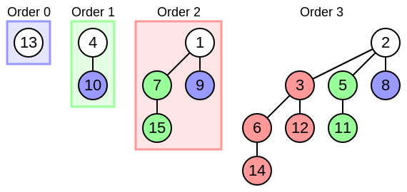
1.3. Binomial Heap Structure

Slide 8
2.Fibonacci Heaps
2.1. Introduction
Similar to binomial heaps, but less structured.
Like Binomial Heap, Fibonacci Heap is a collection of trees with min-heap or max-heap property.
In Fibonacci Heap, trees can can have any shape even all trees can be single nodes (This is unlike Binomial Heap where every tree has to be Binomial Tree).
Decrease-key, Insertion and union run in O(1) time.

Slide 9
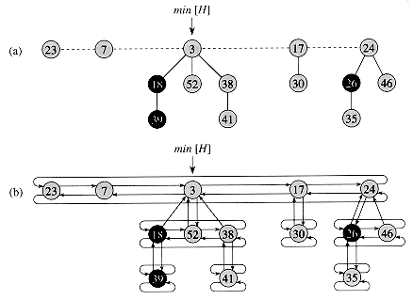
2.2 Fibonacci Heap Structure
Set of min-heap ordered trees.
Children of a node are linked together in a Circular Doubly List.

Slide 10
2.3 Operations and Time Complexities
1) Find Min: Θ(1) [Same as both Binary and Binomial]
2) Delete Min: O(Log n) [Θ(Log n) in both Binary and Binomial]
3) Insert: Θ(1) [Θ(Log n) in Binary and Θ(1) in Binomial]
4) Decrease-Key: Θ(1) [Θ(Log n) in both Binary and Binomial]
5) Merge: Θ(1) [Θ(m Log n) or Θ(m+n) in Binary and
Θ(Log n) in Binomial]

Slide 11
2.3 Operations and Time Complexities
1) Find Min: Θ(1) [Same as both Binary and Binomial]
2) Delete Min: O(Log n) [Θ(Log n) in both Binary and Binomial]
3) Insert: Θ(1) [Θ(Log n) in Binary and Θ(1) in Binomial]
4) Decrease-Key: Θ(1) [Θ(Log n) in both Binary and Binomial]
5) Merge: Θ(1) [Θ(m Log n) or Θ(m+n) in Binary and
Θ(Log n) in Binomial]

Slide 12
2.4 Advantage of Fibonacci Heaps
Most asymptotically fastest algorithms for computing minimum spanning trees and finding single source shortest paths, make use of the Fibonacci heaps.
Examples :
    Dijkstra Shortest Path Algorithm
    Prim’s Minimum Spanning Tree
Time Complexity of Prim’s and Dijkstra’s algorithm
    Without Fibonacci Heap : O(E*logV + V*logE)
    With Fibonacci Heap : O(E + V*logV)

Slide 13
3. Pairing Heap
3.1. Introduction
Pairing Heap islike a simplified form of fibonacci Heap.
It also maintains the property of min heap.
It can be considered as a self-adjusting binomial heap.
NODE STRUCTURE
Child
    Pointer to first node of children list.
Left and Right Sibling
    Used for doubly linked linked list (not circular) of siblings.
    Left pointer of first node is to parent.
    x is first node in list iff x.left.child = x.
Data
Note: No Parent, Degree, or Child fields.

Slide 14
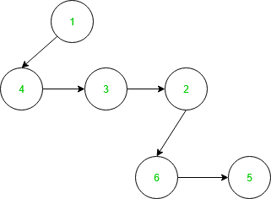
3.2 Structure of Pairing Heap
Each node has a pointer towards the left child and left child points towards the next sibling of the child.

Slide 15
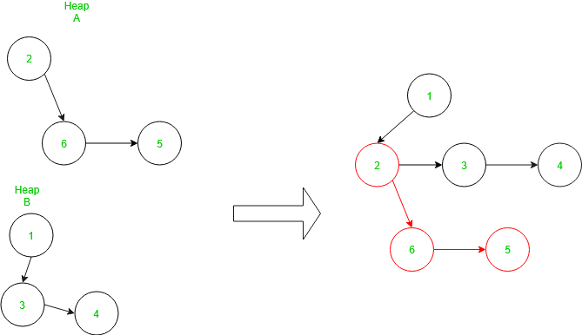
MERGE OPERATION
Merge Operation :

Slide 16
THANK YOU

