Slide 1

CENTRAL INSTITUTE OF TECHNOLOGY KOKRAJHAR
Final Presentation for term Project
Medical Shop Automation System
Course code: - UCSE672(Software Engineering Laboratory)
Module: - B Tech, 6th semester
Department: - Computer Science and Engineering
Submitted by: -
Amrit Kumar Tiwari 202002021002
Jimmy Brahma 202002021050
Ringkang Basumatary 202002021010
Saptarshi Ganguly 202002022116

Slide 2
Content
1.Introduction
2.Objective
3.SRS
4.DFD
5.Tool and Technologies Requirements
6.Hardware Requirement
7.Implementation
8.Conclusion
9.Reference

Slide 3
Introduction
In today's medical industry, there is a growing emphasis on providing reliable and accurate services to customers and employees alike. Many leading medical shops are leveraging technology to offer a wider range of choices and better customer experiences. To achieve this, businesses are turning to computerized equipment and software to automate their existing manual systems. By doing so, they can store valuable data and information for longer periods and easily access and manipulate it as needed. The goal is to improve overall efficiency and provide a seamless experience for all parties involved. This "Medical Shop Automation System" project aims to provide similar features by managing and recording the activities of an entire medical shop with multiple facilities. This system is designed to streamline the management process and ensure that all operations are properly recorded and tracked.
The Medicines Automation System is a software system that automates and streamlines medication dispensing, administration, and monitoring in healthcare facilities. The system will improve patient safety by reducing medication errors and enhancing medication management.

Slide 4
Objective
The Medicines Automation System will manage medication dispensing, administration, and monitoring in healthcare facilities. The system will integrate with electronic health records (EHRs) and pharmacy information systems (PISs).
The main objectives behind the development of this project are as follows:
1) To assist the medical shopkeeper and wholesalers in capturing the effort spent on their respective working areas.
2) To keep track of purchased medicines and stock status
3) To provide computerized sale and generate bill for a particular sale.
4) To keep and manage transaction from suppliers.
5) To maintain the payment system for supplier.
6) To store the details of medicines category wise.
7) To search a medicine in stock.
8) To generate report of sale between two dates.
9) To generate the reports from various transaction table as per query.

Slide 5
SRS
This Software Requirements Specification (SRS) document is to outline the functional and non-functional requirements for the Medicines Automation System.
For Functional requirement we used -
Inventory Management
Sales Management
Prescription Management
User Management
Reporting and Analytics
Search Functionality
Notification System
Integration with External Systems

Slide 6
SRS
For Non-Functional requirement we used -
Performance
Security
User Interface
Reliability
Scalability
Accessibility
Compatibility
Regulatory
Compliance

Slide 7
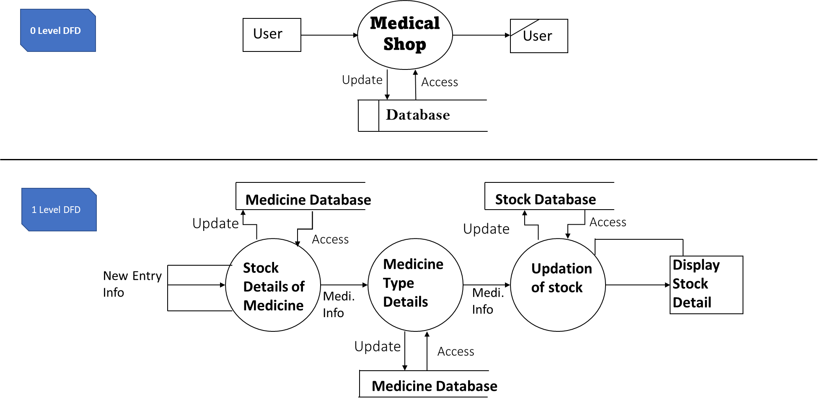
DFD
Our Software DFD is -

Slide 8
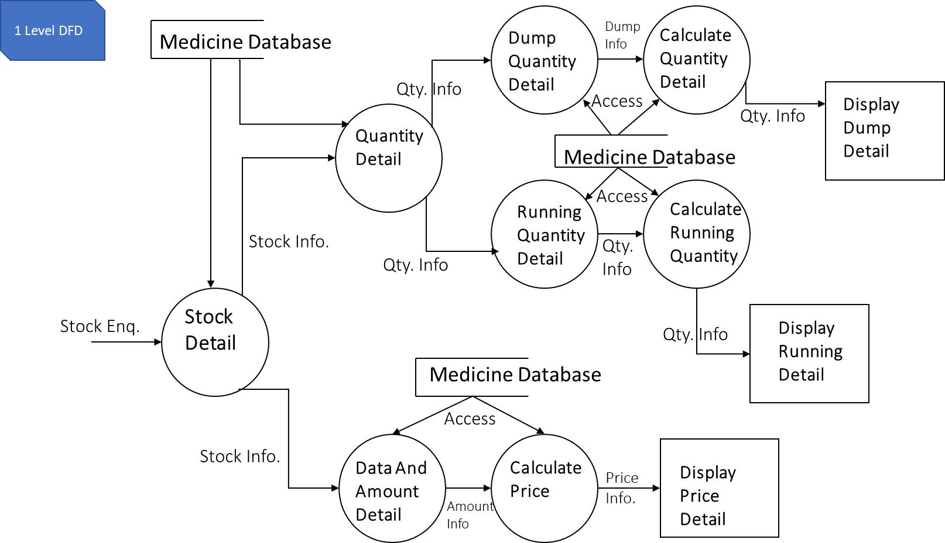
DFD

Slide 9
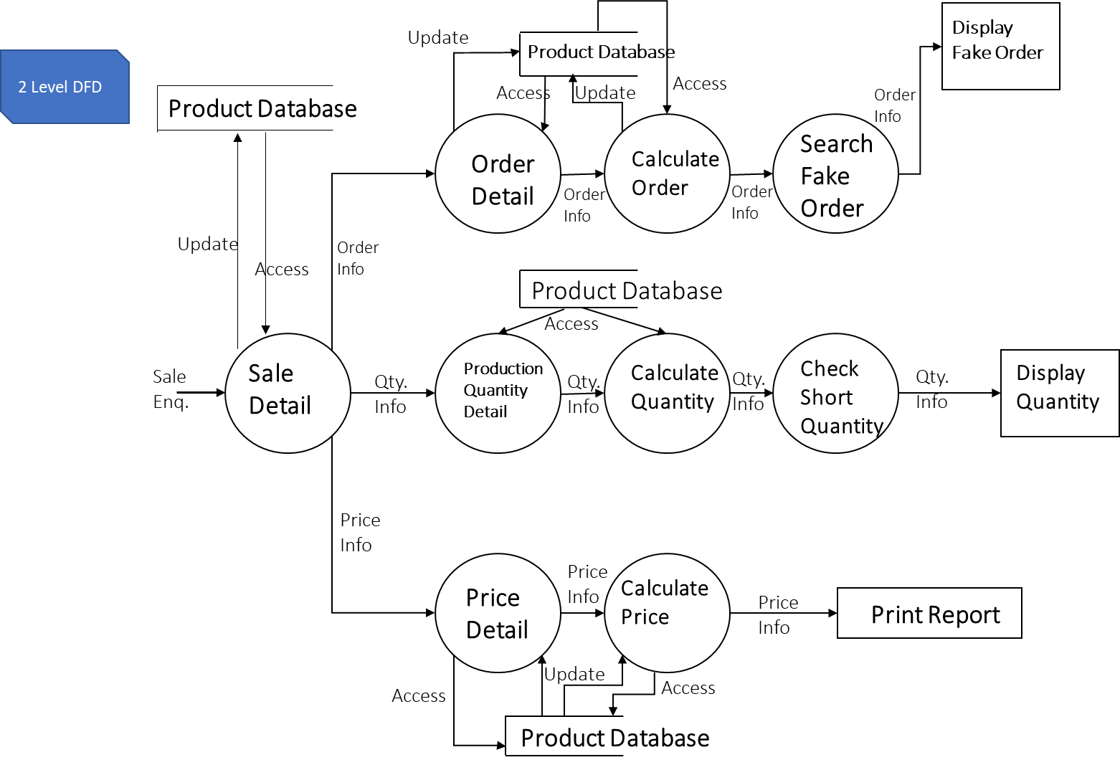
DFD

Slide 10
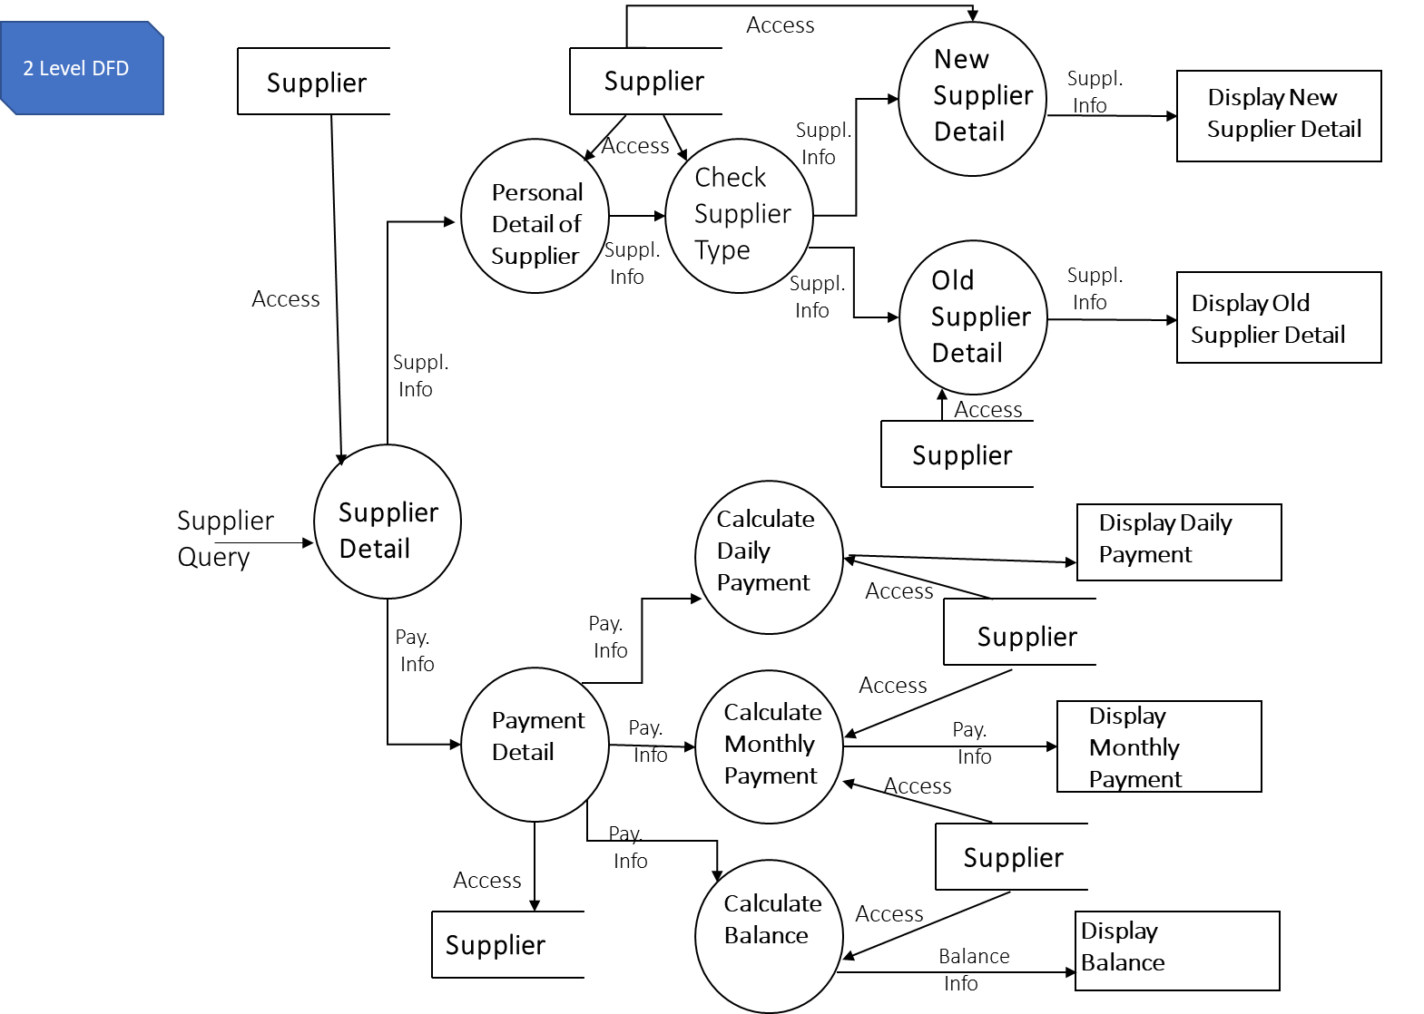
DFD

Slide 11
Tool and Technologies Requirements
To Build this software we used some tools ,those are –
Front-end Tools and Technologies
Sublime Text
HTML
CSS
JavaScript
PHP
Back-end Tools and Technologies
My SQL & XAMPP server
Other Tools and Technologies
Microsoft word 2016 (for documentation)

Slide 12
Hardware Requirement
Computers equipped with a Pentium 4 processor or higher, the computer must have approximately 800MB of free hard drive space and 4GB of RAM.

Slide 13
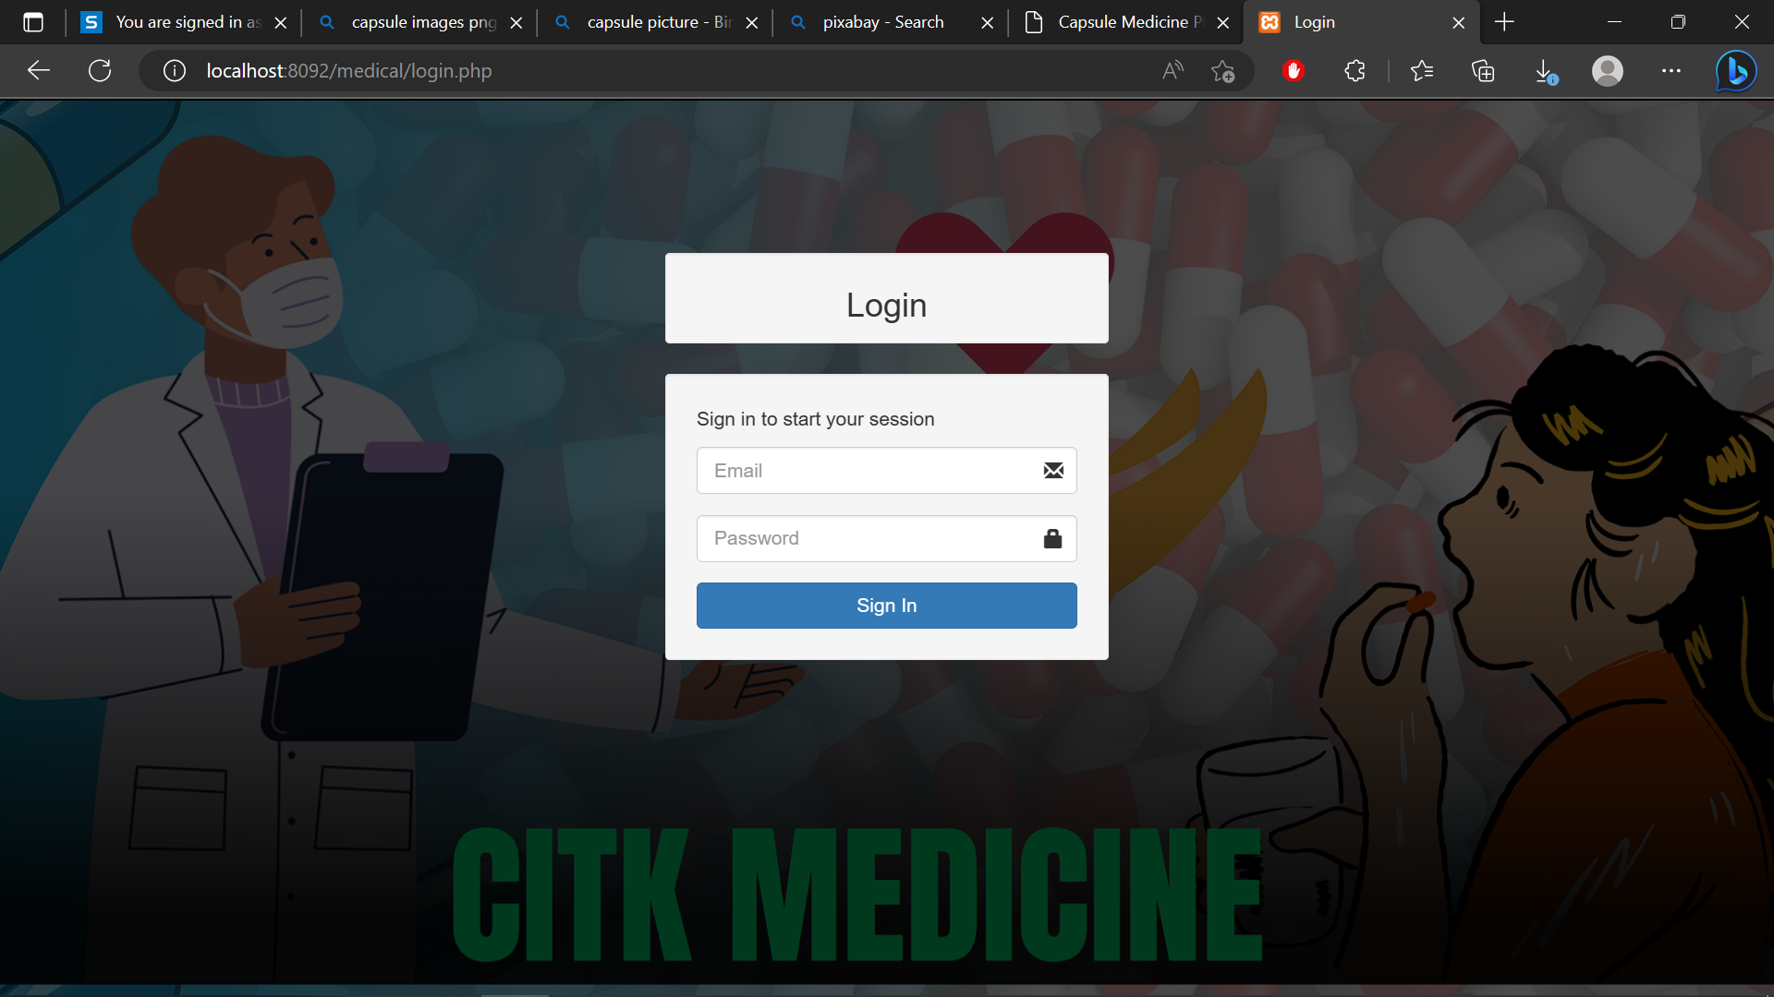
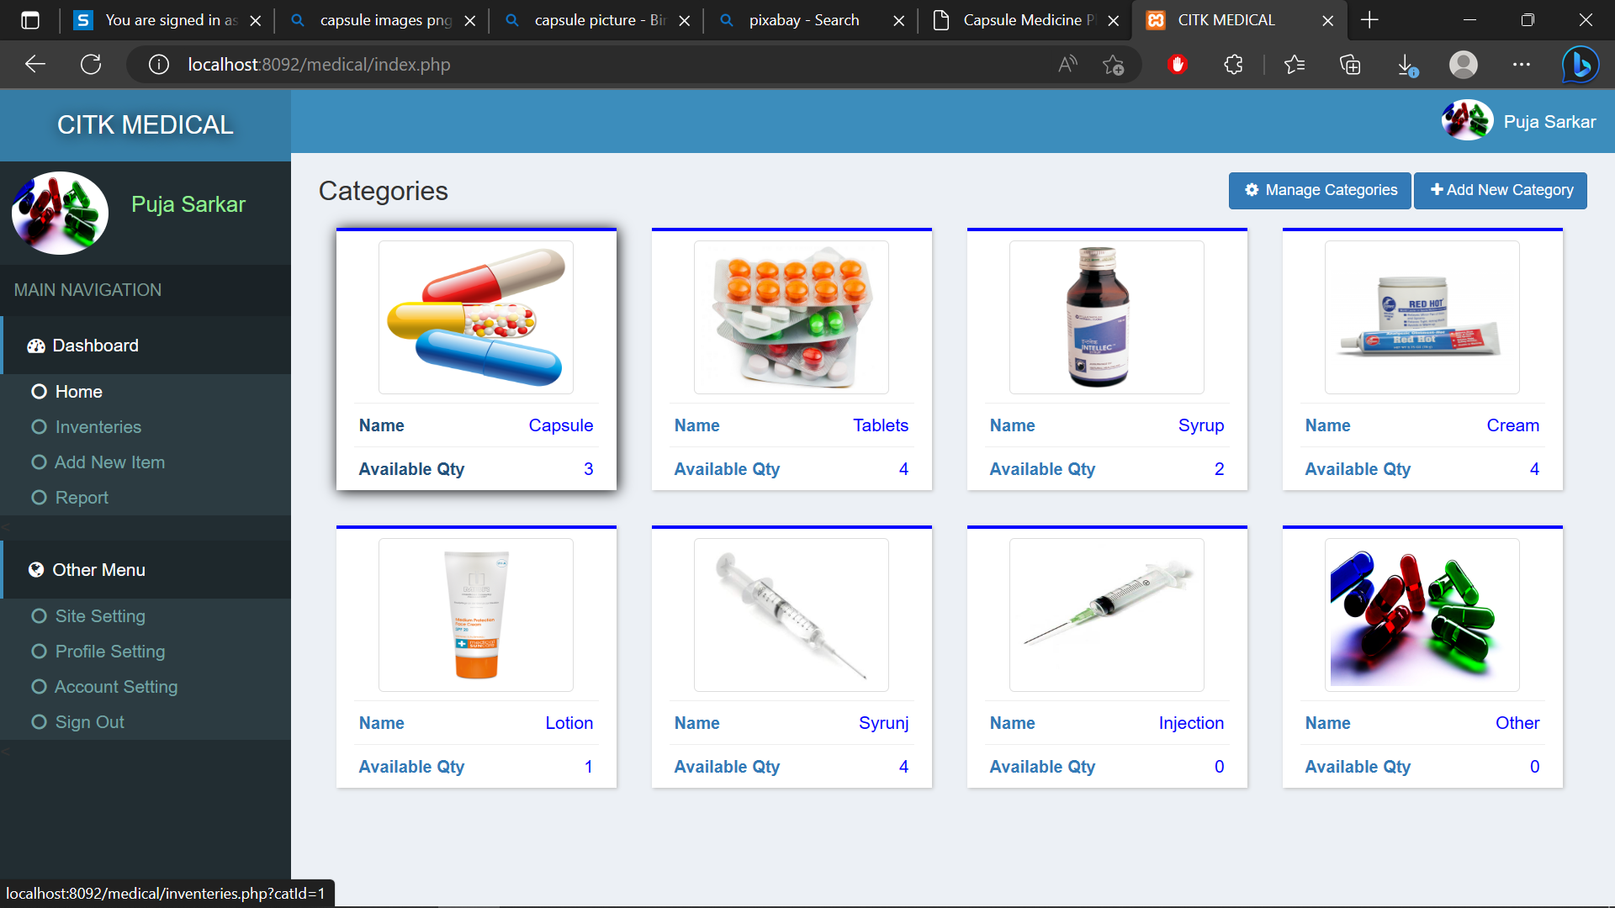
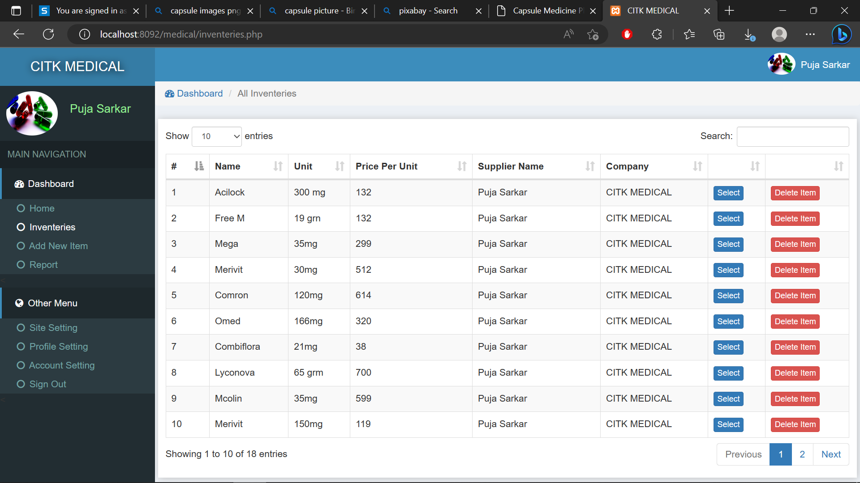
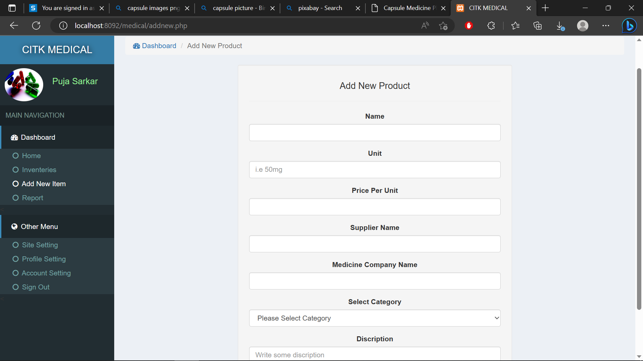
Implementation

Slide 14
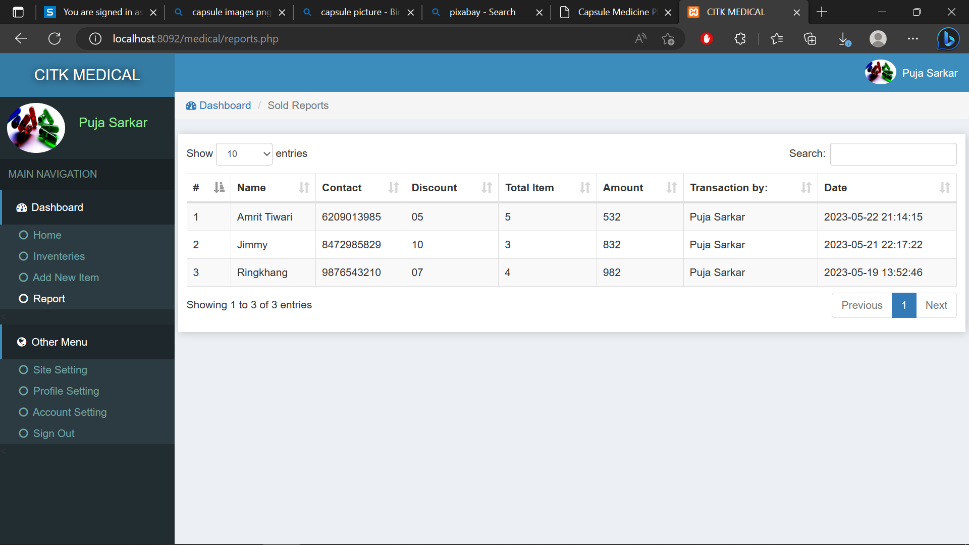
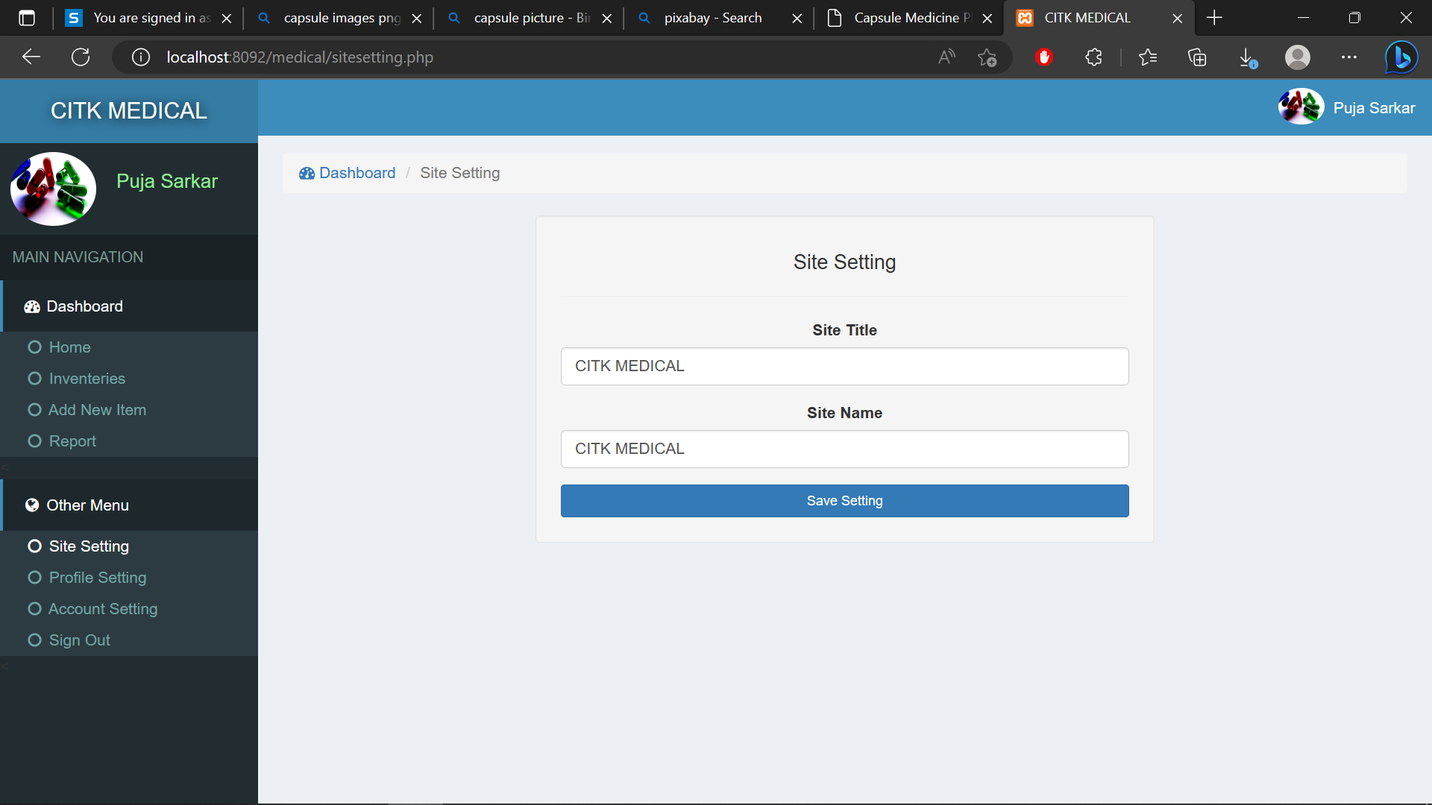
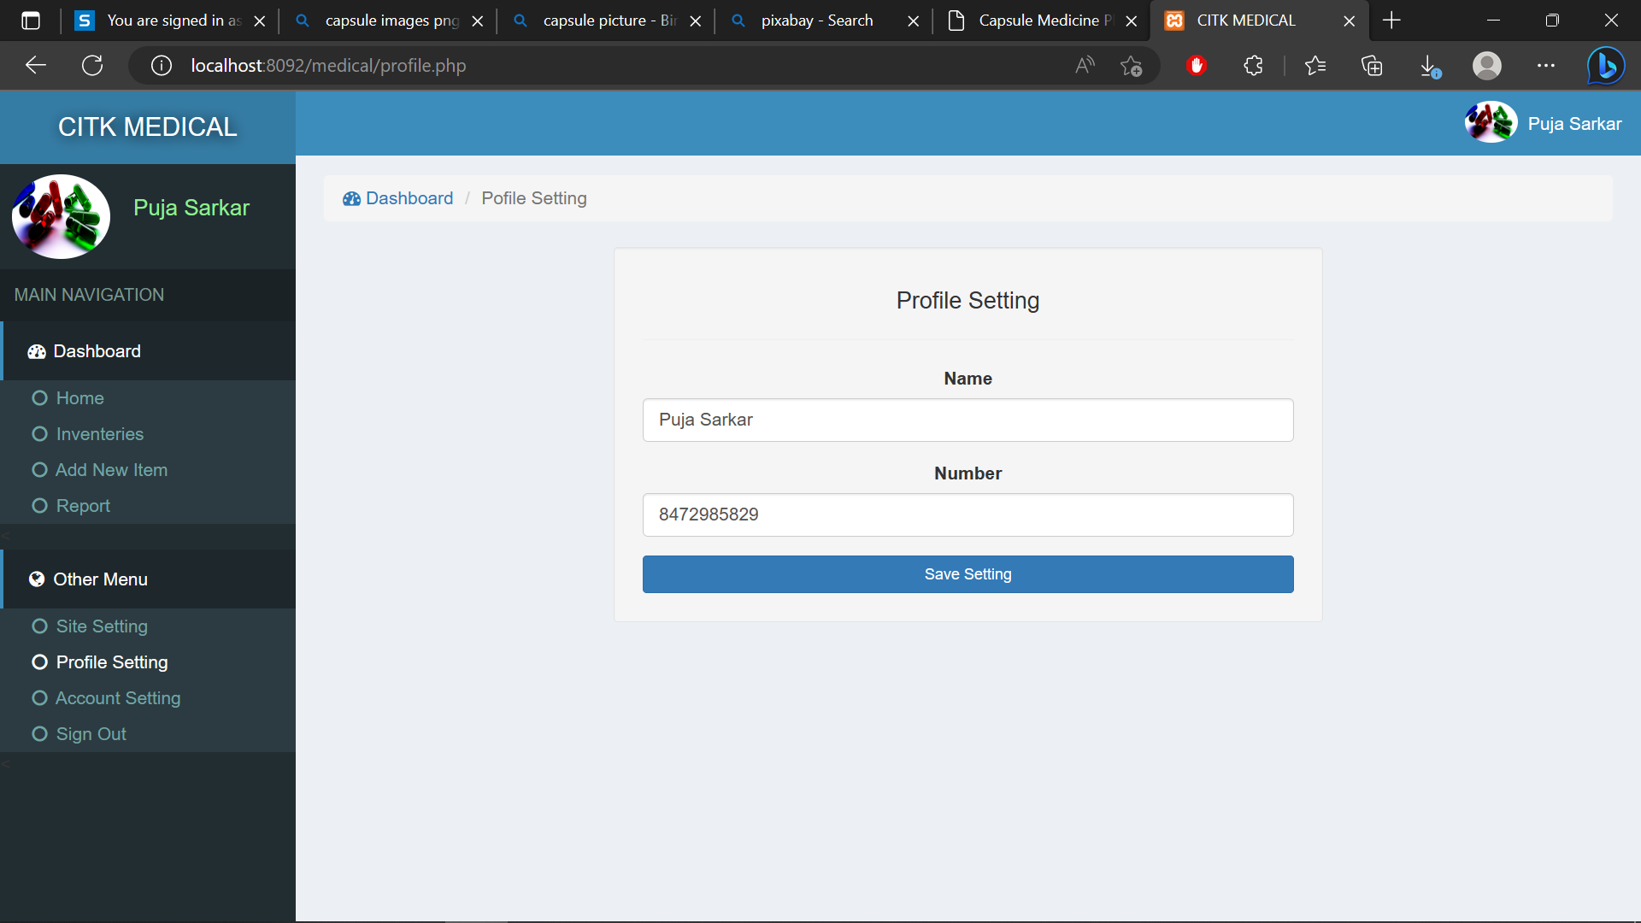

Implementation

Slide 15
Conclusion
The Medicines Automation System will enhance medication management, improve patient safety, and streamline medication dispensing and administration in healthcare facilities. The system shall provide user management, patient management, medication management, prescription management, dispensing management, alerts and warnings, reporting and analytics functionalities. The system shall also comply with security, performance, availability, usability, compatibility, and regulatory constraints.

Slide 16
Reference
www.scribd.com/document/256044765/Medical-Shop-Automation-System#fullscreen&from_embed

