Slide 1
Analysis, Identification and Multi-label Classification of Toxic Online Comments using Machine Learning and Deep Learning Members Madhu Sudhan Bhattrai Amrit Gurung Santosh Tharu Shankar Poudel Madan Pandey Tej Narayan Chaudhary

Slide 2
CONTENTS
Introduction
Problem Formulation
Motivation/Purpose/Goals
Project Workflow
Methodologies
Techniques
Results
Conclusions
References

Slide 3
INTRODUCTION
Over the decade, there has been a tremendous in social networking and social media platforms. People are now able to express themselves and their opinions and also discuss among others via these platforms.
However, a conflicts may arise due to the differences in the opinions. Most of the times, this conflicts goes beyond simple differences and results in fight over the social media and often leads to the use of obscene and abusive language.
Such conversational toxicity is an issue that can lead people both to stop genuinely expressing themselves and stop seeking others’ opinions out of fear of abuse/harassments

Slide 4
MOTIVATION AND GOALS
With the increasing use of social media platforms, there has been sharp increase in toxic comments in these online platforms. Platforms struggles to effectively facilitate conversations, leading many communities to limit or completely shut down user comments. It is important that toxicity in online platforms is reduced so that the internet is safe place for people no matter their gender, age, race, nationality, likes, dislikes, religious beliefs or political beliefs.
PROBLEM STATEMENTS
The input to our algorithms are the comments from online platforms. We than use natural processing techniques with machine learning and deep learning algorithms to detect and classify these comments for toxicity for example identity hate, obscene etc

Slide 5
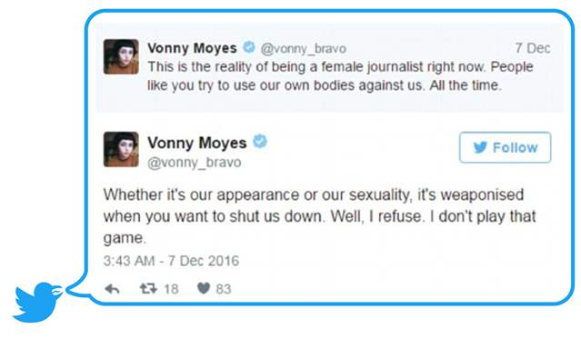

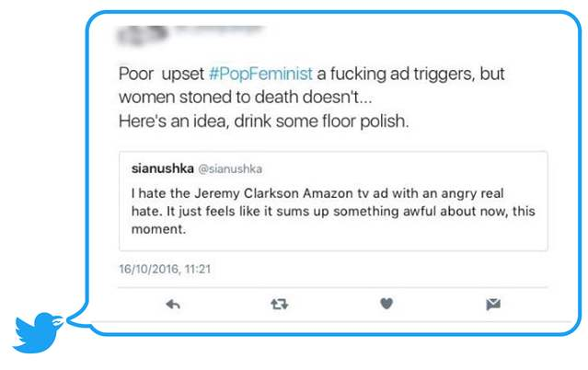
Some of the toxic comments taken from online media

Slide 6
APPLICATION
Filtering posts and comments
Social media policing
User Education

Slide 7
DATA
The data is collected from Toxic Comment Classification Challenge from Kaggle .
Dataset included 159,571 Wikipedia comments that have been hand labelled by human raters for toxicity label.
Different classes of toxicity: toxic, severe toxic, obscene, threat, insult and identity hate.
Over 140,000 comments are non-toxic.
A comment can belong to multiple toxicity classes.
Data split – Train:Test = 80:20
Dataset example :
comments - I don't give the fuck those goddamn morons says.
toxicity classes - toxic, obscene, insult

Slide 8
.
The toxicity class distribution is shown below,
Toxic Categories | No. of data/comments with toxic remarks
Toxic | 15294
Severe toxic | 1595
Obscene | 8449
Insult | 7877
Threat Identity hate | 478 1405

Slide 9
PROCESS WORKFLOW
.
Fig. Project workflow
Dataset
Text cleaning
Tokenization
Clean Text Data
Pre-trained word
embedding
Glove Vector
Target Section
TF-IDF
Non-RNN models
RNN model
Word Embedding
Toxicity Classification

Slide 10
TEXT PREPROCESSING
Text data are very unstructured and hence they need to be preprocessed to give them some formal structure that is predictable and analyzable.
At first we need to clean our text. We cleaned our data by removing
1. stop words : ‘is’, ‘the’, ‘a’ etc.
2. all characters, symbols and numbers
3. short words (many times words with length less than 3 does not carry valueble information)
There are many more text cleaning techniques, for our use case, only above method were performed.
Note; text cleaning and text preprocessing is not same. Text cleaning is subset of text preprocessing. Text Preprocessing is extremely time consuming and it takes more than 70% of the project duration.

Slide 11
TF-IDF
It denotes Term Frequency and Inverse Document Frequency.
TF-IDF is a numerical statistics that is intended to reflect how important a word is to a document in a collection of corpus.
Common words or Stop words like ‘is’, ‘the’, ‘a’ etc. tends to appear quite frequently in every documents. Such stop words does not carry much information. TF-IDF penalizes these common words by assigning them lower weights.
TF(x) = (Number of times word x appears in a document) / (Total number of words in the document)
IDF(x) = log(Total number of documents) / (Number of documents with word x in it)
Finally, TF(x) * IDF(x)

Slide 12
Glove Vectors
For our deep learning model, Glove was chosen to embed the text in the data.
Glove is a pre-trained word vectors which were trained on words from Wikipedia 2014– and Gigaword 5 corpus.
The text file was parsed and each line are converted into numpy array and imputed into dictionary.
Next, the dictionary was mapped to the words that were acquired from the tokenization process.

Slide 13
NAÏVE-BAYES ALGORITHM
It is a supervised machine learning algorithms
Naïve Bayes model is based on Bayes Theorem and is particularly suited for when the dimensionality of the input is high.
It reduces computational complexity.
Naïve Bayesian Classifier assumes that the effect of an attribute value on the given class is independent of the value of other attributes i.e. class conditional independent.
In theory, Bayesian classifier have minimum error rate compared to all other classifiers. However, in practice this is not always the case, owing inaccuracies in the assumptions made for its use, such as class-conditional independence, and lack of available probability data.

Slide 14
SUPPORT VECTOR MACHINE
Support Vector Machine (SVMs) is method for the classification of both linear and non-linear data. SVM can be used for both classification as well as regression tasks.
It uses nonlinear mapping to transform the original training data into higher dimension and within this new dimension, it searches for linear optimal separating hyperplane (i.e., a ‘decision boundary’ separating the tuples of one classes from another). With appropriate nonlinear mapping to sufficiently high dimension, data from two classes can always be separated by hyperplanes.
Two parallel hyperplanes are constructed on each side of the hyperplane that separate the data. The separating hyperplane is the hyperplane that maximize the distance between the two parallel hyperplanes. An assumption is made that the larger the margin or distance between these parallel hyperplanes the better the generalization error of the classifier will be.

Slide 15
LONG SHORT TERM MEMORY
LSTM is a variant of Recurrent Neural Network (RNN)
RNN is incapable of handling long-term dependencies. It simply means that if the input data/text is long, it cannot remember the information from earlier sections of data/text.
LSTM is capable of learning long-term dependencies.
LSTM architecture have gates that regulate the flow of information inside cell.

Slide 16
MODEL BUILDING
Our problem deals with multi-label classification.
So each toxic comment can belong to multiple toxicity classes.
We used OneVsRest strategy to train our classifiers.
So according to this strategy, we train 6 binary classifiers with one class at a time and leaving the rest out. These 6 binary classifiers will be mutually exclusive to each other.
We apply this method for Multinomial Naïve Bayes, Logistic Regression and Support Vector Machine.
Similarly, for our LSTM model, we used 300 dimensional Glove Vectors for word embedding and 128 LSTM recurrent neural layers.

Slide 17
RESULTS
Evaluation Metrics
Accuracy Score, Precision, Recall, f-score
Table below shows average accuracy score of different models
All models have average accuracy of over 90 % and are almost comparable.
Table; Model Accuracy
Model | Mean Accuracy
MultinomialNB | 97.7%
Logistic Regression | 98.08%
Support Vector Machine | 98.15%
LSTM | 98.68%

Slide 18
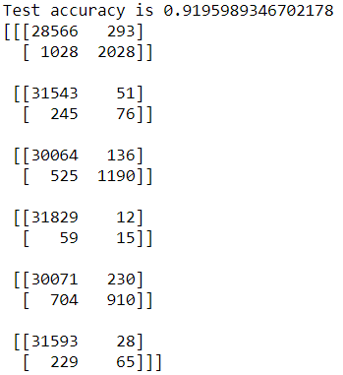
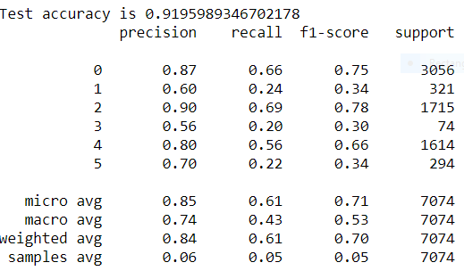
CONFUSION MATRIX AND CLASSIFICATION REPORT
As seen earlier , all our models have almost comparable average accuracy, but SVM slightly outperformed other except LSTM which is a deep learning model.
We have only present confusion matrix and classification report of SVM here
Confusion Matrix Classification report

Slide 19
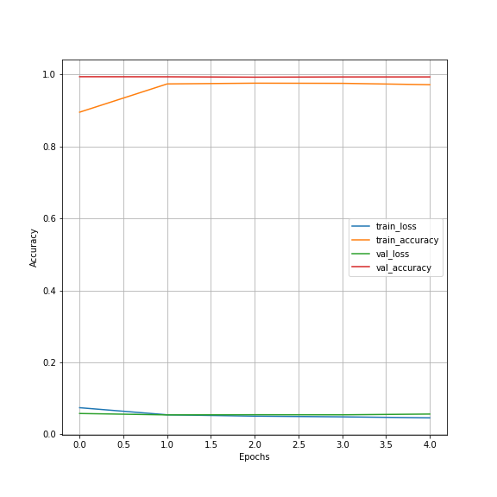
Validation Loss and validation Accuracy
We val_acc is 0.9716 and val_loss is 0.056 which is pretty decent. No issues of model overfitting and underfitting

Slide 20
Model Comparison
Category | Acc NB | Acc LogReg | Acc SVM | SVM advantage to NB | SVM advantage to LogReg
Toxic | 0.9499295002349992 | 0.956509478301739 | 0.9586088046373179 | 0.008679304402318677 | 0.002099326335578855
severe_toxic | 0.990474698417672 | 0.9905060316465611 | 0.9907253642487859 | 0.0002506658311138832 | 0.00021933260222473105
obscene | 0.9721760927463575 | 0.977659407801974 | 0.9792887357042144 | 0.007112642957856852 | 0.0016293279022403517
Threat | 0.9976813410621964 | 0.9977753407488642 | 0.9977753407488642 | 9.399968666778946e-05 | 0.0
Insult | 0.9665674447751841 | 0.9705467648441172 | 0.9707347642174526 | 0.004167319442268558 | 0.0001879993733354679
identity_hate | 0.9911013629954567 | 0.9918533604887984 | 0.991947360175466 | 0.000845997180009328 | 9.399968666767844e-05

Slide 21
TESTING
As we have already seen, our model performance is pretty decent. We tested our model on toxic online comment which is not part of our dataset, and compare its output label to the category that a human would give it
"You little piece of shit do you really want me to smack on your fucking face goddamn moron’’
For above test data,
SVM predicted toxic classes : toxic, obscene and insult
LSTM predicted toxicity classes : toxic, obscene and insult
SVM predicted toxic classes : toxic, obscene and insult
Since performance of all of our models are comparable, for above test data, we got same prediction.

Slide 22
CONCLUSIONS
For our model, we used three machine learning algorithms and one deep learning algorithm.
We also found that all performance of all our models were almost comparable with slight differences.
Average accuracy of all of our model are above 90%.
LSTM and SVM were highest performers with average accuracy of 98.68% and 98.15%.
Since the results of our models are good enough to trust our models, we didn’t performed hyperparameter tuning and cross-validation.

Slide 23
References
[1] Jiawei Han, Micheline kamber, Jian Pei. ‘’ Data Mining concepts and Techniques’’. Third Edition , Morgan kaufmann Publisher, 2012. (page no. 350 to 355 and 408 to 415)
[2] Durgesh Srivastava, Lekha Bhambhu. “Data Classification using Support Vector Machine”. Article in Journal of Theoretical and Applied Information Technology · February 2010.
[3] Christopher Olah ‘’ Understanding LSTM Networks’’. Colah’s blog, Posted on August 27, 2015.
[4] Sebastian Laverde, ‘’Automatic Classification of Sexual Harassment Cases’’. A NLP based project by Omdena.
[5] Chu, T & Jue, K. ‘’Comment Abuse Classification with Deep Learning’’.
[6] Kevin Khieu and Neha Narwal. ‘’Detecting and Classifying Toxic Comments’’
[7] Stanford CS244N lectures series on Natural Language Processing with Deep Learning. (lecture 5 and 6)
[8] Analytics Vidhya’s article on ‘’An Intuitive Understanding of Word Embedding: From Count Vector to Word2Vec’’.

