Slide 1

INTRODUCTION
TO
COMPUTER NETWORK

Slide 2
Computer Networks
A computer network is a group of computer systems and other computing hardware devices that are linked together through communication channels to facilitate communication and resource-sharing among a wide range of users.
Computer Network is defined as procedure of linking many computers that can allocate shared resources, information interchange and communication.

Slide 3
Computer Networks
Computer networking is the practice of interfacing two or more computing devices with each other for the purpose of sharing data. Computer networks are built with a combination of hardware and software.

Slide 4
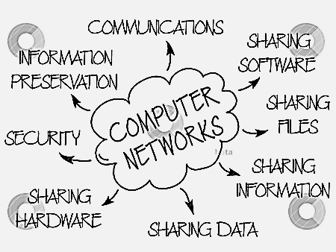
Uses of Computer Networks
Facilitate communication
Resource Sharing : like printer, storage etc
File Sharing
Software sharing
Easy access to Information and maintain it
Ecommerce

Slide 5
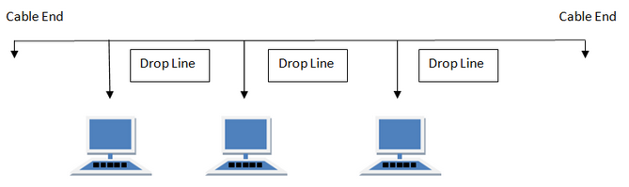
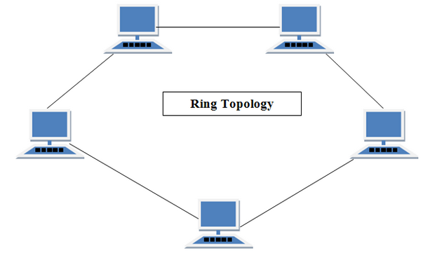
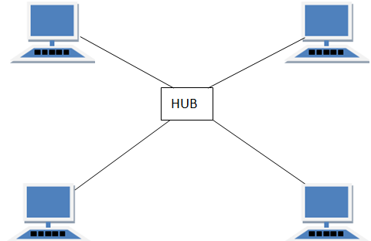
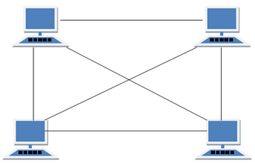
Overview of Network Topologies
Bus Topology
Ring Topology
Star Topology
Mess Topology

Slide 6
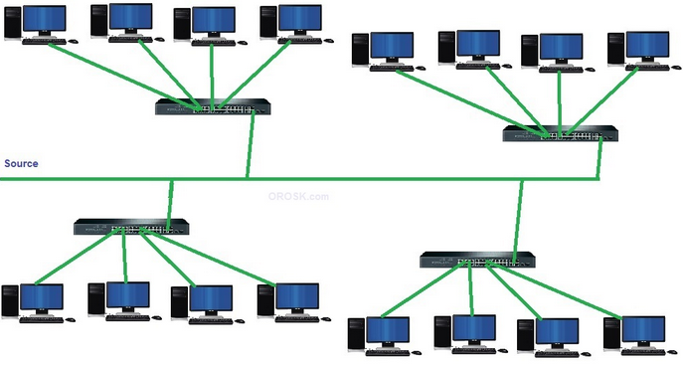
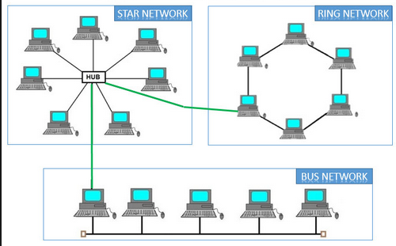
Tree Topology
Hybrid Topology

Slide 7
Overview of Network Types
Personal Area Network (PAN)
Local Area Network (LAN)
Wireless Local Area Network (WLAN)
Campus Area Network (CAN)
Wide Area Network (WAN)
Metropolitan Area Network (MAN)
Storage-Area Network (SAN)
Enterprise Private Network (EPN)
Virtual Private Network (VPN)
Notes:
Passive Optical Local Area Network (POLAN)
System-Area Network (also known as SAN)

Slide 8
Networking Types
Client Server network
P2P (peer-to-peer) network

Slide 9
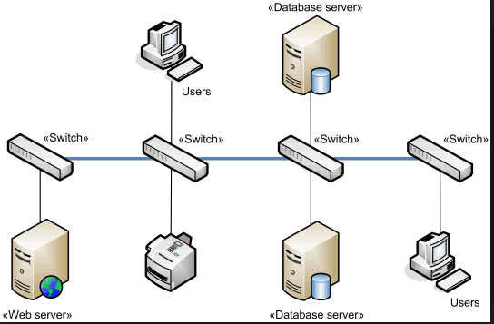
1. Client Server network
Client Computer
Generally controlled by server
Make a request to server
Accept the response of request from server
Server Computer
Control all the resources
Accept the request from client
Serve the request of Client

Slide 10
Types of Server
Application Server
Proxy Server
Mail Server
File Server
Policy Server
Web Server ….. etc

Slide 11
Advantages and Disadvantages of Client Server network
Advantages:
Centralize Control
Scalability
Easy maintenance
Provides better security
Proper Management
Centralize data management

Slide 12
Advantages and Disadvantages of Client Server network
Disadvantages:
Require expensive, more powerful hardware for the server machine.
Server failure leads to whole network failure
Requires expensive specialized network administrative and operational software.
Requires a professional administrator.

Slide 13
2. Peer-to-Peer (P2P) Network
Network computers act as equal partners, or peers.
Each computer can take on the client function or the server function.
Individual users control their own resources.
The users may decide to share certain files with other users.

Slide 14
Peer-to-Peer (P2P) Network
Advantages:
Less expensive to implement.
Doesn’t require additional specialized network administration software.
Doesn’t require a dedicated network administrator.

Slide 15
Peer-to-Peer (P2P) Network
Disadvantages:
Less secure.
Doesn’t scale well to large networks and administration becomes unmanageable.
Each user must be trained to perform administrative tasks.
All machines sharing resources negatively impact the performance.

Slide 16
Advantages and Disadvantages of Computer Networking
Advantages:
It enhances communication and availability of information.
It allows for more convenient resource sharing.
It makes file sharing easier.
It is highly flexible.
It is an inexpensive system.
It increases cost efficiency.
It boosts storage capacity.

Slide 17
Advantages and Disadvantages of Computer Networking
Disadvantages:
It lacks independence.
It poses security difficulties.
It lacks robustness.
It allows for more presence of computer viruses and malware.
Its light policing usage promotes negative acts.
It requires an efficient handler.
It requires an expensive set-up.

Slide 18
Protocol
A protocol defines the format and the order of messages exchanged between two or more communicating entities, as well as the actions taken on the transmission and/or receipt of a message or other event.
In our human protocol, there are specific messages we send, and specific actions we take in response to the received reply messages or other events

Slide 19
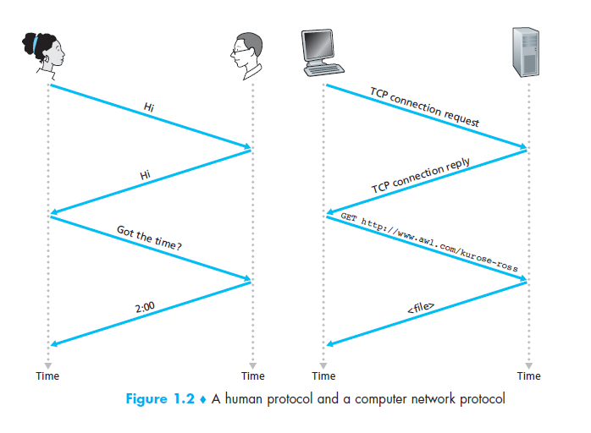
Protocol

Slide 20
Network Protocol
A network protocol is similar to a human protocol, except that the entities exchanging messages and taking actions are hardware or software components of some device (for example, computer, smart phone, tablet, router, or other network-capable device).
All activity in the Internet that involves two or more communicating remote entities is governed by a protocol.

Slide 21
Network Protocol
The Internet, and computer networks in general, make extensive use of protocols.
Different protocols are used to accomplish different communication tasks.

Slide 22
Key Elements of Protocol
Syntax
refers to the structure or format of the data
Semantics
refers to the meaning of each section of bits
How is a particular pattern to be interpreted, and what action is to be taken based on that interpretation?
Timing
Timing refers to two characteristics: when data should be sent and how fast it should be sent.
Notes:
Syntax:
meaning the order in which they are presented. For example, a simple protocol might expect the first 8 bits of data to be the address of the sender, the second 8 bits to be the address of the receiver and the rest of the stream to be the message itself.

Slide 23
Protocol Standards
Standards provide guidelines to ensure the kind of interconnectivity necessary in today’s market place and in international community
Essential in creating and maintaining an open and competitive market
Two types of data communication standard
De facto (by fact or by convention)
Not approved by organization but have been adopted as standards through widespread use
De jure (by law or by regulation)
Legislated by an officially recognized body

Slide 24
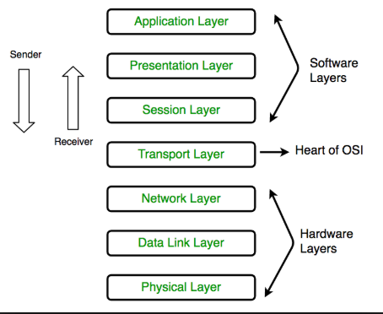
OSI Reference Model
Refer to Open System Interconnection
Developed by ISO in the year 1974.
7 layer architecture
defines a networking framework to implement protocols in seven layers
Notes:
ISO- International standardization Organization

Slide 25
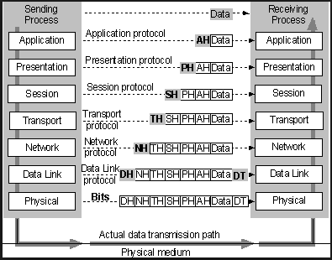
OSI Reference Model
Notes:
ISO- International standardization Organization

Slide 26
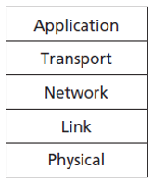
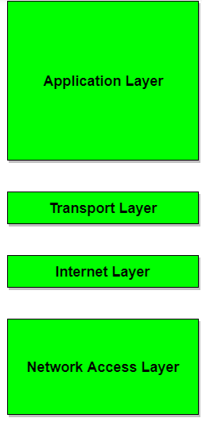
TCP/IP Model
designed and developed by Department of Defense (DoD) in 1960s.
Hierarchical protocol made up of interactive modules, each of which provides a specific functionality
Contains relatively independent protocols that can be mixed and matched depending on the needs of system
Notes:
Hierarchical means each upper layer protocol is supported by one or more lower-level protocols

Slide 27
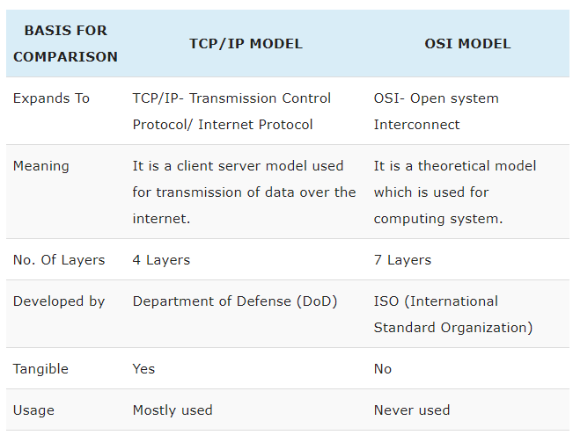
OSI vs TCP/IP Model

Slide 28
Connection Oriented Services
Connection-oriented service is analogous to the telephone system that requires communication entities to establish a connection before sending data.
In connection oriented service we have to establish a connection before starting the communication. When connection is established we send the message or the information and then we release the connection.

Slide 29
Connection Oriented Services
Connection oriented service is more reliable than connectionless service.
We can send the message in connection oriented service if there is an error at the receivers end.
Example of connection oriented is TCP (Transmission Control Protocol) protocol.

Slide 30
Connection Oriented Services
There is a sequence of operation to be followed by the users of connection oriented service.
These are :
Connection is established
Information is sent
Connection is released

Slide 31
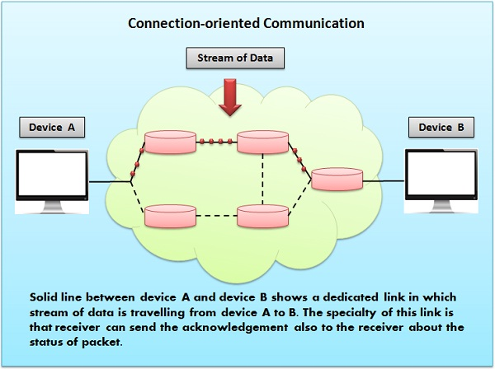
Connection Oriented Services

Slide 32
Connectionless Oriented Services
Connection-less service is analogous to the postal system in which packets of data (usually known as a datagram) is transmitted from source to destination directly.
Each packet is treated as individual entity, which allows communication entities to send data before establishing communication.

Slide 33
Connectionless Oriented Services
Each packet carries a destination address to identify the intended recipient.
Packets don’t follow a fixed path that is the reason the packets received at receiver end can be out of order.
It uses packet switching for transmission of data.

Slide 34
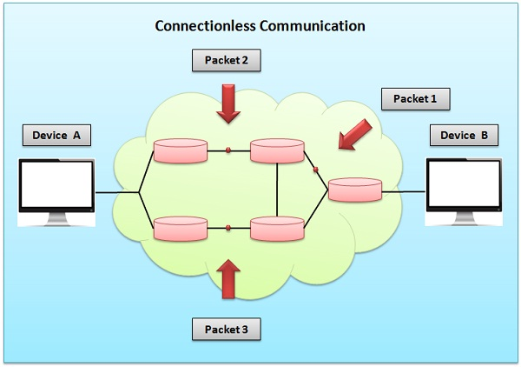
Connectionless Oriented Services

Slide 35
Comparison Chart
BASIS OF COMPARISON | CONNECTION-ORIENTED SERVICE | CONNECTION-LESS SERVICE
Prior Connection Requirement | Necessary | Not required
Reliability | Ensures reliable transfer of data. | Not guaranteed.
Congestion | Unlikely | Occur likely.
Transferring mode | It can be implemented using circuit switching and virtual circuit. | It is implemented using packet switching.
Lost data retransmission | Feasible | Practically not possible.
Suitability | Suitable for long and steady communication. | Suitable for bursty Transmission.
Signalling | Used for connection establishment. | There is no concept of signalling.
Packet forwarding | Packets sequentially travel to their destination node and follows the same route. | Packets reach the destination randomly without following the same route.
Delay | There is a delay in transfer of information, but once the connection is established faster delivery can be achieved. | Due to the absence of connection establishment phase, the transmission is faster.
Resource Allocation | Need to be allocated. | No prior allocation of the resource is required.

Slide 36
Internet
The internet is a globally connected network system that uses TCP/IP to transmit data via various types of media.
The internet is a network of global exchanges – including private, public, business, academic and government networks – connected by guided, wireless and fiber-optic technologies.
The internet is a telecommunications network that uses telephone lines, cables, satellites and wireless connections to connect computers and other devices to the World Wide Web.

Slide 37
What is Internet?
The Internet is a computer network that interconnects hundreds of millions of computing devices throughout the world.
The nuts and bolts of the Internet, that is, the basic hardware and software components that make up the Internet.
The Internet is a networking infrastructure that provides services to distributed applications.

Slide 38
Uses of Internet
Access a huge 'library' of information from the millions of websites around the world
Send and receive email messages
Share photographs and video clips with your friends and family
Purchase goods and services
Carry out online banking
Use Skype to make free phone calls to other computer users
Play games with other people online
Learn something new with an online course.

Slide 39
The Access Network
An access network is a user network that connects subscribers to a particular service provider and, through the carrier network, to other networks such as the Internet.
The access network is the network or the part of a telecommunications network that gives the user access to the telecommunications service(s).

Slide 40
Home Access
Digital Subscriber Line (DSL)
Fiber to the home (FTTH)
Dial Up
Wide-Area Wireless Access
3G
4G/LTE
WiMAX
WiFi
Satellite communication
Notes:
Long Term Evolution

Slide 41
ISP (Internet service provider)
An ISP (Internet service provider) is a company that provides individuals and other companies access to the Internet and other related services such as Web site building and virtual hosting.
An ISP has the equipment and the telecommunication line access required to have a point-of-presence on the Internet for the geographic area served.
The larger ISPs have their own high-speed leased lines so that they are less dependent on the telecommunication providers and can provide better service to their customers.

Slide 42
ISP (Internet service provider)
End systems access the Internet through Internet Service Providers (ISPs), including residential ISPs such as local cable or telephone companies; corporate ISPs; university ISPs; and ISPs that provide WiFi access in airports, hotels, coffee shops, and other public places.
Each ISP is in itself a network of packet switches and communication links.

Slide 43
ISP (Internet service provider)
ISPs provide a variety of types of network access to the end systems, including residential broadband access such as cable modem or DSL, high-speed local area network access, wireless access, and 56 kbps dial-up modem access.
ISPs also provide Internet access to content providers, connecting Web sites directly to the Internet.

Slide 44
ISP (Internet service provider)
Lower-tier ISPs are interconnected through national and international upper-tier ISPs such as Level 3 Communications.
An upper-tier ISP consists of high-speed routers interconnected with high-speed fiber-optic links.
Each ISP network, whether upper-tier or lower-tier, is managed independently, runs the IP protocol and conforms to certain naming and address conventions.

Slide 45
List of ISPs in Nepal
Mercantile Communications Private Limited
Net Max Technologies Pvt Ltd
Worldlink Communications Private Limited
Global Internet Services Private Limited
Eastern Networks Pvt Ltd
Himalayan Online Services Private Limited
Logic Information Business Pvt ltd
I Plus Pvt Ltd
Everest Net Private Limited
Infocom Private Limited
Nepal Door sanchar Company Limited

Slide 46
List of ISPs in Nepal
ViaNet Communications Private Limited
Access Net Communication Pvt. Ltd.
Web Surfer Nepal Communications Private Limited
Himal Technologies Private Limited
Subisu Cablenet Private Limited
Japan Nepal Information Communication Technology Private Limited
Netplus Technology Private Limited
Health Net Nepal Private Limited
Buddha Net Private Limited
Namche Networks Private Limited
Broadlink Network and Communications Private Limited

Slide 47
List of ISPs in Nepal
Satelink Nepal Pvt Ltd
Zentech Pvt Ltd
Namaste Asia Link P. Ltd
Fiber Online P. Ltd
Surf In P. Ltd
Pokhara Internet P. Ltd
Telenet Pvt. Ltd.
Cherry World Communication Pvt. Ltd.
Betal Networks Pvt. Ltd.
Aastha Network Pvt. Ltd.

Slide 48
List of ISPs in Nepal
Radius Communications Private Limited
Nepal Net Sanchar Private Limited
Mitra Network Private Limited
Sustainable Network Private Limited
Hotlink Nepal Private Limited
Classic Tech Pvt. Ltd.
Integrated Business Solution (IBSYS) Nepal Pvt Ltd
STM Telecom Sanchar Pvt Ltd
Allied Netlink Technologies Pvt. Ltd.
United Telecom Limited

Slide 49
Backbone
A backbone is a larger transmission line that carries data gathered from smaller lines that interconnect with it.
In computer networking, a backbone is a central conduit designed to transfer network traffic at high speeds.
Backbones connect local area networks (LANs) and wide area networks (WANs) together.

Slide 50
Backbone
Network backbones are designed to maximize the reliability and performance of large-scale, long-distance data communications.
The best-known network backbones are those used on the Internet.
Nearly all Web browsing, video streaming, and other common online traffic flows through Internet backbones.

Slide 51
Backbone
They consist of network routers and switches connected mainly by fiber optic cables.
Each fiber link on the backbone normally provides 100 gbps of network bandwidth. Computers rarely connect to a backbone directly.
Instead, the networks of Internet service providers or large organizations connect to these backbones and computers access the backbone indirectly.

Slide 52
Backbone
Backbone contains Distributed (Bus) and Collapsed (Star) backbone
Bus Backbone (Distributed Backbone)
Handles bus topology as well as its protocol, adaptable with bus topology like 10Base2 or 10Base5
Connect multiple LAN through a bus backbone to exchange the data and share resources

Slide 53
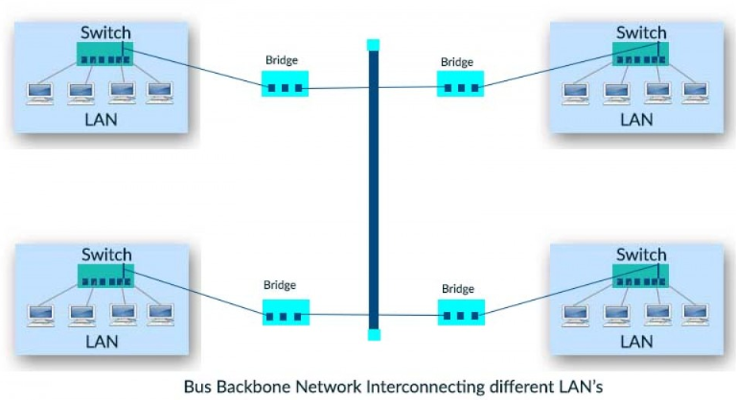

Slide 54
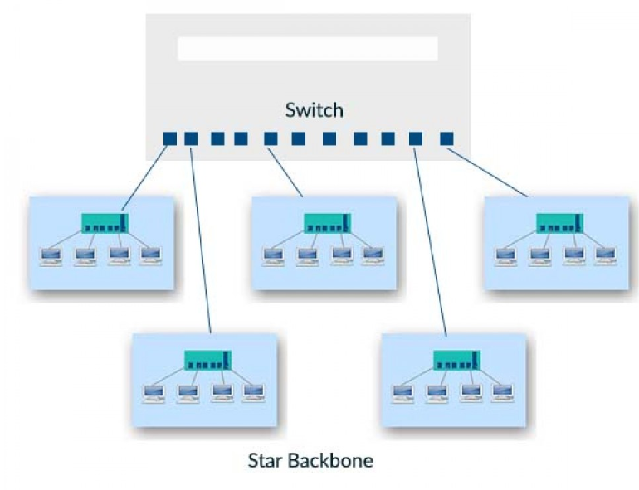
Backbone
Star Backbone (Collapsed Backbone)
Uses wiring hubs, switches to generate a backbone to connect different LANs.
Since one switch is used to interconnect the different LAN’s it is referred as a switched backbone

