Slide 1
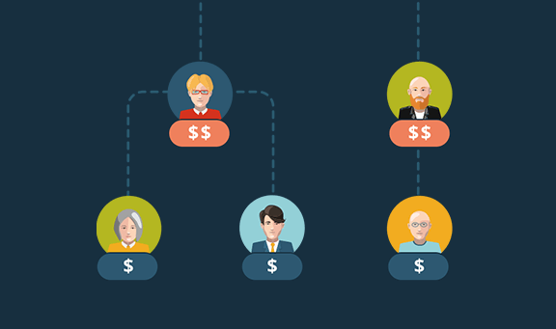
"Organizational Analysis: Understanding Employee Distribution, Gender Dynamics, Hiring Trends, and Compensation Disparities"

Slide 2
team
Vijay Lathwal
(0822116)
Amrit Saini (0811653)
Krishma Kundal (0825513)

Slide 3

PROBLEM STATEMENT
"Our project aims to analyze and optimize the distribution of employees across various departments, the gender ratio in management levels, and the salary structure within our organization. We will investigate trends in hiring, assess salary distributions, and explore potential disparities in gender pay across job titles. The goal is to identify opportunities for enhancing diversity, fairness, and operational efficiency in our workforce. In this project, we will be incorporating most trending and powerful tool namely Excel, Sql, Tableau and Python.”

Slide 4
Questions
1. Overall Employee Distribution:
- What is the distribution of employees across different departments?
2. Employee Demographics:
- How does the gender ratio vary across different management levels within departments?
3. Annual Hiring Trends:
- What is the annual trend in employee hiring for each department in our organization?
4. Employee Titles Breakdown:
- Display a bar chart depicting the distribution of employees across different job titles.
5. Salary Overview:
- How does the average salary vary across different departments in our company?
6. Top Earners:
- Show a bar chart listing the top 10 employees based on their salary.
7. Gender Pay Gap Analysis:
-Is there any evidence of a gender-based pay gap within the same job titles across various departments?

Slide 5
Timeline
Week 1- 3
Proposed a logical and detailed formulation of a problem that solves a specific need
Week 4 - 5
Did basic machine learning such as data reading in python, data cleaning.
Week 6
Mid term week
Week 7-8
Did Visualization on tableau
Enhanced Visualization
Week 9-10

Slide 6
Timeline
Week 11
Prepared two Dashboards
Week 12
Prepare and deliver an interim report that summarizes all work done to date
Week 13
Prepare and deliver an interim presentation that summarizes all work done to date
Week 14-15
Final Exam week
6

Slide 7
STEPS FOLLOWED
Data Extraction: This initial phase involves extracting data from various internal records, focusing on employee demographics, departmental affiliations, management structures, and salary details. This data forms the foundation for our analysis, directly aligning with the project's objectives.
Data Preprocessing: Utilizing Python, we conduct an Exploratory Data Analysis to understand the raw data's structure and nuances. This step includes cleaning the data, where we impute missing values, remove duplicates, and identify and treat any anomalies or outliers. This process ensures the reliability and accuracy of our data.
Data Exporting: After preprocessing, we export the cleaned and structured data into a .csv file. This file serves as the primary data source for our in-depth analysis.
Data Loading and Modification: The preprocessed data, now in a .csv format, is loaded into a SQL database. We add several key columns to enrich the data, enhancing its relevance to our study. Subsequently, this enriched dataset is integrated into Tableau Desktop for further analysis. Here, we also make modifications to simplify the data, tailoring it for more effective visualization and interpretation.
Data Analysis: With the data successfully loaded into Tableau, we leverage its robust analytical features to delve into our research questions. This involves examining departmental staffing distributions, gender diversity in management roles, trends in employee hiring, salary variations across departments, and potential gender-based pay disparities. Our findings are represented through a series of insightful Tableau visualizations, each designed to highlight critical aspects of our workforce dynamics.

Slide 9
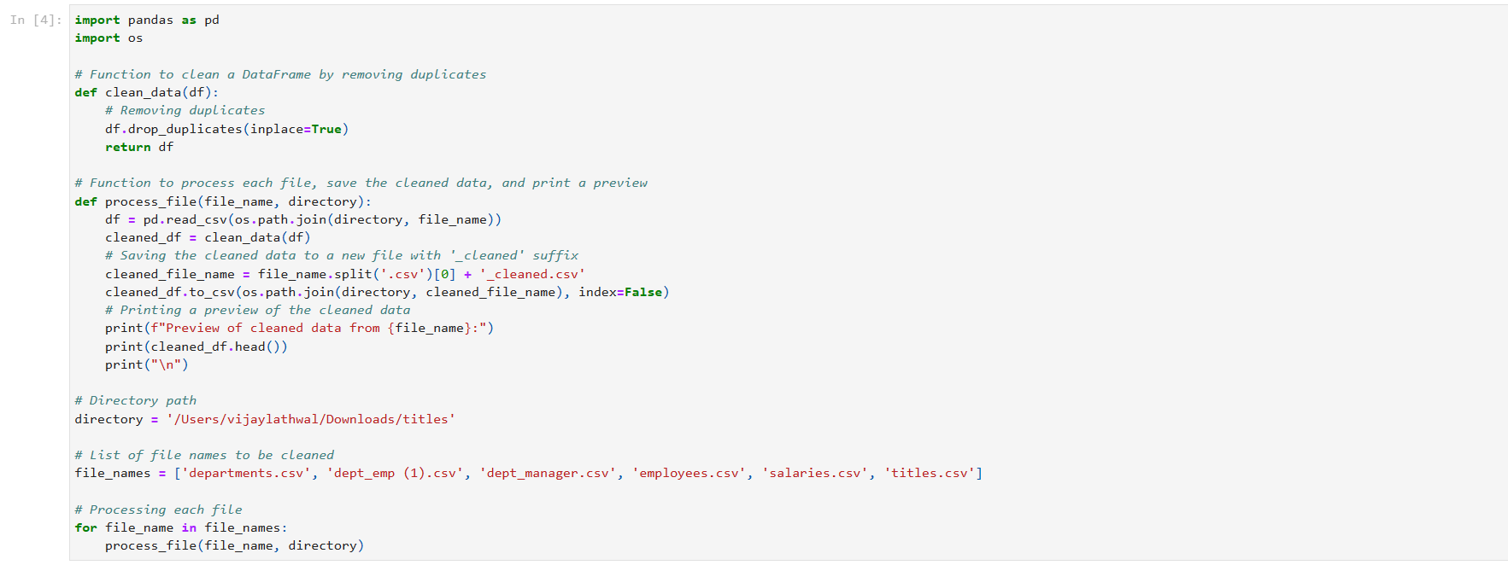
DATA CLEANING

Slide 10

VISUALIZATION
We imported heart our dataset into tableau.
Once the data has been loaded into the Tableau Desktop software, we perform the analysis for the various parameters provided in the dataset and study the relationship between them.
Link : Visualization

Slide 11
THANK YOU

