Slide 1
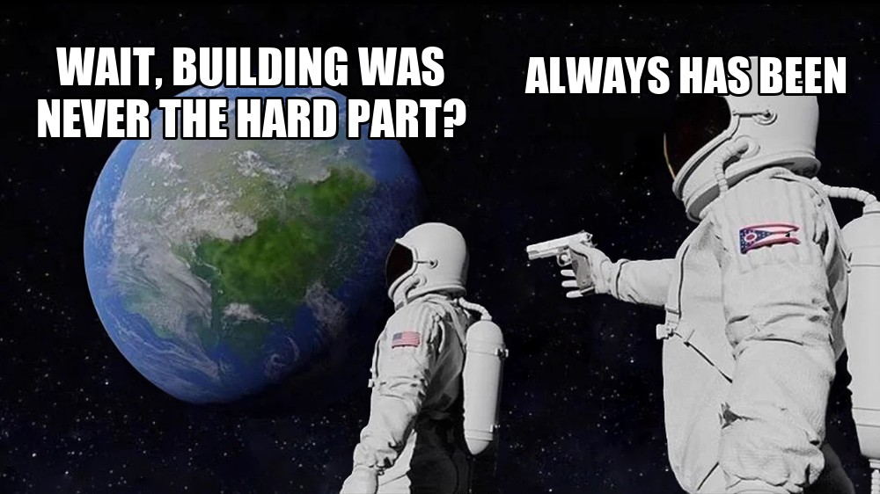
Shipcast
Building is solved.
Distribution isn't.
Your AI agent ships the launch, too.
Notes:
Shipcast distributes your product organically. Building is solved; distribution isn't.

Slide 2
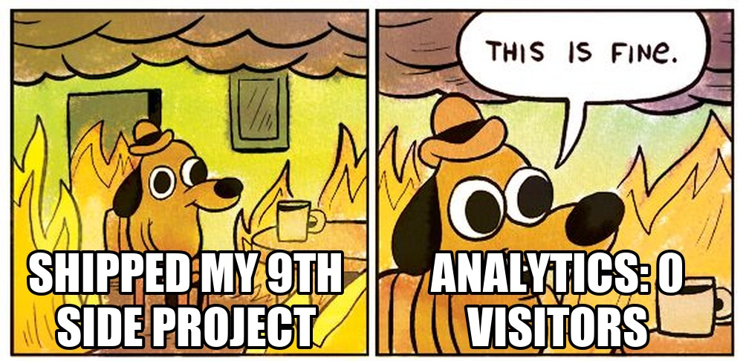
THE PAIN
Everyone ships. Nobody watches
Agents made building fast.
Launching is still a blank text box and a prayer.
02

Slide 3
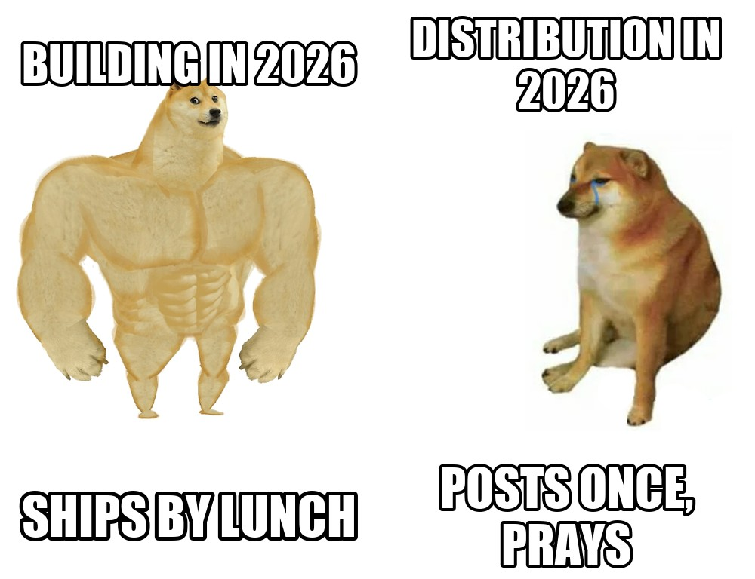
WHY NOW
Building got buff. Distribution didn't
Codex, Claude Code and Gemini CLI ship products in a weekend.
Getting anyone to see them is the new bottleneck.
03

Slide 4
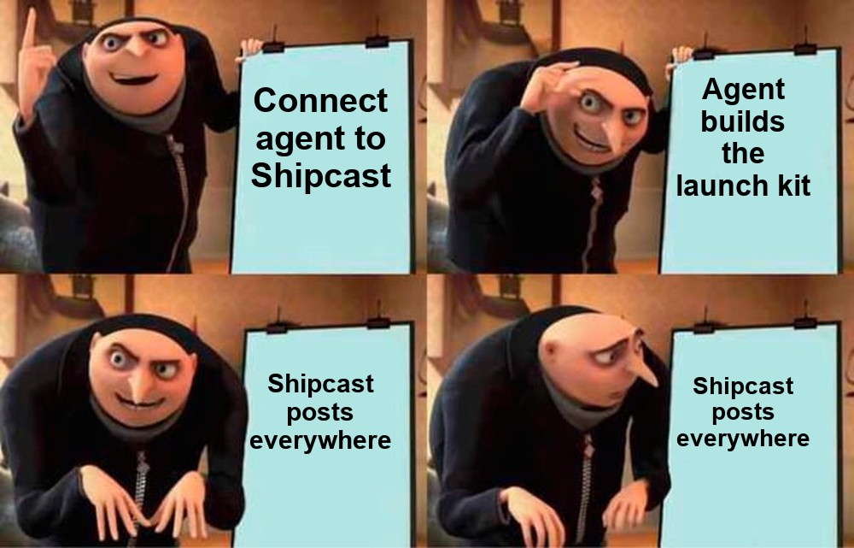
HOW IT WORKS
Connect → Research → Film → Kit → Post
Exa researches your product with sourced facts.
Your agent writes the launch film, memes and channel copy.
Shipcast posts it.
04

Slide 5
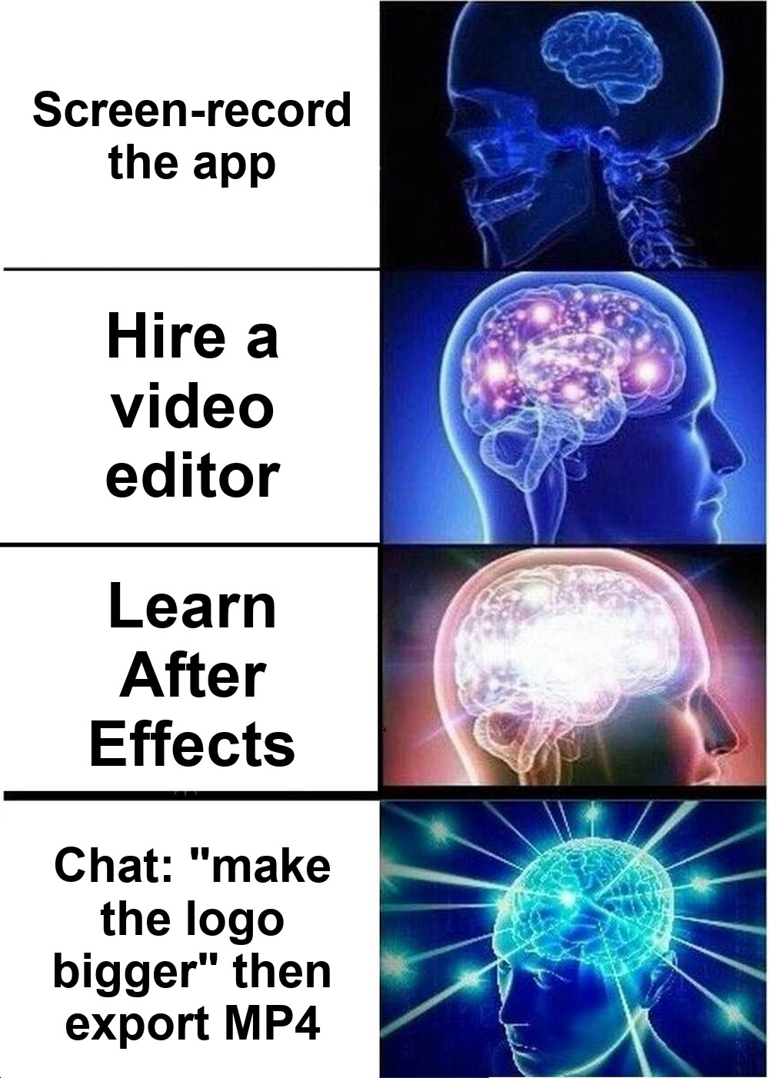
DEMO FLOW
Edit a launch film like a doc
Video as code: every layer editable.
16:9, 9:16 and 1:1 from one project.
Studio: NLE timeline, chat edits, MP4 export.
05

Slide 6
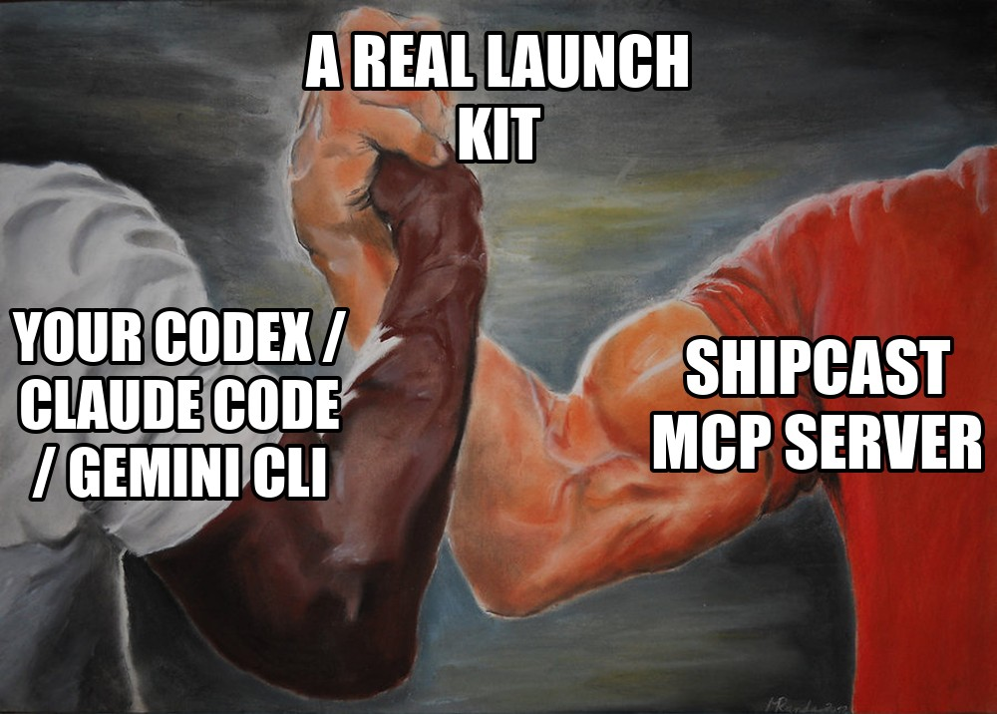
THE TRICK
MCP server + skill = your agent does the work
Plug Codex CLI, Claude Code or Gemini CLI into Shipcast's MCP server.
Your subscription builds the launch.
06

Slide 7
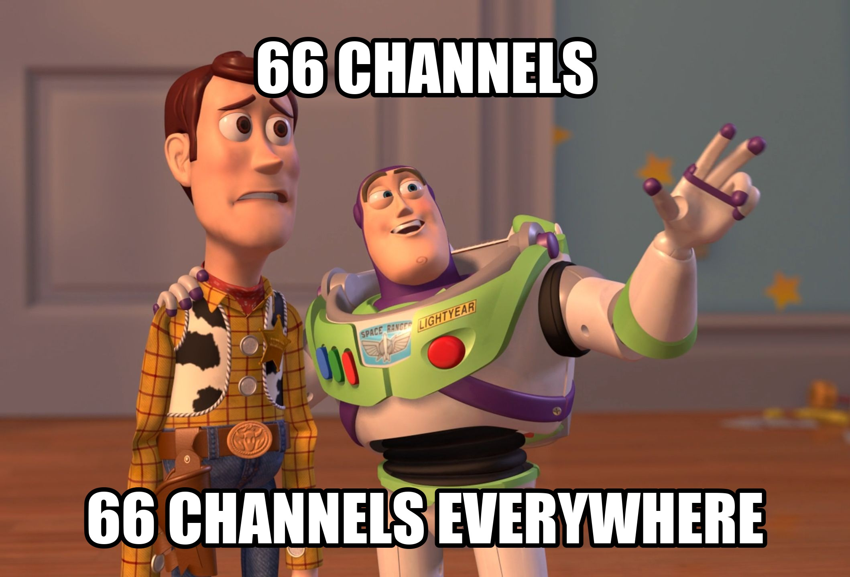
DISTRIBUTION HUB
66 channels. 9 agents
Every channel researched.
Channel-specific copy, not one post pasted everywhere.
07

Slide 8
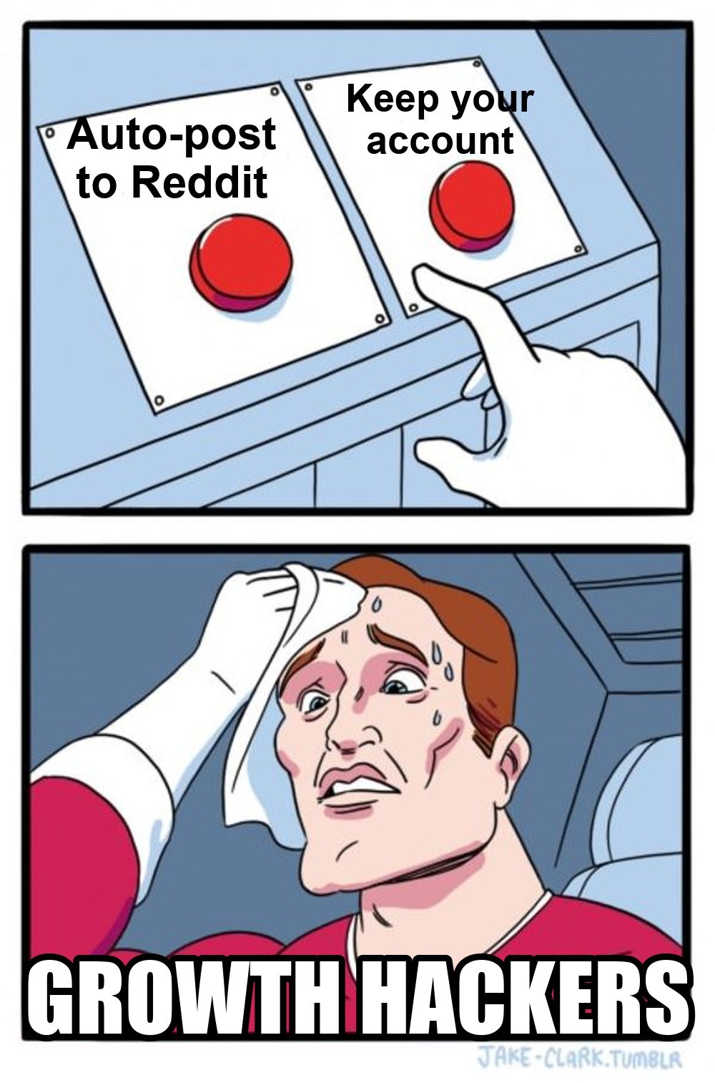
HONESTY
We post where it's allowed. We draft where it isn't
Posts: X, Bluesky, Threads, Mastodon, Telegram; TikTok, Shorts, Pinterest, LinkedIn via aggregator.
Drafts: Reddit, Product Hunt, Hacker News.
Never double-posts.
08

Slide 9
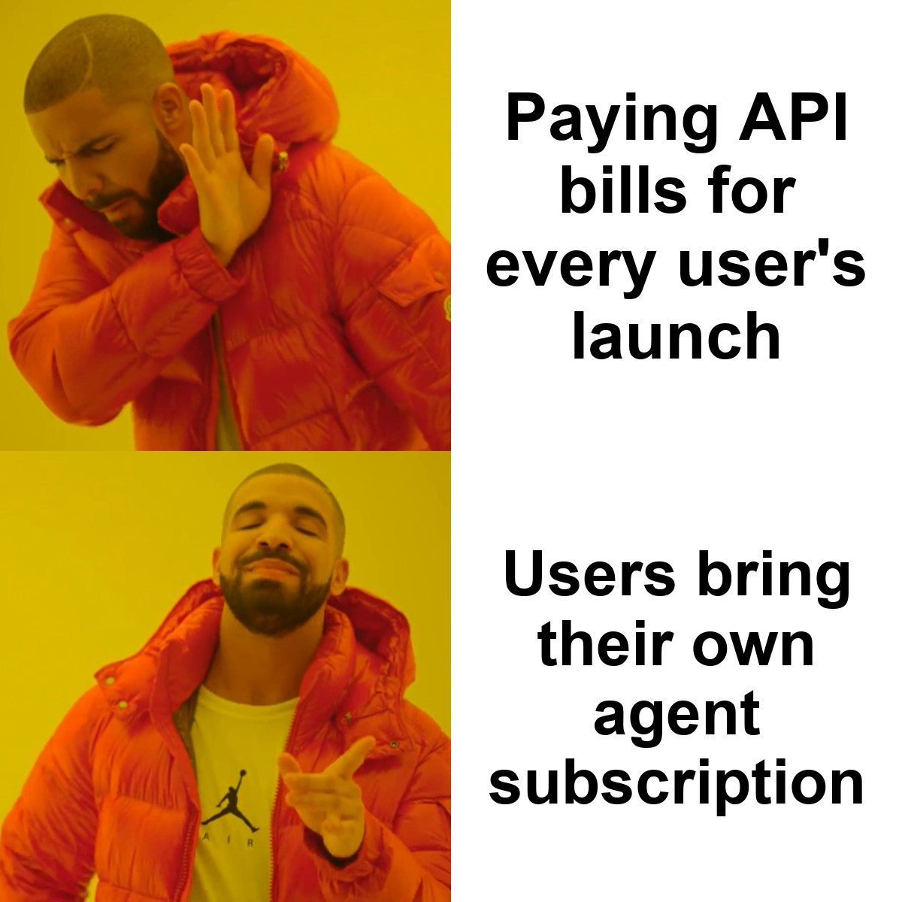
BUSINESS MODEL
Your subscription does the heavy lifting
Users bring their own agent, so we spend almost no API money.
No agent? 20 free credits.
09

Slide 10
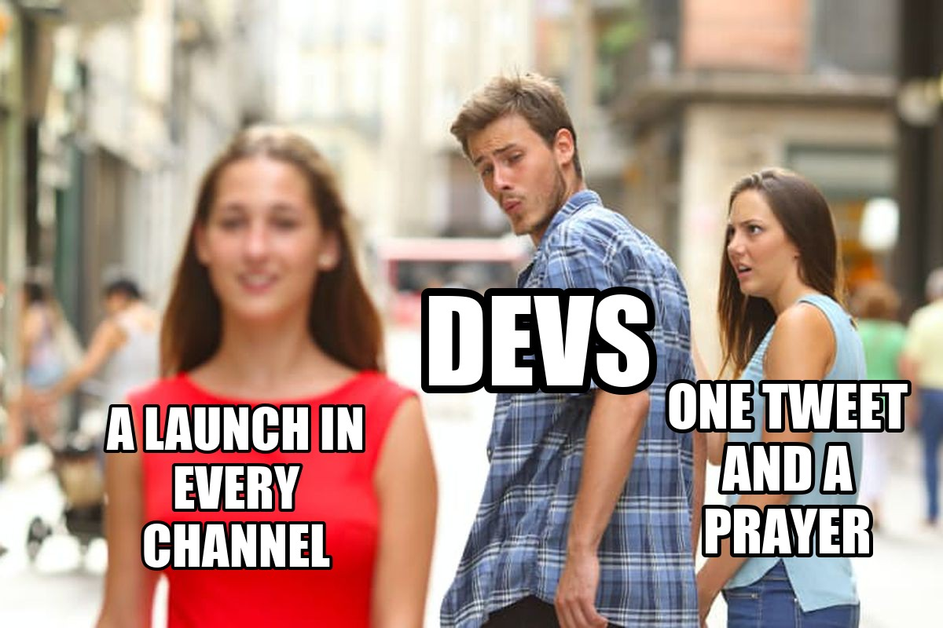
WHAT'S NEXT
Stop launching to one tweet
Connect your agent, get a full launch kit.
Post to the channels that allow it, draft the rest.
10

Slide 11
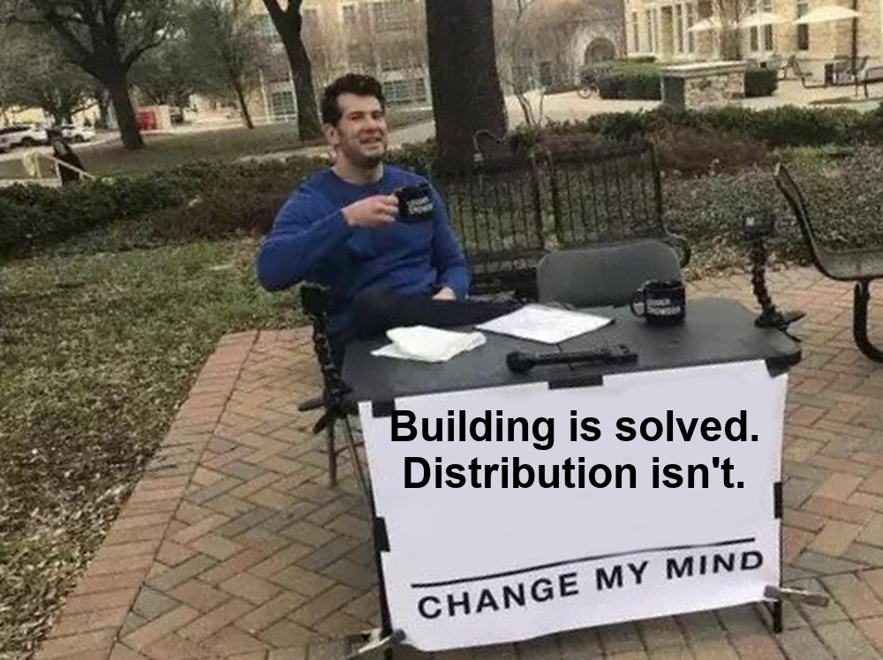
Ship it. Then Shipcast it.
Connect your agent to the Shipcast MCP server.
Shipcast

