Slide 1
Heart Disease Prediction

Slide 2

Introduction
Since each one of us are prone to unhealthy lifestyle and unsuitable environment, it is required to provide appropriate techniques to test the presence of any disease, specifically for heart related problems.
Now-a-days heart related problems are very common among the generation such as cardiac arrest, diabetes, high blood pressure levels, high cholesterol and irregular pulse rates.
Nature of heart diseases are complicated and difficult to predict

Slide 3

Continued...
There is a need to predict such diseases in advance properly so that proper treatment shall be given to patients.For predicting such diseases appropriate tools and techniques are needed which could increase the precision of such predictions.
Many data mining related techniques are used for this purpose such as decision-tree, KNN, etc. Before applying any such data-mining algorithm, efficient feature selection mechanisms need to be adopted so that model could be train well and produces more efficient outcomes.

Slide 4
Related Works/ Research Paper
There are various prediction models which has been used in predicting the heart related diseases, such as ANN, SVM, etc.
ANN was considered as highly efficient model since it gave the highest accuracy among other data mining related algorithms.
Various classification algorithms were also used without segmentation like Convolutional neural network.
Many researchers are also working towards building models that could predict heart diseases in an efficient manner and that can decrease the cost associated with such predictions.
Many data mining algorithms or machine learning algorithms are also deployed for this purpose and they are proved to provide better and accurate results as compare to other techniques.

Slide 5
Limitations of Existing Methods
Various data mining and machine learning algorithms or models were applied on provided data-set to predict cardiovascular diseases on various features provided.
These machine learning techniques are retrieving accurate results but lacks proper precision.
They doesn't scale well enough for clinical data or attributes and therefore there is a need to bring changes into previous approaches.
For getting higher accuracy for clinical precision, many data mining algorithms are deployed and hybrid approaches are adopted.

Slide 6
Proposed Strategies
Since Cardiovascular diseases are very sensitive in nature, therefore there exists a need to predict it efficiently with all clinical data available.
Existing methodologies are giving high accuracy but lacks precision when it comes to clinical content.
To mitigate this problem, we have implemented models such as SVM,Naive-Bayes, KNN, Random-Forest, language model etc.
Among them SVM is more accurate prediction.
In order to increase the overall precision, we have introduced a Hybrid approach of random forest and linear model such as Lasso.
By introducing such hybrid approaches, we could take the advantage of both random-forest and linear models and could predict the model accurately.

Slide 7
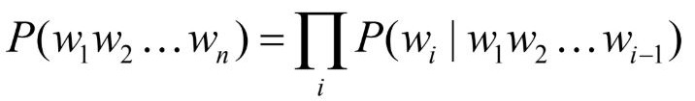
Materials & Methods
Random Forest : Random Forest is a tree based algorithm which run decision tree algorithm over different subsets of training set, and then vote for the class label i.e assign the class label with maximum occurrences from decision tree over different subsets.
Support Vector Machine(SVM) : Support vector machine evaluates the hyperplane to separate the data points. The dimension of hyperplane depends on the number of features. There can be multiple hyperplanes possible to separate the same set of data points, so the svm algorithm finds out the hyperplane which is having maximum margin with the data points.
Language Model : Language model is used to find the probability or likelihood of a sequence based on the previous sequence observed. The probability of a sequence is evaluated by using the chain rule formula :
Logistic Regression : Logistic regression is suitable for the classification that are having categorical target value. It has the following parameters :
Output : 0 or 1
Hypothesis : Z = WX + B (W is weight matrix, and X is Input feature matrix)

Slide 8
Continued...
Decision-Tree: Decision-tree is the classification model that could predict the labels of test data target using input-features provided. Here each internal node is labeled with input features that are being provided and an outgoing edge from that node contains the label of the target. In Decision-Tree, we have used Entropy as a distance metric.
KNN: In the KNN model each input instance or row is considered as a vector. With the testing node firstly euclidean distance is calculated from all the nodes. Then find out the k-nearest node. Finally, assign the highest occurring label among those k-nearest nodes.
Naive-Bayes: In Naive-Bayes algorithm Bayes theorem and conditional probability are used. From the train data firstly, prior probabilities are calculated. These prior probabilities are finally used to find out the probability of an instance being in a particular class. Whichever class gets a higher probability, the data gets labeled accordingly.

Slide 9
Continued...
Neural-Network: In Neural Network, the multi-layer perceptron model is built with various layers. Each layer has it’s output stream size and an activation function. In our implementation, there are four layers and the last layer uses “softmax” as an activation function. The rest three layers use “relu” as an activation function. This model tries to reduce the loss after each epoch. In our implementation, the “sparse categorical cross-entropy” function is used for calculating loss and “adam” is used as an optimizer. Each layer passes it’s output as an input to the next layer and the last layer finally produces the labels.
HRFLM: This is a hybrid approach which is named as, Hybrid Random Forest and Linear Model. This model combines the advantages of random forest and linear models. Firstly, a linear model i.e., “Lasso” is used to refine the best features out of all the features present in the dataset. These features are finally used to implement the random forest algorithm and generate the labels. After finding the set of best features, the Random forest model is trained and finally, labels are generated for test data.

Slide 10
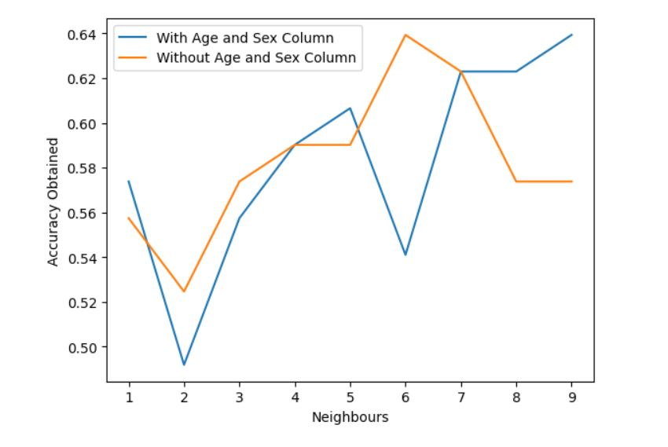
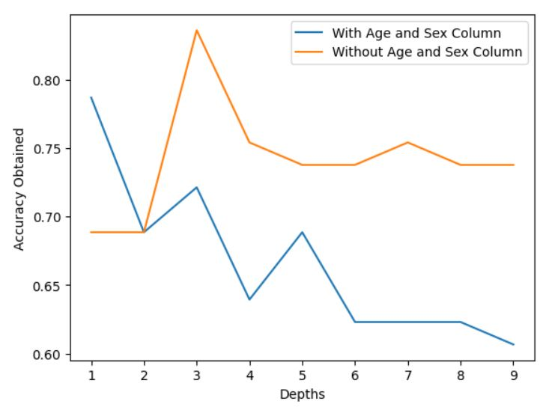
Experimental Results
We have splitted our dataset into train and test subsets in the ratio of 80:20, and applied various machine learning and deep learning models to predict the class labels for the test records and calculated accuracy after 5 cross- fold validation.
In KNN, we have calculated accuracy at different value of k and found out that at K=6, with age and sex column, accuracy obtained is highest, and when age and sex are not considered as features, maximum accuracy is obtained at K=7.
In Decision-Tree, we have calculated accuracy at different depth values and found out that, at depth 3, with and without age and sex attributes, Decision tree model is giving higher accuracy.

Slide 11
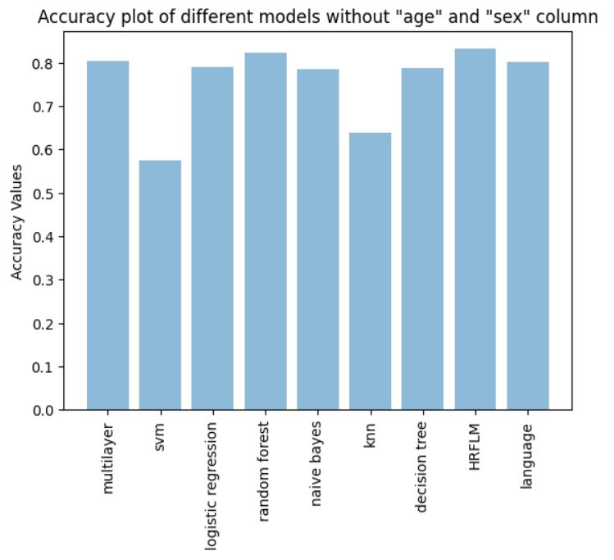
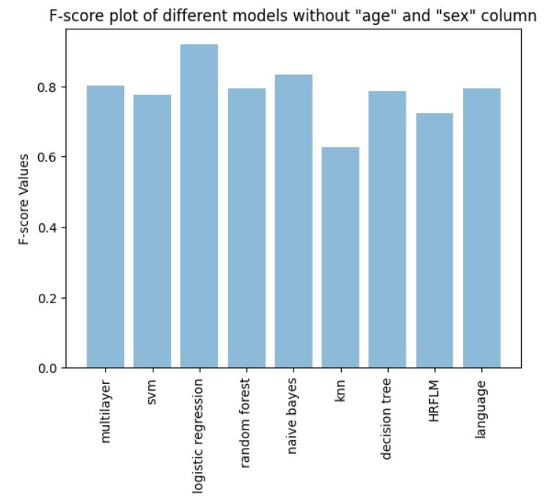
Continued...
We have used accuracy and f1 score as the evaluation criterion for our models . Here are the some of the results :
From these graphs we can infer that after removing “age” and “sex” features from dataset, the model which is performing good is ‘HRFLM’.
And the models which performing poor are ‘SVM” and “KNN” algorithms with values lies approximately 0.6 .

Slide 12
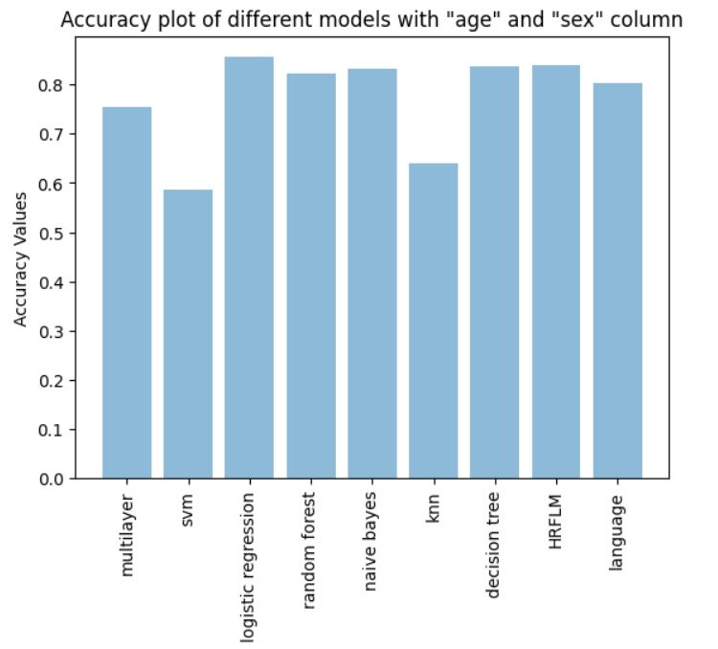
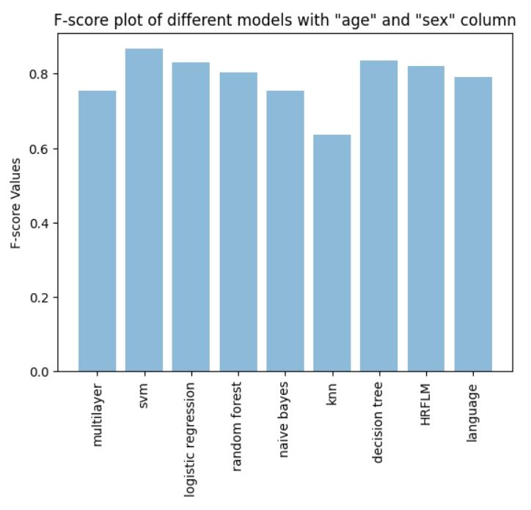
Continued...
From these graphs(with age and sex as attributes), we can infer that all the models are performing well with values ranging from 0.75 to 0.9, except that of knn and svm which is having value 0.58 approximately.

Slide 13
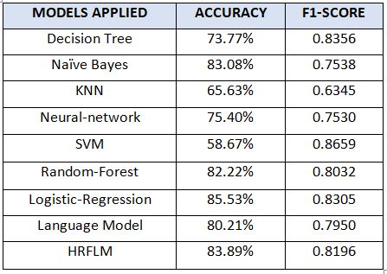
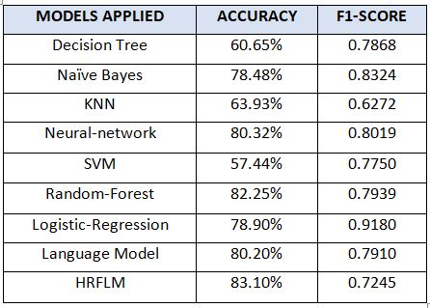
Result Summary
Including age and sex features
Excluding age and sex features

Slide 14
Discussion
We use different machine learning techniques and models to predict Cardio-vascular diseases.
We do our analysis for both cases i.e including non-medical features as sex and age and excluding non-medical features .
For evaluation of we use two metrics which are accuracy and F1 score.
In case when non-medical features as age and sex are excluded, the best performing model based on accuracy is HRFLM and based on f1-score is logistic regression.
In another case when non-medical features are included the best performance is obtained by logistic-regression model.
To get better results from existing models we find best parameters for them and do our analysis using those parameters.
We also use cross validation with 5 folds for betterment of models.

Slide 15
Continued...
We take care of basic details as we find best depth in case of decision tree and best value of K in case of KNN.
In our analysis we get better accuracy as well as better F1 score than the work which was done before.
We also have provided bar chart representation of different performance measures as accuracy and F1-score for both cases.
Using given features we are able to predict good results which can be used to predict symptoms of heart disease in early stage and can play an important role to control mortality rate.
Future work can also be done in same field by including more features and using larger and real time data from different sources.
As technology is improving and advancing day by day so further new methods can also be generated for the such prediction in favour of humanity.

