Slide 1
Analyze IMDB Score using Data Mining Algorithm
Amrit Mohan Kaushik MT18022

Slide 2
Introduction
This project is aimed to analyze the IMDB score using data mining algorithms.
The given dataset have some information related to 5000 movies. This data spans over 100 years and 66 countries.
It has 28 different features for each movie. IMDB score is the target or response variable and 27 attributes are used as features to predict the IMDB scores.

Slide 3
Data Exploration and Pre-Processing
Many attributes contains null value in it. For handling these null values we replace those null values with the mean value for some attributes and for some, we replace with the maximum occurring value of that attribute .
New feature as profit is calculated by subtracting the budget from gross value.
facenumber_in_poster and title_year are least correlated. So, We can drop these features.
The data is encoded for applying classification algorithms by using Label Encoder

Slide 4
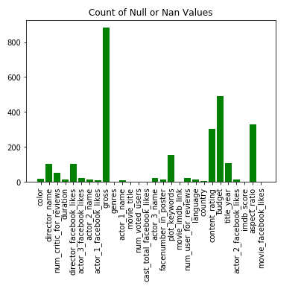
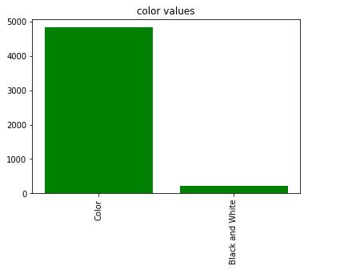
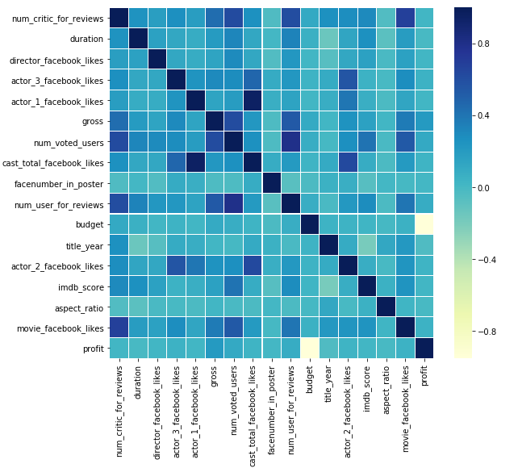
Some Graphs Drawn in Pre-Processing
Graph showing Null value
count
Graph showing that color
Attribute have same value
So, it is not that important.
Heat Map to show
Correlation.

Slide 5
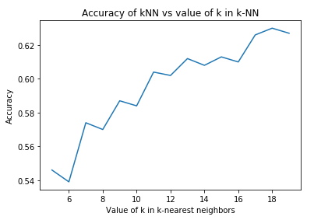
K-Nearest Neighbour
K-Nearest Neighbour is applied with the help of sklearn libraries .
Minkowski is used as the metric for evaluating nearest neighbour.
Implemented K-NN for different value of k to find the optimal one.

Slide 6
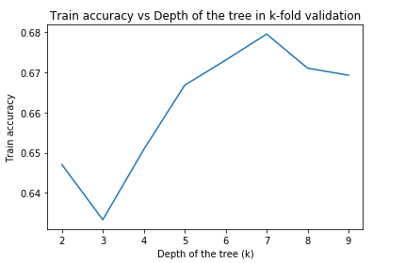
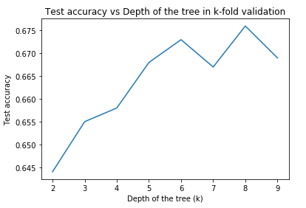
Decision Tree Classifier
Decision Tree Classifier is applied with the help of sklearn libraries .
Cross Validation is applied for k-fold validation with k=5.
Accuracy is measured at different depth of the tree.

Slide 7
Results and Inferences
K-Nearest Neighbour shows worst performance as compared to Decision Tree classifier .
K-Nearest Neighbour shows 63% accuracy for k=18 where as Decision Tree classifier gives 66% accuracy.
Highest Train accuracy for decision tree classifier is obtained at depth =4 and highest test accuracy at depth=5

