Slide 1
Data Visualization and Interpretation
Review 2
Digital Enigma

Slide 2
Data Visualization

Slide 3
Data Visualization
Created interactive dashboards in Power BI using pie, bar and scatter charts
Used slicers and filters to enable dynamic data exploration
Highlighted key trends and price influencers through visual storytelling

Slide 4
Interpretation

Slide 5
Interpretation
Most properties sold are Houses with 2–3 rooms and bedrooms
Smaller building areas generally indicate affordable homes
Room count and property size are key factors influencing price

Slide 6
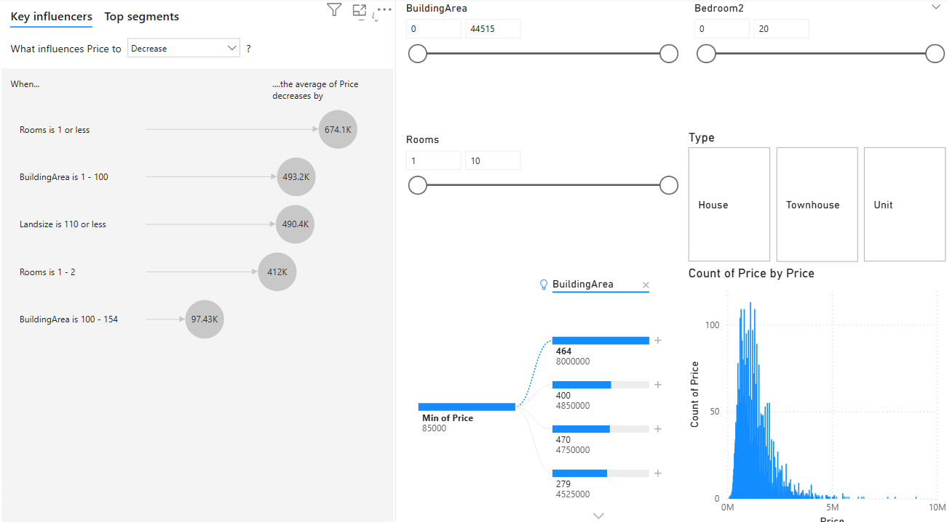
Key influencers for price

Slide 7
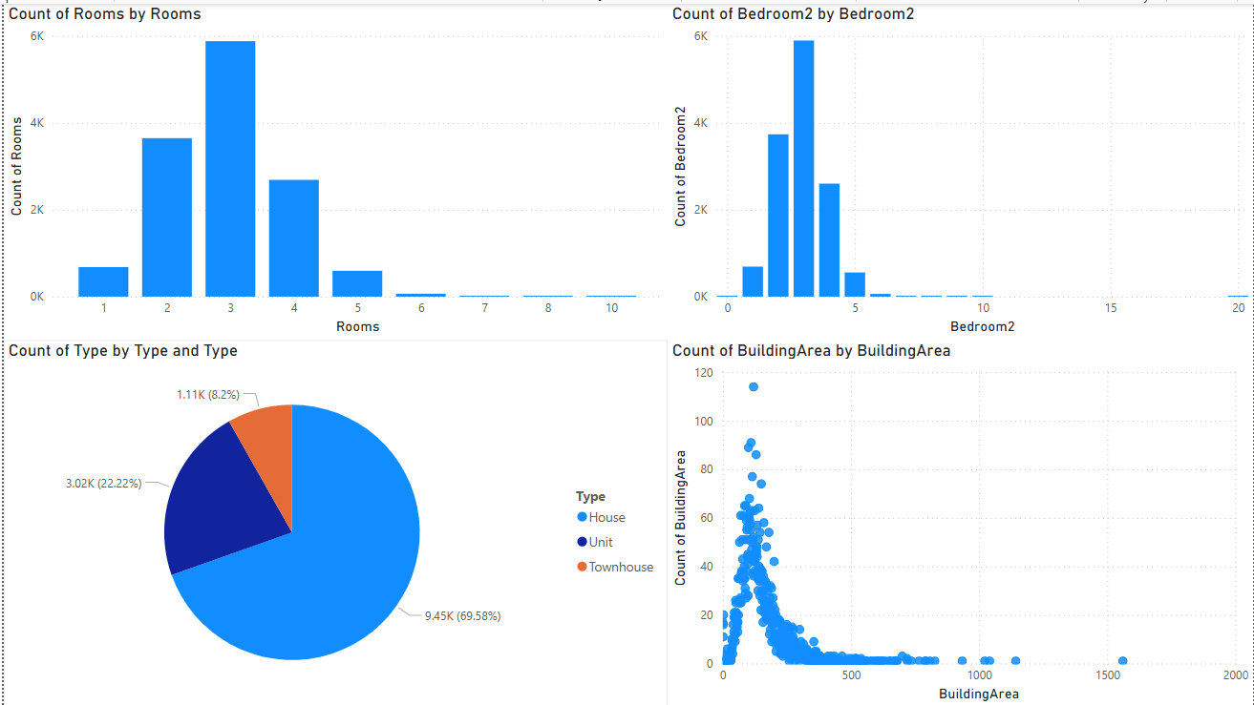
Distribution of Rooms, Bedrooms, Type and Area

Slide 8
Thank you!

