Slide 1
Data Preprocessing and EDA
Review 1
Digital Enigma

Slide 2
Data Preprocessing

Slide 3
Data preparation
Dropping columns that are obvious like address, seller, date which do not contribute to price
Dropping rows which have NA values
Convert non-numerical values (like suburb, region and type) into integers for numerical analysis

Slide 4
Exploratory Data Analysis

Slide 5
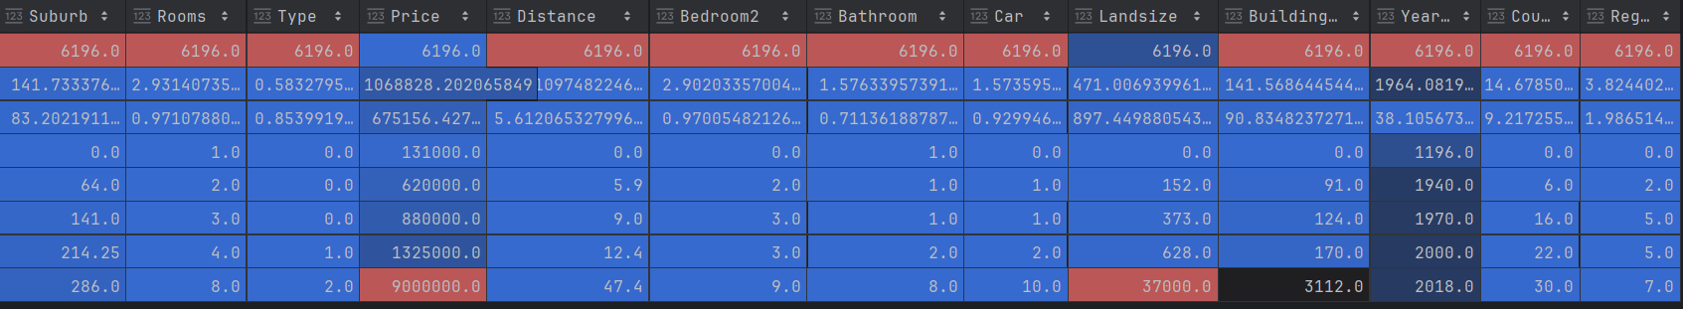
Overview of data

Slide 6
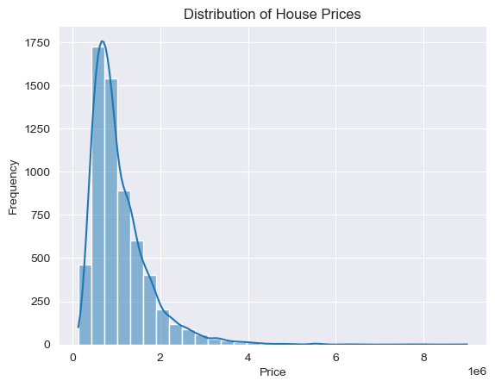
Analyzing price distribution

Slide 7
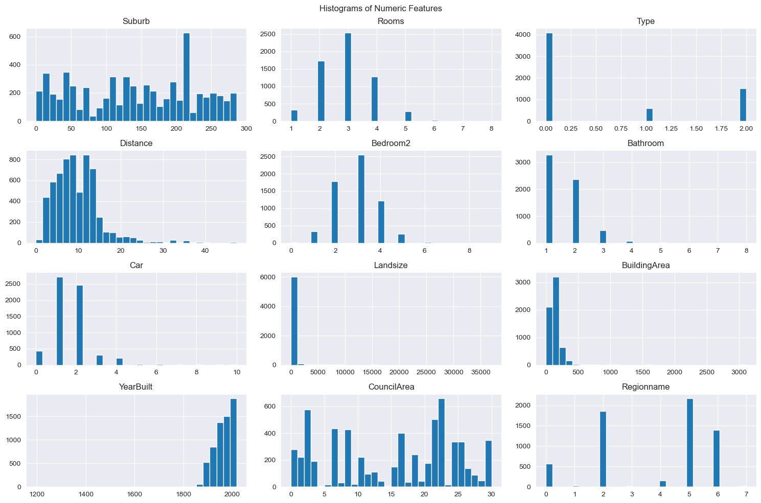
Analysis of features

Slide 8
Handling outliers
Detecting and visualising outliers using box plots
01
Removing outliers by doing calculations on IQR
02

Slide 9
Handling outliers
Detecting and visualising outliers using box plots
Removing outliers by doing calculations on IQR

Slide 10
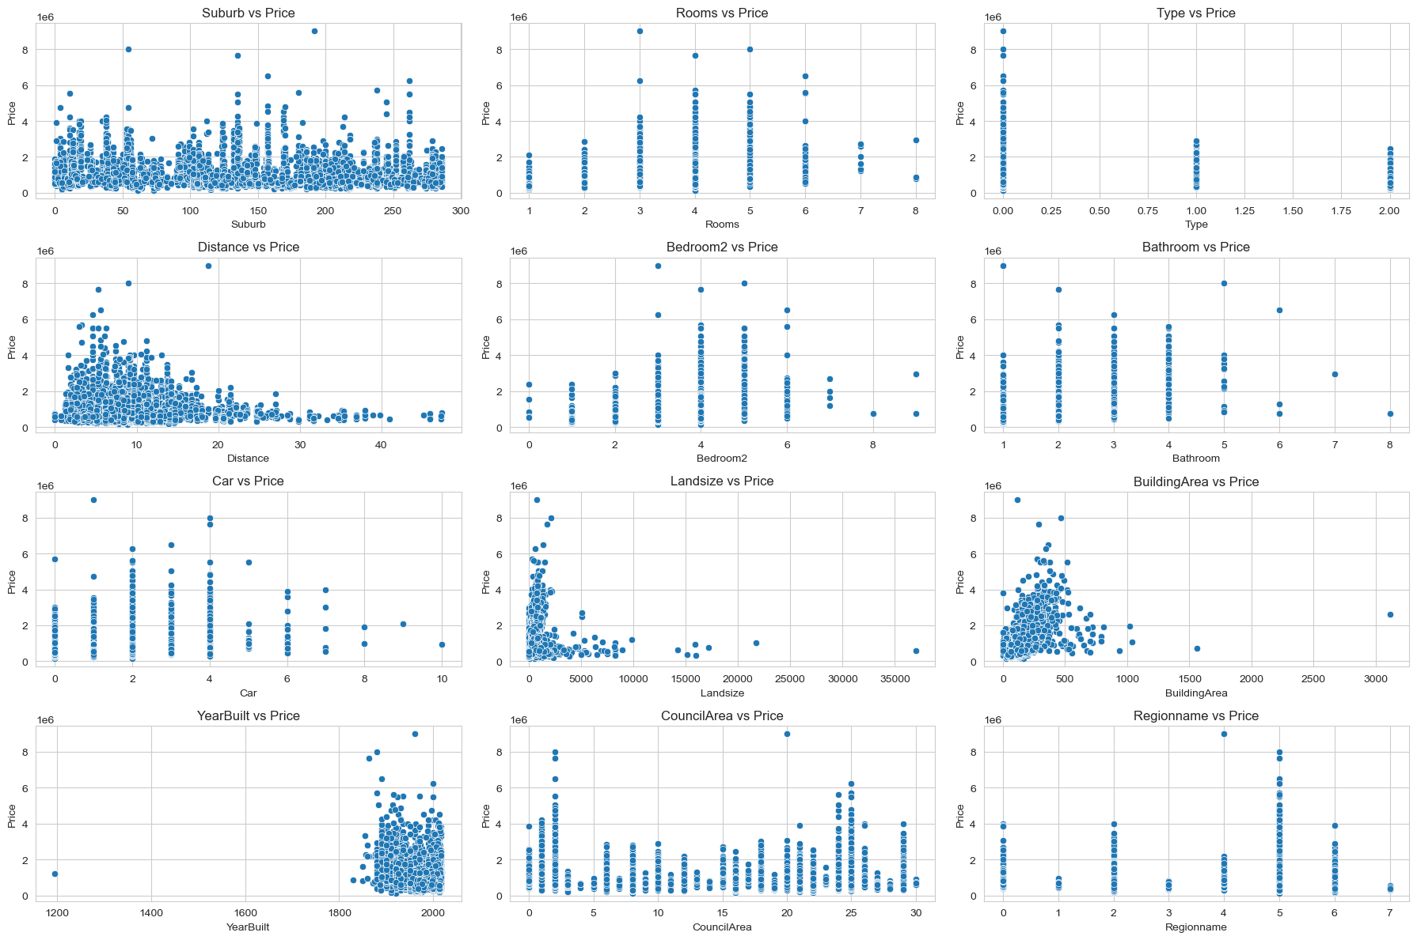
Relationship between price and features

Slide 11
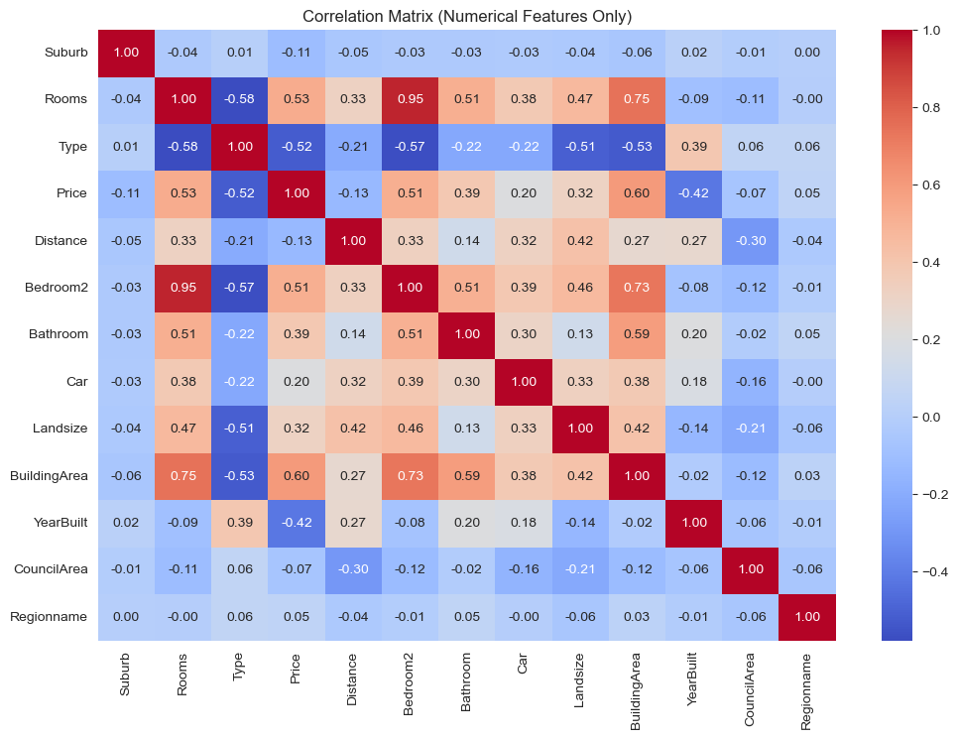
Final correlation matrix

Slide 12
Relevant features
After completing EDA, the features to focus on are:
No. of rooms
Type of house
Scraped no. of bedrooms
Building size

Slide 13
Thank you!

