Slide 1
Information Retrieval & Integrated Services (IRIS)

Slide 2
Reference
http://cater.cs.nyu.edu/wiki/index.php/RuralCafe
http://www.googleguide.com/google_works.htm
http://www.google.com/complete/search
http://www.en.wikipedia.org
http://www.hakia.com
http://wordnet.princeton.edu/
http://activemq.apache.org/
http://lowband.org/

Slide 3
Content Adaptation
Filter the contents of the web pages according to the user preferences and bandwidth
The functionalities are:
Subscribes the link
Download the page

Slide 4


Slide 5
Net Beans 6.1
Java 5.1
Visual Studio 2008
C# .NET
ActiveMQ
Apache NMS
Microsoft Visio
Rational Rose
Microsoft Office Access 2007

Slide 6
Lossy compression
Stores the adapted content in the storage server

Slide 7
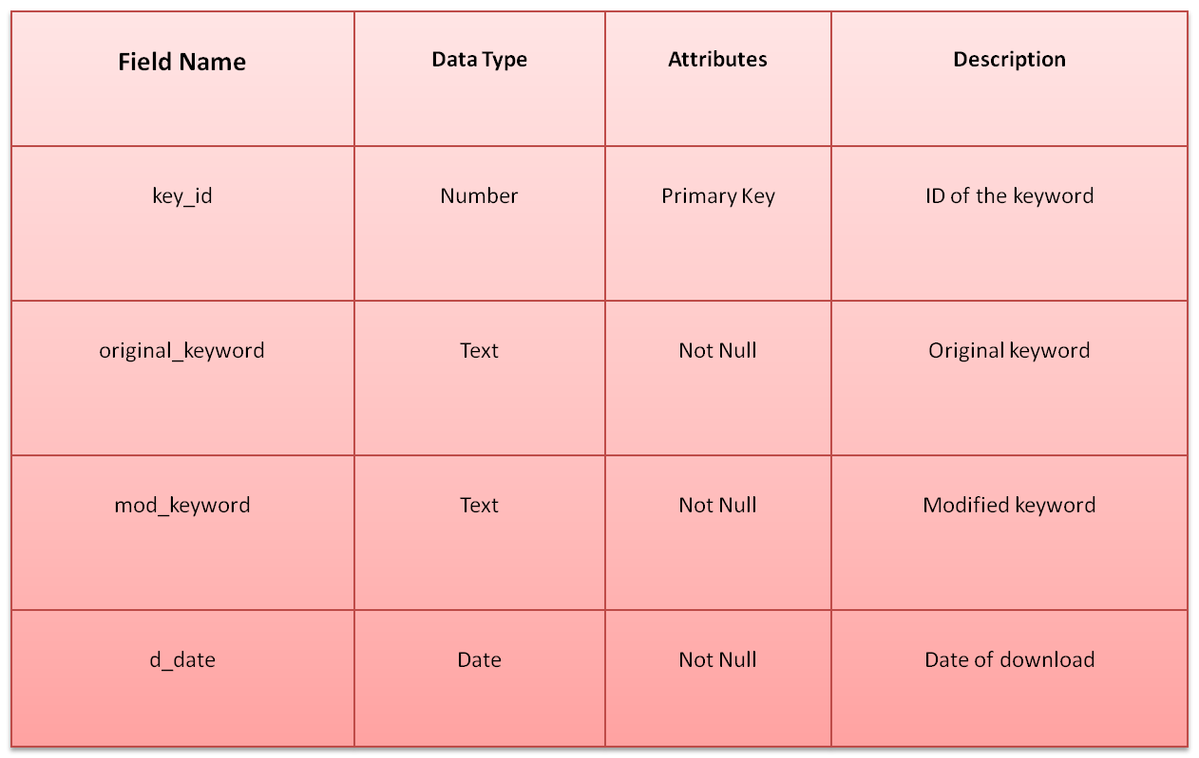
Keyword_store

Slide 8
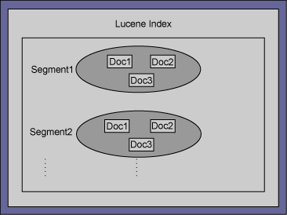
Logical View

Slide 9


Slide 10


Slide 11


home

Slide 12
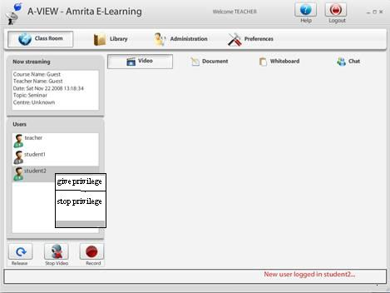

Slide 13

World around me

Slide 14


Slide 15
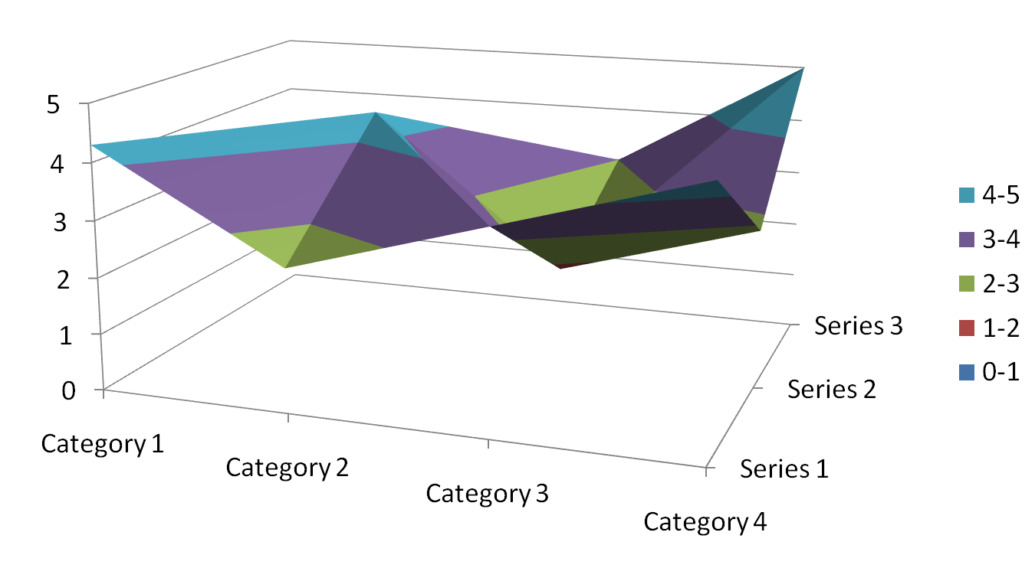

Slide 16
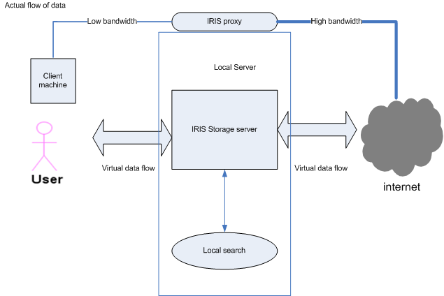
Architecture of IRIS

Slide 17
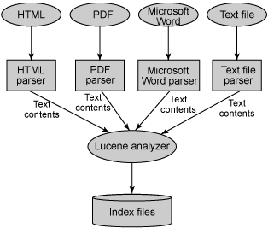
Indexing Architecture

Slide 18
Logical View

Slide 19
Content Adaptation
Filter the contents of the web pages according to the user preferences and bandwidth
The functionalities are:
Subscribes the link
Download the page

Slide 20
Lossy compression
Stores the adapted content in the storage server

Slide 21
Focused crawling
It is the process of searching for relevant pages. It includes filtering for finding authentic pages.
The functionalities are
    Starts crawling from an authentic page
    Breadth first Search
    Search Query expansion
    Filter to find relevancy
    Subscribes the search query and publishes the link

Slide 22
Semantic search
Creation of e-books

Slide 23
Thank You

Slide 24
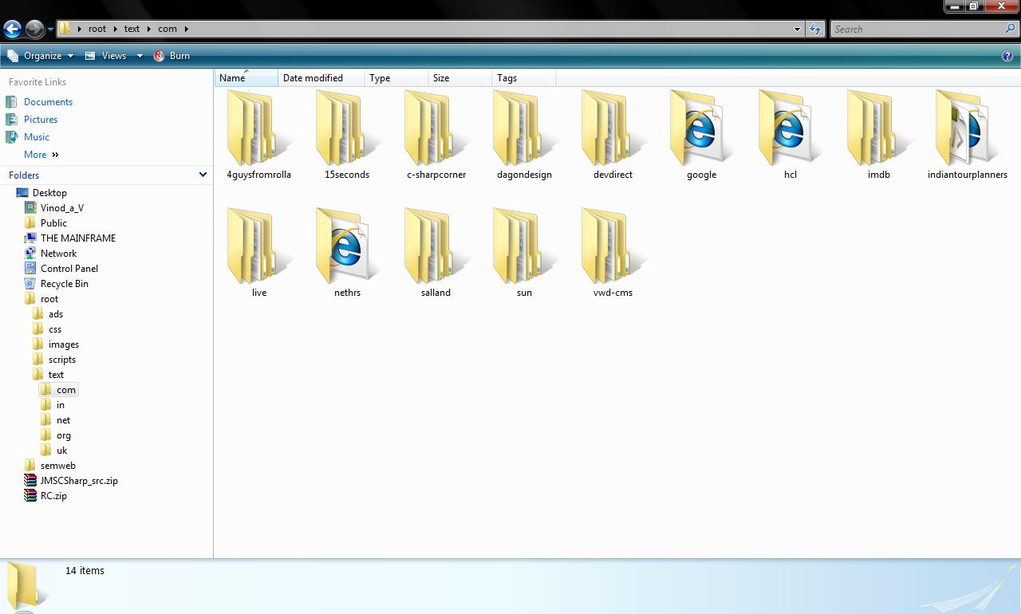

Slide 25
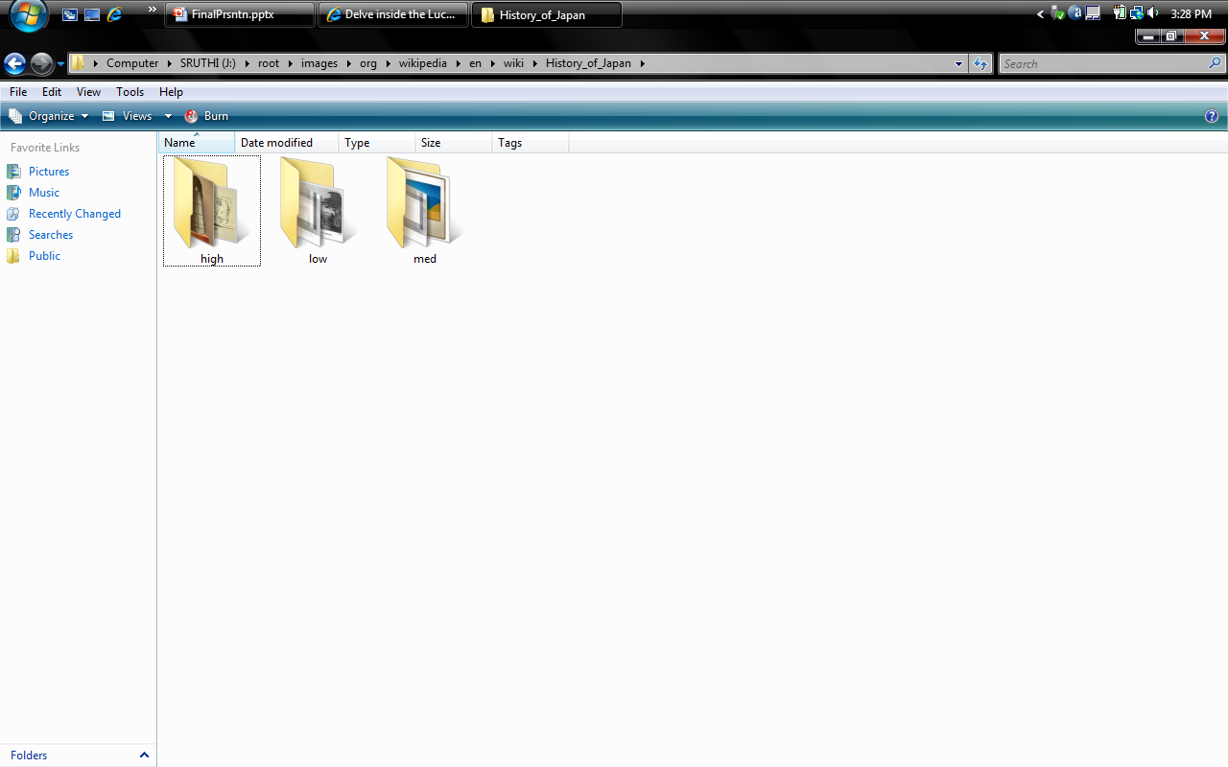

Slide 26
Future Enhancements

Slide 27
Semantic search
Creation of e-books

Slide 28
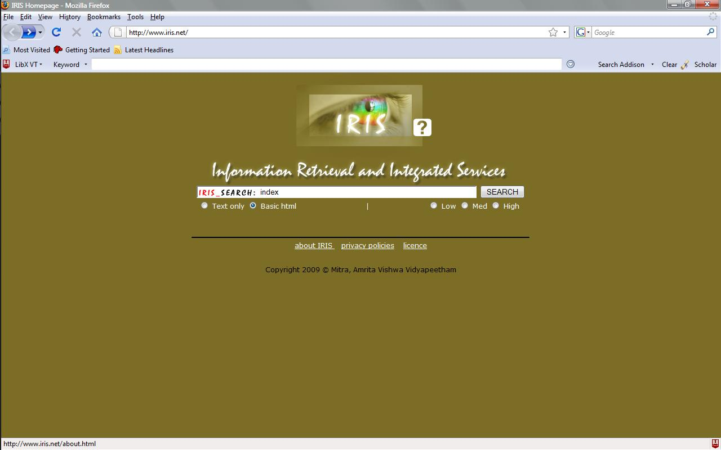

Slide 29
Learn > Succeed
WebEx University

Slide 30


WebEx University
Online Self-Paced Training:
Anytime, Anywhere!
What is Self-Paced Training?
• WebEx Interactive Learning features a 'virtual trainer' who leads you through animations that teach how to use WebEx services. You can then try tasks yourself and even test your knowledge. If you take a break, the program will bookmark your spot so you can return anytime. When you're done, you will automatically receive a printable Certificate of Completion.
• How Do I resources are a series of short, feature specific training modules for those who know what they want to learn.
Online Instructor-Led Training:
It’s Live!
What is Instructor-Led Training?
In our dynamic online sessions, a Live Instructor guides you step-by-step, and answers your questions on the spot. Choose the session that best fits your busy schedule. Meet other WebEx users in our small, interactive classes.

Slide 31
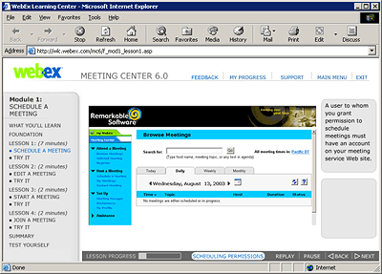
WebEx University
Online Self-Paced Training:
What You Get!
WebEx Interactive Learning:
• Take it anytime, anywhere.
• Take it at your own pace.
• Use it and return to it as a valuable resource.
• Engaging and interactive learning tool.

Slide 32
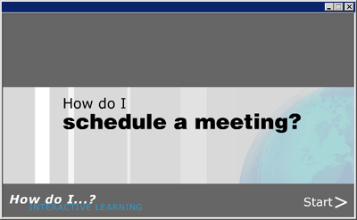
WebEx University
Online Self-Paced Training:
What You Get!
WebEx Interactive Learning:
• Take it anytime, anywhere.
• Take it at your own pace.
• Use it and return to it as a valuable resource.
• Engaging and interactive learning tool.
How Do I’s:
• Short, feature specific training modules.
• No login required.
How Do I resources are located on
http://howdoi.webex.com

Slide 33
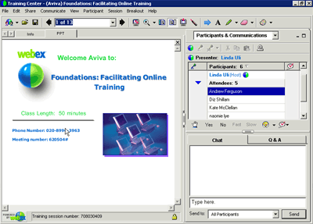
WebEx University
Live, Online Instructor-Led Training:
What You Get!
• Live Instructors guide you through the learning experience.
• Live Instructors answer all your important questions on the spot.
• Meet and learn with other WebEx users in our small, interactive classes.

Slide 34
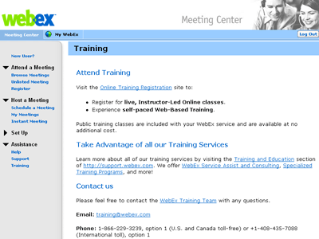
WebEx University
How to Access Training:
• Go directly to: http://university.webex.com
or
• From your company's WebEx service site:
(ex: companyname.webex.com)
1) On the left navigation, click Assistance.
2) Next, click the Training link.
(If you have not logged in, you will be asked to enter your user name and password for your company’s WebEx service site.)
3) At the top of the Training page, click the link to Online Training Registration.
(WebEx University will recognize you and you will already be logged in to the site.)

Slide 35



WebEx University
Take With You:
> WebEx Customer Training Catalog PDF
Check out the Interactive Version of this Presentation:
> WebEx Online Training Quick Tour
Any Questions?
Feel free to contact our Customer Care team:
• support.webex.com
• 1.866.229.3239

Slide 36
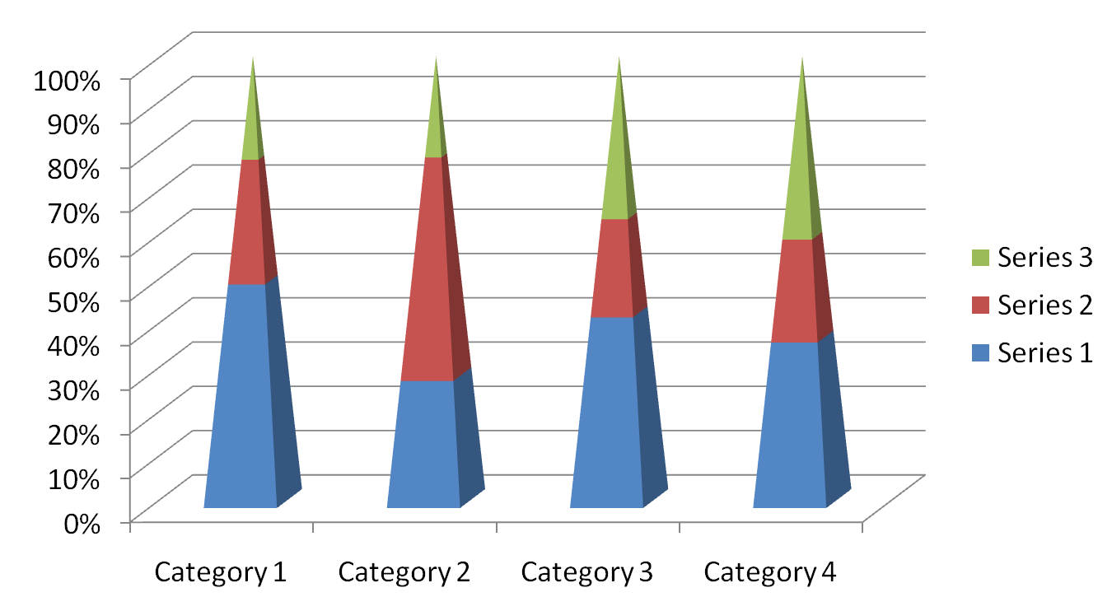

Slide 37


Slide 38
Gfgf | Vgfjf | Jhghkg | Jgfjh | Hgcgh1 | Hggj
Ghjg | Hggfg | Jhghjg | Jvhj | Hggh | Hggh
Cfdh | Hhgf | Ghfhgf | Jhgj | Jgka | Sagjk
Ksajklf | Kjsfa | Ksagj | Sgkaj | Sjgka | bkcla

Slide 39
You know what to do
Bricks pile up to make a building. And that mere building becomes a home when it’s made of hearts. The love, care, understanding and sacrifice form the cement that hold the bricks and make the home strong, keeping it safe from any storm.

Slide 40
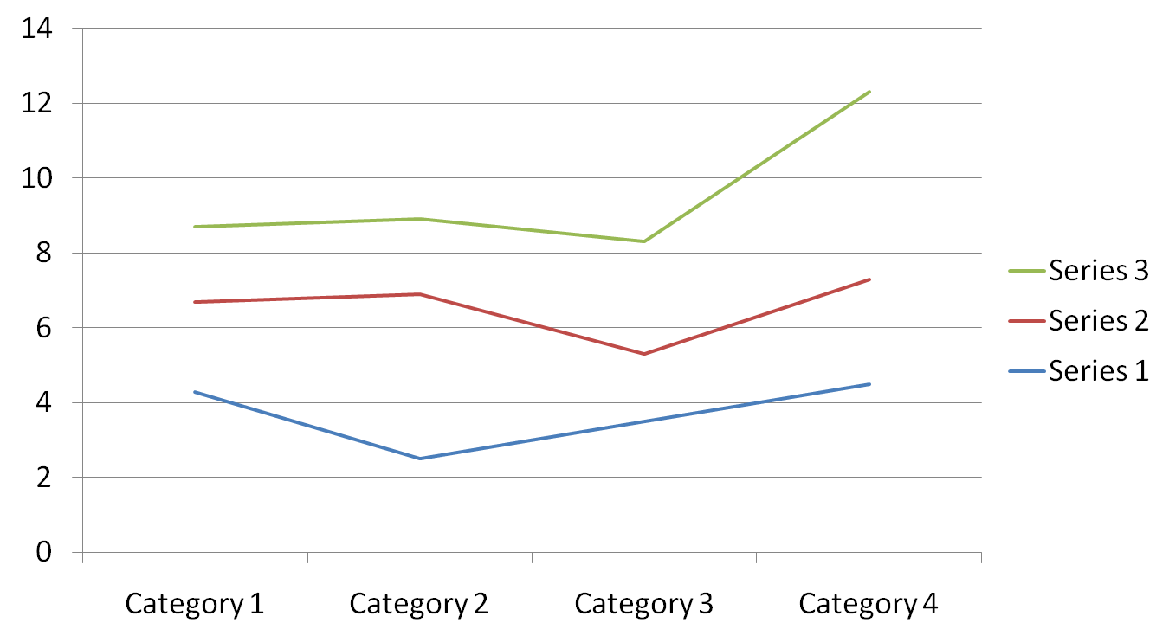

Slide 41
When the members become the bricks... the love and care of others in their heart becomes the Binding cement that help the house withstand any and all of the problems that may occur. When a build is build of bricks its just a building. But when its build of hearts it becomes a home.. a sweet home...

Slide 42
where everyone is comfortable even sharing silence. Where each one will find hundreds of reasons to make one happy

Slide 43
[Bindable]
private var dpHierarchy:ArrayCollection = new ArrayCollection([
{Region:"Southwest", children: [
{Region:"Arizona", children: [
{Territory_Rep:"Barbara Jennings", Actual:38865, Estimate:40000},

Slide 44
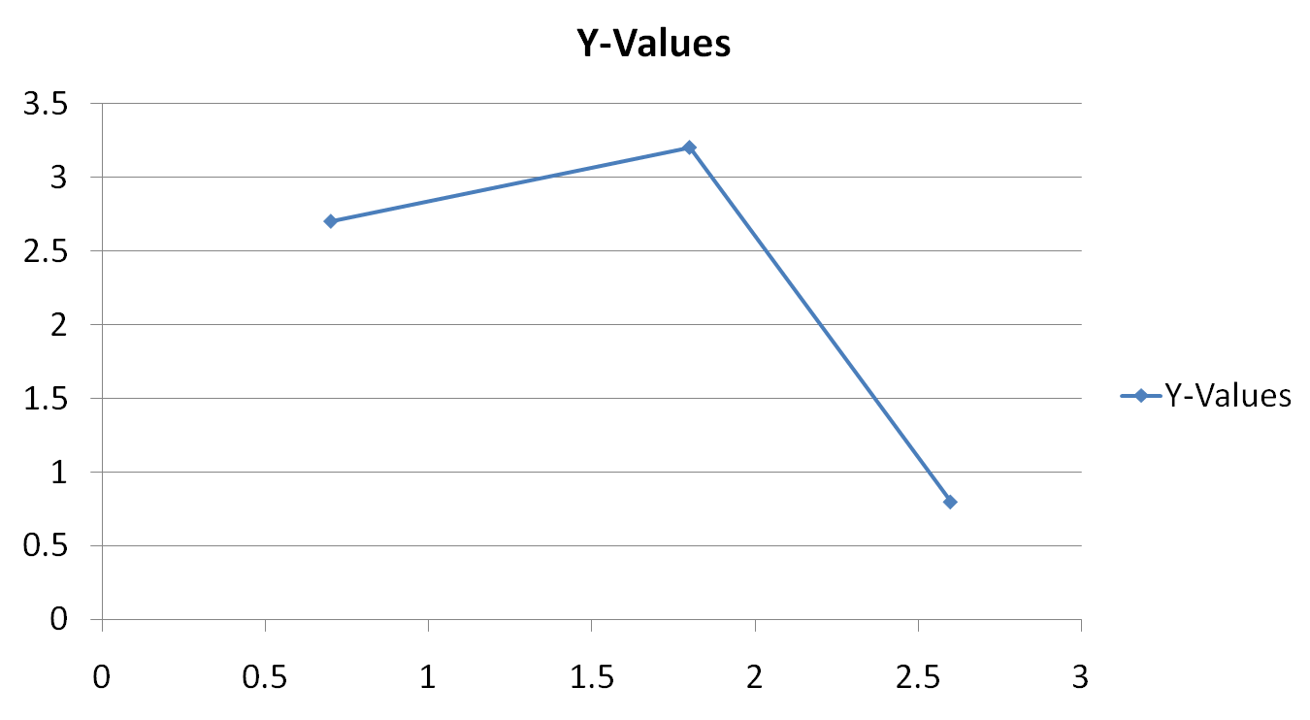

Slide 45
java
{Territory_Rep:"Lauren Ipsum", Actual:38805, Estimate:40000},
{Territory_Rep:"T.R. Smith", Actual:55498, Estimate:40000}]},
{Region:"Southern California", children: [
{Territory_Rep:"Alice Treu", Actual:44985, Estimate:45000},

Slide 46
<mx:Panel title="PrintAdvancedDataGrid Control Example"
height="75%" width="75%" layout="horizontal"
paddingTop="10" paddingBottom="10" paddingLeft="10" paddingRight="10">
<mx:AdvancedDataGrid id="adg"

Slide 47
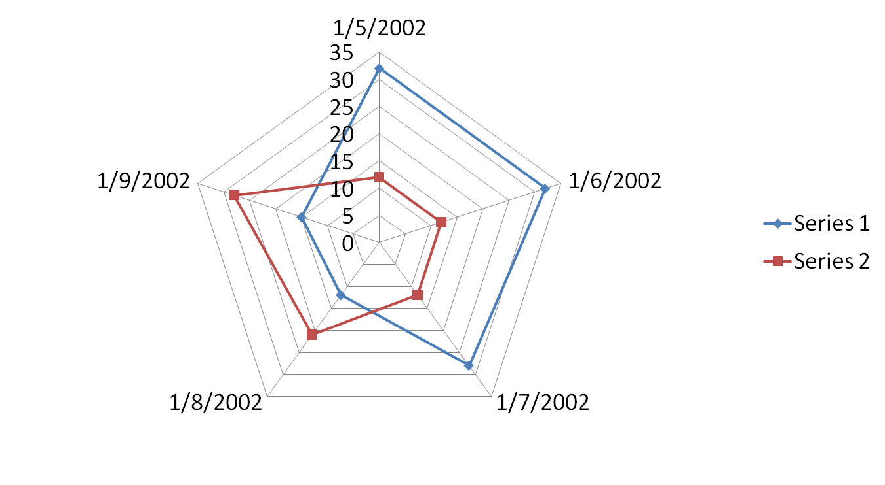

Slide 48


Slide 49
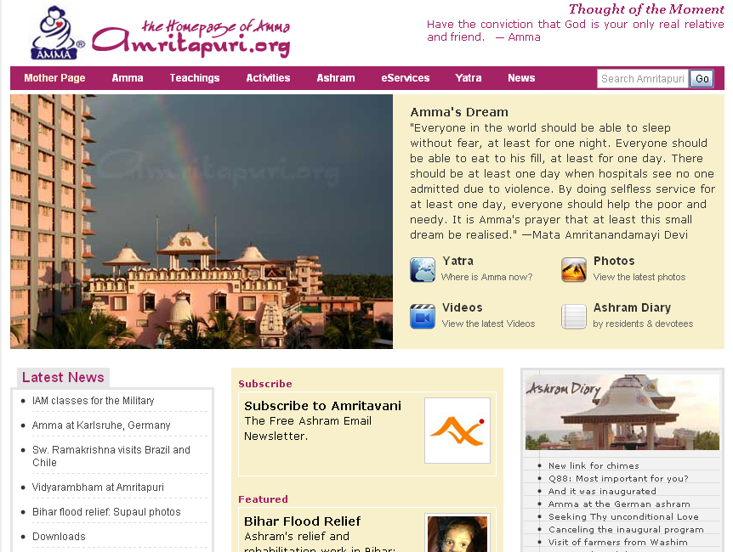

Slide 50
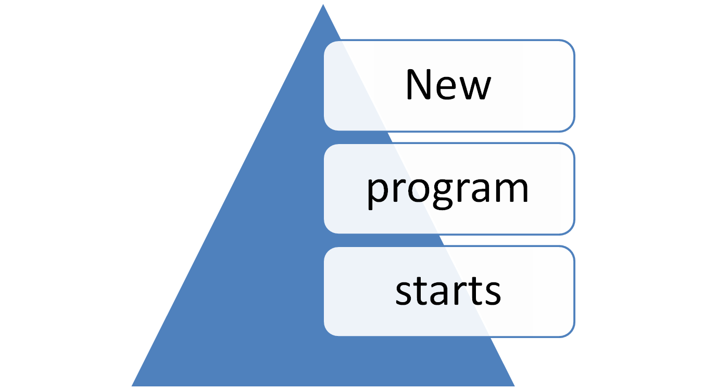

Slide 51
Sl no | Name | Age
1 | Sa | 23
2 | Klkdjfa | 22

Slide 52
Desktop/ Window Sharing

Slide 53
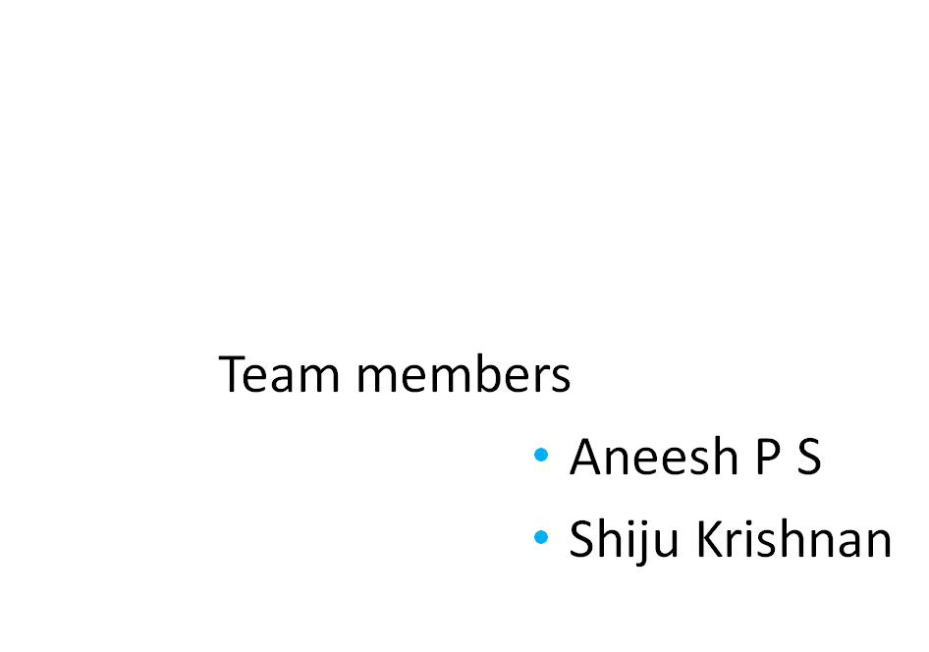

Slide 54
Introduction
Desktop/ Window Sharing will share
        a specified area of desktop
        entire desktop among number of client
        user.
Student – Teacher communication.
Platform Independent.

Slide 55
The shared window will be running on a host computer (trainer).
The shared content will be provided to other users by the host user (trainee).
Permission based software approach.
View Access –passively view the shared content.
remote users have no ability to edit .

Slide 56
scope
Teacher- student interaction.
Paper presentation.
E-education.
Possible to hide private areas.

Slide 57
Goals & Objectives
Desktop/ Window Sharing
        The remote user (trainee) can passively view the actions of the host (trainer) without being able to interrupt or manipulate the shared content.
Text chatting

Slide 58
Existing System
Remote desktop
  It share the whole desktop to the client users.
  It normally control one system at a time.
  No option for public sharing.
  The sharing is conducted through video streaming which uses high band width.
Camtasia Studio, TechSmith's Screen Recording Software
Marratech the screen capture

Slide 59
Proposed system
Desktop/window sharing
        It share the whole desktop as well as the selected area of desktop to the client users.
        The sharing is conducted through picture/ video streaming.
        There is an option for public text chatting.
        There is a facility for trainee’s to save the current streaming picture.

Slide 60
Modules
Screen selection.
Identifying the users in the network.
Sharing the window.
Text Chatting.

Slide 61
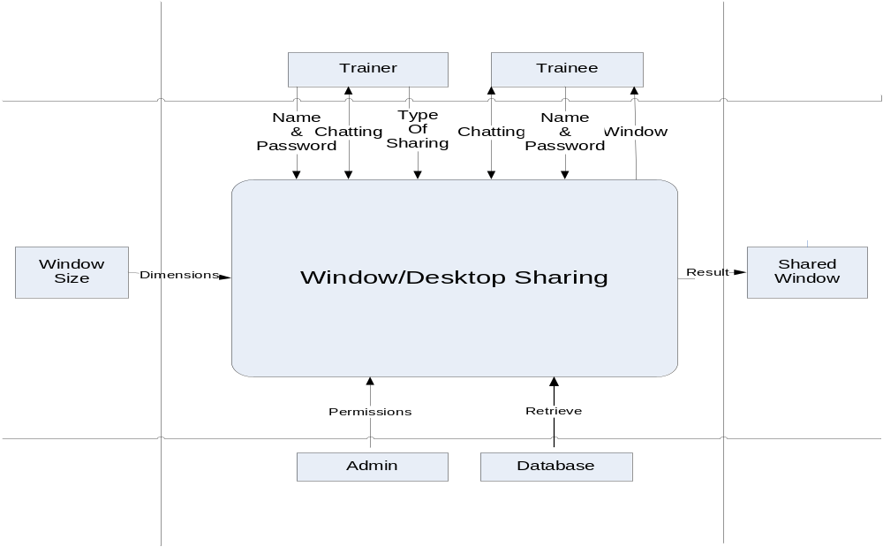
Context Diagram

Slide 62
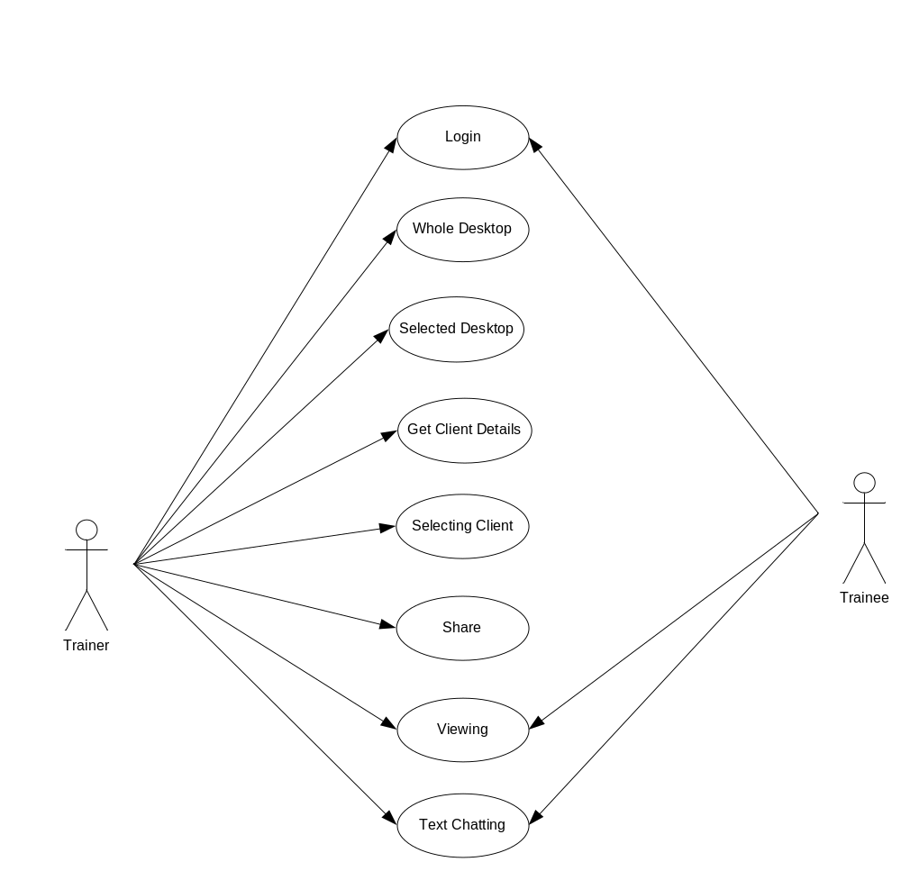
Use case Diagram

Slide 63
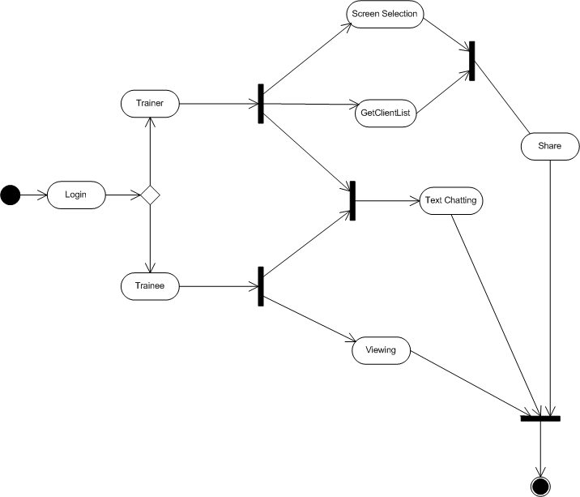
activity Diagram

Slide 64
User Database
Field | Data type
Name | String
Id | String
Class id | String
Password | String

Slide 65
Hardware Requirements
1 GB Ram (2 GB Recommended)
80 GB HDD
Pentium 4 Processor

Slide 66
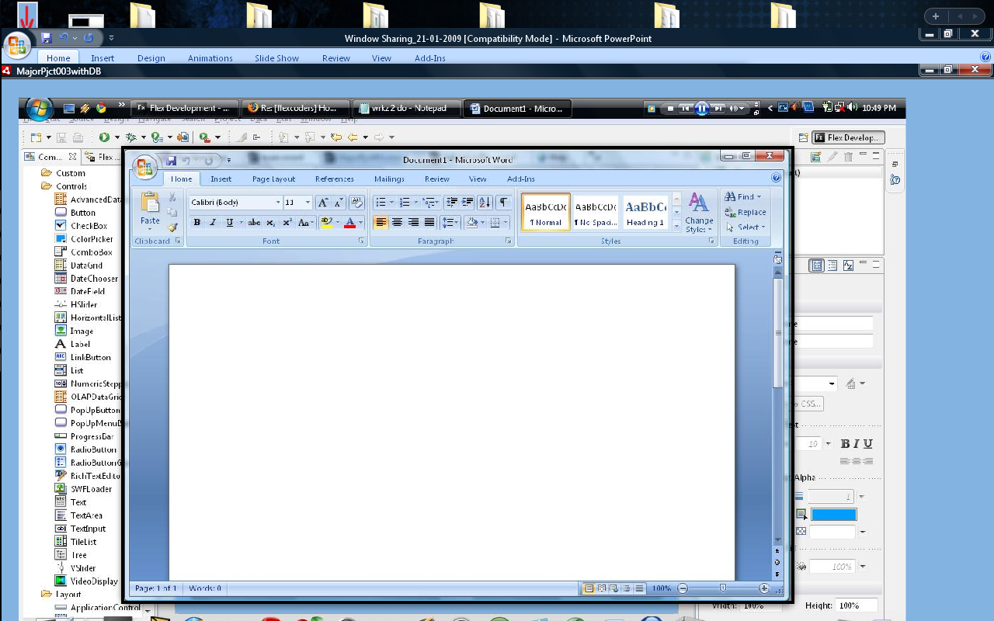
Screen Selection

Slide 67
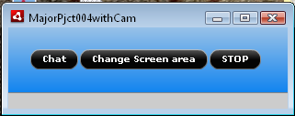
Capturing window

Slide 68
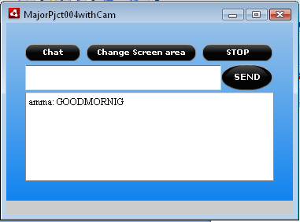
TEXT CHATTING

Slide 69
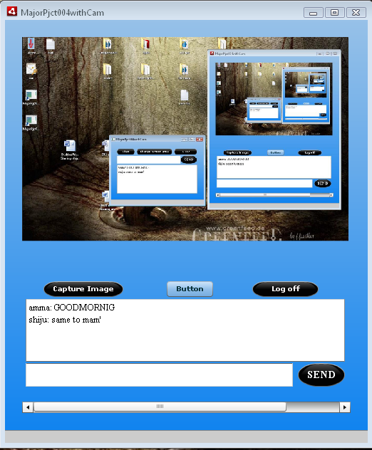
Student

Slide 70
Thank You

