Slide 1
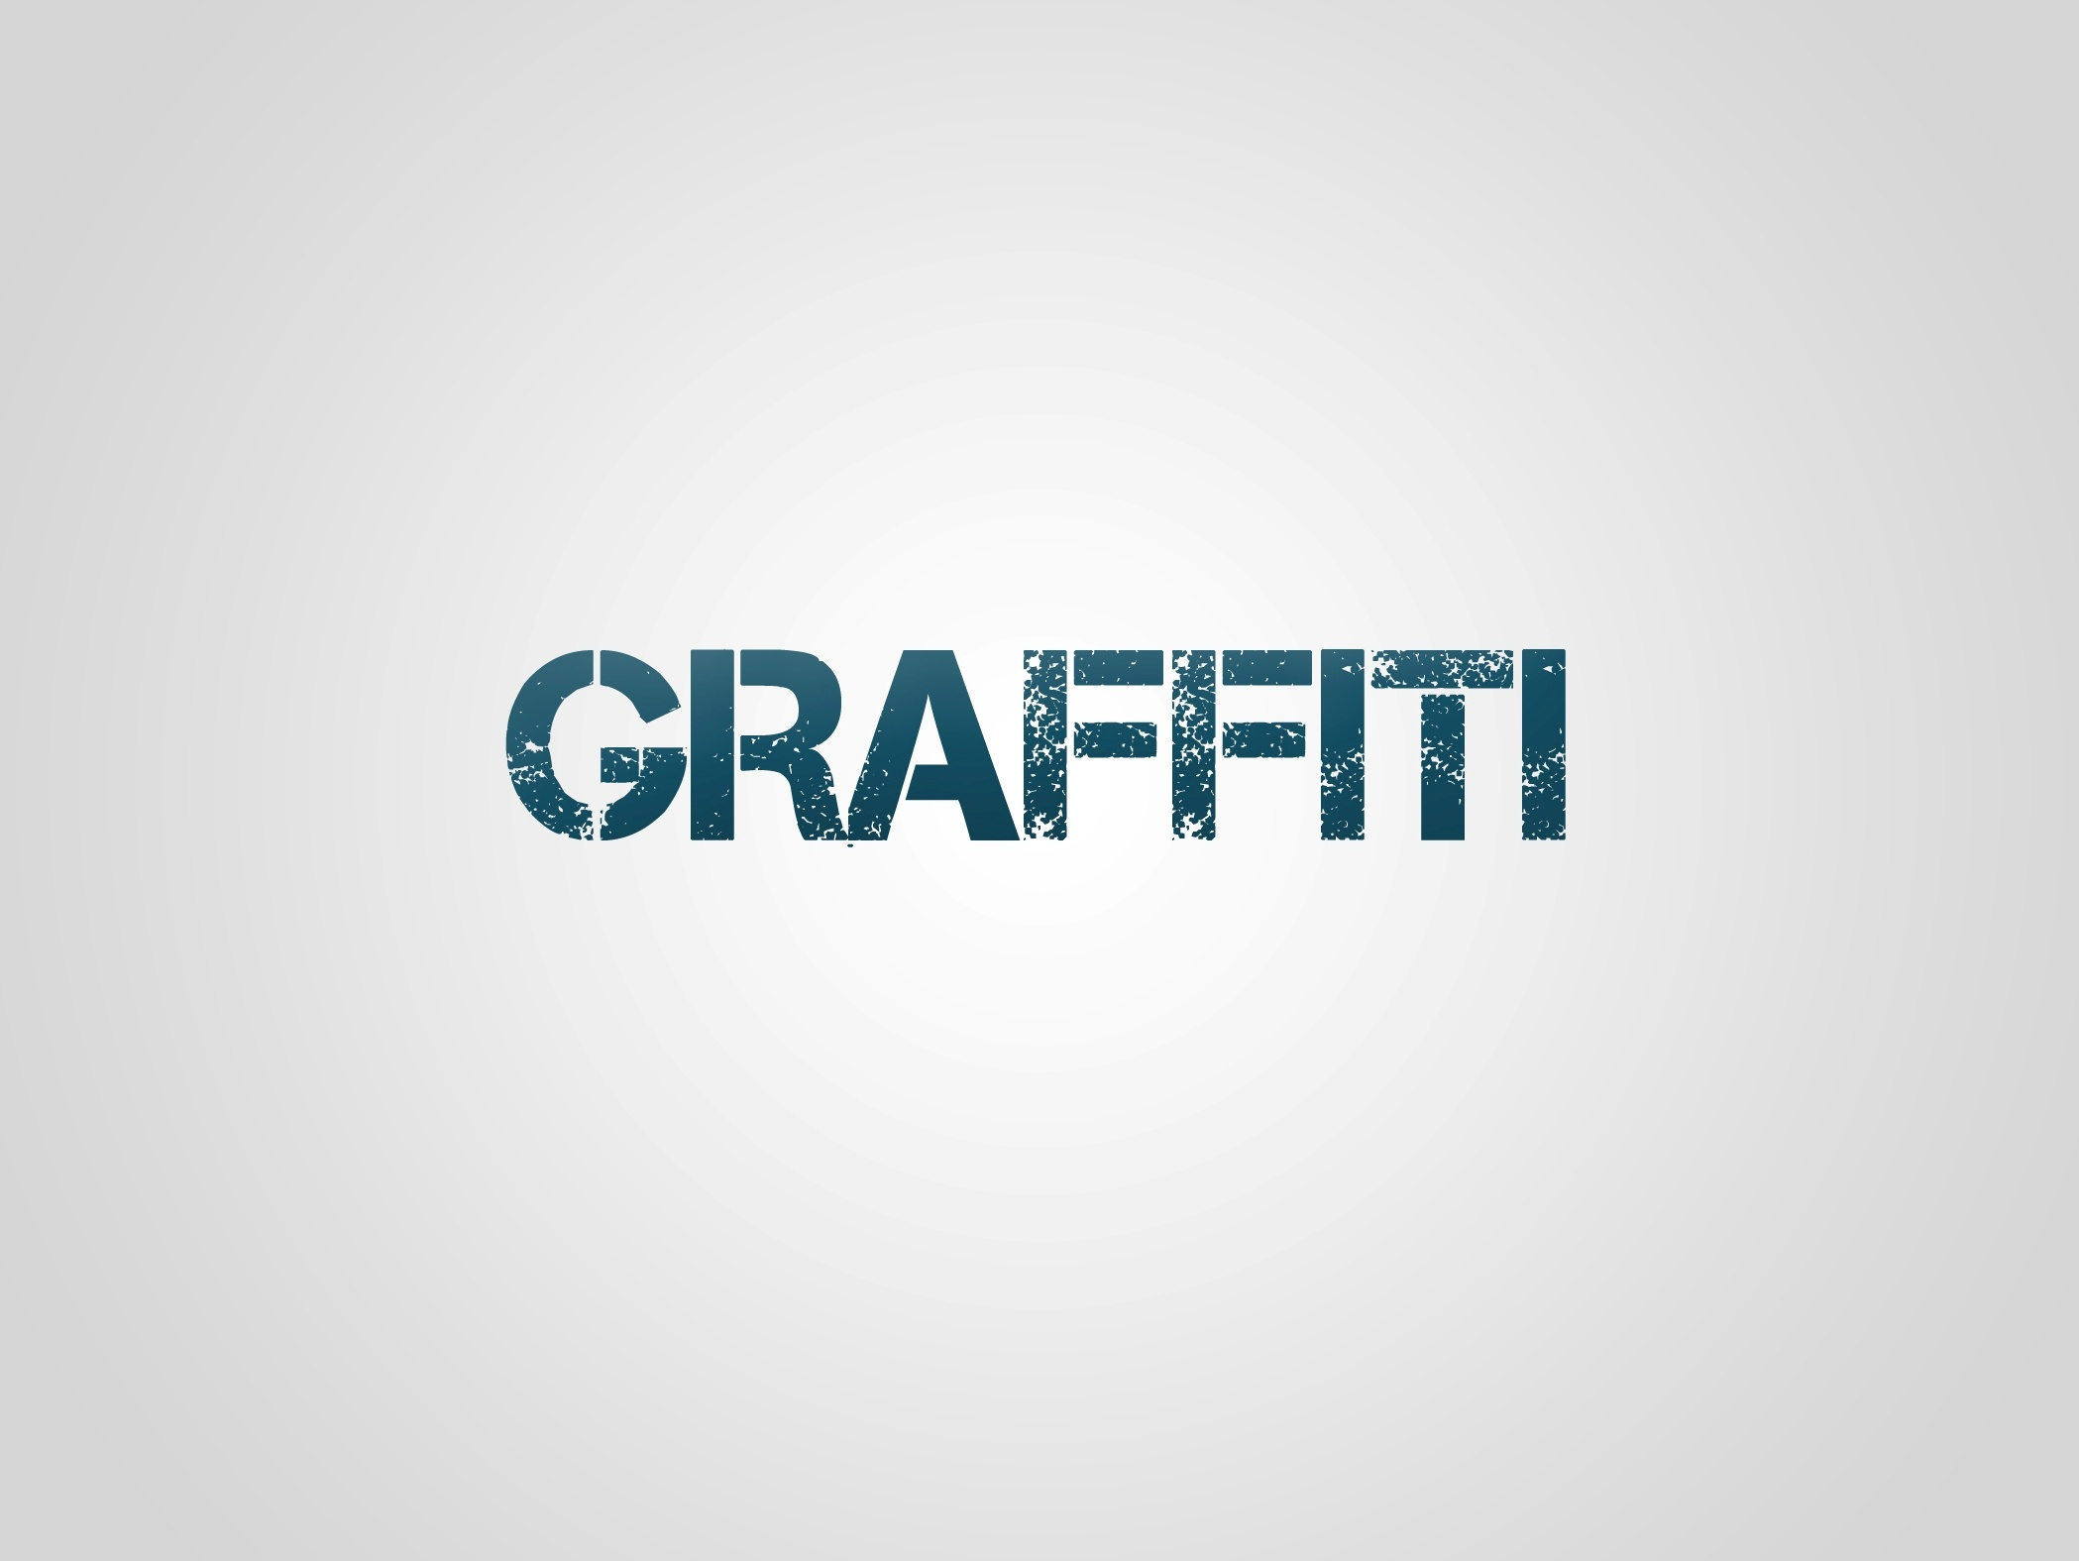
Portfolio

Slide 2
Print Ads

Slide 3
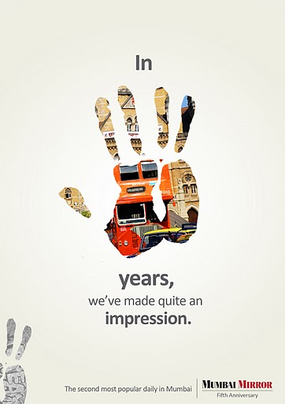
Award Winning ad made for Mumbai Mirror

Slide 4
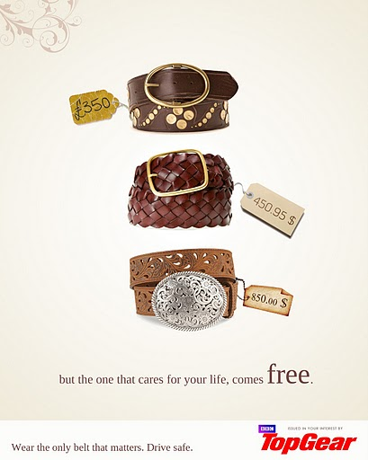
Award winning ad made for BBC TopGear

Slide 5
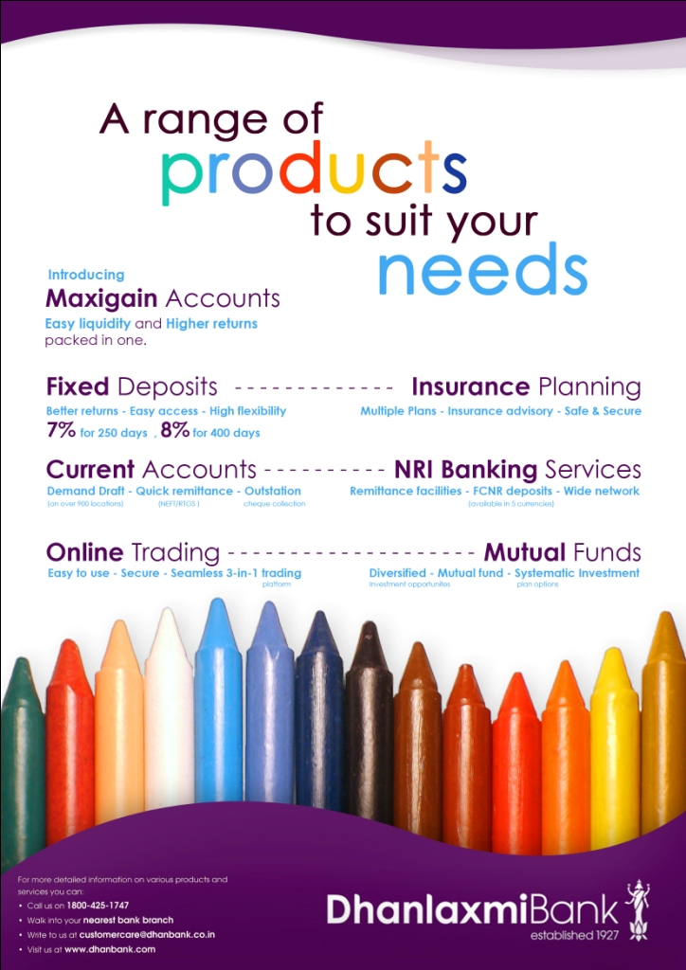
Ad made for DhanlaxmiBank

Slide 6
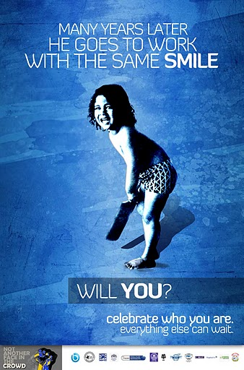

Slide 7
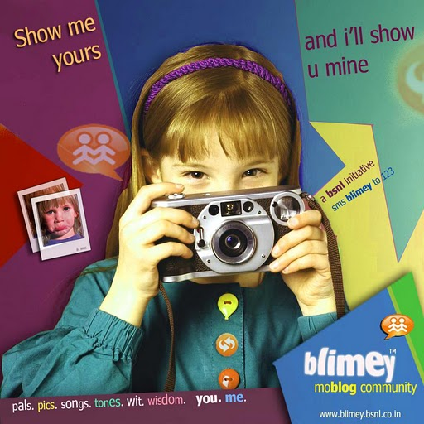

Slide 8


Slide 9
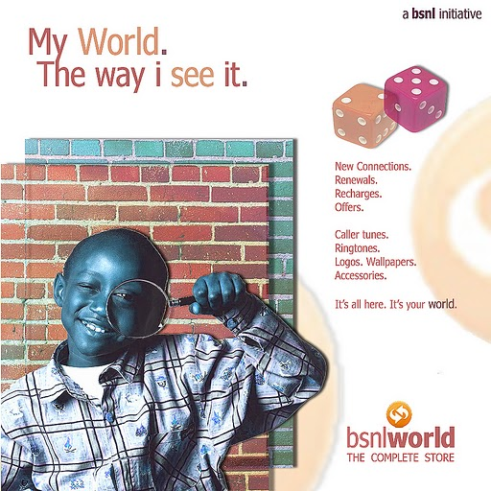

Slide 10
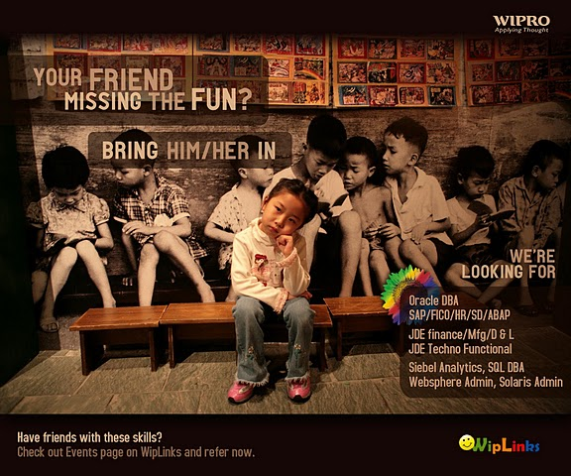

Slide 11


Slide 12


Slide 13
Viral Ads

Slide 14
Award winning viral ad made for Mumbai Mirror (Shift F5 to see the animation)

Slide 15
Logos

Slide 16

Logo designed for a friend’s start up, ‘ONAIR’

Slide 17

Logo designed for a ‘STARGEMS’

Slide 18

Logo Designed for Indian Railways

Slide 19
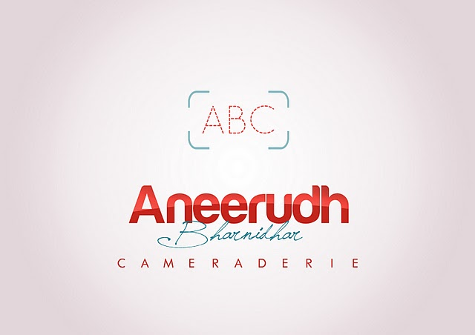
Logo designed for a friend’s photography portfolio

Slide 20

Logo designed for a friend’s firm, ‘Steps technologies’

Slide 21

Logo Designed for Sudanese Petroleum National Data Centre

Slide 22
Posters

Slide 23
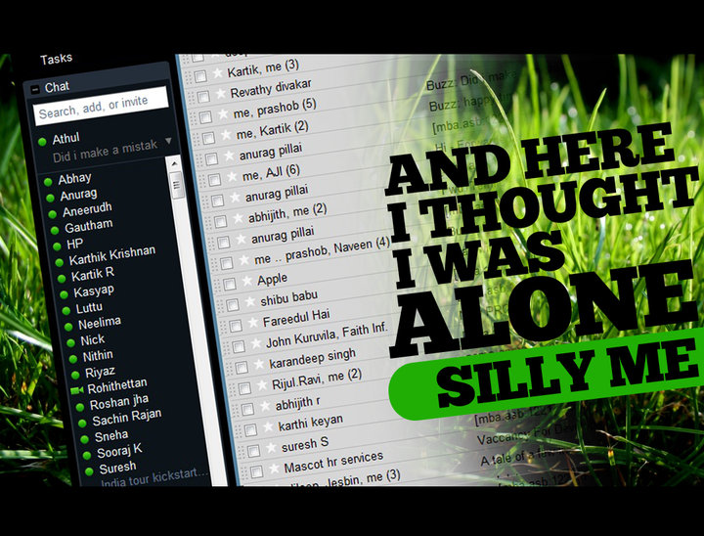

Slide 24
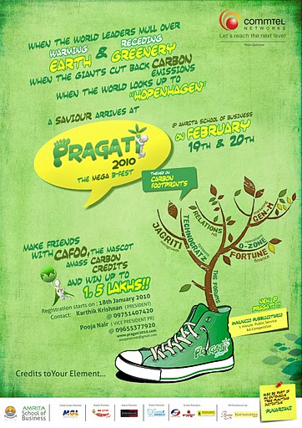
Poster designed for a B-Fest, ‘Pragati’

Slide 25
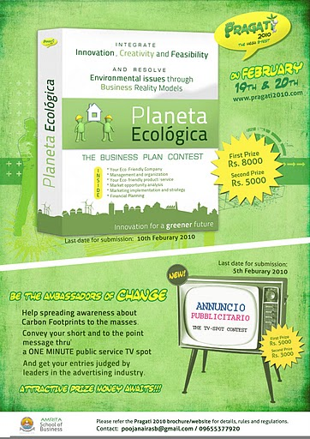

Slide 26
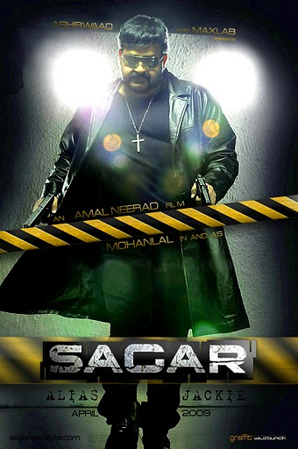
A Virtual Poster designed for a Movie, ‘Sagar Alias Jacky’

Slide 27
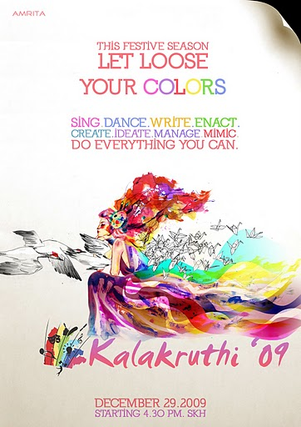

Slide 28


Slide 29


Slide 30
Brochures

Slide 31
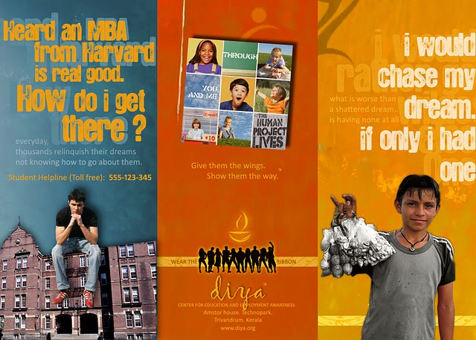
Brochure Designed for an Academic project in Amrita School of Business

Slide 32
Cards

Slide 33
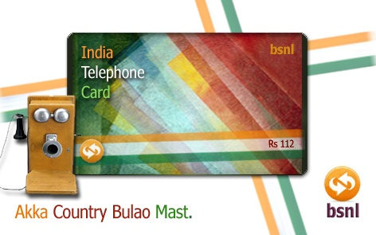
A Card designed for BSNL

Slide 34
Websites

Slide 35
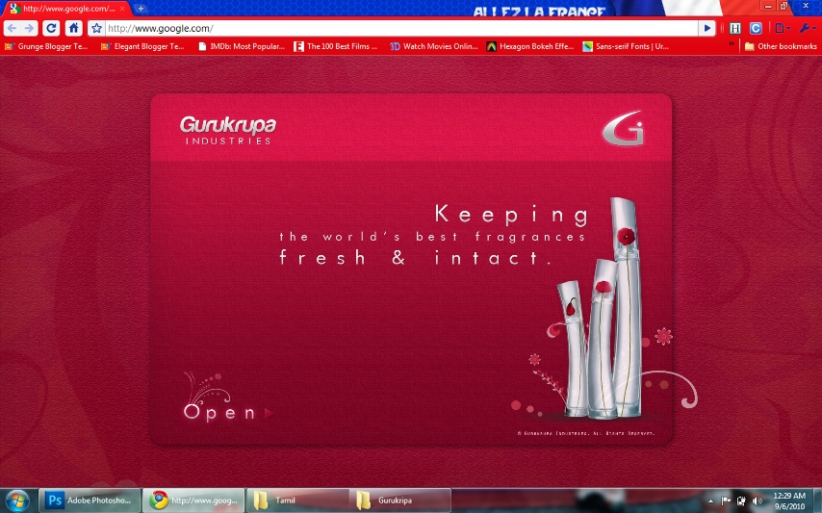

Slide 36
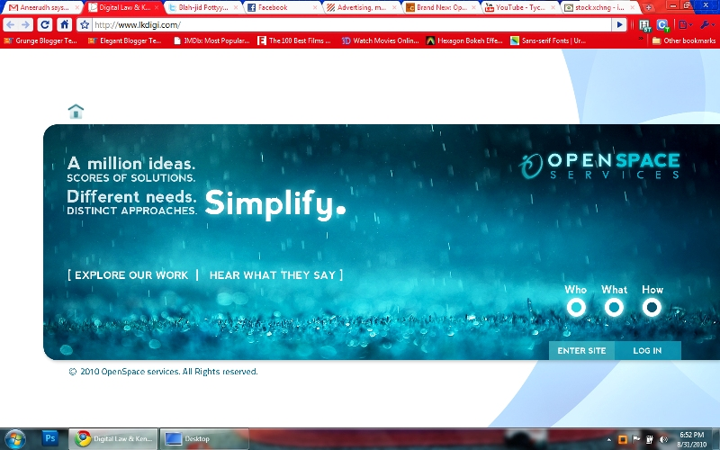

Slide 37
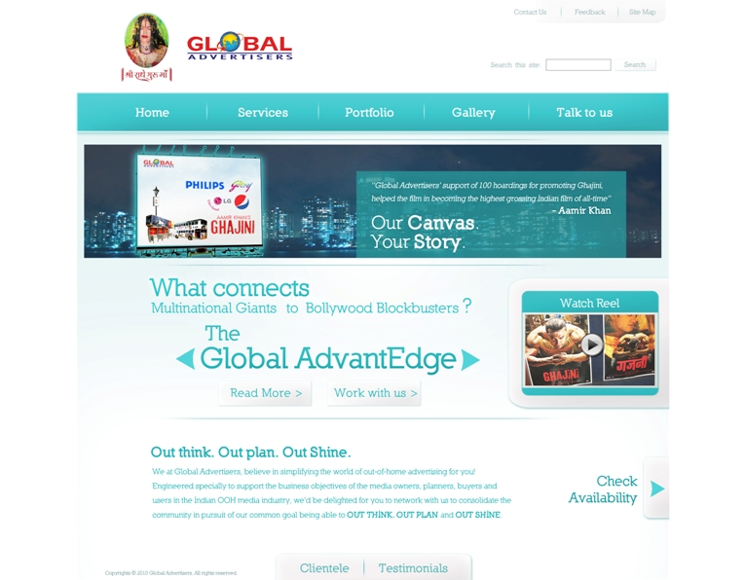

Slide 38
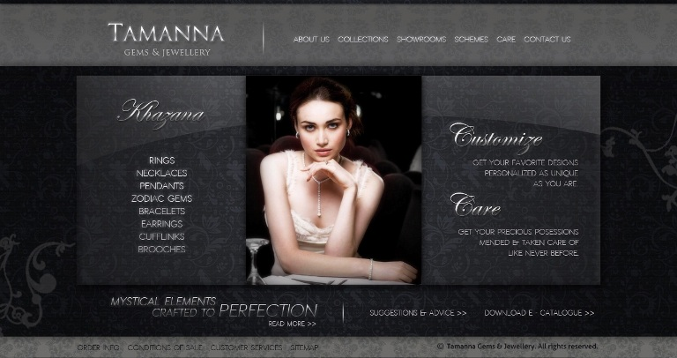

Slide 39
Thank You…
getgraffiti@gmail.com
+91 9539182337
Creatives by Athul Chathukutty

