Slide 1

Project Title -Seasonal Agriculture Performance Analysis
[Student Name:-Amrita Prashantkumar Gouda
College Name-Vishwbharti Girl College ]
AICTE STU ID : (STU6a6ca5d02c2061785505232)

Slide 2

PROBLEM STATEMENT
Agricultural activities are influenced by seasonal variations in environmental conditions, farming practices, resource availability and market conditions. As a result, agricultural performance may differ from one season to another. However, raw agricultural data does not clearly explain how agricultural performance changes across seasons or what patterns can be observed in different seasonal conditions. The problem is to analyze the given agricultural dataset and investigate seasonal differences in agricultural performance by identifying meaningful patterns, trends, relationships and variations within the available data.

Slide 3
Project Description
Seasonal Agriculture Performance Analysis is a data analytics project that examines agricultural performance across different seasons using Python. The project analyzes factors such as crop yield, rainfall, temperature, humidity, revenue, profit, water usage, and irrigation methods to identify seasonal trends and patterns. Data cleaning, visualization, and statistical analysis are performed using Pandas, NumPy, Matplotlib, and Seaborn. The insights generated from the analysis help understand seasonal variations, improve resource utilization, and support data-driven decision-making for better agricultural planning. This project is implemented in Google Colab using Python.

Slide 4

WHO ARE THE END USERS?
Farmers
Agricultural Researchers
Government Agencies
Agricultural Officers
Agribusiness Companies
Data Analysts
Students and Educational Institutions

Slide 5

Technology Used
Python
Google Colab
Pandas
NumPy
Matplotlib
Seaborn
CSV Dataset

Slide 6
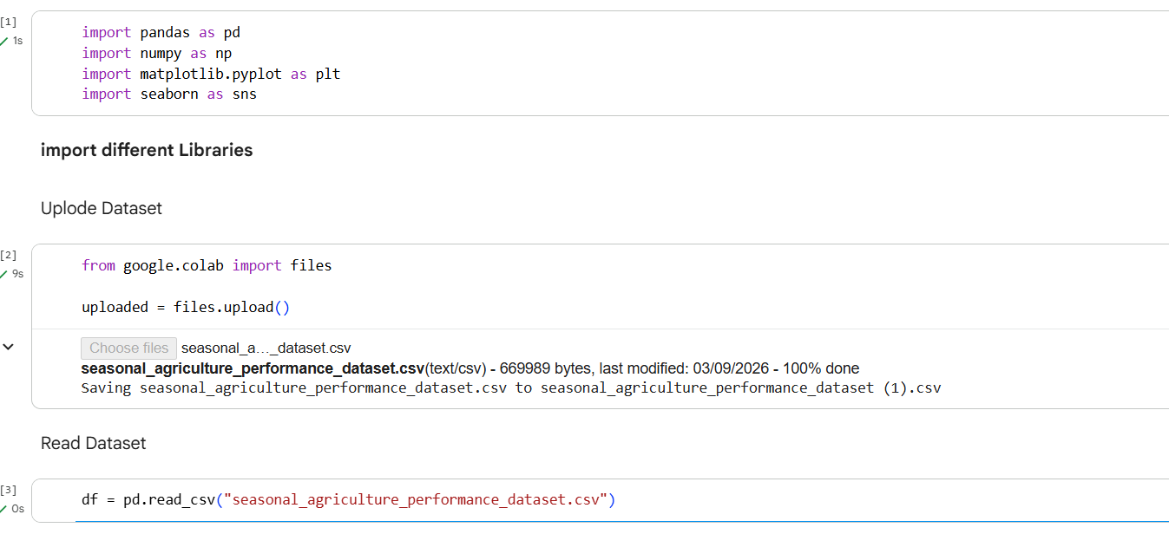
RESULTS
[In this slide I am import the dataset and different Libraries in google colab ] ]

Slide 7
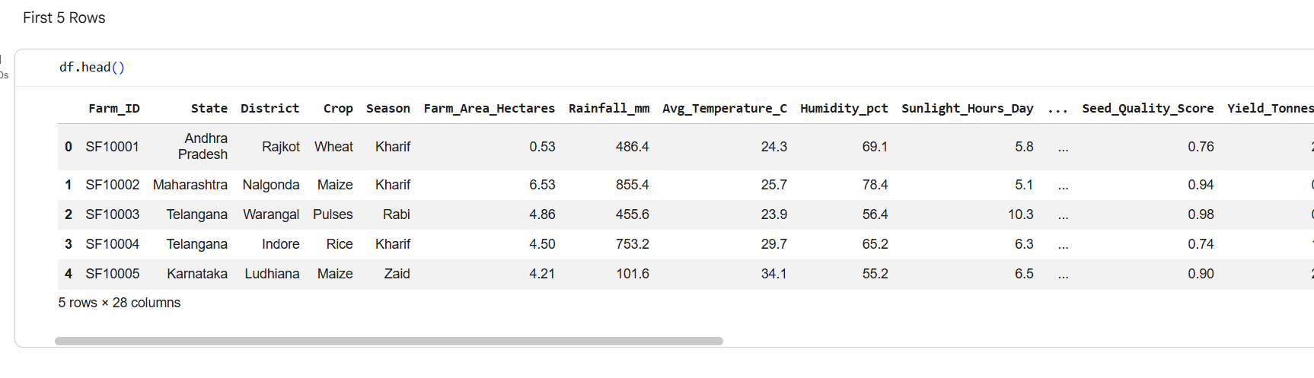
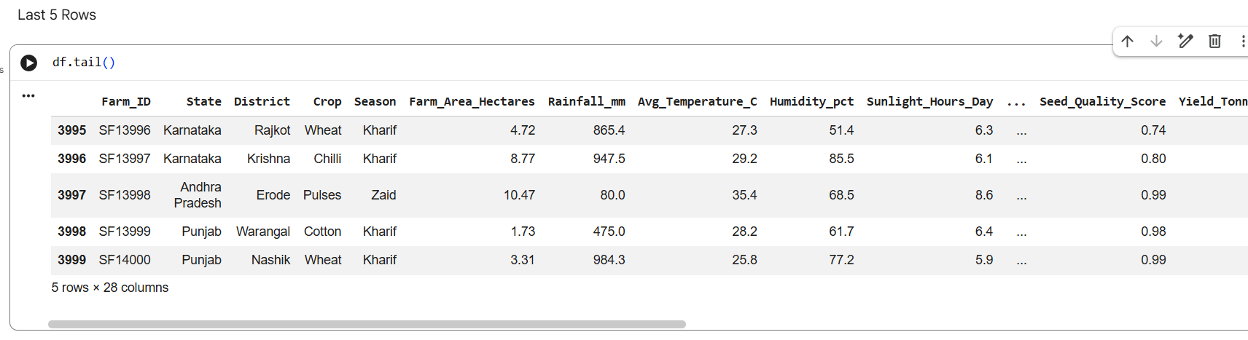
RESULTS
[In this slide we can saw first 5 and last 5 Rows ]

Slide 8
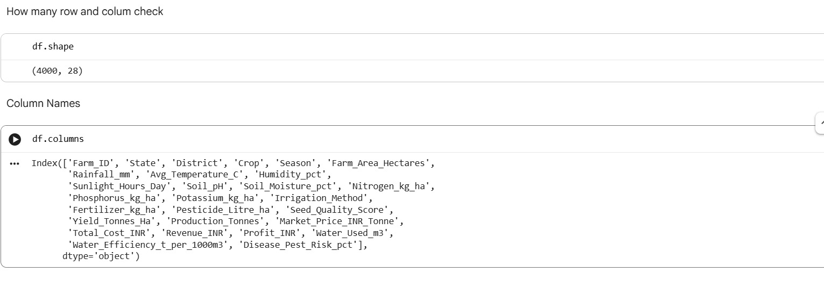
RESULTS
[in this slide we can saw how any row and colum inside the Dataset

Slide 9
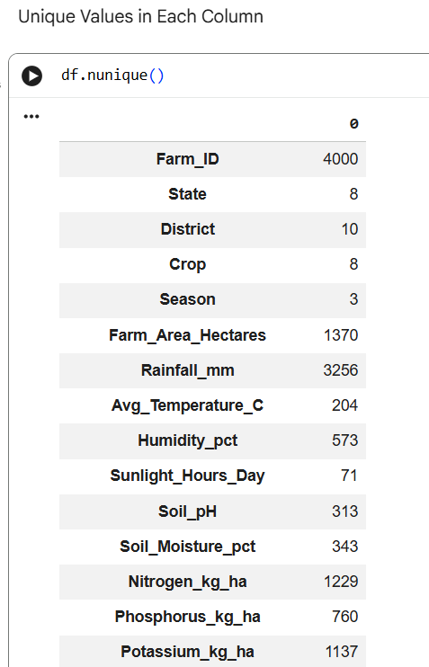
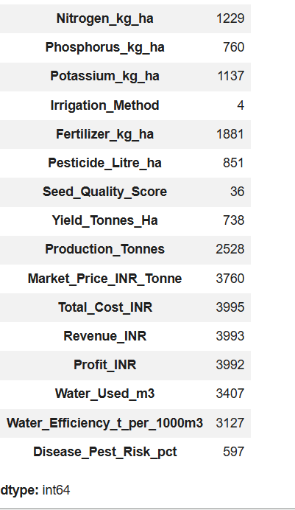
RESULTS
[In this slide we can check uniquw value each colum

Slide 10
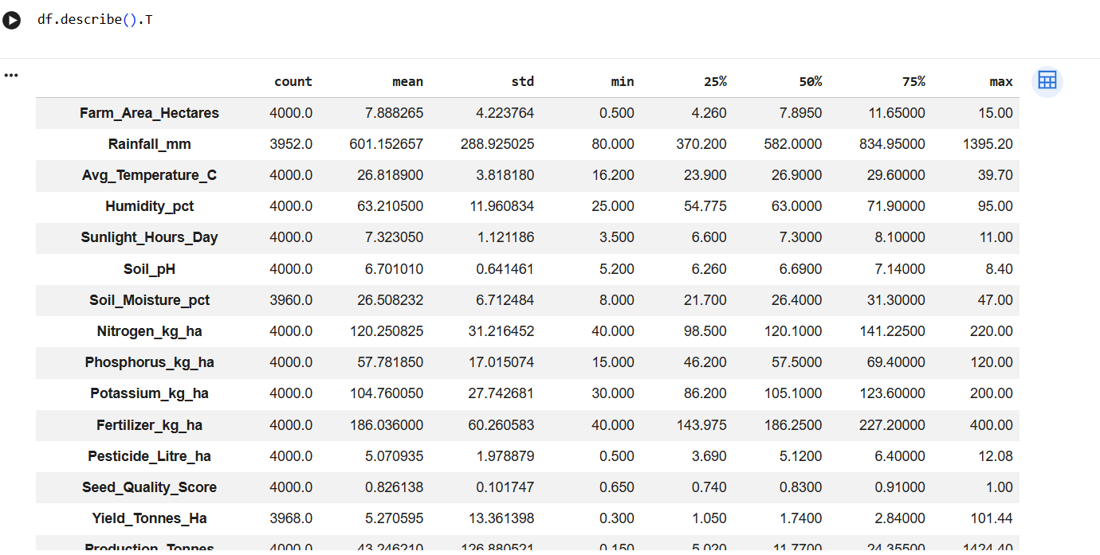
RESULTS
[In this slide be can check Check StatisticalSummary of Numerical Data]

Slide 11
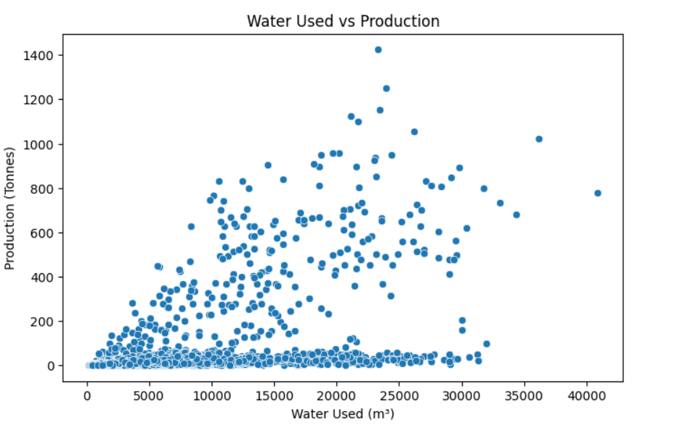
RESULTS
[ in this slide we can see the Water Used vs Production]

Slide 12
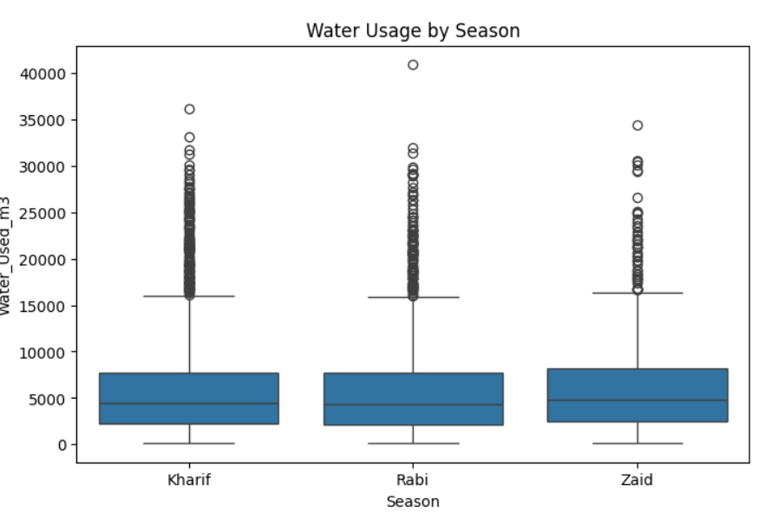
RESULTS
[ In this slide we can see the Water Used vs Production]

Slide 13
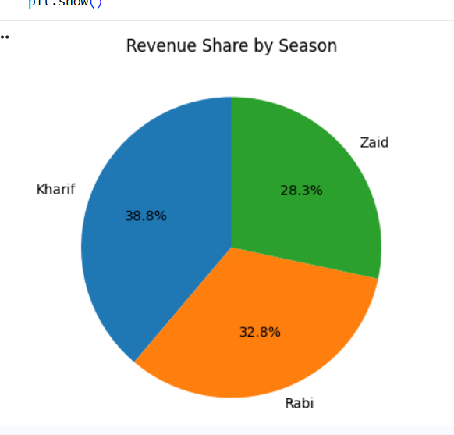
RESULTS
[in this slide Average Revenue by Season:-This pie chart represents the percentage share of average revenue contributed by each season]

Slide 14
Future scope
This project can be improved by adding real-time weather data and machine learning to predict crop performance. A mobile application and interactive dashboard can also be developed to help farmers access insights easily. In the future, AI and IoT technologies can be integrated to support better farming decisions and improve agricultural productivity.

Slide 15
GitHub Link

Slide 16
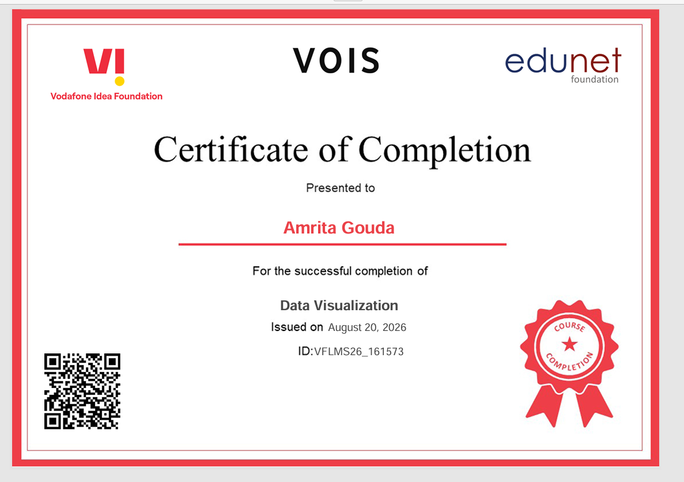
VOIS Course completion certificate -
Course name- Data Visualization

Slide 17
Thank you
.
.

