Slide 1


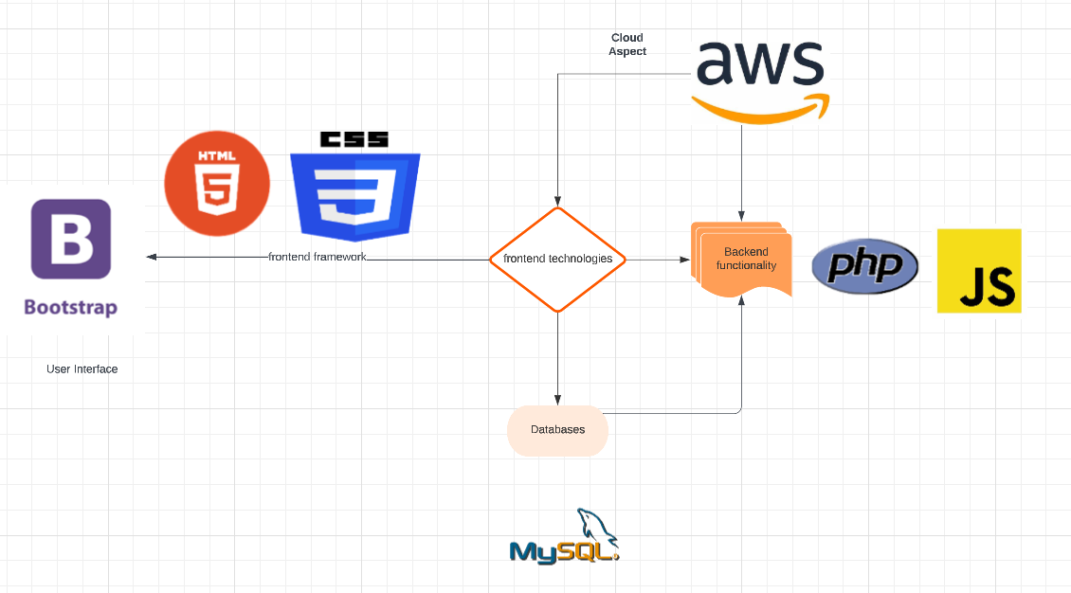
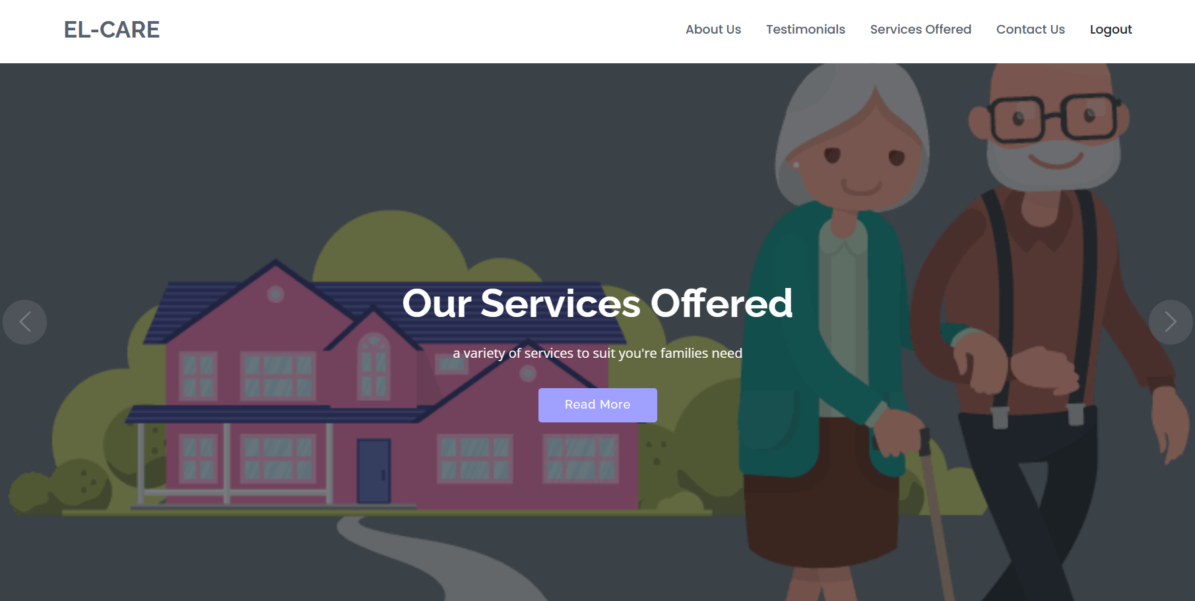







EL-CARE | BSc (Hons) in Computing in Cloud Computing
Amrita Giri
Supervisor : Tony Mc Carron
Dundalk Institute of Technology
Introduction
This is the world of Cloud Computing and AI, and we can only be a changing world along with it for our daily life usage
The purpose of this project to use multiple technologies along with a cloud aspect and give a solution to our users
The user can have their data safe in the database and use the application from any web browser
Project Architecture Diagram
Abstract
The main goal of this project is to build a scalable cloud-based web application that will allow the user to book services. This projects includes the need-to-know steps and features for doing a booking. The web application is called El care. As the web application will be hosted on cloud it can be accessed through a browser to avail the services.
Methodology
The El-Care website is developed in VS Code using Bootstrap and JS to create the web application as the core with the general features like the website structure/ look and buttons. The features and functionality are with PHP , JS and MySQL. El-Care will be hosted to EC2 Instances with AWS. This project code is designed to generate dynamic web contents
Conclusions / Discussions
From this project I learnt that
Time management is key in a project success
AWS EC2 Instances are a little difficult to understand but require practice to implement well
Being able to deploy the project and host it successfully will be a challenge
Completing the core project and reducing functionality is very important according to time constraint
Results
Technologies Used
Future Work
The future for El-Care is to create a mobile app that could be used by user for payment or subscription option for using the services. Using payment system like stripe or PayPal. Also, several login features with other credentials
Further Information
For more information on this project please contact me on :
Email : D00226038@student.dkit.ie
LinkedIn : Amrita Giri | LinkedIn

