Slide 1
Lending Club Case Study

Slide 2
Problem Statement
The objective is to analyze loan data to uncover patterns in loan issuance and identify potential business insights that can drive strategic decision-making.
A large online loan marketplace, facilitating personal loans, business loans, wants to understand the driving factors (or driver variables) behind loan default, i.e. the variables which are strong indicators of default.
Aim of the Case Study
The aim of the case study is to identify applicants who are likely to default using EDA(Exploratory Data Analysis).
A Data-Driven Approach to Understanding Loan Issuance Trends

Slide 3
Analysis Approach
Data Preparation: Data Understanding, Cleaning and preprocessing of the loan data.
Univariate Analysis: Investigated individual features such as loan amount, annual income, interest rate, etc.
Segmented Univariate Analysis: Analyzing a single variable within different subgroups of a dataset (e.g., Loan Amount segmented by Default Status).
Bivariate Analysis: Examined relationships between pairs of variables (e.g., loan status vs. interest rate).
Correlation Analysis: Measures the strength and direction of the relationship between variables.

Slide 4
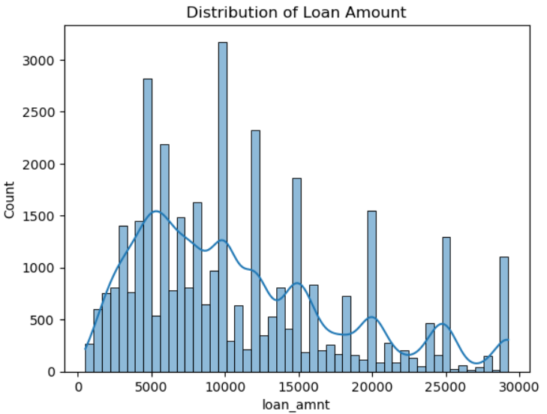
Univariate Analysis
Insights: The histogram reveals that the majority of loans are for smaller amounts, but there is also a notable presence of larger loans, reflecting varied borrowing requirements.
Business Sense: Given the higher loan amounts, the lender may need to refine their risk evaluation models to better manage the increased potential risks associated with these larger sums.

Slide 5
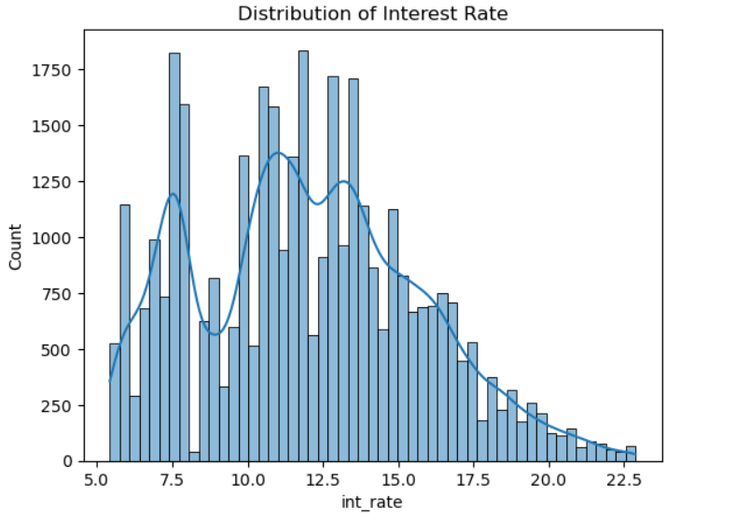
Univariate Analysis
Insights: The histogram reveals that most loans have interest rates centered around 12.5%, but there is a significant presence of larger loans with higher rates.
Business Sense: Higher interest rates typically indicate borrowers with increased risk. Therefore, the lender must be diligent in assessing the potential default risk across different interest rate brackets.

Slide 6
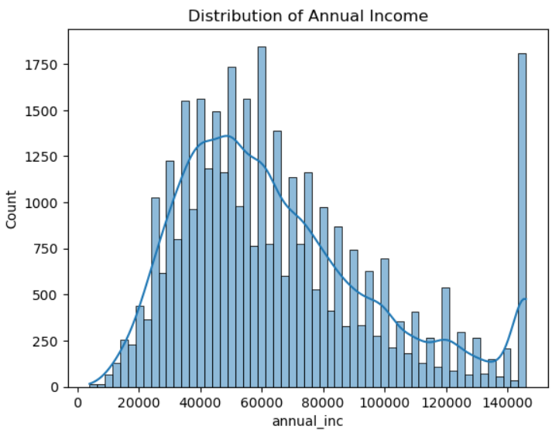
Univariate Analysis
Insights: The histogram indicates that while the majority of borrowers report incomes around 60,000, there is a considerable portion of borrowers with higher income levels.
Business Sense: Higher income borrowers might have lower default risk. The lender could use income as a factor in their credit risk assessment.

Slide 7
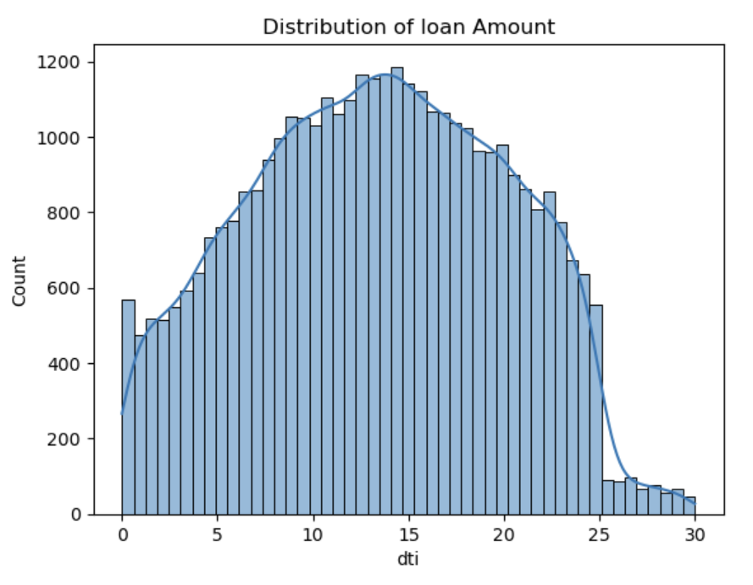
Univariate Analysis
Insights: The histogram indicates that although the majority of borrowers have a debt-to-income (DTI) ratio close to 15, there is a notable number of borrowers with higher ratios.
Business Sense: A higher debt-to-income (DTI) ratio is typically linked to an increased risk of default. The lender could incorporate DTI as a crucial element in evaluating credit risk.
Since elevated DTI ratios often correlate with greater default risk, lenders may consider using this metric as a key factor in their credit risk evaluation process.

Slide 8
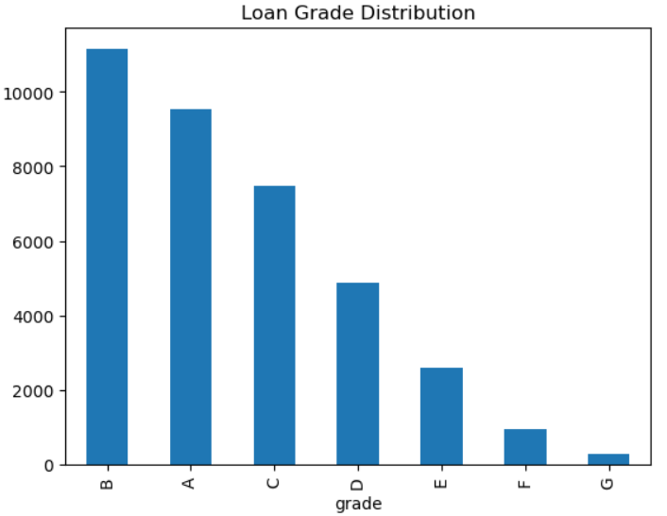
Univariate Analysis
Insights: The majority of loans are issued with grades B and A, indicating that most borrowers are considered to be in the lower-risk categories.
Business Sense: To minimize default rates and improve profitability, the lender appears to be focusing on lower-risk borrowers, which could be a strategic decision.

Slide 9
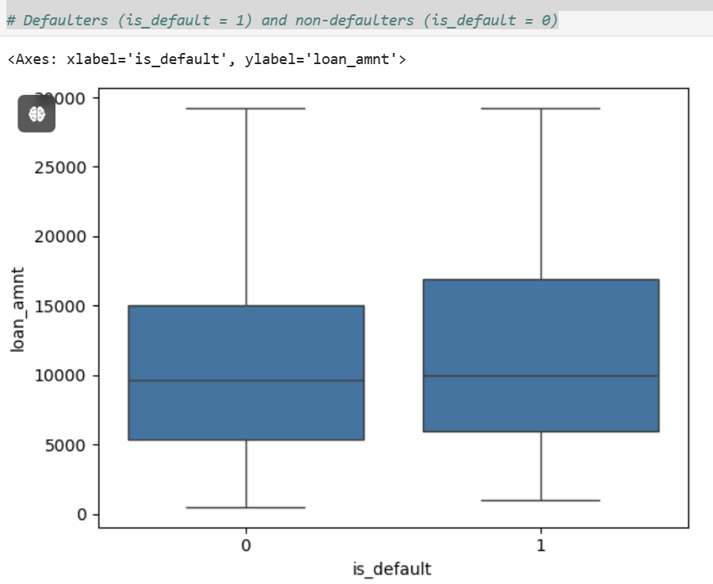
Segmented Univariate Analysis
Insights: The IQR(interquartile range) and overall spread of the data seems to be similar for both groups. This indicates that the variability in loan amounts is comparable btw defaulters and non defaulters.
Business Sense: While loan amount might not be a strong predictor of default on its own, it could be useful when combined with other factors.

Slide 10
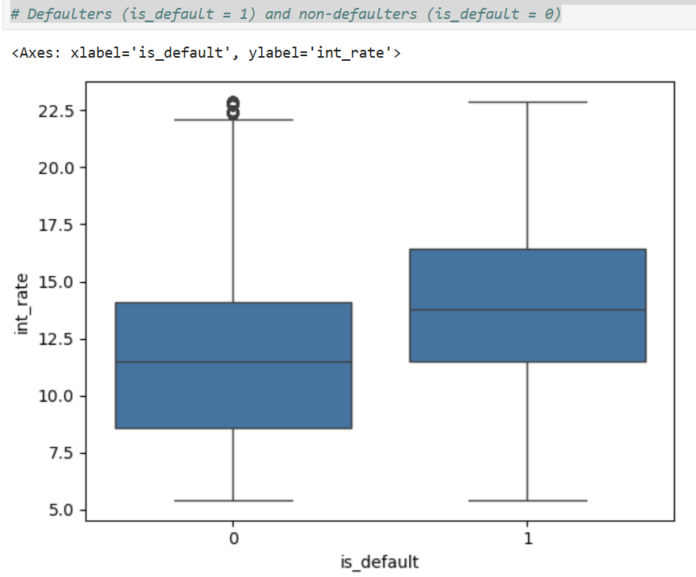
Segmented Univariate Analysis
Insights: The median interest rate of defaulters appears to be slightly higher than non defaulters. This suggests that borrowers who defaulted on their loans might have been charged higher interest rates.
Business Sense: The slightly higher median rate of defaulter suggests that interest rate might be a factor influencing default risk.

Slide 11
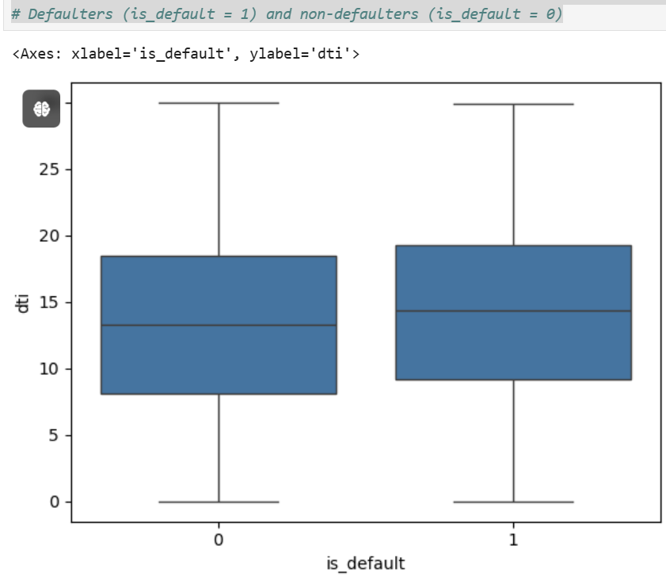
Segmented Univariate Analysis
Insights: The interquartile range(IQR) and overall spread of the data seems to be similar. This indicates that the variabilitiy in DTI is comparable between defaulters and non defaulters.
Business Sense: The lender could consider incorporating DTI into their credit risk assessment.

Slide 12
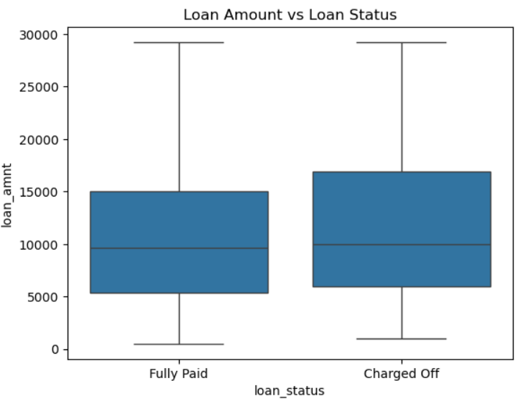
Bivariate Analysis
Insights: The median loan amount for 'Charged Off' loans appears to be slightly higher than that for 'Fully Paid' loans. This suggests that borrowers who defaulted on their loans might borrow larger amount.
Business Sense: The lender could consider incorporating loan amount into their credit risk assessment models.

Slide 13
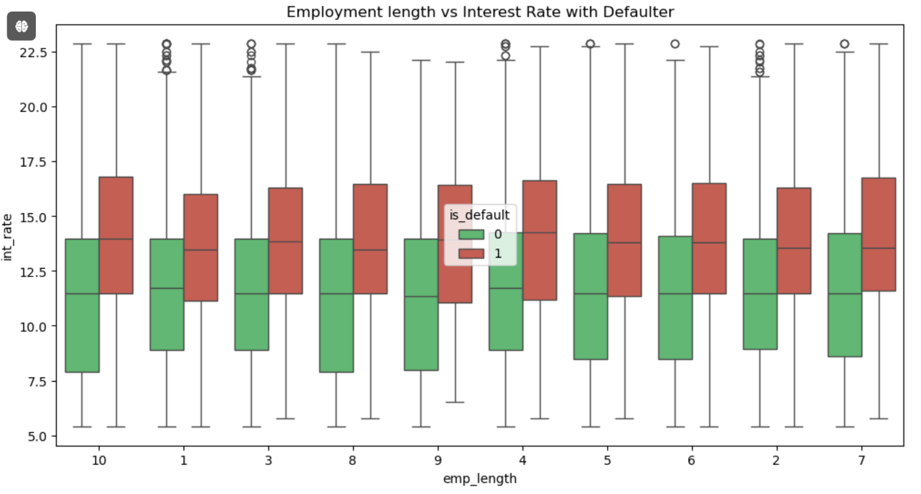
Bivariate Analysis
Insights: The boxplot reveals a minor overlap in interest rates between defaulters and non-defaulters across various employment lengths.
Business Sense: The lender might want to integrate employment length into their credit risk assessment models, especially if it demonstrates a correlation with other factors.

Slide 14
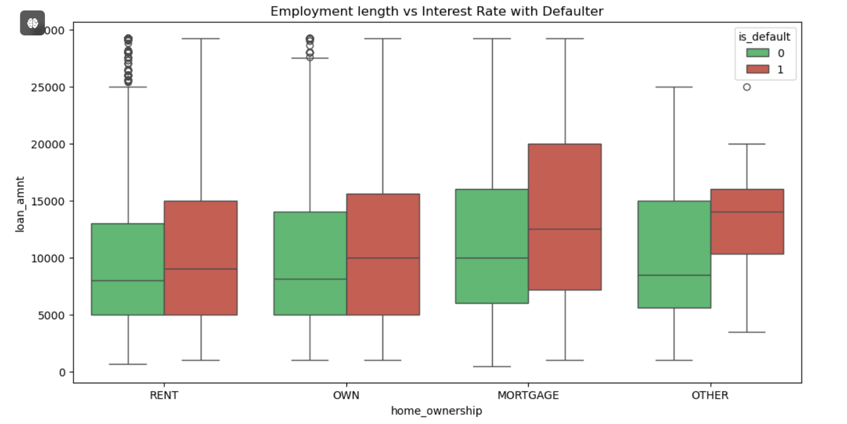
Bivariate Analysis
Insights: The median loan amount for the RENT and MORTAGE categories appear to be higher than the OWN and OTHER categories. This suggests that borrowers who are renting or having a mortage tends to borrow larger amounts.
Business Sense: The lender could consider incorporating home ownership into their credit risk assessment models, if it shows correlation with other variables.

Slide 15
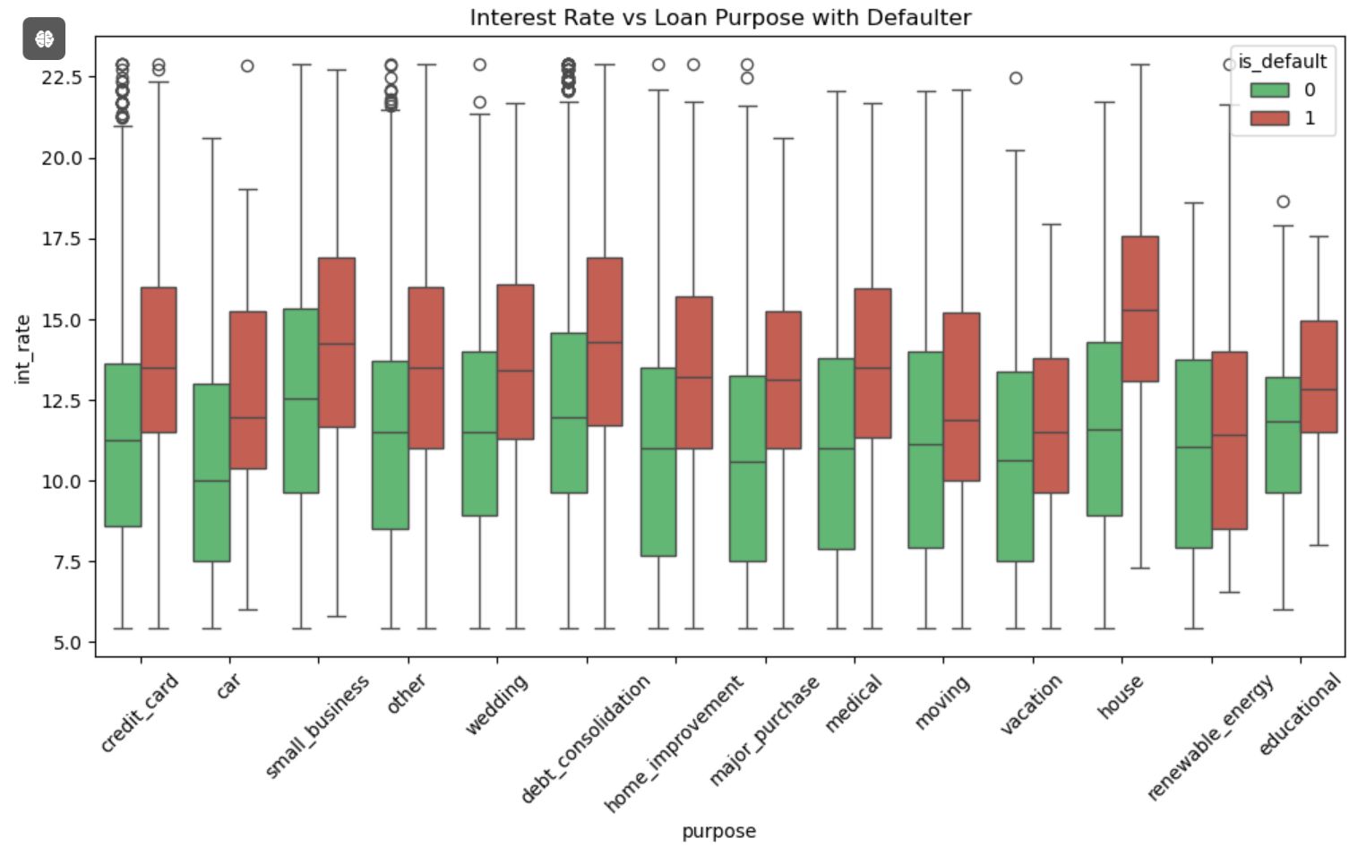
Bivariate Analysis
Insights: Interest rates vary slightly across different loan purposes, with some showing consistently higher or lower median rates compared to others.
Business Sense: The lender may want to factor in loan purpose when developing their credit risk assessment models.

Slide 16
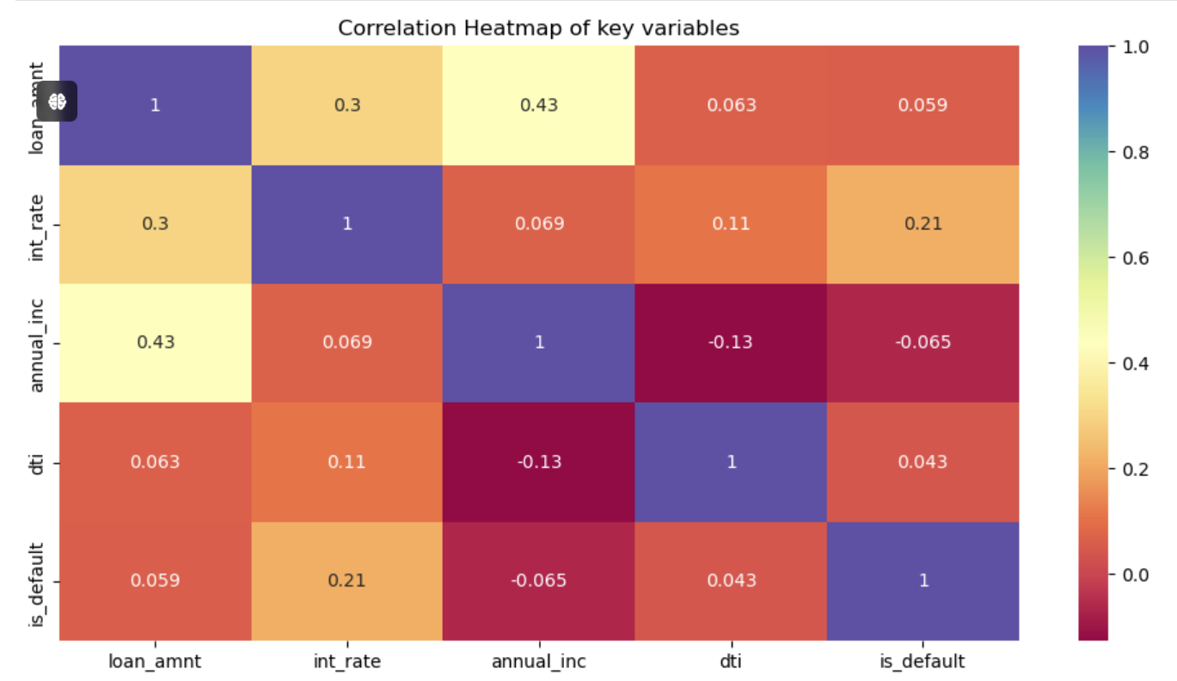
Correlation Analysis
Insights:
1.Strong Positive Correlation: loan_amt and annual_inc with correlation 0.43, suggesting that borrowers with higher incomes tends to borrow larger amount.
2. Weak Positive Correlations: loan_amt and int_rate with correlation 0.3, annual_inc and int_rate with correlation 0.069. Indicating borrowers with higher income or larger loan amounts could be charged higher interest rates.
3. Negative Correlation: annual_inc and is_default with correlation -0.065.
Business Sense: The lender could consider incorporating annual_inc and dti into their credit risk assessment models.

Slide 17
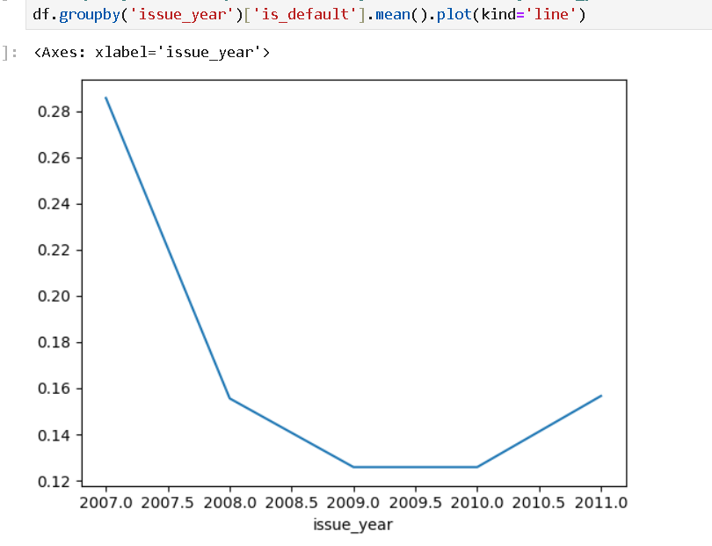
Date Analysis
Insights: The default rate seems to have dropped between 2007 and 2009, hitting its lowest in 2009, before rising slightly in 2010 and 2011.
Business Sense: The lender could examine the factors behind the decrease in default rates and use those insights to inform their product development strategies.

Slide 18
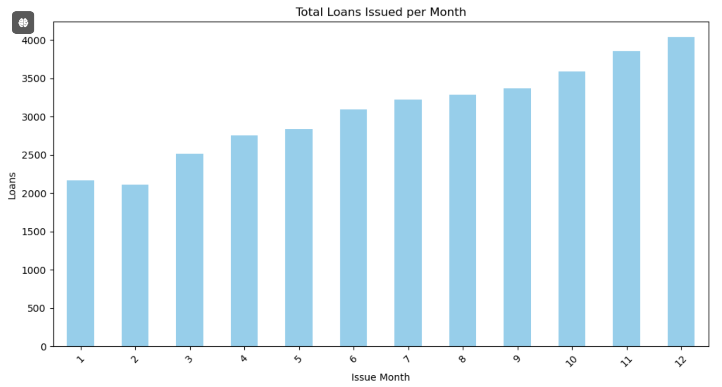
Date Analysis
Insights: The number of loans issued tends to rise steadily from month 1 to month 12, indicating an upward trend in lending activity over the course of the year.
Business Sense: The lender could investigate the factors behind the growing loan demand to uncover potential development opportunities.

Slide 19
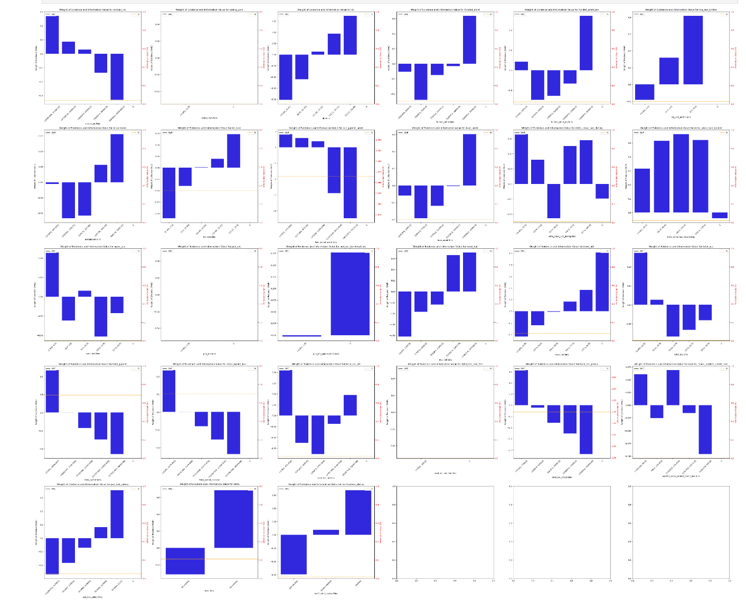
Weight of evidence (WoE)
In the example above, the bins with a significantly positive weight of evidence compared to other bins of the same feature have good predictive power for identifying defaulters.

Slide 20
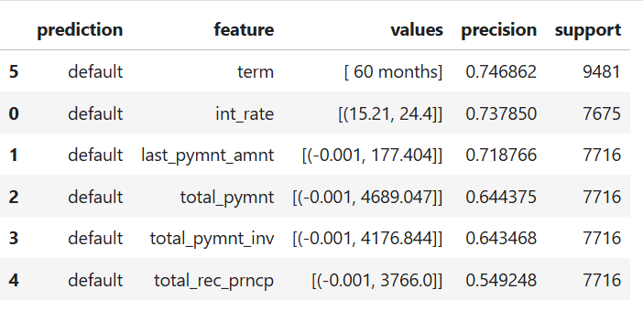
Loan Default Prediction
Term: Loans with a term of 60 months have a higher precision in predicting defaults (0.75).
Interest Rate: Higher interest rates (15.21% - 24.4%) also show significant precision (0.74) in predicting defaults.
Last Payment Amount: Smaller last payments (up to 177.40) have a notable precision (0.72) in predicting defaults.
Total Payment: Lower total payments (up to 4,689.05) and its components like total payment invested and total principal received show relatively lower precision in predicting defaults (0.64 and 0.55).

Slide 21
Conclusion
In this examination of Lending Club loan data, our objective was to uncover the primary factors impacting loan defaults through a detailed Exploratory Data Analysis (EDA).
The univariate and segmented univariate analyses indicated that variables like loan amount, interest rate, employment length, and debt-to-income (DTI) ratio are significant predictors of loan defaults. The bivariate analysis, which integrated these insights, reinforced our conclusions, showing that higher-risk borrowers often secured larger loans with elevated interest rates, coupled with shorter employment histories or greater financial obligations.

