Slide 1
PROJECTS
AMRITA SHUKLA

Slide 2
THESIS
“Traffic Signal Phase Timing Optimization using Machine Learning for reducing Traffic Congestion”
At present stage, the Scope of the Topic, related Literature Review and Proposed plan has been worked upon.
Real time traffic data can be incorporated using Map APIs into the simulation software to improve the applicability to real life.
Reinforcement Learning will be used for analysis

Slide 3
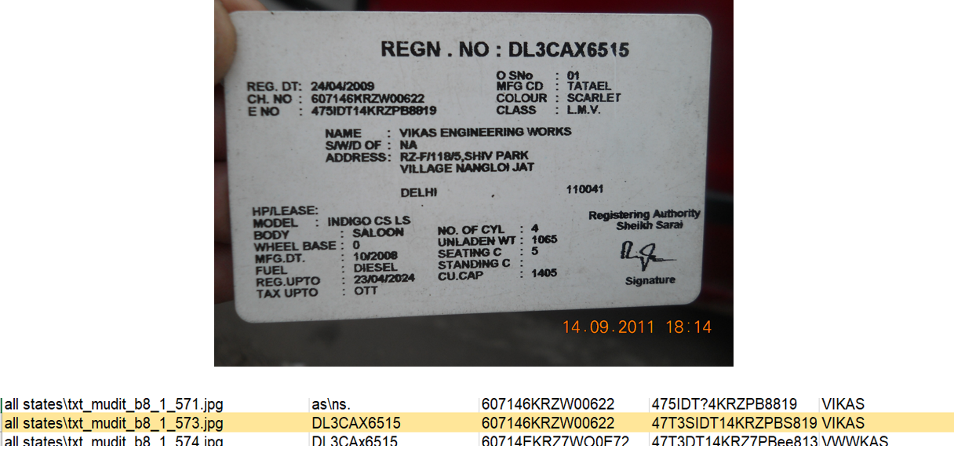
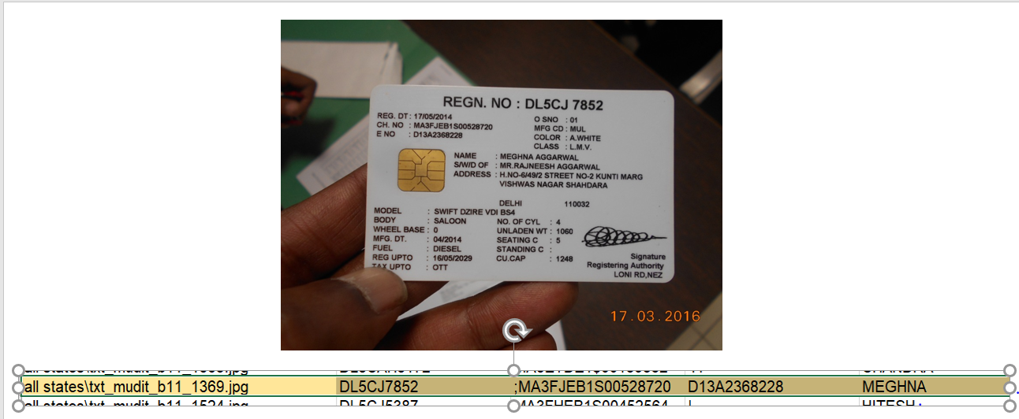
Driving License Reader
In this project, I have attempted to read Driving Licenses of various users and saving the vital information from it like User Name, Vehicle Reg.no, Chassis no etc.
Library used :
Pytessaract
OpenCV

Slide 4
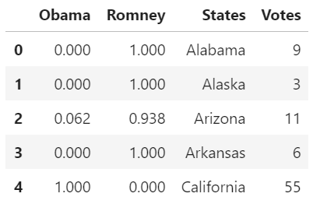
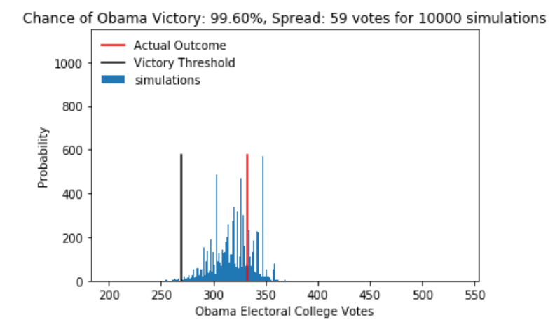
Probability Prediction for Covid 19 in people
Prediction of election results 2012 US Elections
Training dataset had close to 25 features for prediction
Using feature selection based on f test (features with p value less than 0.2 were selected)
Then the model was trained using those features
NN was created to predict the probabilities.

