Slide 1

SMART LIBRARY MANAGEMENT SYSTEM
Internship Project
Submitted to: Mr. Harshit Raj
Presented by: Amritansh Krishn Asthana (AL-3A)
Domain: AI-ML

Slide 2
ACKNOWLEDGEMENT
My heartfelt gratitude to my Course Coordinator Er. Aayush P. Singh and my Internship Instructor Er. Harshit Raj for providing me with the golden opportunity to present my project on Artificial Intelligence and Machine Learning.
It is truly a pristine honor for me to learn, develop and deploy the revolutionary concepts of Artificial Intelligence together with my Instructor and equip myself with both theoretical and practical knowledge. This Internship paved a way for me in exploring the bigger boundaries of AI.
A warmful regard and acknowledgement to my mother and colleagues who inspired and aided me in fulfilling this assignment in the nick of time.

Slide 3
TABLE OF CONTENTS
01
Topics Covered During Internship
02
Problem Statement
03
Smart Library Management System
04
Project Demonstration
05
Conclusion

Slide 4

TOPICS COVERED DURING INTERNSHIP
Introduction To Artificial Intelligence:
Introduction to the topic being taught. Roadmap and tools to be used.
Programming In Python:
A programming language for creating machine learning models was taught.
Data Analysis:
How raw data is managed, cleaned, processed for machine learning algorithms.
Machine Learning:
Machine Leaning introduction and algorithms and hands-on work on projects.

Slide 5
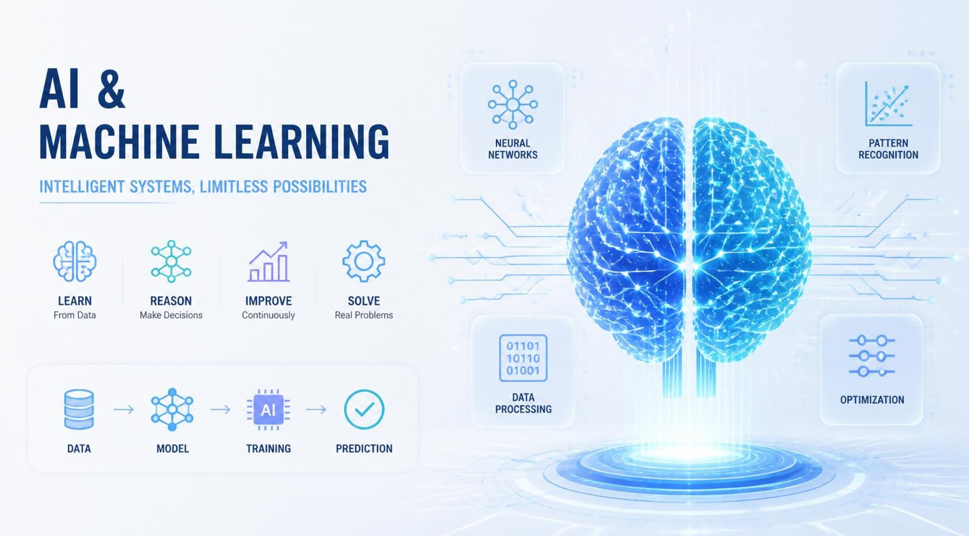

Slide 6


PROBLEM STATEMENT
Current library operations suffer from inefficient book tracking, high administrative overhead, and poor user engagement due to fragmented processes.
Specifically, the library faces three critical challenges:
OPERATIONAL INEFFICIENCIES: Manual book checkout, return, and catalog searches lead to long
wait times and frequent errors in inventory logs.
LACK OF REAL-TIME VISIBILITY: Members cannot easily check book availability, hold status, or due dates remotely, leading to missed return windows and unexpected late fees.
INADEQUATE REPORTING & INSIGHTS:
Administrators lack automated tools to track popular genres, member activity trends, fine collection
analytics, or lost/damaged inventory.

Slide 7
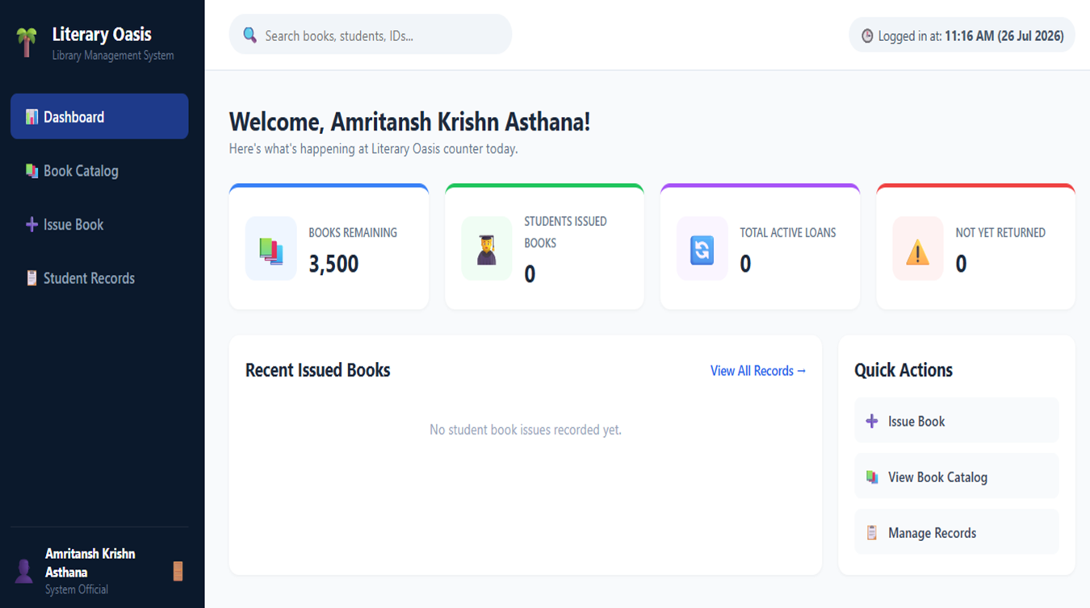
SMART LIBRARY MANAGEMENT SYSTEM

Slide 8

PROJECT DEMONSTRATION
The Smart Library Management System works on the concepts of Machine Learning where in you can register yourself as a member and allocate the records of books being issued or sold and the duration left for return. It only requires the face recognition of the individual issuing the book and his/her college/institute details.

Slide 9
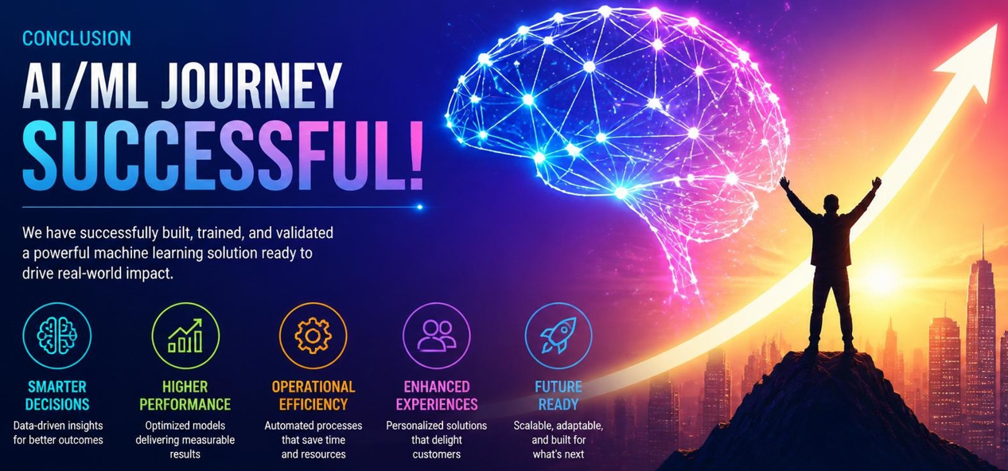
CONCLUSION
A PICTURE IS WORTH A THOUSAND WORDS

Slide 10
The Internship Program has provided me with deep insights on development of real-world Artificial Intelligence and Machine Learning projects and inspired me to discover and learn more. It provided me with skills not taught in classrooms and bring up a better version of myself.
Thank You

