Slide 1
SecureMe-Platform to Secure your Daily Life
Submitted by:
Amritanshu Kumar
Ritesh Singh Kushwaha

Slide 2
Introduction
Digital data security is a growing concern.
SecureMe is a lightweight, local platform for securing files, passwords, and notes.
Developed using Python Flask Framework.
Uses encryption algorithms for confidentiality and protection.

Slide 3
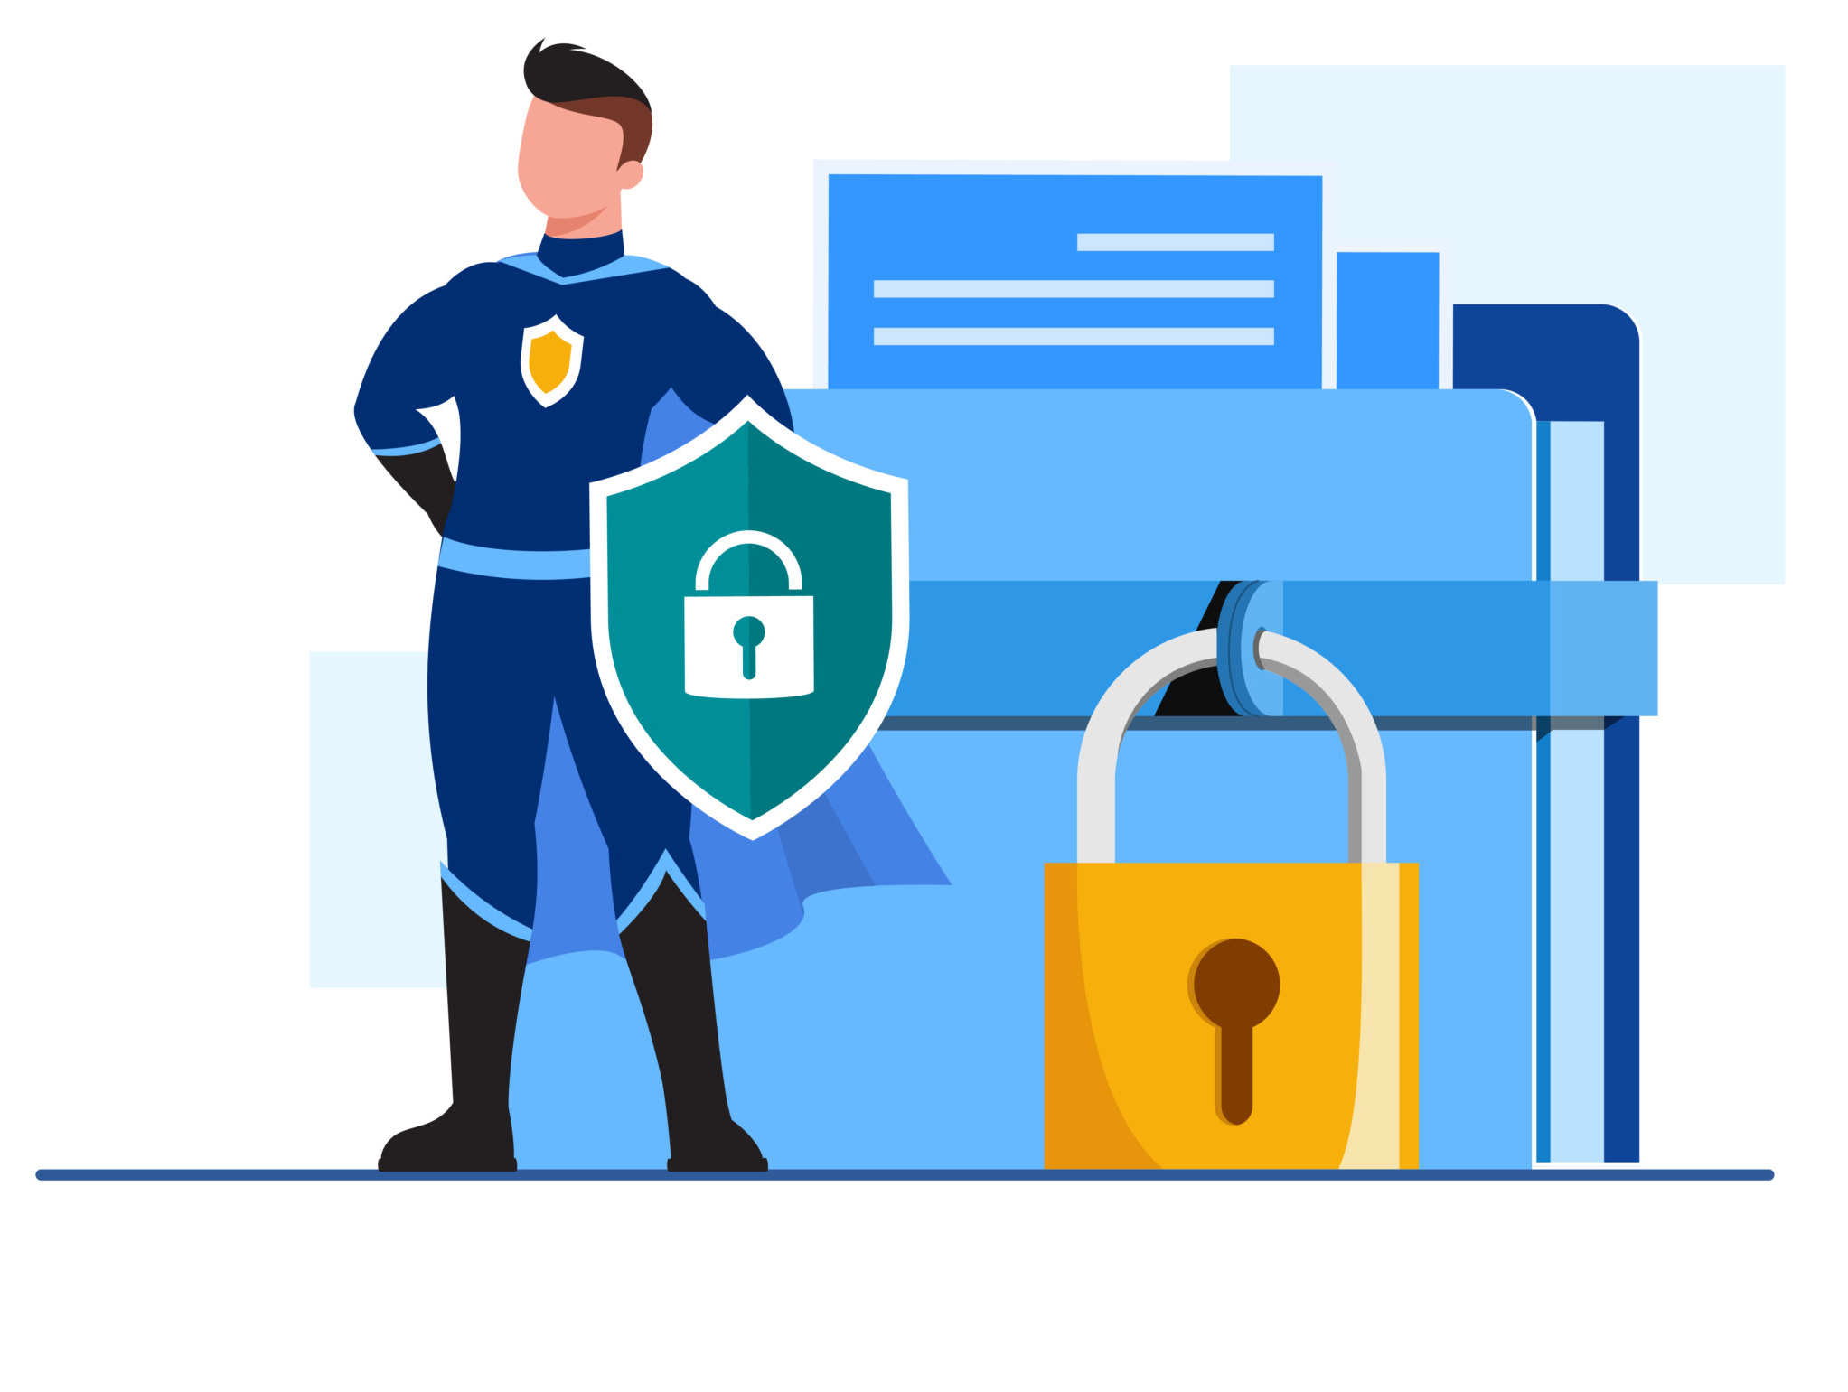
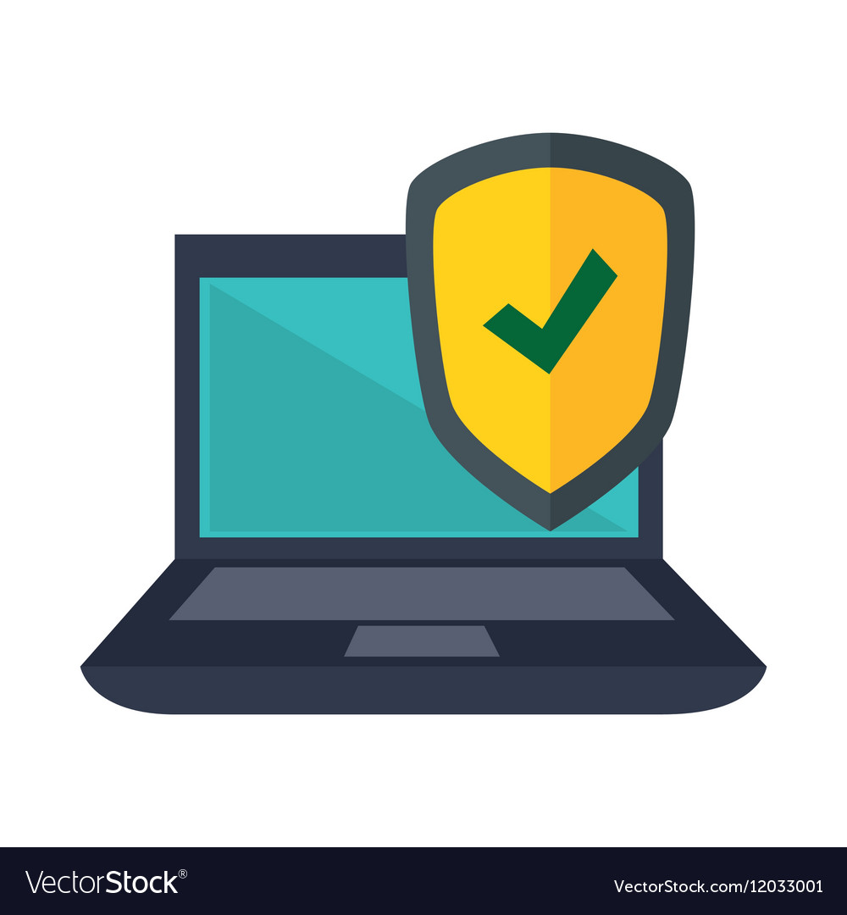

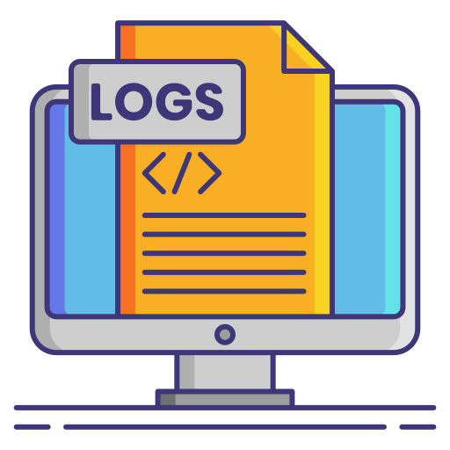
Objectives
Provide a unified platform for personal data security.
Enable folder locking, password vault management, and encrypted note storage.
Ensure all operations happen locally for better privacy.
Maintain metadata logs for transparency.

Slide 4
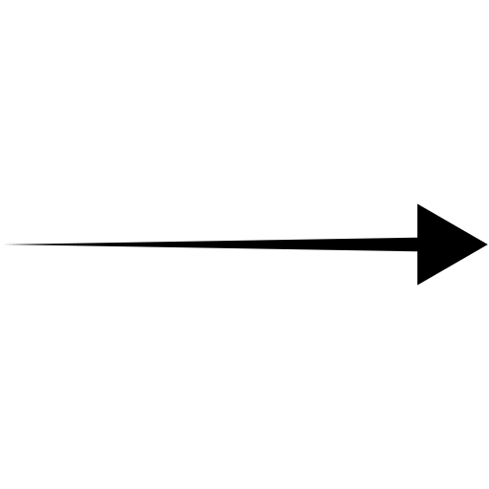

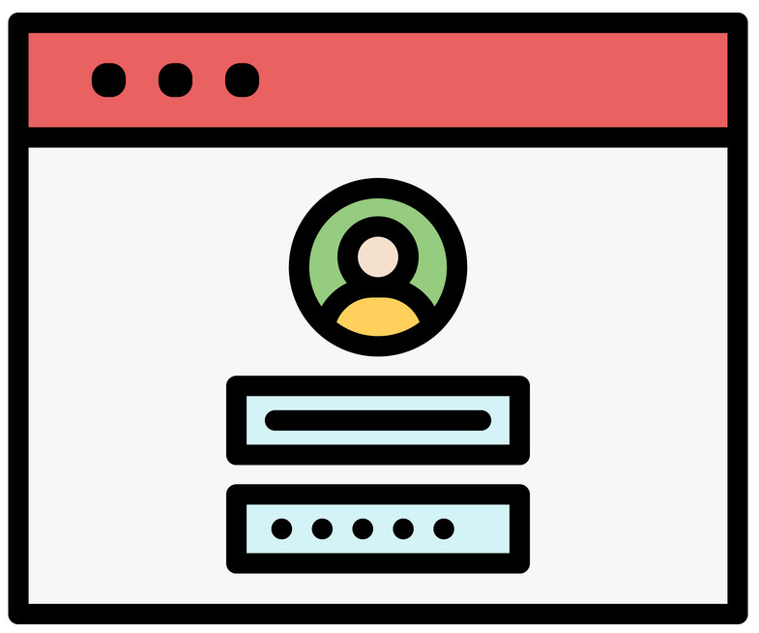

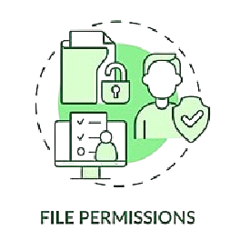
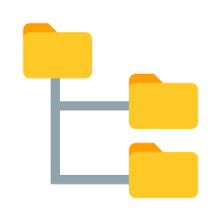
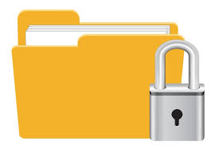
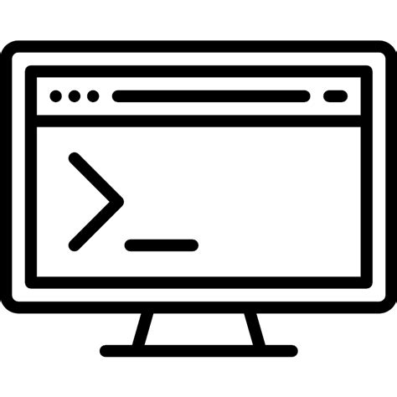
Module Architecture
User Login Module :
Folder Lock Module :

Slide 5
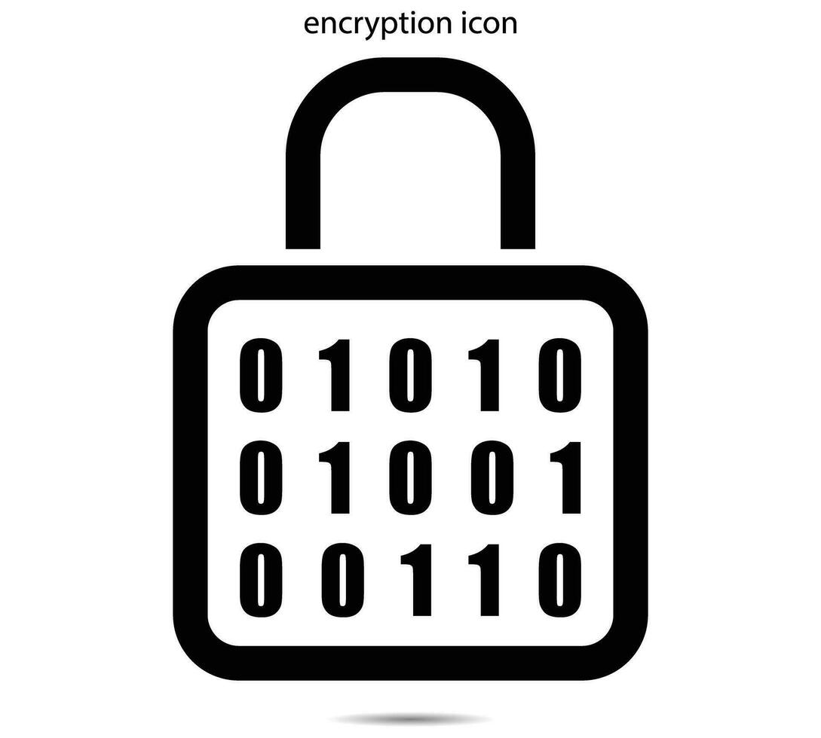
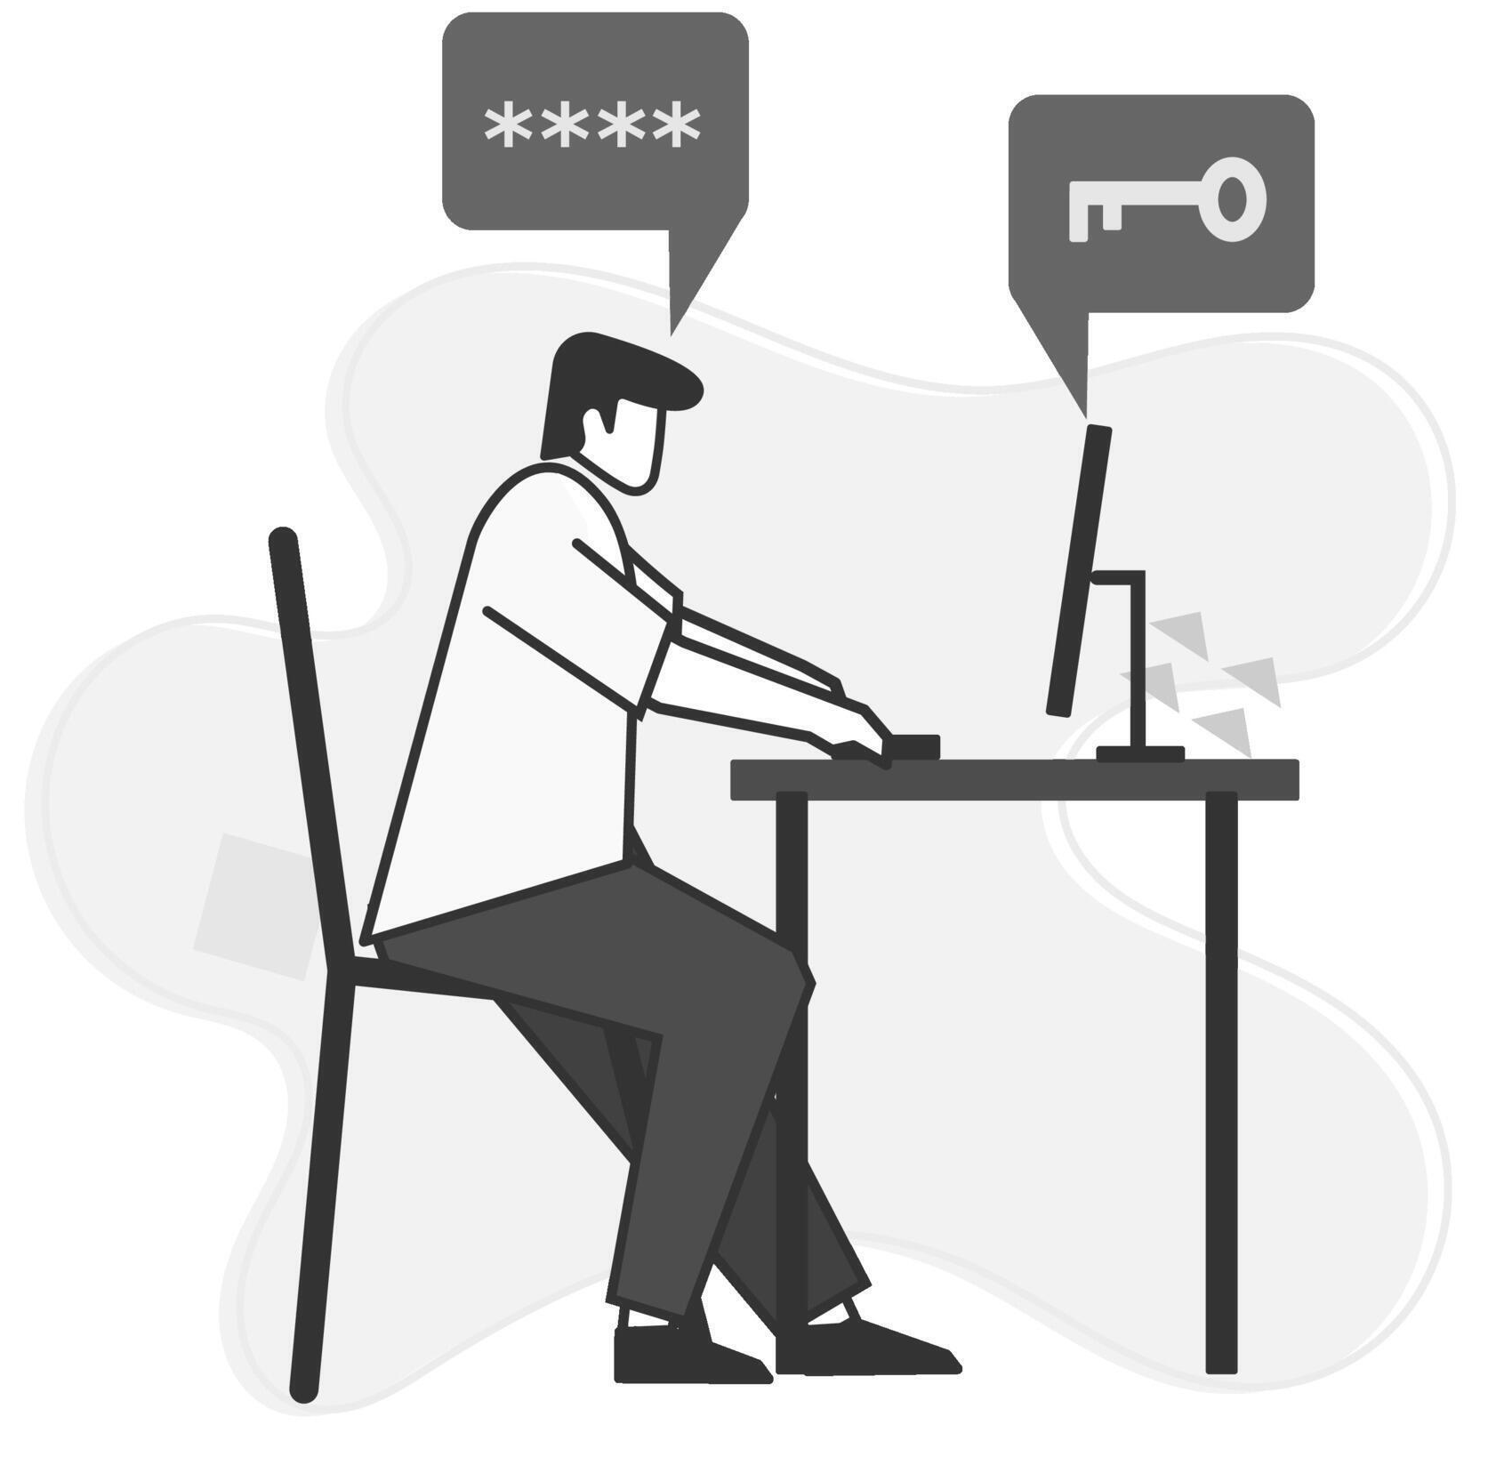
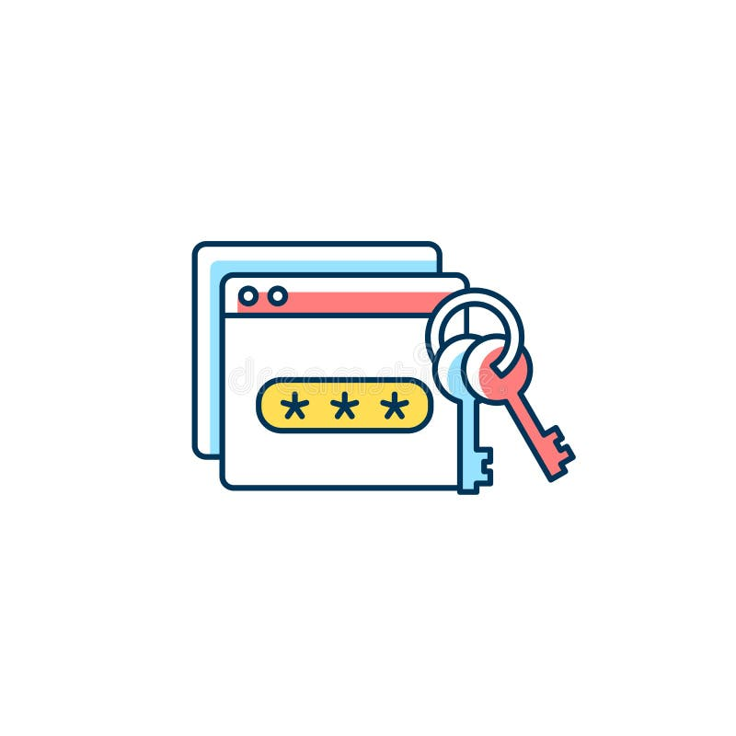
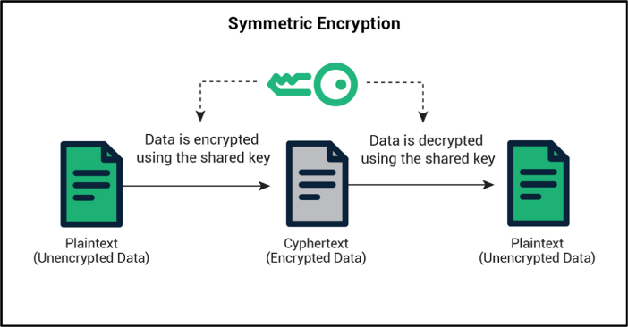
Module Architecture
Password Vault Module :
Secure Notes Module :

Slide 6
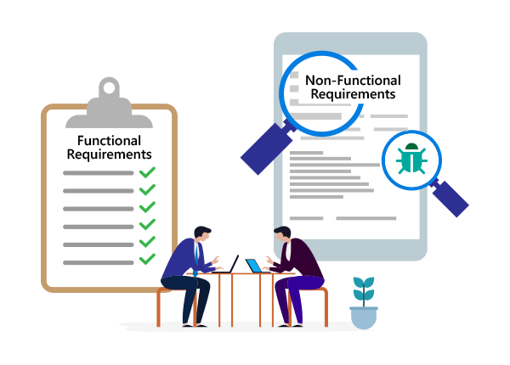
Requirements
Security using AES/Fernet encryption.
Reliability and data integrity.
User-friendly Flask web interface.
Cross-platform compatibility.
Maintainable modular design.
User authentication with passkey.
Folder encryption/decryption.
Encrypted password management.
Secure note creation and retrieval.
Metadata logging for every operation.

Slide 7

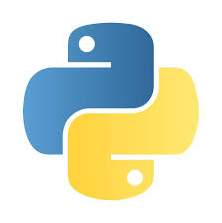
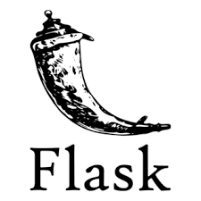

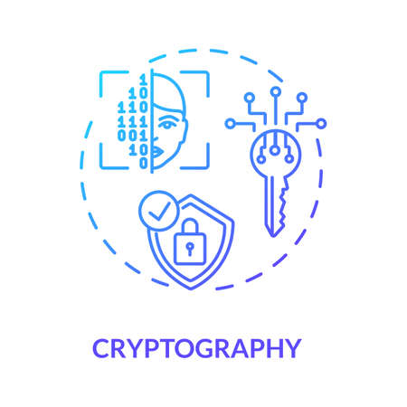


Tools & Technologies Used

Slide 8
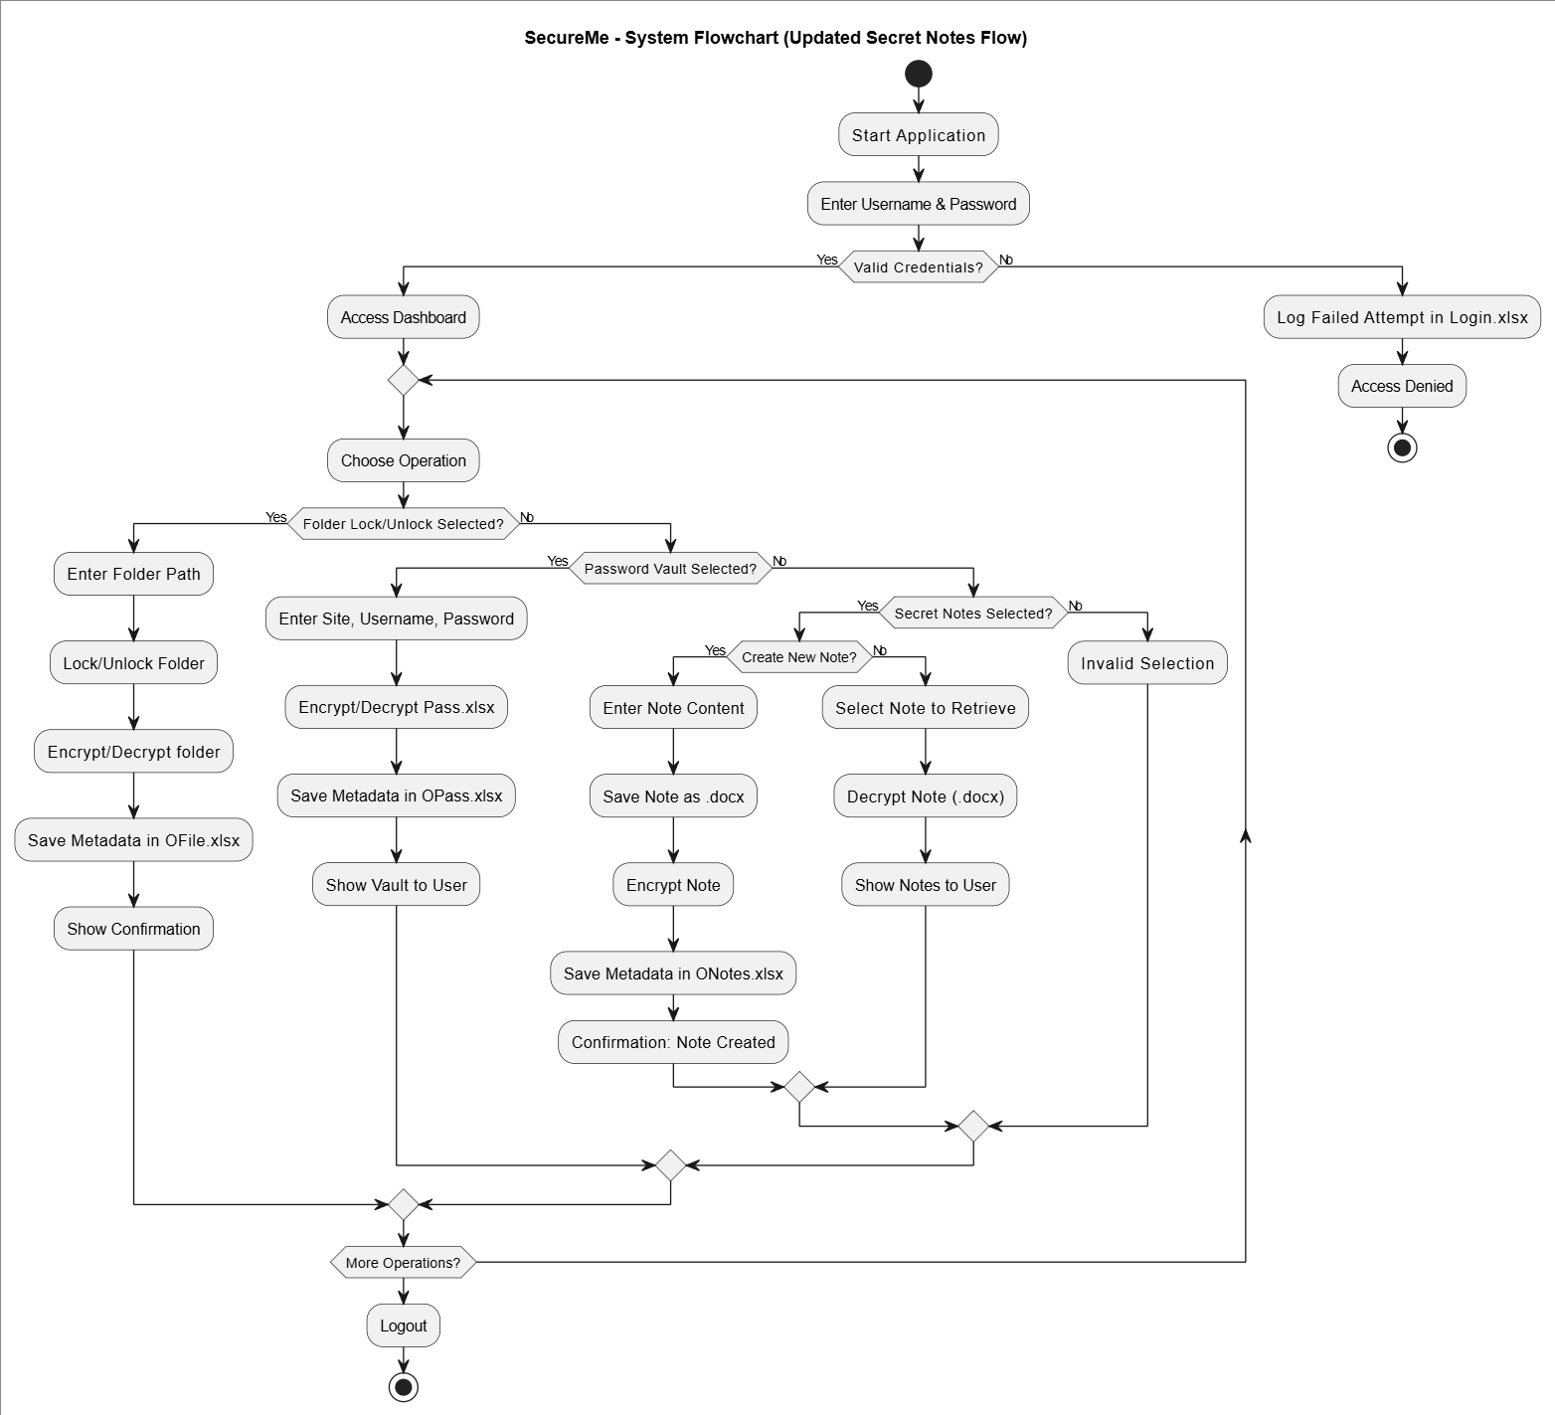
System Workflow

Slide 9
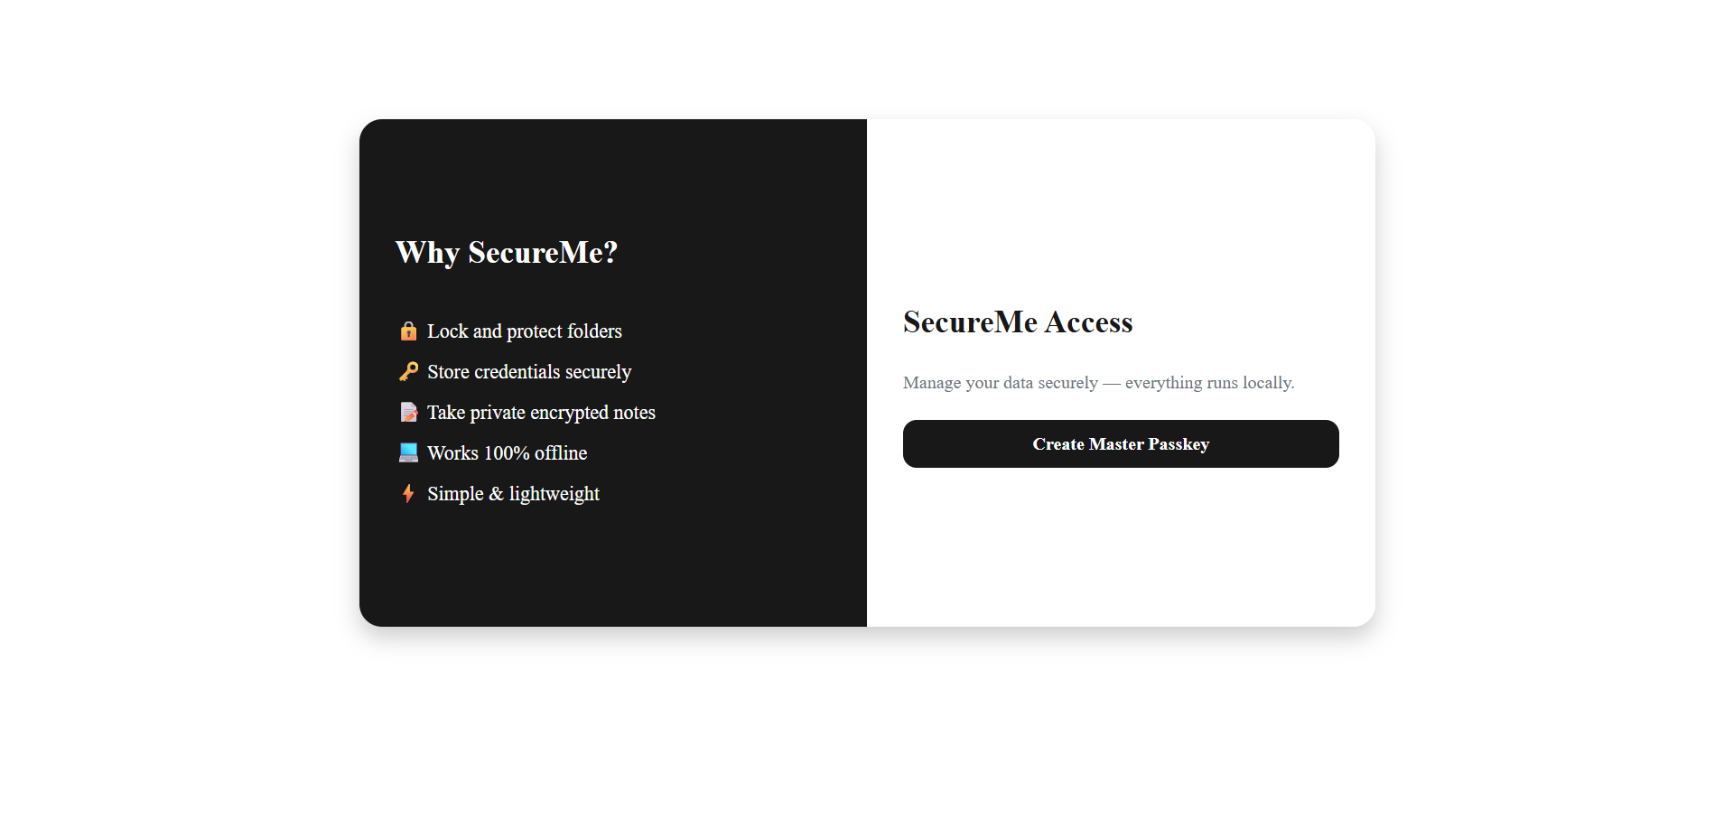
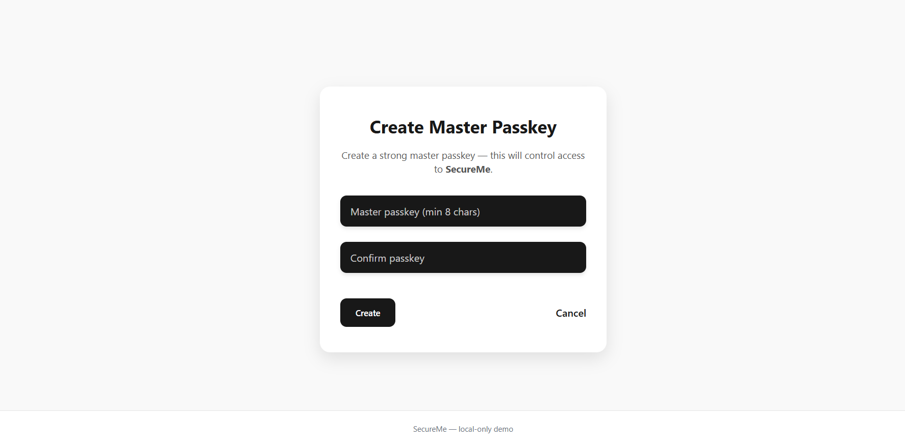
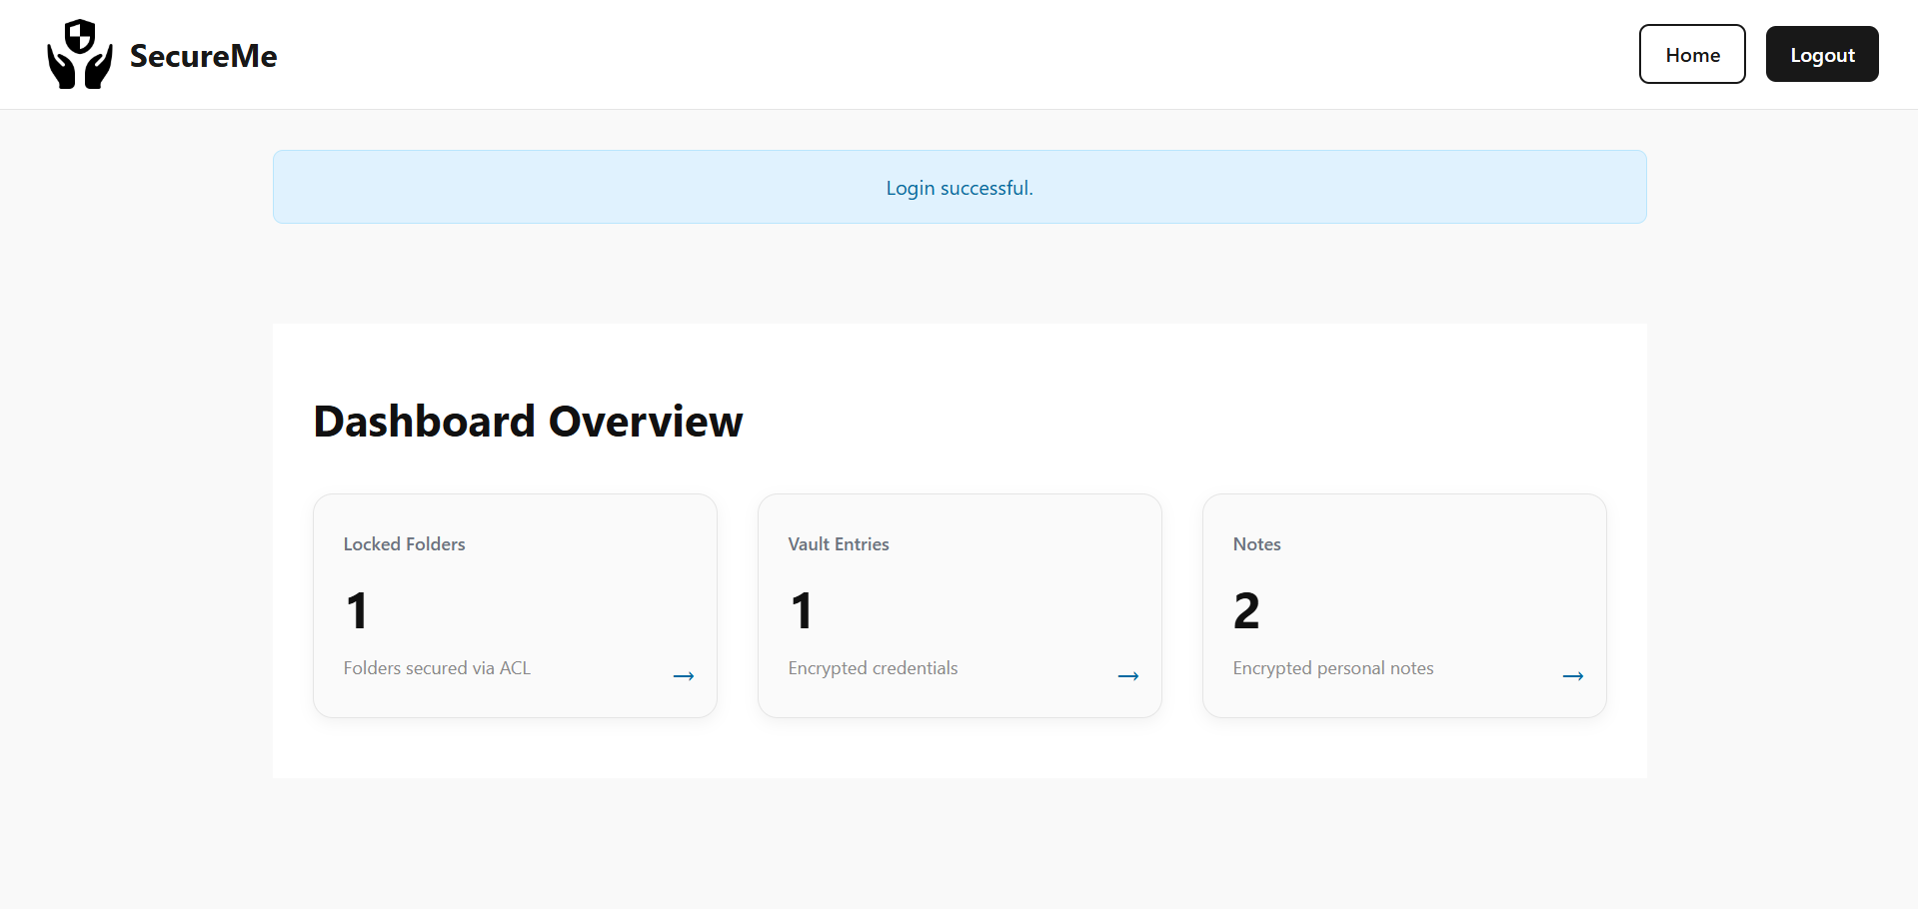
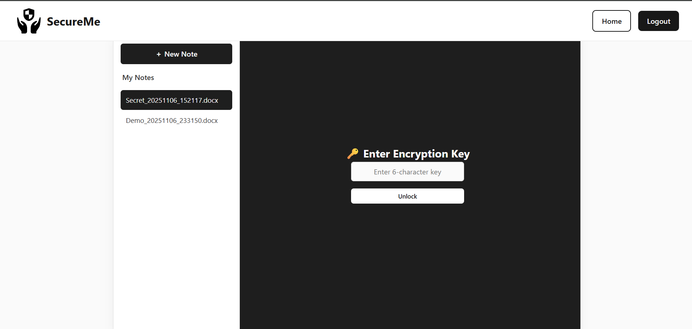
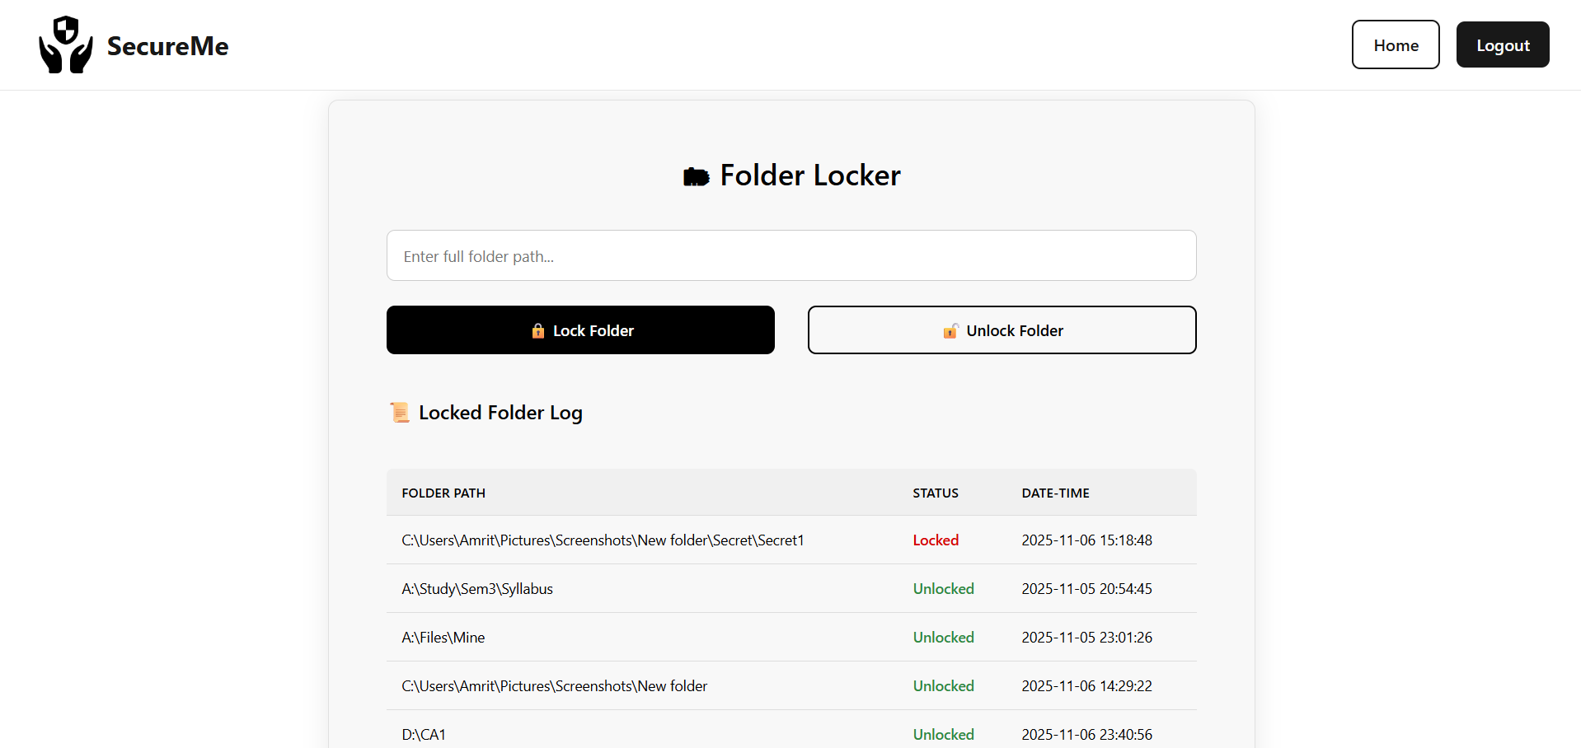
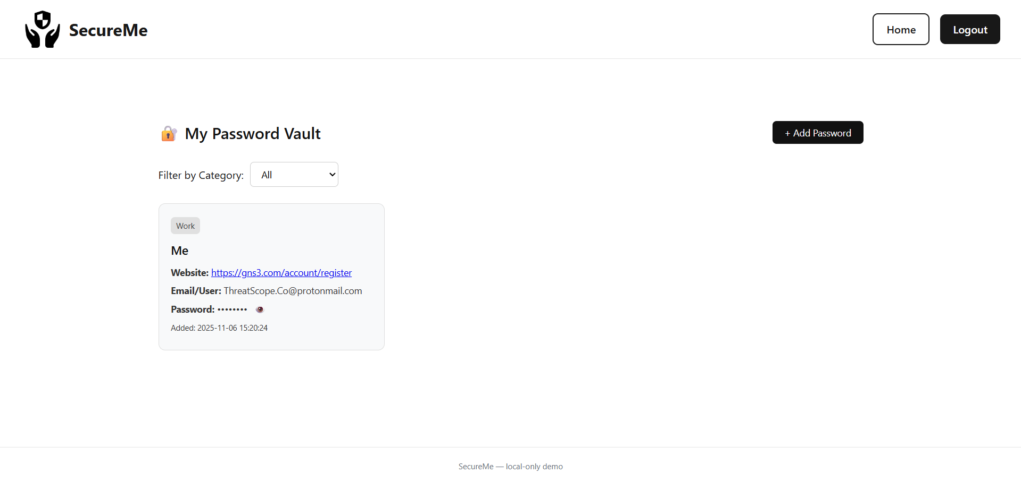
Implementation & Output
Landing Page
Key Creation page
Dashboard
Notes Management page
Folder Locker page
Password Vault page

Slide 10

Future Scope
Convert to full desktop app (PyQt / Electron).
Add biometric authentication (fingerprint, face).
Enable multi-user role-based access.
Support secure cloud backup ( e.g Google Drive ).

Slide 11
Conclusion
SecureMe provides a robust, local, and user-friendly solution for data security.
Combines encryption, usability, and modular design.
Protects users’ data from unauthorized access.

