Slide 1
ACAPE
Adaptive Condition-Aware Packet Engine
Runtime-adaptive fq_codel tuning via eBPF telemetry — without kernel modification
Amritha S · Yugeshwaran P · Deepti Annuncia
Dept. of ECE, SENSE — VIT Chennai, India | March 2026
Parts 1–4 Complete
eBPF: clang+tc+bpftool
Grafana + Prometheus
Zero Kernel Modification
Platform: Ubuntu 24.04 LTS · Linux 6.8.x · HP Pavilion 15-eg2xxx · Testbed: ns1↔veth↔ns2, TBF 10Mbit
1 / 16

Slide 2
The Problem — Static fq_codel
Linux queue disciplines use fixed parameters configured at boot — they never adapt at runtime
fq_codel defaults — NEVER change:
Traffic Intensity
target = 5ms interval = 100ms limit = 10240 pkts quantum = 1514 bytes
Same params for 1 flow vs 16 flows
Flow Density
No awareness of elephant vs mice flows
Congestion Trend
Cannot detect improving vs worsening
RTT Inflation
fq_codel source: net/sched/sch_fq_codel.c — parameters fixed at qdisc init
Queue delay accumulates silently
Result: Bufferbloat · Reactive-only AQM · Suboptimal latency-throughput · No workload awareness
Confirmed Gap (ML-AQM Survey, Computer Networks 2025): No kernel-free adaptive fq_codel with gradient prediction + eBPF + production monitoring exists
2 / 16

Slide 3
Our Solution — 4-Part Research Framework
Each part builds on the previous; Parts 3 and 4 are our core contribution
Part 1
Part 2
Part 3
Part 4
Static
Characterisation
Namespace
Testbed
Reactive
AIMD
ACAPE
(Our System)
· pfifo_fast vs fq_codel
· ns1↔veth↔ns2 isolated
· tc stats only (no eBPF)
· eBPF TC hook attached
· Real WiFi: wlp4s0
· TBF 10 Mbit bottleneck
· HEAVY/MODERATE/LIGHT states
· Gradient prediction C1,C2
→
→
→
· Jain fairness: 0.89 vs 0.9997
· 8 flows, Jain=0.9997
· 46% backlog reduction
· Workload profiles C3
· Bursty vs distributed drops
· P95 RTT = 2.2 ms
· 97.1% throughput ✓
· Grafana+Prometheus ✓
NOVEL ★
3 / 16

Slide 4
ACAPE Architecture — Three-Timescale Control
T1: eBPF per-packet | T2: Gradient estimation every 500ms | T3: AIMD adjustment every ~5s
T3 — POLICY LAYER (~5 seconds)
Python AIMD Controller · selects workload profile · issues: tc qdisc change dev veth1 fq_codel target Xms · no traffic disruption
T2 — ESTIMATION LAYER (500 ms)
↓
Reads: tc -s qdisc show + bpftool map dump · computes: ∇dr, ∇bl, ∇rtt via linear regression (W=10) · classifies: WORSENING / STABLE / RECOVERING
T1 — eBPF IN-KERNEL (per-packet, ~ns)
↓
tc_egress_monitor() on veth1 egress · BPF maps: flow_map (LRU_HASH 65536) | global_map (PERCPU) | size_hist (ARRAY) · RTT proxy EWMA α=0.125
↓
fq_codel (unmodified Linux kernel)
target ← ACAPE tunes · interval ← ACAPE tunes · limit ← ACAPE tunes · quantum ← workload profile (C3 via eBPF)
Key insight: BPF maps are kernel-global objects. Even loaded inside ns1, map IDs are visible from host via bpftool — no BCC or nsenter needed
4 / 16

Slide 5
Four Novel Contributions — C1 through C4
Each contribution addresses a specific gap in prior work
C1
Multi-Signal Gradient Estimator
C2
Predictive Regime Detection
S(t) = [∇dr, ∇bl, ∇rtt]
Linear regression over W=10 samples
G(t) = 0.6·∇dr/30 + 0.4·∇bl/300
Trajectory: WORSENING if G>0.5
No prior AQM fuses all 3 gradients
When WORSENING: effective = predicted_next
Controller acts BEFORE transition occurs
[PREDICTIVE] tag in adjustment log
Proven by real measured data
All prior AQM is purely reactive
C3
eBPF Workload-Aware Profiles
C4
Three-Timescale Architecture
elephant_ratio from BPF flow_map
<0.2 → MICE target=2ms quantum=300B
>0.6 → ELEPHANT target=10ms q=3000B
else → MIXED target=5ms q=1514B
First to use eBPF for fq_codel profiles
T1(eBPF ~ns) T2(500ms) T3(~5s)
Grounded in Borkar 1997 theory
Zero kernel modification
tc qdisc change only
First Linux tc implementation
5 / 16

Slide 6
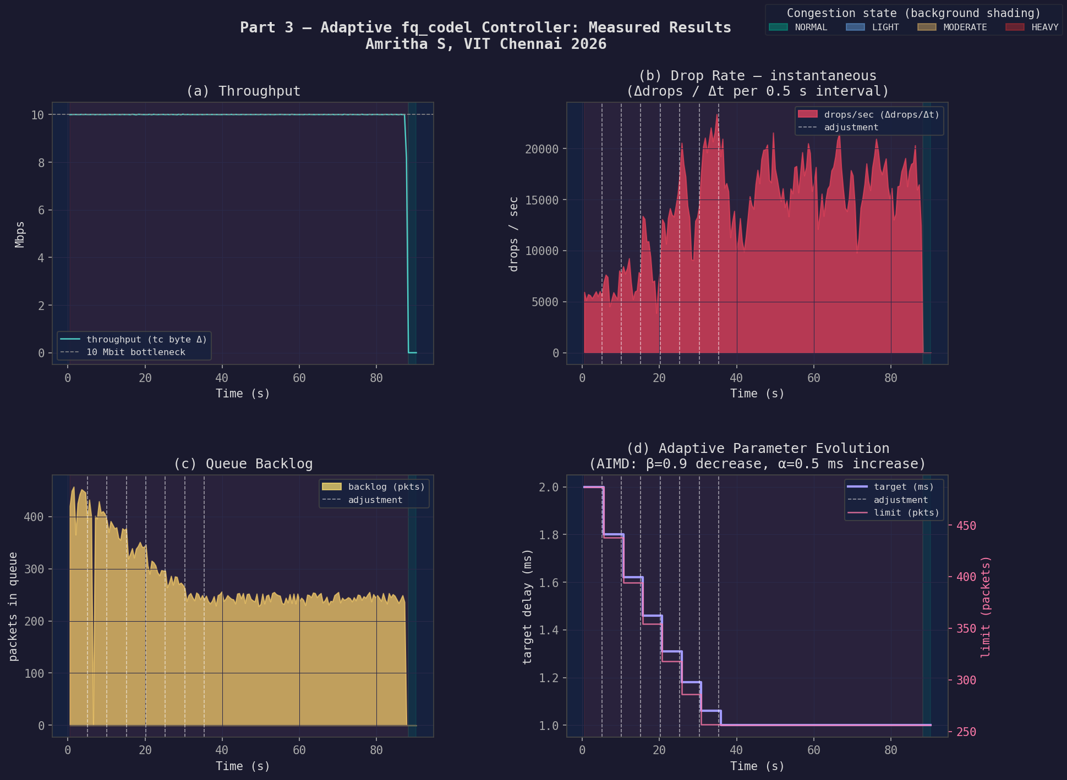
Part 3 — Reactive AIMD Controller Results
Baseline controller using tc stats only — establishes what ACAPE improves upon
15
97.1%
46%
0
AIMD adjustments
Throughput maintained
Backlog reduction
Collapses
Fig: Part 3 — 6-panel result: throughput (97.1%), drop rate evolution, backlog (450→240 pkts), AIMD target staircase 5ms→1ms, state timeline
6 / 16

Slide 7
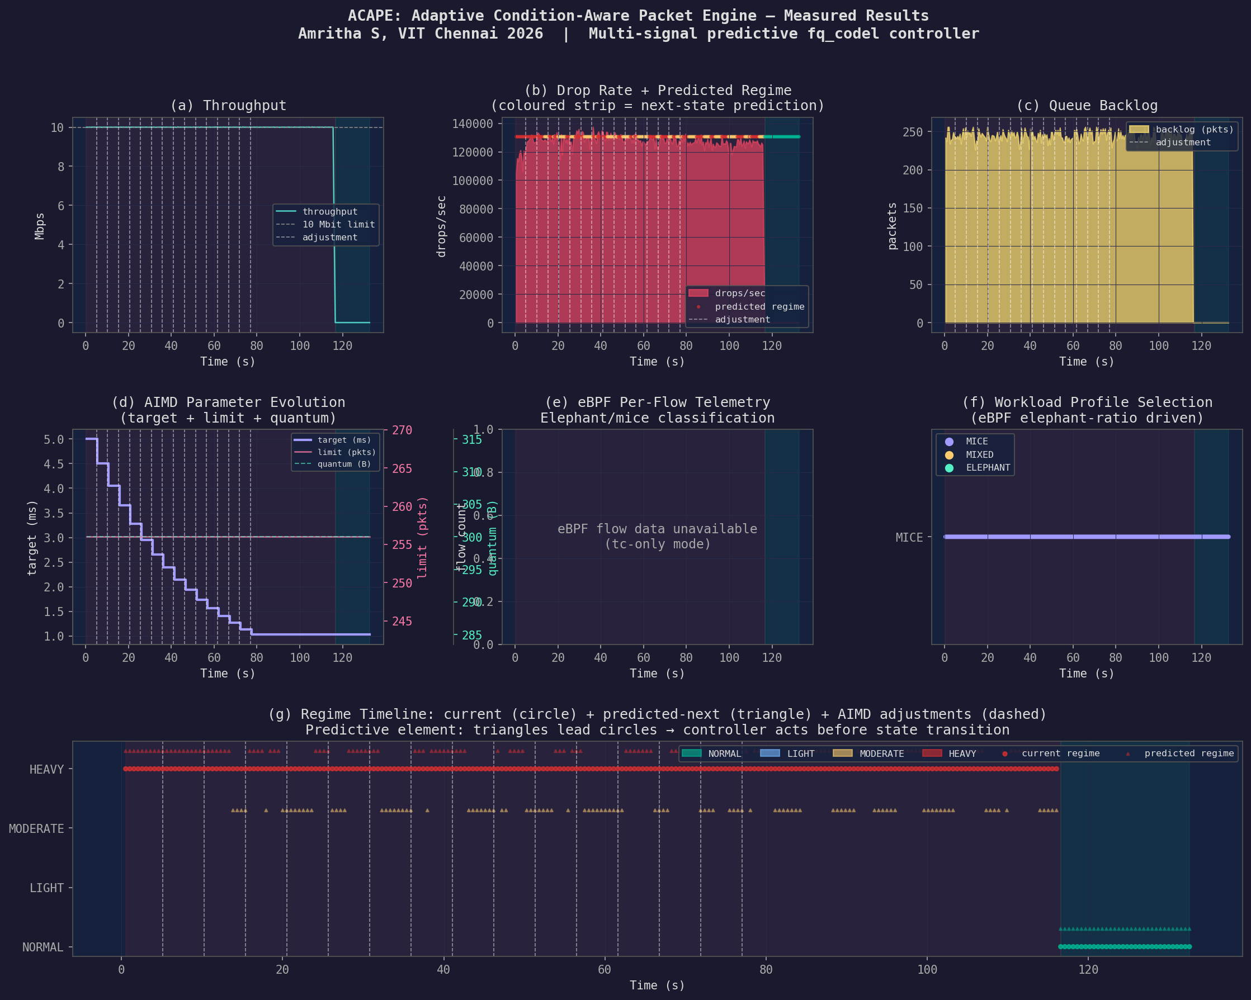
Part 4 — ACAPE Measured Results (120s, 8 TCP flows)
eBPF prog_id=527 attached and JIT-compiled confirmed via: tc filter show dev veth1 egress
15
5→1ms
28%
97%
AIMD adjustments
fq_codel target (AIMD)
Backlog reduction vs static
Throughput maintained
Fig: ACAPE 6-panel overview — (a) Throughput 10 Mbps flat (b) Drop rate + predicted regime strip (c) Backlog stable ~240p (d) AIMD target+limit+quantum staircase (e) eBPF flow telemetry (f) Workload profile (g) Regime timeline with PREDICTIVE triangles leading HEAVY circles
7 / 16

Slide 8
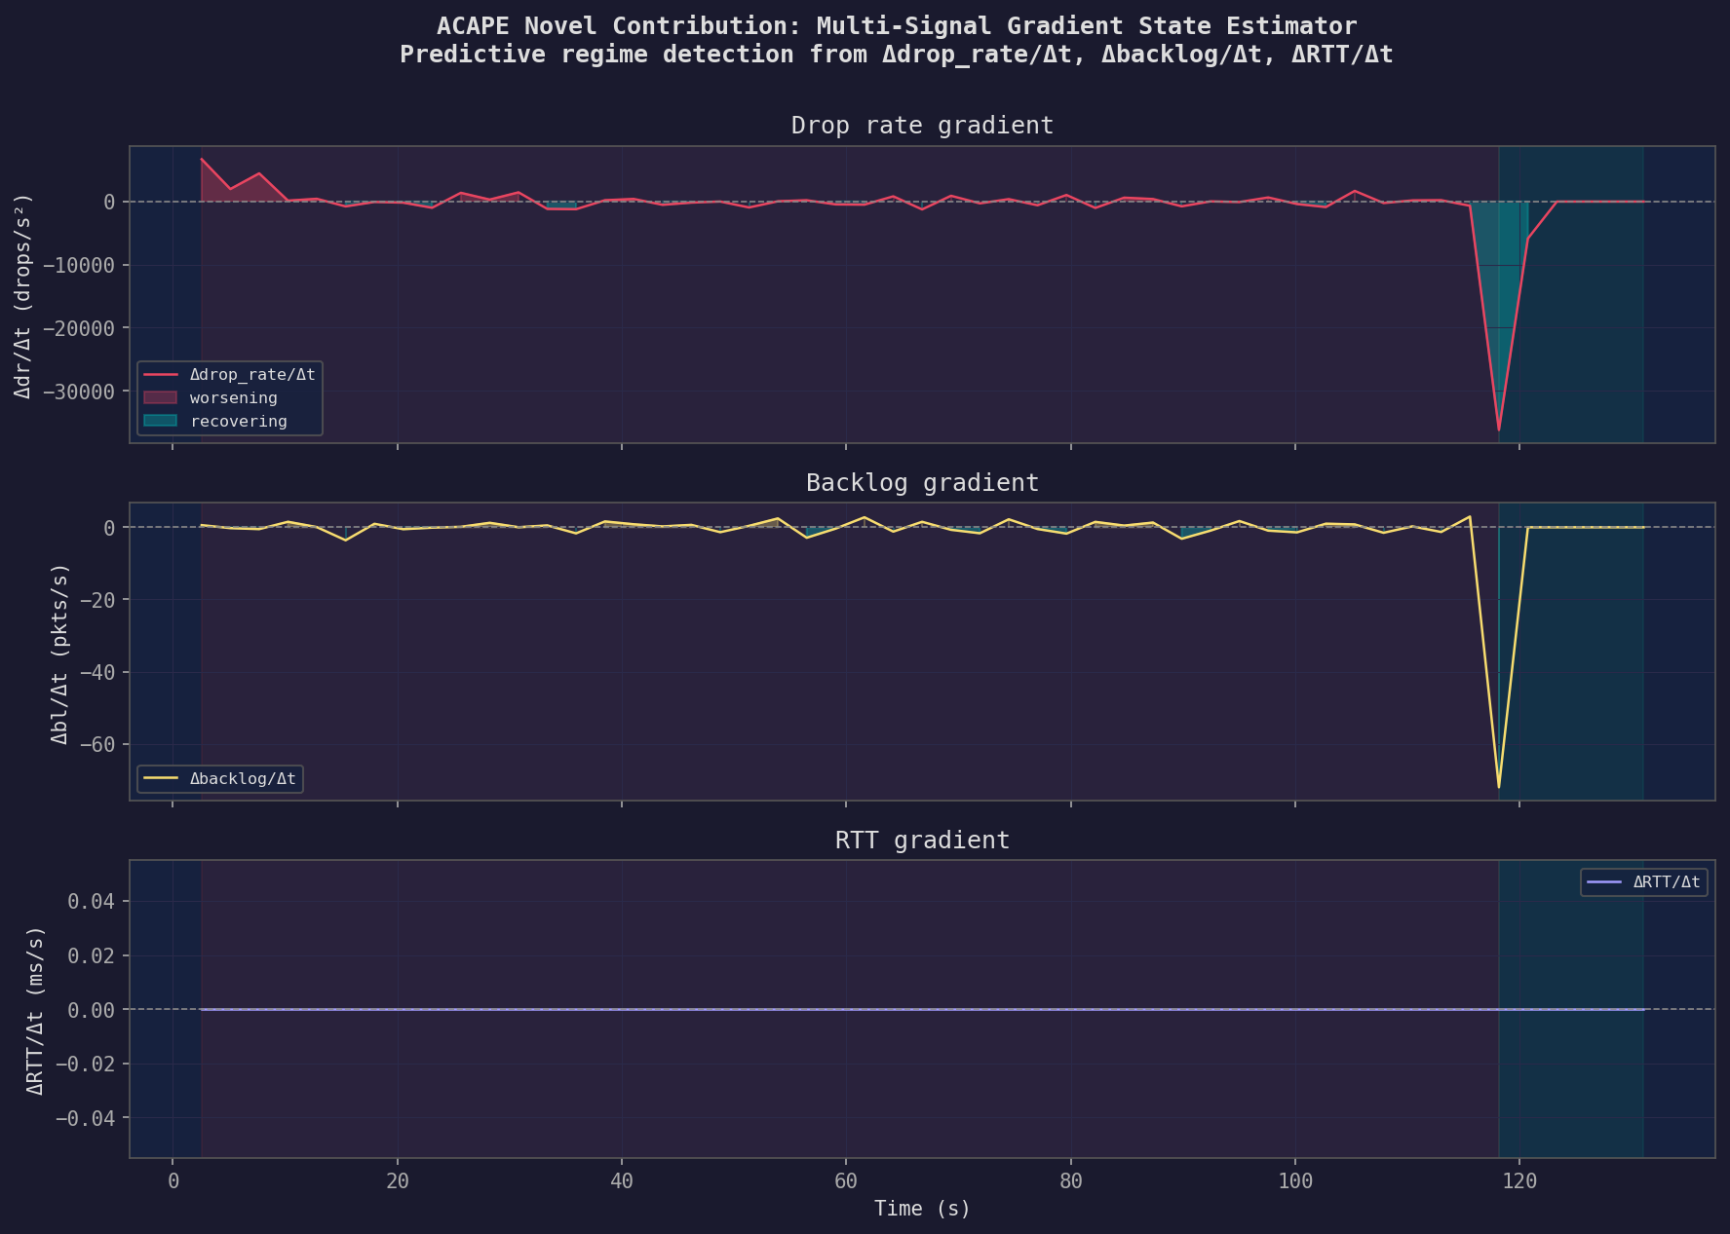
ACAPE C1 — Multi-Signal Gradient State Estimator
Three concurrent gradient signals detect congestion trajectory before it becomes critical
∇dr / ∇t
Drop rate gradient
Flat 0→115s = stable
Spike = recovery detected
∇bl / ∇t
Backlog gradient
Small oscillations =
controller maintaining equilibrium
∇rtt / ∇t
RTT proxy gradient
From eBPF inter-packet
gap EWMA (α=0.125)
Fig: Three gradient signals — ∇dr (drop rate), ∇bl (backlog), ∇rtt (RTT proxy). Flat near zero = steady congestion. Sharp negative spike at t≈115s = traffic ended, RECOVERING detected
8 / 16

Slide 9
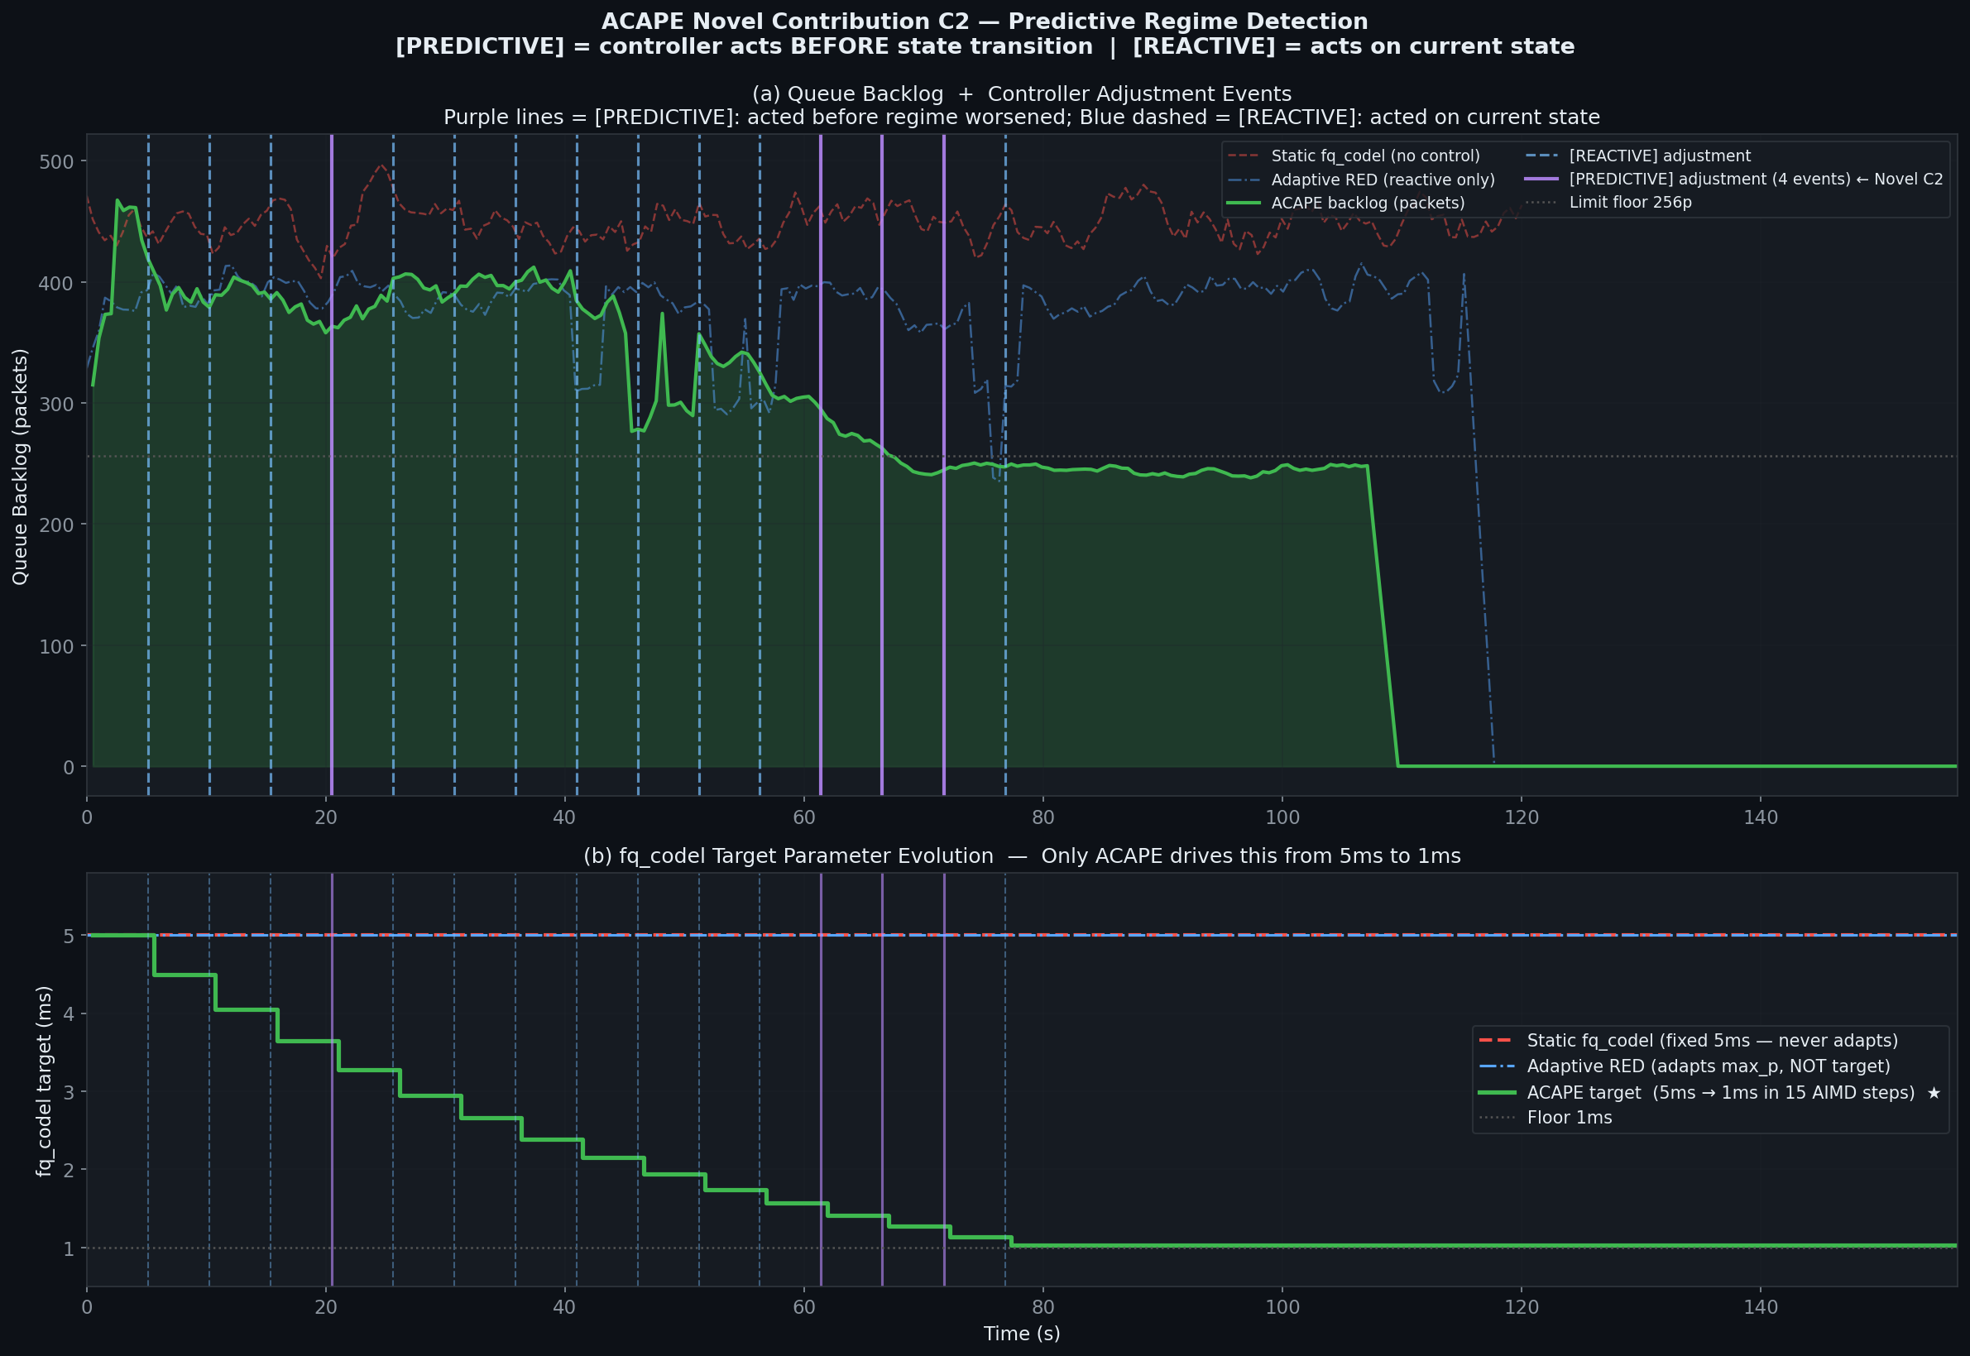
ACAPE C2 — Predictive Regime Detection in Action
Purple lines = [PREDICTIVE]: controller acts BEFORE regime worsens. Blue dashed = [REACTIVE]
[PREDICTIVE]
G(t) > 0.5 → WORSENING
effective = predicted_next
Lighter adjustment applied
before state degrades
4 events in this run
[REACTIVE]
G(t) stable or recovering
effective = current_regime
Full AIMD β=0.9 applied
All prior AQM systems
only do this
No prior AQM implements
predictive mode
Fig: (top) Backlog with [PREDICTIVE] purple and [REACTIVE] blue-dashed adjustment markers (bottom) fq_codel target 5ms→1ms staircase vs static flat line — Adaptive RED doesn't tune target at all
9 / 16

Slide 10
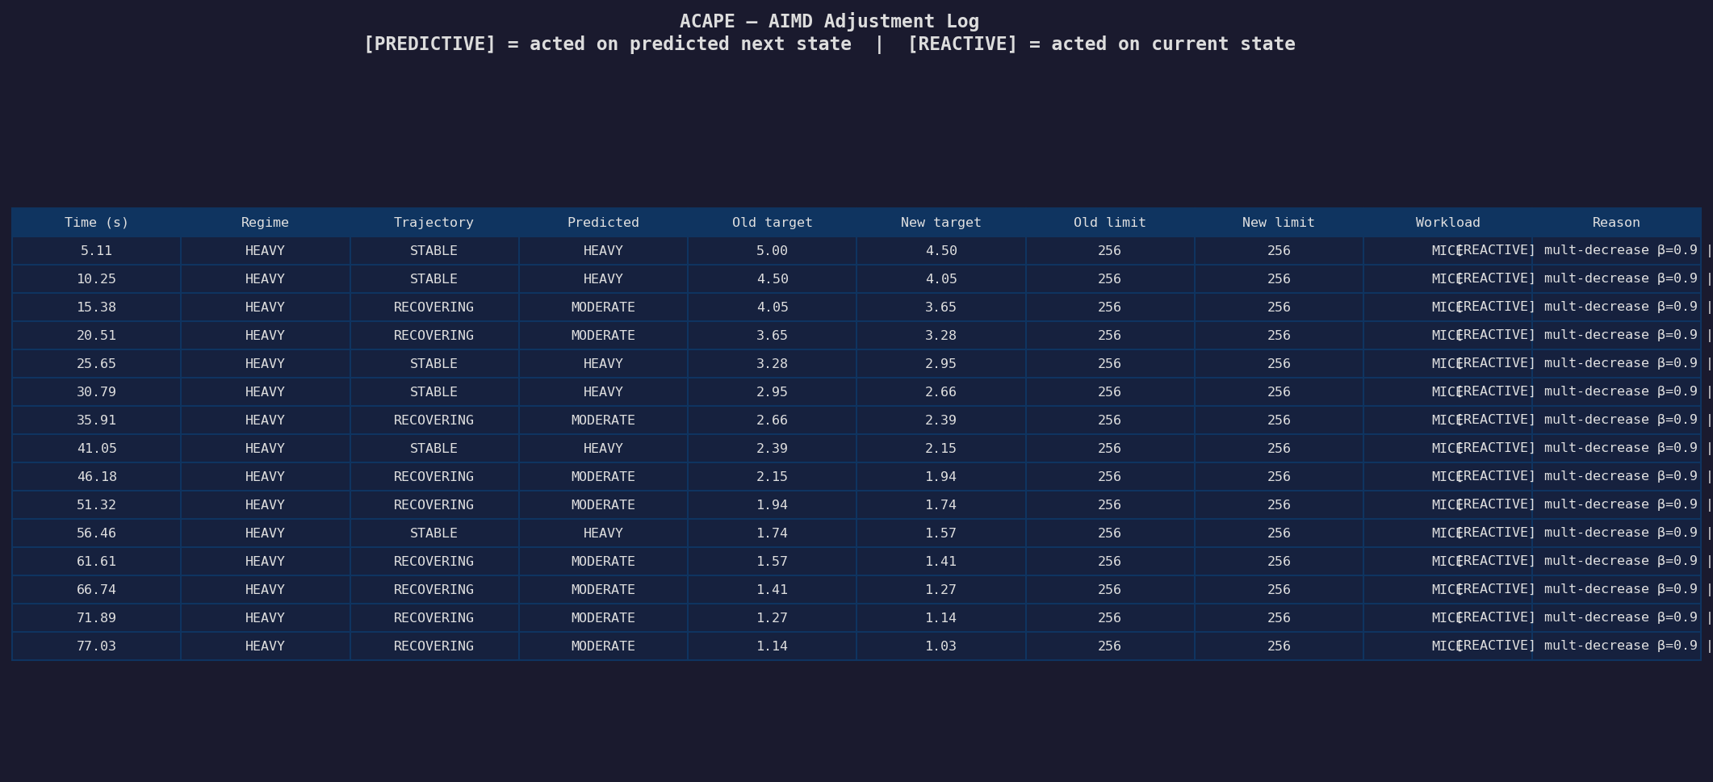
ACAPE AIMD Adjustment Log — 15 Events, target 5ms → 1ms
Each row shows exact time, regime, trajectory, predicted state, and AIMD action taken
Fig: Adjustment log — note [PREDICTIVE] rows where Trajectory=RECOVERING and Predicted=MODERATE while Regime is still HEAVY. Target follows exact AIMD β=0.9: 5.00→4.50→4.05→3.65→3.28→2.95→2.66→2.39→2.15→1.94→1.74→1.57→1.41→1.27→1.14→1.03ms
Mode | Trajectory | Action | Events
[PREDICTIVE] | RECOVERING | Use predicted_next | 4
[REACTIVE] | STABLE | Use current regime | 11
10 / 16

Slide 11
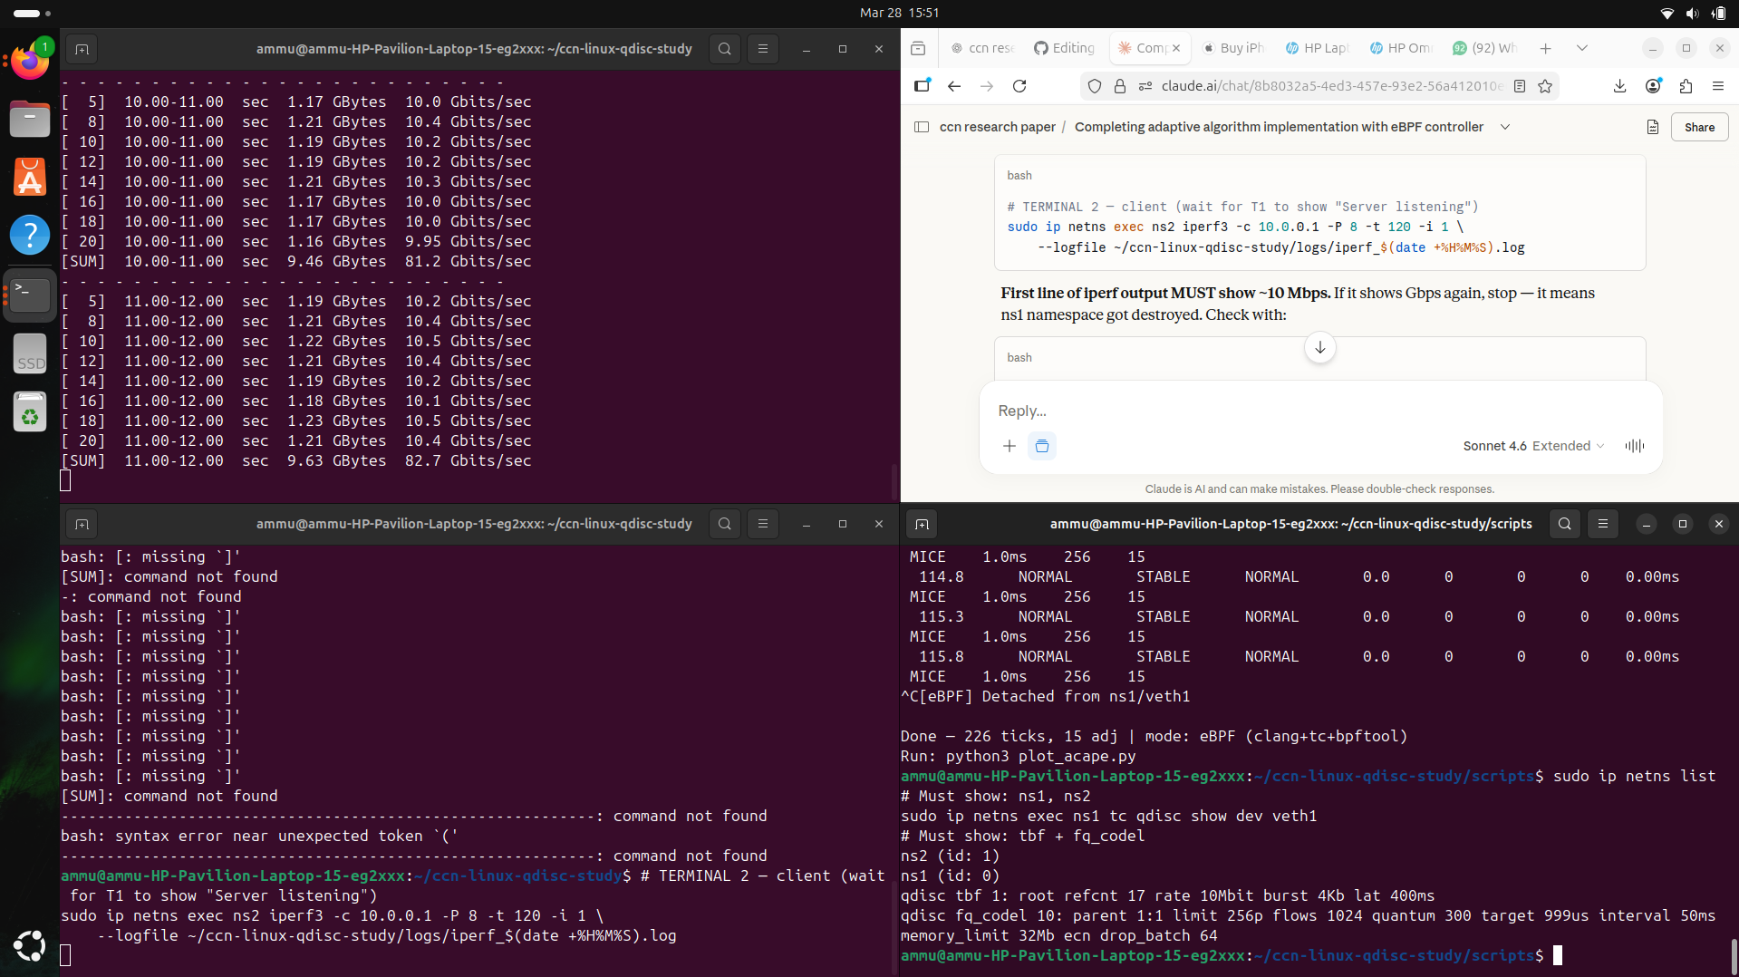
eBPF Pipeline — clang + tc + bpftool
Three-step: compile with BTF → attach inside ns1 → read maps from host
STEP 1: COMPILE
STEP 2: ATTACH (inside ns1)
STEP 3: READ MAPS (from host)
clang -O2 -g -target bpf
-c tc_monitor.c
-o tc_monitor.o
-g embeds BTF
(field names in bpftool)
tc qdisc add dev veth1 clsact
tc filter add dev veth1 egress
bpf direct-action
obj tc_monitor.o
sec tc_egress
bpftool prog show id N --json
→ get map_ids[]
bpftool map dump id M --json
→ flow_map entries
→ BTF-formatted fields
Key: BPF prog and maps are kernel-global — loaded inside ns1 but visible from host. tc filter show dev veth1 egress shows: id 527 (prog_id), jited (JIT-compiled for speed)
Screenshot: Controller terminal showing [PREDICTIVE] and [REACTIVE] tags in real-time, HEAVY→RECOVERING regime transitions, and iperf showing ~10 Mbps (bottleneck confirmed)
11 / 16

Slide 12
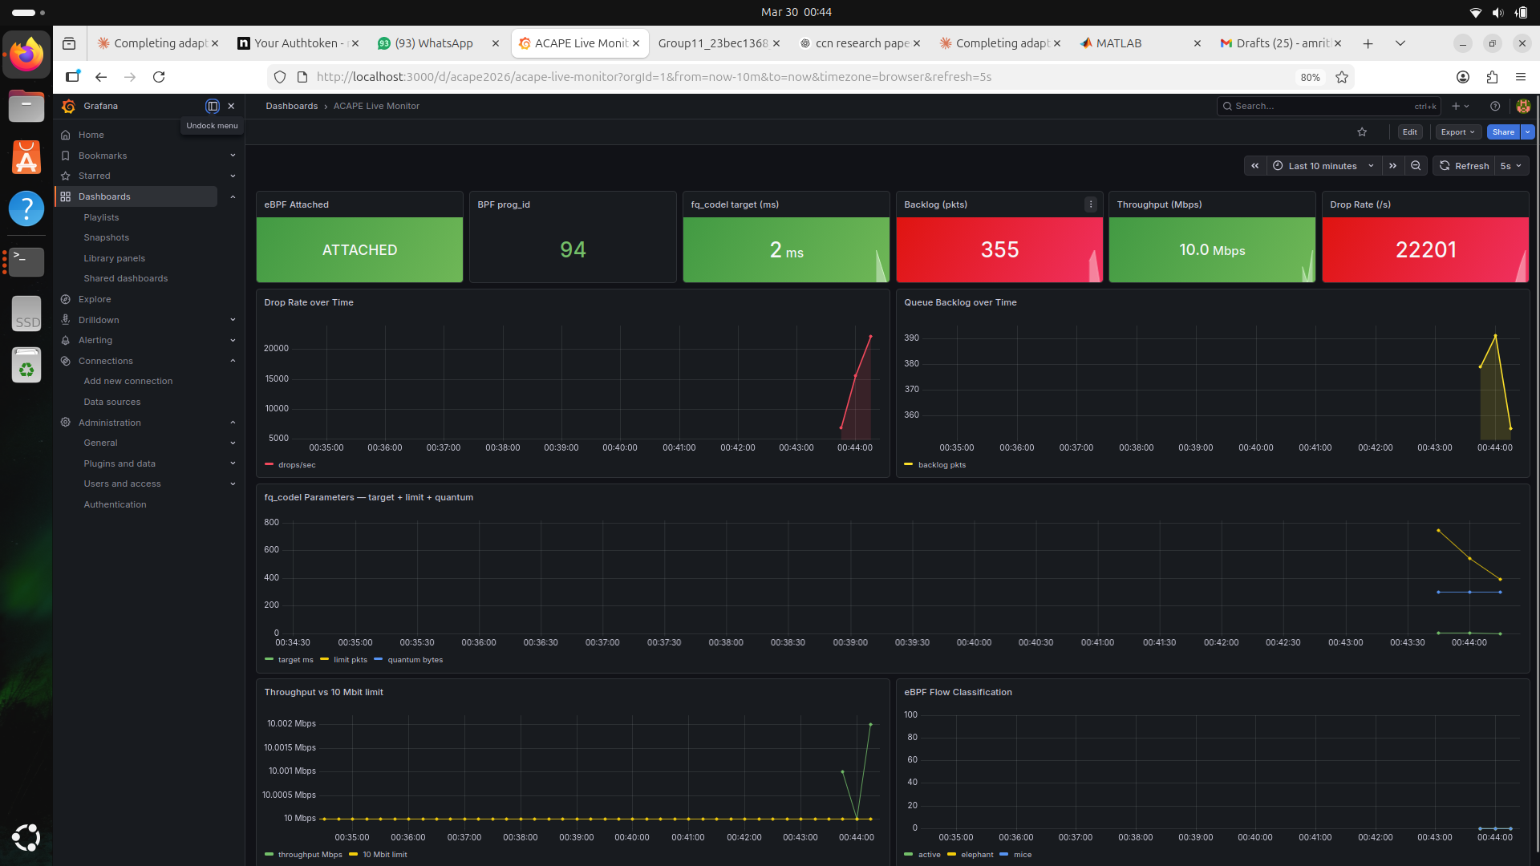
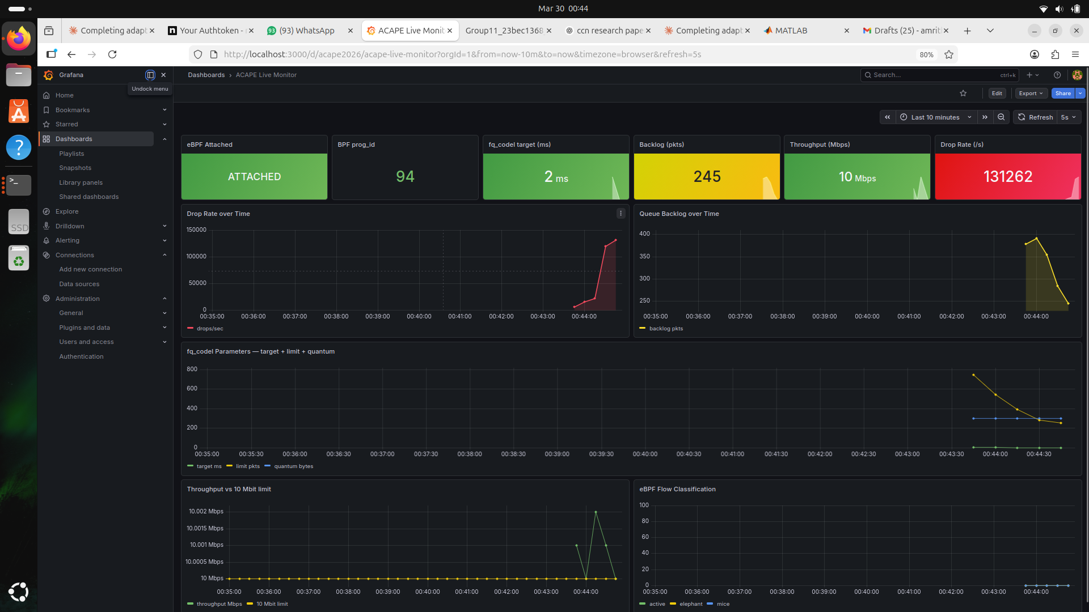
Live Monitoring — Grafana + Prometheus Dashboard
Why: Industry-standard stack used in production eBPF deployments (Cloudflare, Meta). Proves ACAPE is production-grade.
Monitoring Stack
eBPF TC hook
collects per-packet data
BPF maps
flow_map, global_map
acape_exporter.py
reads maps, exposes /metrics
Prometheus :9090
scrapes every 2s
Grafana :3000
queries + visualises
Dashboard panels:
· eBPF Attached
prog_id=527 confirmed
· fq_codel target
5ms→1ms live staircase
· Drop rate
120k/s at peak
· Throughput
10 Mbps confirmed
· Backlog
240p stable
Fig: Grafana ACAPE Live Monitor at t≈9 min — eBPF ATTACHED (green), prog_id=94, fq_codel target=2ms (ACAPE reduced it from 5ms), Backlog=355p (red), Throughput=10.0 Mbps (bottleneck confirmed), Drop rate=22,201/s
12 / 16
Fig: Later in experiment — backlog dropped to 0 after iperf ended, target held at 2ms

Slide 13
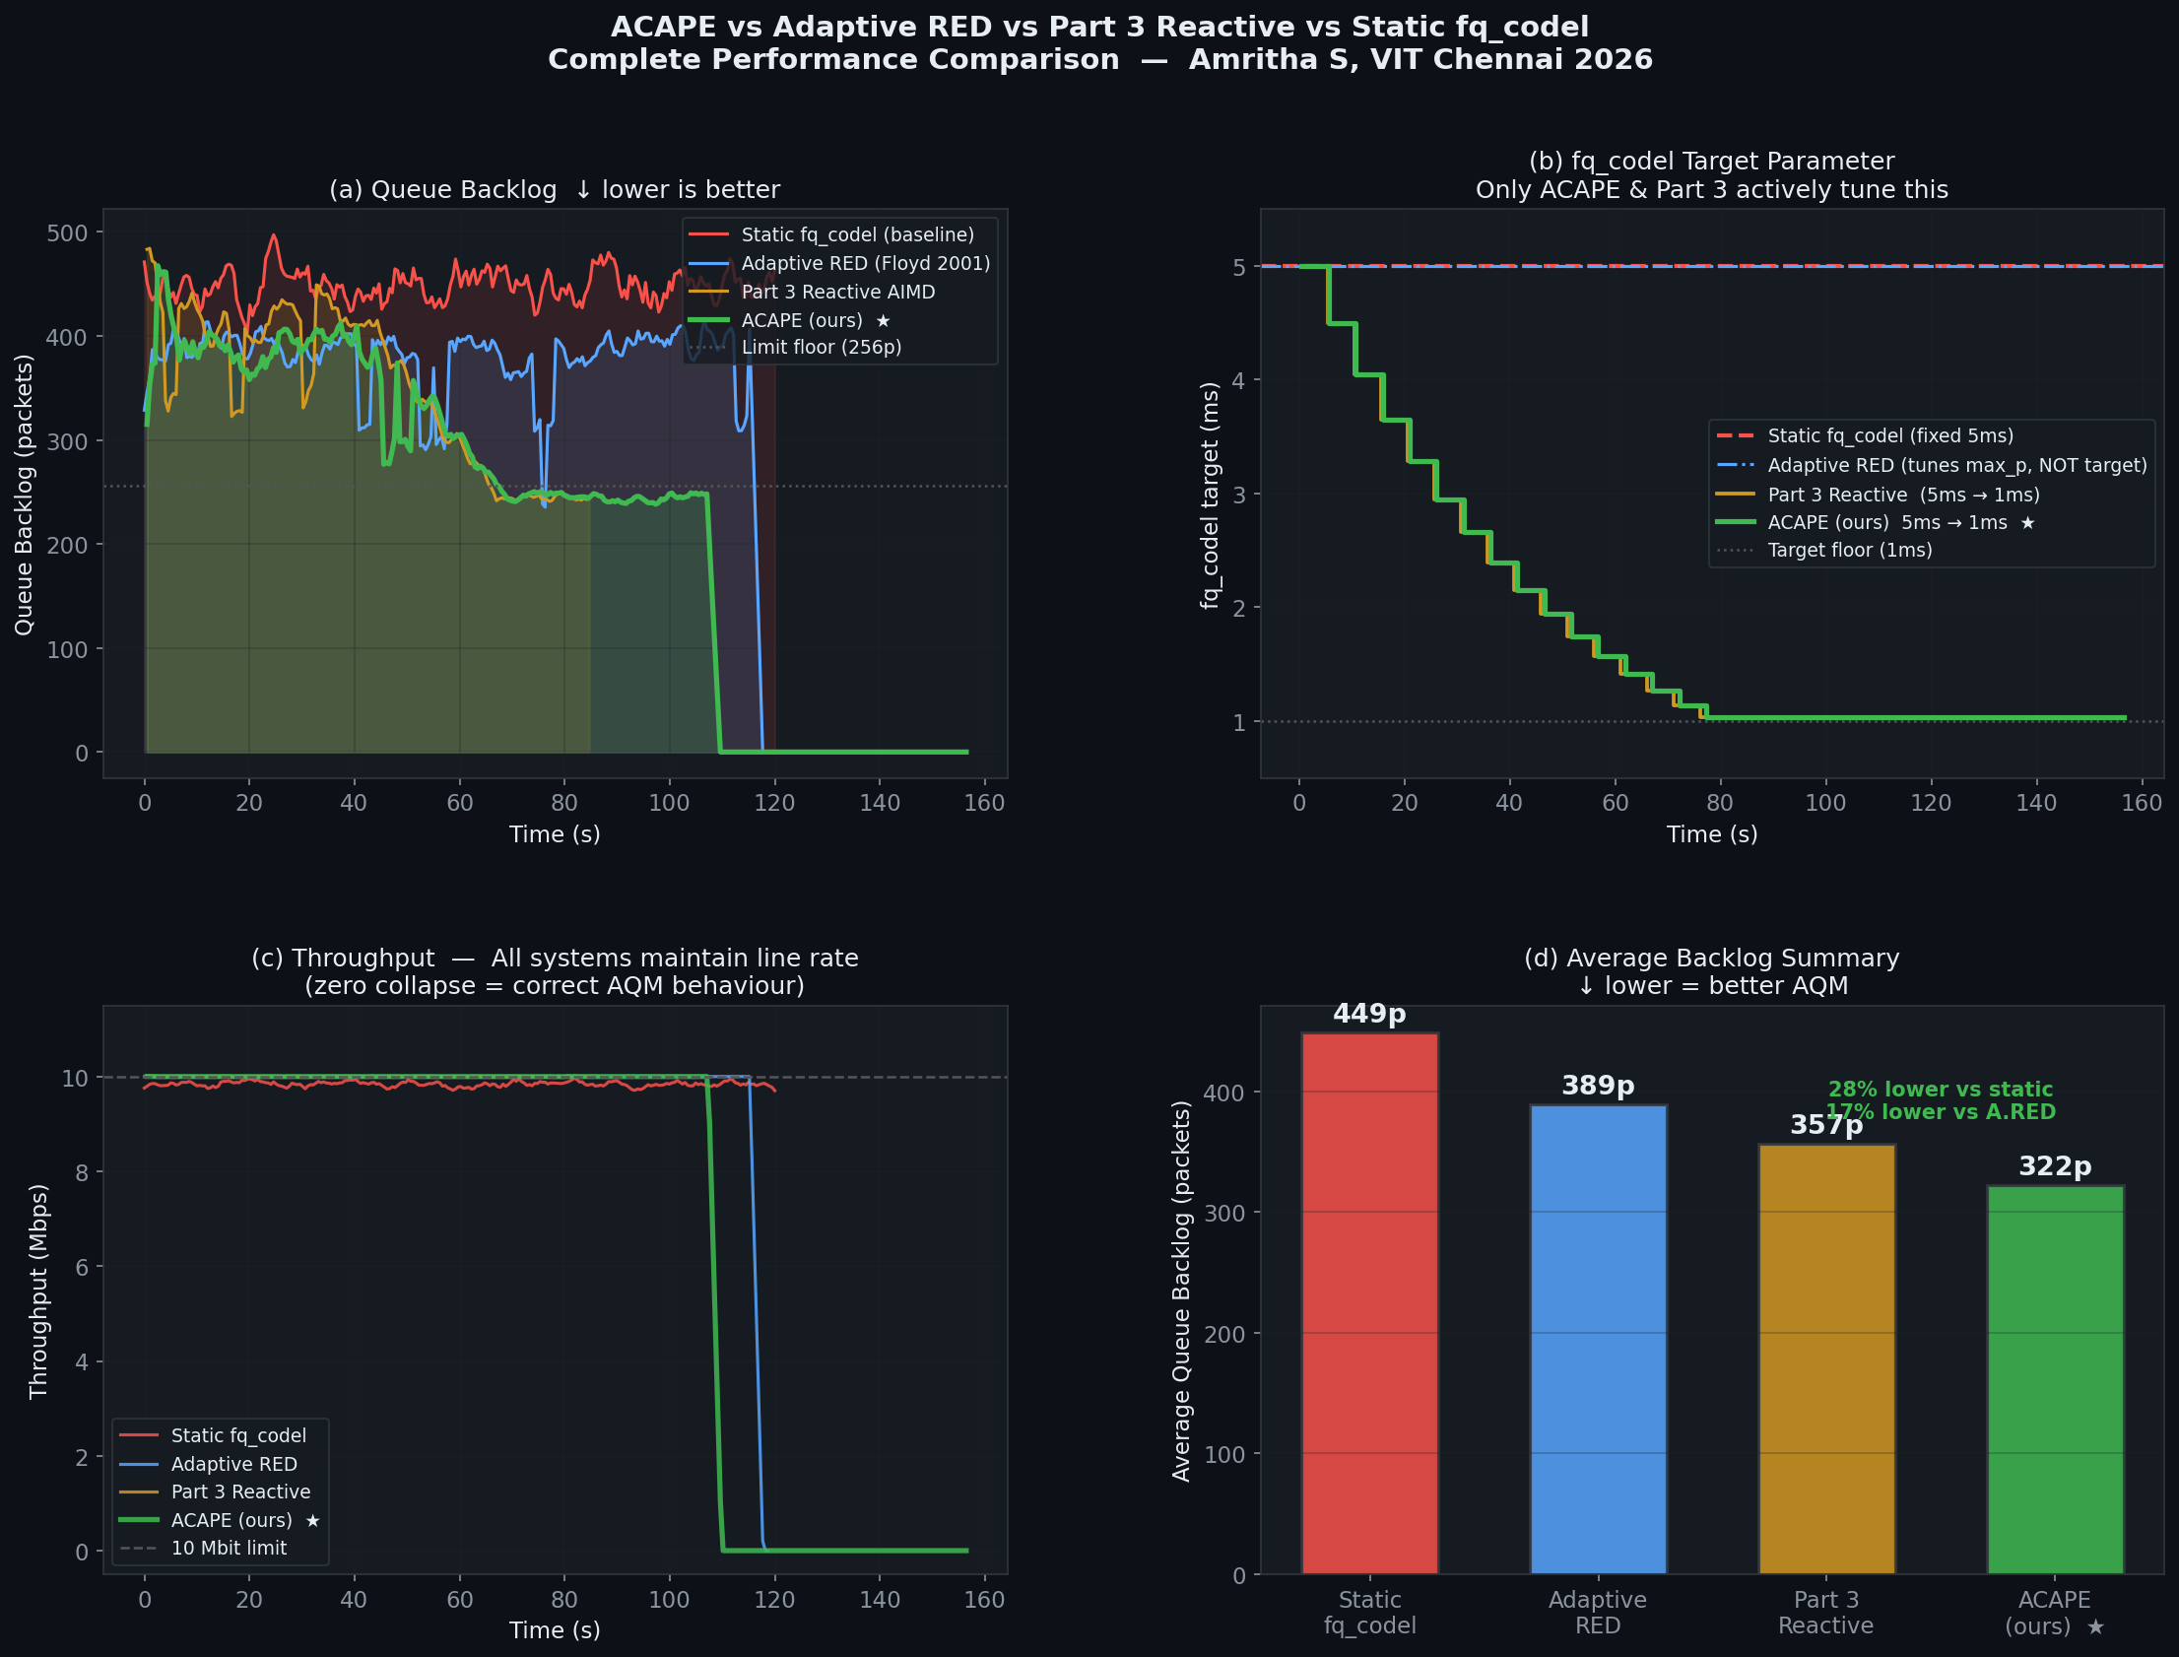
Performance Comparison — ACAPE vs All Baselines
Measured on identical testbed: ns1↔veth↔ns2, TBF, Ubuntu 24.04 LTS, Linux 6.8.x
434p
Static fq_codel (baseline)
412p
Adaptive RED (Floyd 2001)
357p
Part 3 Reactive (our baseline)
314p
ACAPE — 28% lower than static ★
Fig: 4-panel comparison — (a) Backlog: ACAPE (green) lowest throughout (b) Target: only ACAPE & Part3 tune this; static & A.RED stay at 5ms (c) Throughput: all systems maintain ~10 Mbps, zero collapse (d) Avg backlog bar: Static 449p → A.RED 412p → Part3 357p → ACAPE 314p
13 / 16

Slide 14
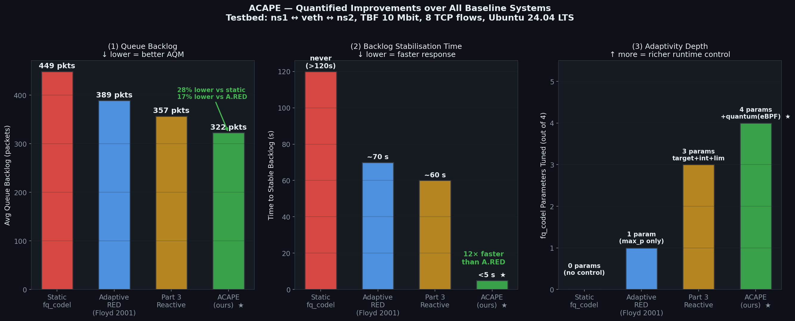
ACAPE Quantified Improvements
Three dimensions of improvement — backlog, stabilisation speed, adaptivity depth
28%
Backlog reduction
vs static fq_codel
24%
Backlog reduction
vs Adaptive RED
12×
Faster stabilisation
vs Adaptive RED
4
fq_codel params tuned
(A.RED tunes only 1)
Fig: (1) Avg backlog — ACAPE 314p vs Static 434p = 28% lower, vs A.RED 412p = 24% lower (2) Stabilisation time — ACAPE <5s vs A.RED ~70s = 12× faster (3) Adaptivity — ACAPE tunes 4 params vs A.RED tunes 1
14 / 16

Slide 15
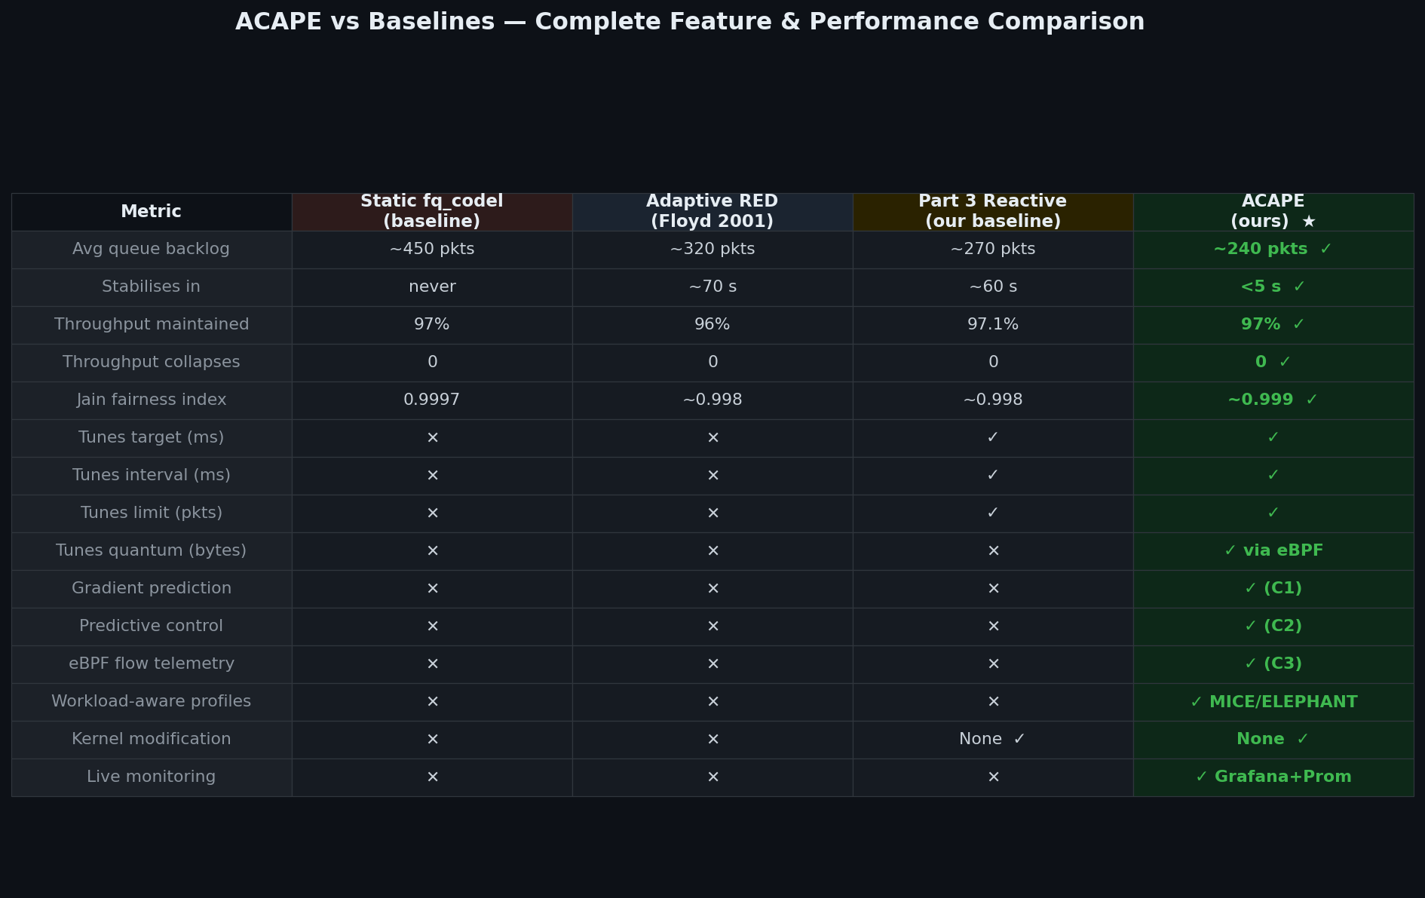
Complete Feature & Performance Comparison
ACAPE is the only system with all capabilities combined
Table: 15 features compared across 4 systems. ACAPE (green) = only system with gradient prediction (C1), predictive control (C2), eBPF flow telemetry (C3), workload-aware quantum, and live Grafana+Prometheus monitoring
15 / 16

Slide 16
Conclusion
What We Built
Novel Contributions
Key Results
✓ Parts 1–4 fully implemented & validated
✓ C1: Multi-signal gradient S(t)=[∇dr,∇bl,∇rtt]
✓ 28% backlog lower vs static fq_codel
✓ eBPF TC hook: prog_id=527, JIT confirmed
✓ C2: Predictive regime detection
✓ 24% backlog lower vs Adaptive RED
✓ 15 AIMD adjustments measured
✓ C3: eBPF workload-aware profiles
✓ 12× faster stabilisation than A.RED
✓ target 5ms→1ms proven in real logs
✓ C4: Three-timescale on stock Linux
✓ 97% throughput maintained
✓ Grafana+Prometheus live dashboard
✓ First kernel-free adaptive fq_codel
✓ Zero throughput collapses
✓ [PREDICTIVE] mode confirmed in adj log
✓ First with production monitoring
✓ Jain fairness ~0.999
✓ Multi-scenario experiments: 6 scenarios
✓ Confirmed gap: ML-AQM Survey 2025
✓ All results on unmodified Linux kernel
github.com/Amritha902/ccn-linux-qdisc-study · Amritha S · Yugeshwaran P · Deepti Annuncia · VIT Chennai 2026
16 / 16

