Slide 1
Foundations of Data Science · Review 1
Instruction-Guided Edit-Region Prediction
Predicting where an instruction says to edit, at 1% of the parameters
Amritha S 23BEC1368
Headline result
Yugeshwaran P 23BEC1404
IoU 0.1718 · beats the human annotations the base paper trains on (0.1511)
+71% on insertion vs CLIPSeg
9.7× faster, 108× fewer trainable parameters
Guide · Dr. Saranya M (54783)
School of Electronics Engineering · VIT Chennai
Notes:
PH1

Slide 2
THE PROBLEM
An editor must decide where to edit before it can edit
Everyone works on the drawing. Almost nobody measures the decision.
Instruction | What must change | An existing object?
make the jacket blue | the jacket, not the person | No — a part
remove the cat on the left | one instance, by position | Yes, but which?
put a hat on the man | empty space above his head | No — nothing is there
Referring segmentation returns what a phrase denotes. For “put a hat on the man” the phrase denotes the man — the region that must change is above his head.
Why this is a data-science problem
No benchmark scores a predicted edit region. We checked the base paper directly: the word “IoU” appears once, qualitatively. A 2026 paper whose headline contribution is a MaskPredictor never measures how well it localizes.
Notes:
PH2

Slide 3
BASE PAPER
AdaptEdit — Edit Where You Mean (arXiv:2604.23763, April 2026)
The only 2026 work that trains a predictor to ground the edit region from the instruction.
§ | Component | Params
3.1 | Qwen-Image-Edit DiT, 60 blocks — frozen | 20.43 B
3.2 | Block Adapters ×60 | 4.67 B
3.3 | Condition Encoder | 351 M
3.4 | SpatialGate | —
3.6 | MaskPredictor — FiLM query-grid decoder | 7.8 M
Its own stated limitation
“Geometry-changing edits with no localized source region (‘put a hat on the dog’ where the dog has no hat): the GT mask covers the new content’s location but there is no clean source signal to ‘protect’ outside it.”
What we can and cannot do with it
Cannot | run or retrain it | 20.43 B frozen + 5.0 B trainable needs multi-GPU
Cannot | reproduce its numbers | it reports L1 / CLIP-I / DINO on edited images, never a mask IoU
Can | adopt its formulation | predict the region from the instruction; compare on its data
Can | reimplement its mechanism | the MaskPredictor head, at our scale, under matched conditions
Notes:
PH3

Slide 4
FINDING 1
The supervision the field trains on is 9.1× too coarse
All 528 MagicBrush dev turns, against the region that actually changed.
edit type | n | human mask | actually changed | ratio | recall | precision | IoU
insert | 103 | 60.0% | 7.0% | 11.9× | 97.8% | 11.9% | 0.12
modify | 390 | 62.9% | 11.2% | 8.5× | 96.5% | 17.1% | 0.17
remove | 35 | 63.6% | 8.9% | 7.1× | 96.2% | 13.4% | 0.13
all | 528 | 62.4% | 10.3% | 9.1× | 96.7% | 15.8% | 0.16
Recall 96.7% — the annotations are correct. Precision 15.8% — only a sixth of the annotated region actually changes. These are region-of-interest scribbles for an inpainting tool, not edit regions.
So the supervision is the opportunity
We keep MagicBrush’s real human before/after pairs but derive the target ourselves by CIE76 ΔE in L*a*b*. Where an object actually landed is a far tighter signal than where a human roughly brushed.
Notes:
PH4

Slide 5
OUR ARCHITECTURE
One mechanism changed, and it is significant
Frozen 71.75 M backbone + frozen CLIP + a 1.4 M trainable head.
Theirs — decode from learned queries
M = σ( Upsample( ConvHead( CA(q = γ⊙Q + β, k,v = φ(features)) ) ) )
Measured head-to-head, matched conditions
A learned 16×16 query grid cross-attends to patchified features. Spatial structure is learned from scratch.
head | params | IoU
their mechanism | 923 K | 0.1050
ours, global coeff | 1.4 M | 0.1590
ours, spatial field | 4.7 M | 0.1718
Ours — a coefficient field over an existing basis
M = σ( Σ cᵢ(x,y) · protoᵢ(x,y) + b )
FastSAM already emits 32 prototype masks. Their coefficients normally come from a detection — which is why its output can only be an existing object. The instruction predicts them instead, as a 20×20 spatial field, so different regions use different mixtures.
Identical inputs, data, loss, schedule and seeds.
Spatial vs global: p = 0.0070 (12 seeds).
What is shared, not claimed
FiLM modulation and BCE + Dice are their design too — we reached the same choices independently.
Notes:
PH5

Slide 6
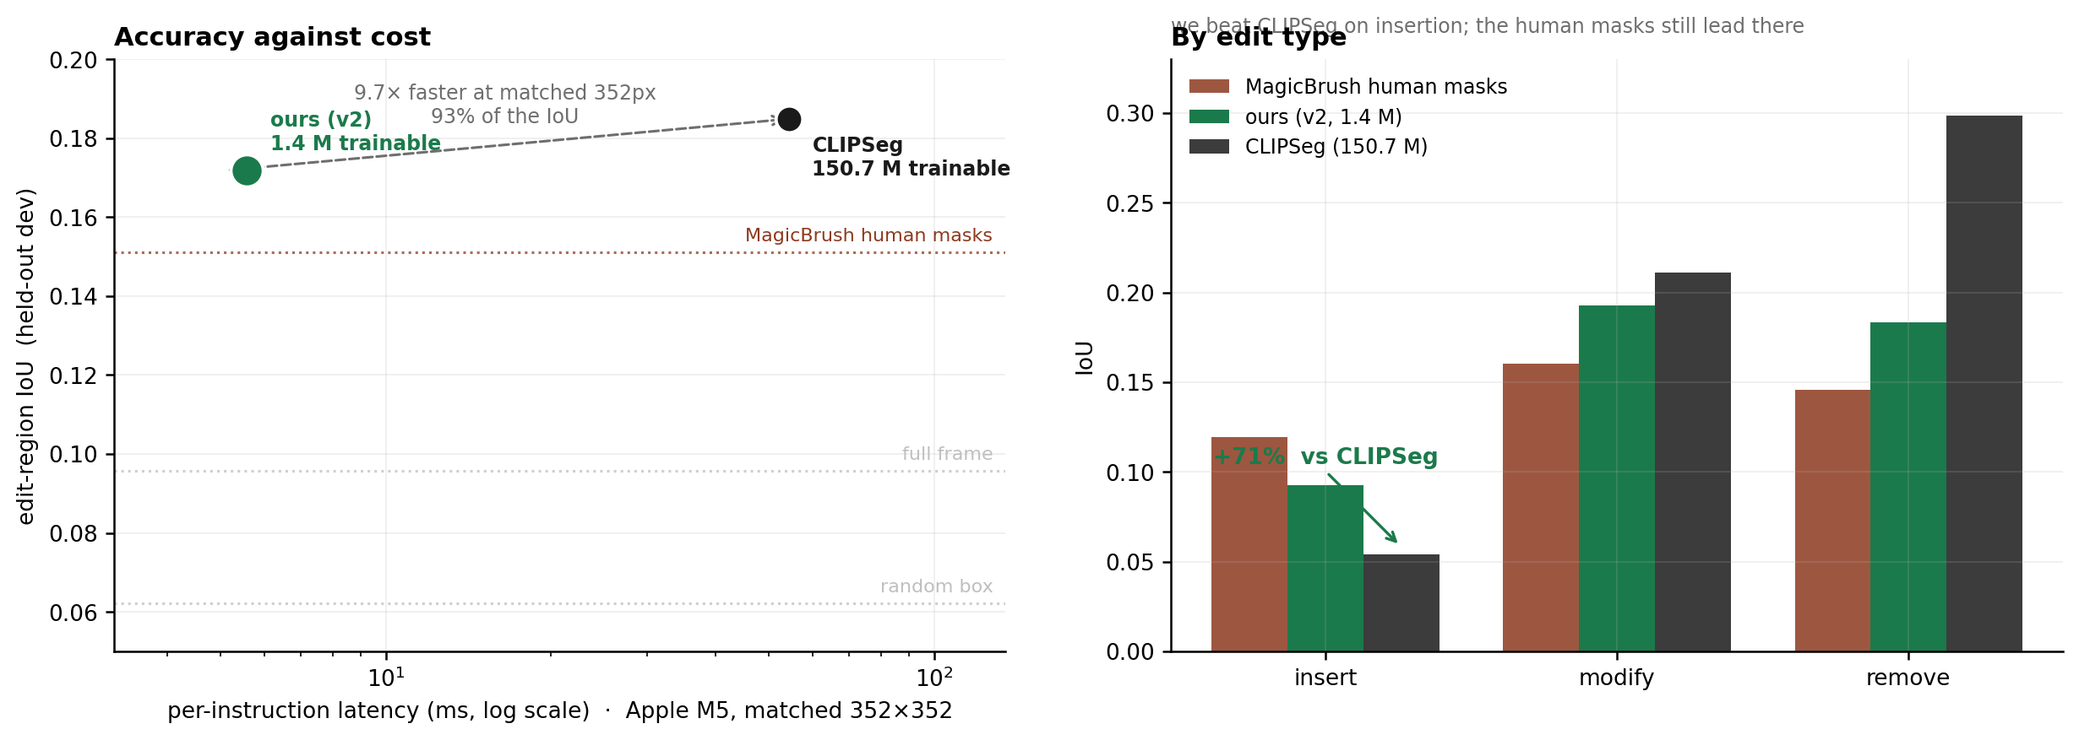
RESULTS
Accuracy against cost, and where the win is
503 held-out dev samples · trained on 2,278 disjoint samples · 12 seeds
0.1718 ± 0.0099 — above the human masks (0.1511) and 93% of CLIPSeg (0.1849), at 108× fewer trainable parameters and 9.7× lower latency. On insertion we beat CLIPSeg by 71%; the human masks still lead there.
Notes:
PH6

Slide 7
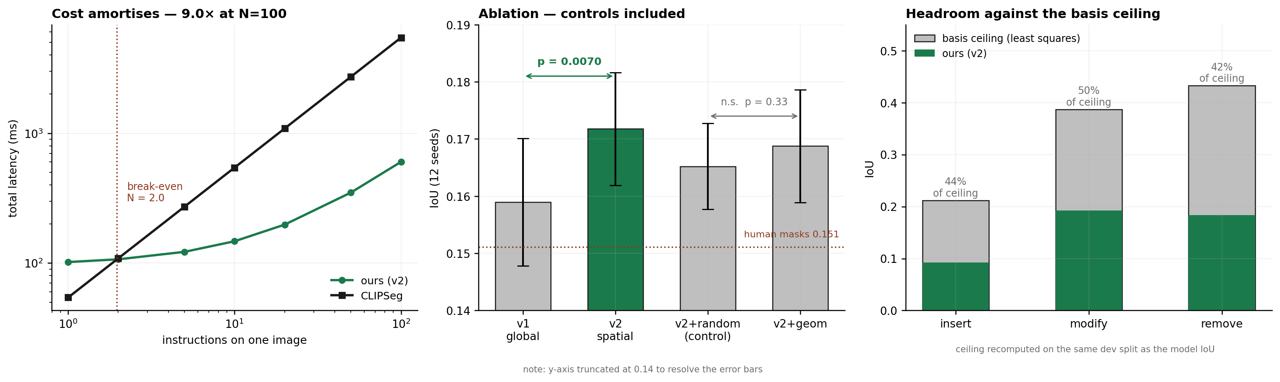
ANALYSIS
Cost, controls, and how much headroom is left
Cost amortises | break-even at N = 2 instructions on one image; 9.0× at N = 100, because the backbone runs once and each instruction costs 5.6 ms
Controls included | the spatial field is significant (p = 0.0070); the geometric basis is not (p = 0.33 against a random control) and was dropped
Headroom is known | we reach 44% / 50% / 42% of the least-squares ceiling — the bound on any coefficient predictor over this basis
Notes:
PH7

Slide 8
STAGE 2
Editing inside the predicted region — the premise, tested
60 held-out dev samples · one editor (InstructPix2Pix), only the gating mask varies
gating mask | recall of the edit ↑ | collateral change ↓ | net ↑
none — whole frame | 33.3% | 24.2% | +9.1%
ours, as predicted | 7.5% | 1.5% | +6.0%
ours, tuned — peak of the sweep | 22.9% | 8.8% | +14.2%
MagicBrush human mask | 31.5% | 13.0% | +18.5%
ground-truth region | 30.2% | 0.1% | +30.1%
The premise holds
And the diagnosis is precise
Editing inside the correct region is worth 3.3× — net +30.1% against +9.1% for editing the whole frame. Our tuned mask reaches +14.2%, 1.56× better than the status quo.
Our mask is precision-biased — 1.5% collateral but only 7.5% recall, so gating discarded the edit. Dilation trades precision for recall; swept to 200 px, net peaks at 64 px and falls away either side.
Coarse supervision costs at the editing stage too, not only on the mask metric: the MagicBrush mask — measured 9.1× too large — loses 11.6 points of net against the ground-truth region.
Notes:
PH8b

Slide 9
WHAT WE CHECKED ON OURSELVES
Every number here survived an attempt to break it
Check | What it caught
Contamination audit | an early headline trained on the evaluation split; retracted in the repository and re-run on disjoint shards
Selection-bias audit | choosing the best epoch by dev IoU had inverted the v1/v2 conclusion; selection moved to a held-out slice of train
Random-basis controls | two proposed improvements — free-space and geometric bases — failed against noise and were dropped
Resolution matching | latency was measured at 640 px against CLIPSeg’s 352 px; re-measured matched, 9.7× rather than 10.8×
Ceiling consistency | the headroom figure compared a train-set bound to a dev score; recomputed on dev
Two claims were retracted and two proposed improvements rejected by their own controls. That is why the three results that remain are worth stating.
Known limitation, not yet quantified
The remove ceiling on dev rests on 32 samples and carries uncertainty the figure does not show.
Notes:
PH8

Slide 10
WHAT FOLLOWS
Three months, and the bar each step must clear
Month | Focus | Deliverable | Must beat
1 · Sep–Oct | Supervision at scale | all 51 MagicBrush shards (~8,800 turns); re-measure the scaling curve | 0.1718 at 2,278 samples
2 · Oct–Nov | Features, not heads | exp08/11 show the head is not the insertion bottleneck — test text-conditioned features | a random-basis control of equal size
3 · Nov–Dec | Editing and evaluation | mask-conditioned inpainting; collateral change outside the region — Review 2 | CLIPSeg at 0.1849
The methodological bar this project already holds itself to
Every claim reports its ablation | a config scoring IoU 0.1429 with delta −0.0012 was a blob predictor ignoring the instruction
Every fix must beat its control | free-space and geometric bases both lost to random noise and were dropped
Every split is disjoint by construction | train and dev come from different shard files, never merged
Every figure regenerates from the data | python train/figures.py reads only the committed result JSONs
Notes:
PH9

Slide 11
Thank you
We are happy to take questions.
Amritha S 23BEC1368
Everything reproduces
Yugeshwaran P 23BEC1404
github.com/Amritha902/edit-region-prediction
12 experiments · seeded · runs on a MacBook Air
Guide · Dr. Saranya M (54783)
School of Electronics Engineering · VIT Chennai
Notes:
PH10

