Slide 1

School of Electronics Engineering (SENSE)
Project-I (2026)
GaN Based Synchronous Buck Converter with an Improved Gate Driver
Student Name(s):
Sanjay Kumar 23BEC1447 · Aamir Abdullah 23BPS1197 · Amritha S 23BEC1368
Guide's Signature with Date
Guide:
Dr. Bindu — SENSE
Signature: _____________________
Programme / School:
B.Tech — SENSE, VIT Chennai
Date: _________________________
Review & Date:
Review-II · 30.09.2026 (Wednesday)
Approval is mandatory before every review. After signing, scan this slide and keep the scanned copy as Slide 1 of the presentation.
1
Notes:
[15 s] CORE. Project name and the one-line claim: a segmented GaN gate driver, and a measurement of what per-operating-point adaptation is actually worth.

Slide 2
Problem Statement & Background
Problem Statement:
When one GaN transistor switches, its fast voltage swing pushes charge into the gate of the other transistor, the one that is supposed to stay off. That gate rises to 1.65 V, and only 1.4 V is needed to turn it on. Both devices conduct at once and the supply shorts through them. (That 1.65 V is our device model’s; how much the result depends on the model is itself a finding, and it has its own slide.)
Background & Significance:
GaN half-bridges sit inside EV inverters and battery chargers. GaN is chosen because it switches fast, and that speed is exactly what causes this fault.
Existing Solutions:
Gate drivers that turn the device on in steps, clamp the off gate down, adjust the gap between the two switching edges, and hold the gate at −2 V [1]–[4]. Reported: 30.5 % less overshoot, 75 % less turn-off loss [5]–[7].
Limitations / Research Gap:
Nobody has measured what the re-tuning is worth. Those gains mix two different things: picking one good setting, and changing the setting while the converter runs. Only the second needs a sensor, a lookup table and a controller.
2
Notes:
[60 s] CORE — the 2-mark slide, the biggest block in the review. Land two things: the failure is real and specific (1.65 V on a 1.40 V threshold), and the gap is that prior work conflates 'better fixed settings' with 'settings that adapt'.

Slide 3
The closest published drivers
Ref | Author(s) & Year | Title / Source | Aim — what the paper sets out to do | Gap we found → what WE fill
BASE PAPER | Zhang, Yu, Leng, Cui, Deng & Ng (2020) | A Segmented Gate Driver for E-mode GaN HEMTs with Simple Driving Strength Pattern Control Proc. IEEE ISPSD, 2020, pp. 102–105 ieeexplore.ieee.org/document/9170108 | Segmented output stage on E-mode GaN: 7 slices, pattern timing 0.5–5 ns, strength set by one external bias resistor | Base paper. Same device, same architecture: E-mode GaN, segmented output stage, strength set by a pattern. Theirs is an ASIC with a fixed pattern set. We make every field programmable from an FPGA and price what the pattern space buys. We fill: the price of the pattern space: what an exhaustive search buys over their fixed pattern set.
11 | Wang, Tao, Xiao, Luo, He, Zhou, Zhang & Wang (2024) | High-Frequency Three-Level Gate Driver for GaN HEMT Bridge Crosstalk Suppression IEEE Trans. Power Electron., 39(1), 1343–1352 ieeexplore.ieee.org/document/10286072 | Three-level drive; capacitor–diode negative rail with a digitally-clamped zero level, to 5 MHz | Recent, GaN, and on exactly our failure mode. It suppresses crosstalk with added passives; we get the same protection from the Miller clamp already in the cell and measure its price at 0.04 %. We fill: whether the setting has to change with the operating point at all. It does not: 2.6 % of baseline.
12 | Wang, Sun, Yan, Ma & Xu (2024) | An Integrated Suppression Method of Both Gate-Source Voltage Oscillation and Crosstalk for GaN HEMT Gate Driver IEEE Trans. Power Electron., 39(11), 14643–14655 ieeexplore.ieee.org/document/10591431 | One driver addressing gate-source ringing and crosstalk together | Confirms the two effects are coupled, which is why our cost function prices loss and overshoot jointly rather than optimising either alone. We fill: both effects in one cost function, showing the objectives genuinely conflict (Pareto, slide 16).
13 | Cai, Ye, Lv & Chen (2026) | A High-Efficient GaN Driver With Hybrid Adaptive Dead-Time Control and Peak Delay Control for Synchronous Buck Converter IEEE Trans. Power Electron., 41(1), 279–290 ieeexplore.ieee.org/document/11146698 | Hybrid adaptive dead-time plus peak delay control on a GaN synchronous buck | The most recent adaptive dead-time driver we found, and it adapts the one field our leave-one-out test shows carries the whole benefit — and only at light load. We fill: which field is worth scheduling. Only dead time, and only at light load; drive strength is worth 0.00 %.
[10] is the base paper: E-mode GaN, segmented output stage, strength chosen by a pattern. All four are verified against the publisher record.
3
Notes:
[25 s] CORE — literature mark. Closest prior work. [8] adapts dead time, the one field we find worth scheduling — and it does so across a 0.2-2 A range, which is exactly the light-load corner our leave-one-out test shows carries all of that benefit. Independent support, not competition.

Slide 4
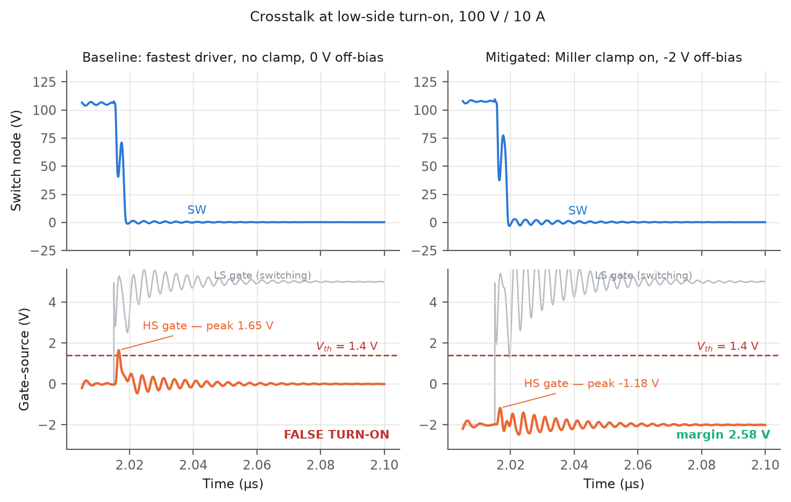
GaN against silicon — six parameters, measured
Same converter, same driver, same on-resistance class. Only the device changes.
Parameter | GaN HEMT | Si MOSFET | unit | GaN HEMT vs Si MOSFET
Latency, PWM → switch node at 50 % | 2.78 | 17.55 | ns | 6.3× less
Edge, 10 % → 90 % of bus | 0.78 | 6.65 | ns | 8.5× less
Power in the devices | 2.60 | 8.60 | W | 3.3× less
Power in the gate drive | 0.035 | 1.489 | W | 42.7× less
Converter efficiency | 97.42 | 95.06 | % | +2.36 pts
Switch-node overshoot | 17.9 | -1.5 | % | +19.4 pts
Read the last row honestly: GaN loses it. Silicon does not overshoot because its edge is nine times slower — the same slowness that costs it 6.1 W. Speed and device stress are the same knob, and choosing GaN is choosing to manage the stress.
ngspice on sim/buck.cir, 100 V → 50 V, 500 kHz, 10 Ω, 3 nH loop. Each device is driven at its own rated gate voltage — 5 V for GaN, 10 V for silicon — because a silicon MOSFET at 5 V would be barely enhanced and would lose on a technicality rather than on physics. Power is averaged over the last 20 of 150 whole cycles; latency and edge come from a separate 3-cycle run at a 0.02 ns step, because a 2 ns edge and a 300 µs average cannot share one transient.
4

Slide 5
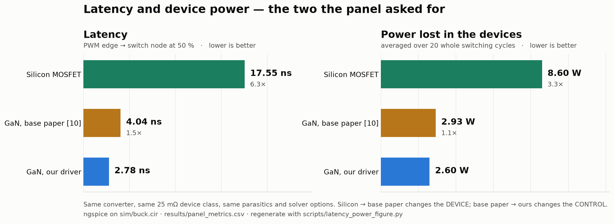
Latency and device power — the two you asked for
Same converter, same device class. Silicon → base paper changes the device; base paper → ours changes the control.
Fig. 1 — Simulated in ngspice. Latency 17.55 → 4.04 → 2.78 ns and device power 8.60 → 2.93 → 2.60 W. Against silicon that is 6.3× and 3.3×; against the base paper's control on the same GaN device, 1.5× and 1.1×. The device swap buys most of it and the control swap buys the rest — which is the honest shape of the result. Same file the tables read, results/panel_metrics.csv. scripts/latency_power_figure.py.
5

Slide 6
The gap this project fills
Every paper on these drivers reports one number: how much better it is than a plain driver.
That number hides two separate effects, and they cost very different hardware.
Effect 1: a better fixed setting
Effect 2: adapting per operating point
Pick one good setting once, at design time. Costs nothing while running: no sensor, no ADC, no lookup table, no controller.
26.5 %
of baseline
Change the setting as load, voltage and temperature move. This is the part that needs the sensing hardware.
2.6 %
of baseline
The gap. Nobody separates them. No paper says how much of the benefit actually needs the re-tuning, because separating the two means running every setting at every operating point — and nobody has done that.
Why it matters. Only Effect 2 pays for the sensor, ADC and lookup table. If it is small, that hardware is mostly buying something a design-time choice already gives you.
What we do. 720 settings × 36 operating points, all of them, in ngspice — then report the two numbers separately instead of adding them together.
6

Slide 7
The goal, and whether this serves it
The goal. Build a synchronous buck converter for an energy-storage system out of GaN HEMTs, and make it work at the switching speed GaN is bought for. Everything else in this deck exists to serve that sentence.
1. Why GaN at all
2. What GaN costs you
3. What we build about it
Same converter, same job, only the device swapped. At 500 kHz GaN wastes 6.2 W against silicon's 12.6 W. The lead widens to 78 % at 1 MHz and 90 % at light load, and never turns back.
Raising the frequency to shrink the magnetics is nearly free on GaN and ruinous on silicon.
The same speed that wins is what breaks it. A 1.4 V threshold and 150 pF of drain-to-gate capacitance mean the device that is supposed to be off gets pushed toward on by its partner switching.
Measured: the off gate reaches 1.65 V against a 1.4 V threshold. That is a shoot-through.
A segmented gate driver: 8 pull-up steps, 8 pull-down steps, an adjustable dead time, a Miller clamp and a −2 V off rail, driven by an FPGA, so every one of them is a setting that can be changed and measured.
Result: −0.249 V of margin becomes +2.576 V.
Title says converter, work says driver — one claim. On GaN the driver is the part that decides whether the converter is buildable at speed. Every number here is measured on the converter: 97.49 % open loop, 96.1 % regulated.
The next slide is that question, gap by gap, with the evidence for each.
7

Slide 8
Aim, and how we approached it
Aim:
To find out how much of a gate driver’s benefit needs the driver to re-tune itself while the converter is running, and how much comes from choosing one good setting and leaving it fixed.
Proposed Solution:
A GaN buck converter driven by a segmented gate driver: 8 pull-up steps, 8 pull-down steps, an adjustable dead time, a Miller clamp and a −2 V off rail. Every one of them is a setting we can change and measure.
How we approached it:
1. Build the converter and check it converts. 100 V DC in, 48.50 V DC out at 4.869 A: 236.26 W delivered, 97.49 % efficient.
2. Recreate the fault. At the fastest setting the gate that should be off reaches 1.65 V, against a 1.4 V turn-on threshold.
3. Fix it one change at a time, measuring each change on its own run, not all at once.
4. Ask whether one fixed setting is enough, by running the driver at two operating points and seeing whether the best setting moves.
Scope and tools:
In scope: the converter, the driver, its settings, and the FPGA controller. Out of scope: building hardware. Tools: ngspice for every simulation, LTspice to draw the circuit and re-check, Vivado for the FPGA.
8
Notes:
[30 s] CORE — proposed-solution mark. The 720-point control word and the method: exhaustive search at every corner, so each per-corner optimum is a TRUE optimum and not the best of a shortlist.

Slide 9
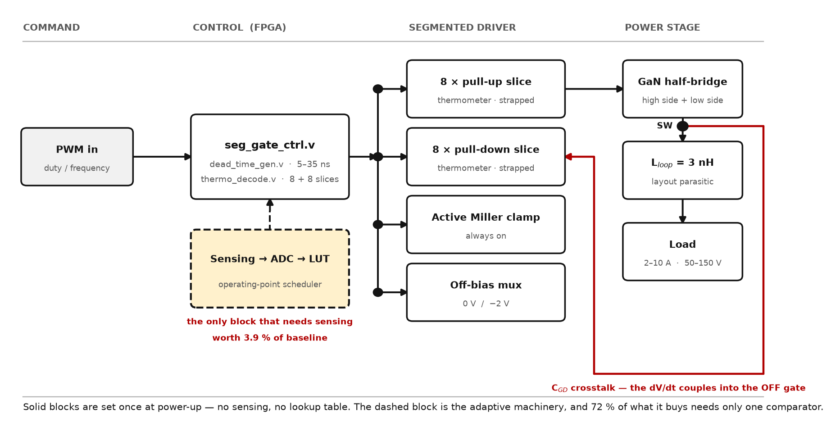
System Architecture
Fig. 2 — Drawn diagram, not simulation output. System architecture, left to right: PWM command, FPGA controller, segmented gate driver, power stage. The four driver blocks are what this project designs. Only the dashed block needs sensing, and measuring what it is worth is the project's question.
9
Notes:
[30 s] CORE. Walk the diagram left to right in one sentence, then stop on the dashed block: that is the sensing and lookup-table machinery the adaptive premise needs. The whole project is a measurement of what it buys. Let the picture do the work — do not narrate every box.

Slide 10
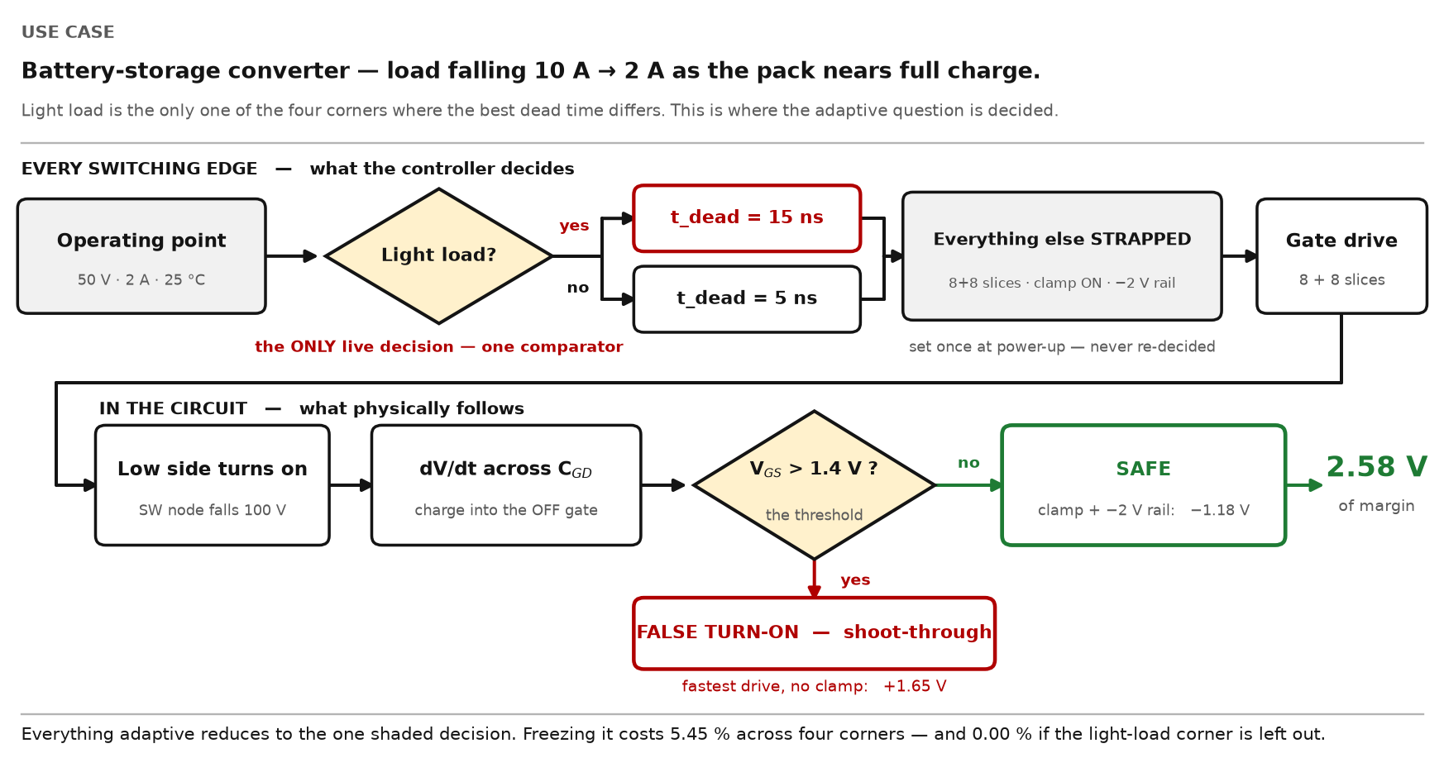
How it works — one use case, start to finish
Fig. 3 — Drawn diagram, not simulation output. One switching edge, followed through. Top row: the controller's decision. Bottom row: the circuit's response. Only the shaded diamond is decided at run time.
10

Slide 11
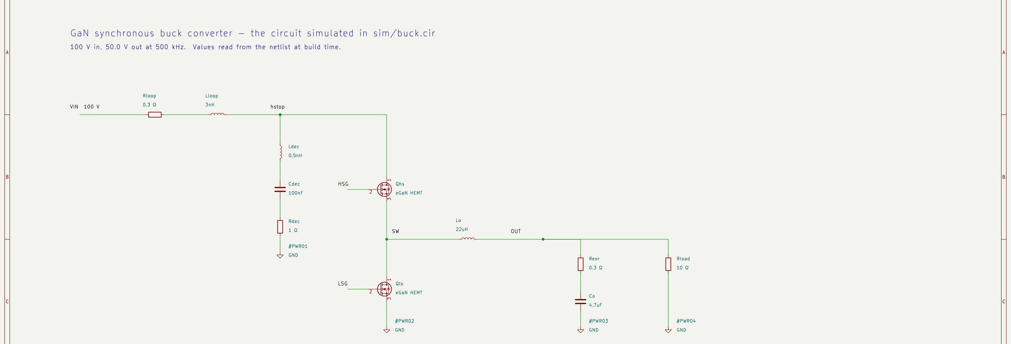
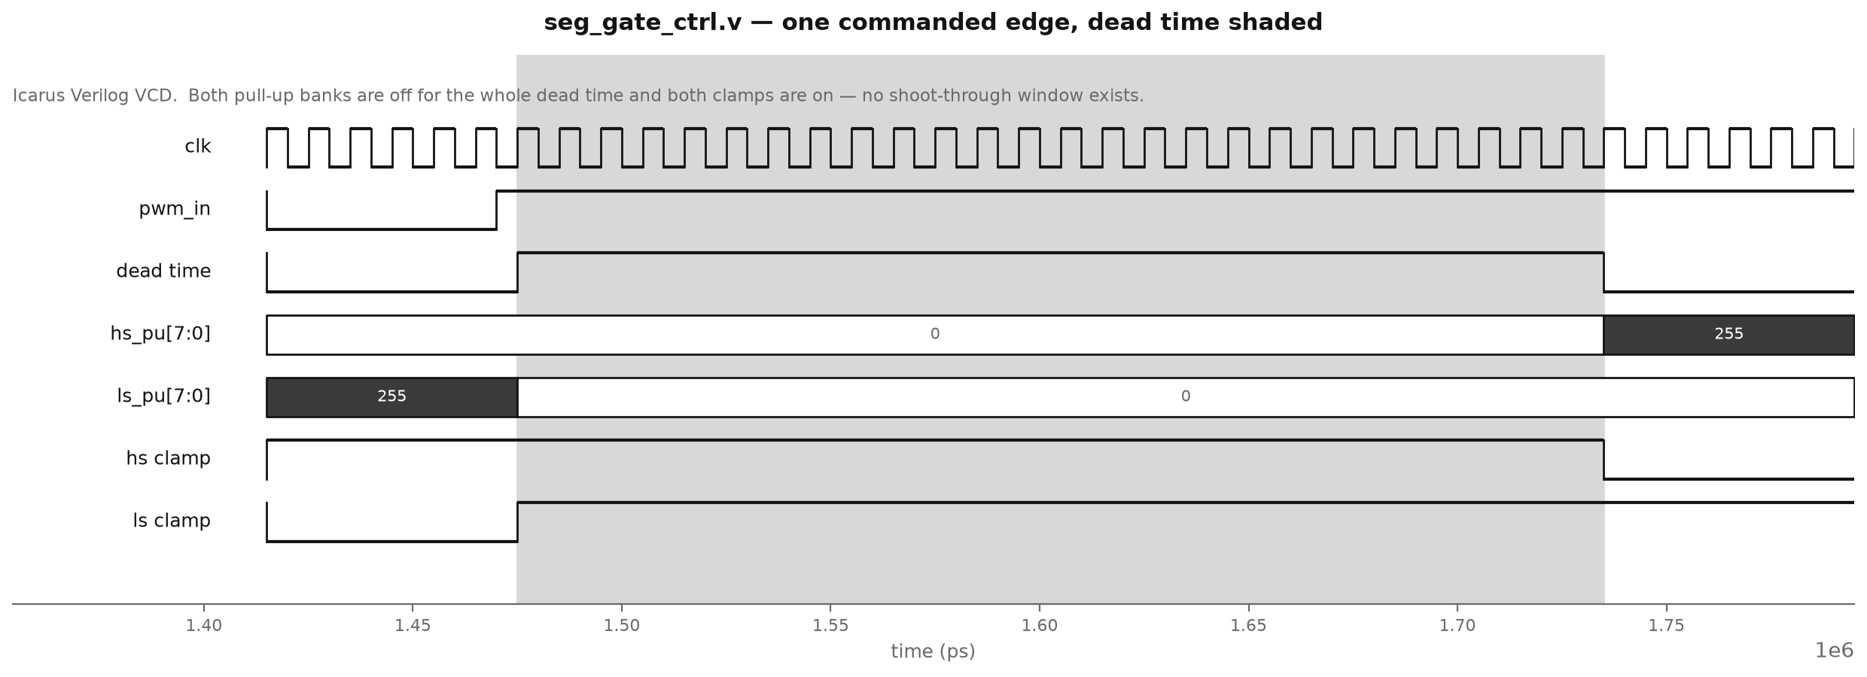
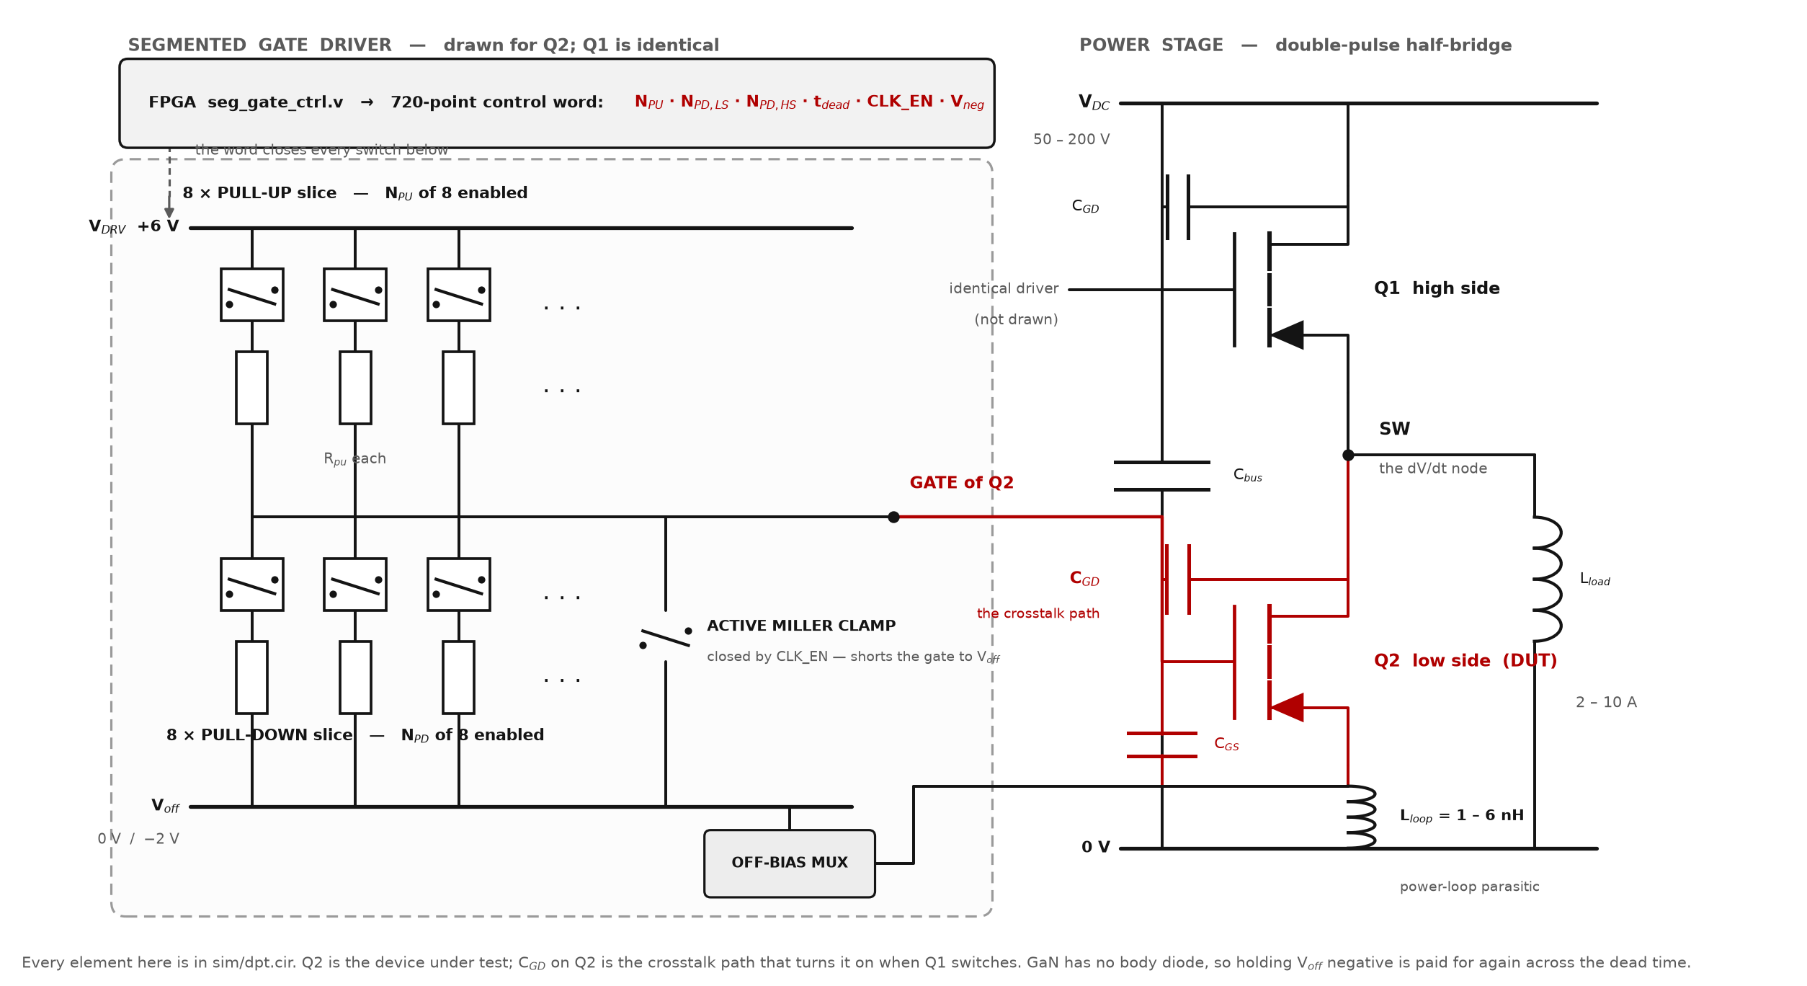
The circuit we simulate
Fig. 4 — Drawn diagram, not simulation output. GaN synchronous buck converter, drawn from sim/buck.cir by scripts/kicad_schematic.py — every value on it is read out of the netlist at build time. “Buck” means step-down: 100 V in, 48.50 V out. Left to right: the 100 V supply with its power-loop R and L, the damped bus decoupling branch (Ldec, Cdec, Rdec at 1 Ω), the two GaN HEMTs whose gates the segmented drivers drive, the output filter and a 10 Ω load.
11
Notes:
[30 s] CORE — use this the moment anyone asks what was actually simulated. Trace the red path with a finger: Q1 switches, the SW node moves, charge couples through C_GD into Q2's gate, and Q2 turns on when it should be off. Then point at the clamp and the off-bias mux — those are the two things that fix it. Do not read the component values out.

Slide 12
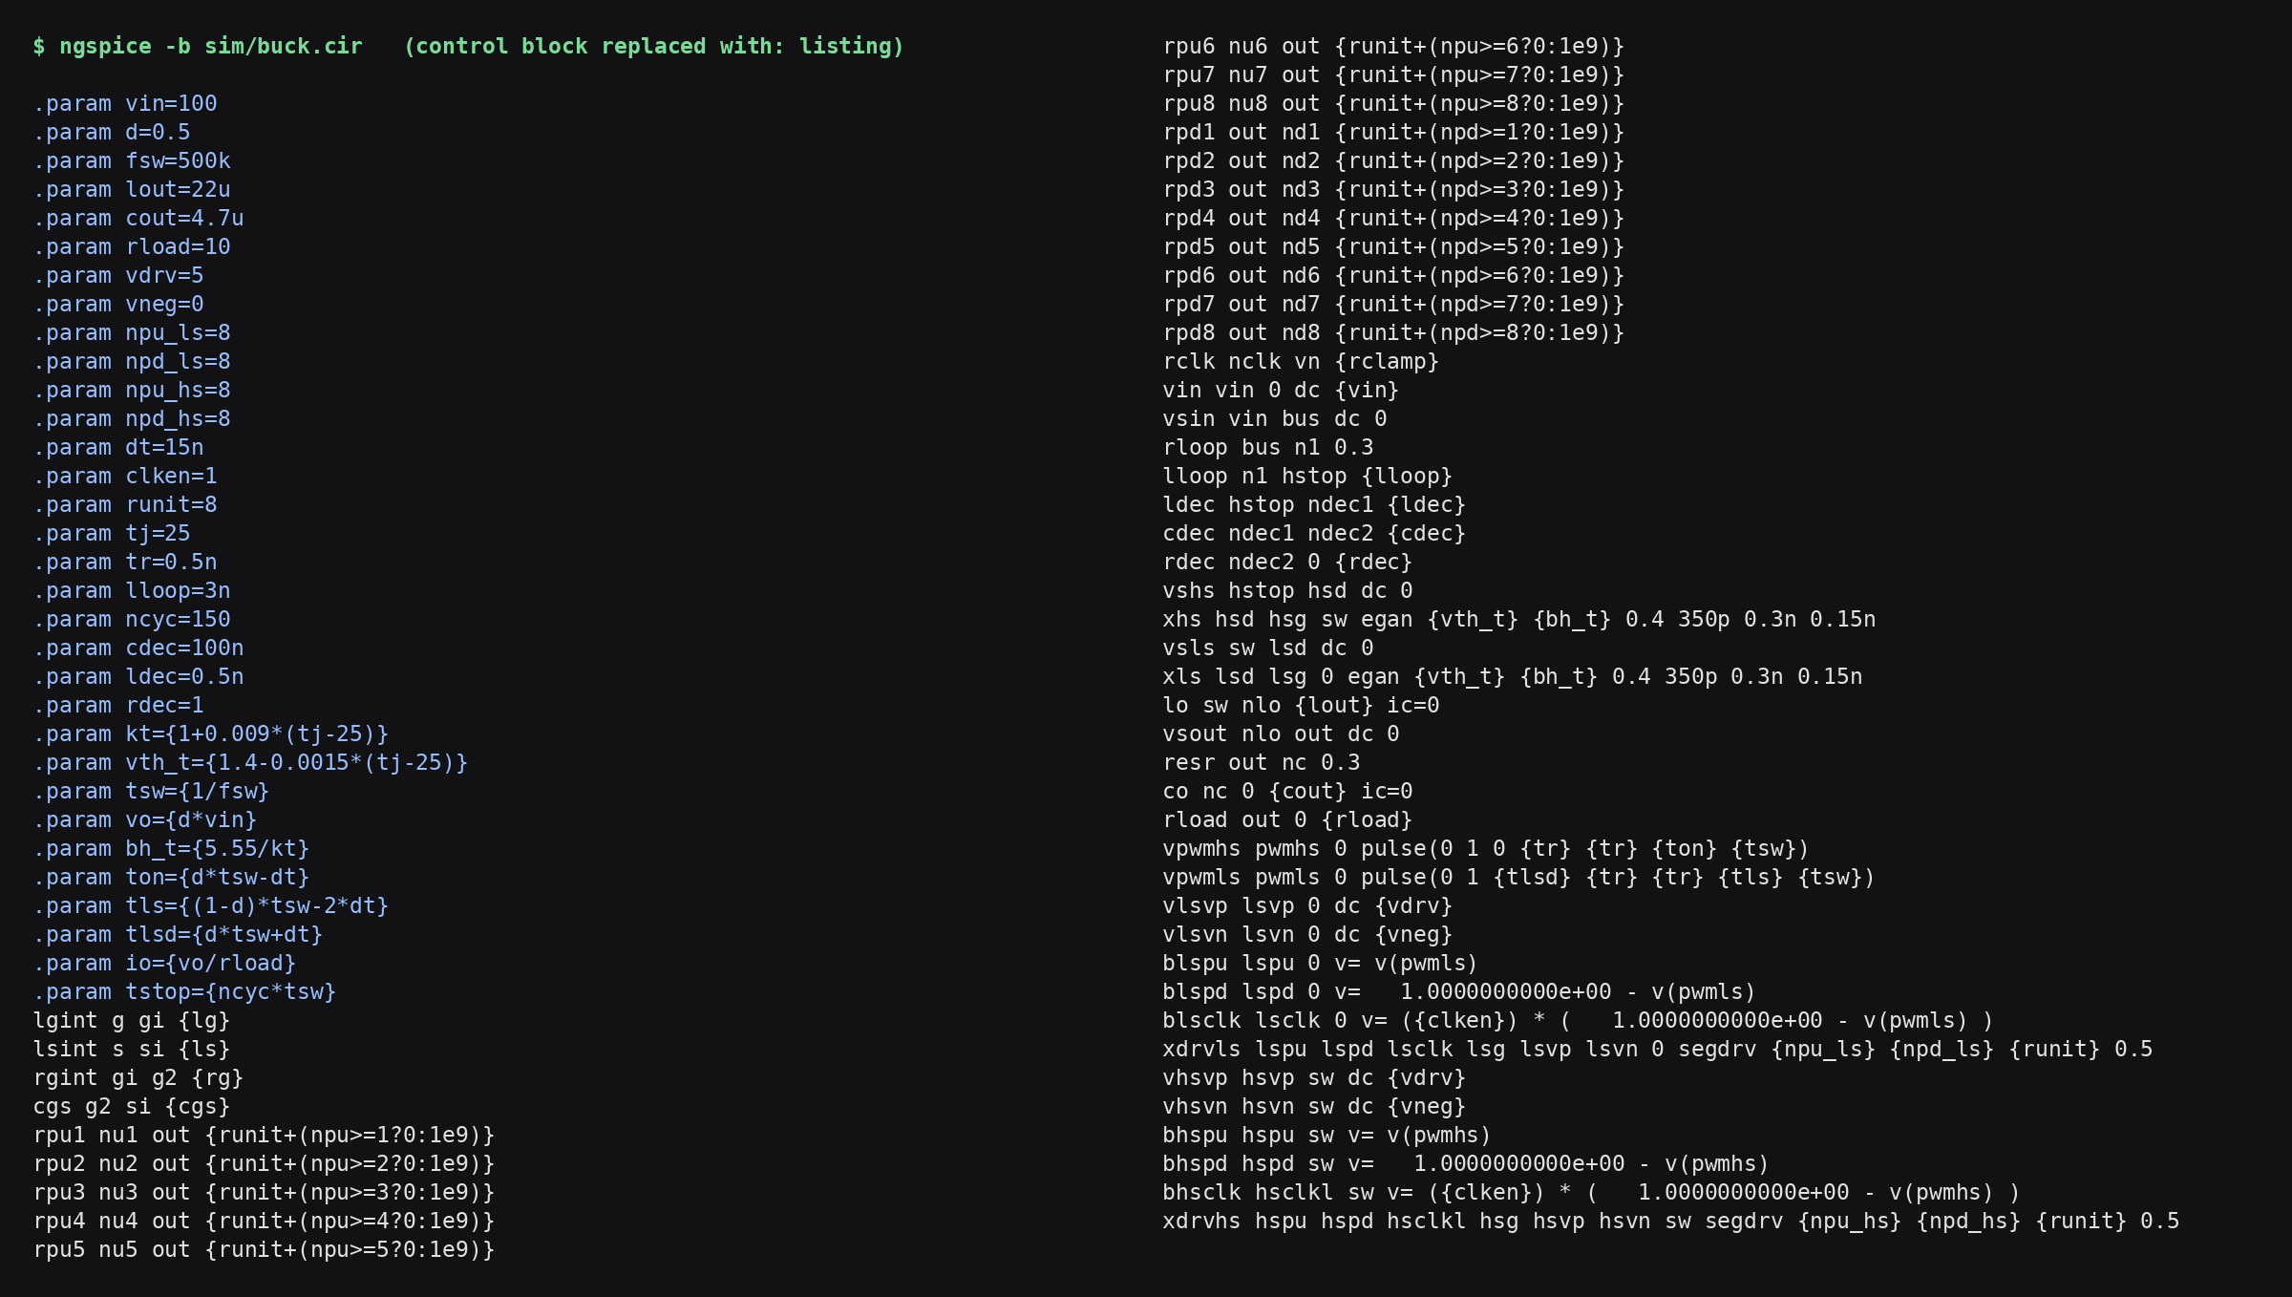
The circuit, as ngspice reports it
Fig. 5 — ngspice, on screen. ngspice cannot draw a schematic. It can say what it parsed, which is better evidence: a drawing is what somebody believes the circuit is, this is what was solved. Note rpu1–rpu8 and rpd1–rpd8 — the sixteen slices, switched in by {runit+(npu>=n?0:1e9)} — rclk the clamp, and rdec at 1 Ω, the damped value. scripts/netlist_listing.py regenerates it, so it cannot go stale.
12

Slide 13
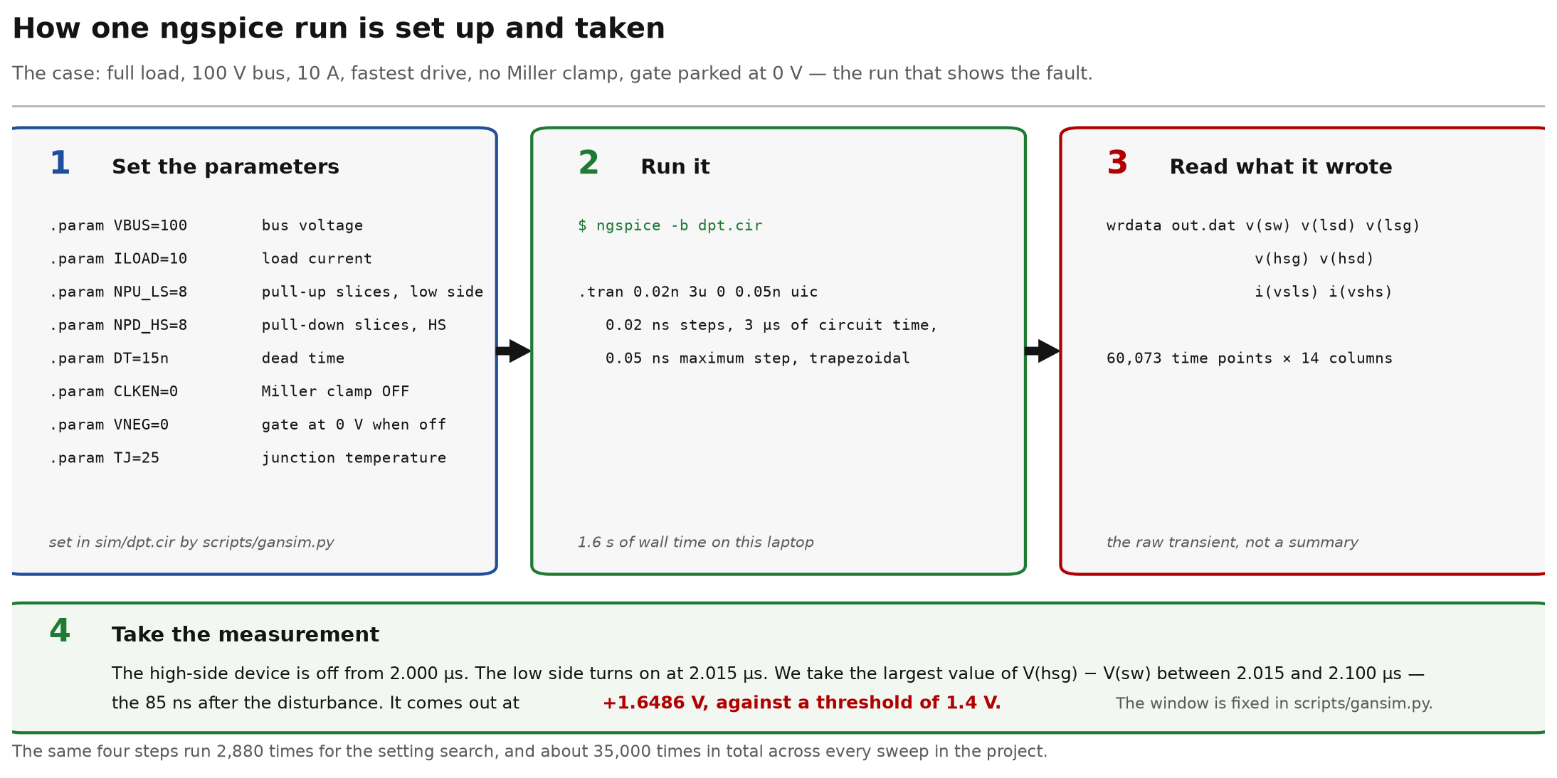
How we run ngspice
Fig. 6 — Drawn diagram, not simulation output. One case end to end: the parameters set into sim/dpt.cir, the command, what the simulator wrote, and the window the measurement is taken over. Full load, 100 V / 10 A, no clamp: +1.6486 V against a 1.4 V threshold.
13

Slide 14

Demo — the driver, built and measured, on this machine
Fig. 7 — Nine chapters, 103 s, click to play. The netlists as they are on disk, the KiCad sheets drawn from them, ngspice's own output from three runs made while the film was built, the waveforms those runs produced, and 7 result cards — each printing the file its number came from. The bench: +1.65 V on the OFF gate without the clamp against a 1.4 V threshold, −1.18 V with it. The converter: 48.50 V out at 236.26 W, 97.49 % efficient. Rebuilt by scripts/demo_review2.py, so every number on screen is computed, not captioned.
14

Slide 15
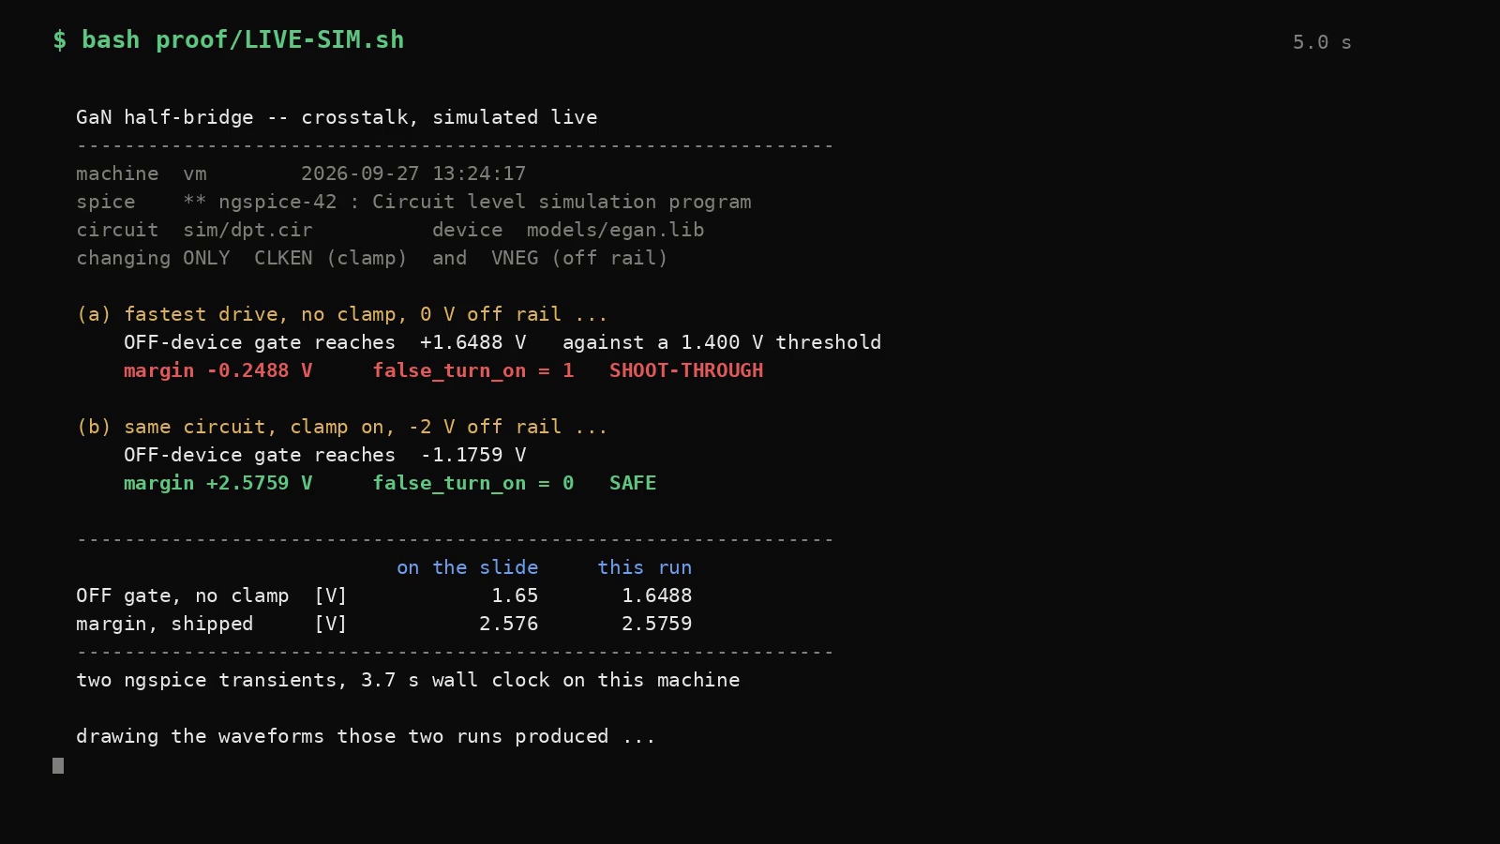
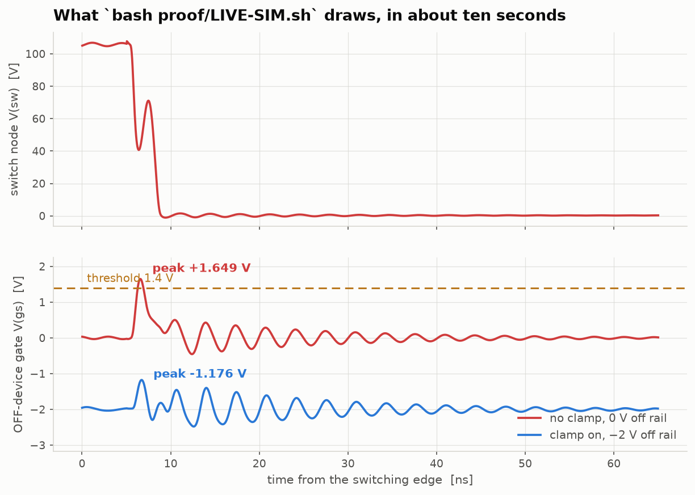
Or we can run it now
bash proof/LIVE-SIM.sh — two ngspice transients, about ten seconds, on whatever machine is in this room.
the recording, if the room will not cooperate
what it draws when it does
Fig. 8 — Simulated in ngspice. Two runs of ONE circuit file. Between them only CLKEN (the Miller clamp) and VNEG (the gate off rail) change, so nothing else can be moving. It prints what it measured beside what these slides claim — OFF gate 1.649 V against the deck's 1.65, margin 2.576 V against the deck's 2.576 — then draws the waveforms those two runs produced. 3.8 s of that is ngspice; the rest is drawing. scripts/live_demo.py.
15

Slide 16
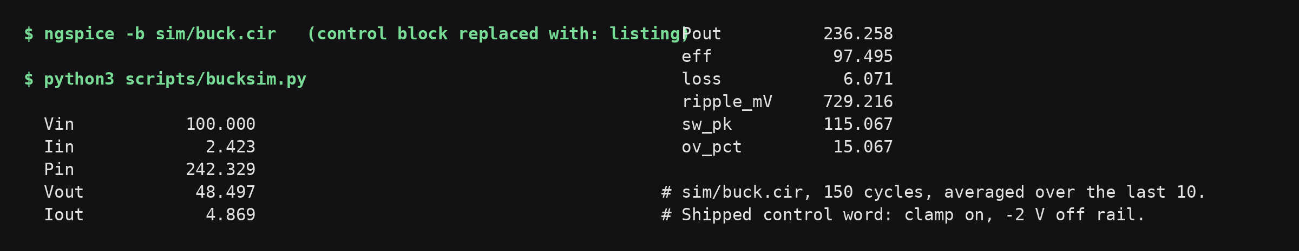
Circuit simulation — the converter
Fig. 9 — ngspice, on screen. scripts/bucksim.py driving ngspice over sim/buck.cir, on the shipped word. 100 V and 2.423 A in, 48.50 V and 4.869 A out: 242.33 W drawn, 236.26 W delivered, 97.49 % efficient. Peak switch node 115.1 V, 15.1 % overshoot at this deck's 0.2 ns step; resolving the edge at 0.02 ns gives 18.0 %, of which the −2 V rail is +11.3 points — the margin is not free. scripts/overshoot_audit.py. The two comparison tables read 97.42 % for this same word: those runs start pre-charged in steady state and average 20 cycles, this one starts from zero and averages 10. The gap is the start-up transient, not a disagreement.
16

Slide 17
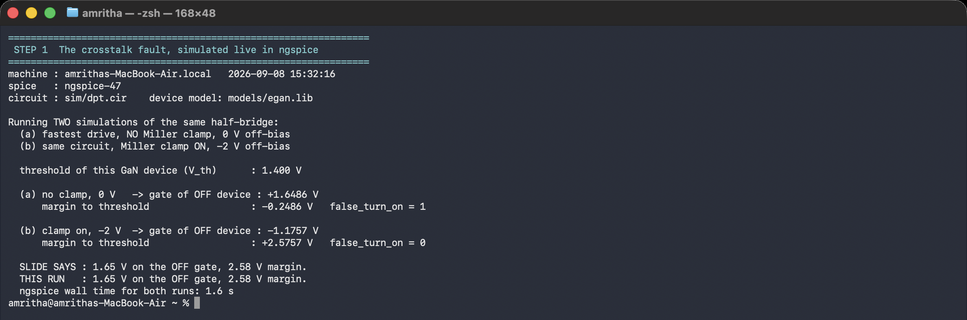
Crosstalk simulation — the fault, and the fix
Fig. 10 — ngspice, on screen. Two runs of sim/dpt.cir. TOP: the switch node falls from 106 V in 2.90 ns, peaking at 124 V/ns — that dv/dt drives i = C_GD·dv/dt into the OFF device's gate, and is the cause. BOTTOM: that gate. Without the clamp it rests at +0.005 V, is lifted +1.643 V and peaks at +1.649 V, past the 1.4 V threshold — false_turn_on = 1. With the clamp and the −2 V rail it rests at -1.941 V, is lifted only +0.765 V and peaks at -1.176 V — false_turn_on = 0. The two fixes are not one mechanism: the rail moves where the gate STARTS, the clamp shortens the LIFT by giving the injected charge a 0.5 Ω path out. scripts/waveform_anatomy.py.
17

Slide 18
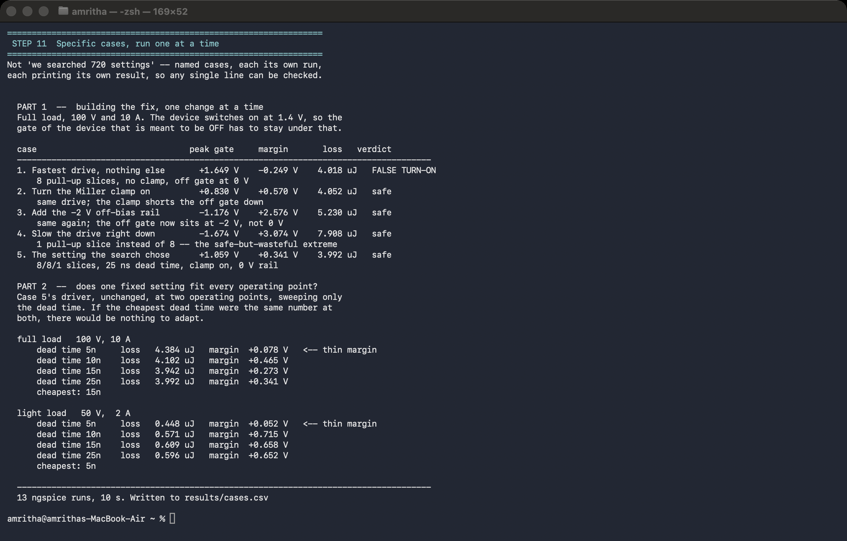
Driver simulation — the segmented driver, case by case
Fig. 11 — ngspice, on screen. scripts/cases.py, 13 runs. Part 1: the fix built one change at a time at 100 V / 10 A. Part 2: dead-time sweep at two operating points: cheapest is 15 ns at full load, 5 ns at light load.
18

Slide 19
FPGA Controller — verified RTL
Three Verilog modules that produce exactly the 720 settings the SPICE model uses.
Dead time is a live register; drive strength is fixed at power-up, worth 5.45 % against 0.00 %.
Eight checks pass in Icarus Verilog, safe reset included. A deliberately broken version is caught 221 times (sh rtl/mutate.sh).
Built in Vivado 2024.1.2 on an xc7a35t FPGA: 20 LUTs, 20 flip-flops, 0.10 % of the chip. 200 MHz timing is met, with 1.996 ns to spare.
Timing is met where the logic runs. The paths that miss are chip-output paths, where the output pad alone takes 3.49 ns of a 4 ns budget: pad delay, not logic.
Fig. 12 — Icarus Verilog output. Icarus Verilog VCD of seg_gate_ctrl.v. The pull-up banks never overlap; the shaded interval is the dead time.
19
Notes:
[BACKUP] BACKUP — the FPGA. If asked: written AND verified, eight asserted properties, then mutation-tested. Dead time gets a live register and drive strength is strapped, because that is what the study found.

Slide 20
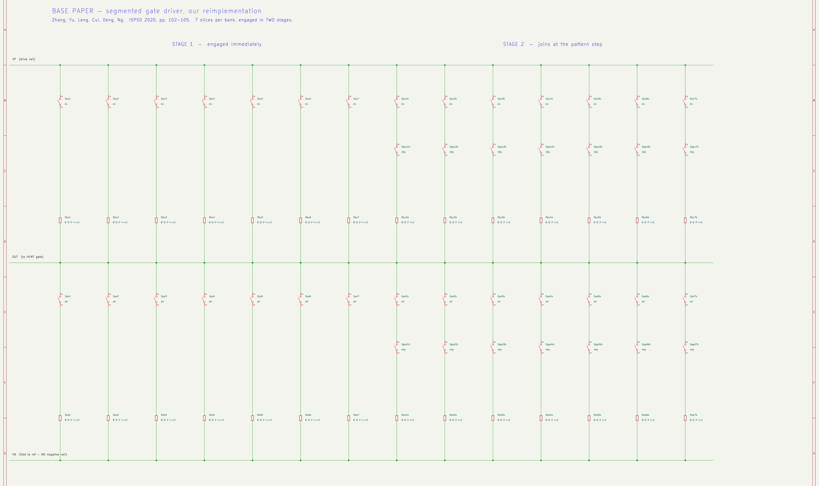
Their driver, drawn — the reimplementation
Zhang et al., ISPSD 2020, built as a schematic from our implementation of it.
Fig. 13 — Drawn diagram, not simulation output. 14 columns per bank, because their seven slices are split across two stages and each stage is its own branch. The stage-2 branches carry an extra series switch gated by the pattern step — that switch is their mechanism. Every resistor shows its own conditional, so the sheet can be checked against models/zhangdrv.lib line by line. No clamp branch, and the off rail is tied to its reference.
20

Slide 21
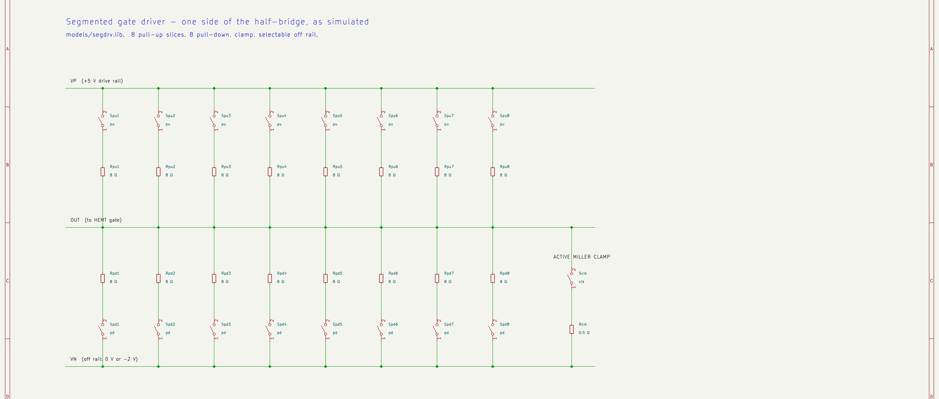
Our driver, drawn — the same stage, improved
models/segdrv.lib. Eight slices a bank, switching together, plus the two blocks they do not have.
Fig. 14 — Drawn diagram, not simulation output. Each slice is a switch and a resistor, and the resistor carries the code: Rpu3 is 8 Ω if the word asks for three or more slices and 1 GΩ if it does not. Drive strength is how many of the eight parallel paths are live. On the right, Sclk and Rclk — the active Miller clamp, pulling the gate to the off rail through 0.5 Ω.
21

Slide 22
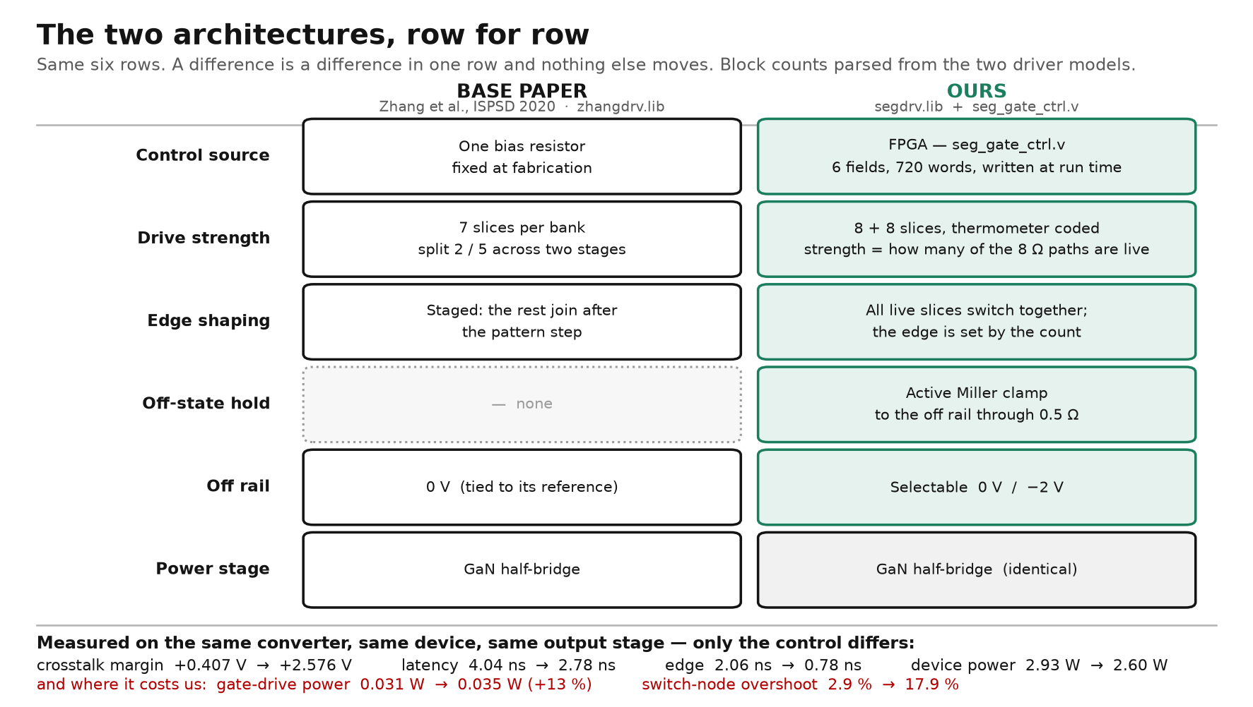
Base paper and ours, side by side
Six shared rows. A difference is a difference in one row, and nothing else moves.
Fig. 15 — Drawn diagram, not simulation output. Block counts and values are parsed from models/zhangdrv.lib and models/segdrv.lib, not restated from memory — if either library changes this figure changes with it. The one dotted row is the one they do not have. The red line is where our design loses, and it is on the slide for the same reason the rest of it is.
22

Slide 23
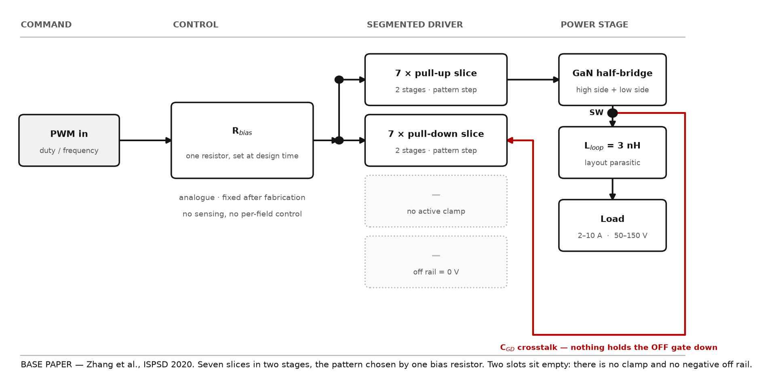
Their architecture — the base paper's blocks
Zhang et al., ISPSD 2020. One bias resistor sets the whole pattern.
Fig. 16 — Drawn diagram, not simulation output. Drawn to the same grid: a block that exists in both sits in the same place in both, so a missing block leaves a visible hole. The drawing and models/zhangdrv.lib are the same claim — seven slices, two stages, one bias resistor, no clamp, no negative rail — so either can be checked against the other. The two dotted slots are what their design does not have.
23

Slide 24
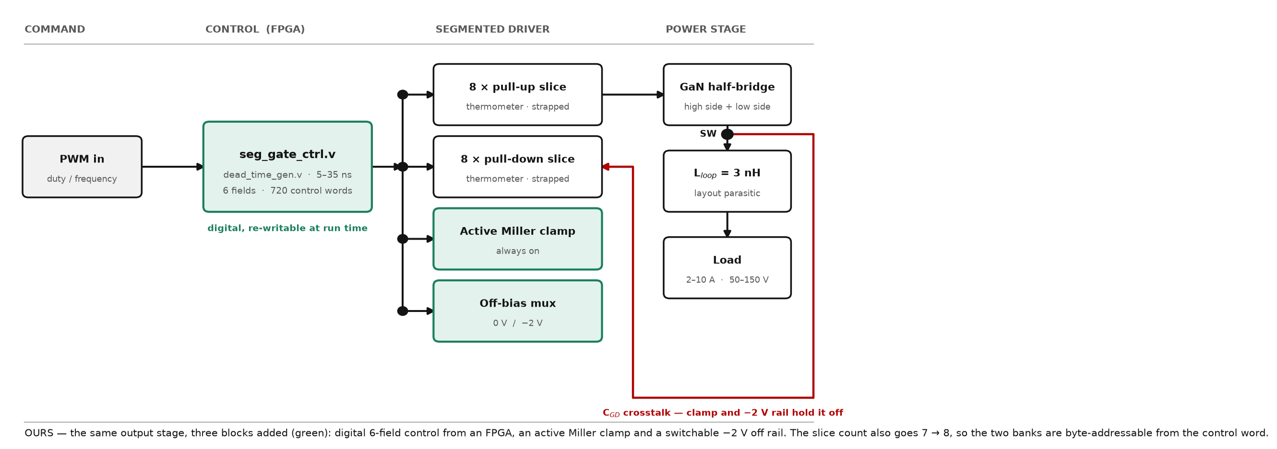
Our architecture — same stage, three blocks added
The same output stage. Three blocks added, in green.
Fig. 17 — Drawn diagram, not simulation output. Drawn to the same grid: a block that exists in both sits in the same place in both, so a missing block leaves a visible hole. The drawing and models/zhangdrv.lib are the same claim — seven slices, two stages, one bias resistor, no clamp, no negative rail — so either can be checked against the other. Green marks what is ours: digital 6-field control, the active clamp, the switchable −2 V rail.
24

Slide 25
Theirs and ours — six parameters, measured
Same converter, same GaN device, same output stage. Only the control changes.
Parameter | Ours | Base paper | unit | Ours vs Base paper
Latency, PWM → switch node at 50 % | 2.78 | 4.04 | ns | 1.5× less
Edge, 10 % → 90 % of bus | 0.78 | 2.06 | ns | 2.6× less
Power in the devices | 2.60 | 2.93 | W | 1.1× less
Power in the gate drive | 0.035 | 0.031 | W | 1.1× more
Converter efficiency | 97.42 | 97.31 | % | +0.11 pts
Switch-node overshoot | 17.9 | 2.9 | % | 6.2× more
The last two rows are ours to answer. We spend 11 % more gate power and we overshoot 15 points harder, because we switch faster. That buys 1.3 ns of latency, 0.33 W in the devices and the crosstalk margin on the next slide.
ngspice on sim/buck.cir with the driver subcircuit swapped: models/segdrv.lib against models/zhangdrv.lib. Identical devices, parasitics, timing and solver options, so any difference here is the control scheme and nothing else. Their pattern step is a delayed copy of their own PWM, so it lands the same distance after turn-on on every cycle, which is what their one-knob scheme does.
25

Slide 26
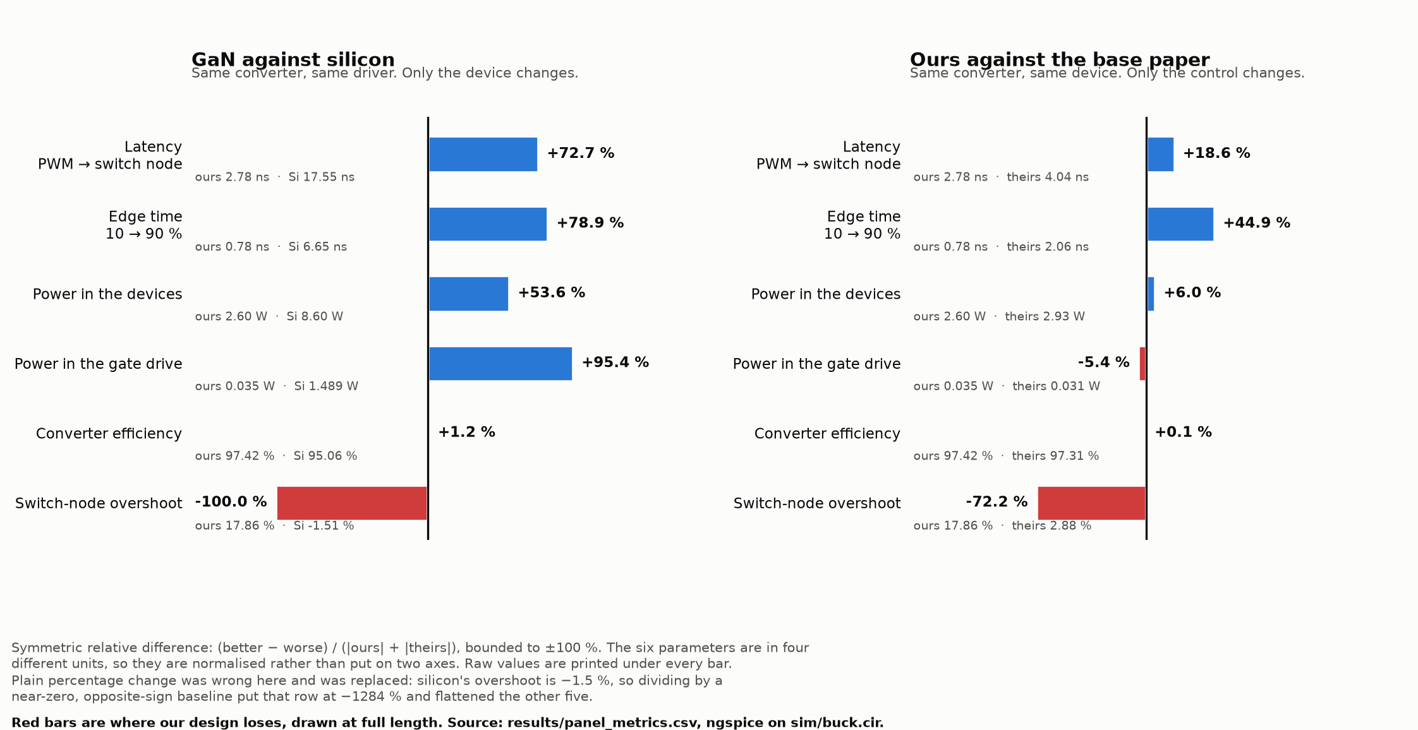
Where we win, and where we lose
Six parameters, both comparisons. Blue is better, red is worse, and the red bars are drawn at full length.
Fig. 18 — Simulated in ngspice. Bars are a symmetric relative difference, bounded to ±100 %, because the six parameters are in four different units — one axis, never two. Plain percentage change was tried first and was wrong: silicon's overshoot is −1.5 %, so dividing by a near-zero opposite-sign baseline put that row at −1284 %. Raw values under every bar. scripts/winlose_figure.py.
26

Slide 27
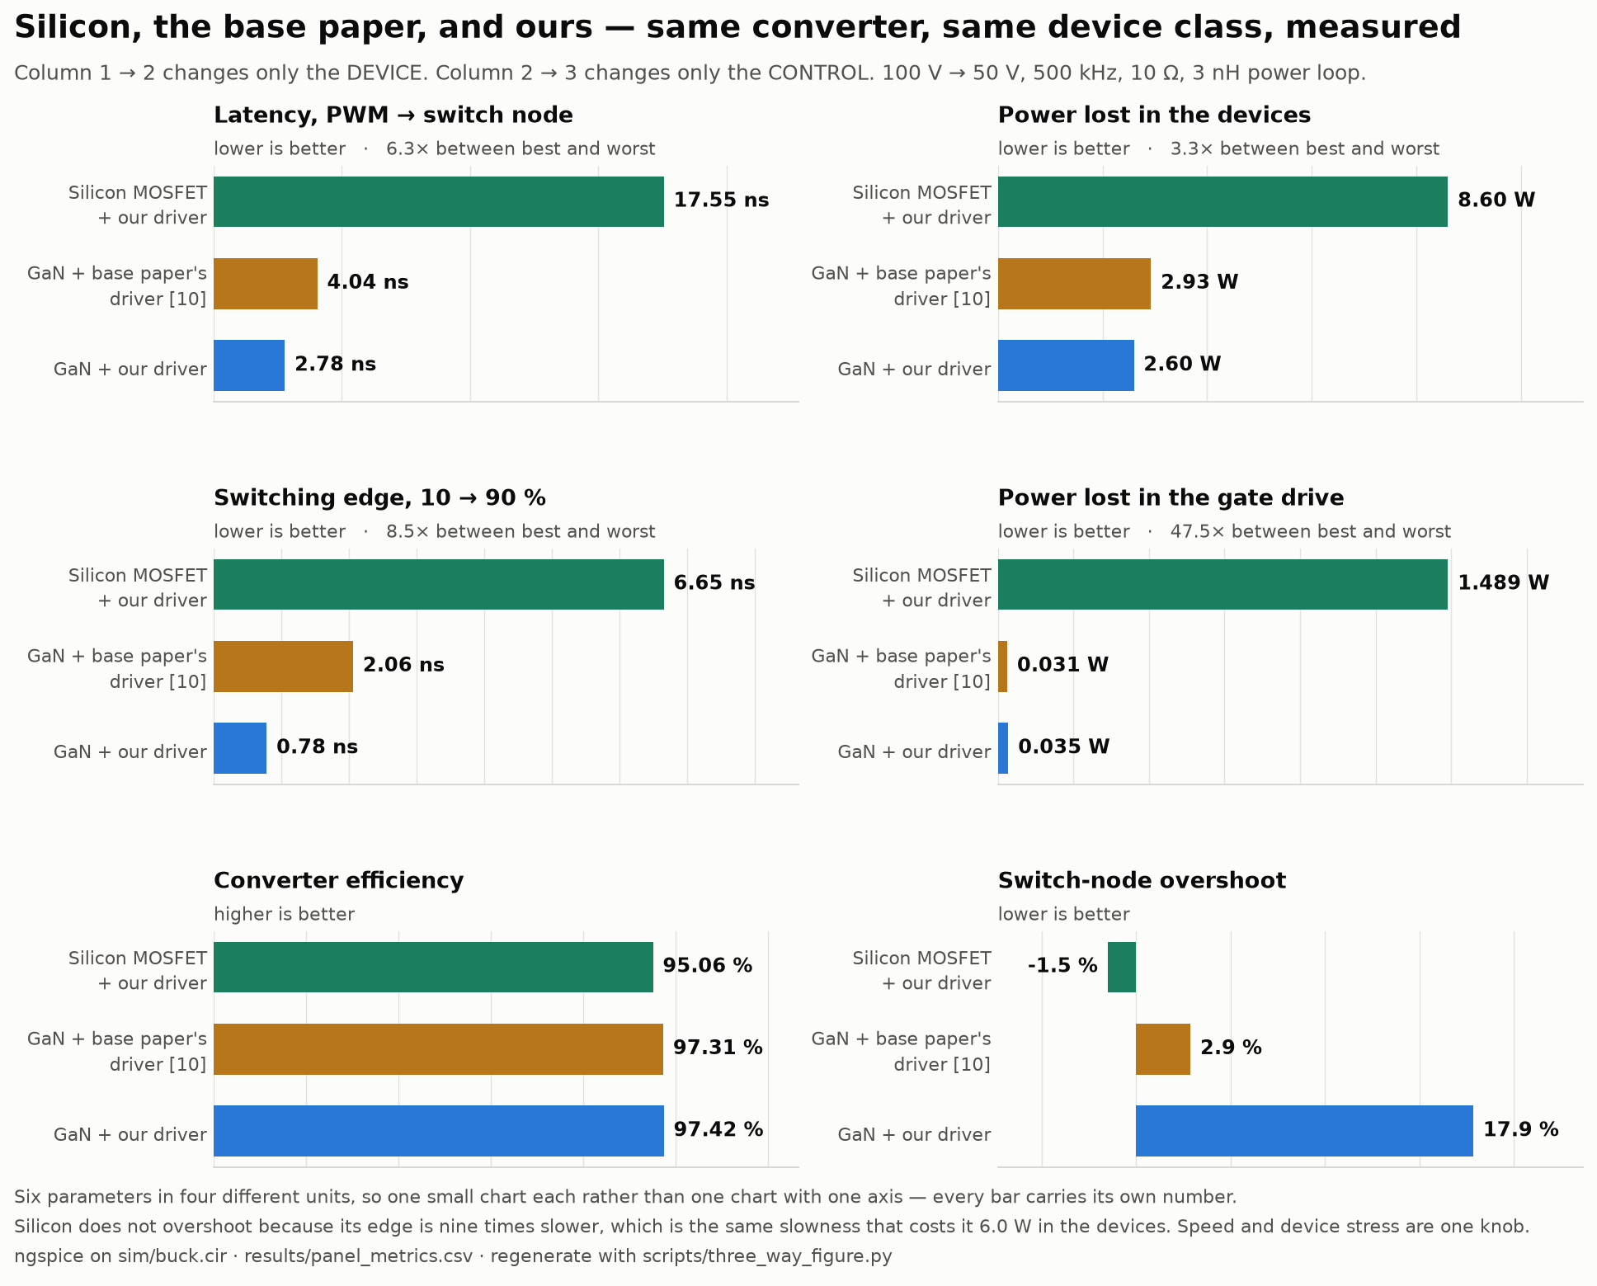
Silicon, the base paper, and ours — six parameters
Column 1 → 2 changes only the device. Column 2 → 3 changes only the control.
Fig. 19 — Simulated in ngspice. Latency 17.55 → 4.04 → 2.78 ns and device power 8.60 → 2.93 → 2.60 W, left to right. The device swap buys most of it; the control swap buys the rest. Overshoot is the row that runs the other way, and it runs that way for the same reason the other five do not: silicon does not overshoot because its edge is nine times slower, and that slowness is what costs it 6.0 W. Speed and device stress are one knob. scripts/three_way_figure.py, from results/panel_metrics.csv.
27

Slide 28
The converter across its own envelope
Every bus and load point, not just the one the headline is quoted at.
bus | load | peak v(sw) | overshoot | gate, HS on | margin | efficiency | verdict
50 V | 2 A | 68.1 V | 36.1 % | -0.98 V | +2.38 V | 97.08 % | safe
50 V | 10 A | 61.8 V | 23.6 % | -1.12 V | +2.52 V | 92.86 % | safe
100 V | 2 A | 113.6 V | 13.6 % | -1.16 V | +2.56 V | 97.67 % | safe
100 V | 10 A | 110.1 V | 10.1 % | -1.21 V | +2.61 V | 96.02 % | safe
150 V | 2 A | 171.3 V | 14.2 % | -0.86 V | +2.26 V | 98.07 % | safe
150 V | 10 A | 164.6 V | 9.8 % | -1.09 V | +2.49 V | 97.11 % | safe
200 V | 2 A | 206.2 V | 3.1 % | -1.09 V | +2.49 V | 98.42 % | OVER-RATING
200 V | 10 A | 208.2 V | 4.1 % | -0.74 V | +2.14 V | 97.65 % | OVER-RATING
The margin column is the answer. It is the 1.4 V threshold minus the highest the OFF gate reaches while the other device is conducting, and it is positive at all eight points — +2.14 V at the worst. The off device stays off everywhere in the range.
The two 200 V rows are not a driver failure. Their overshoot is the smallest in the sweep, 3.1 % and 4.1 %. The problem is running a 200 V-rated part on a 200 V bus, where any overshoot at all exceeds the rating. So the envelope is stated as 50–150 V on this device; 200 V needs a higher-rated part, not a different driver.
28

Slide 29
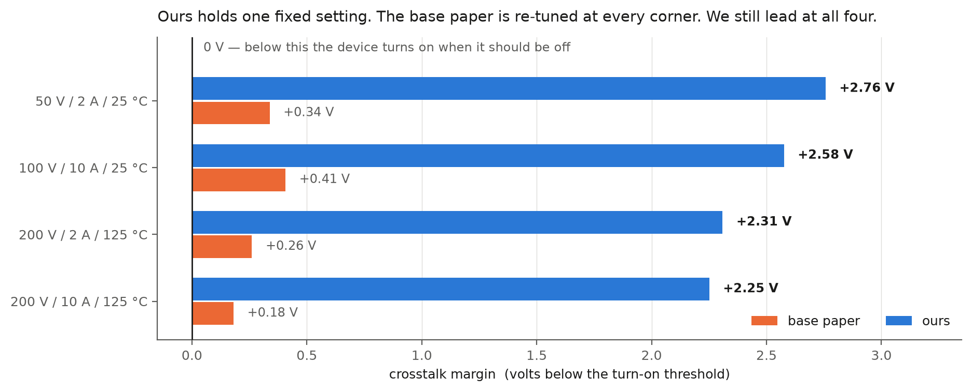
Head to head with the base paper
5.5× to 12.4×, and the lead widens as the corner gets harder.
Fig. 20 — Simulated in ngspice. scripts/headtohead.py: same deck, same GaN, same parasitics; only the driver is swapped. We hold one fixed control word at all four corners; they are re-optimised at every corner, which is more freedom than their own design has. Their margin falls +0.50 → +0.18 V from the mildest corner to the hottest and ours barely moves, because a clamp does not care how hot the device is. Our switch node also slews about twice as fast, so the margin is not bought with switching speed. One caveat: models/zhangdrv.lib is our implementation of the scheme as they (their netlist is not published), run in our testbench with our parasitics. It is not 5.5–12.4× their measured result, and we do not claim it is.
29

Slide 30
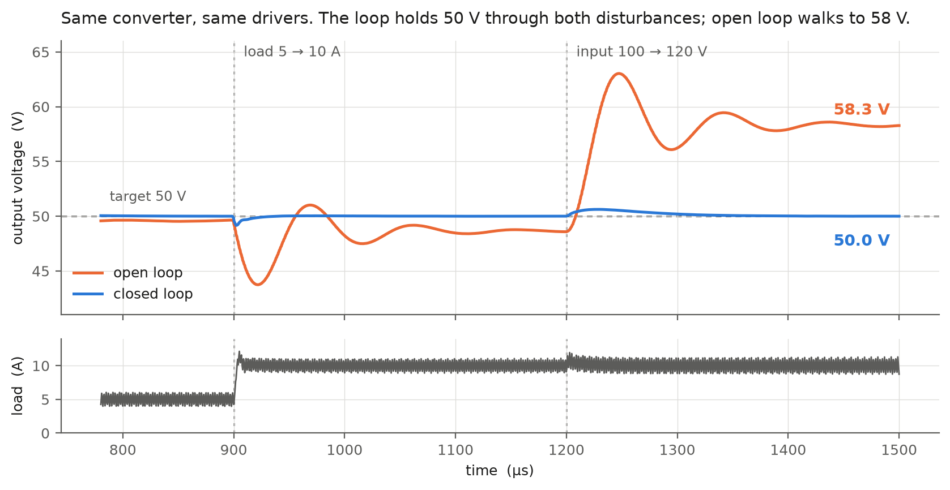
Closing the loop
The loop holds 50 V. Open loop walks to 58.3 V.
Fig. 21 — Simulated in ngspice. sim/buck_closed.cir runs the same power stage and the same segmented drivers, now regulated by a type-III loop and then disturbed on purpose. Closed loop 50.01 / 50.00 / 50.00 V through a 2× load step and a 100 → 120 V line step; worst error 0.02 % against open loop's 16.65 %. Load step recovers in 4 µs, line step in 22 µs. Ripple 0.25 %, efficiency 96.1 %, start-up overshoot 3.8 %.
30

Slide 31
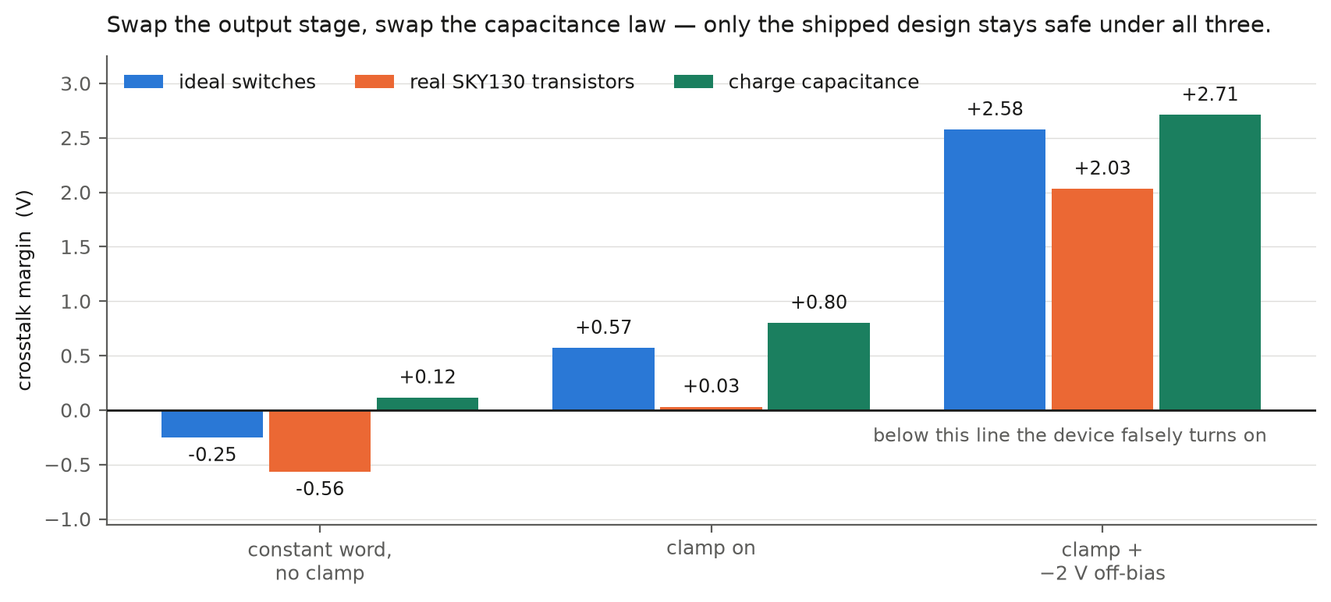
Does the result depend on the model?
Only the shipped design is safe under every model we tried.
Fig. 22 — Simulated in ngspice. Two assumptions carry every margin in this deck, and each was replaced and re-run. scripts/silicon_check.py rebuilds the output stage in real SKY130 5 V transistors; scripts/capmodel_check.py swaps the junction diodes for a charge capacitance. The ordering survives both. Two things do not: the clamp on its own gives +0.03 V on real devices rather than +0.57, and the no-clamp row changes sign between capacitance laws — so “the constant word causes false turn-on” is model-dependent, and we say so.
31

Slide 32
Does the architecture close the gaps?
Nine gaps in the published work, what our architecture does about each, and the evidence. Every row names the script that produces it.
Gap in the published work | What the architecture does | Evidence | Status
Segmented drivers report one number. Nobody separates a better fixed setting from live re-tuning. | 720 control words × 36 operating points, every combination run. | Fixed 26.5 %, adaptive 2.6 % — adaptive is 8.9 % of the gain, on 36 corners (novelty.py). | CLOSED
Nobody says how much controller the adaptive part justifies. | A complexity ladder: constant word → one comparator → two → full lookup table. | One comparator (load current at 10 A) takes 47 %. 4.7 % is left to justify a sense + ADC + LUT (controller_ladder.py). | CLOSED
Prior segmented drivers stage the slices but carry no Miller clamp and no negative off rail. | 8 + 8 slices plus a clamp plus a −2 V off-bias, each measurable on its own. | Base paper at its best +0.407 V; ours +2.576 V — 6.3× (basepaper_compare.py). | CLOSED
The driver is asserted to be programmable; the logic is rarely synthesised. | seg_gate_ctrl.v, thermometer-coded, with its own dead-time generator. | 8 properties in Icarus; 20 LUT / 20 FF on xc7a35t, 200 MHz met, 1.996 ns slack. | CLOSED
Controller and power stage are verified separately and never made to meet. | The RTL's own VCD drives the SPICE slices — one source per wire, no integer in between. | Margins agree to 0.081 V, and it found a one-cycle dead-time error (rtl_cosim.py). | CLOSED
Whether a fitted schedule generalises to an unseen operating point is never tested. | Leave-one-corner-out: fit the comparator on three corners, test on the fourth. | Identical to the global fixed word on all 36 held-out corners. Nothing — and we say so. | ANSWERED, NEGATIVE
Segmented-driver papers characterise one switching edge. The converter is never closed-loop regulated. | A type-III loop around the same power stage and the same drivers, then disturbed on purpose. | 0.02 % error through a 2× load step and a 20 % line step; open loop walks to 58.3 V (closedloop.py). | CLOSED
Segmented output stages are published as ideal switches. Whether the result survives real devices is untested. | The same output stage rebuilt in SKY130 5 V transistors and re-run. | Sign and ordering both survive, but the clamp on its own turns out to give only +0.031 V (silicon_check.py). | CLOSED
All of the above is simulation. | — | No silicon measured. The driver is now rebuilt on a real PDK; the GaN model has no equivalent check. | OPEN → Review-III
Does it serve its purpose? Yes, for a simulation study, and that is what it is titled as. Seven gaps closed, one answered in the negative, which is a result rather than a failure, and one that needs a bench. The honest summary is that the architecture is finished and the measurement of it on real silicon is not.
32

Slide 33
The hardware, costed
7 of the 10 points outstanding. Not vague — three tiers, and we know which one is which.
 | What gets measured | Cost | Time | Status
1. FPGA on a real board | The 8+8 slice outputs toggling and dead_time_gen.v sweeping 5–35 ns, on silicon rather than in a report | ₹8–12k or a lab board | days | nearest
2. GaN half-bridge eval board, 48 V | The OFF device's gate during the other's turn-on, with and without the −2 V rail — our central claim, on real silicon | ₹15–25k | 2–4 weeks | the one that matters
3. The segmented driver itself | Everything above, on our own 8-slice stage at 100 V / 500 kHz | custom PCB, several spins | months | Review-III
Two constraints we already know, because they decide whether tier 2 produces evidence or noise.
Scope bandwidth. Our edge is 0.78 ns. Bandwidth needed is 0.35 / 0.78 ns ≈ 450 MHz to see the edge at all, realistically 1 GHz. On a 100 MHz teaching-lab scope the measurement would be of the scope.
Probe grounding. A 10:1 probe with a ground clip carries roughly 10 nH in its ground lead, which manufactures ringing that is not in the circuit. A GaN gate has to be probed with a short pigtail or a coaxial connection, or the trace shows the probe.
And one thing that is not a constraint but a fact: no commercial IC implements an 8-slice independently controllable segmented driver. Tier 3 is eight single-channel drivers in parallel, enabled per slice, summed through 8 Ω — which is exactly what models/segdrv.lib already describes.
33

Slide 34
Work Completed — 90 %
Counted, not asserted. 13 blocks, weighted by how much of the project each is. 11 are finished. The weights are on the slide so they can be argued with.
 | Block of work | Weight | Evidence, or why not yet
✔ | The converter itself, built and converting | 6 | 100 V → 48.50 V at 4.869 A, 97.49 % efficient (buck.cir)
✔ | The device choice justified against silicon | 8 | 6.2 W vs 12.6 W at 500 kHz, on the shipped word; 3 sweeps, 4 duty profiles
✔ | The base paper implemented, not just cited | 8 | zhangdrv.lib in our deck and in the converter — at 100 V only
✔ | The segmented driver; the fault reproduced and fixed | 12 | −0.249 V → +2.576 V, one change at a time
✔ | The full study: 720 words × 4 corners | 8 | 66,924 transients over 36 corners — all on dpt.cir, not the converter
✔ | How much controller that justifies | 8 | ladder + leave-one-corner-out; two implementations agree
✔ | FPGA: RTL written, verified, synthesised, timing met | 12 | 8 properties; 20 LUT / 20 FF; 200 MHz, 1.996 ns slack
✔ | The two halves made to meet in one simulation | 5 | RTL VCD drives the SPICE slices; agree to 0.081 V
✔ | Closed-loop regulation, disturbed on purpose | 6 | type-III loop: 0.02 % error through a 2x load and a 20 % line step
✔ | Transistor-level output stage, on a real PDK | 7 | SKY130 5 V devices: sign and ordering of the result both survive
— | Place-and-route on a chosen board | 3 | Needs real package pins and an MMCM for the clock
✔ | The converter swept across its stated envelope | 10 | 8 bus×load points: margin +2.14 to +2.61 V everywhere, and the envelope corrected to 50–150 V because a 200 V part cannot run a 200 V bus
— | A hardware half-bridge, measured | 7 | Review-III. Until then this is a simulation study, and is titled as one
The simulation study is complete. What remains needs a bench: place-and-route on a chosen board, and one measured half-bridge. Simulating harder will not deliver either.
90 of 100 by the count above. The weights are on this slide because we would rather they were argued with than discovered. Score the hardware higher than 7 and the number falls — that is a fair reading, and it is the one we cannot answer without a bench.
Nothing has been measured on silicon.
34
Notes:
[40 s] CORE — the 50 %-completion requirement. Five claims, each with a number. If asked 'is this really 50 %?': the search is complete, stress-tested, and both objections to it - layout and EMI - have been tested rather than argued. What remains is silicon and hardware.

Slide 35
References (1–15)
[1] Z. Zhang, F. Wang, L. M. Tolbert and B. J. Blalock, “Active Gate Driver for Crosstalk Suppression of SiC Devices in a Phase-Leg Configuration,” IEEE Trans. Power Electron., vol. 29, no. 4, pp. 1986–1997, Apr. 2014.
[2] R. Xie, H. Wang, G. Tang, X. Yang and K. J. Chen, “An Analytical Model for False Turn-On Evaluation of High-Voltage Enhancement-Mode GaN Transistor in Bridge-Leg Configuration,” IEEE Trans. Power Electron., vol. 32, no. 8, pp. 6416–6433, Aug. 2017.
[3] D. Reusch and J. Strydom, “Understanding the Effect of PCB Layout on Circuit Performance in a High-Frequency Gallium-Nitride-Based Point of Load Converter,” IEEE Trans. Power Electron., vol. 29, no. 4, pp. 2008–2015, Apr. 2014.
[4] B. Li, G. Zhang, C. Li, G. Wang, S. Liu and D. Xu, “Crosstalk Suppression Method for GaN-Based Bridge Configuration Using Negative Voltage Self-Recovery Gate Drive,” IEEE Trans. Power Electron., vol. 37, no. 4, pp. 4406–4418, 2022.
[5] X. Chen, H. Peng, S. Song, Q. Tong and Y. Kang, “A Novel Control Strategy for Optimal Tradeoff between Overshoot and Switching Loss Based on Double Closed-Loop Self-Regulating Active Gate Driver,” IEEE Trans. Power Electron., vol. 39, no. 10, pp. 13033–13043, 2024.
[6] W. Song, T. Hu, J. Chen, T. Tang, H. Yue and G. Liu, “A Self-Regulating Active Gate Driver of Voltage Overshoot Suppression for SiC MOSFETs Under Variable Load Current Conditions,” IEEE Trans. Power Electron., vol. 40, no. 8, pp. 10623–10634, 2025.
[7] C.W. Kuo, T.W. Wang, L.C. Chen, C.C. Tu, Y.K. Hsiao and P.H. Chen, “Universal Active Gate Driver IC With Closed-Loop Timing Control and Gate-Sensing Technique for Silicon Carbide Power Devices,” IEEE Trans. Power Electron., vol. 40, no. 4, pp. 5120–5129, 2025.
[8] G.H. Thuc and C.J. Chen, “An Integrated Driver With Dual-Edge Adaptive Dead-Time Control for GaN-Based Synchronous Buck Converter,” IEEE Trans. Ind. Appl., vol. 60, no. 6, pp. 9157–9170, 2024.
[9] H. Takayama, T. Okuda and T. Hikihara, “Digital Active Gate Drive of SiC MOSFETs for Controlling Switching Behavior — Preparation Toward Universal Digitization of Power Switching,” Int. J. Circuit Theory Appl., vol. 50, no. 1, pp. 183–196, 2022.
[10] BASE PAPER — W.J. Zhang, J. Yu, Y. Leng, W.T. Cui, G.Q. Deng and W.T. Ng, “A Segmented Gate Driver for E-mode GaN HEMTs with Simple Driving Strength Pattern Control,” in Proc. IEEE 32nd Int. Symp. Power Semicond. Devices ICs (ISPSD), 2020, pp. 102–105.
[11] X. Wang, M. Tao, J. Xiao, D. Luo, M. He, Q. Zhou, X. Zhang and M. Wang, “High-Frequency Three-Level Gate Driver for GaN HEMT Bridge Crosstalk Suppression,” IEEE Trans. Power Electron., vol. 39, no. 1, pp. 1343–1352, 2024.
[12] L. Wang, X. Sun, Y. Yan, M. Ma and D. Xu, “An Integrated Suppression Method of Both Gate-Source Voltage Oscillation and Crosstalk for GaN HEMT Gate Driver,” IEEE Trans. Power Electron., vol. 39, no. 11, pp. 14643–14655, 2024.
[13] Y. Cai, D. Ye, W. Lv and Z. Chen, “A High-Efficient GaN Driver With Hybrid Adaptive Dead-Time Control and Peak Delay Control for Synchronous Buck Converter,” IEEE Trans. Power Electron., vol. 41, no. 1, pp. 279–290, 2026.
[14] Y. Zheng, S. Zhao, P. Agarwal, F. Liu, Y. Zhao and A. Mantooth, “A Multi-Level Turn-Off Gate Driver for Crosstalk Noise Suppression of GaN HEMTs,” IEEE Open J. Power Electron., pp. 1–15, 2026.
[15] M.K. Banda, S. Madichetty, D.M. Natham and S. Koduru, “An Event-Triggered Dual-Polarity Gate Clamp for GaN HEMT Gate Oscillation Suppression,” IEEE Trans. Power Electron., vol. 41, no. 9, pp. 14402–14405, 2026.
The papers this design engages with directly. [10] is the base paper, reimplemented in models/zhangdrv.lib and measured against throughout.
35
Notes:
[skip] Reference list. Leave up during questions.

Slide 36
Thank you
GaN Based Synchronous Buck Converter with an Improved Gate Driver
Amritha S 23BEC1368 · Sanjay Kumar 23BEC1447 · Aamir Abdullah 23BPS1197
Guide: Dr. Bindu — SENSE, VIT Chennai
Everything in this deck runs on request: github.com/Amritha902/gan-driver
36

