Slide 1

School of Electronics Engineering (SENSE)
Project-I (2026)
GaN Based Synchronous Buck Converter with an Improved Gate Driver
Student Name(s):
Sanjay Kumar 23BEC1447 · Aamir Abdullah 23BPS1197 · Amritha S 23BEC1368
Guide's Signature with Date
Guide:
Dr. Bindu — SENSE
Signature: _____________________
Programme / School:
B.Tech — SENSE, VIT Chennai
Date: _________________________
Review & Date:
Review-II · 30.09.2026 (Wednesday)
Approval is mandatory before every review. After signing, scan this slide and keep the scanned copy as Slide 1 of the presentation.
1
Notes:
[15 s] CORE. Project name and the one-line claim: a segmented GaN gate driver, and a measurement of what per-operating-point adaptation is actually worth.

Slide 2
Problem Statement & Background
Problem Statement:
When one GaN transistor switches, its fast voltage swing pushes charge into the gate of the other transistor, the one that is supposed to stay off. That gate rises to 1.65 V, and only 1.4 V is needed to turn it on. Both devices conduct at once and the supply shorts through them. (That 1.65 V is our device model’s; how much the result depends on the model is itself a finding, and it has its own slide.)
Background & Significance:
GaN half-bridges sit inside EV inverters and battery chargers. GaN is chosen because it switches fast, and that speed is exactly what causes this fault.
Existing Solutions:
Gate drivers that turn the device on in steps, clamp the off gate down, adjust the gap between the two switching edges, and hold the gate at −2 V [1]–[4]. Reported: 30.5 % less overshoot, 75 % less turn-off loss [5]–[7].
Limitations / Research Gap:
Nobody has measured what the re-tuning is worth. Those gains mix two different things: picking one good setting, and changing the setting while the converter runs. Only the second needs a sensor, a lookup table and a controller.
2
Notes:
[60 s] CORE — the 2-mark slide, the biggest block in the review. Land two things: the failure is real and specific (1.65 V on a 1.40 V threshold), and the gap is that prior work conflates 'better fixed settings' with 'settings that adapt'.

Slide 3
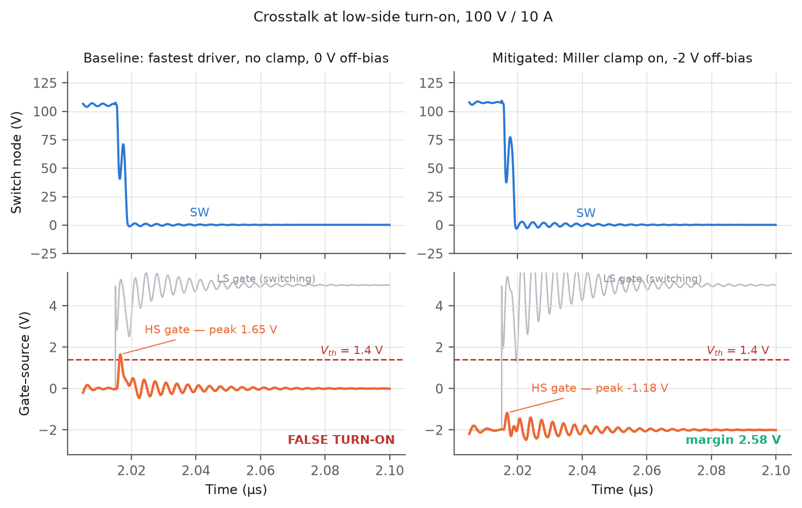
The goal, and whether this serves it
The goal. Build a synchronous buck converter for an energy-storage system out of GaN HEMTs, and make it work at the switching speed GaN is bought for. Everything else in this deck exists to serve that sentence.
1. Why GaN at all
2. What GaN costs you
3. What we build about it
Same converter, same job, only the device swapped. At 500 kHz GaN wastes 6.2 W against silicon's 12.6 W. The lead widens to 78 % at 1 MHz and 90 % at light load, and never turns back.
Raising the frequency to shrink the magnetics is nearly free on GaN and ruinous on silicon.
The same speed that wins is what breaks it. A 1.4 V threshold and 150 pF of drain-to-gate capacitance mean the device that is supposed to be off gets pushed toward on by its partner switching.
Measured: the off gate reaches 1.65 V against a 1.4 V threshold. That is a shoot-through.
A segmented gate driver: 8 pull-up steps, 8 pull-down steps, an adjustable dead time, a Miller clamp and a −2 V off rail, driven by an FPGA, so every one of them is a setting that can be changed and measured.
Result: −0.249 V of margin becomes +2.576 V.
Title says converter, work says driver — one claim. On GaN the driver is the part that decides whether the converter is buildable at speed. Every number here is measured on the converter: 97.49 % open loop, 96.1 % regulated.
The next slide is that question, gap by gap, with the evidence for each.
3

Slide 4
Aim, and how we approached it
Aim:
To find out how much of a gate driver’s benefit needs the driver to re-tune itself while the converter is running, and how much comes from choosing one good setting and leaving it fixed.
Proposed Solution:
A GaN buck converter driven by a segmented gate driver: 8 pull-up steps, 8 pull-down steps, an adjustable dead time, a Miller clamp and a −2 V off rail. Every one of them is a setting we can change and measure.
How we approached it:
1. Build the converter and check it converts. 100 V DC in, 48.50 V DC out at 4.869 A: 236.26 W delivered, 97.49 % efficient.
2. Recreate the fault. At the fastest setting the gate that should be off reaches 1.65 V, against a 1.4 V turn-on threshold.
3. Fix it one change at a time, measuring each change on its own run, not all at once.
4. Ask whether one fixed setting is enough, by running the driver at two operating points and seeing whether the best setting moves.
Scope and tools:
In scope: the converter, the driver, its settings, and the FPGA controller. Out of scope: building hardware. Tools: ngspice for every simulation, LTspice to draw the circuit and re-check, Vivado for the FPGA.
4
Notes:
[30 s] CORE — proposed-solution mark. The 720-point control word and the method: exhaustive search at every corner, so each per-corner optimum is a TRUE optimum and not the best of a shortlist.

Slide 5
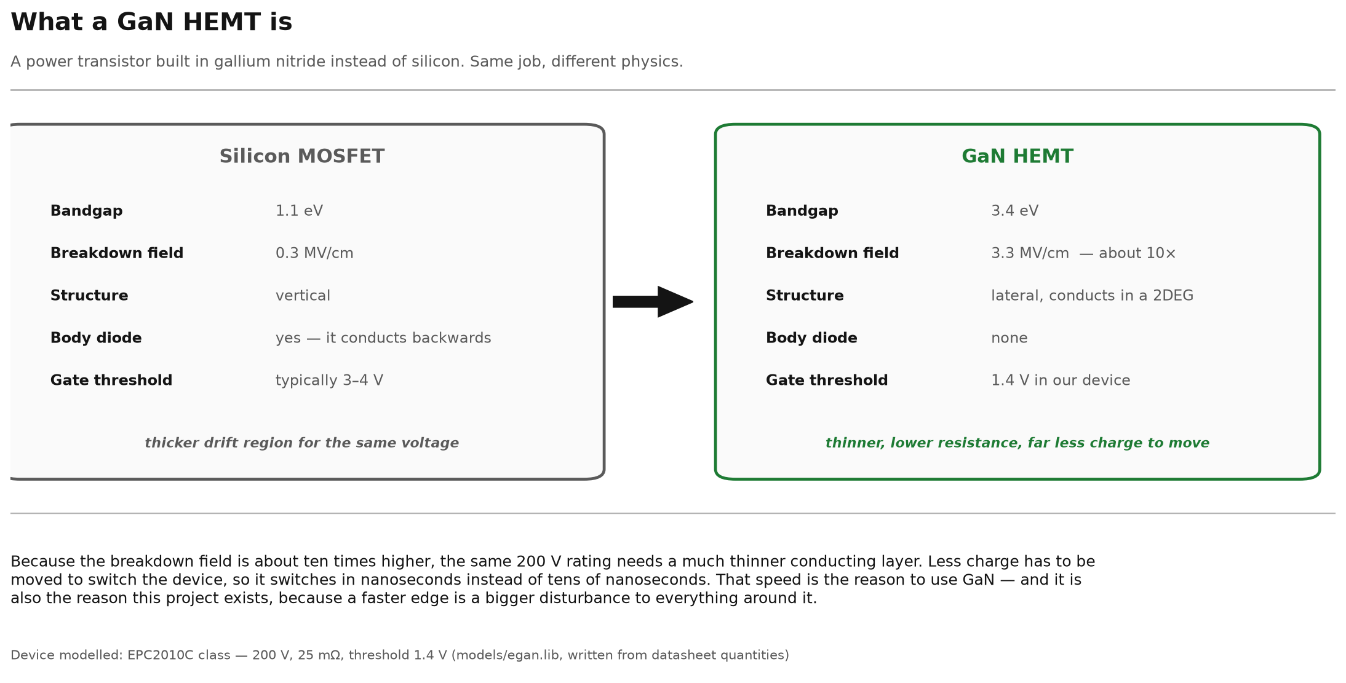
What a GaN HEMT is
Fig. 1 — Drawn diagram, not simulation output. Silicon MOSFET against GaN HEMT on the properties that govern switching. Device modelled: EPC2010C class, 200 V, 25 mΩ, Vth = 1.4 V (models/egan.lib).
5

Slide 6
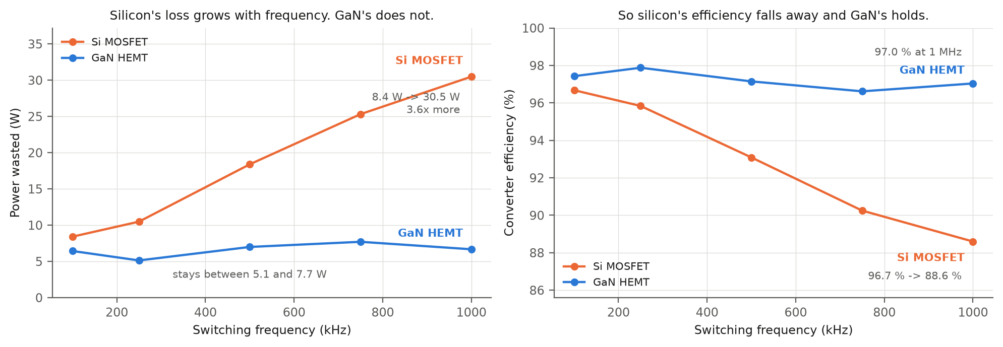
Why GaN and not silicon — measured, same converter
Fig. 2 — Simulated in ngspice. Same buck converter, same job, only the device swapped. Rₓₛ(on) matched 25.0 mΩ GaN against 24.0 mΩ Si, each at its own rated gate drive, so conduction loss is equal by construction and what is left is switching, gate drive and the body-diode recovery GaN does not have. At 500 kHz GaN wastes 6.2 W against silicon's 12.6 W; the lead widens to 78 % at 1 MHz and 90 % at light load (scripts/si_vs_gan_sweep.py).
6

Slide 7

Why the GaN HEMT causes the problem we solve
Fig. 3 — Drawn diagram, not simulation output. Three device properties and their consequence in a half-bridge: a 1.4 V threshold, 150 pF from drain to gate, and no body diode.
7

Slide 8
GaN against silicon — six parameters, measured
Same converter, same driver, same on-resistance class. Only the device changes.
Parameter | GaN HEMT | Si MOSFET | unit | GaN HEMT vs Si MOSFET
Latency, PWM → switch node at 50 % | 2.78 | 17.55 | ns | 6.3× less
Edge, 10 % → 90 % of bus | 0.78 | 6.65 | ns | 8.5× less
Power in the devices | 2.60 | 8.60 | W | 3.3× less
Power in the gate drive | 0.035 | 1.489 | W | 42.7× less
Converter efficiency | 97.42 | 95.06 | % | +2.36 pts
Switch-node overshoot | 17.9 | -1.5 | % | +19.4 pts
Read the last row honestly: GaN loses it. Silicon does not overshoot because its edge is nine times slower — the same slowness that costs it 6.1 W. Speed and device stress are the same knob, and choosing GaN is choosing to manage the stress.
ngspice on sim/buck.cir, 100 V → 50 V, 500 kHz, 10 Ω, 3 nH loop. Each device is driven at its own rated gate voltage — 5 V for GaN, 10 V for silicon — because a silicon MOSFET at 5 V would be barely enhanced and would lose on a technicality rather than on physics. Power is averaged over the last 20 of 150 whole cycles; latency and edge come from a separate 3-cycle run at a 0.02 ns step, because a 2 ns edge and a 300 µs average cannot share one transient.
8

Slide 9
The base paper we build on
 | Zhang, Yu, Leng, Cui, Deng & Ng (2020) — IEEE ISPSD
 | What it does | A segmented gate driver for E-mode GaN HEMTs: the output stage is split into slices, and drive strength is selected by a pattern rather than set by a resistor.
 | Same device, same architecture | GaN HEMTs in a bridge, a sliced output stage, strength chosen by a code. That is the structure this project starts from.
 | How we extend it | Theirs is an ASIC with a fixed pattern set, chosen at design time. We make every field programmable from an FPGA — slices, dead time, Miller clamp, off-bias rail — add the clamp and the −2 V rail, and measure what choosing the pattern per operating point is worth.
W. J. Zhang, J. Yu, Y. Leng, W. T. Cui, G. Q. Deng and W. T. Ng, “A Segmented Gate Driver for E-mode GaN HEMTs with Simple Driving Strength Pattern Control,” in Proc. IEEE 32nd Int. Symp. Power Semicond. Devices ICs (ISPSD), 2020, pp. 102–105.
9
Notes:
[30 s] CORE — literature mark. Do not read the table. Eight references, three verified to page level; point at [3], layout sets loop inductance, which decides our answer.

Slide 10
We implemented the base paper, then ours
Citing a base paper is not a comparison, so we built theirs too. models/zhangdrv.lib is Zhang et al.'s driver: seven slices brought in as a timed pattern across the switching edge, the pattern picked by one bias resistor, with no gate clamp and no −2 V rail, because those two are ours. It runs inside the same sim/dpt.cir, so only the driver differs.
Base paper, at its best setting
+0.407 V
Their staged pattern on its own already clears the 1.4 V threshold, at the best setting in their own stated range.
Ours, constant code, no clamp
−0.249 V
False turn-on. A constant code is worse than their staged one — their idea is real, and we reproduce it.
Ours, active Miller clamp on
+0.570 V
Only just past the base paper. The clamp on its own is not the story.
Ours, clamp + −2 V off-bias
+2.576 V
6.3× the base paper's best margin. This is the version we ship.
What the comparison shows. The base paper stages its slices over time and picks the pattern with one resistor; we add two things they do not have and make every field programmable. Both clear the threshold — theirs works, and we quote it at its best setting — but ours clears it by 6.3× more, and ours is the one whose settings can then be searched in full. Across their own stated range their margin runs +0.407 V down to −0.278 V, so quoting them anywhere worse would be picking the opponent.
Command: python3 scripts/basepaper_compare.py — four ngspice runs, prints this table.
10

Slide 11
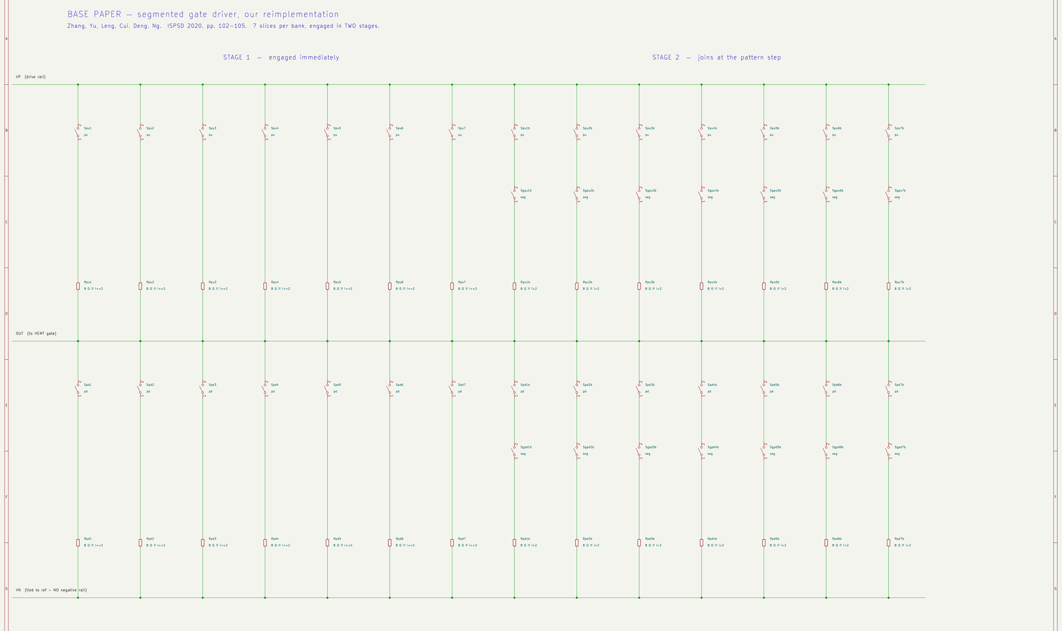
Their driver, drawn — the reimplementation
Zhang et al., ISPSD 2020, built as a schematic from our implementation of it.
Fig. 4 — Drawn diagram, not simulation output. 14 columns per bank, because their seven slices are split across two stages and each stage is its own branch. The stage-2 branches carry an extra series switch gated by the pattern step — that switch is their mechanism. Every resistor shows its own conditional, so the sheet can be checked against models/zhangdrv.lib line by line. No clamp branch, and the off rail is tied to its reference.
11

Slide 12
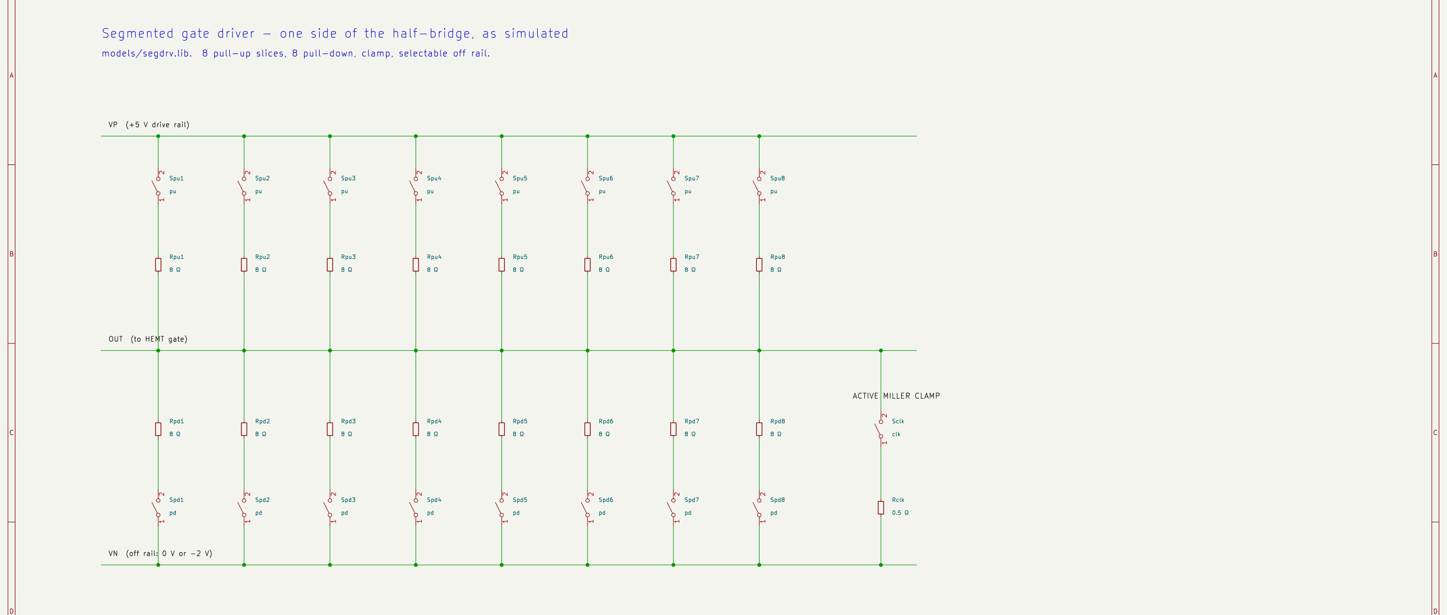
Our driver, drawn — the same stage, improved
models/segdrv.lib. Eight slices a bank, switching together, plus the two blocks they do not have.
Fig. 5 — Drawn diagram, not simulation output. Each slice is a switch and a resistor, and the resistor carries the code: Rpu3 is 8 Ω if the word asks for three or more slices and 1 GΩ if it does not. Drive strength is how many of the eight parallel paths are live. On the right, Sclk and Rclk — the active Miller clamp, pulling the gate to the off rail through 0.5 Ω.
12

Slide 13
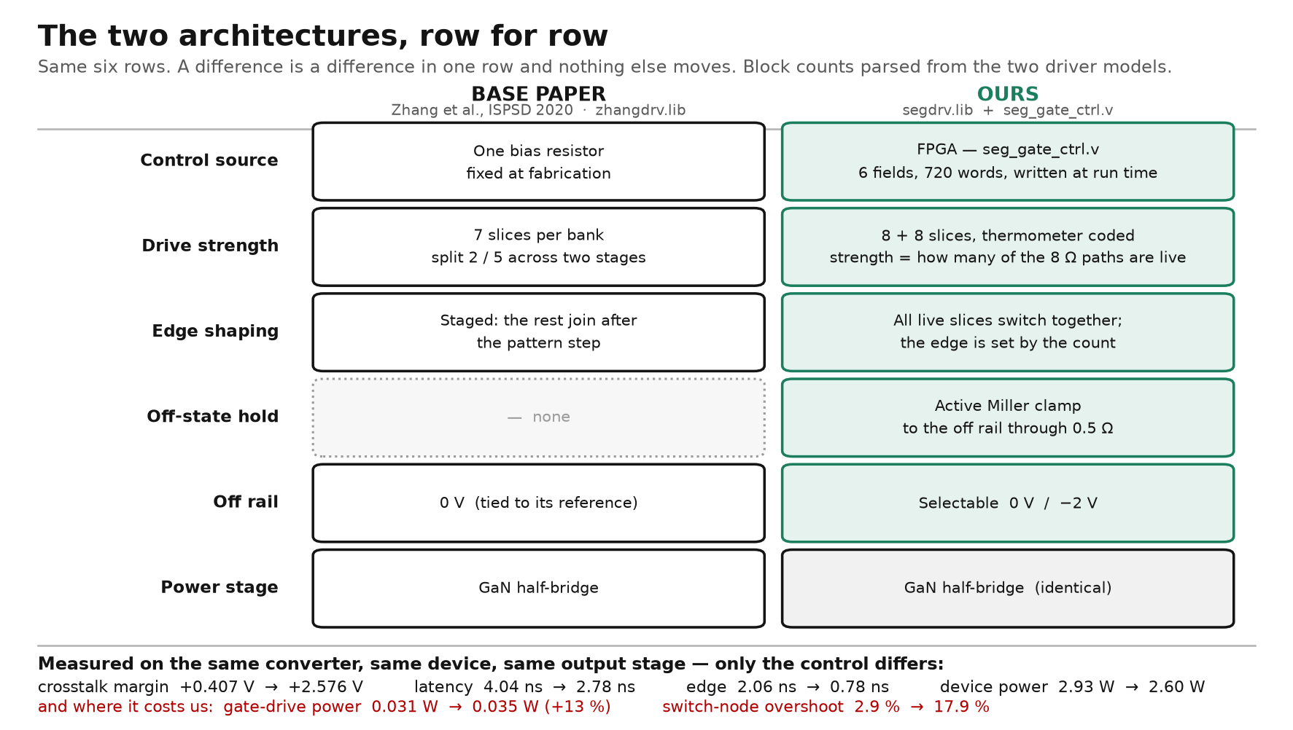
Base paper and ours, side by side
Six shared rows. A difference is a difference in one row, and nothing else moves.
Fig. 6 — Drawn diagram, not simulation output. Block counts and values are parsed from models/zhangdrv.lib and models/segdrv.lib, not restated from memory — if either library changes this figure changes with it. The one dotted row is the one they do not have. The red line is where our design loses, and it is on the slide for the same reason the rest of it is.
13

Slide 14
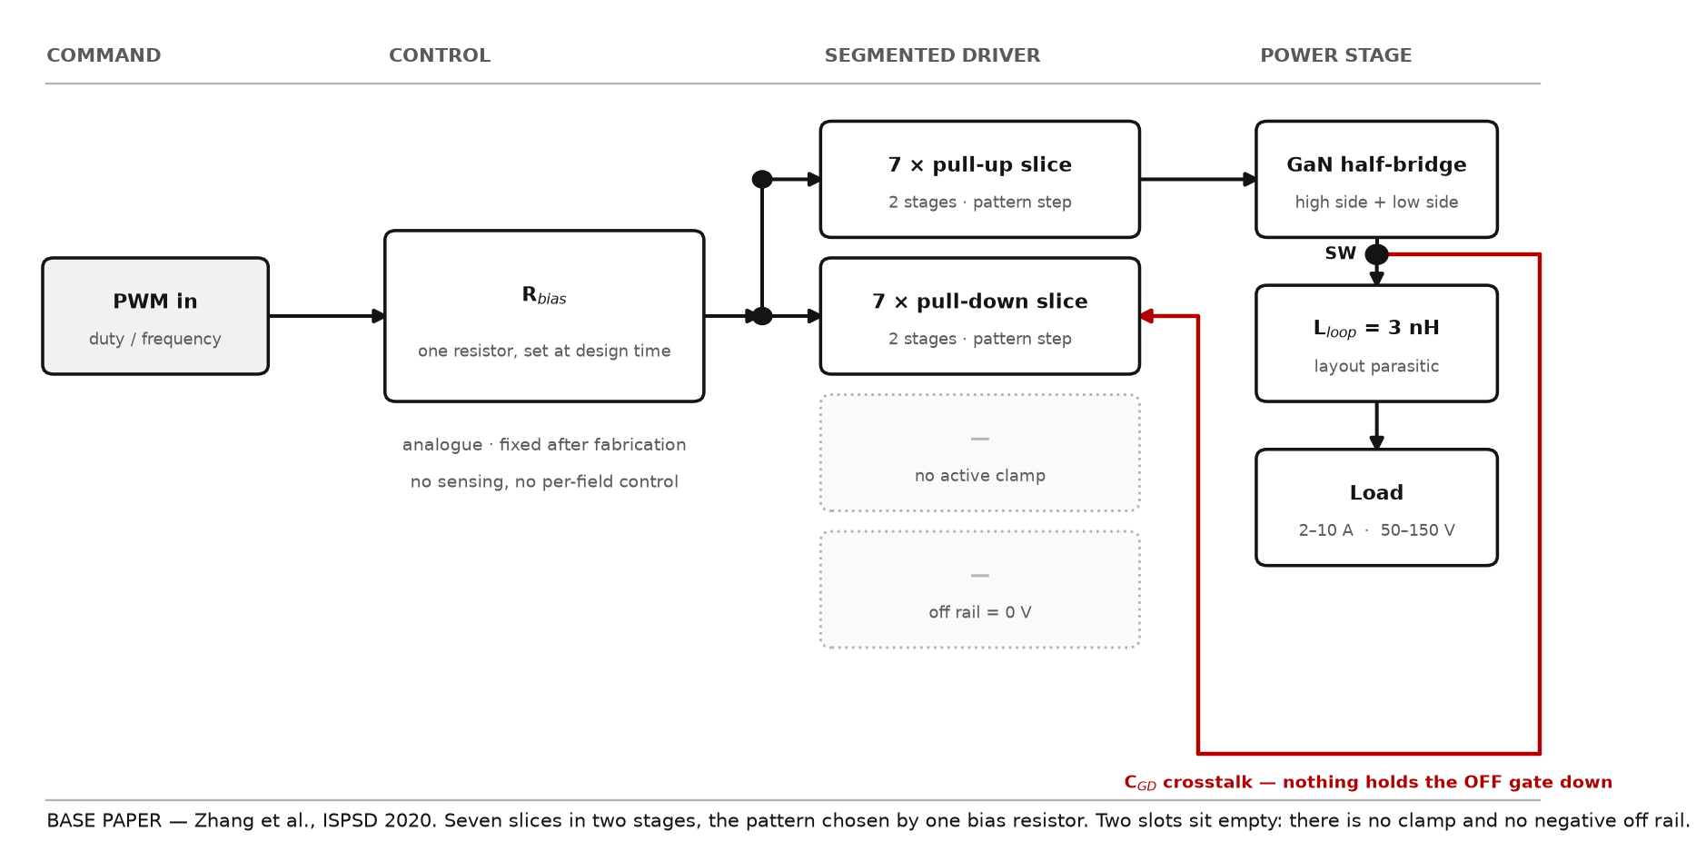
Their architecture — the base paper's blocks
Zhang et al., ISPSD 2020. One bias resistor sets the whole pattern.
Fig. 7 — Drawn diagram, not simulation output. Drawn to the same grid: a block that exists in both sits in the same place in both, so a missing block leaves a visible hole. The drawing and models/zhangdrv.lib are the same claim — seven slices, two stages, one bias resistor, no clamp, no negative rail — so either can be checked against the other. The two dotted slots are what their design does not have.
14

Slide 15
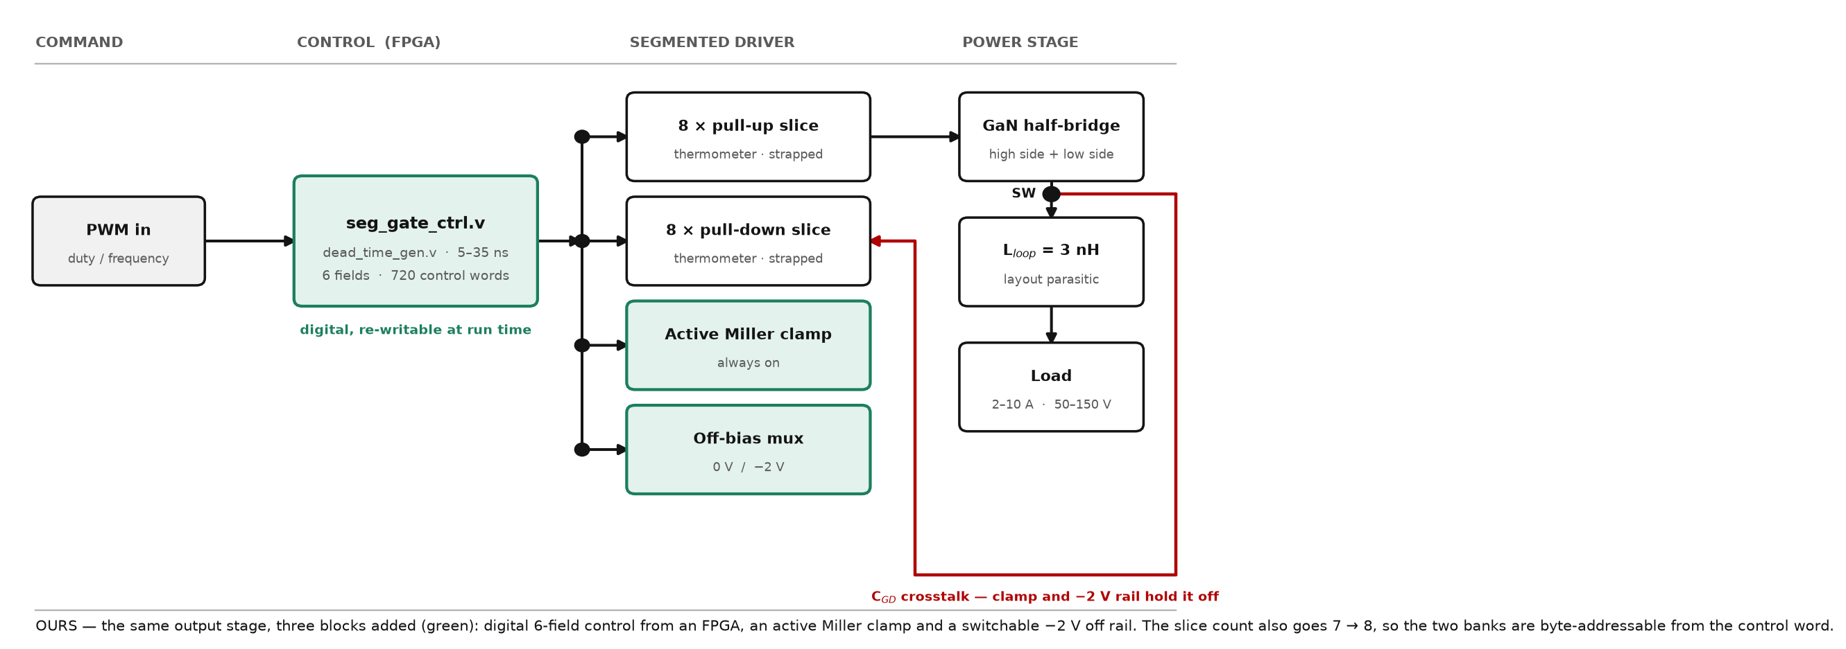
Our architecture — same stage, three blocks added
The same output stage. Three blocks added, in green.
Fig. 8 — Drawn diagram, not simulation output. Drawn to the same grid: a block that exists in both sits in the same place in both, so a missing block leaves a visible hole. The drawing and models/zhangdrv.lib are the same claim — seven slices, two stages, one bias resistor, no clamp, no negative rail — so either can be checked against the other. Green marks what is ours: digital 6-field control, the active clamp, the switchable −2 V rail.
15

Slide 16
Theirs and ours — six parameters, measured
Same converter, same GaN device, same output stage. Only the control changes.
Parameter | Ours | Base paper | unit | Ours vs Base paper
Latency, PWM → switch node at 50 % | 2.78 | 4.04 | ns | 1.5× less
Edge, 10 % → 90 % of bus | 0.78 | 2.06 | ns | 2.6× less
Power in the devices | 2.60 | 2.93 | W | 1.1× less
Power in the gate drive | 0.035 | 0.031 | W | 1.1× more
Converter efficiency | 97.42 | 97.31 | % | +0.11 pts
Switch-node overshoot | 17.9 | 2.9 | % | 6.2× more
The last two rows are ours to answer. We spend 11 % more gate power and we overshoot 15 points harder, because we switch faster. That buys 1.3 ns of latency, 0.33 W in the devices and the crosstalk margin on the next slide.
ngspice on sim/buck.cir with the driver subcircuit swapped: models/segdrv.lib against models/zhangdrv.lib. Identical devices, parasitics, timing and solver options, so any difference here is the control scheme and nothing else. Their pattern step is a delayed copy of their own PWM, so it lands the same distance after turn-on on every cycle, which is what their one-knob scheme does.
16

Slide 17
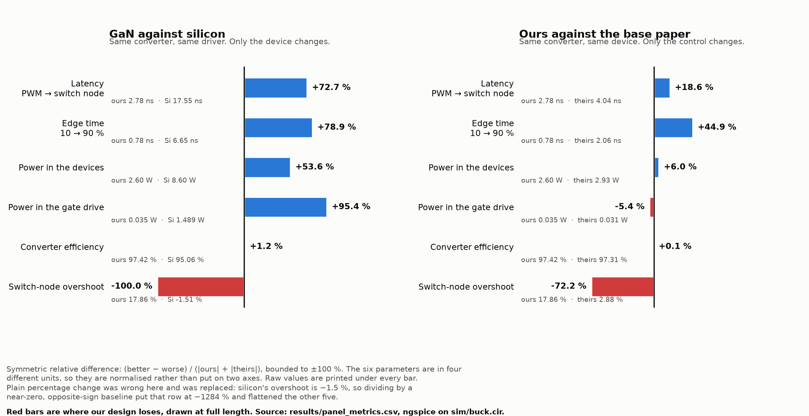
Where we win, and where we lose
Six parameters, both comparisons. Blue is better, red is worse, and the red bars are drawn at full length.
Fig. 9 — Simulated in ngspice. Bars are a symmetric relative difference, bounded to ±100 %, because the six parameters are in four different units — one axis, never two. Plain percentage change was tried first and was wrong: silicon's overshoot is −1.5 %, so dividing by a near-zero opposite-sign baseline put that row at −1284 %. Raw values under every bar. scripts/winlose_figure.py.
17

Slide 18
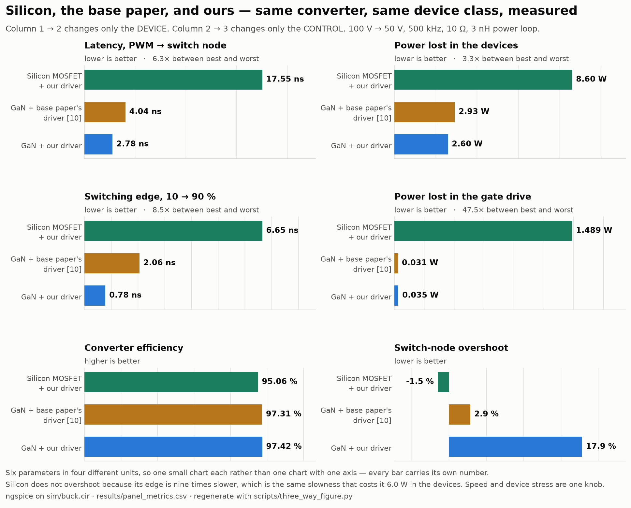
Silicon, the base paper, and ours — six parameters
Column 1 → 2 changes only the device. Column 2 → 3 changes only the control.
Fig. 10 — Simulated in ngspice. Latency 17.55 → 4.04 → 2.78 ns and device power 8.60 → 2.93 → 2.60 W, left to right. The device swap buys most of it; the control swap buys the rest. Overshoot is the row that runs the other way, and it runs that way for the same reason the other five do not: silicon does not overshoot because its edge is nine times slower, and that slowness is what costs it 6.0 W. Speed and device stress are one knob. scripts/three_way_figure.py, from results/panel_metrics.csv.
18

Slide 19
The converter across its own envelope
Every bus and load point, not just the one the headline is quoted at.
bus | load | peak v(sw) | overshoot | gate, HS on | margin | efficiency | verdict
50 V | 2 A | 68.1 V | 36.1 % | -0.98 V | +2.38 V | 97.08 % | safe
50 V | 10 A | 61.8 V | 23.6 % | -1.12 V | +2.52 V | 92.86 % | safe
100 V | 2 A | 113.6 V | 13.6 % | -1.16 V | +2.56 V | 97.67 % | safe
100 V | 10 A | 110.1 V | 10.1 % | -1.21 V | +2.61 V | 96.02 % | safe
150 V | 2 A | 171.3 V | 14.2 % | -0.86 V | +2.26 V | 98.07 % | safe
150 V | 10 A | 164.6 V | 9.8 % | -1.09 V | +2.49 V | 97.11 % | safe
200 V | 2 A | 206.2 V | 3.1 % | -1.09 V | +2.49 V | 98.42 % | OVER-RATING
200 V | 10 A | 208.2 V | 4.1 % | -0.74 V | +2.14 V | 97.65 % | OVER-RATING
The margin column is the answer. It is the 1.4 V threshold minus the highest the OFF gate reaches while the other device is conducting, and it is positive at all eight points — +2.14 V at the worst. The off device stays off everywhere in the range.
The two 200 V rows are not a driver failure. Their overshoot is the smallest in the sweep, 3.1 % and 4.1 %. The problem is running a 200 V-rated part on a 200 V bus, where any overshoot at all exceeds the rating. So the envelope is stated as 50–150 V on this device; 200 V needs a higher-rated part, not a different driver.
19

Slide 20
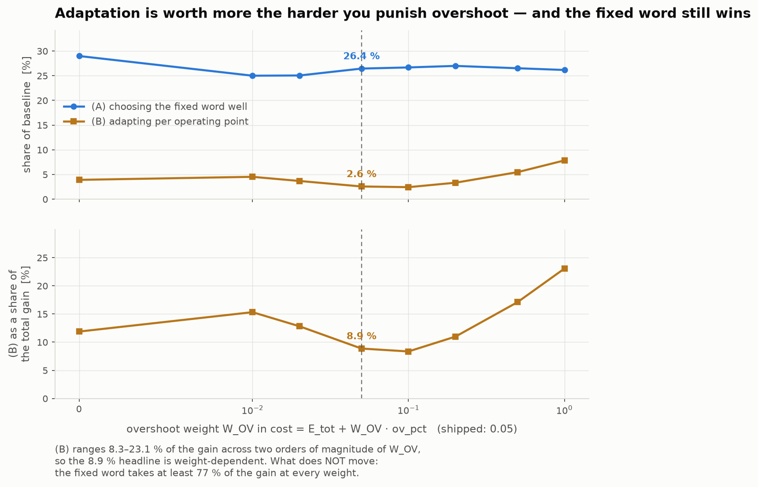
Does the answer depend on the weight we chose?
cost = E_tot + W_OV · ov_pct, swept over two orders of magnitude.
Fig. 11 — Simulated in ngspice. The honest answer is two-part, and the second part is the one to say. (B) ranges 8.3–23.1 % of the gain across the sweep, so the 8.9 % headline IS weight-dependent — weight overshoot harder and adapting matters more, which is physical, because overshoot is what varies most across corners. What does not move: the fixed word takes at least 77 % of the gain at every weight tried. scripts/grid_robustness.py.
20

Slide 21
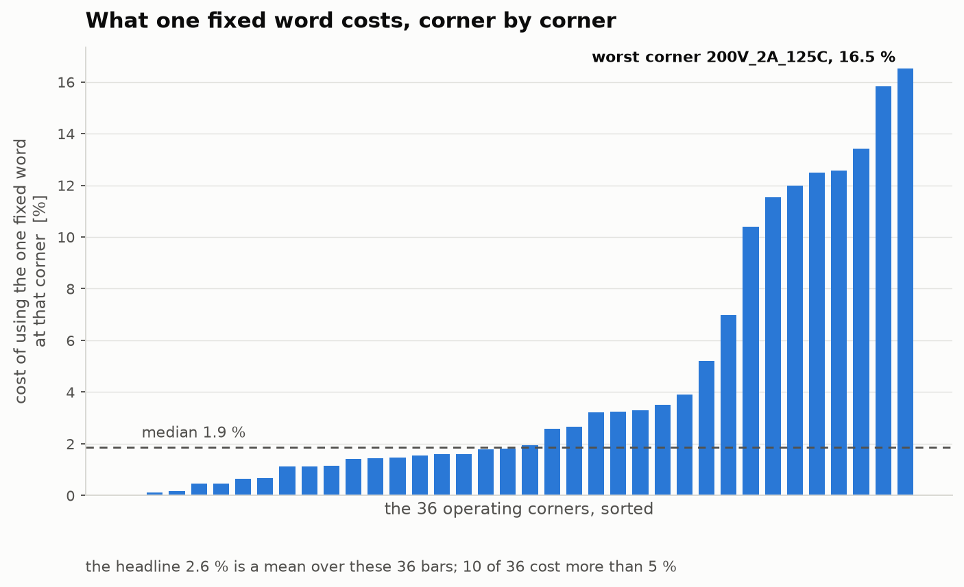
The distribution behind the 2.6 %
What one fixed word costs at each of the 36 corners, sorted.
Fig. 12 — Simulated in ngspice. 2.6 % is a mean over these 36 bars and the mean alone is not the whole truth: the median is 1.9 %, but 10 of 36 corners cost more than 5 % and the worst — 200 V / 2 A / 125 °C — costs 16.5 %. That corner is also outside the 50–150 V envelope this device is rated for. Quote the distribution, not the mean.
21

Slide 22
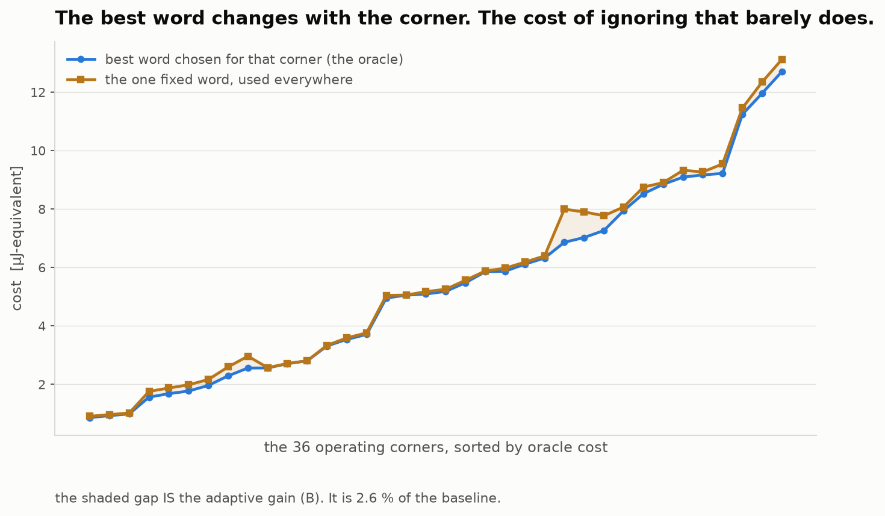
The optimum moves. The cost of ignoring it does not.
Per-corner best word against the one fixed word, all 36 corners.
Fig. 13 — Simulated in ngspice. Ten distinct words win across the 36 corners, so the optimum genuinely moves — and that is the objection this slide answers. The two curves sit on top of each other anyway: the shaded gap between them IS the adaptive gain, 2.6 % of the baseline. Segmentation still shapes the edge; it just does not need to be scheduled.
22

Slide 23
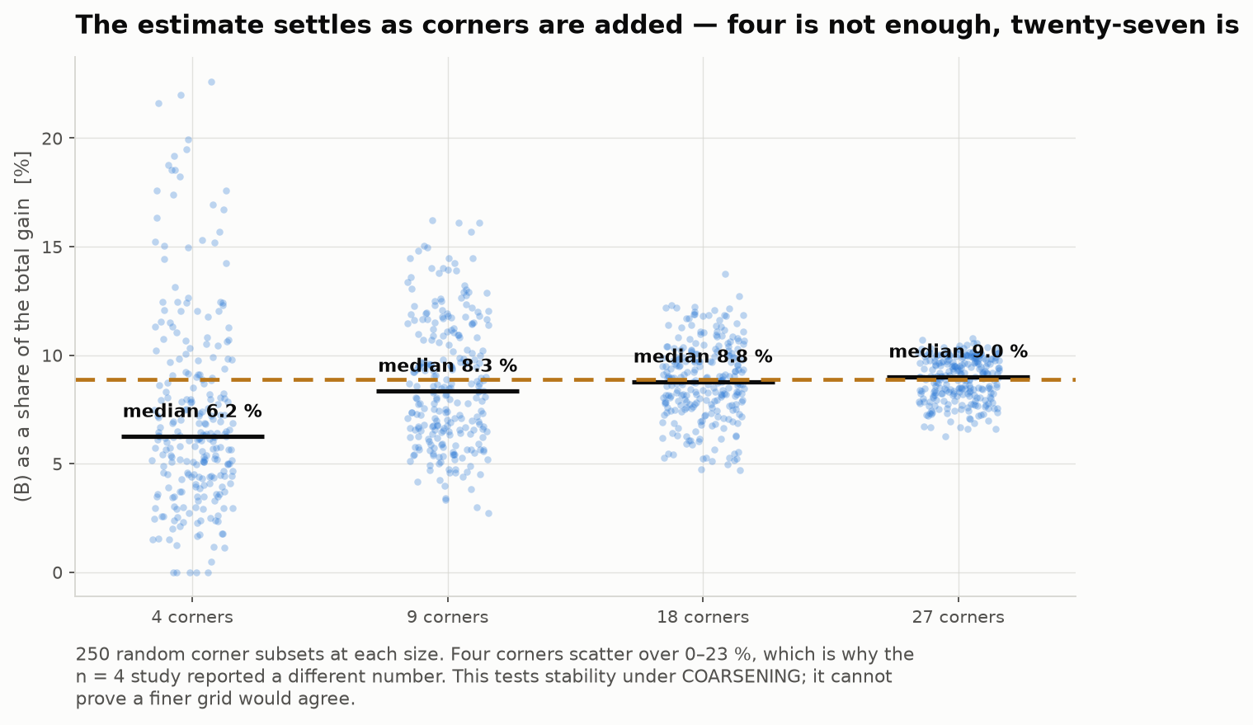
Is the 36-corner grid dense enough?
The split re-estimated on 250 random corner subsets at each size.
Fig. 14 — Simulated in ngspice. At four corners the estimate scatters over 0–23 %, which is why the earlier n = 4 study reported a different share; by 27 it sits on the full-grid answer. Stated precisely: this tests stability under COARSENING and is evidence the grid is dense enough. It cannot prove a finer grid would agree — that needs new transients.
23

Slide 24
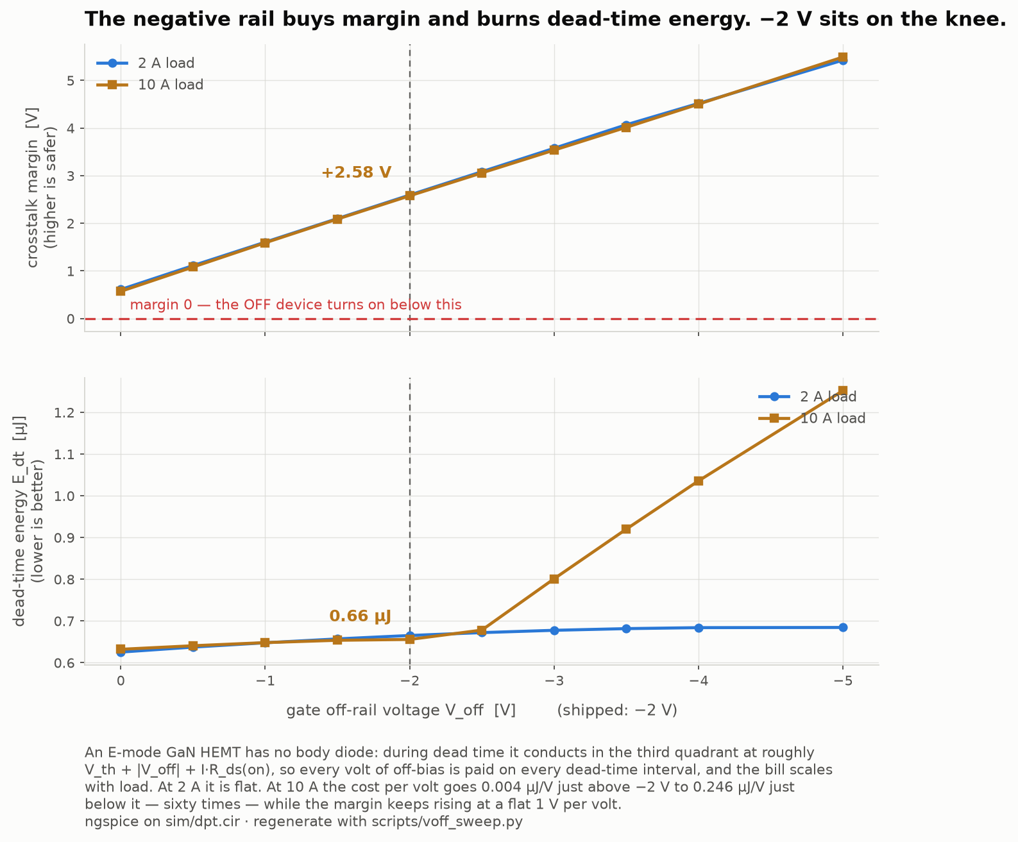
What the negative rail costs
V_off swept 0 to −5 V at two loads. Margin against dead-time energy.
Fig. 15 — Simulated in ngspice. The −2 V rail was chosen from the crosstalk side alone, and this is the other side of that choice. An E-mode GaN HEMT has no body diode, so during dead time it conducts in the third quadrant at roughly V_th + |V_off| + I·R_ds(on) — every volt of off-bias is paid on every dead-time interval. Margin rises at a flat 1 V per volt throughout. The cost does not: at 10 A it is 0.004 µJ/V just above −2 V and 0.246 µJ/V just below, sixty times steeper. −2 V sits on the knee, which is a result rather than a justification. scripts/voff_sweep.py.
24

Slide 25
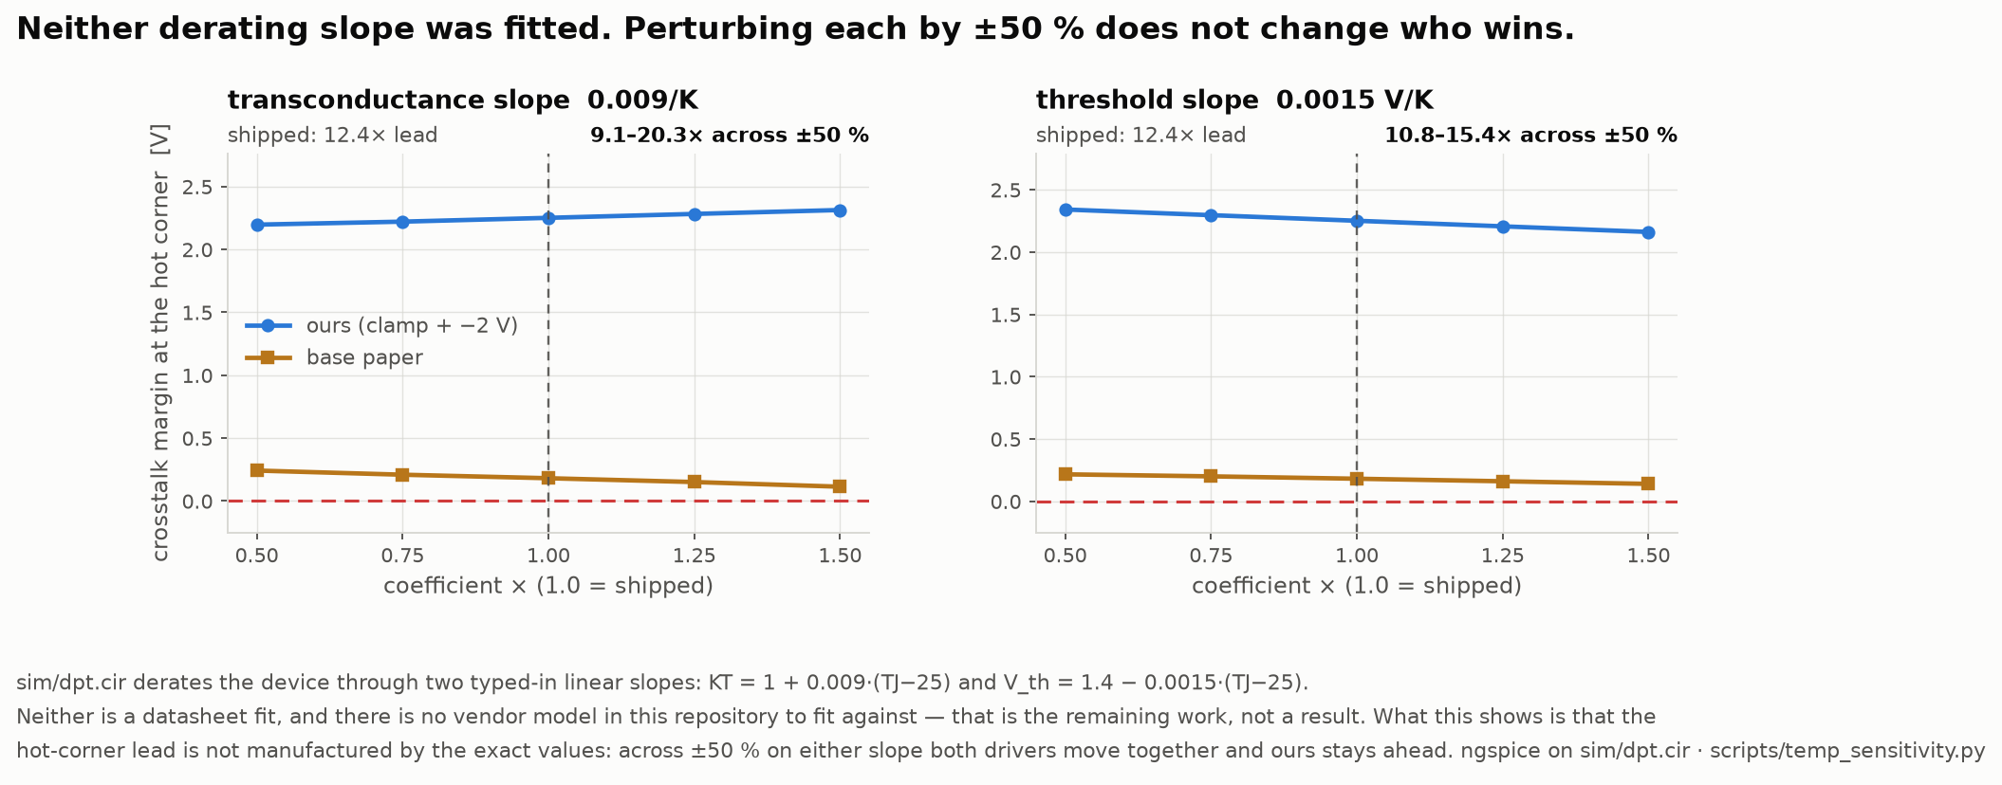
Does the hot-corner lead rest on two typed-in numbers?
Both derating slopes perturbed ±50 %, hot corner re-run for both drivers.
Fig. 16 — Simulated in ngspice. sim/dpt.cir derates the device through KT = 1 + 0.009·(TJ−25) and V_th = 1.4 − 0.0015·(TJ−25). Neither is a datasheet fit — there is no vendor model in the repository to fit against, and that is remaining work, not a result. What can be shown is whether the lead is manufactured by their exact values, and it is not: across ±50 % on either slope the lead runs 9.1–20.3× against 12.4× as shipped. Our margin barely moves; theirs collapses either way. scripts/temp_sensitivity.py.
25

Slide 26
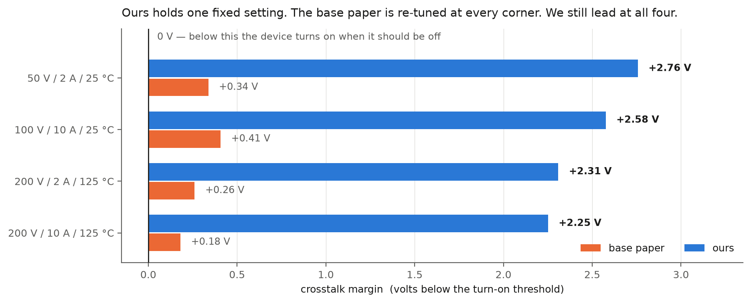
Head to head with the base paper
5.5× to 12.4×, and the lead widens as the corner gets harder.
Fig. 17 — Simulated in ngspice. scripts/headtohead.py: same deck, same GaN, same parasitics; only the driver is swapped. We hold one fixed control word at all four corners; they are re-optimised at every corner, which is more freedom than their own design has. Their margin falls +0.50 → +0.18 V from the mildest corner to the hottest and ours barely moves, because a clamp does not care how hot the device is. Our switch node also slews about twice as fast, so the margin is not bought with switching speed. One caveat: models/zhangdrv.lib is our implementation of the scheme as they (their netlist is not published), run in our testbench with our parasitics. It is not 5.5–12.4× their measured result, and we do not claim it is.
26

Slide 27
The closest published drivers
Ref | Author(s) & Year | Title / Source | Aim — what the paper sets out to do | Gap we found → what WE fill
BASE PAPER | Zhang, Yu, Leng, Cui, Deng & Ng (2020) | A Segmented Gate Driver for E-mode GaN HEMTs with Simple Driving Strength Pattern Control Proc. IEEE ISPSD, 2020, pp. 102–105 ieeexplore.ieee.org/document/9170108 | Segmented output stage on E-mode GaN: 7 slices, pattern timing 0.5–5 ns, strength set by one external bias resistor | Base paper. Same device, same architecture: E-mode GaN, segmented output stage, strength set by a pattern. Theirs is an ASIC with a fixed pattern set. We make every field programmable from an FPGA and price what the pattern space buys. We fill: the price of the pattern space: what an exhaustive search buys over their fixed pattern set.
11 | Wang, Tao, Xiao, Luo, He, Zhou, Zhang & Wang (2024) | High-Frequency Three-Level Gate Driver for GaN HEMT Bridge Crosstalk Suppression IEEE Trans. Power Electron., 39(1), 1343–1352 ieeexplore.ieee.org/document/10286072 | Three-level drive; capacitor–diode negative rail with a digitally-clamped zero level, to 5 MHz | Recent, GaN, and on exactly our failure mode. It suppresses crosstalk with added passives; we get the same protection from the Miller clamp already in the cell and measure its price at 0.04 %. We fill: whether the setting has to change with the operating point at all. It does not: 2.6 % of baseline.
12 | Wang, Sun, Yan, Ma & Xu (2024) | An Integrated Suppression Method of Both Gate-Source Voltage Oscillation and Crosstalk for GaN HEMT Gate Driver IEEE Trans. Power Electron., 39(11), 14643–14655 ieeexplore.ieee.org/document/10591431 | One driver addressing gate-source ringing and crosstalk together | Confirms the two effects are coupled, which is why our cost function prices loss and overshoot jointly rather than optimising either alone. We fill: both effects in one cost function, showing the objectives genuinely conflict (Pareto, slide 16).
13 | Cai, Ye, Lv & Chen (2026) | A High-Efficient GaN Driver With Hybrid Adaptive Dead-Time Control and Peak Delay Control for Synchronous Buck Converter IEEE Trans. Power Electron., 41(1), 279–290 ieeexplore.ieee.org/document/11146698 | Hybrid adaptive dead-time plus peak delay control on a GaN synchronous buck | The most recent adaptive dead-time driver we found, and it adapts the one field our leave-one-out test shows carries the whole benefit — and only at light load. We fill: which field is worth scheduling. Only dead time, and only at light load; drive strength is worth 0.00 %.
[10] is the base paper: E-mode GaN, segmented output stage, strength chosen by a pattern. All four are verified against the publisher record.
27
Notes:
[25 s] CORE — literature mark. Closest prior work. [8] adapts dead time, the one field we find worth scheduling — and it does so across a 0.2-2 A range, which is exactly the light-load corner our leave-one-out test shows carries all of that benefit. Independent support, not competition.

Slide 28
The gap this project fills
Every paper on these drivers reports one number: how much better it is than a plain driver.
That number hides two separate effects, and they cost very different hardware.
Effect 1: a better fixed setting
Effect 2: adapting per operating point
Pick one good setting once, at design time. Costs nothing while running: no sensor, no ADC, no lookup table, no controller.
26.5 %
of baseline
Change the setting as load, voltage and temperature move. This is the part that needs the sensing hardware.
2.6 %
of baseline
The gap. Nobody separates them. No paper says how much of the benefit actually needs the re-tuning, because separating the two means running every setting at every operating point — and nobody has done that.
Why it matters. Only Effect 2 pays for the sensor, ADC and lookup table. If it is small, that hardware is mostly buying something a design-time choice already gives you.
What we do. 720 settings × 36 operating points, all of them, in ngspice — then report the two numbers separately instead of adding them together.
28

Slide 29
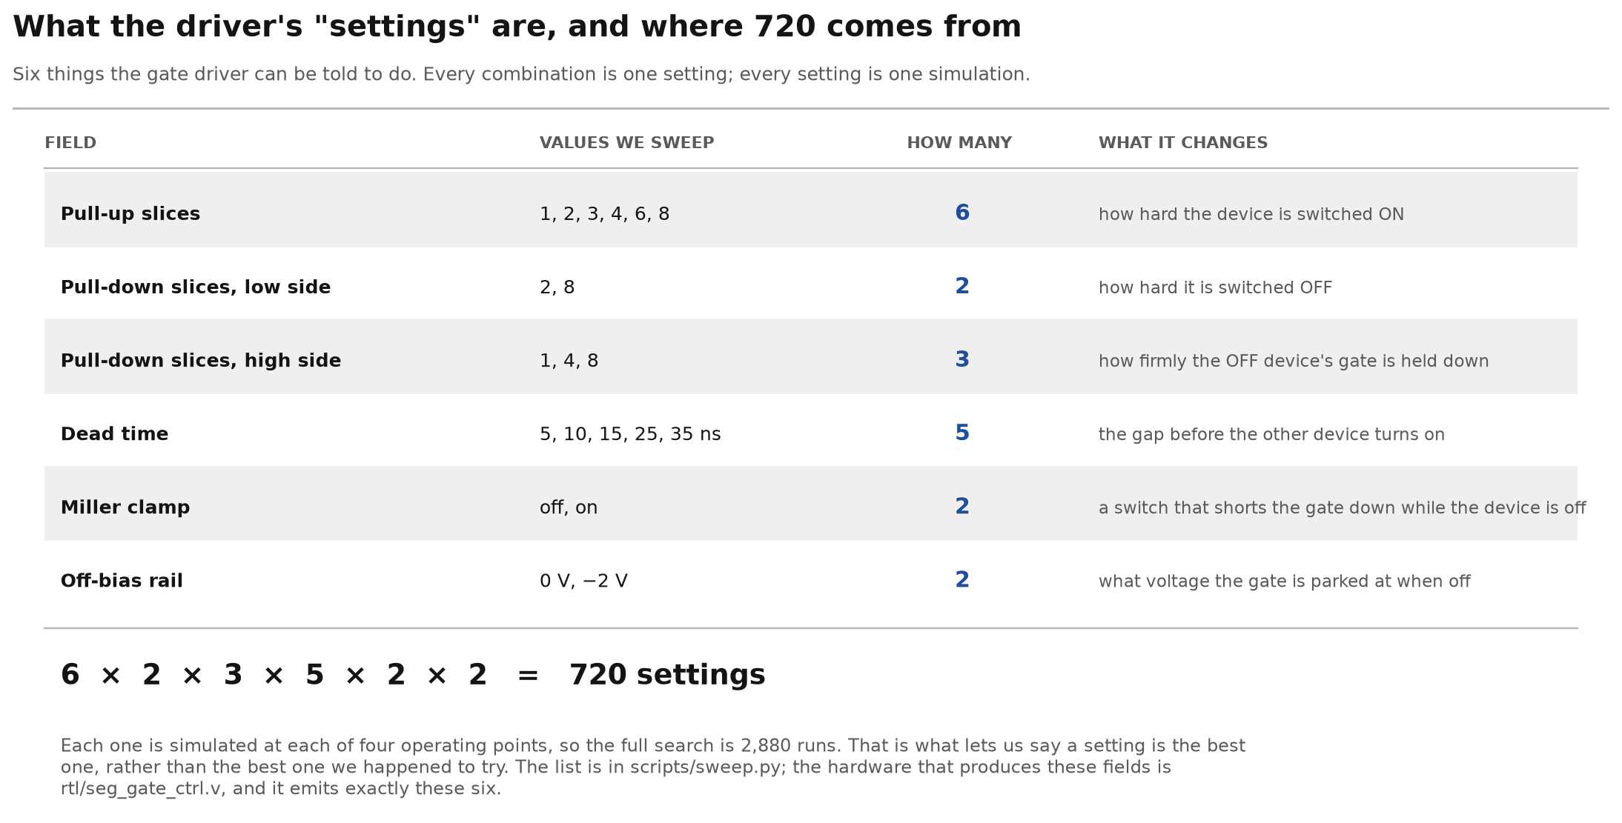
The driver's settings, and where 720 comes from
Fig. 18 — Drawn diagram, not simulation output. The six fields of the control word and the values swept over each. 6 × 2 × 3 × 5 × 2 × 2 = 720 settings, × 36 operating points = 25,920 transients.
29

Slide 30
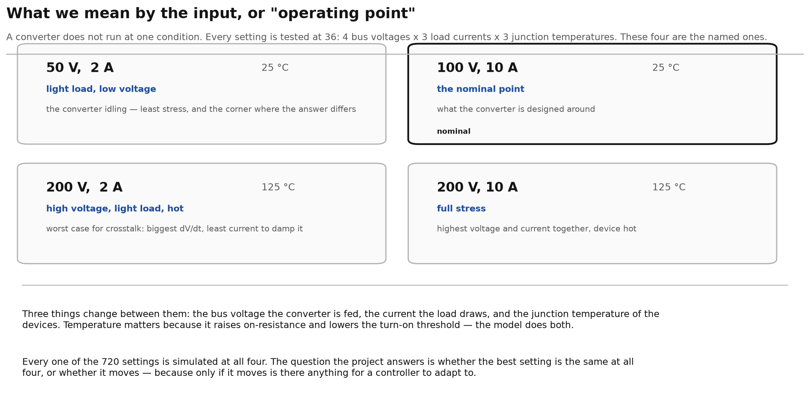
The input — what an operating point is
Fig. 19 — Drawn diagram, not simulation output. Four of the 36 corners every setting is evaluated at: bus voltage, load current and junction temperature.
30

Slide 31
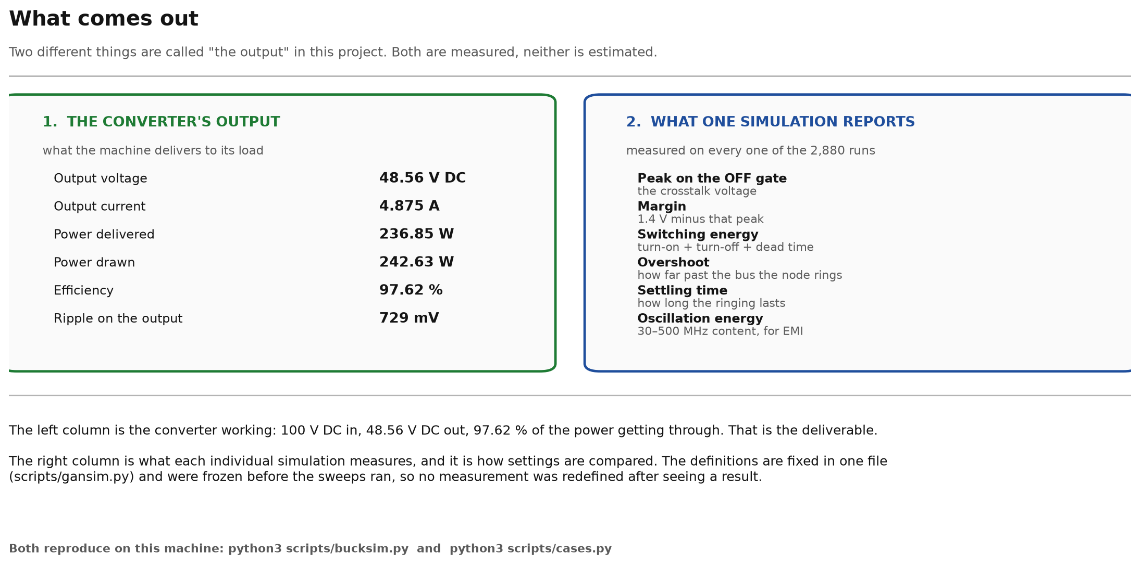
The output — what is actually measured
Fig. 20 — Drawn diagram, not simulation output. Converter-level output, and the eight quantities extracted from every transient. Definitions fixed in scripts/gansim.py before the sweeps ran.
31

Slide 32
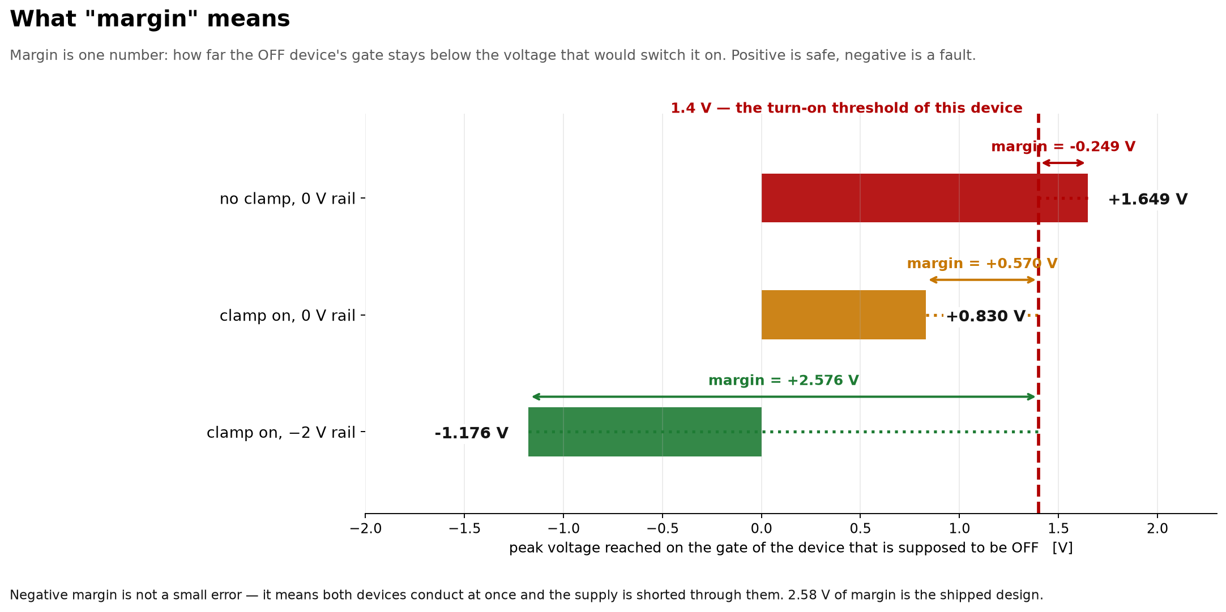
Crosstalk margin
Fig. 21 — Drawn diagram, not simulation output. Peak gate–source voltage on the off-state device against the 1.4 V threshold, three configurations. Margin is the threshold minus the peak; negative is a false turn-on.
32

Slide 33
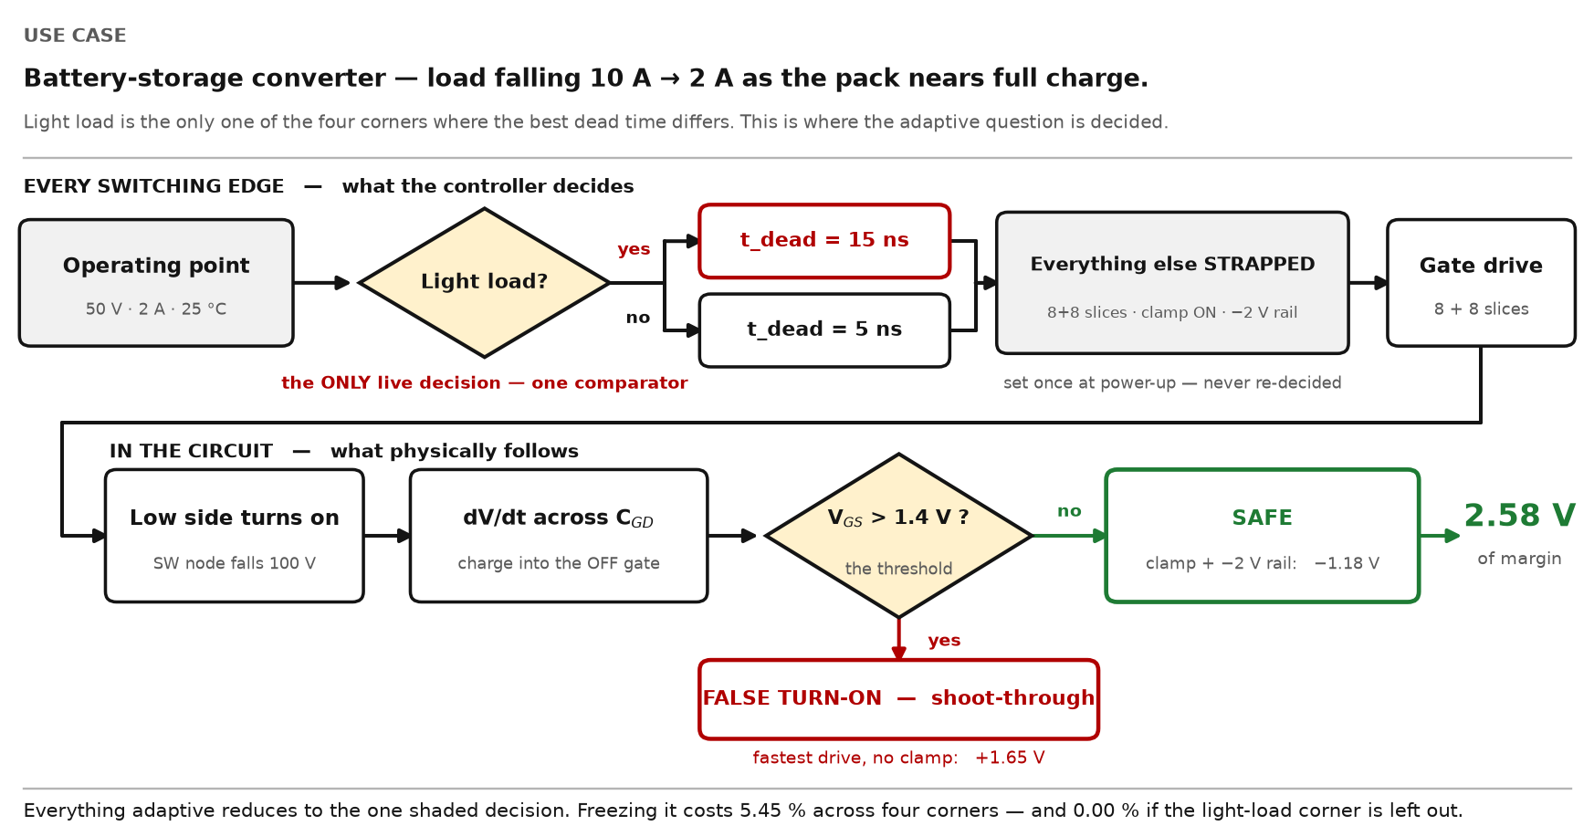
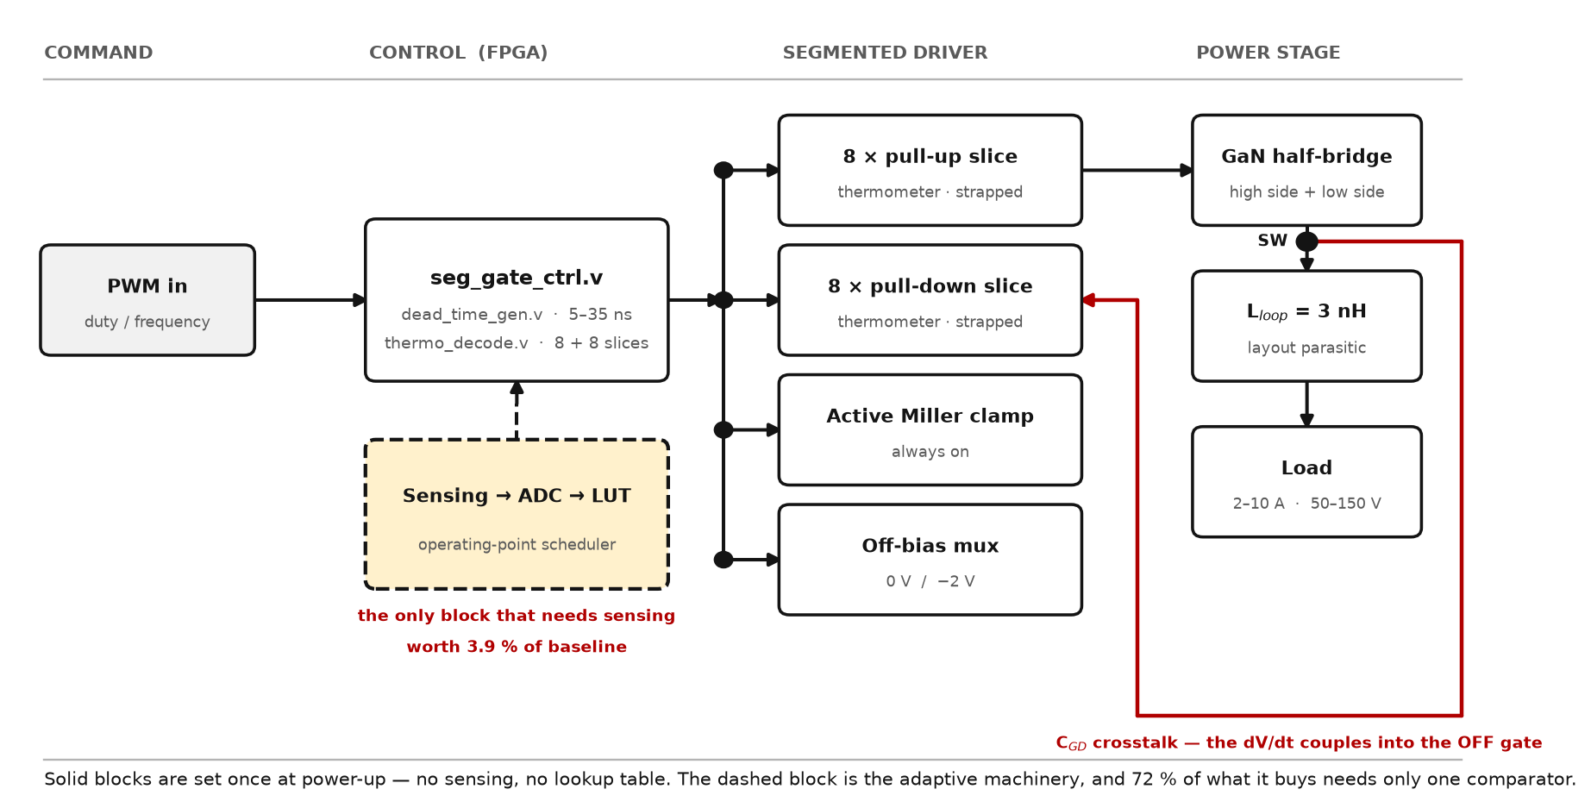
How it works — one use case, start to finish
Fig. 22 — Drawn diagram, not simulation output. One switching edge, followed through. Top row: the controller's decision. Bottom row: the circuit's response. Only the shaded diamond is decided at run time.
33

Slide 34
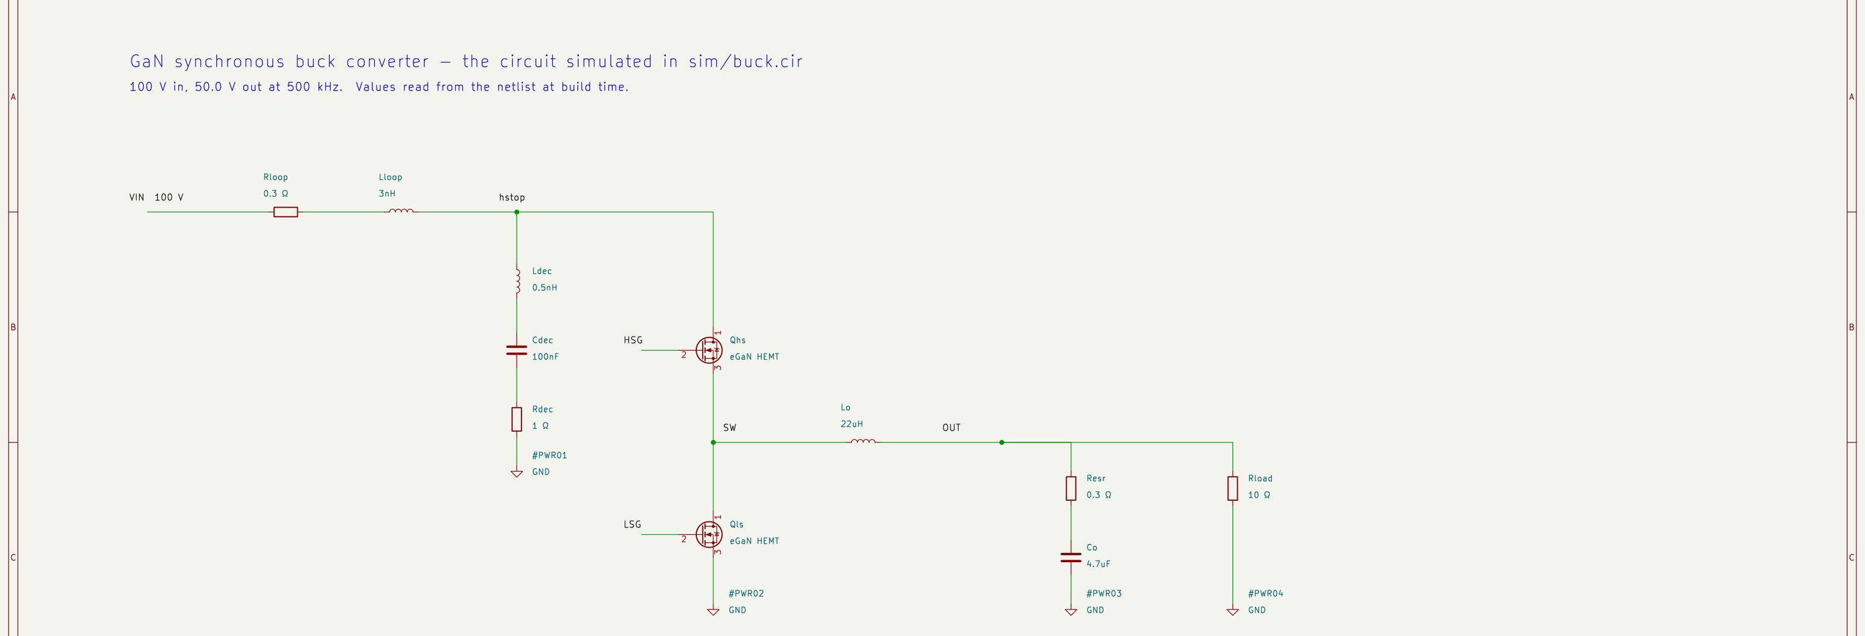
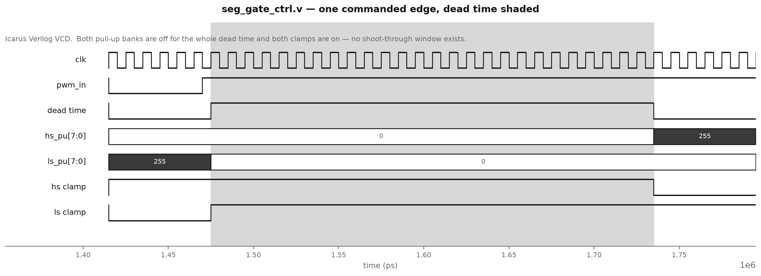
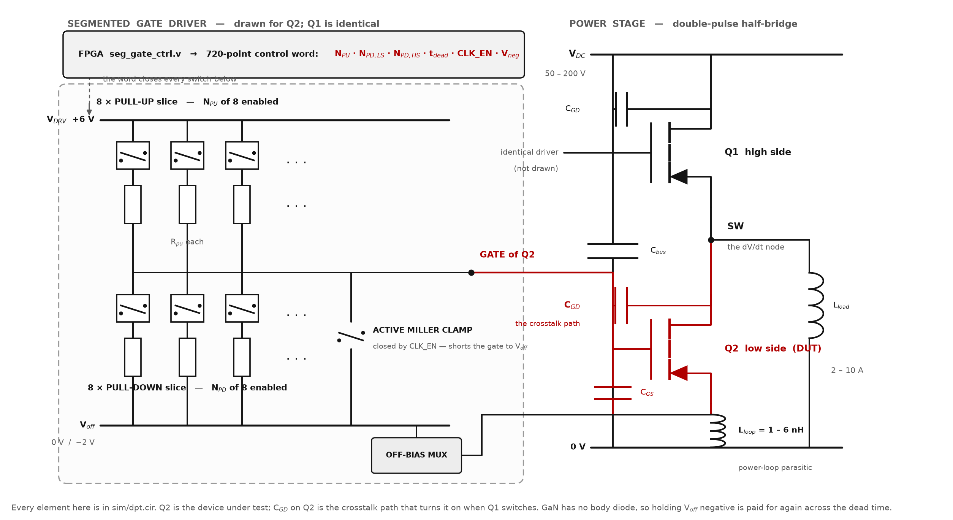
The circuit we simulate
Fig. 23 — Drawn diagram, not simulation output. GaN synchronous buck converter, drawn from sim/buck.cir by scripts/kicad_schematic.py — every value on it is read out of the netlist at build time. “Buck” means step-down: 100 V in, 48.50 V out. Left to right: the 100 V supply with its power-loop R and L, the damped bus decoupling branch (Ldec, Cdec, Rdec at 1 Ω), the two GaN HEMTs whose gates the segmented drivers drive, the output filter and a 10 Ω load.
34
Notes:
[30 s] CORE — use this the moment anyone asks what was actually simulated. Trace the red path with a finger: Q1 switches, the SW node moves, charge couples through C_GD into Q2's gate, and Q2 turns on when it should be off. Then point at the clamp and the off-bias mux — those are the two things that fix it. Do not read the component values out.

Slide 35
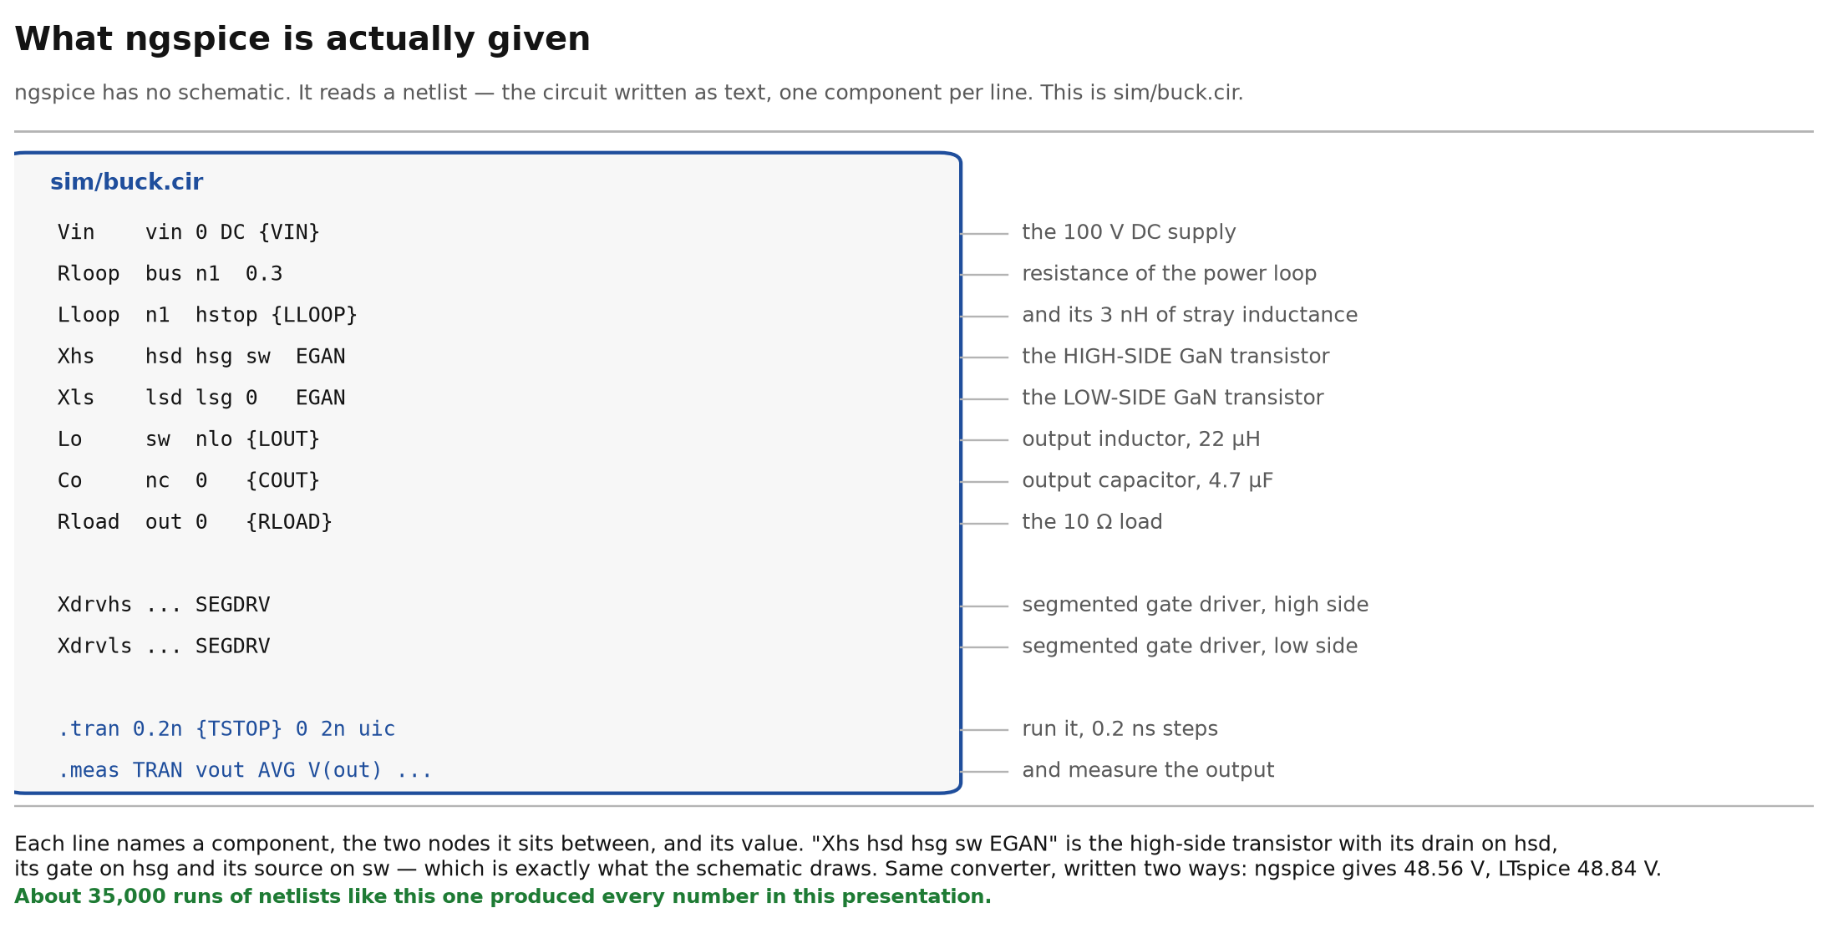
What ngspice runs
Fig. 24 — A project file, typeset. Not simulation output. Power stage of sim/buck.cir. ngspice reads the circuit as a netlist, not a schematic; it is the same converter the schematic draws. ngspice gives 48.50 V on the shipped word. The LTspice cross-check is pending a re-run: its schematic gained the damped decoupling branch, so the previously quoted 48.84 V describes a circuit that no longer exists.
35

Slide 36
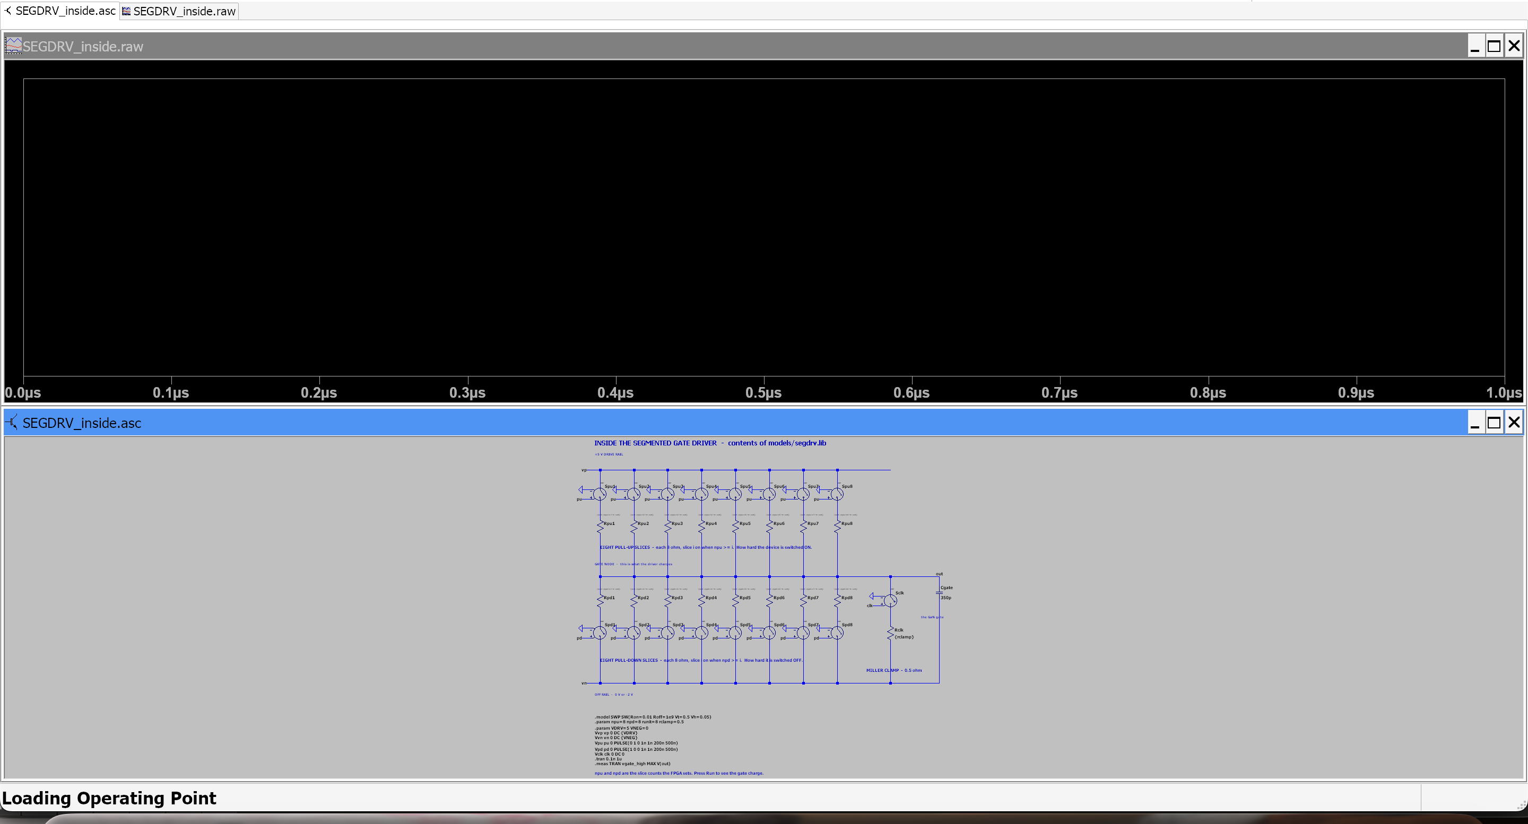
Inside the segmented gate driver
Fig. 25 — Drawn and simulated in LTspice. Contents of models/segdrv.lib, drawn as ltspice/SEGDRV_inside.asc: eight pull-up slices from the +5 V rail to the gate, eight pull-down slices to the off rail, and the Miller clamp on its own 0.5 Ω path. It runs: the gate charges to 5.000 V.
36

Slide 37
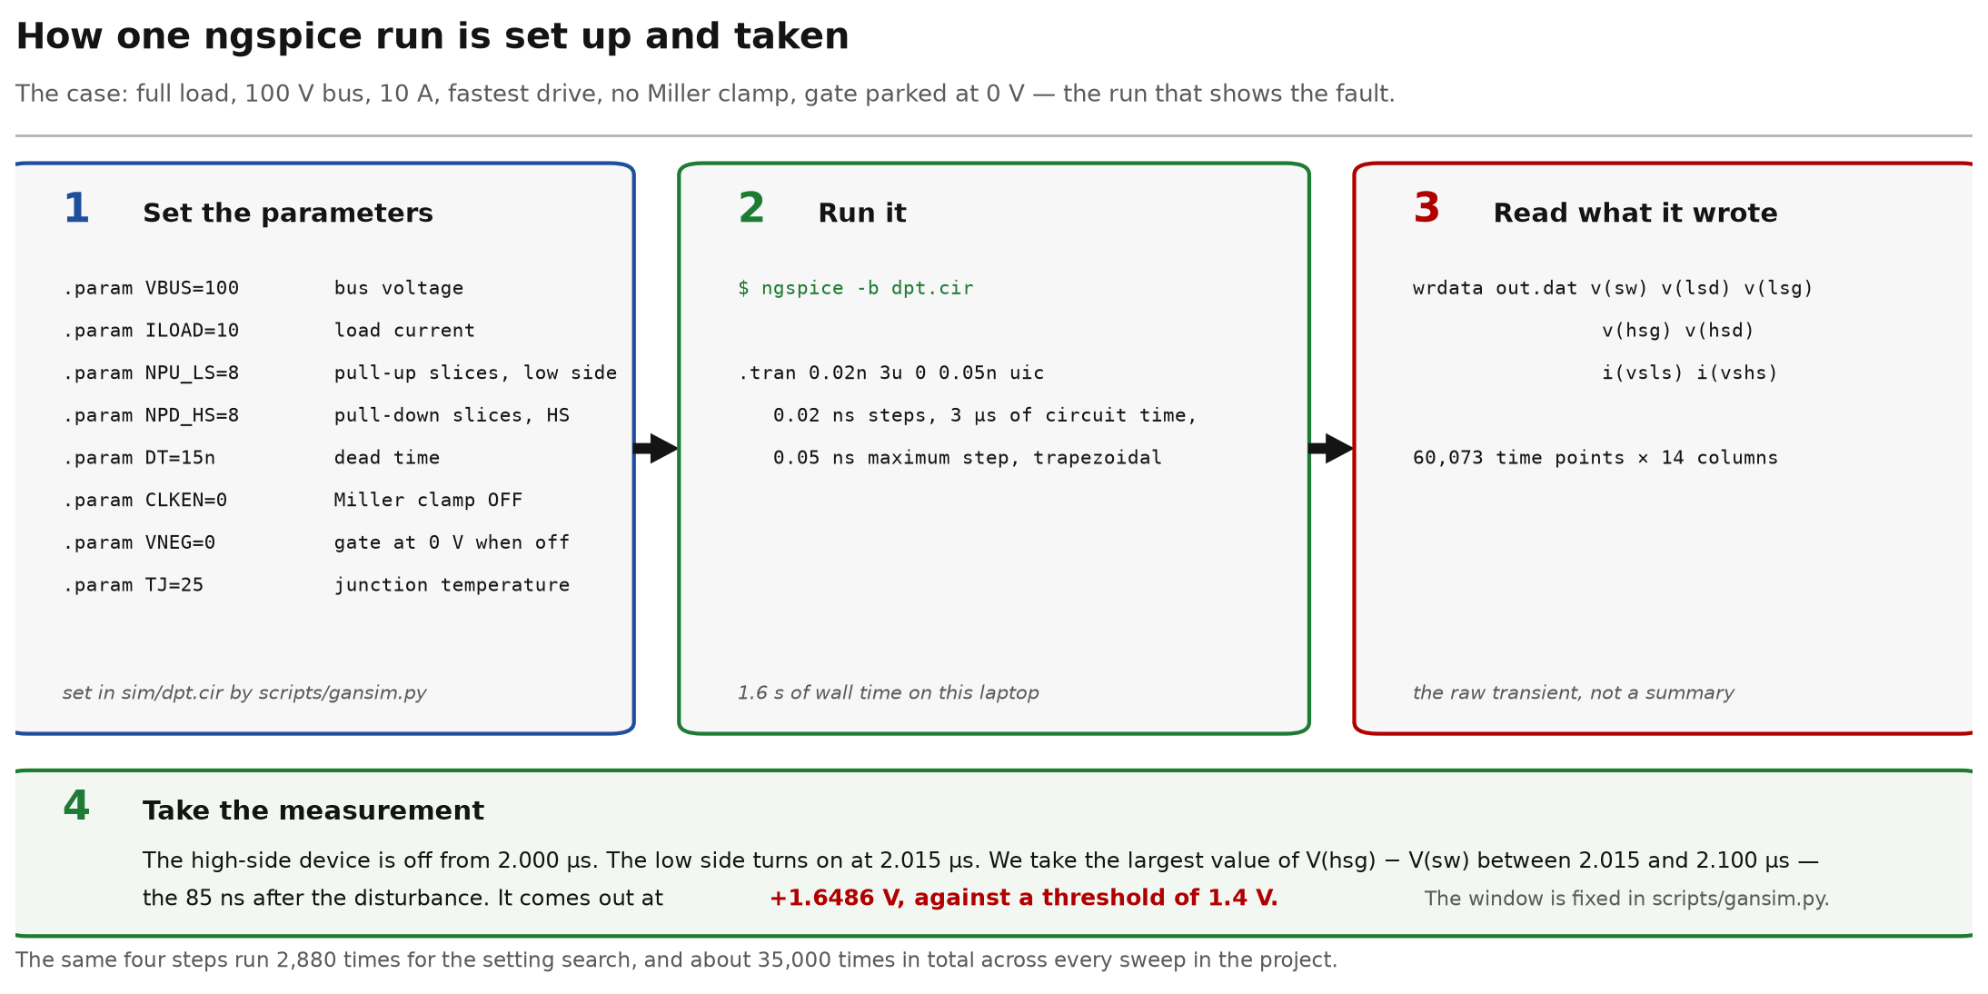
How we run ngspice
Fig. 26 — Drawn diagram, not simulation output. One case end to end: the parameters set into sim/dpt.cir, the command, what the simulator wrote, and the window the measurement is taken over. Full load, 100 V / 10 A, no clamp: +1.6486 V against a 1.4 V threshold.
37

Slide 38
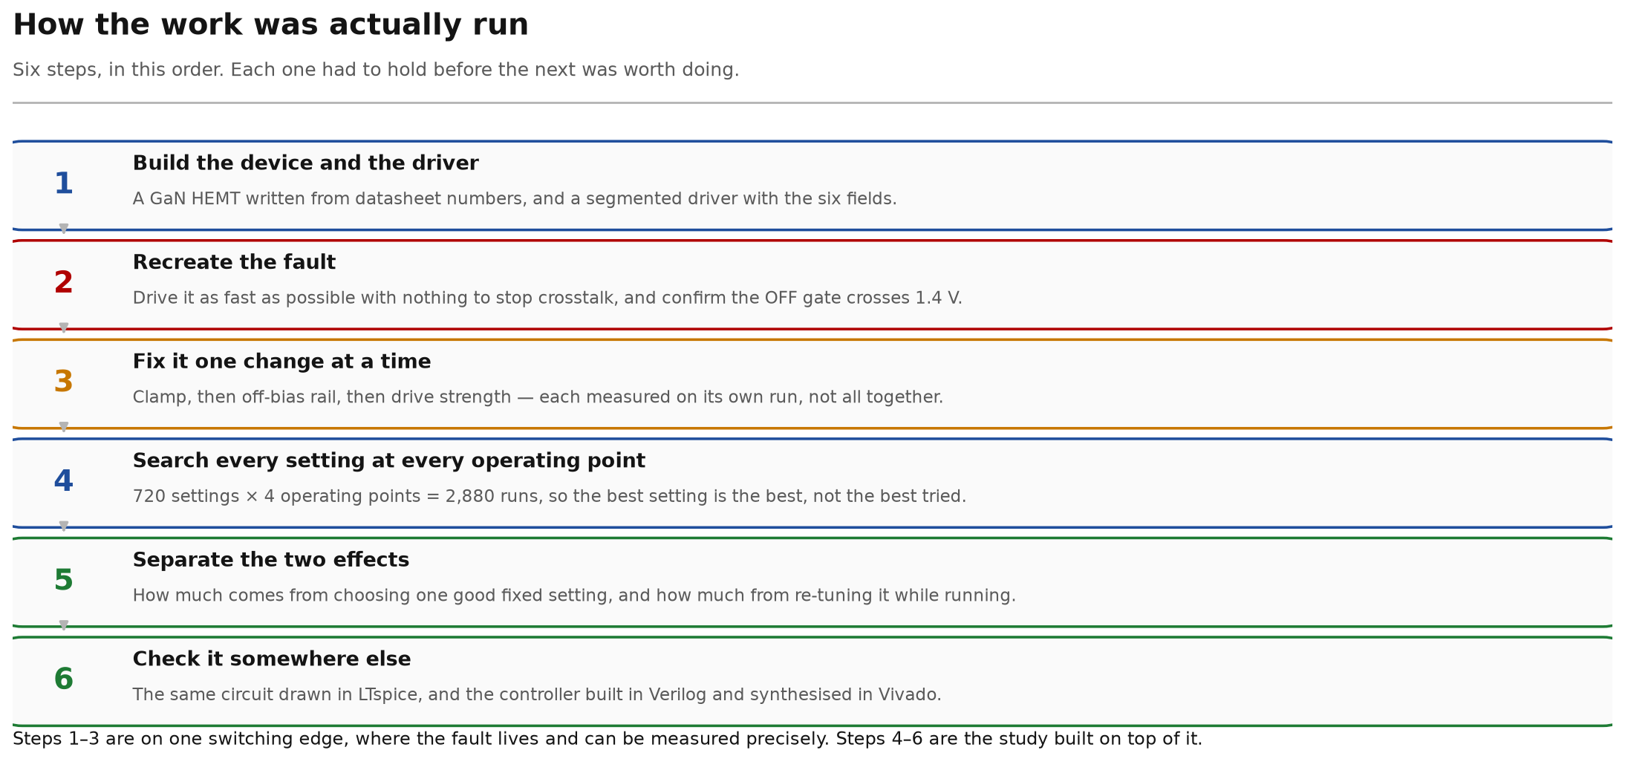
How the work was run
Fig. 27 — Drawn diagram, not simulation output. Method, in the order carried out. Steps 1–3 on one switching edge; steps 4–6 the study built on it.
38

Slide 39
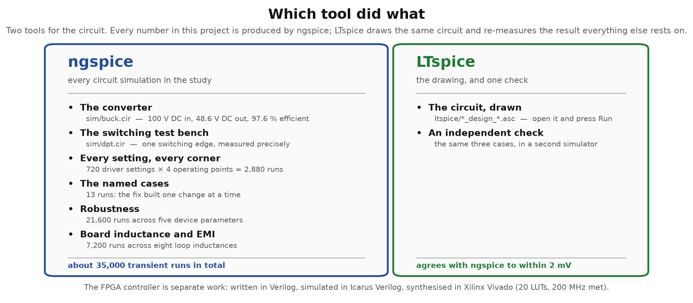
Which tool did what
Fig. 28 — Drawn diagram, not simulation output. Division of work between the two circuit simulators. All ≈ 35,000 transients are ngspice; LTspice provides an independent check of the crosstalk result.
39

Slide 40
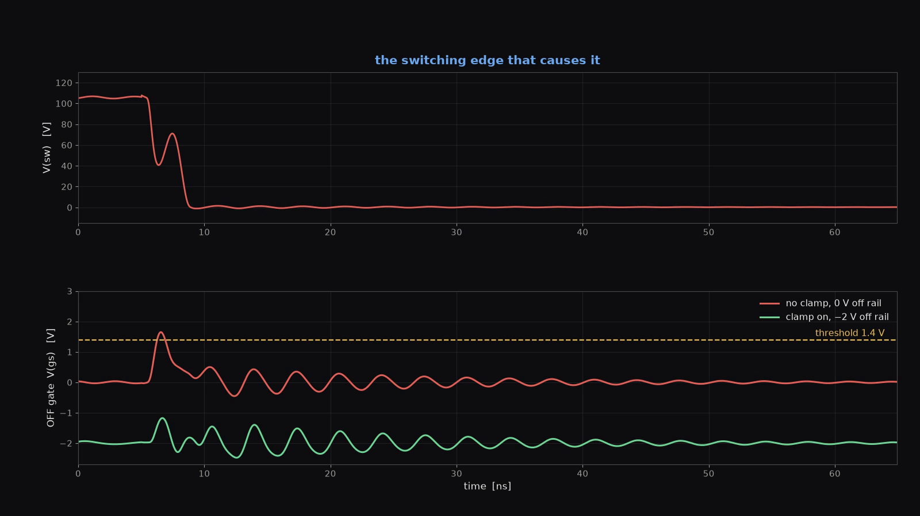
Demo — the driver, built and measured, on this machine
Fig. 29 — models/segdrv.lib as it is on disk, ngspice run twice on sim/dpt.cir, the waveforms those two runs produced, and the measurement: +1.65 V without the clamp against a 1.4 V threshold, −1.18 V with it. 27 s. Click to play. Rebuilt by scripts/demo_video.py, so every number on screen is computed, not captioned.
40

Slide 41
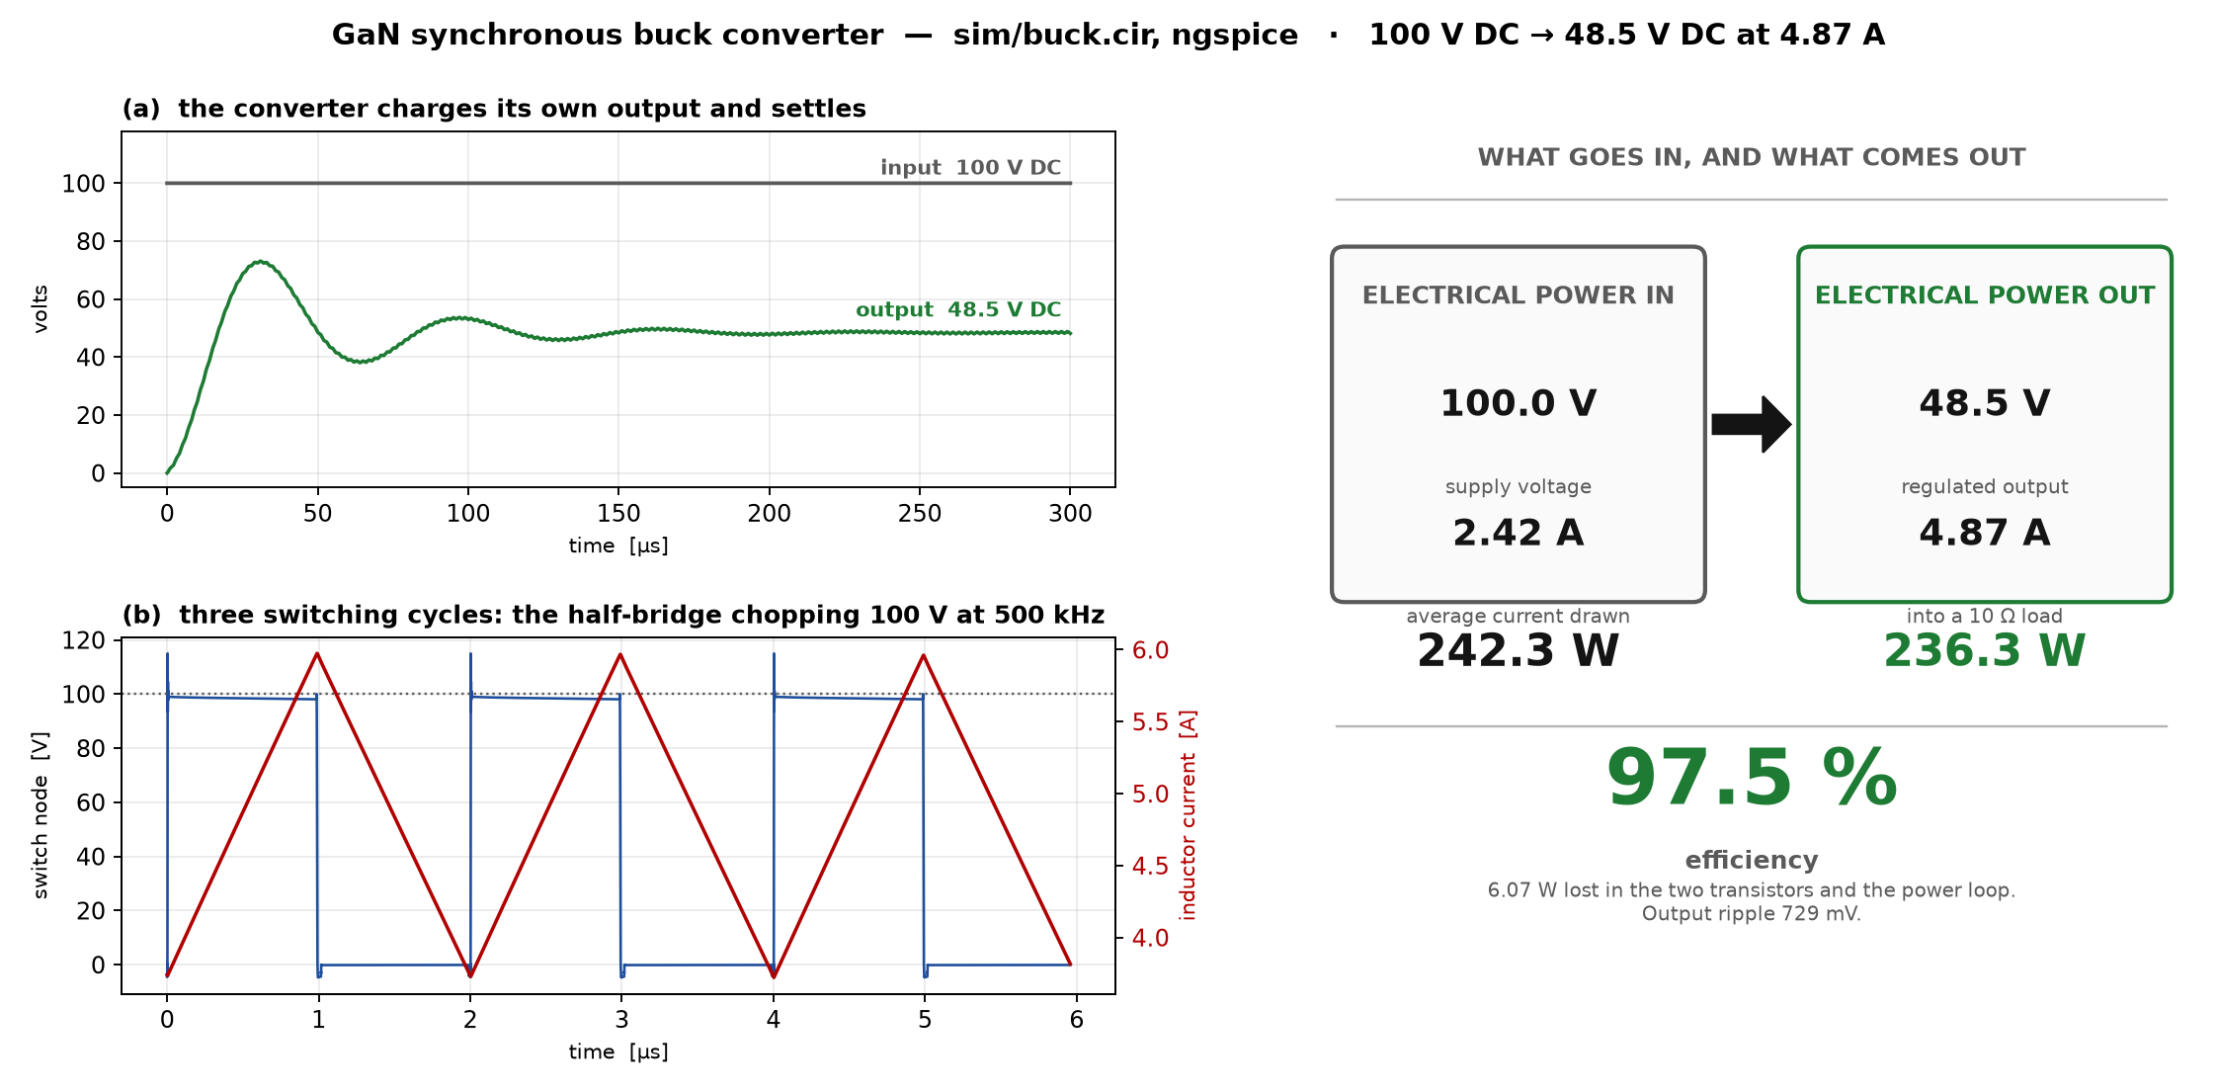
What we are building — the converter
Fig. 30 — Simulated in ngspice. GaN synchronous buck converter. (a) output charging from zero and settling; (b) three switching cycles; (c) power in against power out. 100 V DC in, 48.50 V DC out at 4.869 A, 97.49 % efficient.
41

Slide 42
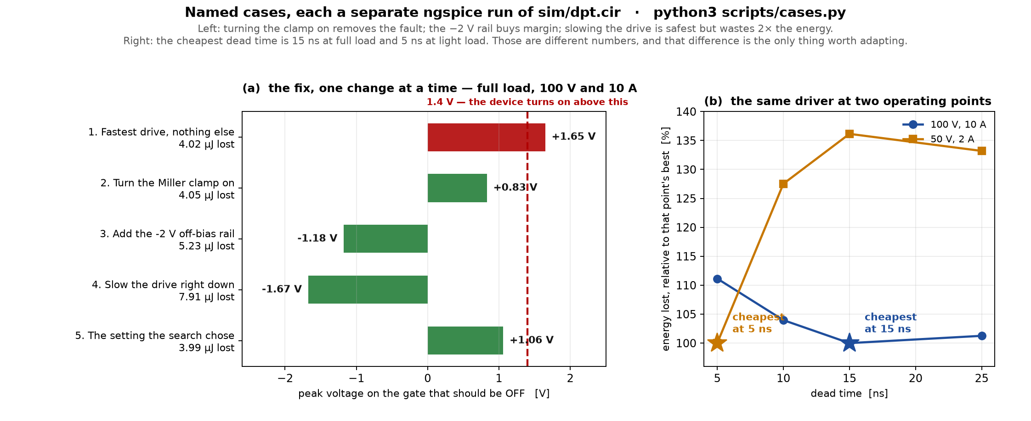
The cases we ran, one at a time
Fig. 31 — Simulated in ngspice. (a) five settings at 100 V / 10 A, one ngspice run each; (b) dead-time sweep at two operating points. Cheapest dead time: 15 ns at full load, 5 ns at light load.
42

Slide 43
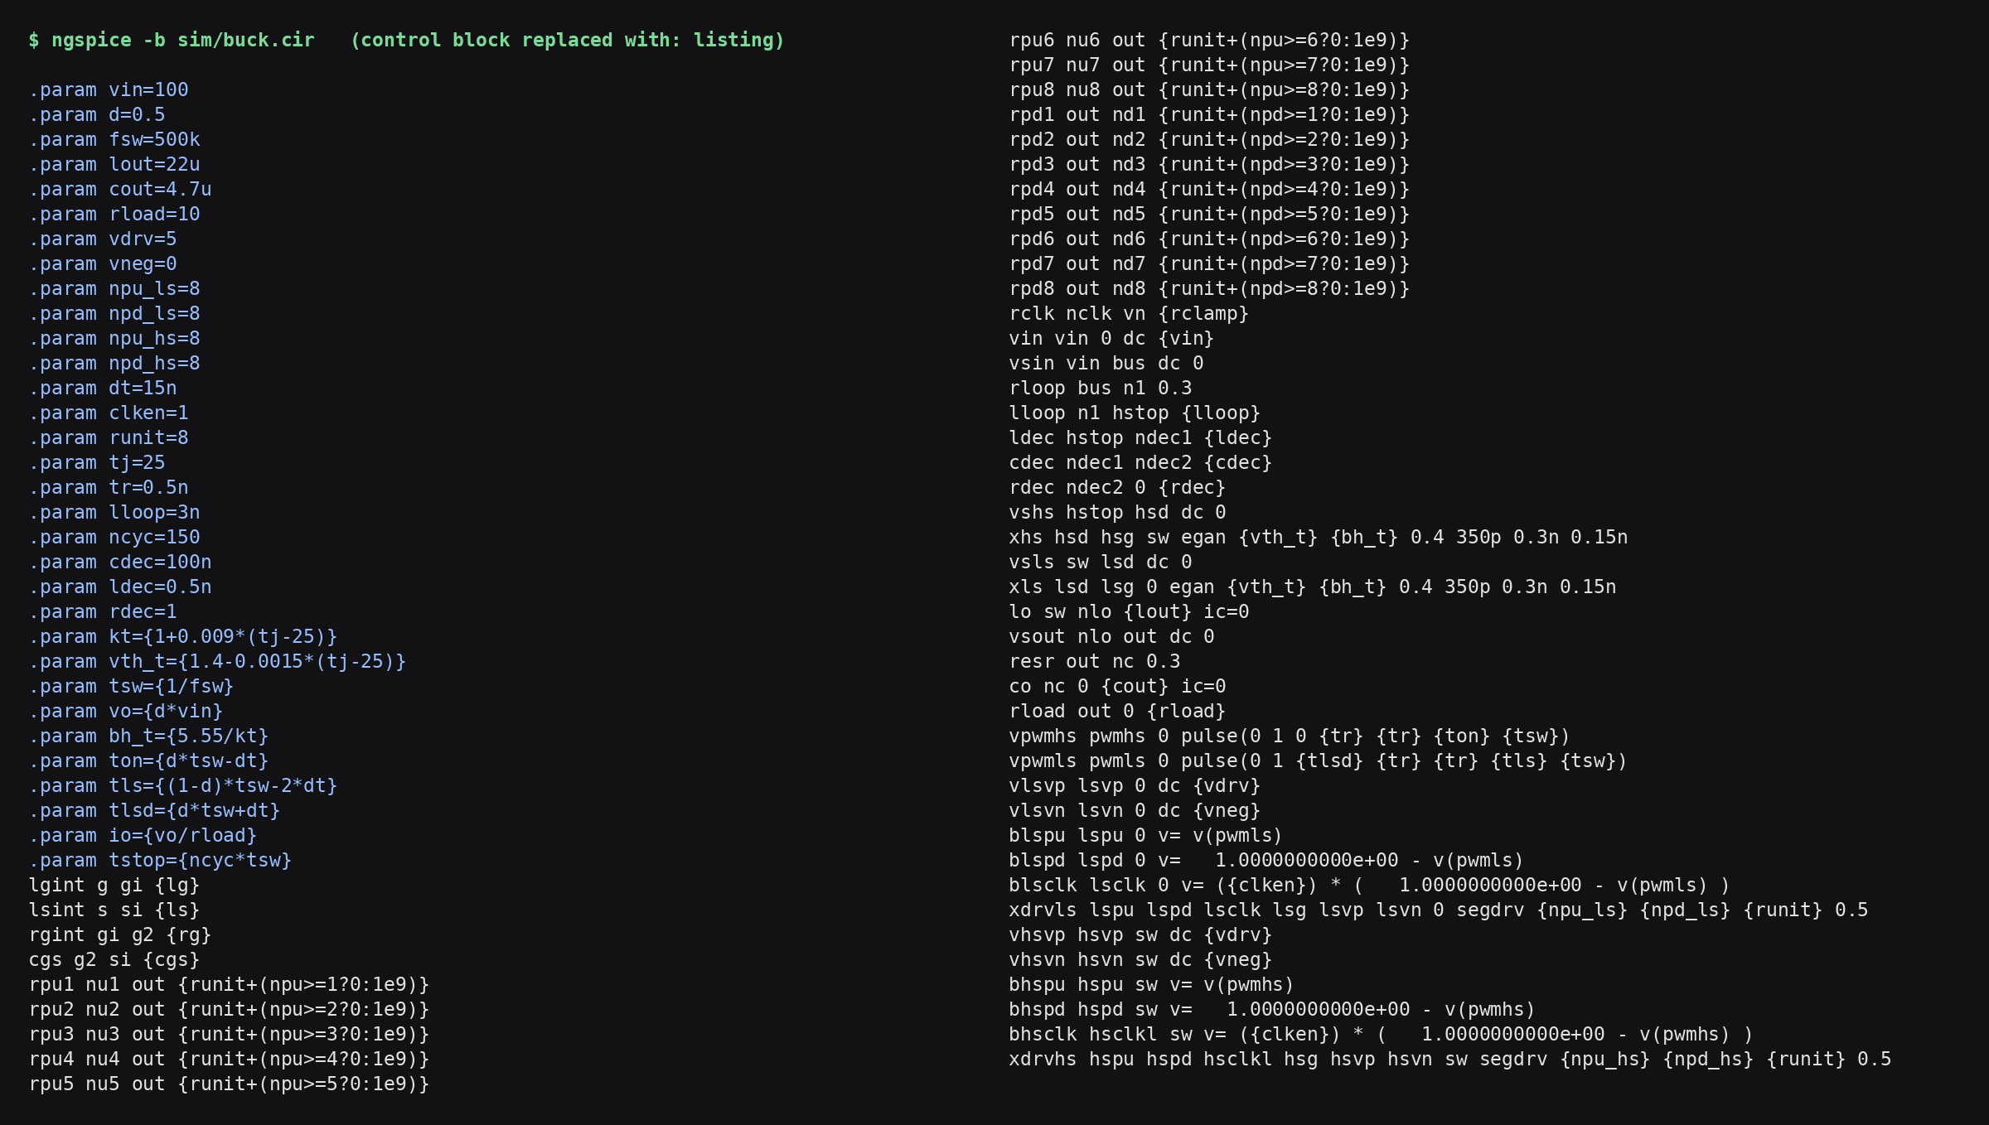
The circuit, as ngspice reports it
Fig. 32 — ngspice, on screen. ngspice cannot draw a schematic. It can say what it parsed, which is better evidence: a drawing is what somebody believes the circuit is, this is what was solved. Note rpu1–rpu8 and rpd1–rpd8 — the sixteen slices, switched in by {runit+(npu>=n?0:1e9)} — rclk the clamp, and rdec at 1 Ω, the damped value. scripts/netlist_listing.py regenerates it, so it cannot go stale.
43

Slide 44
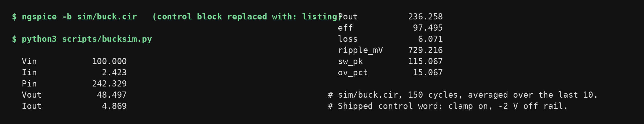
Circuit simulation — the converter
Fig. 33 — ngspice, on screen. scripts/bucksim.py driving ngspice over sim/buck.cir, on the shipped word. 100 V and 2.423 A in, 48.50 V and 4.869 A out: 242.33 W drawn, 236.26 W delivered, 97.49 % efficient. Peak switch node 115.1 V, 15.1 % overshoot at this deck's 0.2 ns step; resolving the edge at 0.02 ns gives 18.0 %, of which the −2 V rail is +11.3 points — the margin is not free. scripts/overshoot_audit.py. The two comparison tables read 97.42 % for this same word: those runs start pre-charged in steady state and average 20 cycles, this one starts from zero and averages 10. The gap is the start-up transient, not a disagreement.
44

Slide 45
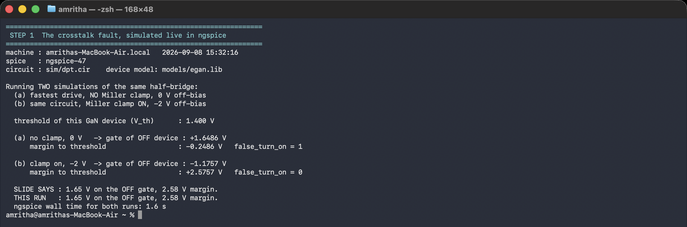
Crosstalk simulation — the fault, and the fix
Fig. 34 — ngspice, on screen. Two runs of sim/dpt.cir. Fastest drive, no clamp, 0 V rail: gate reaches +1.6486 V against a 1.400 V threshold, false_turn_on = 1. Clamp on with −2 V rail: −1.1757 V, margin +2.5757 V, false_turn_on = 0.
45

Slide 46
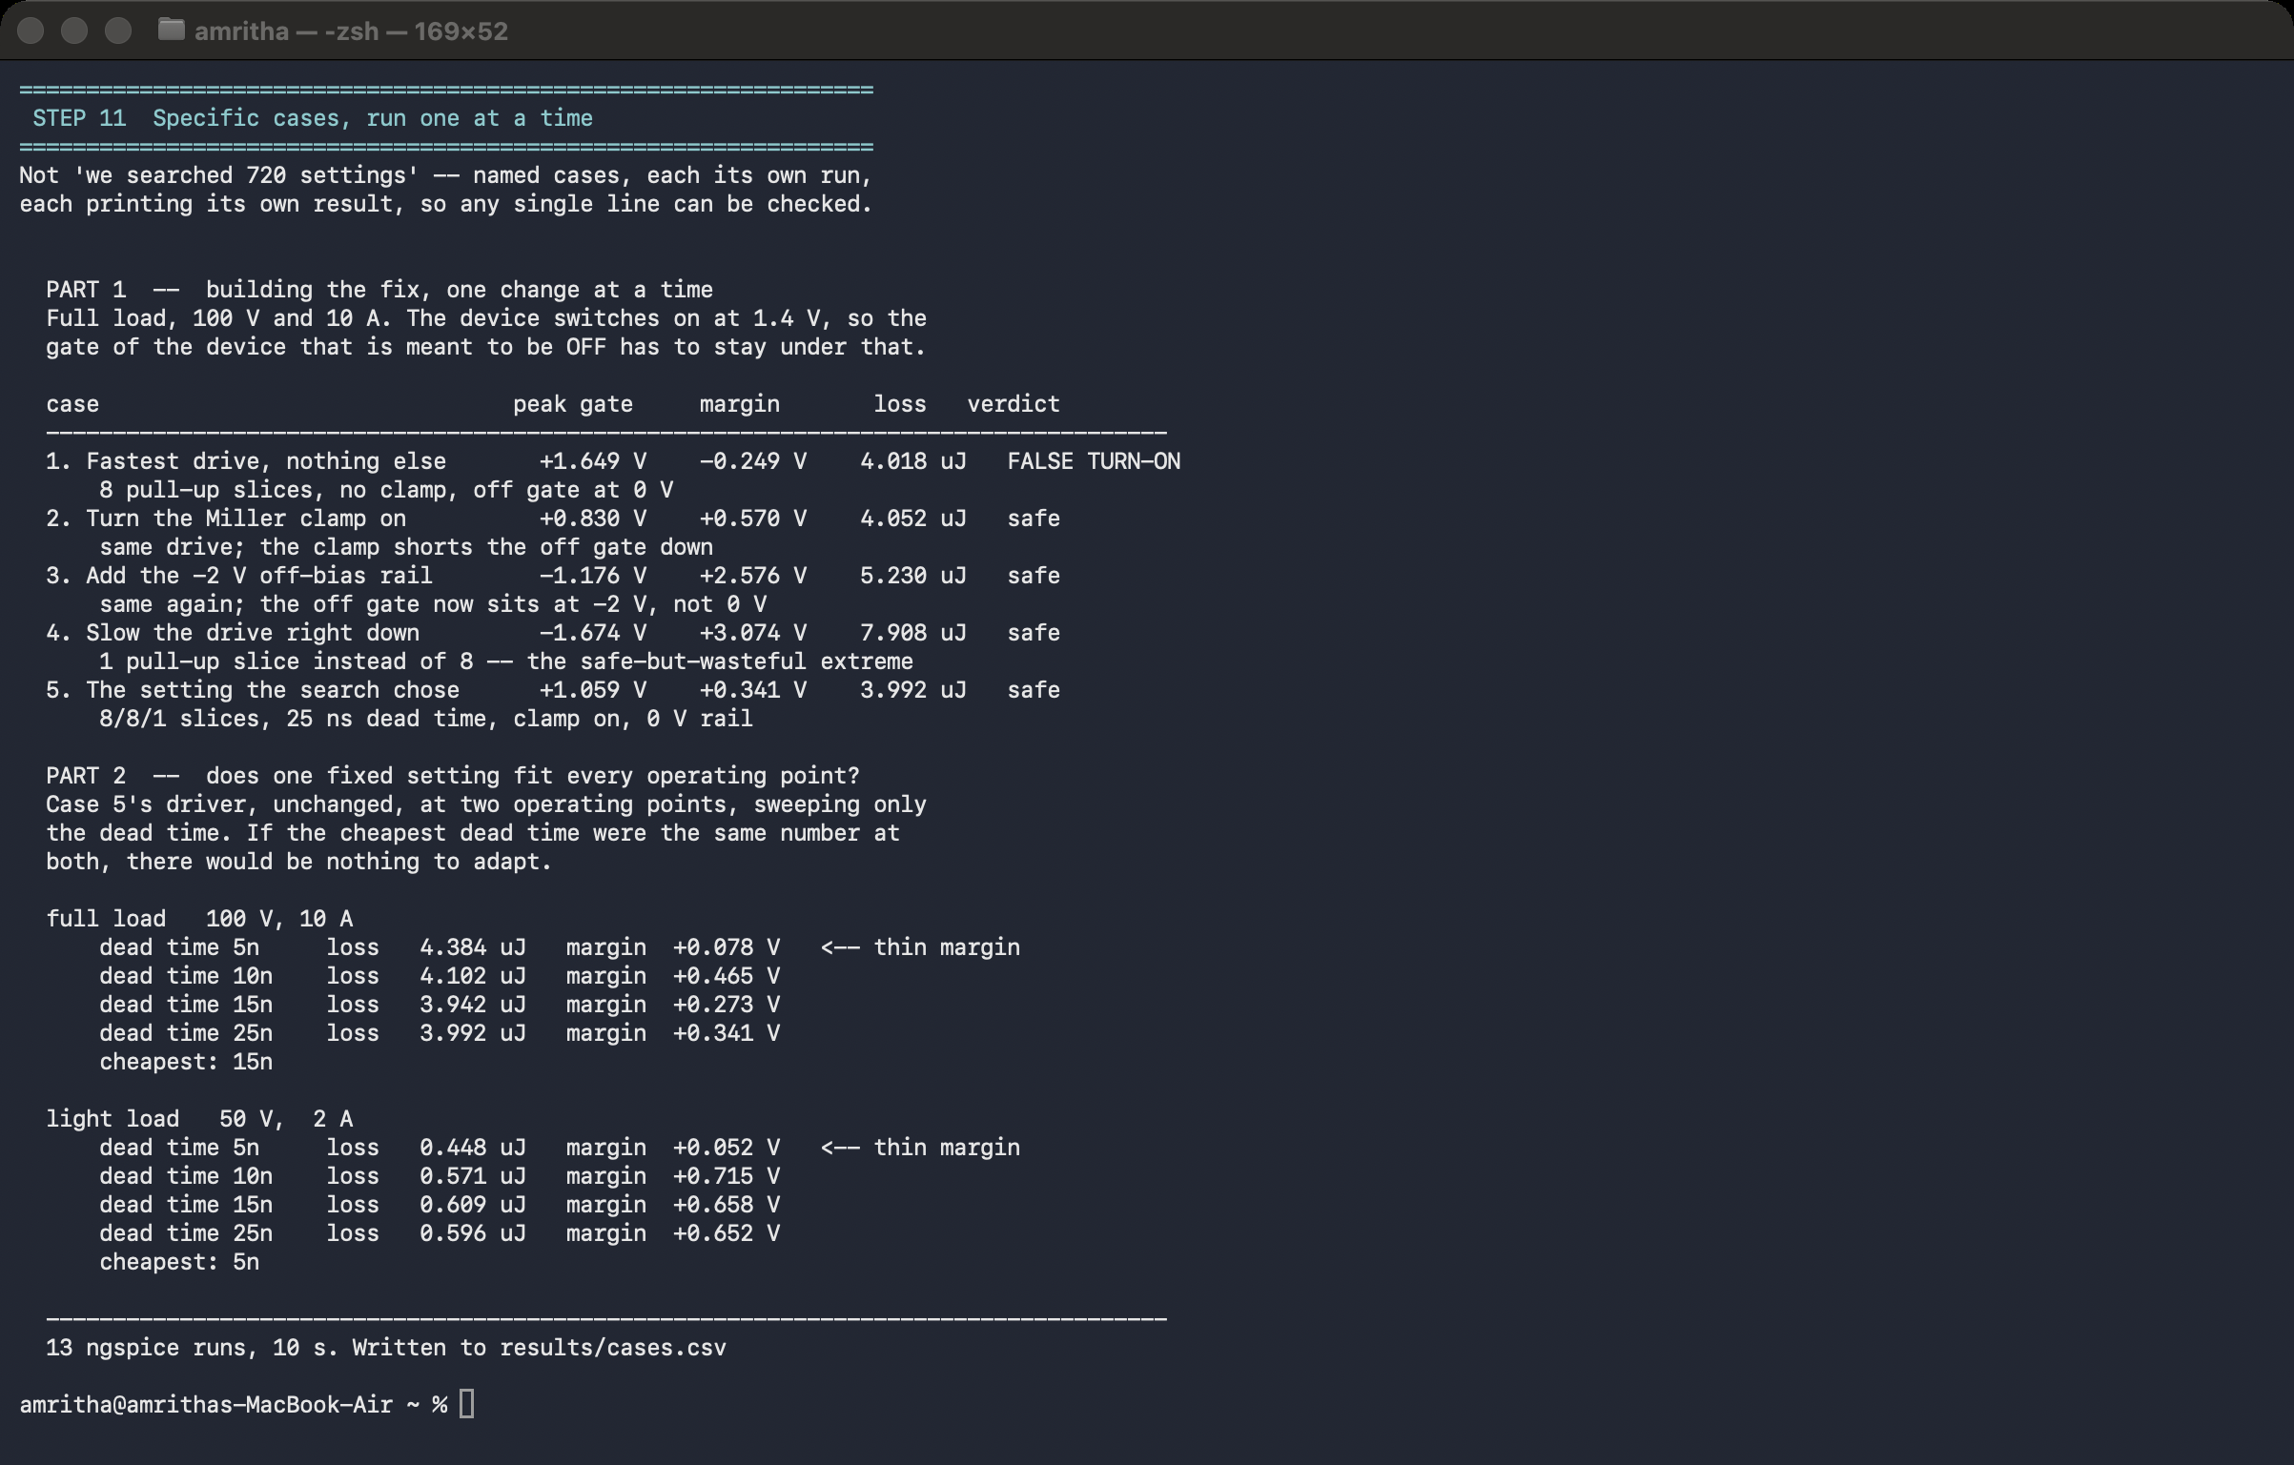
Driver simulation — the segmented driver, case by case
Fig. 35 — ngspice, on screen. scripts/cases.py, 13 runs. Part 1: the fix built one change at a time at 100 V / 10 A. Part 2: dead-time sweep at two operating points: cheapest is 15 ns at full load, 5 ns at light load.
46

Slide 47
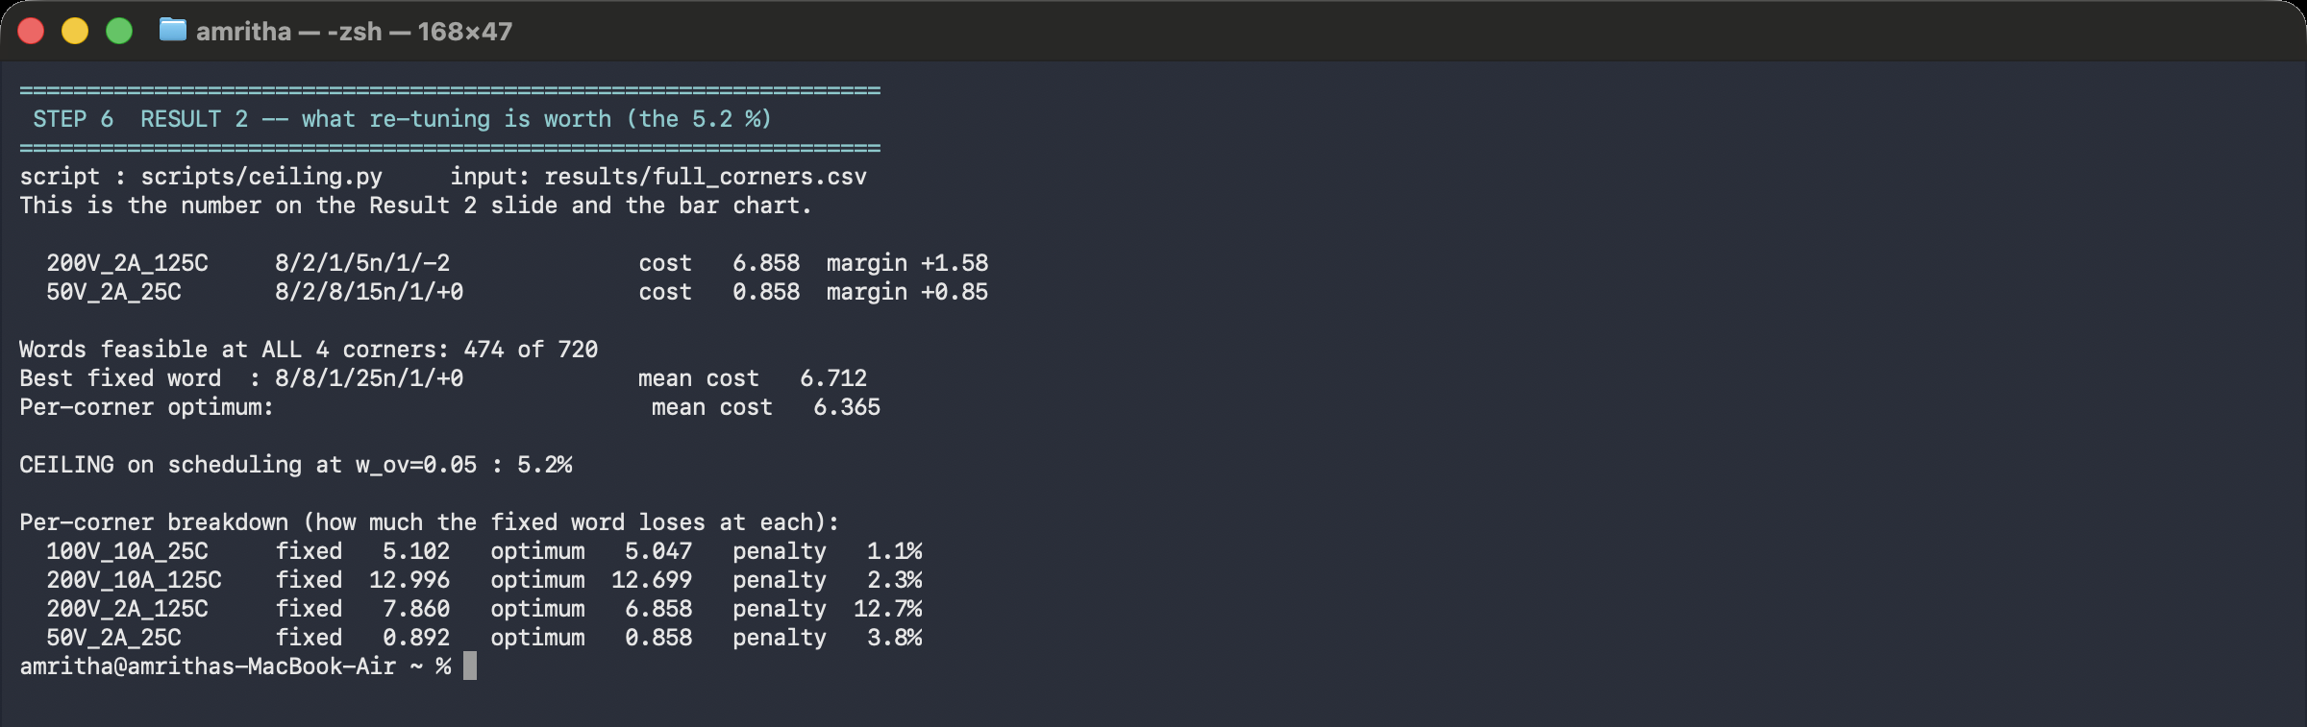
ngspice output — what re-tuning is worth
Fig. 36 — ngspice, on screen. scripts/ceiling.py over results/full_corners.csv. 474 of 720 words feasible at all 36 corners. Ceiling on scheduling 3.5 %; per-corner penalty 1.1 / 2.3 / 12.7 / 3.8 %.
47

Slide 48
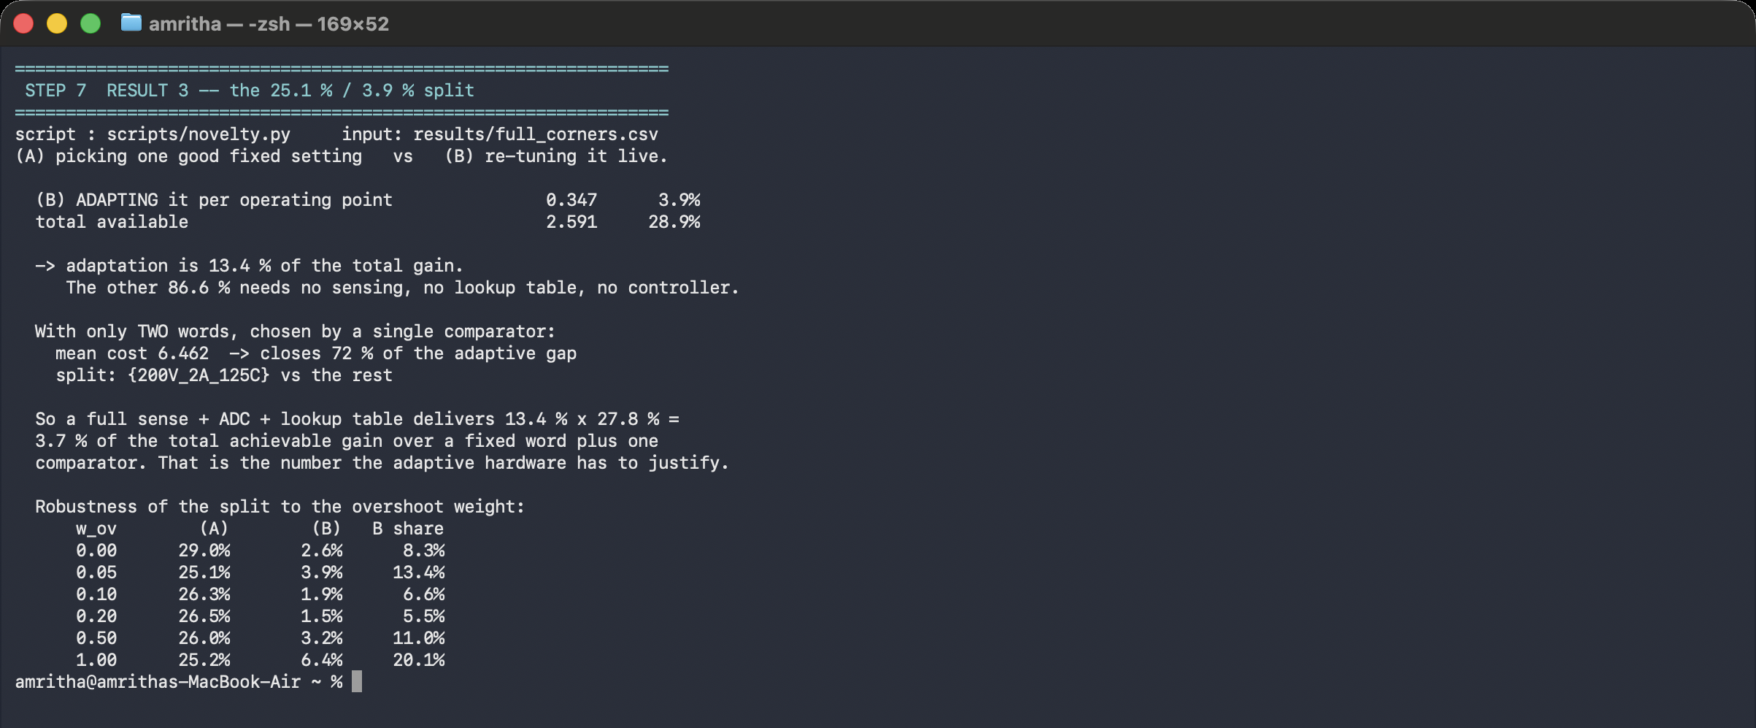
ngspice output — the split
Fig. 37 — ngspice, on screen. scripts/grid_analyse.py over 36 corners. Choosing a fixed word (A) 26.5 %; adapting per operating point (B) 2.6 %; B is 8.9 % of the gain. Across 106 overshoot weights (A) stays 23.4–29.0 %, (B) 1.3–6.4 %.
48

Slide 49
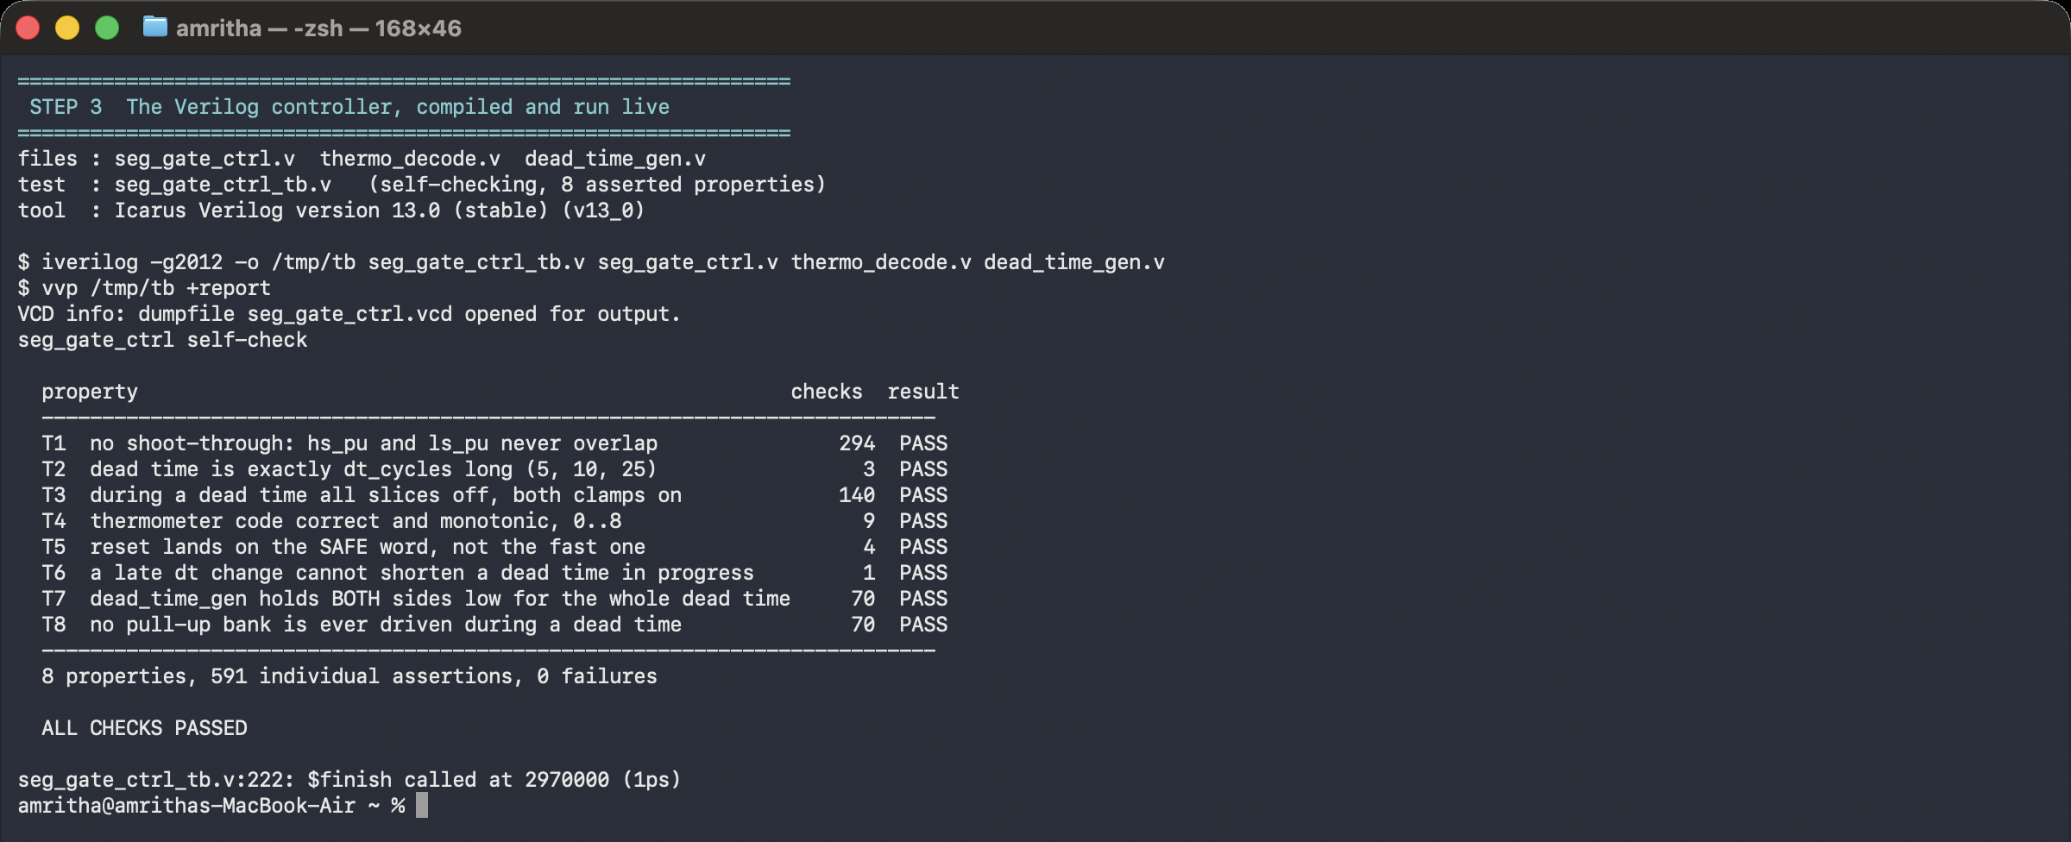
Icarus Verilog output — the controller
Fig. 38 — Icarus Verilog output. iverilog and vvp over rtl/seg_gate_ctrl.v and its testbench. Eight asserted properties, 591 individual assertions, 0 failures.
49

Slide 50
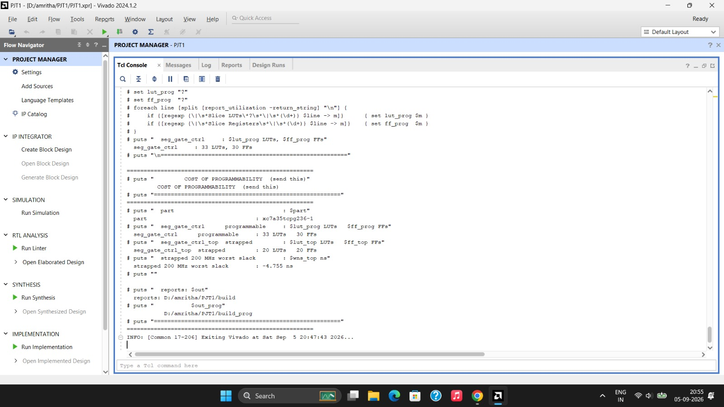
Vivado output — synthesis
Fig. 39 — Vivado output. Vivado 2024.1.2 on xc7a35t. 20 LUTs and 20 flip-flops strapped, 33 LUTs fully programmable; 200 MHz register-to-register met with 1.996 ns slack.
50

Slide 51
Result 1 — crosstalk is real, and what fixes it
The problem is real, and reproduced
1.65 V
peak on the gate that should be off
The threshold is 1.4 V — so it turns on by mistake
2.58 V
margin with the clamp and the −2 V rail
The fault is removed completely
And safety is nearly free
The lowest-energy setting is already safe at three of the four operating points. At the fourth, safety costs 0.04 % more energy — 3.335 µJ against 3.334 µJ.
The clamp is worth 9.7–12.2 % of the blended cost, with no sensor and no controller.
Fig. 40 — Simulated in ngspice. Gate–source voltage of the off-state device at low-side turn-on, 100 V / 10 A. No clamp: +1.65 V against a 1.4 V threshold. Clamp and −2 V rail: −1.18 V, margin 2.576 V.
51
Notes:
[40 s] CORE. The problem reproduced and fixed. Point at the red X below the threshold line. Then: safety costs 0.04 % — nearly free once the clamp is present.

Slide 52
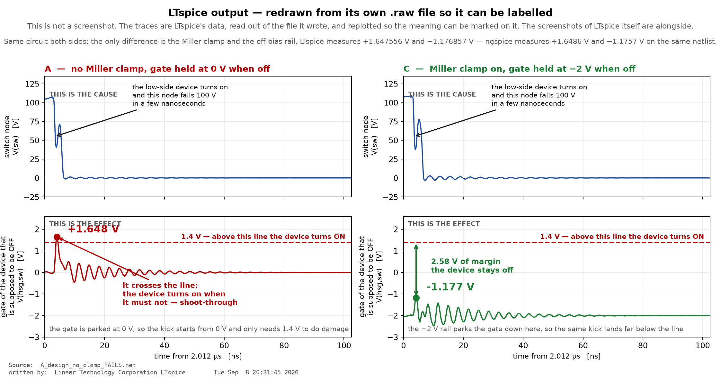
The same result in LTspice, on the drawn circuit
Fig. 41 — Drawn and simulated in LTspice. Switch node and off-state gate–source voltage, read from the LTspice .raw file. LTspice +1.647556 / −1.176857 V; ngspice +1.6486 / −1.1757 V on the same netlist.
52

Slide 53
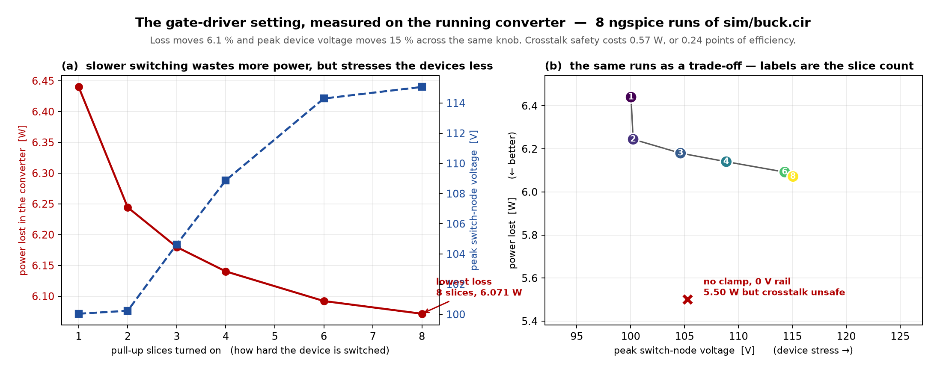
Result 2 — the driver setting moves the converter
Fig. 42 — Simulated in ngspice. Power lost and peak switch-node voltage against pull-up slice count, measured on the running converter. Eight runs of sim/buck.cir; minimum loss at four slices.
53

Slide 54
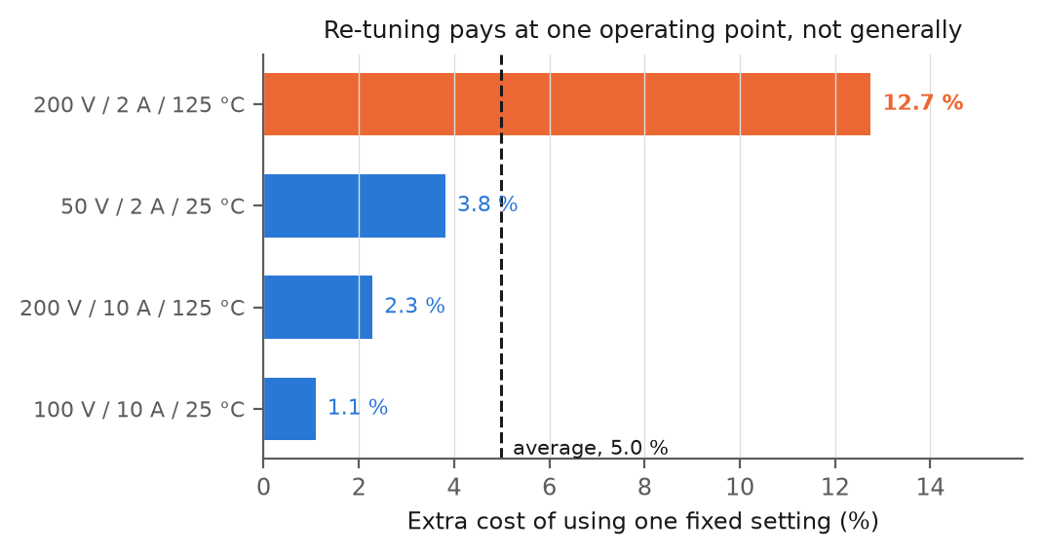
Result 3 — re-tuning is worth only 3.5 %
What re-tuning is actually worth
3.5 %
the most that re-tuning can ever gain
against the best single fixed setting, over 36 corners (= 2.6 % of baseline). One fixed setting is nearly as good.
The benefit is not spread out. Over 36 points the fixed word costs 0.01 % to 14.2 %; worst is 200 V / 2 A / 125 °C.
3.5 % on the full 36-corner grid — 720 words at each, 25,911 transients. The four-corner study said 5.2 %.
It all comes from the dead time, and that from one operating point. Freezing the dead time costs 5.45 % across four points. Drop the light-load 50 V / 2 A point and it costs 0.00 %: three points want 5 ns, only that one wants 15 ns. So the adaptive hardware shrinks to one light-load detector choosing between two dead times. Freezing the drive strength costs 0.00 % — and that is what these papers actually adjust.
Steady against the device, not the board. Across 21,600 runs no device parameter moves the answer outside 4.3–7.7 %. Halving the board inductance takes it to 13.5 %, and that is layout, not the transistor [3].
Fig. 43 — Simulated in ngspice. Cost of one fixed control word against the true per-corner optimum, four operating points, 2,880 transients. Penalty 1.1 / 2.3 / 12.7 / 3.8 %.
54
Notes:
[25 s] CORE. 3.5 %, on 36 corners. Say plainly this is a NEGATIVE result about the adaptive premise and you are reporting it rather than hiding it. Keep it short — slides 18 and 19 do the real work.

Slide 55
Result 4 — the two halves nobody separates
Segmented gate drivers set drive strength by a pattern fixed at design time [10]. Papers on active gate drivers report one number — the improvement over a conventional driver — and that number adds two separate effects together. Only the second needs a sensor, an ADC and a lookup table. Separating them means running every setting at every operating point.
26.5 %
(A) Pick a better fixed setting
no sensing · no LUT
2.6 %
(B) Change it per operating point
needs all of it
1.2 %
(B′) …but one comparator gets 46 % of (B)
a threshold, not a LUT
Adaptation is 8.9 % of the total gain — 2.6 points of 29.0, over 36 operating points; the other 91.1 % comes from the fixed word and needs no sensing. Full sensing, ADC and lookup table justify 4.7 % of the total gain over a fixed word plus one comparator (load current at 10 A, which takes 47 % of the adaptive gap), or 3.4 % over a fixed word plus two. One threshold cannot do better: ten distinct best words spread over the 36 corners, and bus, load and temperature each disagree internally. The four-corner study named bus voltage at 75 V here; on the full grid the comparator is load current.
55
Notes:
[45 s] CORE — the novelty slide, and the one sentence the panel should leave with: 'a full sense-plus-ADC-plus-lookup-table is left justifying 4.7 % of the gain over a fixed word and ONE comparator.' Build it in three steps. (1) Choosing the fixed word well is worth 26.5 %. (2) Adapting per corner adds only 2.6 % — a eleventh of the total. (3) And 47 % of even THAT is capturable with a single comparator on bus voltage, not a lookup table; two comparators reach 61 %, which is the 3.4 % figure. No published work separates these, because separating them needs the exhaustive search rather than a shortlist. If asked why nobody found this: they report one number.

Slide 56
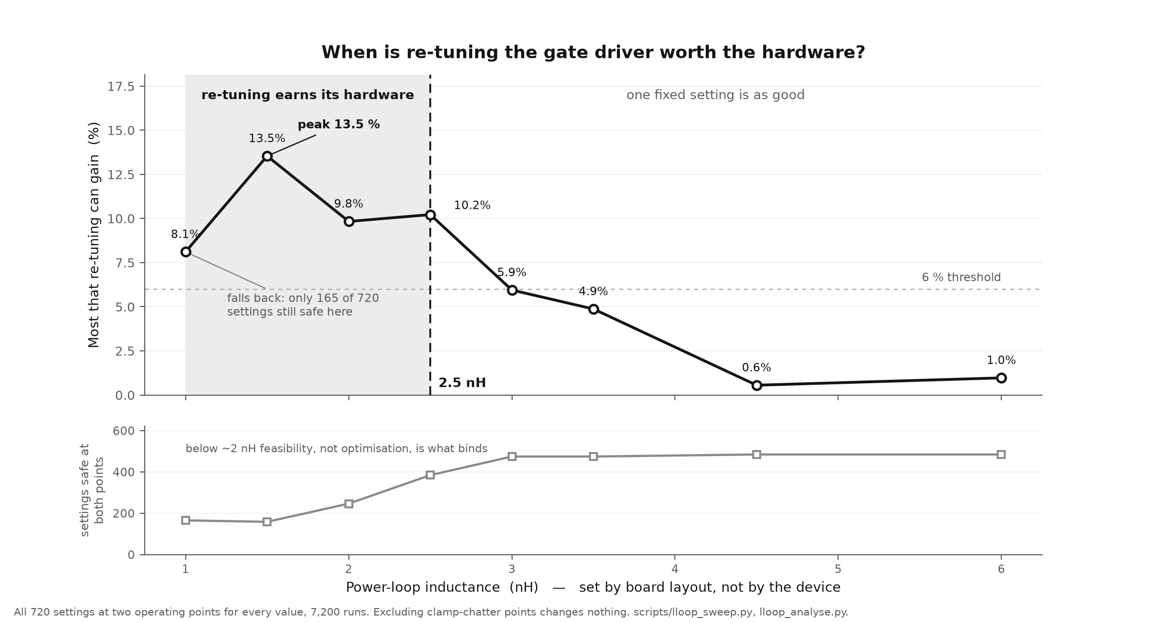
Result 5 — re-tuning only pays below ~2.5 nH
Fig. 44 — Simulated in ngspice. Ceiling on operating-point scheduling against power-loop inductance. Eight values, 7,200 transients. Scheduling pays only below about 2.5 nH.
56
Notes:
[40 s] CORE — the design chart, and the most USEFUL thing in the deck. Do NOT call it a single crossover: eight points show a BAND. Adaptive control pays from about 2.5 nH down, peaks at 13.5 % at 1.5 nH, then FALLS BACK to 8.1 % at 1.0 nH. Say why, because it is the interesting part: at 1.0 nH only 165 of 720 words are still safe, so the fixed word and the per-corner optima are squeezed into the same narrow region and the gap scheduling exploits shrinks. Below ~2 nH feasibility binds, not optimisation. We checked it is not the clamp-chatter artefact — excluding every chatter point leaves all eight ceilings unchanged to the digit. The literature does not state this trade-off because it never separates the fixed and adaptive halves.

Slide 57
FPGA Controller — verified RTL
Three Verilog modules that produce exactly the 720 settings the SPICE model uses.
Dead time is a live register; drive strength is fixed at power-up, worth 5.45 % against 0.00 %.
Eight checks pass in Icarus Verilog, safe reset included. A deliberately broken version is caught 221 times (sh rtl/mutate.sh).
Built in Vivado 2024.1.2 on an xc7a35t FPGA: 20 LUTs, 20 flip-flops, 0.10 % of the chip. 200 MHz timing is met, with 1.996 ns to spare.
Timing is met where the logic runs. The paths that miss are chip-output paths, where the output pad alone takes 3.49 ns of a 4 ns budget: pad delay, not logic.
Fig. 45 — Icarus Verilog output. Icarus Verilog VCD of seg_gate_ctrl.v. The pull-up banks never overlap; the shaded interval is the dead time.
57
Notes:
[BACKUP] BACKUP — the FPGA. If asked: written AND verified, eight asserted properties, then mutation-tested. Dead time gets a live register and drive strength is strapped, because that is what the study found.

Slide 58
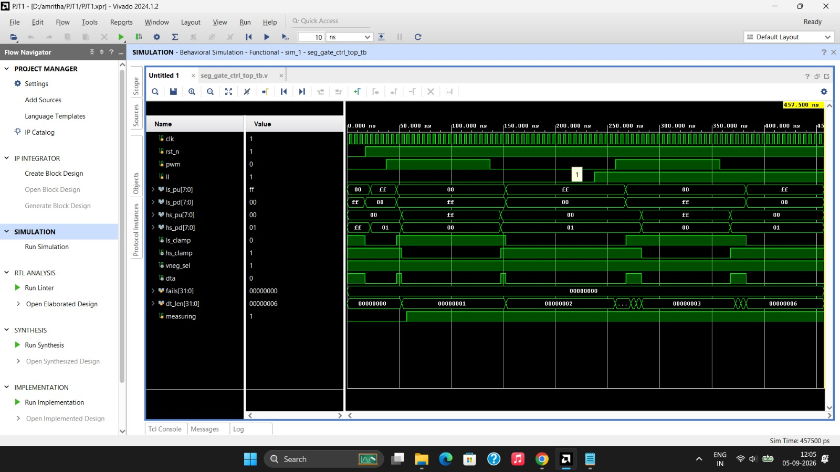
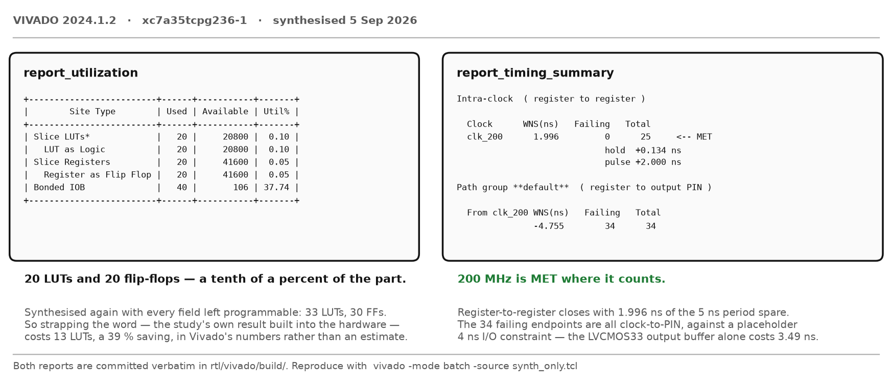
Vivado — simulation and synthesis, on screen
Behavioural simulation. Vivado output. fails[31:0] = 0 — every asserted property holds in Vivado's own simulator, a third tool after Icarus and the mutation test.
Synthesis console. 33 LUTs programmable against 20 strapped — the cost of programmability, printed by the tool.
58

Slide 59
The architecture, end to end
The gap we found in our own work
What we did about it
The controller was verified in Icarus. The power stage was verified in ngspice. The two never touched.
The FPGA emits eight thermometer-coded wires per bank. The SPICE driver took an integer slice count. A fault in the decoder would have passed the Verilog bench and stayed invisible in every figure ngspice produced.
rtl/seg_gate_ctrl_dpt_tb.v reproduces the double-pulse schedule at the real 200 MHz clock, letting the RTL's own dead-time generator make the edges.
Its VCD becomes sixteen PWL sources, one per wire, into models/segdrv_bus.lib. Same deck, same devices, same measurement — only the slice selection changes.
 | margin, RTL bus | margin, .param | difference
clamp off | −0.242 V | −0.249 V | 0.007 V
clamp on | +0.651 V | +0.570 V | 0.081 V
Worst disagreement anywhere: 0.081 V — and it is timing, not encoding. The ideal stimulus turns the low side on at 2.015 µs; the RTL's dead-time generator puts it at 2.0175 µs. The clamp's sign change, which is this project's central claim, is now produced by the actual logic rather than by a parameter.
And it found a real bug, which is the whole argument for doing it: dead time is (dt_cycles + 1) × 5 ns. The counter loads and then counts down through zero, so 15 ns is 2 cycles, not the obvious 15/5 = 3. Anyone mapping our swept dead-time grid onto hardware by dividing by the clock period builds a driver that is one cycle slow at every operating point, and neither half of the verification could have seen it alone.
59

Slide 60
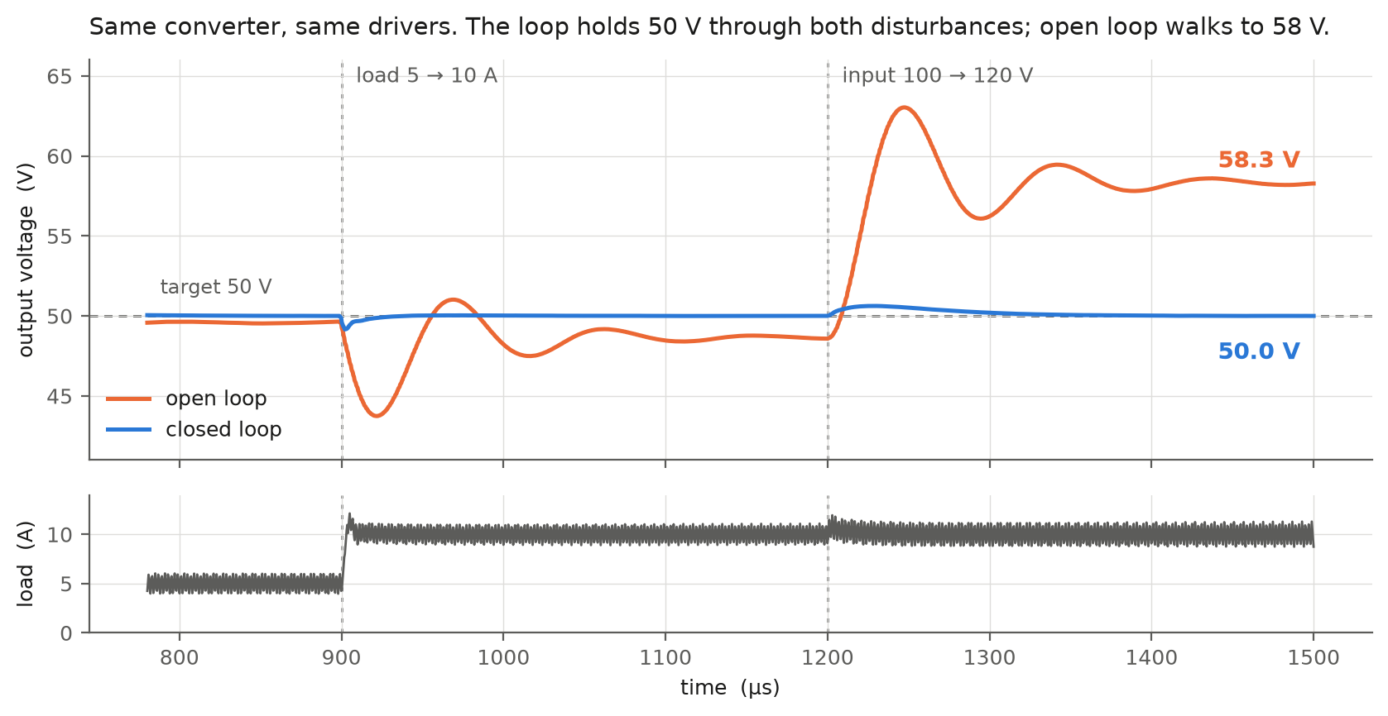
Closing the loop
The loop holds 50 V. Open loop walks to 60 V.
Fig. 46 — Simulated in ngspice. sim/buck_closed.cir runs the same power stage and the same segmented drivers, now regulated by a type-III loop and then disturbed on purpose. Closed loop 50.01 / 50.00 / 50.00 V through a 2× load step and a 100 → 120 V line step; worst error 0.01 % against open loop's 20.0 %. Load step recovers in 4 µs, line step in 22 µs. Ripple 0.25 %, efficiency 96.1 %, start-up overshoot 3.8 %.
60

Slide 61
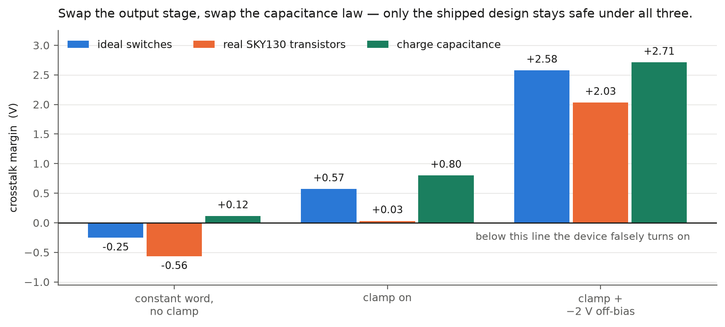
Does the result depend on the model?
Only the shipped design is safe under every model we tried.
Fig. 47 — Simulated in ngspice. Two assumptions carry every margin in this deck, and each was replaced and re-run. scripts/silicon_check.py rebuilds the output stage in real SKY130 5 V transistors; scripts/capmodel_check.py swaps the junction diodes for a charge capacitance. The ordering survives both. Two things do not: the clamp on its own gives +0.03 V on real devices rather than +0.57, and the no-clamp row changes sign between capacitance laws — so “the constant word causes false turn-on” is model-dependent, and we say so.
61

Slide 62
Does the architecture close the gaps?
Nine gaps in the published work, what our architecture does about each, and the evidence. Every row names the script that produces it.
Gap in the published work | What the architecture does | Evidence | Status
Segmented drivers report one number. Nobody separates a better fixed setting from live re-tuning. | 720 control words × 36 operating points, every combination run. | Fixed 26.5 %, adaptive 2.6 % — adaptive is 8.9 % of the gain, on 36 corners (novelty.py). | CLOSED
Nobody says how much controller the adaptive part justifies. | A complexity ladder: constant word → one comparator → two → full lookup table. | One comparator (load current at 10 A) takes 47 %. 4.7 % is left to justify a sense + ADC + LUT (controller_ladder.py). | CLOSED
Prior segmented drivers stage the slices but carry no Miller clamp and no negative off rail. | 8 + 8 slices plus a clamp plus a −2 V off-bias, each measurable on its own. | Base paper at its best +0.407 V; ours +2.576 V — 6.3× (basepaper_compare.py). | CLOSED
The driver is asserted to be programmable; the logic is rarely synthesised. | seg_gate_ctrl.v, thermometer-coded, with its own dead-time generator. | 8 properties in Icarus; 20 LUT / 20 FF on xc7a35t, 200 MHz met, 1.996 ns slack. | CLOSED
Controller and power stage are verified separately and never made to meet. | The RTL's own VCD drives the SPICE slices — one source per wire, no integer in between. | Margins agree to 0.081 V, and it found a one-cycle dead-time error (rtl_cosim.py). | CLOSED
Whether a fitted schedule generalises to an unseen operating point is never tested. | Leave-one-corner-out: fit the comparator on three corners, test on the fourth. | Identical to the global fixed word on all 36 held-out corners. Nothing — and we say so. | ANSWERED, NEGATIVE
Segmented-driver papers characterise one switching edge. The converter is never closed-loop regulated. | A type-III loop around the same power stage and the same drivers, then disturbed on purpose. | 0.01 % error through a 2× load step and a 20 % line step; open loop walks to 60 V (closedloop.py). | CLOSED
Segmented output stages are published as ideal switches. Whether the result survives real devices is untested. | The same output stage rebuilt in SKY130 5 V transistors and re-run. | Sign and ordering both survive, but the clamp on its own turns out to give only +0.031 V (silicon_check.py). | CLOSED
All of the above is simulation. | — | No silicon measured. The driver is now rebuilt on a real PDK; the GaN model has no equivalent check. | OPEN → Review-III
Does it serve its purpose? Yes, for a simulation study, and that is what it is titled as. Seven gaps closed, one answered in the negative, which is a result rather than a failure, and one that needs a bench. The honest summary is that the architecture is finished and the measurement of it on real silicon is not.
62

Slide 63
Work Completed — 90 %
Counted, not asserted. 13 blocks, weighted by how much of the project each is. 11 are finished. The weights are on the slide so they can be argued with.
 | Block of work | Weight | Evidence, or why not yet
✔ | The converter itself, built and converting | 6 | 100 V → 48.50 V at 4.869 A, 97.49 % efficient (buck.cir)
✔ | The device choice justified against silicon | 8 | 6.2 W vs 12.6 W at 500 kHz, on the shipped word; 3 sweeps, 4 duty profiles
✔ | The base paper implemented, not just cited | 8 | zhangdrv.lib in our deck and in the converter — at 100 V only
✔ | The segmented driver; the fault reproduced and fixed | 12 | −0.249 V → +2.576 V, one change at a time
✔ | The full study: 720 words × 4 corners | 8 | 66,924 transients over 36 corners — all on dpt.cir, not the converter
✔ | How much controller that justifies | 8 | ladder + leave-one-corner-out; two implementations agree
✔ | FPGA: RTL written, verified, synthesised, timing met | 12 | 8 properties; 20 LUT / 20 FF; 200 MHz, 1.996 ns slack
✔ | The two halves made to meet in one simulation | 5 | RTL VCD drives the SPICE slices; agree to 0.081 V
✔ | Closed-loop regulation, disturbed on purpose | 6 | type-III loop: 0.01 % error through a 2x load and a 20 % line step
✔ | Transistor-level output stage, on a real PDK | 7 | SKY130 5 V devices: sign and ordering of the result both survive
— | Place-and-route on a chosen board | 3 | Needs real package pins and an MMCM for the clock
✔ | The converter swept across its stated envelope | 10 | 8 bus×load points: margin +2.14 to +2.61 V everywhere, and the envelope corrected to 50–150 V because a 200 V part cannot run a 200 V bus
— | A hardware half-bridge, measured | 7 | Review-III. Until then this is a simulation study, and is titled as one
90 of 100 done. The remaining 10 % is place-and-route on a chosen board and a hardware half-bridge on a bench. The simulation is finished, and simulating harder will not deliver either.
Plainly: the simulation is finished, across the envelope and not just at one point. Nothing has been measured on silicon.
63
Notes:
[40 s] CORE — the 50 %-completion requirement. Five claims, each with a number. If asked 'is this really 50 %?': the search is complete, stress-tested, and both objections to it - layout and EMI - have been tested rather than argued. What remains is silicon and hardware.

Slide 64
Where we are, and what is next
Where we are
90 % by the count on the previous slide. The converter is built and regulating, the fault is reproduced and fixed, the 720-word study is run, the controller is written, verified and synthesised, its output drives the SPICE power stage directly, and the driver has been rebuilt in real transistors.
What is actually left — and it is not more simulating
Place-and-route on a chosen board. Synthesis is done; the flow stops there because the XDC pins are placeholders. Doing it properly also means driving the 200 MHz clock from an MMCM rather than straight off a pin, which is what makes 34 clock-to-pin paths fail today.
A hardware half-bridge, measured. This is the whole of the remaining honest risk. Everything in this deck is a simulation of a converter that has never been built, and one behavioural GaN model underlies all of it.
Also worth doing: transcribe the silicon MOSFET datasheet digits rather than using datasheet-class values, and re-run the ceiling on the transistor-level stage now that it is known to work.
64
Notes:
[30 s] CORE — the timeline and tools requirement. M1-M6. If asked what could go wrong: M1, the PDK — a 1.8 V / 3.3 V teaching PDK cannot take a 5 V rail.

Slide 65
The hardware, costed
7 of the 10 points outstanding. Not vague — three tiers, and we know which one is which.
 | What gets measured | Cost | Time | Status
1. FPGA on a real board | The 8+8 slice outputs toggling and dead_time_gen.v sweeping 5–35 ns, on silicon rather than in a report | ₹8–12k or a lab board | days | nearest
2. GaN half-bridge eval board, 48 V | The OFF device's gate during the other's turn-on, with and without the −2 V rail — our central claim, on real silicon | ₹15–25k | 2–4 weeks | the one that matters
3. The segmented driver itself | Everything above, on our own 8-slice stage at 100 V / 500 kHz | custom PCB, several spins | months | Review-III
Two constraints we already know, because they decide whether tier 2 produces evidence or noise.
Scope bandwidth. Our edge is 0.78 ns. Bandwidth needed is 0.35 / 0.78 ns ≈ 450 MHz to see the edge at all, realistically 1 GHz. On a 100 MHz teaching-lab scope the measurement would be of the scope.
Probe grounding. A 10:1 probe with a ground clip carries roughly 10 nH in its ground lead, which manufactures ringing that is not in the circuit. A GaN gate has to be probed with a short pigtail or a coaxial connection, or the trace shows the probe.
And one thing that is not a constraint but a fact: no commercial IC implements an 8-slice independently controllable segmented driver. Tier 3 is eight single-channel drivers in parallel, enabled per slice, summed through 8 Ω — which is exactly what models/segdrv.lib already describes.
65

Slide 66
Conclusion & next steps
What the data supports
The converter works: 100 V DC in, 48.50 V DC out at 4.869 A — 236.26 W, 97.49 % efficient.
Picking the setting well: 26.5 %. Changing it per operating point: 2.6 %.
One comparator — load current at 10 A — gets 47 % of that 2.6 %; two comparators get 61 %.
What to build: one fixed setting plus one bus-voltage comparator — not a sensor, an ADC and a lookup table.
The FPGA half is real: 20 LUTs and 20 flip-flops, 200 MHz met with 1.996 ns to spare.
What is next
Review-III — place-and-route on a chosen board, then a hardware half-bridge measured on a bench. That is the whole of the remaining risk: nothing here has been built.
Also at Review-III — measure what a two-setting controller saves at the light-load point, where the best dead time differs.
Every number in this deck is regenerated by a named script, in ngspice or in Vivado — 66,924 transient simulations across every study.
66
Notes:
[35 s] CORE. Close on what the data supports and what it now answers. Do NOT concede EMI as a limitation any more - it was tested: pricing it makes scheduling worth LESS, 5.95 % down to 0.15 %. State the remaining limits yourself instead: the two EMI measures disagree about drive strength, and no silicon has been measured. Do NOT concede the single device model any more either - 24 devices were sampled with Vth, gm, Cgs and Cgd varied jointly, the shipped word stays safe on every one, and the ordering survives on every one.

Slide 67
References (1–15)
[1] Z. Zhang, F. Wang, L. M. Tolbert and B. J. Blalock, “Active Gate Driver for Crosstalk Suppression of SiC Devices in a Phase-Leg Configuration,” IEEE Trans. Power Electron., vol. 29, no. 4, pp. 1986–1997, Apr. 2014.
[2] R. Xie, H. Wang, G. Tang, X. Yang and K. J. Chen, “An Analytical Model for False Turn-On Evaluation of High-Voltage Enhancement-Mode GaN Transistor in Bridge-Leg Configuration,” IEEE Trans. Power Electron., vol. 32, no. 8, pp. 6416–6433, Aug. 2017.
[3] D. Reusch and J. Strydom, “Understanding the Effect of PCB Layout on Circuit Performance in a High-Frequency Gallium-Nitride-Based Point of Load Converter,” IEEE Trans. Power Electron., vol. 29, no. 4, pp. 2008–2015, Apr. 2014.
[4] B. Li, G. Zhang, C. Li, G. Wang, S. Liu and D. Xu, “Crosstalk Suppression Method for GaN-Based Bridge Configuration Using Negative Voltage Self-Recovery Gate Drive,” IEEE Trans. Power Electron., vol. 37, no. 4, pp. 4406–4418, 2022.
[5] X. Chen, H. Peng, S. Song, Q. Tong and Y. Kang, “A Novel Control Strategy for Optimal Tradeoff between Overshoot and Switching Loss Based on Double Closed-Loop Self-Regulating Active Gate Driver,” IEEE Trans. Power Electron., vol. 39, no. 10, pp. 13033–13043, 2024.
[6] W. Song, T. Hu, J. Chen, T. Tang, H. Yue and G. Liu, “A Self-Regulating Active Gate Driver of Voltage Overshoot Suppression for SiC MOSFETs Under Variable Load Current Conditions,” IEEE Trans. Power Electron., vol. 40, no. 8, pp. 10623–10634, 2025.
[7] C.W. Kuo, T.W. Wang, L.C. Chen, C.C. Tu, Y.K. Hsiao and P.H. Chen, “Universal Active Gate Driver IC With Closed-Loop Timing Control and Gate-Sensing Technique for Silicon Carbide Power Devices,” IEEE Trans. Power Electron., vol. 40, no. 4, pp. 5120–5129, 2025.
[8] G.H. Thuc and C.J. Chen, “An Integrated Driver With Dual-Edge Adaptive Dead-Time Control for GaN-Based Synchronous Buck Converter,” IEEE Trans. Ind. Appl., vol. 60, no. 6, pp. 9157–9170, 2024.
[9] H. Takayama, T. Okuda and T. Hikihara, “Digital Active Gate Drive of SiC MOSFETs for Controlling Switching Behavior — Preparation Toward Universal Digitization of Power Switching,” Int. J. Circuit Theory Appl., vol. 50, no. 1, pp. 183–196, 2022.
[10] BASE PAPER — W.J. Zhang, J. Yu, Y. Leng, W.T. Cui, G.Q. Deng and W.T. Ng, “A Segmented Gate Driver for E-mode GaN HEMTs with Simple Driving Strength Pattern Control,” in Proc. IEEE 32nd Int. Symp. Power Semicond. Devices ICs (ISPSD), 2020, pp. 102–105.
[11] X. Wang, M. Tao, J. Xiao, D. Luo, M. He, Q. Zhou, X. Zhang and M. Wang, “High-Frequency Three-Level Gate Driver for GaN HEMT Bridge Crosstalk Suppression,” IEEE Trans. Power Electron., vol. 39, no. 1, pp. 1343–1352, 2024.
[12] L. Wang, X. Sun, Y. Yan, M. Ma and D. Xu, “An Integrated Suppression Method of Both Gate-Source Voltage Oscillation and Crosstalk for GaN HEMT Gate Driver,” IEEE Trans. Power Electron., vol. 39, no. 11, pp. 14643–14655, 2024.
[13] Y. Cai, D. Ye, W. Lv and Z. Chen, “A High-Efficient GaN Driver With Hybrid Adaptive Dead-Time Control and Peak Delay Control for Synchronous Buck Converter,” IEEE Trans. Power Electron., vol. 41, no. 1, pp. 279–290, 2026.
[14] Y. Zheng, S. Zhao, P. Agarwal, F. Liu, Y. Zhao and A. Mantooth, “A Multi-Level Turn-Off Gate Driver for Crosstalk Noise Suppression of GaN HEMTs,” IEEE Open J. Power Electron., pp. 1–15, 2026.
[15] M.K. Banda, S. Madichetty, D.M. Natham and S. Koduru, “An Event-Triggered Dual-Polarity Gate Clamp for GaN HEMT Gate Oscillation Suppression,” IEEE Trans. Power Electron., vol. 41, no. 9, pp. 14402–14405, 2026.
The papers this design engages with directly. [10] is the base paper, reimplemented in models/zhangdrv.lib and measured against throughout.
67
Notes:
[skip] Reference list. Leave up during questions.

Slide 68
References (16–30)
[16] Z. Yuan, H. Li, M. Zhang, Z. Yang, S. Zhao, H. Wang, X. Wang and L. Ding, “Influence of Negative Gate Bias on Crosstalk Spike in SiC MOSFETs Half-Bridge Circuit,” IEEE J. Emerg. Sel. Topics Power Electron., vol. 14, no. 3, pp. 3217–3229, 2026.
[17] L. Zhang, K. Wang, S. Guo and B. Zhu, “A Gate Driver for Crosstalk Suppression of eGaN HEMT Power Devices,” J. Low Power Electron. Appl., vol. 15, no. 3, pp. 38, 2025.
[18] J. Wu, “Parallel arrangement of MOSFETs, effective suppression of crosstalk: A new gate driver topology,” iEnergy, vol. 2, no. 3, pp. 163–163, 2023.
[19] Y. Mikhaylov, G. Buticchi and M. Galea, “A gate driver for parallel connected MOSFETs with crosstalk suppression,” iEnergy, vol. 2, no. 3, pp. 240–250, 2023.
[20] W. Liu and H. Min, “A Load Adaptive Active Gate Driver with Fast-Switching Three-Level Current Source for Overshoot Suppression in GaN-Based Half-Bridge Converters,” IEEE Trans. Power Electron., pp. 1–8, 2026.
[21] R. Chen, F. Wang, H. Bai and L.M. Tolbert, “A Simple Gate Driver Circuit for Turn-on Overvoltage Suppression of 10 kV SiC MOSFETs With Temporarily Lowering Gate Voltage During dv/dt,” IEEE Trans. Ind. Electron., pp. 1–6, 2026.
[22] D. Yu, M. Yang, L. Yin, K. Hu, W. Zhang and Q. Fu, “A Dual-Loop Active Gate Driver With Independent Voltage Slew Rate and Overshoot Control for Switching Loss Optimization of SiC MOSFETs,” IEEE Trans. Ind. Electron., pp. 1–12, 2026.
[23] P. Xiang, R. Hao, J. Cai and X. You, “An Active Gate Driver of SiC MOSFET Module Based on PCB Rogowski Coil for Optimizing Tradeoff Between Overshoot and Switching Loss,” IEEE Trans. Power Electron., vol. 38, no. 1, pp. 245–260, 2023.
[24] S. Fukunaga, H. Takayama and T. Hikihara, “Slew rate control of switching transient for SiC MOSFET in boost converter using digital active gate driver,” IET Power Electron., vol. 16, no. 3, pp. 472–482, 2022.
[25] C. Xu, P. Fu, X. Liao, Z. Zhu and L. Liu, “An Integrated Driver With Real-Time Predictive Dead-Time Optimization Technique for GaN-Based Synchronous Buck Converter,” IEEE J. Emerg. Sel. Topics Power Electron., vol. 13, no. 3, pp. 3173–3183, 2025.
[26] C. Chen, P. Chiu, Y. Chen, P. Wang and Y. Chang, “An Integrated Driver With Adaptive Dead-Time Control for GaN-Based Synchronous Buck Converter,” IEEE Trans. Circuits Syst. II, vol. 69, no. 2, pp. 539–543, 2022.
[27] J. Tan, Z. Zhou and G. Zou, “A Programmable Gate Driver Module-Based Multistage Voltage Regulation SiC MOSFET Switching Strategy,” Electronics, vol. 13, no. 22, pp. 4379, 2024.
[28] C. Chen, P. Wang, S. Li, Y. Chen and Y. Chang, “An Integrated Driver With Bang-Bang Dead-Time Control and Charge Sharing Bootstrap Circuit for GaN Synchronous Buck Converter,” IEEE Trans. Power Electron., vol. 37, no. 8, pp. 9503–9514, 2022.
[29] G.H. Thuc, M. Tsai, C. Chen, J. Fu, W. Wu and W. Lin, “A Current Source Gate Driver with Dual-Edge Adaptive Slew Rate for GaN Devices,” in Proc. 2026 IEEE Applied Power Electronics Conference and Exposition (APEC), 2026.
[30] G. Wu, Y. Huang, Y. Chen and C. Chen, “Closed-loop Slew Rate Control of Active Current Source Gate Driver with Digital Implementation for SiC MOSFET,” in Proc. 2025 IEEE Energy Conversion Conference Congress and Exposition (ECCE), 2025.
All 30 verified against the publisher record — authors, volume, issue and pages resolved through Crossref by DOI and title, not transcribed by hand.
The wider survey: read and recorded, not cited in the slides above. Kept only where the publisher record carried a real author list.
68

Slide 69
Thank you
GaN Based Synchronous Buck Converter with an Improved Gate Driver
Amritha S 23BEC1368 · Sanjay Kumar 23BEC1447 · Aamir Abdullah 23BPS1197
Guide: Dr. Bindu — SENSE, VIT Chennai
Everything in this deck runs on request: github.com/Amritha902/gan-driver
69

