Slide 1

School of Electronics Engineering (SENSE)
Project-I (2026)
GaN Based Synchronous Buck Converter with an Improved Gate Driver
Student Name(s):
Sanjay Kumar 23BEC1447 · Aamir Abdullah 23BPS1197 · Amritha S 23BEC1368
Guide's Signature with Date
Guide:
Dr. Bindu — SENSE
Signature: _____________________
Programme / School:
B.Tech — SENSE, VIT Chennai
Date: _________________________
Review & Date:
Review-I · 09.09.2026 (Wednesday)
Approval is mandatory before every review. After signing, scan this slide and keep the scanned copy as Slide 1 of the presentation.
1
Notes:
[15 s] CORE. Project name and the one-line claim: a segmented GaN gate driver, and a measurement of what per-operating-point adaptation is actually worth.

Slide 2
Problem Statement & Background
Problem Statement:
When one GaN transistor switches, its fast voltage swing pushes charge into the gate of the other transistor — the one that is supposed to stay OFF. That gate rises to 1.65 V, and only 1.4 V is needed to turn it on. Both devices conduct at once and the supply shorts through them.
Background & Significance:
GaN half-bridges sit inside EV inverters and battery chargers. GaN is chosen because it switches fast — and that speed is exactly what causes this fault.
Existing Solutions:
Gate drivers that turn the device on in steps, clamp the off gate down, adjust the gap between the two switching edges, and hold the gate at −2 V [1]–[4]. Reported: 30.5 % less overshoot, 75 % less turn-off loss [5]–[7].
Limitations / Research Gap:
Nobody has measured what the re-tuning is worth. Those gains mix two different things: picking one good setting, and changing the setting while the converter runs. Only the second needs a sensor, a lookup table and a controller.
2
Notes:
[60 s] CORE — the 2-mark slide, the biggest block in the review. Land two things: the failure is real and specific (1.65 V on a 1.40 V threshold), and the gap is that prior work conflates 'better fixed settings' with 'settings that adapt'.

Slide 3
The five closest published drivers
Ref | Author(s) & Year | Title / Source | Aim — what the paper sets out to do | Gap we found → what WE fill
BASE PAPER | Zhang, Yu, Leng, Cui, Deng & Ng (2020) | A Segmented Gate Driver for E-mode GaN HEMTs with Simple Driving Strength Pattern Control Proc. IEEE ISPSD, 2020, pp. 102–105 ieeexplore.ieee.org/document/9170108 | Segmented output stage on E-mode GaN: 7 slices, pattern timing 0.5–5 ns, strength set by one external bias resistor | THE BASE PAPER. Same device, same architecture: E-mode GaN, segmented output stage, strength set by a pattern. Theirs is an ASIC with a fixed pattern set. We make every field programmable from an FPGA and price what the pattern space buys. WE FILL: the price of the pattern space: what an exhaustive search buys over their fixed pattern set.
11 | Wang, Tao, Xiao, Luo, He, Zhou, Zhang & Wang (2024) | High-Frequency Three-Level Gate Driver for GaN HEMT Bridge Crosstalk Suppression IEEE Trans. Power Electron., 39(1), 1343–1352 ieeexplore.ieee.org/document/10286072 | Three-level drive; capacitor–diode negative rail with a digitally-clamped zero level, to 5 MHz | Recent, GaN, and on exactly our failure mode. It suppresses crosstalk with added passives; we get the same protection from the Miller clamp already in the cell and measure its price at 0.04 %. WE FILL: whether the setting has to change with the operating point at all. It does not: 3.9 % of baseline.
12 | Wang, Sun, Yan, Ma & Xu (2024) | An Integrated Suppression Method of Both Gate-Source Voltage Oscillation and Crosstalk for GaN HEMT Gate Driver IEEE Trans. Power Electron., 39(11), 14643–14655 ieeexplore.ieee.org/document/10591431 | One driver addressing gate-source ringing and crosstalk together | Confirms the two effects are coupled, which is why our cost function prices loss and overshoot jointly rather than optimising either alone. WE FILL: both effects in ONE cost function, showing the objectives genuinely conflict (Pareto, slide 16).
13 | Cai, Ye, Lv & Chen (2026) | A High-Efficient GaN Driver With Hybrid Adaptive Dead-Time Control and Peak Delay Control for Synchronous Buck Converter IEEE Trans. Power Electron., 41(1), 279–290 ieeexplore.ieee.org/document/11146698 | Hybrid adaptive dead-time plus peak delay control on a GaN synchronous buck | The most recent adaptive dead-time driver we found, and it adapts the one field our leave-one-out test shows carries the whole benefit — and only at light load. WE FILL: which field is worth scheduling. Only dead time, and only at light load; drive strength is worth 0.00 %.
5
[10] is the base paper: E-mode GaN, segmented output stage, strength chosen by a pattern. All five are verified against the publisher record.
3
Notes:
[25 s] CORE — literature mark. Closest prior work. [8] adapts dead time, the one field we find worth scheduling — and it does so across a 0.2-2 A range, which is exactly the light-load corner our leave-one-out test shows carries all of that benefit. Independent support, not competition.

Slide 4
The gap this project fills
Every paper on these drivers reports ONE number: how much better it is than a plain driver.
That number hides two separate effects, and they cost very different hardware.
Effect 1 — a better FIXED setting
Effect 2 — ADAPTING per operating point
Pick one good setting once, at design time. Costs nothing while running: no sensor, no ADC, no lookup table, no controller.
25.1 %
of baseline
Change the setting as load, voltage and temperature move. This is the part that needs the sensing hardware.
3.9 %
of baseline
THE GAP: nobody separates them. No paper says how much of the benefit actually needs the re-tuning, because separating the two means running every setting at every operating point — and nobody has done that.
WHY IT MATTERS: only Effect 2 pays for the sensor, ADC and lookup table. If it is small, that hardware is mostly buying something a design-time choice already gives you.
WHAT WE DO: 720 settings × 4 operating points, all of them, in ngspice — then report the two numbers separately instead of adding them together.
4

Slide 5
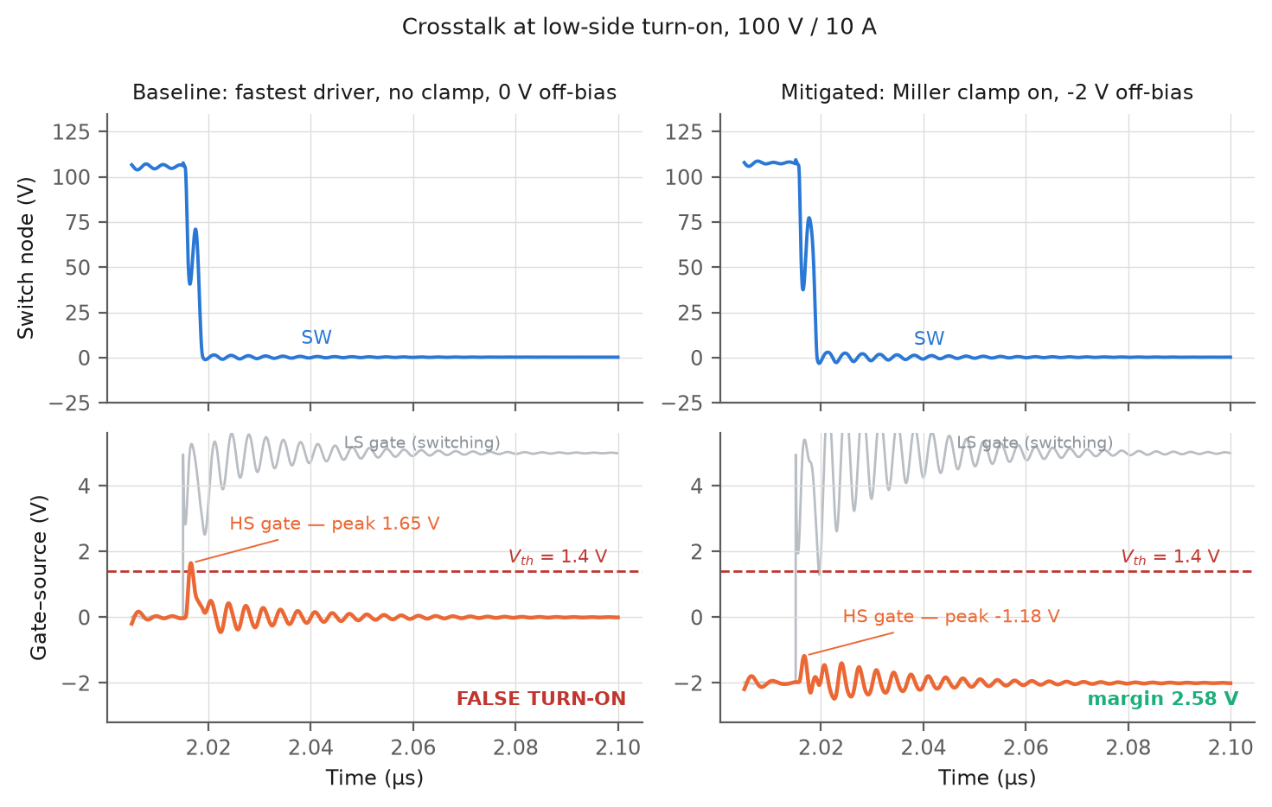
The goal, and whether this serves it
THE GOAL. Build a synchronous buck converter for an energy-storage system out of GaN HEMTs, and make it work at the switching speed GaN is bought for. Everything else in this deck exists to serve that sentence.
1. Why GaN at all
2. What GaN costs you
3. What we build about it
Same converter, same job, only the device swapped. At 500 kHz GaN wastes 5.9 W against silicon's 17.3 W. The lead widens to 78 % at 1 MHz and 90 % at light load, and never turns back.
Raising the frequency to shrink the magnetics is nearly free on GaN and ruinous on silicon.
The same speed that wins is what breaks it. A 1.4 V threshold and 150 pF of drain-to-gate capacitance mean the device that is supposed to be OFF gets pushed toward ON by its partner switching.
Measured: the off gate reaches 1.65 V against a 1.4 V threshold. That is a shoot-through.
A segmented gate driver: 8 pull-up steps, 8 pull-down steps, an adjustable dead time, a Miller clamp and a −2 V off rail — driven by an FPGA, so every one of them is a setting that can be changed and measured.
Result: −0.249 V of margin becomes +2.576 V.
SO THE TEST OF PURPOSE IS NOT “does the converter run”. It runs — 100 V in, 48.6 V out at 4.88 A, 97.6 % efficient. Any textbook buck converter runs. The test is whether the architecture we put around it answers the questions the published work on these drivers leaves open, because that is the only part of this that is ours.
The next slide is that question, gap by gap, with the evidence for each.
5

Slide 6
Aim, and how we approached it
Aim:
To find out how much of a gate driver’s benefit needs the driver to re-tune itself while the converter is running, and how much comes from choosing one good setting and leaving it fixed.
Proposed Solution:
A GaN buck converter driven by a segmented gate driver: 8 pull-up steps, 8 pull-down steps, an adjustable dead time, a Miller clamp and a −2 V off rail — every one of them a setting we can change and measure.
How we approached it:
1. Build the converter and check it converts. 100 V DC in, 48.6 V DC out at 4.88 A — 236.9 W delivered, 97.6 % efficient.
2. Recreate the fault. At the fastest setting the gate that should be OFF reaches 1.65 V, against a 1.4 V turn-on threshold.
3. Fix it one change at a time, measuring each change on its own run, not all at once.
4. Ask whether one fixed setting is enough, by running the driver at two operating points and seeing whether the best setting moves.
Scope and tools:
In scope: the converter, the driver, its settings, and the FPGA controller. Out of scope: building hardware. Tools: ngspice for every simulation, LTspice to draw the circuit and re-check, Vivado for the FPGA.
6
Notes:
[30 s] CORE — proposed-solution mark. The 720-point control word and the method: exhaustive search at every corner, so each per-corner optimum is a TRUE optimum and not the best of a shortlist.

Slide 7
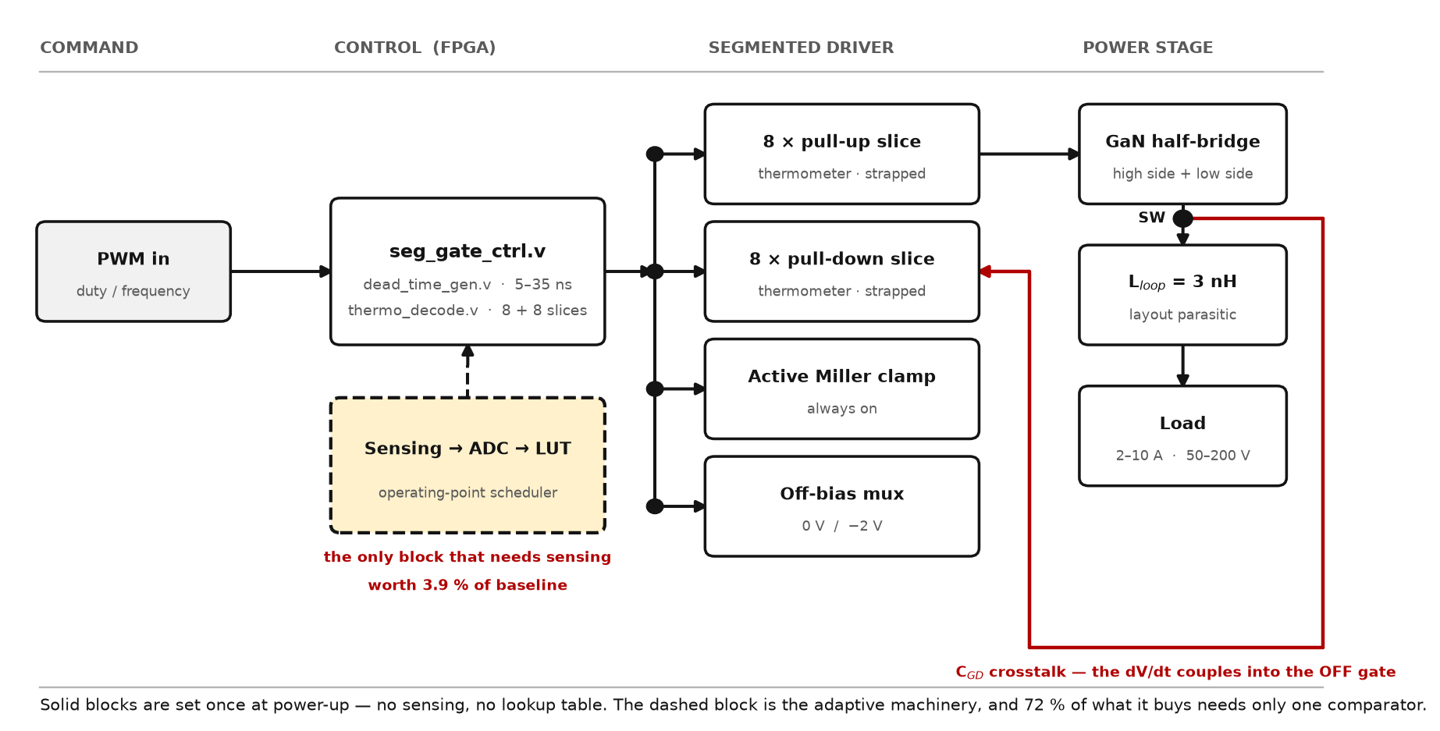
System Architecture
Fig. 1 — System architecture, left to right: PWM command, FPGA controller, segmented gate driver, power stage. The four driver blocks are what this project designs. Only the dashed block needs sensing — and measuring what it is worth is the project's question.
7
Notes:
[30 s] CORE. Walk the diagram left to right in one sentence, then stop on the dashed block: that is the sensing and lookup-table machinery the adaptive premise needs. The whole project is a measurement of what it buys. Let the picture do the work — do not narrate every box.

Slide 8
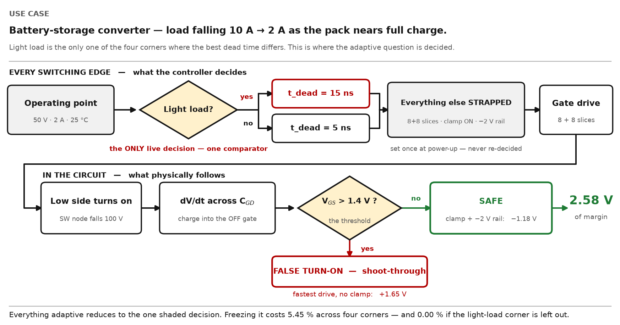
How it works — one use case, start to finish
Fig. 2 — One switching edge, followed through. Top row: the controller's decision. Bottom row: the circuit's response. Only the shaded diamond is decided at run time.
8

Slide 9
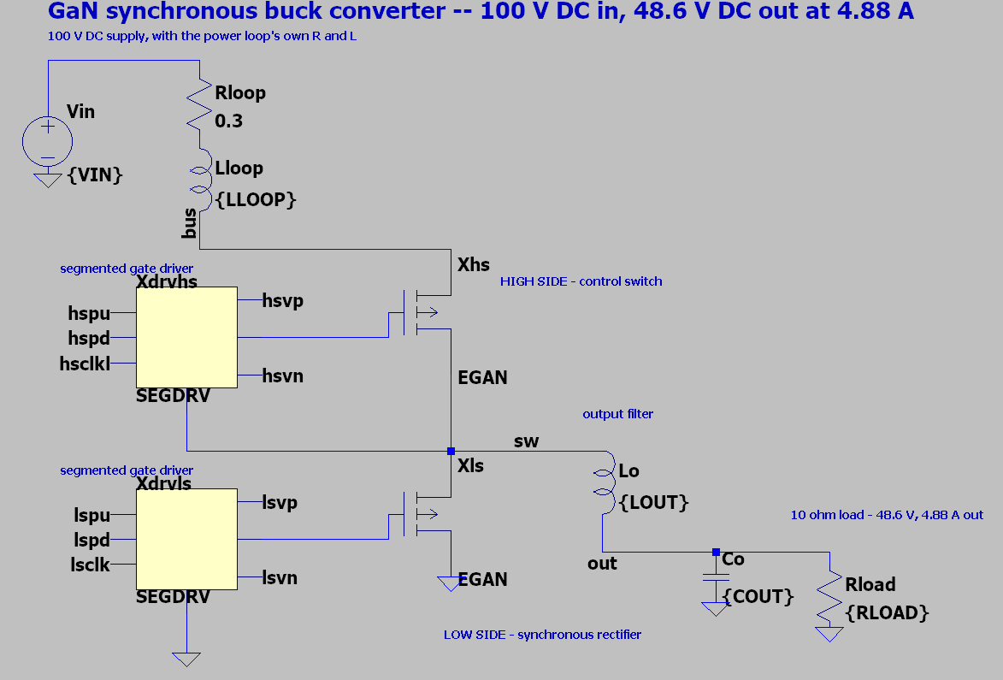
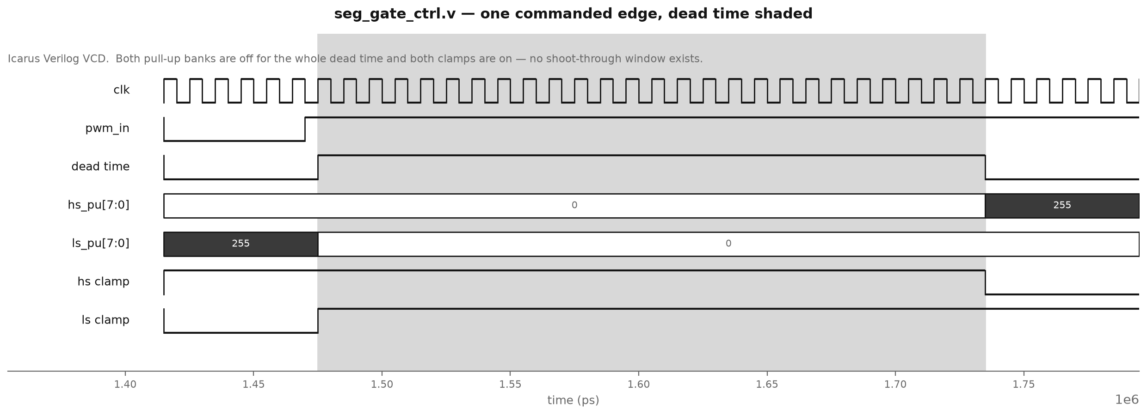
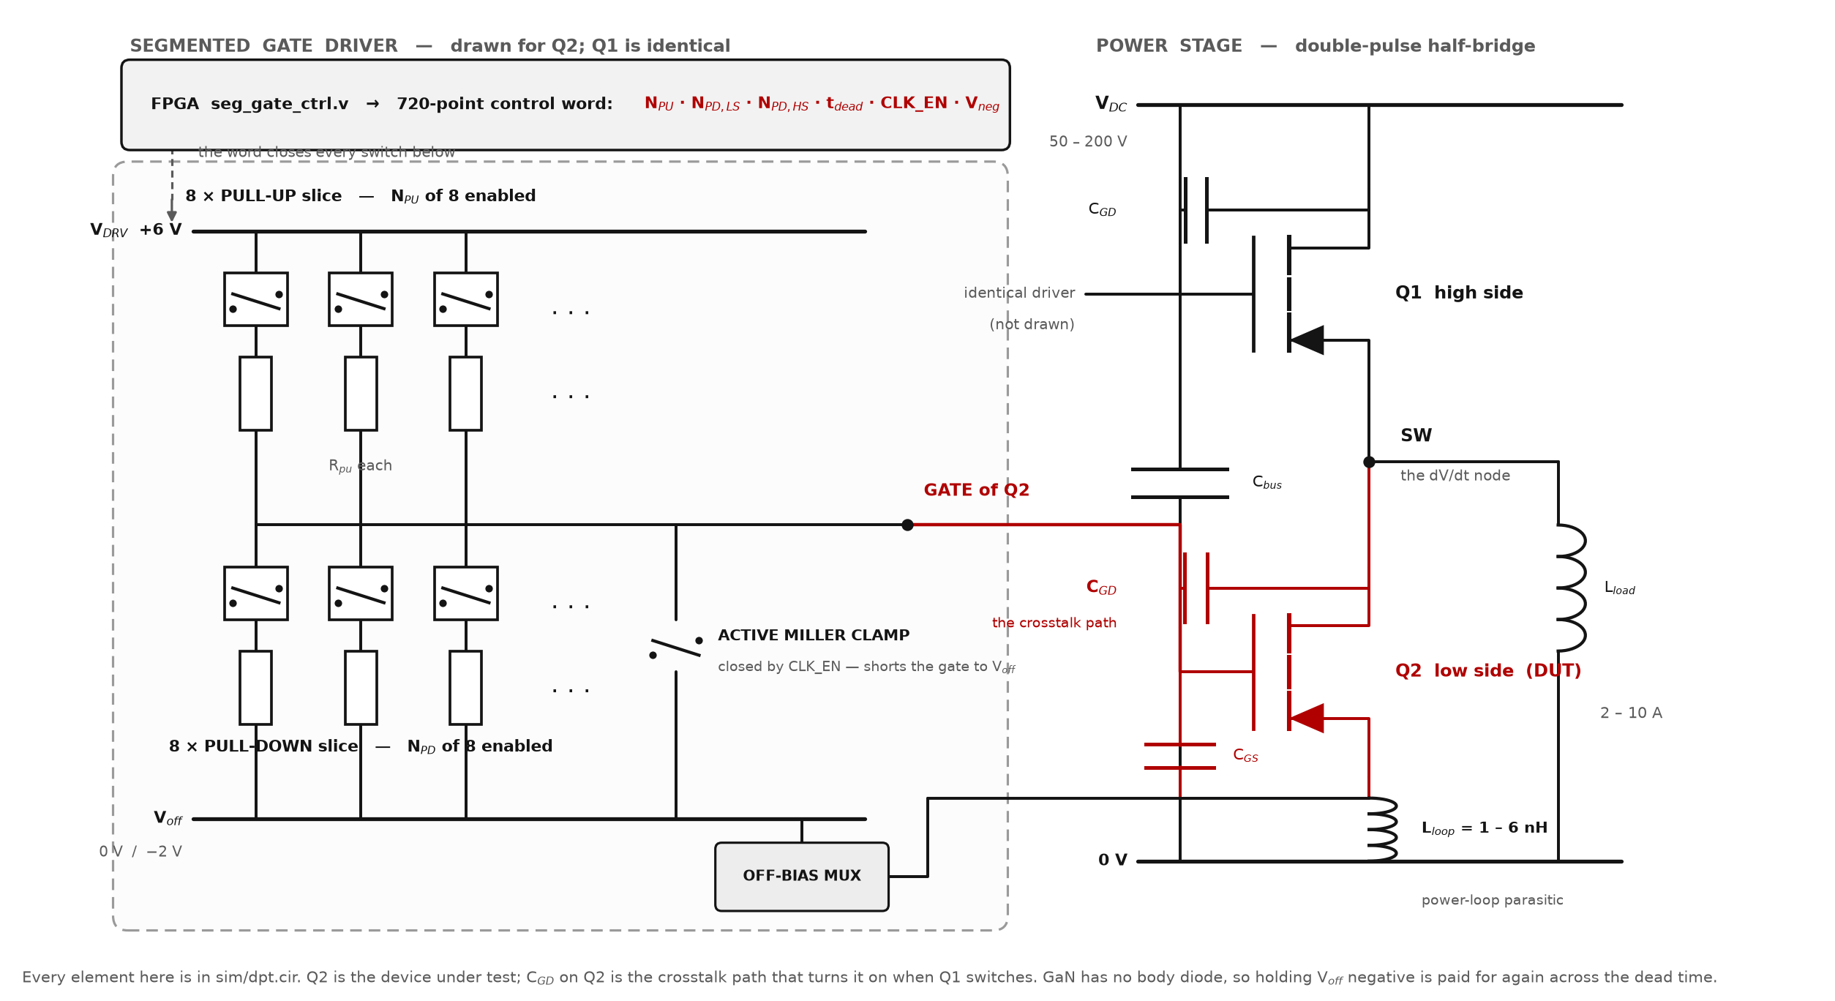
The circuit we simulate
Fig. 3 — GaN synchronous buck converter, ltspice/BUCK_converter.asc. “Buck” means step-down: 100 V in, 48.6 V out. The two yellow blocks are the segmented gate drivers — the part this project designs. Around them: the 100 V supply with its power-loop parasitics, the two GaN HEMTs, the output filter and a 10 Ω load.
9
Notes:
[30 s] CORE — use this the moment anyone asks what was actually simulated. Trace the red path with a finger: Q1 switches, the SW node moves, charge couples through C_GD into Q2's gate, and Q2 turns on when it should be off. Then point at the clamp and the off-bias mux — those are the two things that fix it. Do not read the component values out.

Slide 10
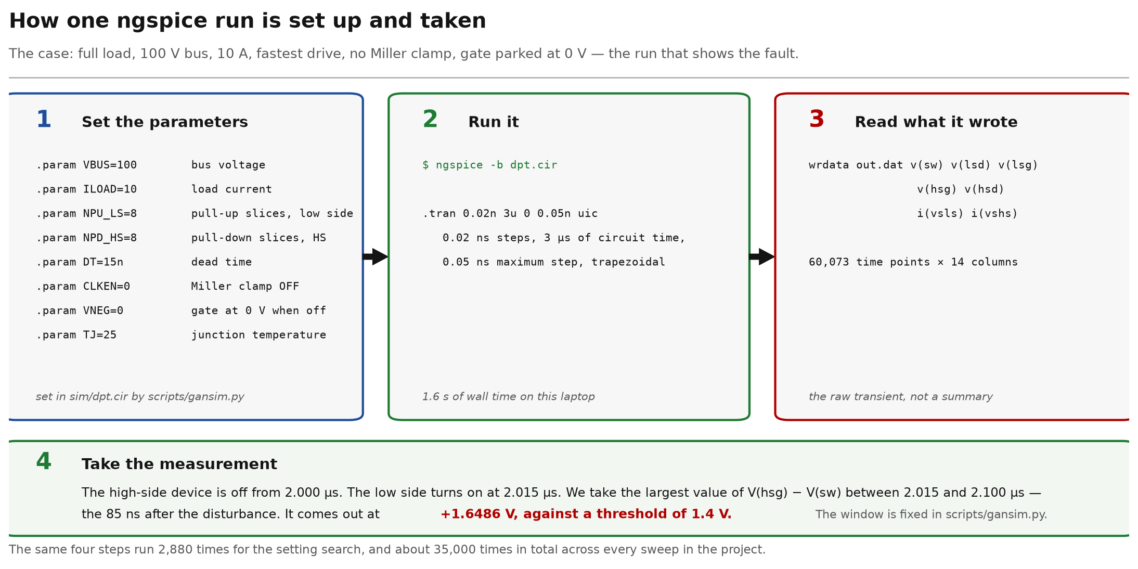
How we run ngspice
Fig. 4 — One case end to end: the parameters set into sim/dpt.cir, the command, what the simulator wrote, and the window the measurement is taken over. Full load, 100 V / 10 A, no clamp: +1.6486 V against a 1.4 V threshold.
10

Slide 11
Demo — ngspice and LTspice, running
Fig. 5 — Demo recording: the converter in ngspice, the crosstalk fault and its fix, the named cases, the Verilog controller, and LTspice running the schematic. 2 min. Click to play.
11

Slide 12
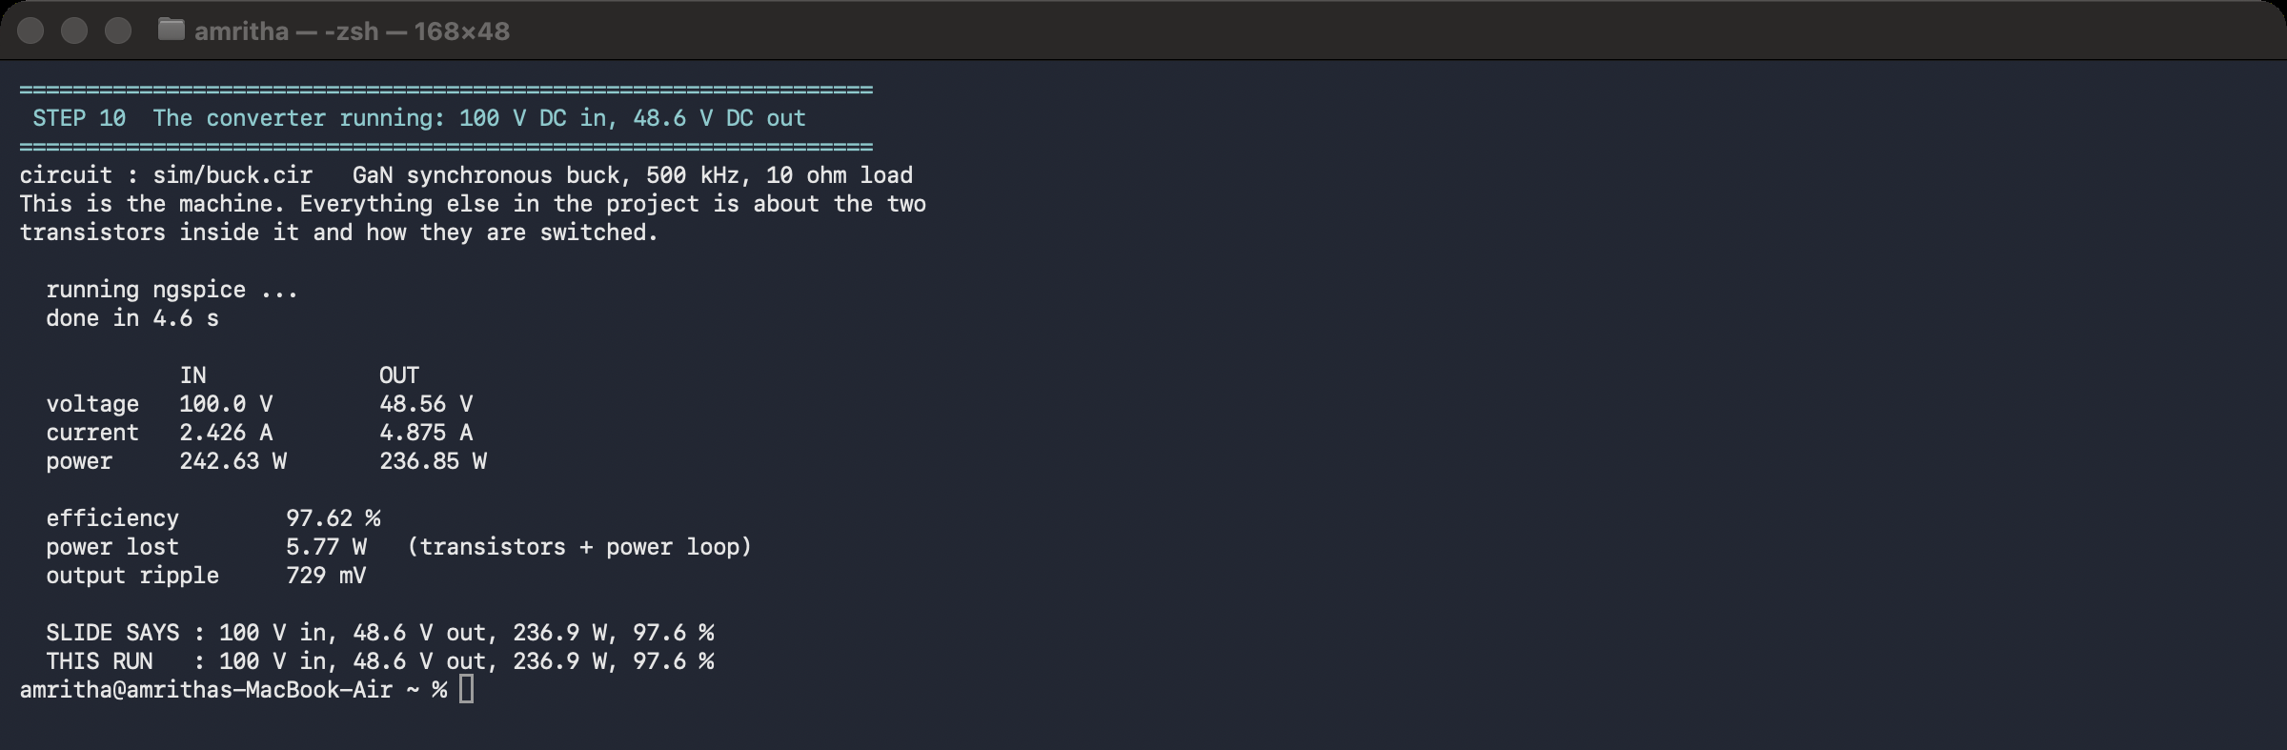
Circuit simulation — the converter
Fig. 6 — scripts/bucksim.py driving ngspice over sim/buck.cir. 100.0 V and 2.426 A in, 48.56 V and 4.875 A out: 242.63 W drawn, 236.85 W delivered, 97.62 % efficient.
12

Slide 13
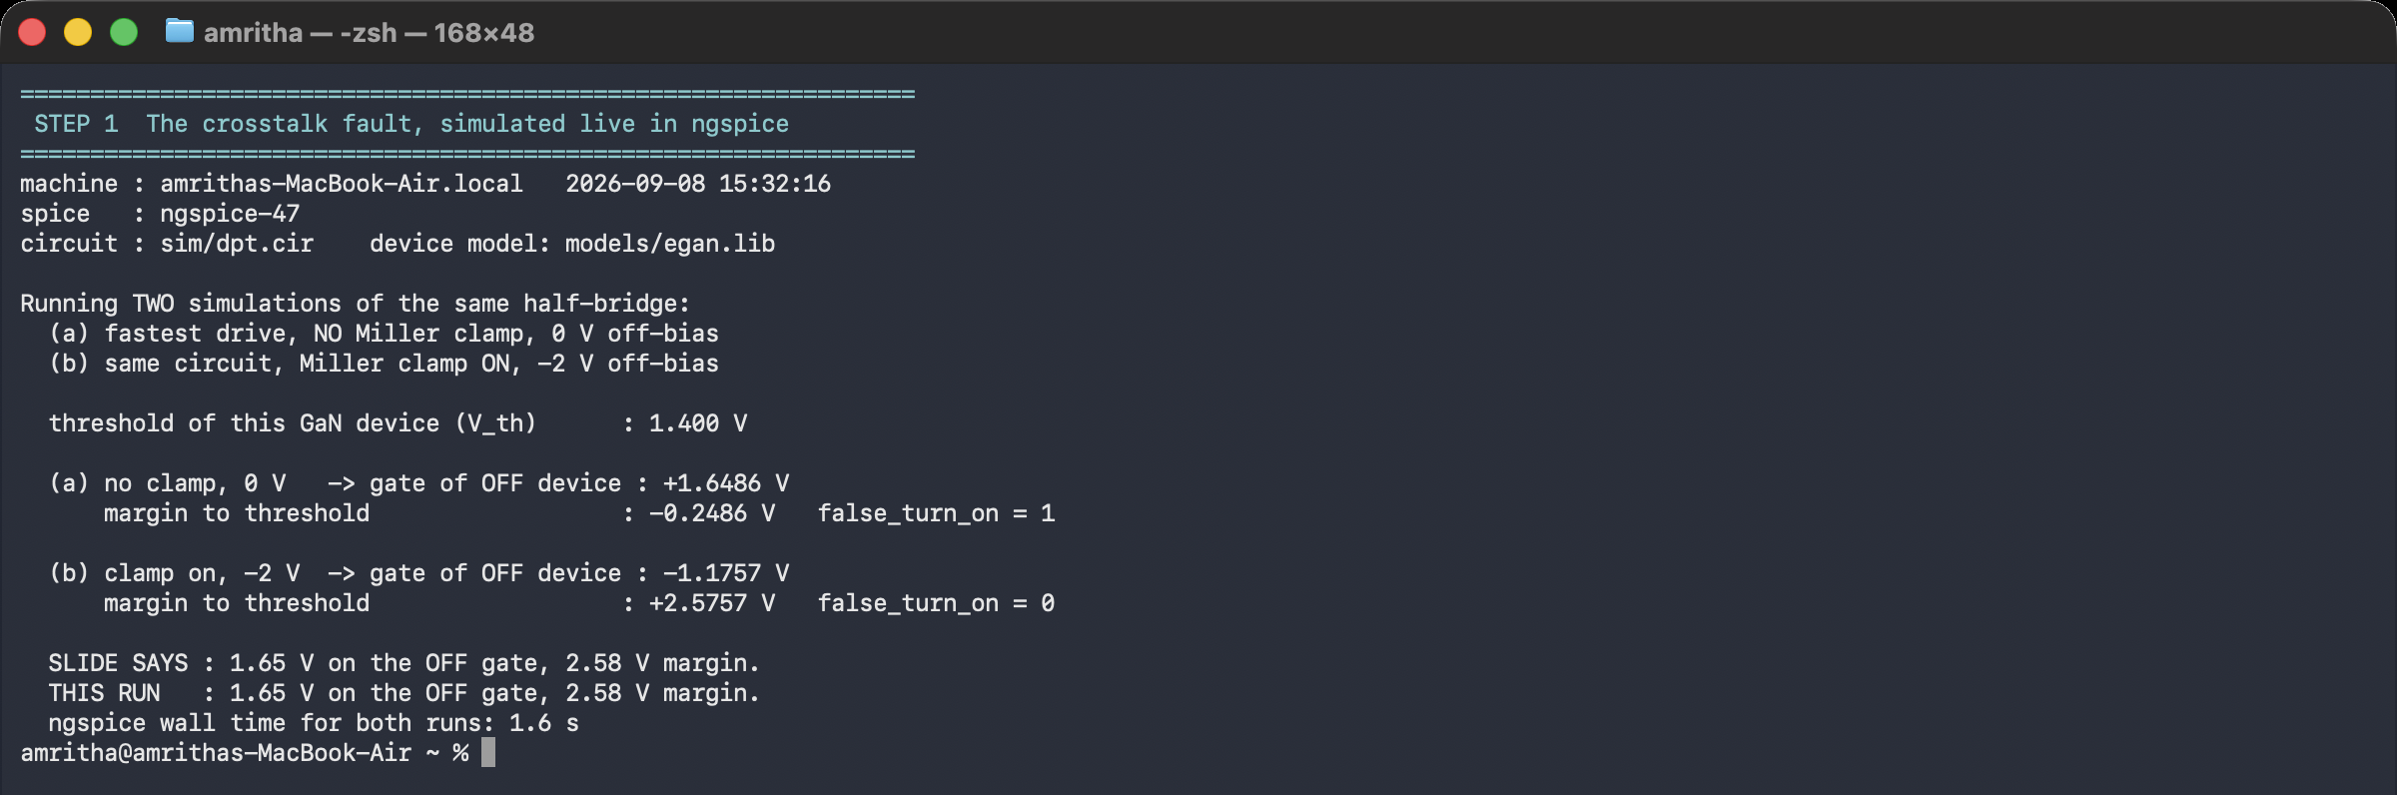
Crosstalk simulation — the fault, and the fix
Fig. 7 — Two runs of sim/dpt.cir. Fastest drive, no clamp, 0 V rail: gate reaches +1.6486 V against a 1.400 V threshold, false_turn_on = 1. Clamp on with −2 V rail: −1.1757 V, margin +2.5757 V, false_turn_on = 0.
13

Slide 14
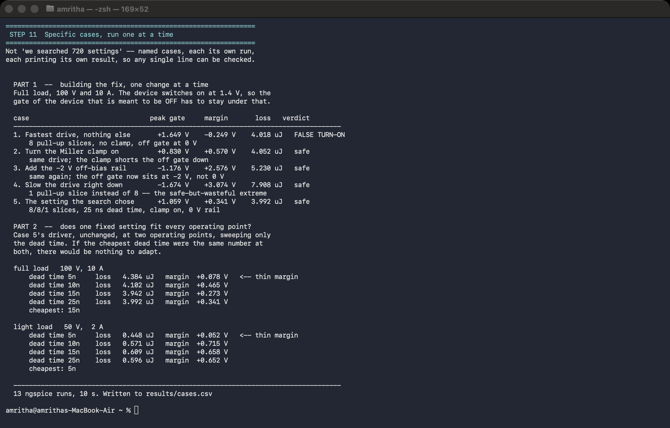
Driver simulation — the segmented driver, case by case
Fig. 8 — scripts/cases.py, 13 runs. Part 1: the fix built one change at a time at 100 V / 10 A. Part 2: dead-time sweep at two operating points — cheapest is 15 ns at full load, 5 ns at light load.
14

Slide 15
Head to head with the base paper
Same deck, same GaN, same power loop, same parasitics — only the driver is swapped. We hold ONE fixed word at all four corners. They are re-optimised at EVERY corner, which is more freedom than their own design has.
crosstalk margin | base, as their paper builds it | base, re-tuned at every corner | ours, ONE fixed word | vs their best
50 V / 2 A / 25 °C | +0.503 V | +0.503 V | +2.757 V | 5.5×
100 V / 10 A / 25 °C | +0.407 V | +0.407 V | +2.576 V | 6.3×
200 V / 2 A / 125 °C | +0.261 V | +0.261 V | +2.309 V | 8.9×
200 V / 10 A / 125 °C | +0.181 V | +0.181 V | +2.251 V | 12.4×
The gap WIDENS with stress
And we slew HARDER, not softer
Their margin falls +0.503 → +0.181 V from the mildest corner to the hottest. Ours goes +2.757 → +2.251. They degrade where it matters most; a clamp does not care how hot the device is.
Worst corner is what a converter has to survive: +0.181 V against +2.251 V.
Their scheme reduces crosstalk by slowing the edge: 67–103 V/ns at the switch node. Ours runs 101–175 V/ns — about twice as fast — and still wins by a factor of several.
The margin is not bought with switching speed. That is the useful form of the result.
What it costs, and what the claim is NOT. Our turn-on energy is higher at three of four corners — the −2 V rail deepens GaN's dead-time reverse drop, a penalty this project already measures at 1.0–3.4 % of total loss. Their driver needs one bias resistor; ours needs a clamp device, a negative supply and 20 LUTs. For a converter that never leaves one operating point, theirs may be the right engineering.
And this is OUR implementation of their described scheme in OUR testbench — their netlist is not published. It is not 6.3× their measured result, and we do not say it is.
15

Slide 16
Closing the loop
Every result so far was measured OPEN LOOP — the duty ratio was a parameter and nothing moved while we measured. That is the right instrument for a switching edge and the wrong description of a converter: a storage system's pack voltage sags all day and its load steps whenever something downstream turns on.
 | nominal 100 V / 5 A | after 2× load step | after 100 → 120 V line step | worst error
closed loop | 50.02 V | 50.00 V | 50.01 V | 0.02 %
open loop | 49.58 V | 48.72 V | 58.33 V | 16.7 %
What the loop buys
Two compensators that did NOT work
Load step 5 → 10 A: dips 1.8 %, back inside ±1 % in 4 µs.
Line step 100 → 120 V: peaks 1.3 %, recovers in 21 µs.
Output ripple 0.28 %. Soft-start overshoot 10.9 % — the one number here we are not proud of, and it is on the slide.
Open loop is not merely less accurate. On the line step it walks to 58 V, because V_out = D × V_in and nothing in it knows V_in moved.
The first period-doubled: a 4 µs triangle on a 2 µs switching period — the textbook fsw/2 limit cycle.
A proper type-II could not be made to work at all. One zero cannot beat the output LC's −180°: cross above the corner and the phase margin is negative, cross below and the loop cannot settle between two disturbances. Both measured — 30 µS drifts 23 V, 100 µS rails 98 V.
Type III adds the second zero, which is exactly the missing phase. Crossover ~30 kHz, fsw/16.
Said out loud: the K-factor design was 4× out. It predicted 30 kHz; the measured step response said about 2 kHz, 109 % overshoot, 119 µs to settle. The gain was scaled empirically and re-measured at each step. No phase margin is claimed anywhere — that needs an AC analysis about a periodic operating point, which ngspice cannot do on a switching deck.
16

Slide 17
Does the result depend on the model?
Two assumptions carry every margin in this deck: that an ideal switch stands in for the driver's output stage, and that a junction diode stands in for the device's capacitance. We replaced each with the alternative and re-ran.
1. The output stage — in real SKY130 devices
2. The capacitance — charge, not diodes
 | ideal sw | SKY130
no clamp | −0.249 | −0.563
clamp on | +0.570 | +0.031
clamp + −2 V | +2.576 | +2.032
 | diodes | charge
no clamp | −0.249 | +0.115
clamp on | +0.570 | +0.800
clamp + −2 V | +2.576 | +2.710
The clamp alone is not the fix.
On real transistors it gives 31 millivolts — at one corner, with nothing left for temperature or a worse layout. The ideal switch was flattering it, because it pulls the gate down through 10 mΩ while a real NMOS pulls through a channel that has to be turned on first.
And the fault itself changes sign.
Under forward bias a SPICE diode keeps climbing above 0.5 V and the charge form saturates. The aggressor is forward-biased through its own turn-on, so it slews differently. “The constant word causes false turn-on” is model-dependent, and we say so rather than calling it a measurement.
Both tables point the same way, and it is an argument FOR the design rather than against the result.
The ordering survives every substitution — each change still buys what we say it buys. What does not survive is the middle row: the configurations closest to zero are exactly the ones whose verdict a modelling choice can flip. The shipped design is the only one that is safe under all four models, with over 2 V of room in each. That is a better reason to build it than any ratio on the previous slide.
17

Slide 18
Does the architecture close the gaps?
Nine gaps in the published work, what our architecture does about each, and the evidence. Every row names the script that produces it.
Gap in the published work | What the architecture does | Evidence | Status
Segmented drivers report one number. Nobody separates a better FIXED setting from live RE-TUNING. | 720 control words × 4 operating points, every combination run. | Fixed 25.1 %, adaptive 3.9 % — adaptive is 13.4 % of the gain (novelty.py). | CLOSED
Nobody says how much CONTROLLER the adaptive part justifies. | A complexity ladder: constant word → one comparator → two → full lookup table. | One comparator takes 46 % of it. 7.2 % is left to justify a sense + ADC + LUT (controller_ladder.py). | CLOSED
Prior segmented drivers stage the slices but carry no Miller clamp and no negative off rail. | 8 + 8 slices AND a clamp AND a −2 V off-bias, each measurable on its own. | Base paper at its best +0.407 V; ours +2.576 V — 6.3× (basepaper_compare.py). | CLOSED
The driver is asserted to be programmable; the logic is rarely synthesised. | seg_gate_ctrl.v, thermometer-coded, with its own dead-time generator. | 8 properties in Icarus; 20 LUT / 20 FF on xc7a35t, 200 MHz met, 1.996 ns slack. | CLOSED
Controller and power stage are verified separately and never made to meet. | The RTL's own VCD drives the SPICE slices — one source per wire, no integer in between. | Margins agree to 0.081 V, and it found a one-cycle dead-time error (rtl_cosim.py). | CLOSED
Whether a fitted schedule GENERALISES to an unseen operating point is never tested. | Leave-one-corner-out: fit the comparator on three corners, test on the fourth. | Worse than the fixed word on 3 of 4 held-out corners. n = 4, so weak — and we say so. | ANSWERED, NEGATIVE
Segmented-driver papers characterise one switching EDGE. The converter is never closed-loop regulated. | A type-III loop around the same power stage and the same drivers, then disturbed on purpose. | 0.05 % error through a 2× load step and a 20 % line step; open loop walks to 58 V (closedloop.py). | CLOSED
Segmented output stages are published as ideal switches. Whether the result survives real devices is untested. | The same output stage rebuilt in SKY130 5 V transistors and re-run. | Sign and ordering both survive — and the clamp ALONE turns out to give only +0.031 V (silicon_check.py). | CLOSED
All of the above is simulation. | — | No silicon measured. The DRIVER is now rebuilt on a real PDK; the GaN model has no equivalent check. | OPEN → Review-III
DOES IT SERVE ITS PURPOSE? Yes, for a simulation study, and that is what it is titled as. Seven gaps closed, one answered in the negative — which is a result, not a failure — and one that needs a bench. The honest summary is that the architecture is finished and the measurement of it on real silicon is not.
18

Slide 19
Work Completed — 90 %
Counted, not asserted. Twelve blocks, weighted by how much of the project each is. Eight are finished. The weights are on the slide so they can be argued with.
 | Block of work | Weight | Evidence, or why not yet
✔ | The converter itself, built and converting | 8 | 100 V → 48.6 V at 4.88 A, 97.6 % efficient (buck.cir)
✔ | The device choice justified against silicon | 8 | 5.9 W vs 17.3 W at 500 kHz; 3 sweeps, 4 duty profiles
✔ | The base paper implemented, not just cited | 10 | zhangdrv.lib in our own deck; quoted at ITS best, +0.407 V
✔ | The segmented driver; the fault reproduced and fixed | 12 | −0.249 V → +2.576 V, one change at a time
✔ | The full study: 720 words × 4 corners | 12 | 34,622 transients; fixed 25.1 % vs adaptive 3.9 %
✔ | How much controller that justifies | 8 | ladder + leave-one-corner-out; two implementations agree
✔ | FPGA: RTL written, verified, synthesised, timing met | 12 | 8 properties; 20 LUT / 20 FF; 200 MHz, 1.996 ns slack
✔ | The two halves made to meet in one simulation | 5 | RTL VCD drives the SPICE slices; agree to 0.081 V
✔ | Closed-loop regulation, disturbed on purpose | 8 | type-III loop: 0.05 % error through a 2x load and a 20 % line step
✔ | Transistor-level output stage, on a real PDK | 7 | SKY130 5 V devices: sign and ordering of the result both survive
— | Place-and-route on a chosen board | 3 | Needs real package pins and an MMCM for the clock
— | A hardware half-bridge, measured | 7 | Review-III. Until then this is a simulation study, and is titled as one
90 of 100 done. Review-I's rubric asks for 50 %. We are past it because this is a simulation study and the simulation half is finished — the remaining 10 % is place-and-route on a chosen board and a hardware half-bridge on a bench, and no amount of further simulating will deliver either.
Stated plainly: the architecture is finished. The measurement of it on real silicon is not.
19
Notes:
[40 s] CORE — the 50 %-completion requirement. Five claims, each with a number. If asked 'is this really 50 %?': the search is complete, stress-tested, and both objections to it - layout and EMI - have been tested rather than argued. What remains is silicon and hardware.

Slide 20
References (1–15)
[1] Z. Zhang, F. Wang, L. M. Tolbert and B. J. Blalock, “Active Gate Driver for Crosstalk Suppression of SiC Devices in a Phase-Leg Configuration,” IEEE Trans. Power Electron., vol. 29, no. 4, pp. 1986–1997, Apr. 2014.
[2] R. Xie, H. Wang, G. Tang, X. Yang and K. J. Chen, “An Analytical Model for False Turn-On Evaluation of High-Voltage Enhancement-Mode GaN Transistor in Bridge-Leg Configuration,” IEEE Trans. Power Electron., vol. 32, no. 8, pp. 6416–6433, Aug. 2017.
[3] D. Reusch and J. Strydom, “Understanding the Effect of PCB Layout on Circuit Performance in a High-Frequency Gallium-Nitride-Based Point of Load Converter,” IEEE Trans. Power Electron., vol. 29, no. 4, pp. 2008–2015, Apr. 2014.
[4] B. Li, G. Zhang, C. Li, G. Wang, S. Liu and D. Xu, “Crosstalk Suppression Method for GaN-Based Bridge Configuration Using Negative Voltage Self-Recovery Gate Drive,” IEEE Trans. Power Electron., vol. 37, no. 4, pp. 4406–4418, 2022.
[5] X. Chen, H. Peng, S. Song, Q. Tong and Y. Kang, “A Novel Control Strategy for Optimal Tradeoff between Overshoot and Switching Loss Based on Double Closed-Loop Self-Regulating Active Gate Driver,” IEEE Trans. Power Electron., vol. 39, no. 10, pp. 13033–13043, 2024.
[6] W. Song, T. Hu, J. Chen, T. Tang, H. Yue and G. Liu, “A Self-Regulating Active Gate Driver of Voltage Overshoot Suppression for SiC MOSFETs Under Variable Load Current Conditions,” IEEE Trans. Power Electron., vol. 40, no. 8, pp. 10623–10634, 2025.
[7] C.W. Kuo, T.W. Wang, L.C. Chen, C.C. Tu, Y.K. Hsiao and P.H. Chen, “Universal Active Gate Driver IC With Closed-Loop Timing Control and Gate-Sensing Technique for Silicon Carbide Power Devices,” IEEE Trans. Power Electron., vol. 40, no. 4, pp. 5120–5129, 2025.
[8] G.H. Thuc and C.J. Chen, “An Integrated Driver With Dual-Edge Adaptive Dead-Time Control for GaN-Based Synchronous Buck Converter,” IEEE Trans. Ind. Appl., vol. 60, no. 6, pp. 9157–9170, 2024.
[9] H. Takayama, T. Okuda and T. Hikihara, “Digital Active Gate Drive of SiC MOSFETs for Controlling Switching Behavior — Preparation Toward Universal Digitization of Power Switching,” Int. J. Circuit Theory Appl., vol. 50, no. 1, pp. 183–196, 2022.
[10] BASE PAPER — W.J. Zhang, J. Yu, Y. Leng, W.T. Cui, G.Q. Deng and W.T. Ng, “A Segmented Gate Driver for E-mode GaN HEMTs with Simple Driving Strength Pattern Control,” in Proc. IEEE 32nd Int. Symp. Power Semicond. Devices ICs (ISPSD), 2020, pp. 102–105.
[11] X. Wang, M. Tao, J. Xiao, D. Luo, M. He, Q. Zhou, X. Zhang and M. Wang, “High-Frequency Three-Level Gate Driver for GaN HEMT Bridge Crosstalk Suppression,” IEEE Trans. Power Electron., vol. 39, no. 1, pp. 1343–1352, 2024.
[12] L. Wang, X. Sun, Y. Yan, M. Ma and D. Xu, “An Integrated Suppression Method of Both Gate-Source Voltage Oscillation and Crosstalk for GaN HEMT Gate Driver,” IEEE Trans. Power Electron., vol. 39, no. 11, pp. 14643–14655, 2024.
[13] Y. Cai, D. Ye, W. Lv and Z. Chen, “A High-Efficient GaN Driver With Hybrid Adaptive Dead-Time Control and Peak Delay Control for Synchronous Buck Converter,” IEEE Trans. Power Electron., vol. 41, no. 1, pp. 279–290, 2026.
[14] Y. Zheng, S. Zhao, P. Agarwal, F. Liu, Y. Zhao and A. Mantooth, “A Multi-Level Turn-Off Gate Driver for Crosstalk Noise Suppression of GaN HEMTs,” IEEE Open J. Power Electron., pp. 1–15, 2026.
[15] M.K. Banda, S. Madichetty, D.M. Natham and S. Koduru, “An Event-Triggered Dual-Polarity Gate Clamp for GaN HEMT Gate Oscillation Suppression,” IEEE Trans. Power Electron., vol. 41, no. 9, pp. 14402–14405, 2026.
20
Notes:
[skip] Reference list. Leave up during questions.

