Slide 1


Team Name: Riaya (رعاية)
Team Size: 1 (solo entry: Amritha S)
Problem Statement: Identifying male reproductive health risks early: a private, culturally sensitive front door that screens (never diagnoses), explains every signal, and routes men to the right level of care with a licensed doctor approving every specialist referral.

Slide 2
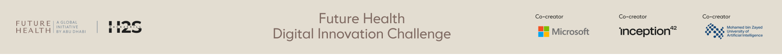
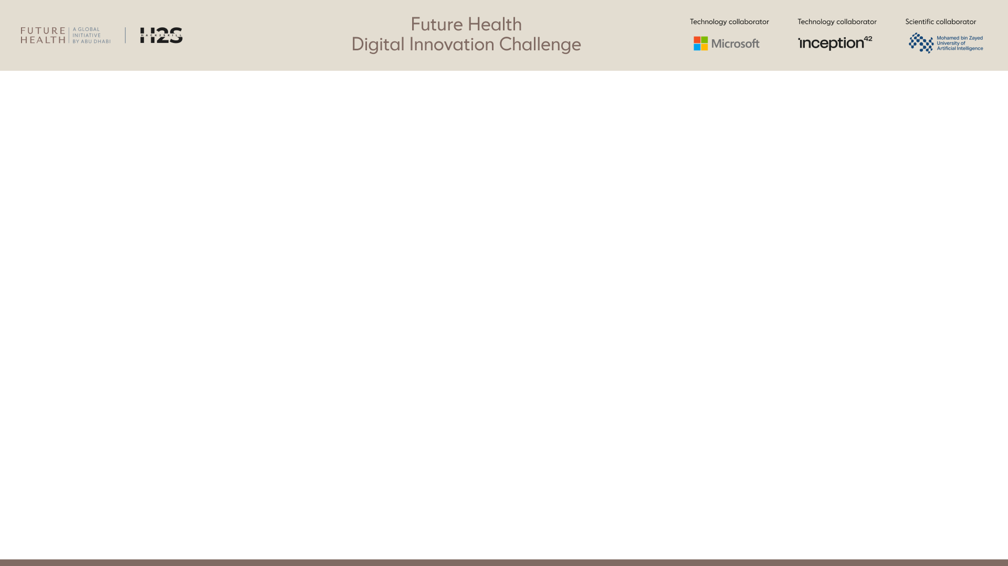
Team members*
[Name, country, role, organization, age confirmation]
S.No | Name | Country | Role | Organization | Age confirmation
1 | Amritha S | [ADD COUNTRY] | Founder; product, research and full-stack engineering | [ADD ORGANISATION] | [CONFIRM 18+]
Solo entry. Every part of Riaya (research, evidence map, design, code, tests and documentation) was produced by Amritha S.

Slide 3
Team Capability Summary*
Maximum 1,000 characters
Solo builder covering health research, product design and software engineering. For Riaya I reviewed and graded 95 published sources (WHO 2021, AUA/ASRM, EAU) into an evidence map of 148 cited links; designed an Arabic-first, privacy-first patient experience; and built the full stack: Python/FastAPI services, PostgreSQL with encryption at rest, explainable machine learning (scikit-learn, SHAP, Shapley attribution), guideline-based triage with human sign-off, lab-report extraction, FHIR R4 hand-off, WhatsApp integration and a clinician console. Quality practice: 32 automated end-to-end tests run on SQLite and PostgreSQL in GitHub Actions, browser testing with Playwright, a security review (lockouts, session limits, upload limits, CSP) and written operations, privacy and Azure UAE deployment guides.
Shown in the working prototype
Research: 95 sources, graded A–D
Clinical logic: guideline triage, red flags
Data science: explainable models, validation
Engineering: FastAPI, PostgreSQL, PWA
Privacy and security: consent, encryption, audit
Design: Arabic-first, accessible
Delivery: CI, tests, Azure UAE template

Slide 4
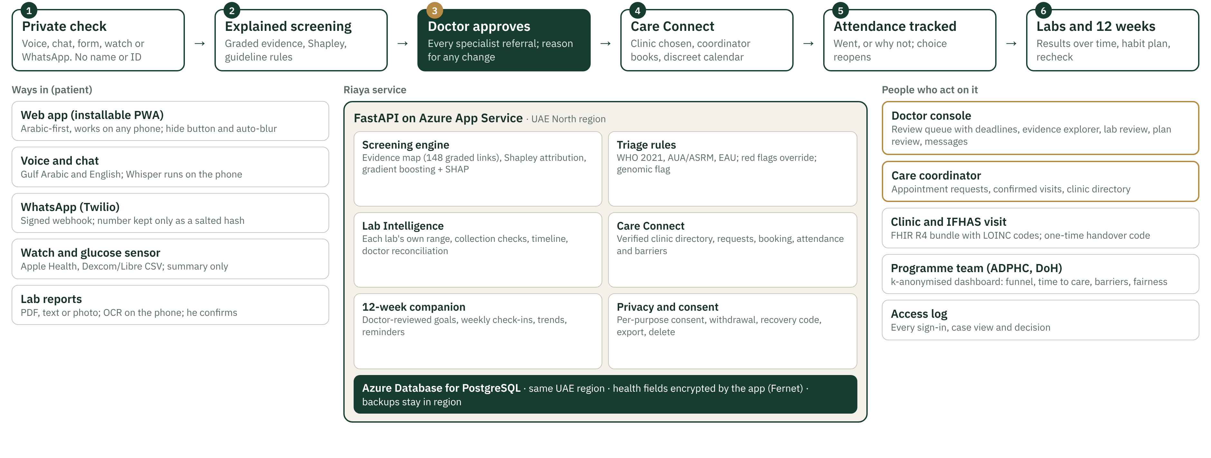
Architecture or workflow diagram*
Deployment: azure/main.bicep provisions App Service and PostgreSQL in Azure UAE North or UAE Central. The public prototype runs on test data only and says so on every page.

Slide 5

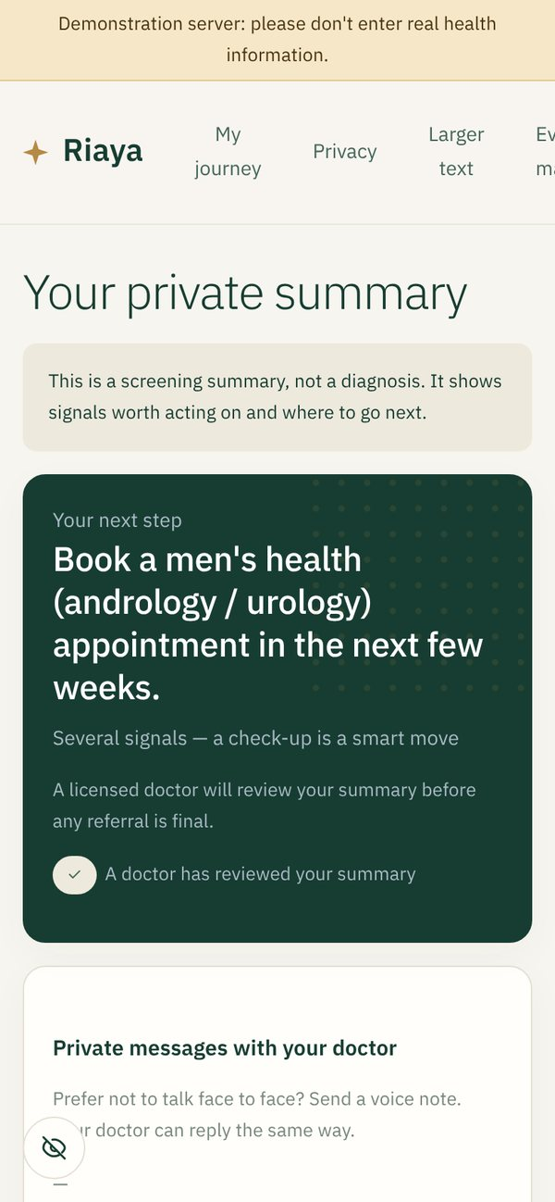
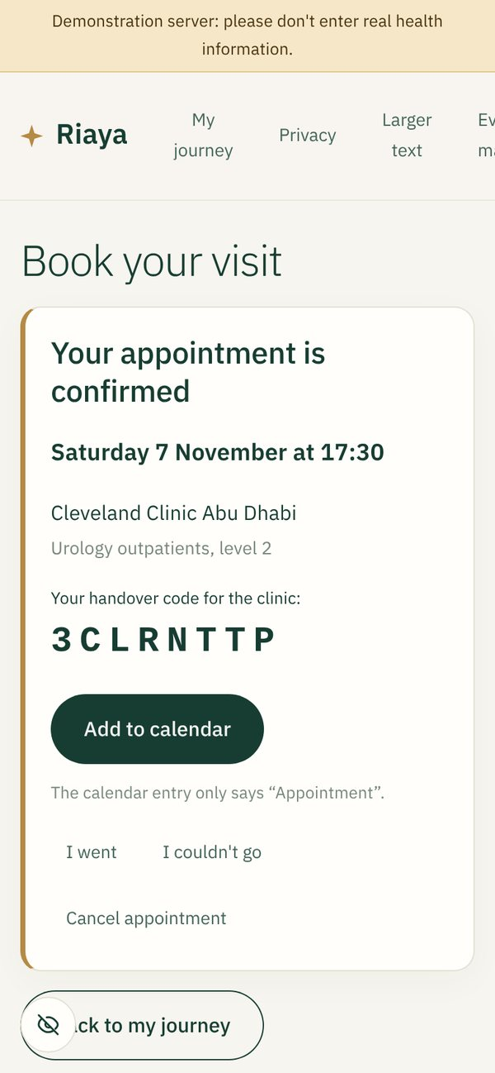
Target users and intended outcome*
Primary users
Men in Abu Dhabi, especially 20–45, Emirati and resident, Arabic or English speaking, who avoid clinics for reasons of privacy or embarrassment
Couples planning a family, who can share a status-only partner link
Professional users
Doctors (family medicine, urology/andrology) who review referrals, labs and plans
Care coordinators who book and track clinic visits
ADPHC / DoH programme teams using the anonymised dashboard; IFHAS providers receiving the FHIR hand-off
Intended outcome
Men identified earlier and sent to the right level of care, with a doctor approving every specialist referral, fewer lost between referral and visit, and habits changed over the 12 weeks sperm take to develop.
Arabic-first, private
Explained summary
Visit booked

Slide 6
How will success be measured?*
Area | Measure (computed live in the clinician metrics and programme dashboard) | Proposed pilot target
Reach | Checks started and completed; median minutes to complete; share who used voice, WhatsApp or watch | ≥ 70% completion, ≤ 10 min
Safety | Under-triage on blinded vignettes reviewed by UAE clinicians; red flags missed | 0 red flags missed
Clinical agreement | Share of suggested referrals approved without change; reasons for overrides | ≥ 80% approved unchanged
Time to care | Median hours to doctor review; median days from check to clinic visit | Review ≤ 48 h; visit ≤ 21 days
Closing the loop | Care Connect booking rate, attendance rate, and why visits did not happen | ≥ 60% of referrals attended
Behaviour change | 12-week check-ins kept; change in cigarettes, sleep and weight; 3-month recheck rate | ≥ 50% log 8+ weeks
Lab quality | Share of extracted lab values doctors accept unchanged | ≥ 95% accepted
Trust and fairness | In-app trust, clarity, comfort (1–5); referral rates by age band and background | Trust ≥ 4 / 5; no unexplained gaps
Targets are proposals to agree with DoH Abu Dhabi and ADPHC before the pilot. Every measure above is already calculated by the prototype.

Slide 7
Evidence supporting the approach*
Citations, studies, benchmarks, or prior testing.
Published evidence behind the rules and the map
WHO (2021) Laboratory manual for human semen, 6th ed.: semen reference limits and collection (2–7 days abstinence)
Schlegel et al. (2021) AUA/ASRM male infertility guideline; EAU (2024) sexual and reproductive health guideline: evaluation pathway, repeat testing
Mulhall et al. (2018) AUA; Bhasin et al. (2018) Endocrine Society: testosterone confirmed by two early-morning tests
Sharma et al. (2016) Eur Urol: smoking and semen quality, 20 studies, 5,865 men
Sermondade et al. (2013) HRU: obesity and lower sperm count
Mínguez-Alarcón et al. (2018) Hum Reprod: tight underwear and testicular function
Levine et al. (2023) HRU: sperm counts declining worldwide; WHO (2023): ~1 in 6 people affected by infertility
All 95 sources, each link graded A–D, are listed in docs/REFERENCES.md.
Prior testing (honest limits)
26 / 26 guideline scenarios gave the expected next step, with 0 under-triage. Scenarios were written by the team, so this checks the rules, not accuracy
AUC 0.62–0.69 on real data (UCI Fertility, n = 100, small)
AUC 0.68 on a simulated cohort of 20,000 men using literature effect sizes, with calibration and subgroup fairness tables
AUC 0.66 from the evidence map alone, untrained: the map agrees with the literature
32 automated tests on SQLite and PostgreSQL; end-to-end browser checks
Next: blinded vignette review by UAE clinicians, then pilot data.

Slide 8
Data sources and legal right to use them*
List source, type, owner, sensitivity, permissions, and whether personal data is used.
Source | Type | Owner | Sensitivity | Permission and handling | Personal?
Answers, voice and chat | Self-reported health | The man | High (health) | Consent per purpose; no name, phone or ID; encrypted; withdraw, export, delete | Yes, pseudonymous
Watch and glucose exports | Device data | The man | High | Uploaded only with device-data consent; summary kept, file discarded | Yes
Lab reports | Clinical results | The man / his lab | High | He confirms each value; file never stored; doctor reconciles | Yes
WhatsApp messages | Conversation | The man (Twilio processes) | High | Number kept only as a salted hash; "delete" erases all; approved channel needed for pilot | Yes
Published literature | 95 papers and guidelines | Publishers | None | Cited, not reproduced | No
UCI Fertility dataset | Open dataset, n = 100 | UCI ML Repository | Anonymised | CC BY 4.0, attributed (Gil et al. 2012) | No
Simulated cohort | Synthetic, 20,000 | Created by the team | None | Generated from literature effect sizes | No
Clinic directory | Public facts | Each provider | Low | Name, area, sector, website only; no invented phone numbers or availability | No

Slide 9
Risks and safeguards*
Privacy; security; bias; explainability; misuse; human oversight; failure modes.
Risk | Safeguard built into the prototype
Privacy | No name, phone or ID. Consent per purpose, withdrawable. Encryption at rest. One-time share codes. Hide button and auto-blur. Status-only partner link. Export and delete everything
Security | Doctor lockout after 5 failures; 8 h sessions, 30 min idle; strong-password rule; access log of every view and decision; upload and zip-bomb limits; CSP and HSTS
Bias | Results by age band and background in the fairness tables; k-anonymised dashboard (groups under 5 hidden); real-data limits stated
Explainability | Every finding shows the evidence, its grade, sources, and limits; Shapley attribution; unknown data shown as unknown, never as normal
Misuse | Screening only; no fertility prediction score; calendar entries say only "Appointment"; partner link shows no answers or results
Human oversight | A doctor approves every specialist referral, lab correction and 12-week plan; any change needs a written reason
Failure modes | Red flags skip scoring and go straight to urgent or emergency advice; implausible lab values are refused; a single abnormal result prompts a repeat test, not a conclusion; video stays off unless an approved UAE service is set up

Slide 10
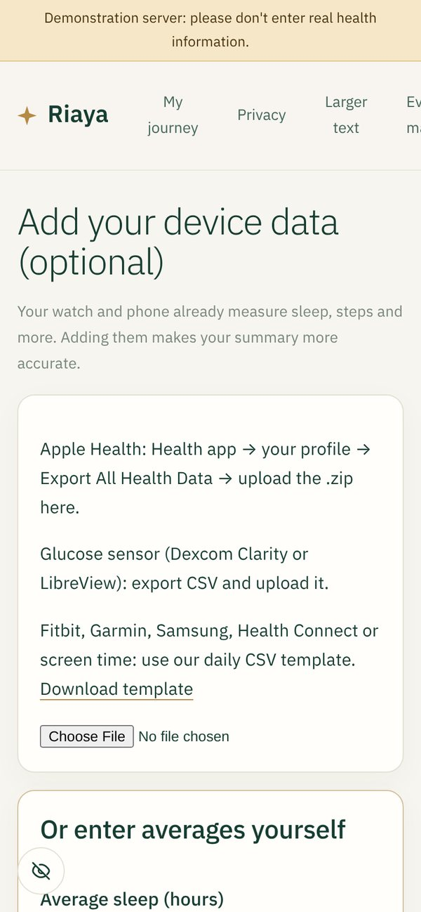
Hardware requirements
Required if wearable, sensor, connected device, or other hardware is there. Include sourcing and safety.
No hardware is required or supplied.
Riaya is software only: a web app that installs on any phone without an app store, plus WhatsApp.
Optional data from devices men already own
Apple Watch / iPhone: Health app export (.zip)
Glucose sensors: Dexcom Clarity or LibreView CSV export
Fitbit, Garmin, Samsung: daily CSV template
Home sperm tests: results typed in, or a lab report uploaded
Riaya never connects to or controls a device. It reads files the man chooses to export, so there is no sourcing, device safety or regulatory burden on hardware.

Slide 11
Path to pilot and scale*
Stakeholders, integration, regulatory needs, timeline assumptions, and sustainability.
Months 0–1
Ready to pilot
Azure UAE deployment, ADHICS review, DPIA, SaMD classification confirmed with the regulator, blinded vignette review by UAE clinicians
Months 1–6
IFHAS pilot
Optional pre-screen at 2–3 IFHAS providers; FHIR hand-off into the visit; measure completion, time to care, agreement, trust
Months 6–12
Specialist pathway
Direct booking with SEHA / M42 urology and andrology clinics; outcomes fed back; retrain models on real paired data
Year 2+
Scale
Emirate-wide through IFHAS and Malaffi; UAE PASS for clinicians; Urdu, Hindi and Malayalam
Stakeholders: DoH Abu Dhabi, ADPHC (IFHAS), SEHA and M42 clinics, Malaffi, Thiqa programme
Integration: FHIR R4 bundle with LOINC codes; one-time handover codes; Azure UAE hosting
Regulation: UAE Federal Law No. 2 of 2019 (health data in the UAE); DoH ADHICS; DoH AI policy; SaMD status to confirm
Sustainability: funded per completed screen by the programme or as a licence to IFHAS providers; low fixed cost (one small App Service and database)
Assumptions: programme sponsor in place; clinics accept referrals; hosting approval within the first month
Why it scales: no hardware, no app store, works on WhatsApp, and the clinical rules live in one versioned, cited file

Slide 12
Pre-existing IP and third-party materials*
Identify ownership, licenses, open-source components, and restrictions.
Ownership
All code, the evidence map, content, design and documentation were created by Amritha S, who owns them. No employer or third party has a claim.
Restrictions
No proprietary third-party code is included
psycopg (LGPL-3.0) is used unmodified as a library
Fonts (OFL) are shipped with their licence
Twilio is a paid service under its own terms
Guidelines and papers are cited, not reproduced
Component | Use | Licence
FastAPI, Pydantic, Uvicorn | Web service | MIT / BSD-3
scikit-learn, NumPy, pandas, joblib | Models and data | BSD-3
SHAP | Model explanations | MIT
cryptography | Encryption at rest | Apache-2.0 / BSD
psycopg 3 | PostgreSQL driver | LGPL-3.0
pypdf, httpx | PDF reading, HTTP | BSD-3
tesseract.js | OCR on the phone | Apache-2.0
transformers.js + Whisper | Speech on the phone | Apache-2.0 / MIT
IBM Plex, Noto Kufi Arabic | Fonts | SIL OFL 1.1
qrcodejs | QR codes | MIT
UCI Fertility dataset | Model training | CC BY 4.0

Slide 13
Conflict of interest declaration*
Disclose relationships with organizers, partners, or judges.
None. No member of our team has a conflict of interest to declare.
Amritha S is not employed by or contracted to the Department of Health – Abu Dhabi, Future Health, Microsoft, Inception42, MBZUAI or Hack2skill, has no family or close personal relationship with a judge, organiser or collaborator, holds no financial interest in an organisation running or judging the challenge, and has had no access to non-public information about the challenge or its evaluation.

Slide 14
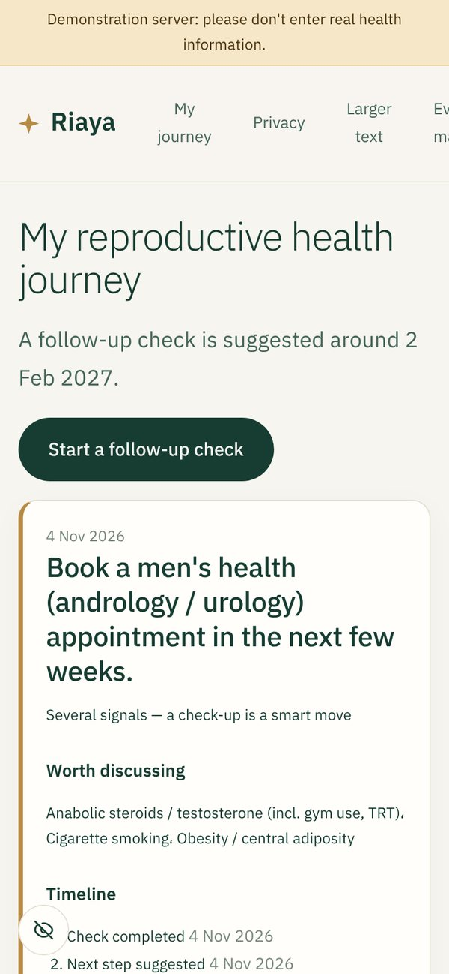
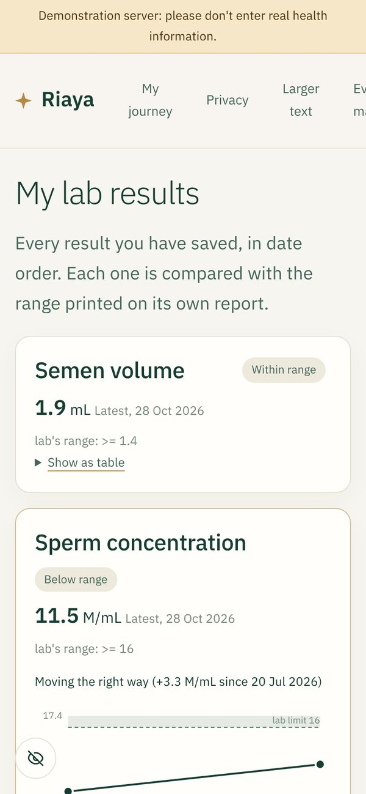
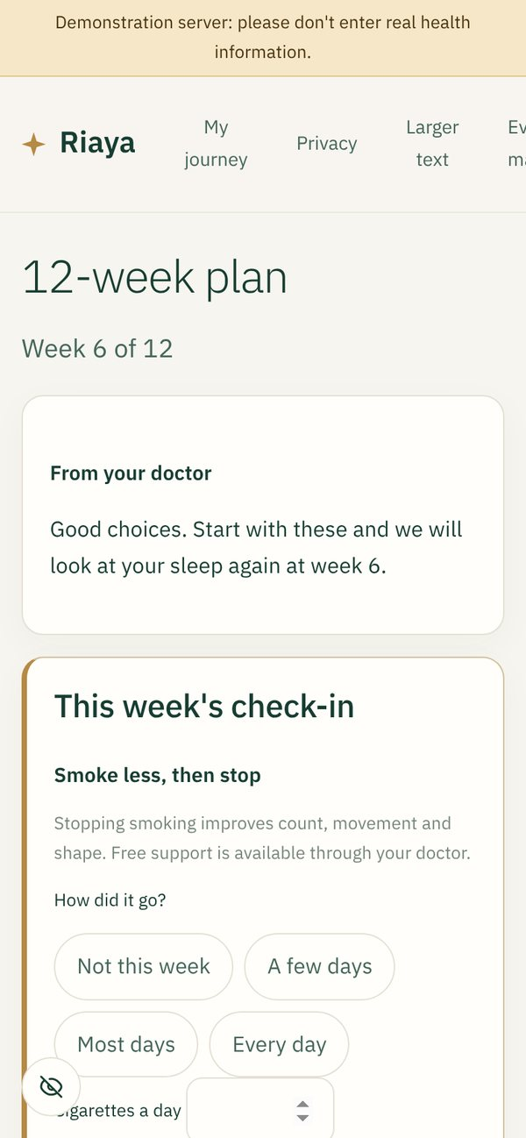
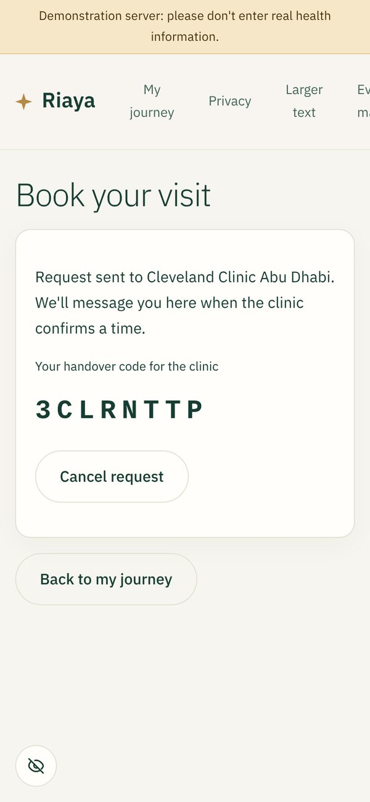
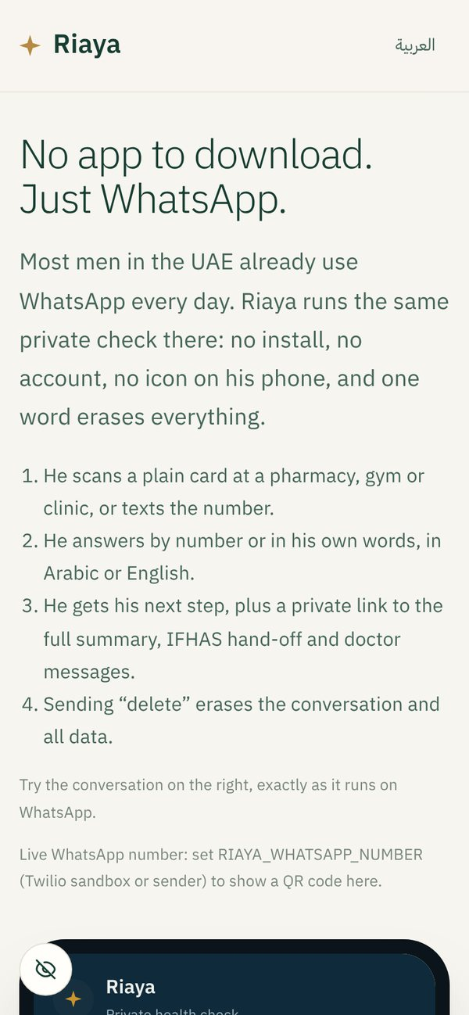
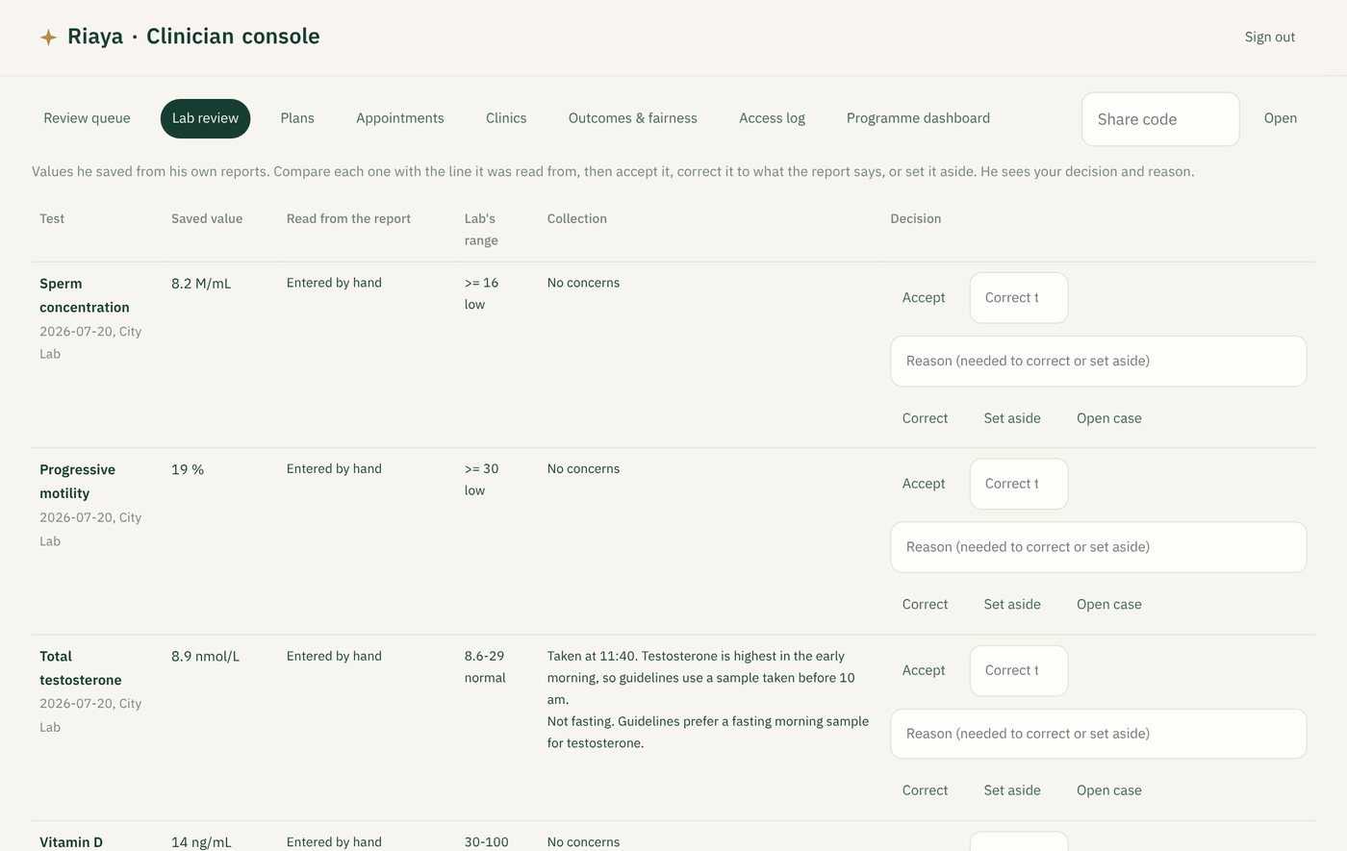
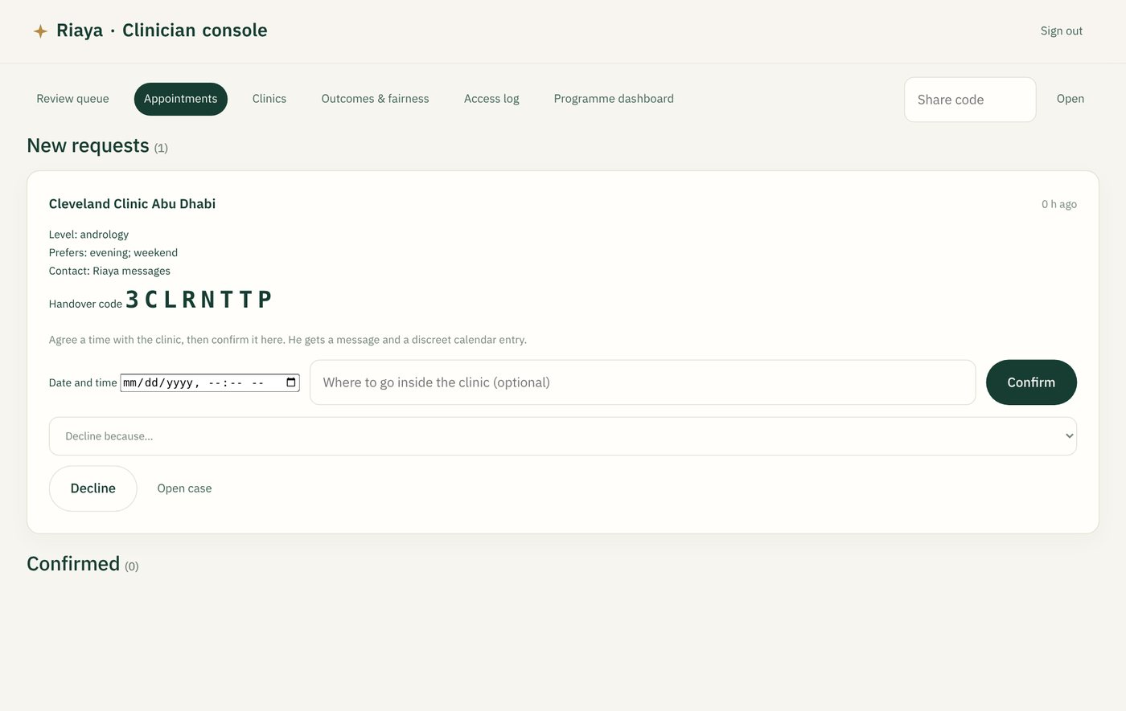
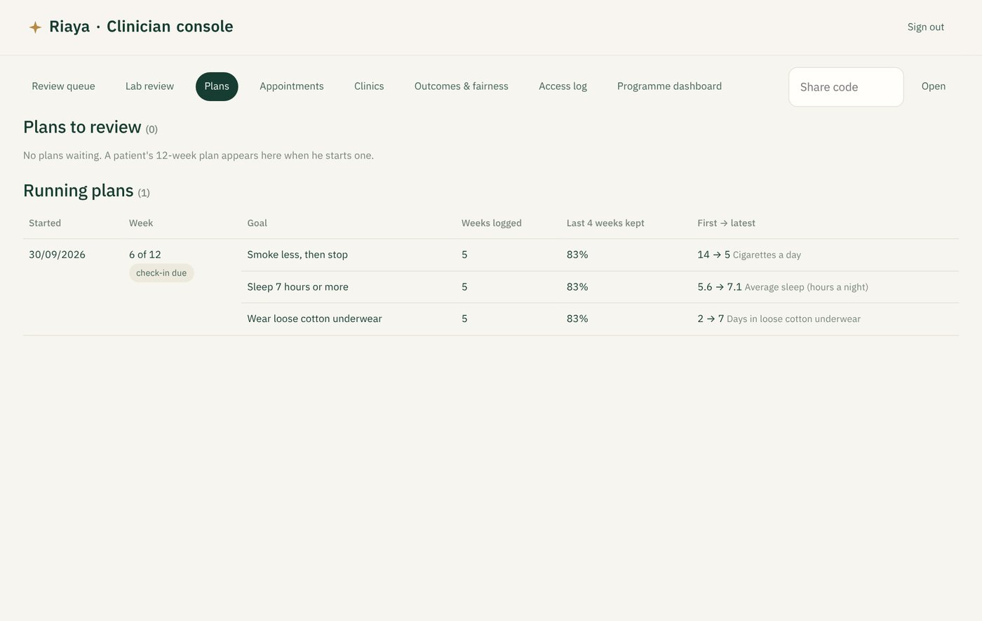
Journey
Lab results over time
12-week check-in
Clinic request sent
WhatsApp
Doctor and coordinator
Additional slide: what is built and working today
Code: github.com/Amritha902/health_innov-.- Prototype: [ADD PROTOTYPE LINK]

Slide 15


