Slide 1
Daily Iterative Learning Control With a Tuned PID Prior for Dissolved Oxygen Control in BSM1: Comparison With Multiagent Adaptive Critic Control
Amritha and Dr. Soumya Ranjan Mahapatro
Vellore Institute of Technology, Chennai

Slide 2
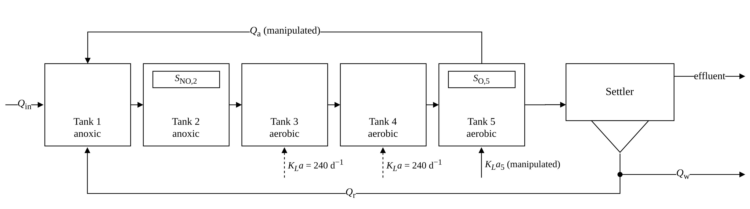
Base paper and control problem
Base paper: D. Wang, X. Li, J. Ren and J. Qiao, “Multiagent Adaptive Critic Control With Expert Knowledge for Wastewater Treatment Plants,” IEEE Trans. Ind. Informat., 2026. Reported oxygen error reductions of 92 to 95 % relative to its PID prior.
BSM1: two anoxic and three aerated tanks, ten-layer settler. Manipulated: KLa,5 (oxygen in tank 5 to 2 mg/L) and Qa (nitrate in tank 2 to 1 mg/L). Sampling period 45 s.
Notes:
The base paper controls the two standard BSM1 loops with one adaptive critic agent per loop on top of an incremental PID.

Slide 3
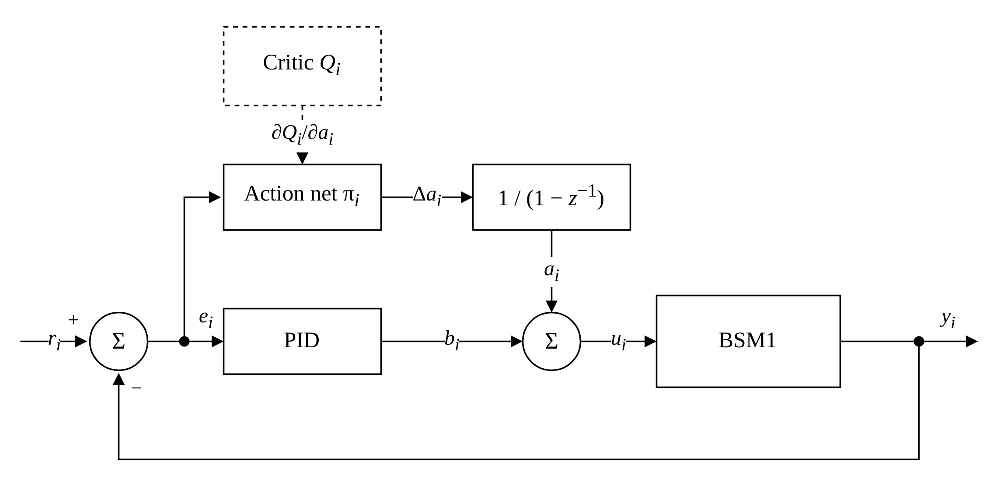
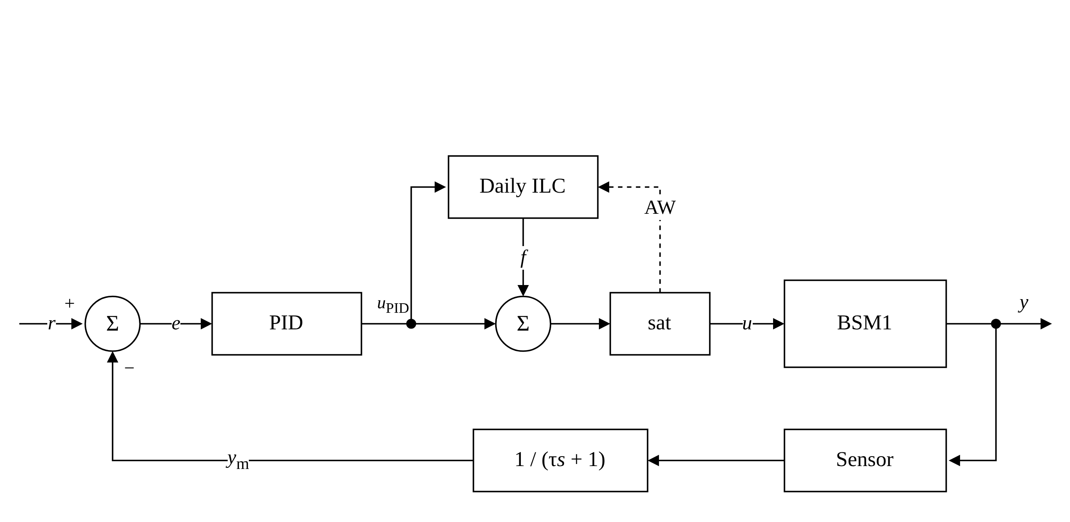
Base architecture and proposed architecture
(a) MAACC, one agent per loop [base paper]
(b) Proposed: tuned PID, daily ILC with anti-windup, measurement filter
Notes:
In MAACC the action network output is integrated and added to the PID output. The proposed controller replaces the networks with a daily feedforward learned from the PID output.

Slide 4
Daily iterative learning control
Profile update at the end of each day d (1920 slots of 45 s):
f(d+1) = S_w [ f(d) + β · L_ℓ ( u_PID(d) − mean u_PID(d) ) ]
1: for each control step k with slot j
2: u_PID ← PID step, limited to [U_min − f(j), U_max − f(j)]
3: u ← sat(u_PID + f(j))
4: record g(j) ← u_PID; o(j) ← 1 if u is not saturated
5: if j = 1920 and at least half of the slots are unsaturated
6: δ(j) ← o(j)(g(j) − mean g); f⁺ ← S_w[f + β L_ℓ δ]
7: PID state ← PID state − (f⁺(1) − f(1)); f ← f⁺
L_ℓ: shift earlier by ℓ = 4 slots (3 min)
S_w: circular moving average, w = 30 slots
β = 1 (tuned PID)
Line 2 and the saturation test: anti-windup
Line 7: bumpless update at midnight
Notes:
The ILC transfers the recurring part of the PID correction to a feedforward. Settings were selected on dry days 0 to 7.

Slide 5
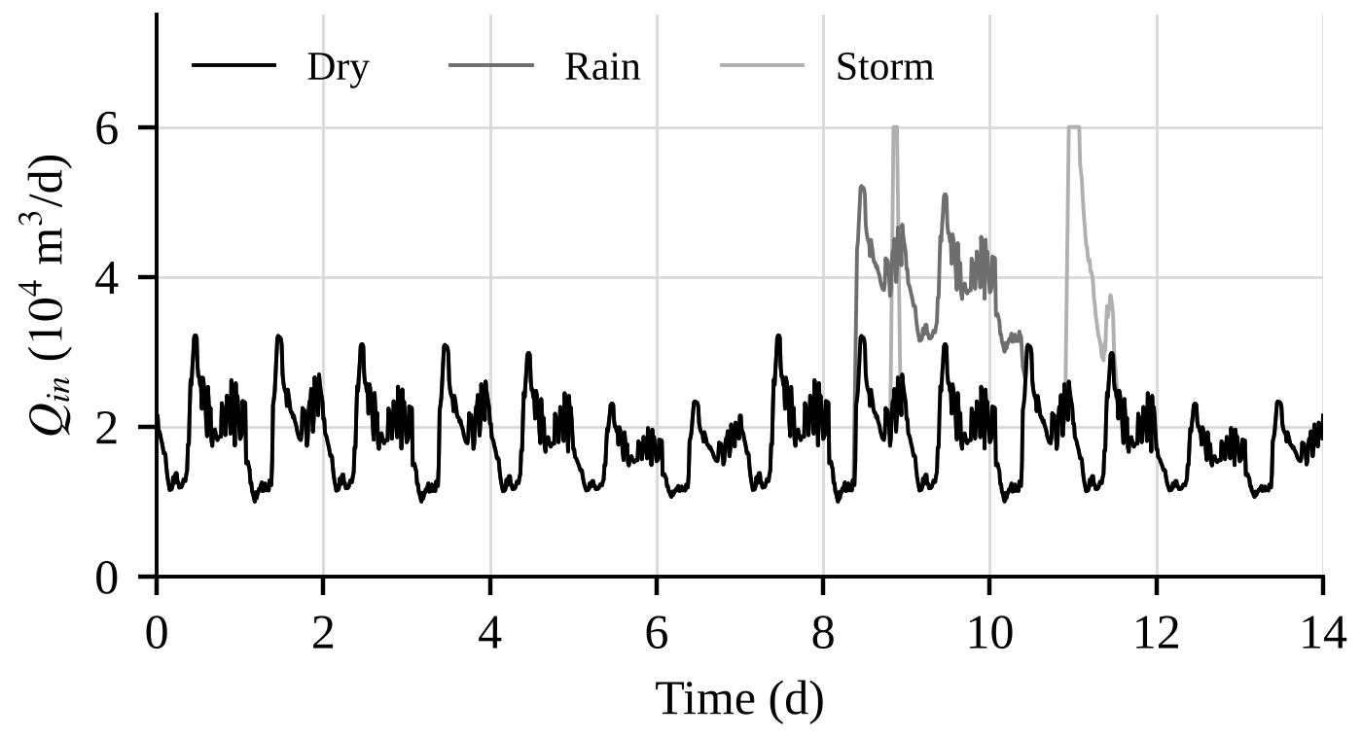
Data and evaluation protocol
BSM1 influent files Inf_dry_2006, Inf_rain_2006, Inf_strm_2006 (14 days, 15 min), the same benchmark files as the base paper
Source: github.com/davidfernand/BSM1_in_Python, commit 5dadb20; dry file identical to the one in bsm2-python 0.0.16
Tuning and training: dry weather, days 0 to 7 only
Test period: days 7 to 14 of dry, rain and storm weather
Additional conditions: BSM2 influent windows, actuator saturation, BSM1 sensor models
Influent flow rate of the three weather files.

Slide 6
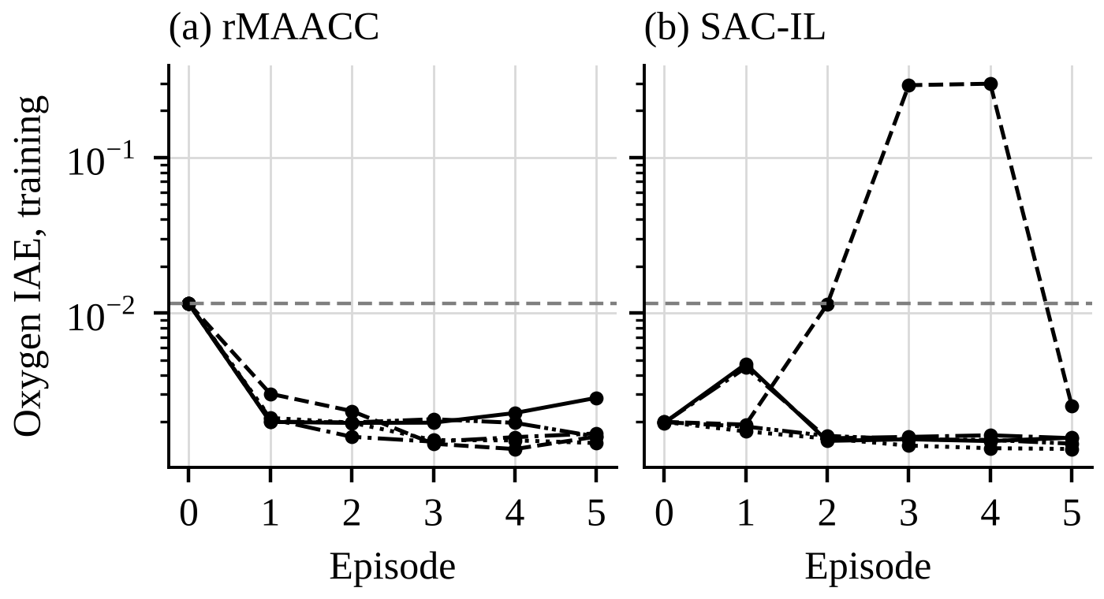
Training of the learned corrections
Five independent training runs per method, five episodes of seven days
rMAACC: oxygen IAE 0.0115 to 0.0013–0.0023 (retained policies)
SAC-IL: stays near its imitation start (about 0.0020); one run diverged in episodes 3 and 4
A complete retraining from scratch reproduced all ten training curves to five decimal places
Oxygen IAE on the training period after each episode. Dashed line: PID prior.

Slide 7
Test period: change in oxygen IAE relative to the PID prior
Controller | Dry | Rain | Storm | Actuator noise | KLa,5 movement
PID prior (IAE) | 0.0113 | 0.0100 | 0.0120 | 0.0249 | 501
MAACC [base paper] | 0 % | 0 % | 0 % | 0 % | 501
rMAACC | −85 % | −52 % | −67 % | −13 % | 1835
PID×3 + ILC + SAC-IL | −87 % | −82 % | −74 % | −26 % | 982
Tuned PID | −85 % | −85 % | −77 % | −22 % | 852
Tuned PID + ILC (proposed) | −90 % | −89 % | −80 % | −23 % | 852
Tuned PID + ILC + SAC-IL | −90 % | −88 % | −80 % | −22 % | 874
Noise-robust variant (proposed) | −83 % | −80 % | −73 % | +10 % | 522
Days 7 to 14, excluded from tuning and training. Learned corrections: mean of five training runs. Aeration energy (3690 kWh/d) and effluent ammonium are equal for all controllers.

Slide 8
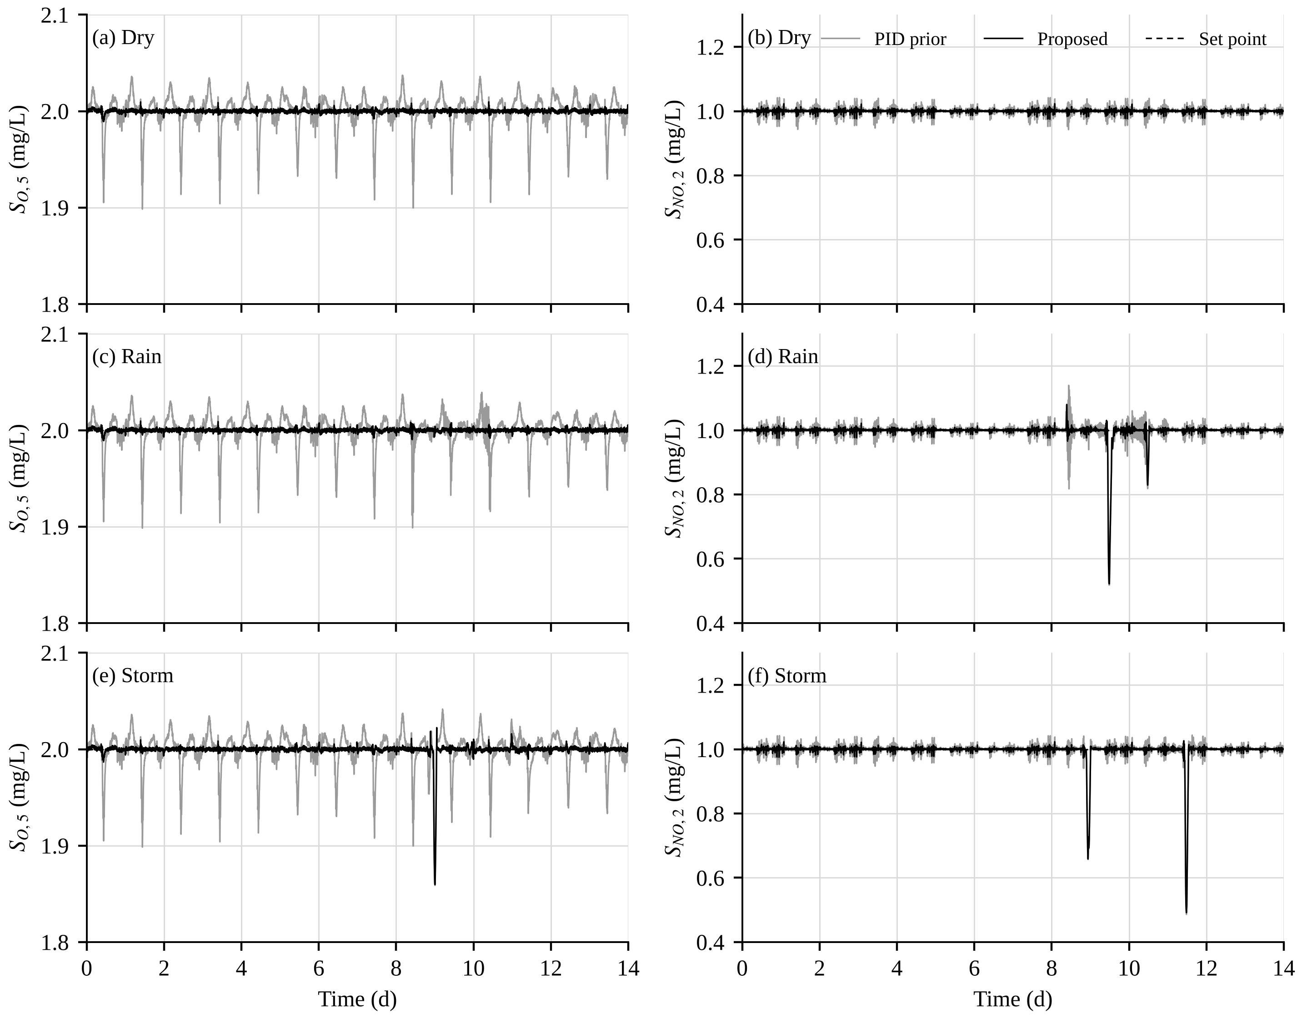
Trajectories of S_O,5 and S_NO,2 over 14 days
Format of Figs. 4 to 6 of the base paper
Grey: PID prior (MAACC coincides with it). Black: proposed
PID prior: oxygen falls by up to 0.10 mg/L at each morning load increase
Proposed: within 0.011 mg/L of the set point in dry and rain weather
Storm on day 9 and nitrate dips in rain and storm: the same for both controllers (Qa at its upper bound)

Slide 9
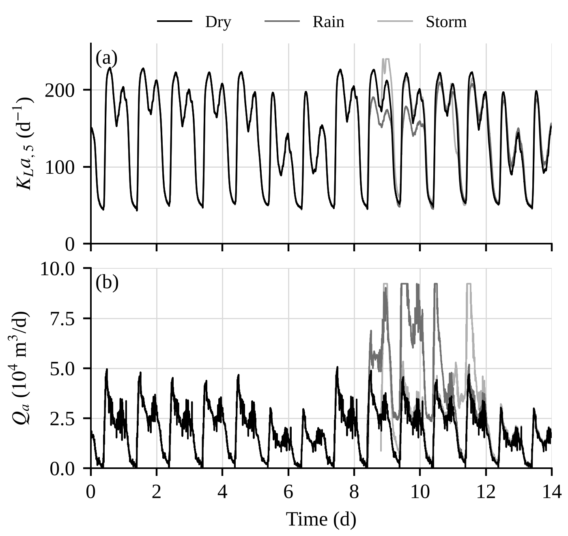
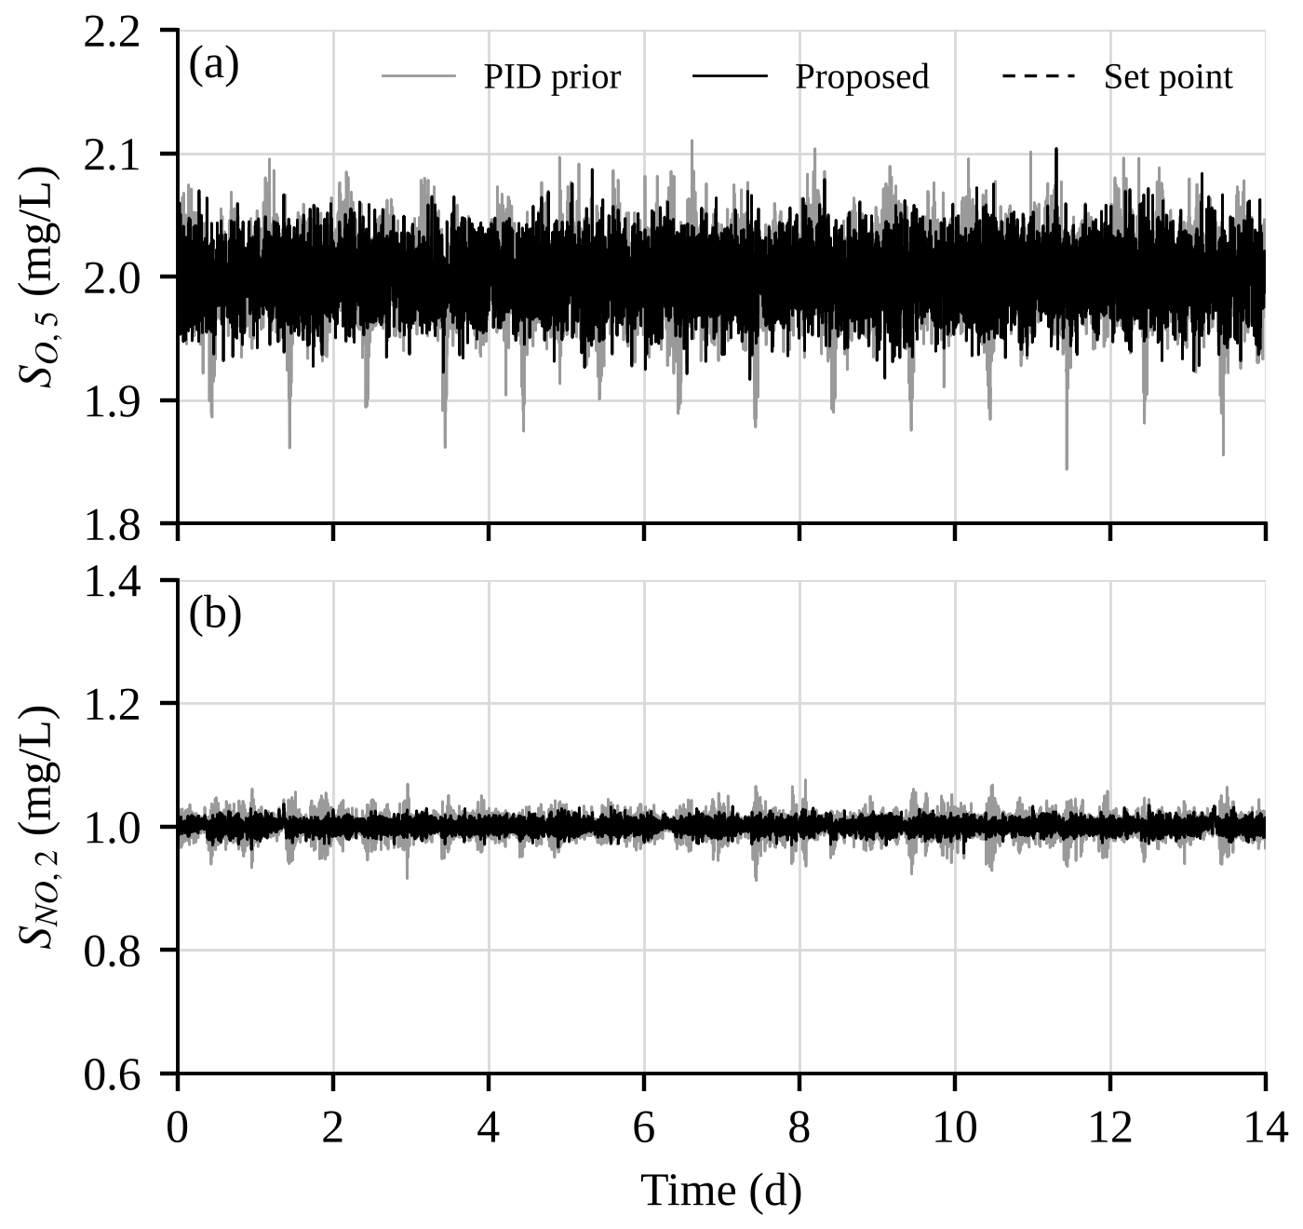
Control inputs and actuator noise
(a) KLa,5 and Qa of the proposed controller, three weathers
(b) Dry weather with actuator noise (3 % of each upper bound); proposed: −23 % oxygen IAE

Slide 10
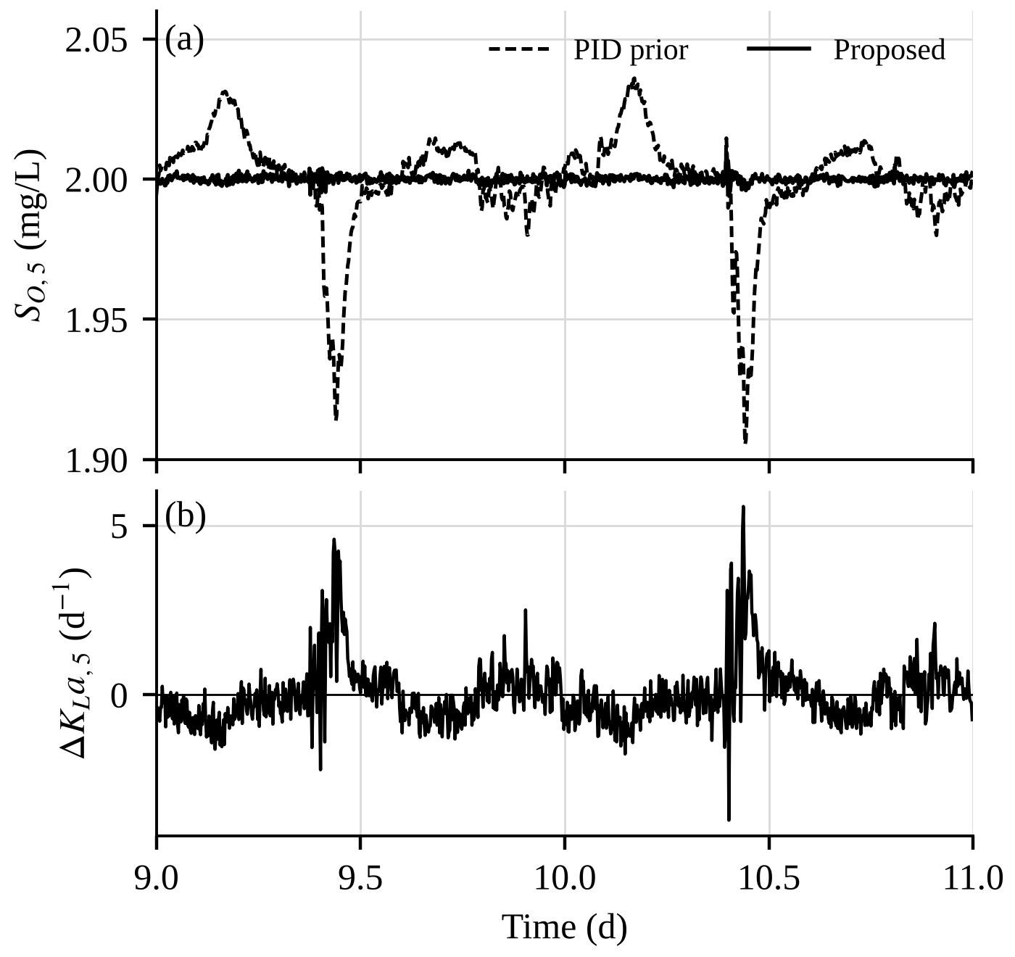
Mechanism: a small correction at the load increase
Two days of the dry test period
(a) PID prior (dashed) against proposed (solid)
(b) The aeration differs by at most 6 d⁻¹, applied at the morning load increase
Mean oxygen error over the two days: 0.0112 (PID prior) and 0.0010 mg/L (proposed)

Slide 11
Additional conditions: change in oxygen IAE relative to the PID prior
Controller | H4 new influent | H5 saturation | H6 sensors | H7 influent + sensors
PID prior (IAE) | 0.0105 | 0.0815 | 0.261 | 0.178
rMAACC | −73 % | −8 % | +1 % (5/45) | +6 % (1/30)
Tuned PID + ILC | −89 % | +48 % | +46 % | +50 %
Tuned PID + ILC with anti-windup | −89 % | −10 % | – | +84 % (5/6)
Noise-robust variant | −83 % | −10 % | +3 % | +24 %
H4: BSM2 influent windows after a simplified primary clarifier; H5: without it (actuator saturation)
H6: BSM1 sensor models (noise 0.25 mg/L) on the BSM1 files; H7: H4 with the sensor models
In brackets: runs terminated (oxygen outside 0.3 to 4 mg/L); –: no completed run
Under measurement noise, none of the evaluated controllers improved on the PID prior

Slide 12
Conclusions and limitations
Tuned PID with a daily ILC: oxygen IAE reduced by 90, 89 and 80 % relative to the PID prior of MAACC, without a neural network and with the same aeration energy
MAACC with the published parameters remains equal to its PID prior; with replay and twin critics it reaches 85, 52 and 67 %
SAC-IL adds no further improvement to the proposed controller
Anti-windup reduces the error under actuator saturation by 39 %
Limitation: under the BSM1 sensor noise, no evaluated controller improves on the PID prior
Limitation: one benchmark, five training runs, six windows or nine noise runs per condition; no significance tests

