Slide 1
Paper 1 reproduced, and what actually controls a wastewater plant better
MAACC (Wang et al., IEEE T-II 2026) on the official BSM1 benchmark · Amritha
Notes:
Paper 1 claims a learning controller that cuts the oxygen tracking error by 92 to 95 per cent. We rebuilt it exactly on the official benchmark, built our own controller, and tested everything on data nothing was tuned on.

Slide 2
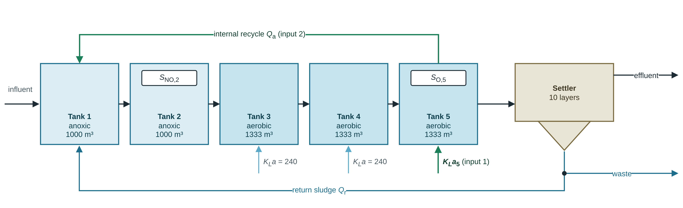
The plant and the control task
Loop 1: oxygen
Loop 2: nitrate
Score
aeration KLa,5 keeps S_O,5 in tank 5 at 2 mg/L
internal recycle Q_a keeps S_NO,2 in tank 2 at 1 mg/L
IAE: mean absolute tracking error (paper 1, eq. 36); 45 s step, 14 days
Notes:
BSM1 is the IWA benchmark plant. Paper 1 controls two inputs, drawn in green. All our runs use the official plant code and the official influent files.

Slide 3
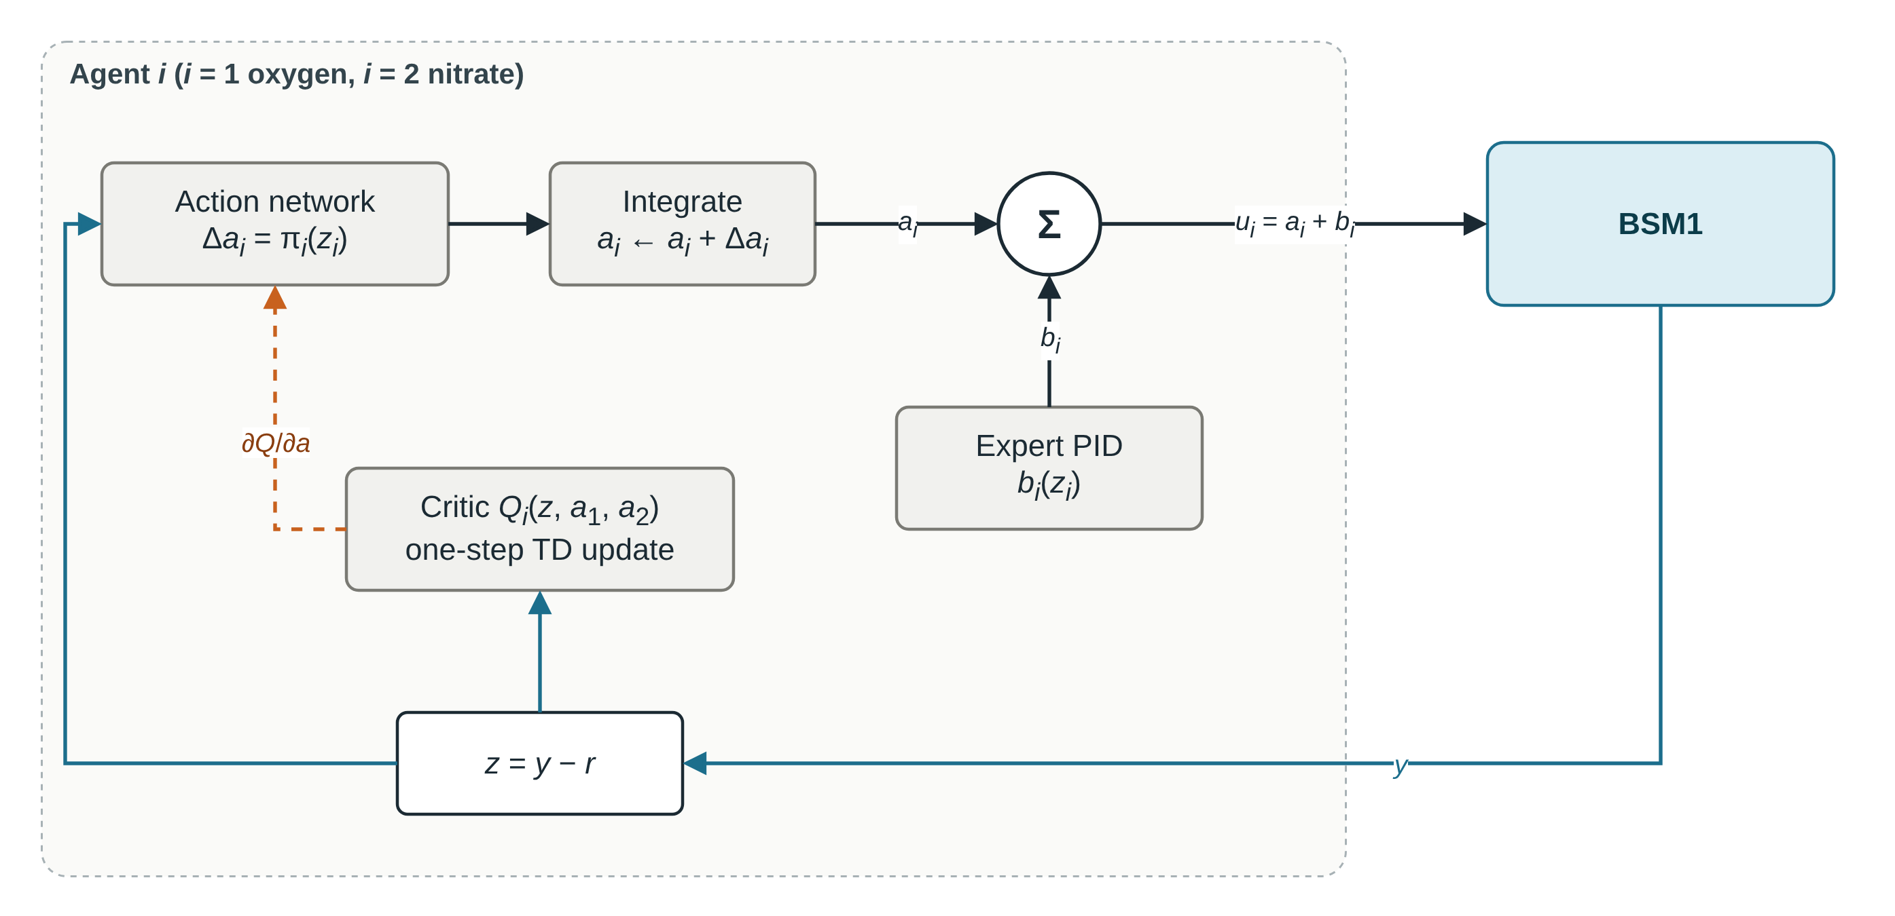
Paper 1's architecture: two adaptive-critic agents on top of a PID
One agent drawn; the oxygen and nitrate agents have the same form and are coupled through their critics, which see both loops. Dashed: the one-step learning update, each sample used once.
Notes:
Each loop has an agent with an action network and a critic. The output is the PID's input plus a learned part, u = a + b. The critic learns from one-step temporal-difference errors, each step used once.

Slide 4
Rebuilt exactly as printed, MAACC never leaves its PID
0 %
80 / 80
10⁻⁴
change in oxygen error against its PID (paper claims −92 to −95 %)
runs in which MAACC equals its PID (20 runs × 4 cases)
size of its learning signal with the printed weights
Oxygen error, 14 days (IAE) | Paper's PID (Table II) | Our PID | MAACC, paper's claim | MAACC, our run
Dry | 0.0114 | 0.0114 | 0.00053 | 0.0114
Rain | 0.0098 | 0.0108 | 0.00051 | 0.0108
Storm | 0.0117 | 0.0118 | 0.00095 | 0.0118
Our plant matches the paper's (PID columns). The PID gains, 45 s step, 14 days, input limits and noise are exactly as printed. Differences we know of: the set points are printed as [1, 2] but the figures match [2, 1]; our nitrate PID error is about half the paper's.
Notes:
So the improvement the paper reports does not come from the method as printed. The plant matches, the settings match, the learner simply does not move.

Slide 5
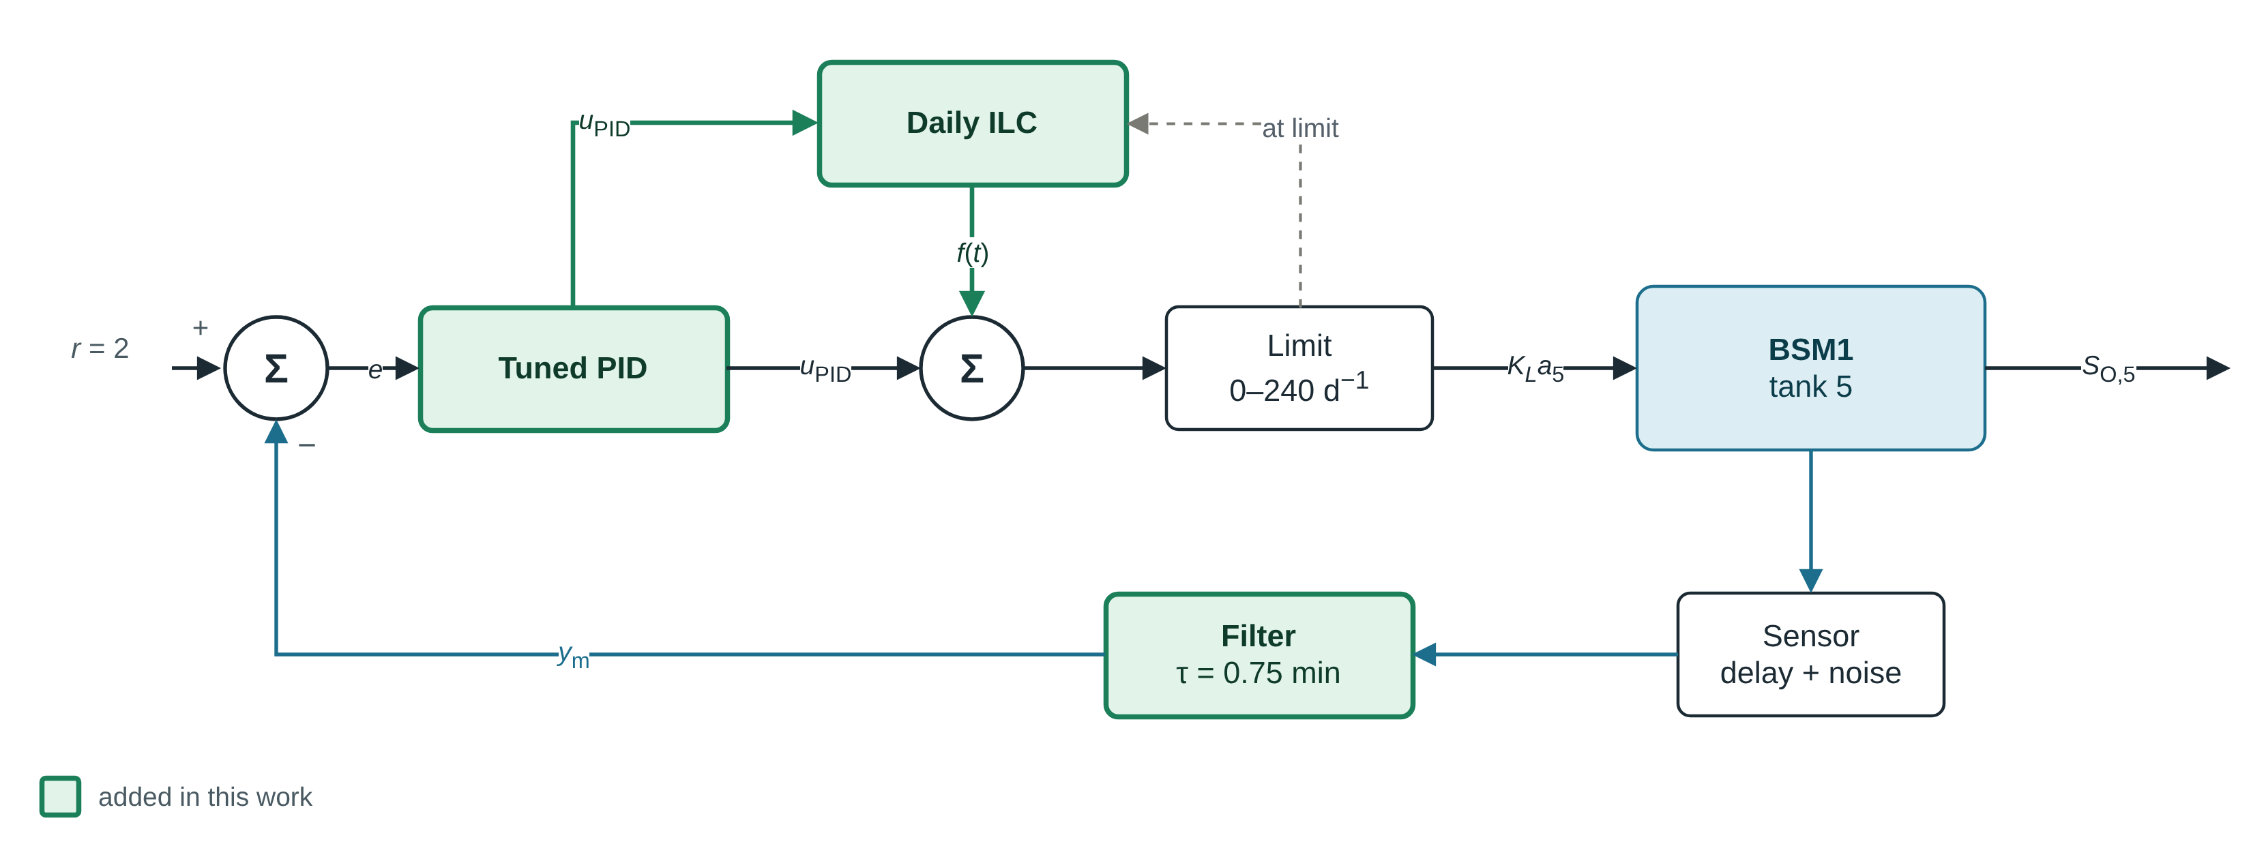
Our controller: what is new
Green: added in this work (robust variant shown). Dashed: anti-windup, at a limit the ILC does not learn. A learned correction (SAC-IL or repaired MAACC) can be added at the second Σ; on this controller it adds nothing, so it is not drawn. Nitrate loop: a PID only.
Notes:
Green is new. The tuned PID and the daily iterative learning control do the work. The learned correction, SAC with imitation learning or the repaired MAACC, was built and tested; on top of the tuned PID with ILC it adds nothing.

Slide 6
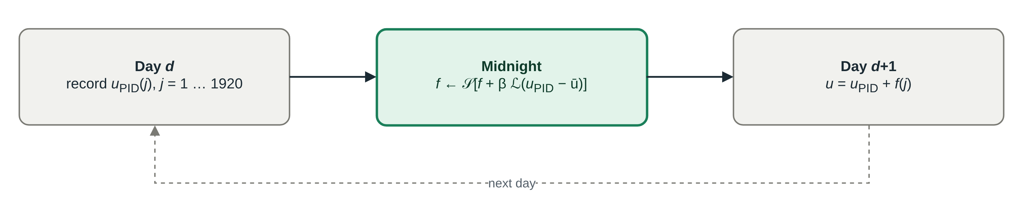
The daily ILC: learning the load pattern, one update per night
The load repeats every day, and about 96 % of the PID's remaining oxygen error repeats with it. Each night the ILC moves the PID's daily correction into a feedforward f, shifted a few minutes earlier and smoothed.
Bumpless update
Anti-windup
At midnight the PID's state is reduced by the same change, so the aeration does not jump. Largest deviation near midnight: 0.053 → 0.011 mg/L.
At an actuator limit the ILC does not learn, and the PID's limits move with f. Under overload: −39 % error (ideal sensors).
Notes:
This is iterative learning control. Each night it takes over part of the correction the PID had to make, and applies it a few minutes earlier the next day. Bumpless transfer removed a jump at midnight; anti-windup stopped it from hurting when the aeration is at its limit.

Slide 7
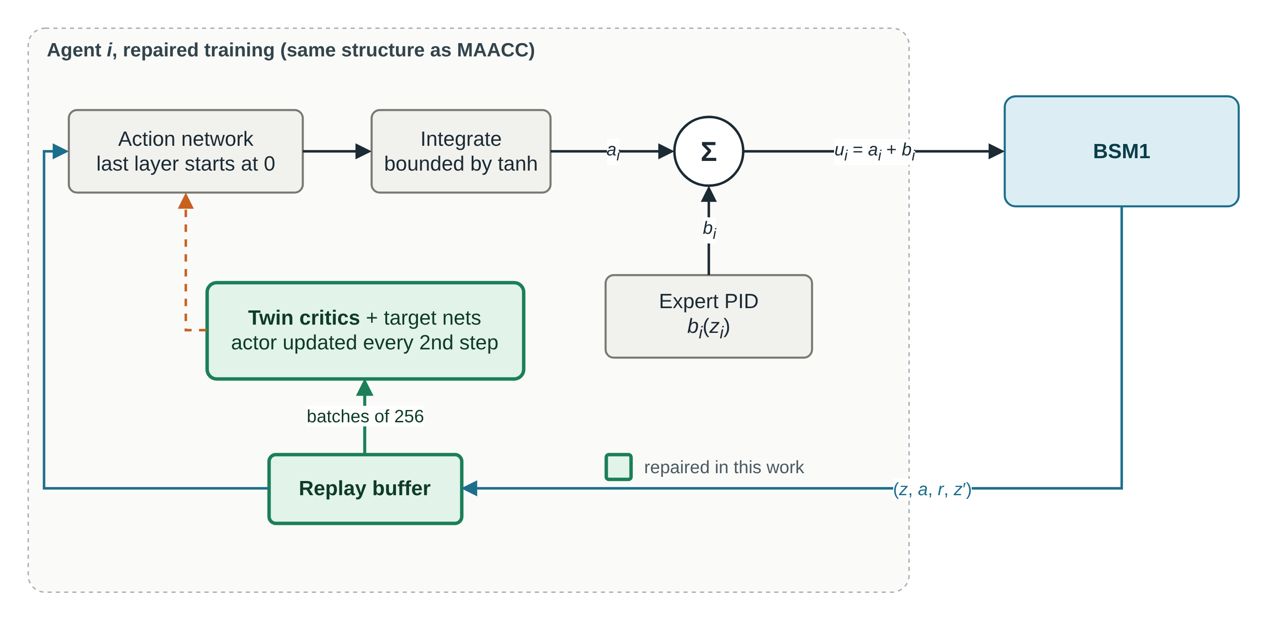
A fair baseline: the paper's learner with its training repaired
Result: it learns. Oxygen error −85 % in dry weather (−52 % rain, −67 % storm), but it moves the aeration 3.7 × as much as the PID.
Notes:
To compare fairly we kept the paper's structure and fixed only the training, with standard fixes. It does learn, so the paper's idea can work; its printed training is what fails.

Slide 8
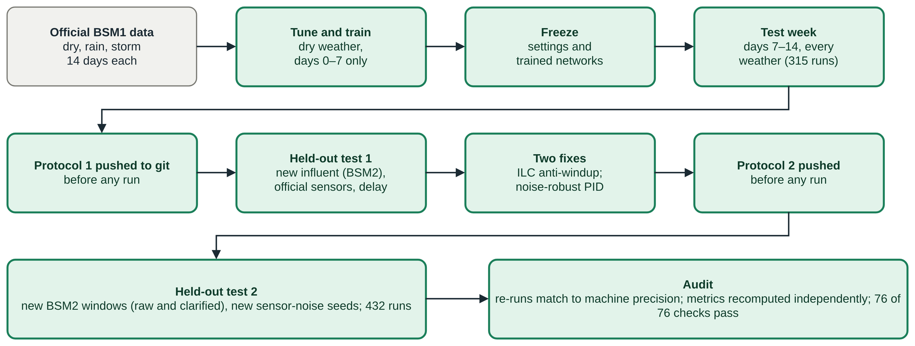
How we tested: nothing was tuned on the test data
Both held-out protocols were pushed to git before their runs, so the order can be checked. The audit re-ran stored runs and recomputed every quoted number.
Notes:
Tuning and training used one dry week. The second week was the test. Then two held-out tests on new data and real sensor models, each fixed in writing before running.

Slide 9
Official test week: tuned PID + ILC is as good as any learner
What this shows
A PID tuned term by term plus the daily ILC: −90 / −89 / −80 %.
SAC-IL on top of it adds 0 %.
The repaired MAACC beats SAC-IL in the same stack.
MAACC as printed: 0 %.
Dry
Rain
Storm
Notes:
Week 2 of the official files, never used for tuning or training. Learned controllers are the mean of five training runs.

Slide 10
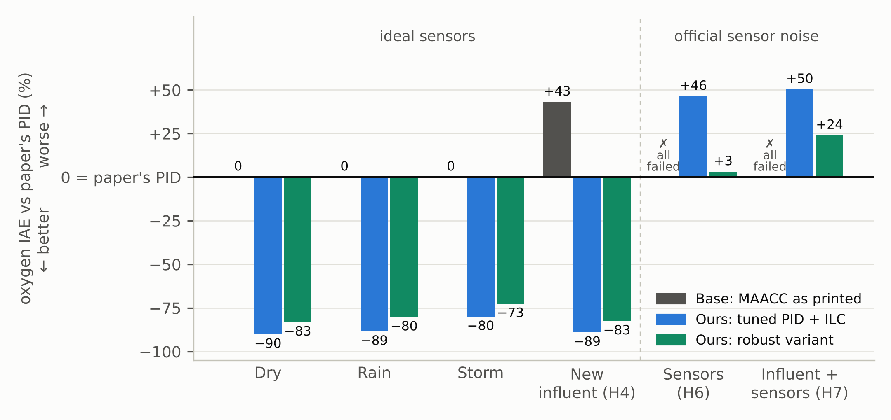
Base vs ours: big gain with ideal sensors, none with sensor noise
Change in oxygen error against the paper's PID, paired over the runs both controllers finished. ✗: every run failed. MAACC as printed lost 1 of 6 windows on new influent (H4).
Notes:
Left: the paper's own kind of test, with ideal sensors, plus new influent. The tuned PID with the daily ILC is 80 to 90 per cent better. Right: with the official sensor noise, it is worse than the paper's PID; the robust variant is close to it but not better.

Slide 11
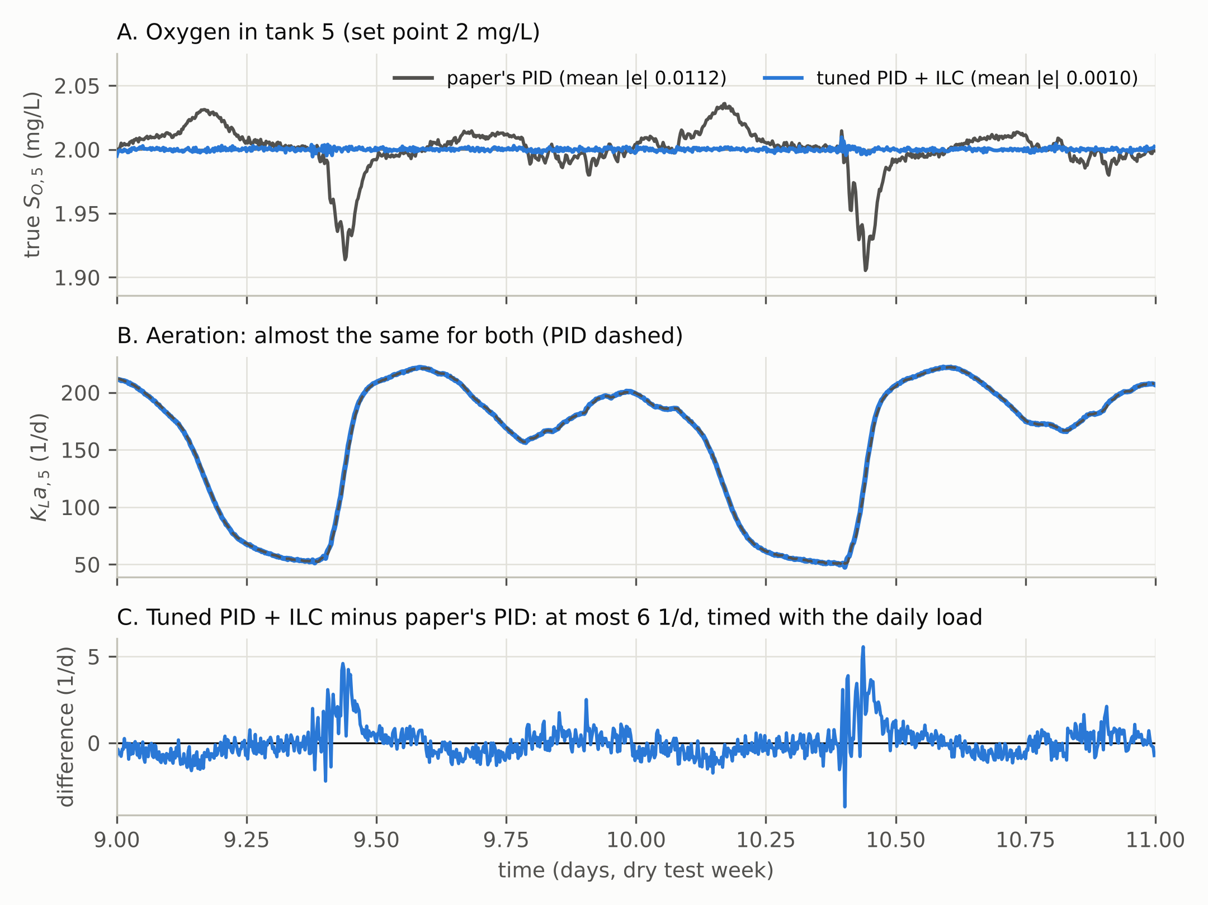
Inside the plant: a small correction at the right time
Two days of the dry test week
The paper's PID dips at every morning load rise.
Tuned PID + ILC stays at 2 mg/L: mean error 0.0010 against 0.0112 mg/L.
The aeration is almost the same; the ILC changes it by at most 6 1/d, at the load rise.
Notes:
These are real traces from the simulation, not a sketch. The gain in tracking comes from timing, not from more aeration: energy is the same for both.

Slide 12
Held-out test 2: new influent and real sensors
Oxygen error vs paper's PID | H4 New influent | H5 Overload | H6 Official sensors | H7 New influent + sensors
Paper's PID | reference | reference | reference | reference
MAACC as printed | +43 % (✗ 1/6) | −59 % (✗ 4/6) | ✗ all failed | ✗ all failed
Repaired MAACC | −73 % | −8 % | +1 % (✗ 5/45) | +6 % (✗ 1/30)
Ours: PID ×3 + ILC + SAC-IL | −77 % | +33 % | ✗ all failed | +144 % (✗ 25/30)
Tuned PID + ILC | −89 % | +48 % | +46 % | +50 %
Tuned PID + ILC, anti-windup | −89 % | −10 % | ✗ all failed | +84 % (✗ 5/6)
Robust (filter, ×0.5, ILC-AW) | −83 % | −10 % | +3 % | +24 %
Green: better than the paper's PID; red: worse; dark: every run failed (oxygen left 0.3–4 mg/L). Each % compares only runs both controllers finished. Protocol pushed before the 432 runs.
Notes:
New BSM2 influent windows, raw and after a simple primary clarifier, and the official sensor models with new noise seeds. Our SAC-IL controller fails every run with the official sensor noise. The robust tuned PID never fails, but with sensor noise it is no better than the paper's PID.

Slide 13
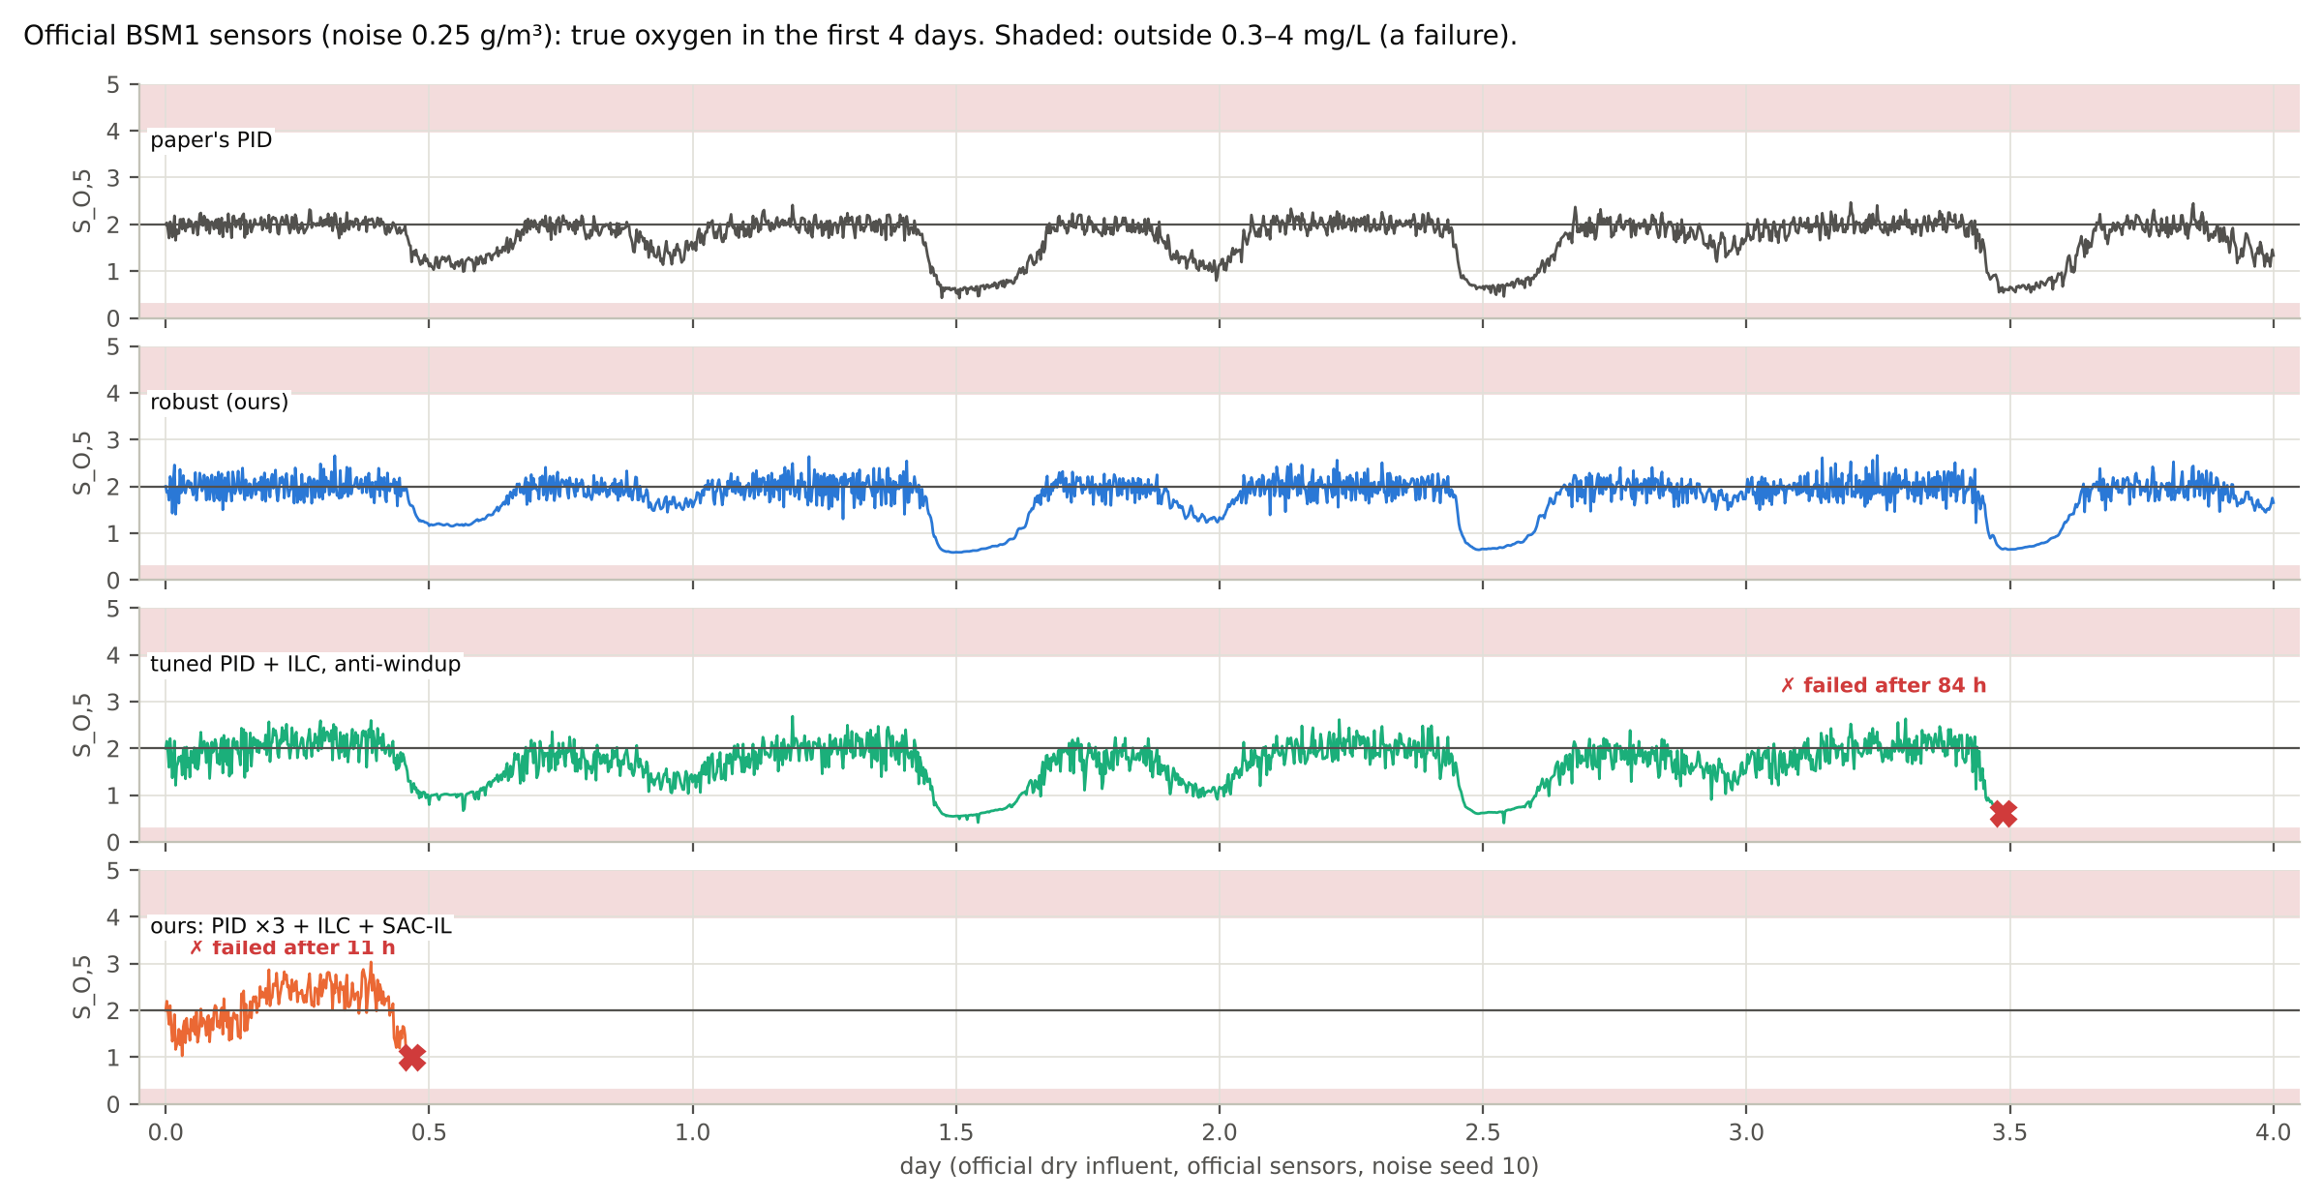
Two fixes, tested on new data: one works, one half-works
−39 %
ILC anti-windup under overload, better in 5 of 6 new windows
0 %
change on normal influent; but with high gains it fails under sensor noise
+3 / +24 %
robust PID vs paper's PID with real sensor noise
True oxygen with the official sensors (noise 0.25 g/m³): the paper's PID and the robust controller stay in range; our SAC-IL controller fails after 11 h.
Notes:
Anti-windup fixed the ILC under overload and changed nothing on normal influent; but with the high tuned gains it failed under the official sensor noise, where the version without it finished. The robust version never failed, kept −83 % on new normal influent, and moves the aeration no more than the paper's PID, but under real sensor noise nothing we built beats the paper's PID. That is the open problem.

Slide 14
Paper 1 against our work
 | Paper 1 | Our work
Controller | two adaptive-critic agents on a PID | tuned PID + daily ILC (bumpless, anti-windup); learned options tested
Learning | online, one step at a time; does not learn as printed | ILC learns daily; repaired MAACC and SAC-IL trained on one dry week
Testing | learns and is scored on the same 14-day run | train week → test week → two pre-registered held-out tests
Robustness | noise added to the two inputs only | new influent, overload, official sensor delay and noise
Verification | — | audit: stored runs re-run exactly, 76 of 76 checks pass
Oxygen result | claims −92 to −95 % | −80 to −90 % on the test week (tuned PID + ILC); not robust to real sensor noise
Notes:
The contribution is a reproducibility and robustness study plus a simple controller that works on nominal data, with every test fixed before it was run.

Slide 15
What we can claim, and what we cannot
We can claim
We cannot claim
MAACC as printed does not learn; it fails every held-out condition
With repaired training it learns (−85 % dry), but is not robust to sensor noise
Tuned PID + daily ILC: −80 to −90 % on the official test week
Anti-windup makes the ILC safe under overload (−39 %, ideal sensors)
Every number re-run and audited
The paper's −92 to −95 %
That SAC-IL beats good tuning
Any gain over the paper's PID under real sensor noise
A real-plant result (simulation, one benchmark)
Statistical significance (5 runs, 6 windows)
Notes:
Be clear about both columns. Every percentage is against our rebuilt PID, which matches the paper's PID on oxygen.

Slide 16
Next: make the controller robust to real sensor noise
1. Model-based filtering (Kalman filter or observer) instead of a simple filter
2. Train the repaired MAACC with the official sensor models in the loop
3. Report nominal and robust results side by side, as standard
Notes:
Under the official sensor noise, nothing we built beats the paper's PID. That is the open problem and the next step.

