Slide 1
EXPERIMENT

Slide 2
Aim
To create a GitHub repository ,add a collaborator,perform collborative file editing and understand commit history and pull request workflow.
Software/Tools Required
GitHub account
web browser (Chrome / Edge / firefox)
Internet connection
Theroy
GitHub is a distributed version control platform that allow multiple users to collaborate on the same project.A respository stores project files and Their revision history.Collaboration can be done by adding collaborators who can directly commit changes or by using forks and pull requests to review and merge changes safely.
Key concepts:
Repository: A storage location for project files
Collaborator: A user who granted access to a repository
Commit: Saving changes to the repository
Branch: A separate line of development
Pull Request: A request to merge changes from one branch or fork into another

Slide 3
Procedure
Step1: create a github repository
1.login in to gitup
2.click new repository
3.enter repository name
4.select public repository
5.click create repository
Step2: create a file
1.open the repository
2.click add file-> create new file
3.name the file data.txt.
4.add sample content
5.click commit change
Step3: add a collaborators
1.go to setting->collaborators
2.click add people
3.enter collaborator’s github username or email
4.click invite collaborator

Slide 4
step4:collaborator accept invitation
1.collaborators logs in to github
2.open notification or email
3.click accept invitation
Step5: collaborators edit the file
1.collaborators open the repository
2.opens data.txt
3.clicks edit
4.makes changes to the content
5.commit the changes
Step6: view commit history
1.open the repository
2.click commits
3.observe commit message and collaborators username

Slide 5
Step7:pull request using fork
1.collaborator click fork
2.edits file in forked repository
3.commit changes
4.click open pull request
5.repository owner reviews and merges the pull request
Result
the collaborators was successfully added to the github repository and was to edit and commit changes. The commit history reflect ollaborators work.pull request workflow was also understood
Conclusion
github enables effective collaboration by allowing multiple user to work on the same project. Through this experiment , repository creation, collaborators management, commit, and pull request were successfully performed.

Slide 6
VISUAL EXAMPLE

Slide 7
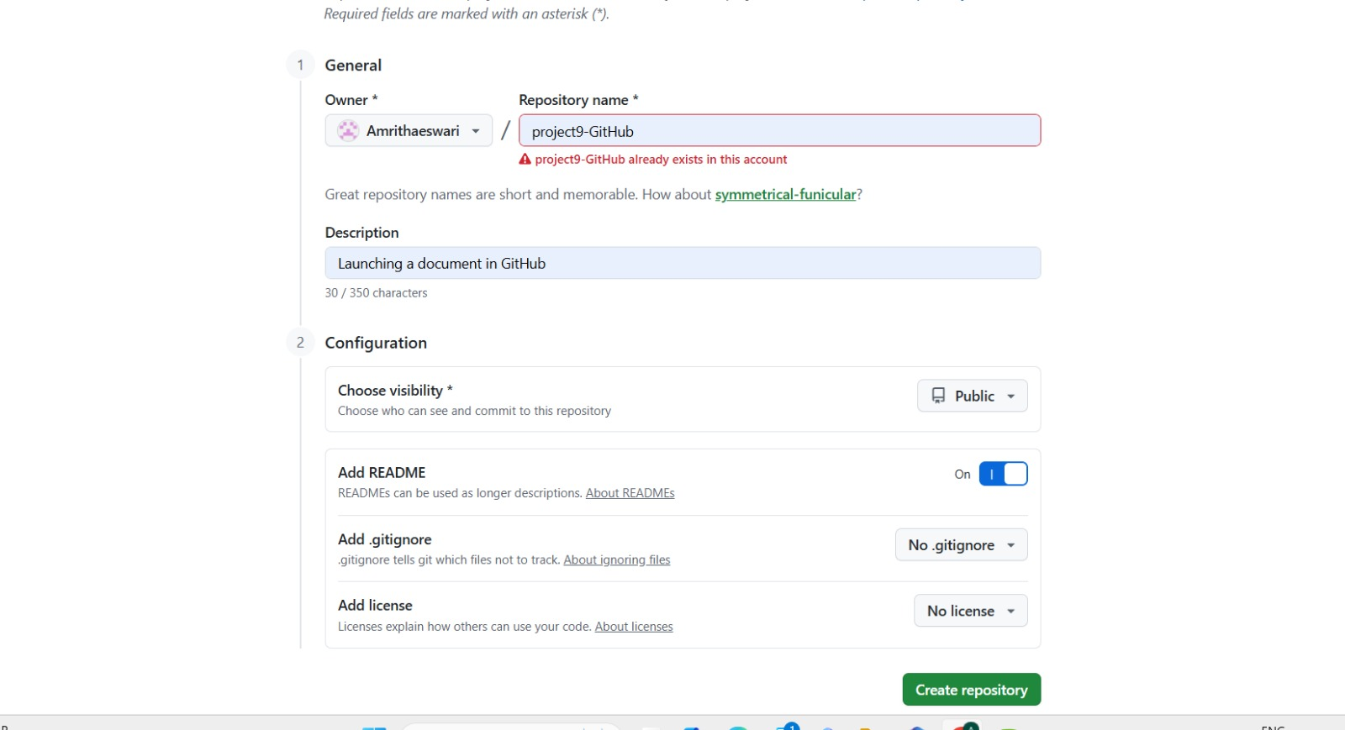

Slide 8
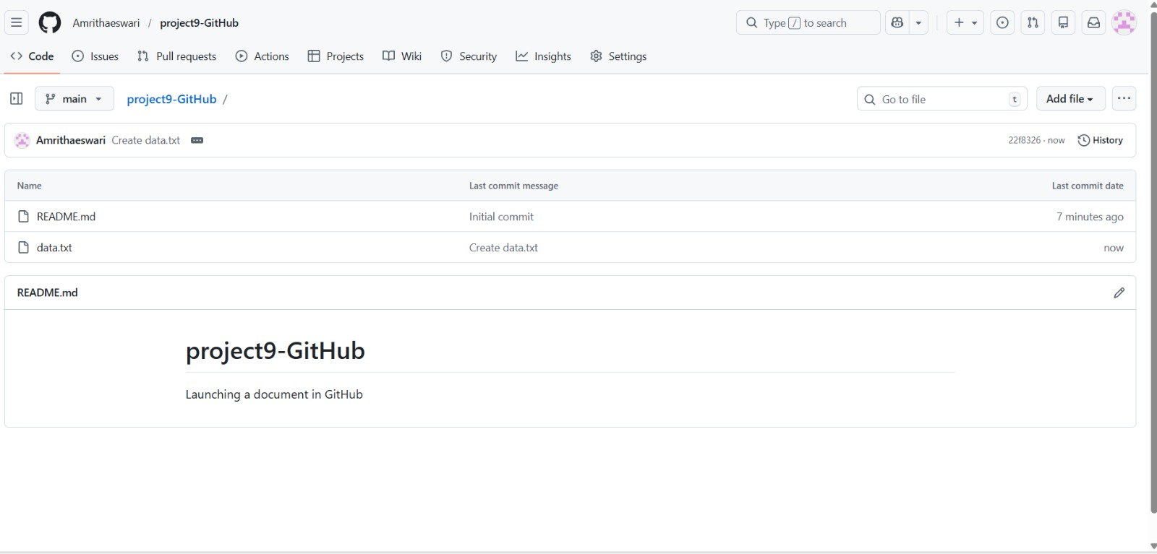

Slide 9
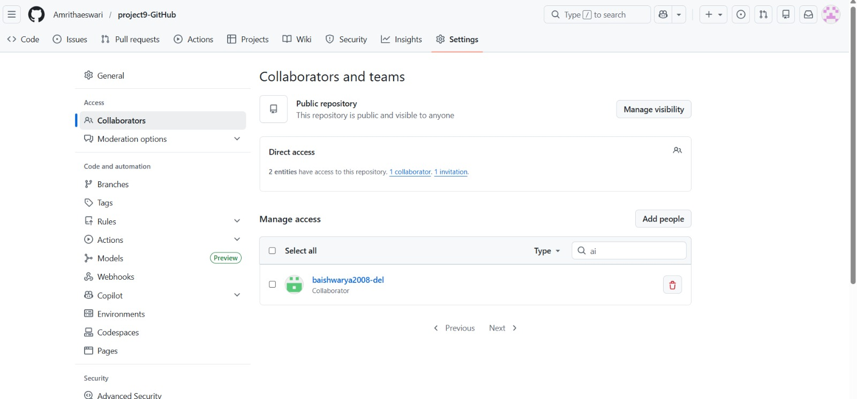


Slide 10
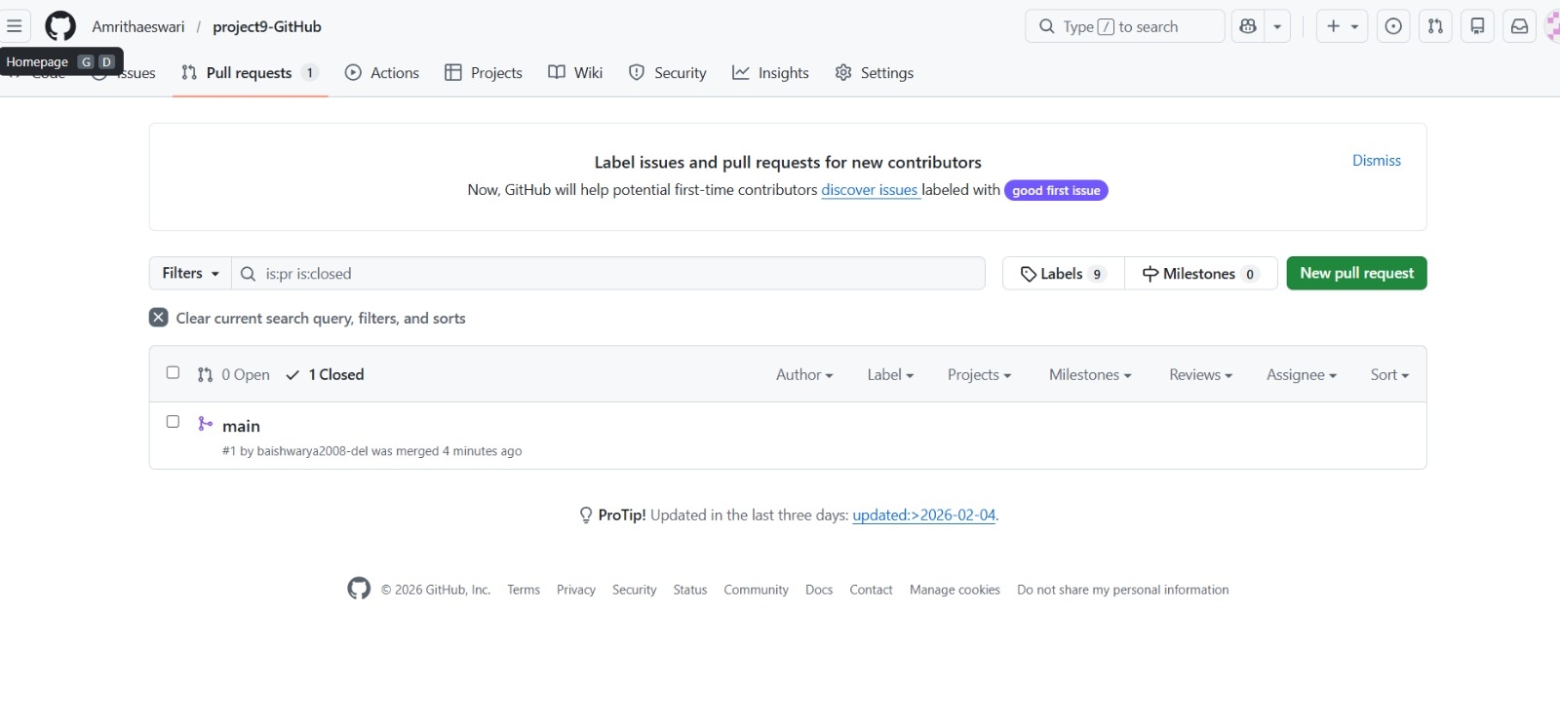

Slide 11
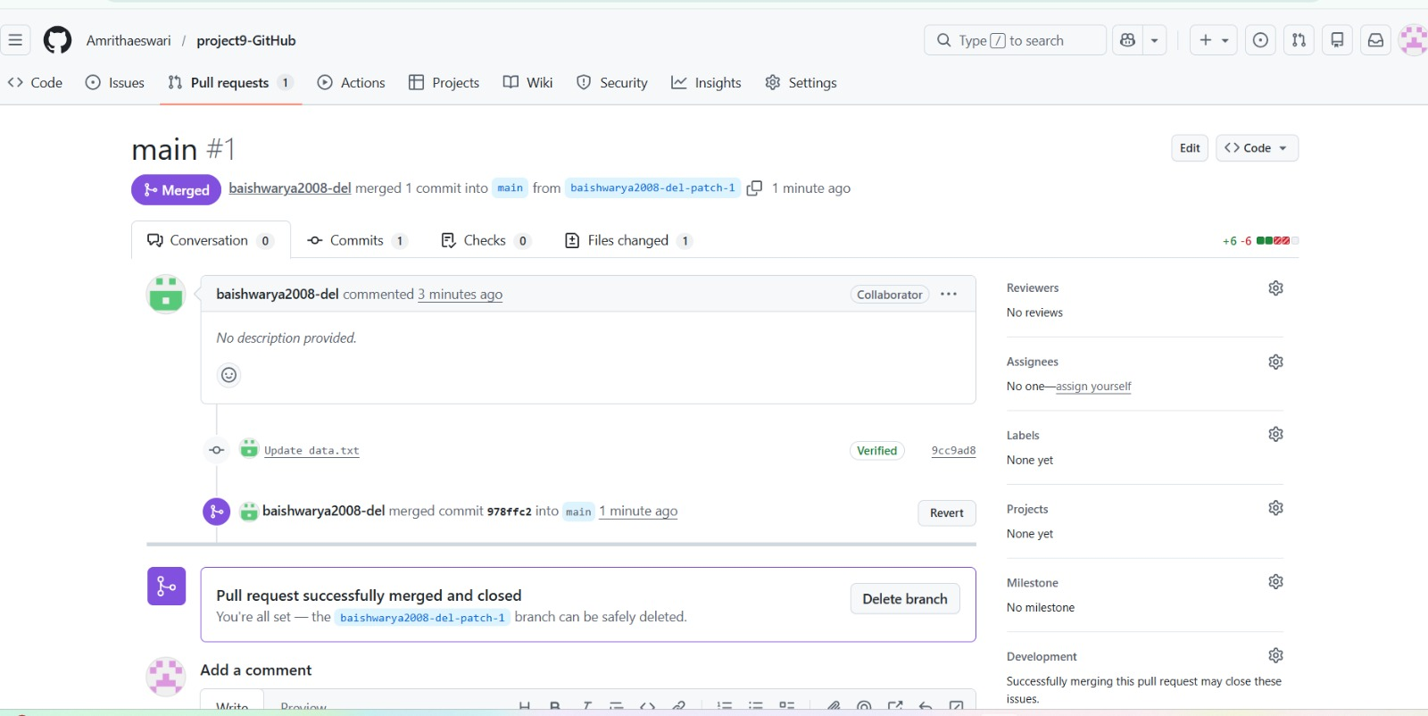

Slide 12
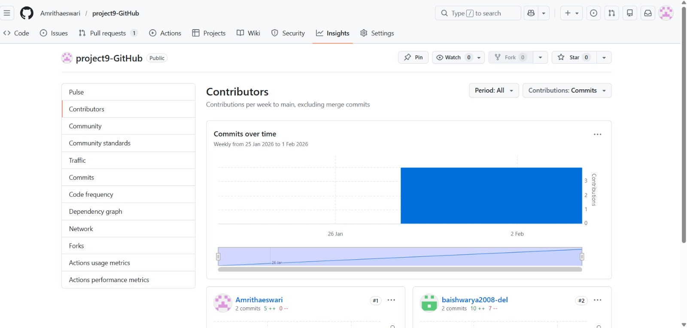

Slide 13
