Slide 1

Empowering Communication: An ASL Interpreter for Individuals with Disabilities Using Computer Vision and YOLOv8 nano
By:- Amritjyot Singh, Yash Khandelwal, Jayant Singh

Slide 2
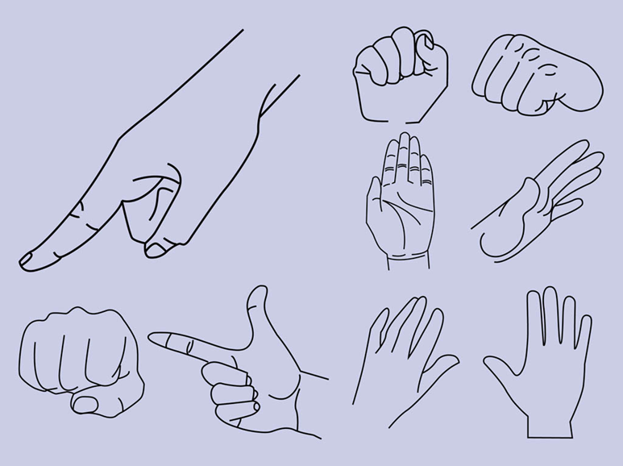
Overview
Problem Statement
People with hearing and speech disabilities worldwide struggle daily to share their thoughts and comprehend others because of the
communication barriers.
Research Goal
Approach
Develop a real-time sign language detection system using YOLOv8 Nano.
Combines efficient neural network modeling with high-quality data preprocessing.
Impact
Enhances accessibility and communication for the hearing impaired.

Slide 3






Introduction to ASL Interpretation System
Communication Barrier
Basic human requirement for all
ASL as Visual Language
Strong communication tool
Computer Vision Solution
Digital interpretation tools
People with hearing and speech disabilities worldwide struggle daily to share their thoughts and comprehend others because communication remains their basic human requirement. The widely recognized visual language American Sign Language (ASL) functions as a strong communication tool for people who need it. Physical interaction between individuals becomes limited because most people do not know or understand the visual language of American Sign Language.
Computer vision and deep learning advances introduced modern possibilities to develop intelligent interpreters which process sign language without delay. These systems operate as digital interpretation tools which transform hand movements into readable or audible outputs to connect people who need to communicate.

Slide 4



System Functionality and Objectives
Real-time Video Processing
Hand Tracking
Classifying Hand Gestures
Capturing live webcam feed
Detecting hand positions
Using YOLOv8 Nano model
The research introduces an American Sign Language (ASL) interpreter with three main functionalities which include real-time video processing and hand tracking and hand gesture classification by implementing YOLOv8 Nano as the lightweight high-speed deep learning model.
This system detects and identifies particular hand signals entering through a live webcam signal with precision. It achieves its objective to boost accessible communication for individuals with disabilities through effective data preparation methods and rapid model training pipeline and real-time processing framework.
This system aims to produce an extendable and fast ASL recognition system that serves as the basis for public space assistive devices including robot companions and mobile applications or stationary embedded systems.

Slide 5
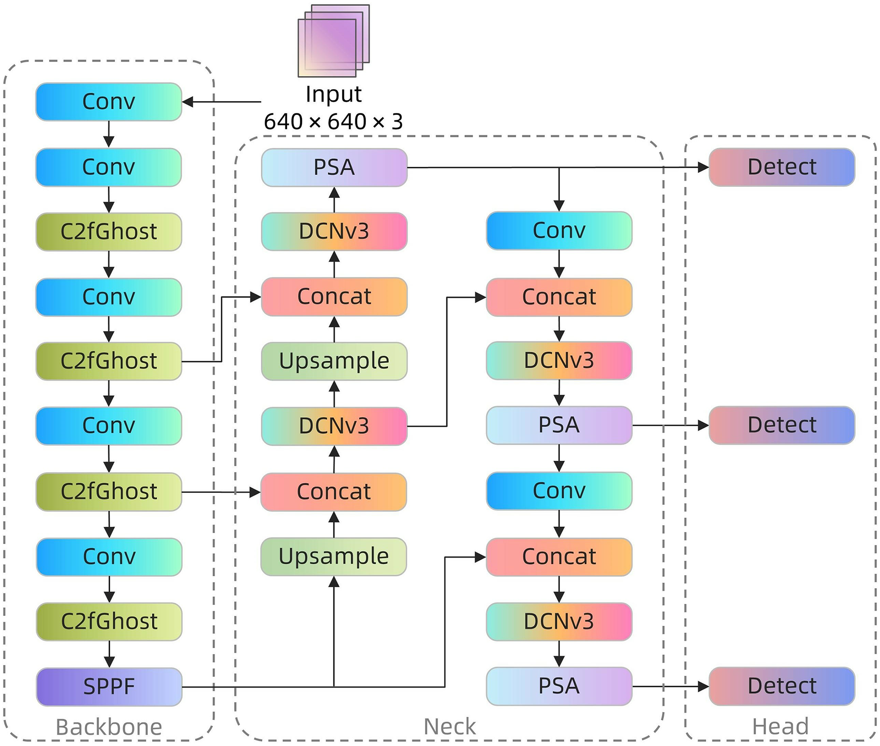




YOLOv8 Architectural Overview
Real-time Performance
Current object detection technology YOLO (You Only Look Once) provides real-time performance and high accuracy in its operation.
Advanced Training Techniques
YOLOv8 implements three advanced training techniques that consist of auto-learning anchors alongside multi-scale predictions and mosaic augmentation in order to enhance model generalization.
Edge-Optimized Variant
The specific edge-optimized YOLOv8 Nano (YOLOv8n) variant brings operational efficiency to low-resource computing systems.
Task Flexibility
Supports detection, segmentation, and classification in a unified framework.

Slide 6





Methodology
Data Collection and Preprocessing
Data Collection
Custom dataset created including images of hand gestures to representative American Sign Language (ASL) characters (A, F, L, and Y).
Image Quality Filtering
Sharpness evaluation performed to exclude blur issues, selecting top 2000 images per class based on brightness and sharpness.
Hand Region Cropping
Hand regions precisely extracted using HandTrackingModule (CVZone) with fixed padding to preserve context.
Label Generation
Labels converted to YOLO format using normalized center coordinates for better generalization.
Corrupted Data Removal
Validation step removed corrupted or incorrectly labeled files to maintain data integrity.

Slide 7






Dataset Splitting and Preparation
Validation Set
20% of total dataset
Used during training to evaluate generalization
Training Set
70% of total dataset
Used for model learning
Testing Set
10% of total dataset
Used for final evaluation on unseen data
The cleaned dataset was divided into three subsets (training = 70%, validation = 20%, testing = 10%) to evaluate the model well. This ensures that the model is trained on the majority of the data to prevent overfitting, but also validated during training get a first look at how well the model has been generalizing during training time, and finally be tested on unseen samples to perform the final evaluation. This was handled by sorting the dataset by shuffling, sorted unique imagelabel pairs, and equally distribute them to the three subsets. Each subset has its separate directory for images and labels.

Slide 8
Model Training and Deployment
Model Training
Training Parameters
Model Deployment
The model was initialized with preserving weights and fine tuned on custom ASL dataset. Data created during preprocessing was used and the training was performed. After each epoch, the model was evaluated on the validation data and the best weights were saved automatically.
Epochs: 300
The model was exported to the TorchScript format so it can be used for deployment in robotic systems or mobile applications.
Batch size: 8 (optimized for 6GB GPU)
Image size: 416×416
Optimizer: Adam
Initial learning rate: 0.01
Patience: 25 (for early stopping)
Device: CUDA (GPU acceleration)

Slide 9
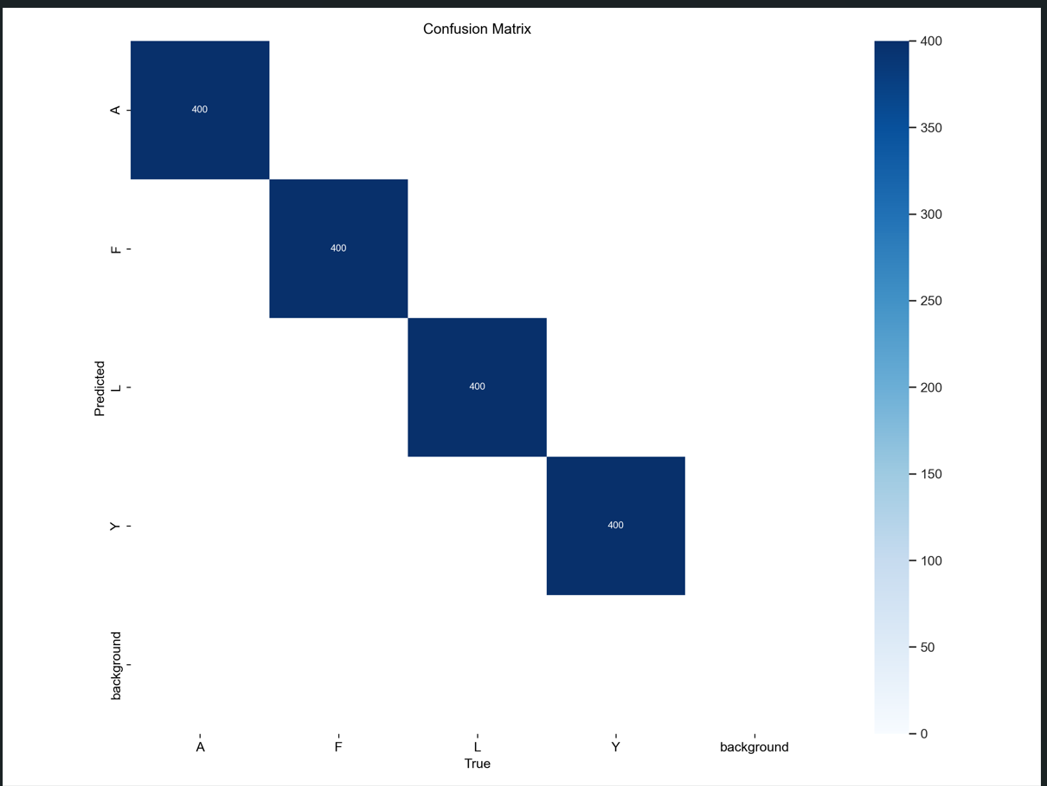
Experimental Results: Performance Metrics
97.5%
96.2%
96.8%
Precision
Recall
F1-Score
Accuracy of positive predictions
Proportion of actual positives identified
Harmonic mean of precision and recall
98.1%
20 fps
mAP@0.5
Inference Speed
Mean Average Precision at IoU threshold 0.5
Frames processed per second during predictions.
A confusion matrix was plotted to visualize the model's performance across the four ASL classes (A, F, L, Y). The confusion matrix clearly demonstrates that the model has correctly classified the majority of test samples, with minimal misclassification.
The matrix highlights strong diagonal dominance, indicating high class-wise accuracy and minimal confusion between gestures.
Confusion Matrix for ASL Gesture Detection using YOLOv8 Nano

Slide 10
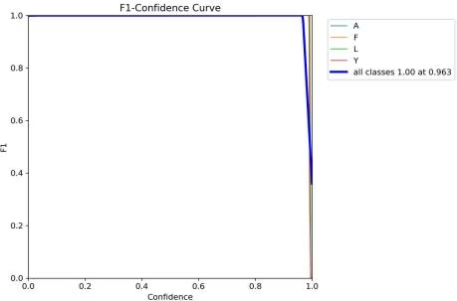
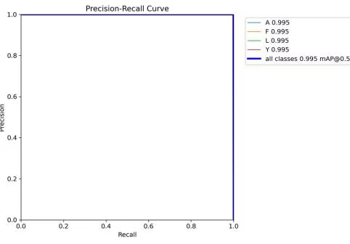
Performance Curves and Visual Analysis
An F1 score curve allowed the assessment of each ASL class's precision-recall balance. The Figure 2 depicts four high-level F1 scores throughout training epochs which verifies steady model performance for all four classes. The F1 scores in the model remain consistent between all classes because it effectively prevents wrong positive and negative classification of gestures.
Class-wise F1 Score Curve for ASL Gesture Detection Using YOLOv8 Nano
The Precision-Recall (PR) curve presented distinctive information about precision-recall trade-offs for different confidence thresholds per ASL class. The PR curve optimally depicts precision-recall relationship for all four classes A, F, L and Y. Each ASL class demonstrates good precision retention at every threshold setting thus showing strong model capabilities for high precision performance alongside accurate recall detection. The PR curve demonstrates both high reliability for true positive detection and minimal false detections which makes it suitable for live sign language interpretation.
Precision-Recall (PR) Curve for ASL Gesture Detection using YOLOv8 Nano

Slide 11
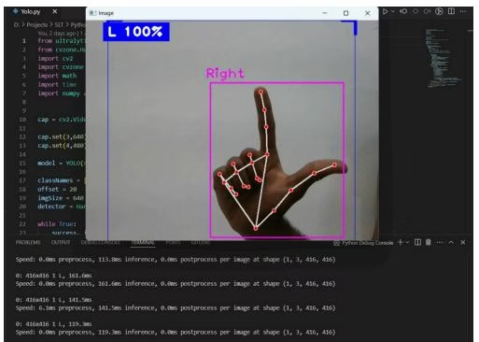
Conclusion
Real-time Testing
Confirmed with webcam tests under varying lighting conditions
Color coded bounding boxes with correspondence to the gesture and confidence score was presented on the video feed correctly
System Robustness
The system properly marked the hand area within the bounding box
The predictions displayed the label 'L' while showing confidence percentages between 92% and 98%
Detecting the hand gesture succeeded consistently while the observer turned their hand slightly between frames
Research Outcomes
A lightweight, realtime American Sign Language (ASL) interpreter built with computer vision techniques
Trained to recognize ASL signs (A, F, L, and Y) at very high accuracy and fast inference speed
Successfully addresses the communication barrier for hearing and speech disabled people

