Slide 1
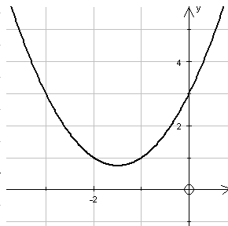

Equation Visualizer
By:
Amrit Kandel (THA078BEI004)
Prasish Timalsina (THA078BEI026)
Sandesh Panthi (THA078BEI035)
Mingmar G. L. Sherpa (THA078BEI021)

Slide 2
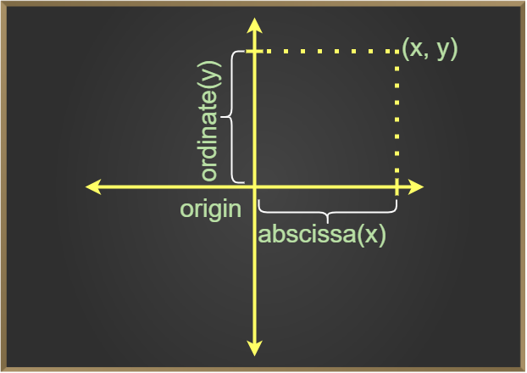






Introduction
Equation Visualizer is a program that shows the graph of second degree equation entered by the user.

Slide 3

Objectives
To make learning of conic section and second degree algebraic equation easier.
To help teachers to attract students towards mathematics.

Slide 4
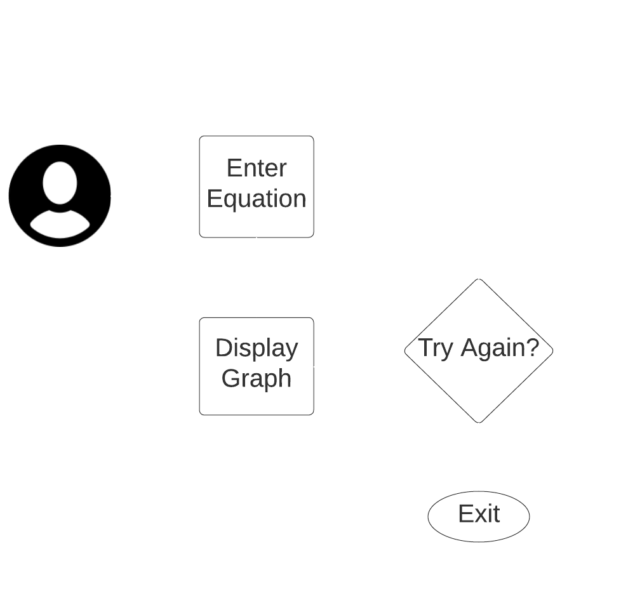
Methodology
Input: The Equation Visualizer takes input in the form of a general second-degree equation from the user, extracting and storing the coefficients for further analysis.
Analysis and Identification: The obtained coefficients are analysed using mathematical equations and formulas to identify the type of curve represented by the equation, determining its specific characteristics and properties.
Graph Plotting: The identified curve type is plotted on a graph using appropriate algorithms, starting with plotting the coordinate axes and setting up the graph boundaries. Advanced algorithms ensure accurate rendering of complex curves, considering their shape, behaviour, and any additional parameters or constraints.?

Slide 5
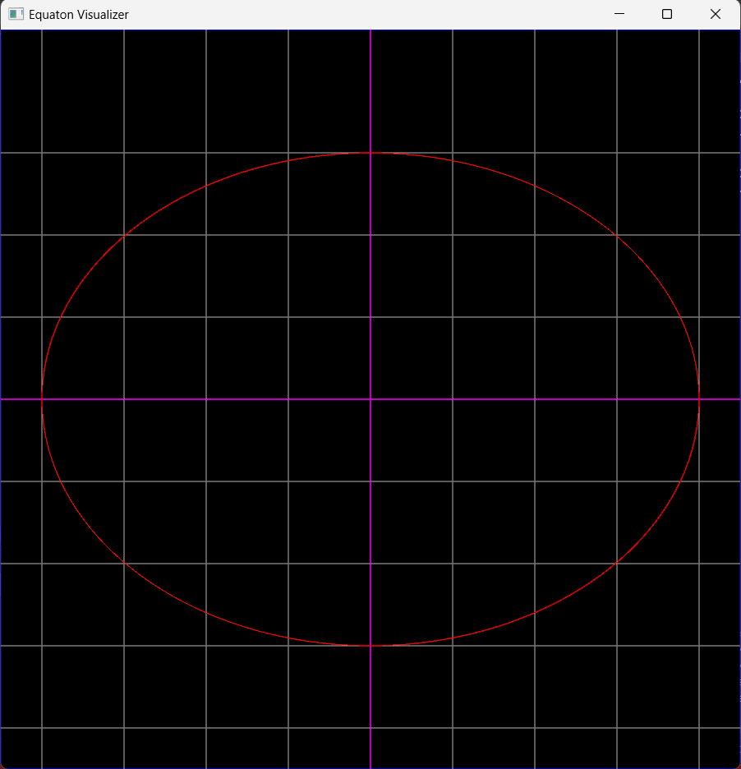
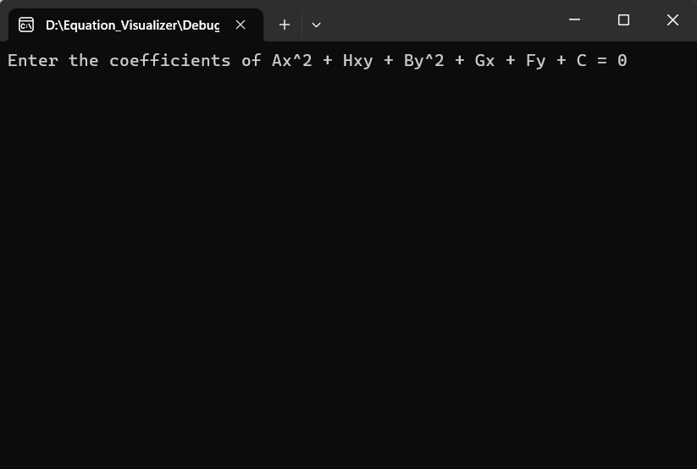
Results
A console window is prompted to ask for the equation.
The final output is in the form of a graph.

Slide 6
Scope and Applications
Enhanced Learning Experience: Equation Visualizer simplifies Conic Section by providing visual representations of equations, enabling students to grasp concepts more effectively and enhancing their understanding and retention of knowledge.
Practical Applications: Equation Visualizer has practical applications in fields such as engineering, physics, and data analysis, allowing professionals to visualize and analyse complex mathematical models and equations relevant to their respective disciplines.

Slide 7
Limitations
Limited Zoom Range: The zoom in and zoom out feature of the graph is currently limited to a specific range, restricting the level of detail that can be observed.
Lack of Graph Numbering: The graph does not include numbering, making it challenging to read and interpret specific data points from the graph.
Rendering Delay: At times, the graph takes some time to render, causing potential delays in visualizing the plotted curves.
Inability to Display Rotated Curves: The project currently lacks the capability to display curves that have been rotated by a certain angle, preventing the visualization of transformed equations.

Slide 8
Thank You
Any Queries?

