Slide 1
CSS Day-2
Date

Slide 2
Background Color
Syntax: .div { background-color: red; }
a valid color name - like "red"
a HEX value - like "#ff0000"
an RGB value - like "rgb(255,0,0)”

Slide 3
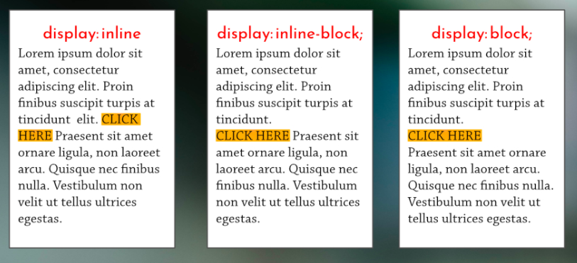
Inline-Block
1. Use span instead of div
2. Using display property

Slide 4
Synatx:
.div { display: property; }
Property can be :
Block (By default)
Inline
Inline-block

Slide 5
Text Decoration
Syntax:
.div{
text-decoration: none; }

Slide 6
Fonts
In CSS, we use the font-family property to specify the font of a text.
Syntax:
.div { font-family: font1, font2, font-family; }
.div { font-family: Arial, Helvetica, sans-serif; }
Generic Font Families:
Font families contain various fonts
Example:
Sans-serif : Arial, Verdana, Helvetica
The font-family property should hold several font names as a "fallback" system, to ensure maximum compatibility between browsers/operating systems. Start with the font you want, and end with a generic family (to let the browser pick a similar font in the generic family, if no other fonts are available). The font names should be separated with comma.
.div { font-family: "Times New Roman", Times, serif; }

Slide 7
Google Fonts
If you do not want to use any of the standard fonts in HTML, you can use Google Fonts.
Google Fonts are free to use, and have more than 1000 fonts to choose from.
Link : https://fonts.google.com/
Copy and paste in head
<link rel="preconnect" href="https://fonts.gstatic.com"> <link href="https://fonts.googleapis.com/css2?family=Luckiest+Guy&display=swap" rel="stylesheet">
@import url('https://fonts.googleapis.com/css2?family=Luckiest+Guy&display=swap');

Slide 8
Background Images
background-image: url("image.jpg");
Background Image Properties:
background-repeat: no-repeat;
background-position: center;
background-size: cover;

Slide 9
Float
The CSS float property specifies how an element should float.
The float property is used for positioning and formatting content e.g. let an image float left to the text in a container.
The float property can have one of the following values:
left - The element floats to the left of its container
right - The element floats to the right of its container
none - The element does not float (will be displayed just where it occurs in the text). This is default

Slide 10
Box Sizing
The CSS box-sizing property allows us to include the padding and border in an element's total width and height.
By default, the width and height of an element is calculated like this:
width + padding + border = actual width of an element height + padding + border = actual height of an element
This means: When you set the width/height of an element, the element often appears bigger than you have set (because the element's border and padding are added to the element's specified width/height).

Slide 11
Box Shadow
Syntax:
.div { box-shadow: 10px 10px 8px #888888; }
The first value is the horizontal offset
The second value is the vertical offset.
The third value adds a blur effect to the shadow.
The fourth value is shadow color (if not provided will be inherited from the text color.)

Slide 12
Border
Syntax:
.div { border: 5px solid red; }
The first value is border width
Second value is border style
Border styles can be :
Dotted
Dashed
Groove
Ridge(etc)
Third value is border colour

Slide 13
:hover Selector
The :hover selector is used to select elements when you mouse over them.
.div:hover { background-color: yellow; }

Slide 14
Transition Duration
The transition-duration property specifies how many seconds (s) or milliseconds (ms) a transition effect takes to complete.
Synatx:
.div { transition-duration: 5s; }

Slide 15
@media Rule
The @media rule is used in media queries to apply different styles for different media types/devices.
Media queries can be used to check many things, such as:
width and height of the viewport
width and height of the device
orientation (is the tablet/phone in landscape or portrait mode?)
resolution
Using media queries are a popular technique for delivering a tailored style sheet (responsive web design) to desktops, laptops, tablets, and mobile phones.

Slide 16
Cont..
Syntax :
@media only screen and (max-width: 600px) { body { background-color: lightblue; } }

Slide 17
::after Selector
To remove float property for the underlying elements :
.row:after {
content: "";
display: table;
clear: both;
}

