Slide 1
SUPPLY CHAIN ROUTING ENGINE
Distributed Logistics Platform
Optimize • Route • Fulfill • Analyze
Team Members
Member 1
Member 2
Member 3
Core & UI Foundation
Backend & Checkout
Frontend & Analytics
Core Algorithms, Database &
Frontend Foundation Lead
API, Logistics Orchestration
& Checkout Lead
Frontend, Analytics &
Geospatial Visualization Lead
College Major Project • September 2026
Notes:
Good morning. We are presenting our major project — the Supply Chain Routing Engine. This is a distributed logistics platform that connects an e-commerce customer experience with a professional host control tower. The system uses a hybrid architecture combining deterministic routing with AI-powered explainability. Our team of three has built this end-to-end — Member 1 handles core algorithms, database, and the UI foundation; Member 2 handles the backend APIs, checkout orchestration, and Redis concurrency; Member 3 handles the analytics dashboards, MapLibre visualization, and frontend integration.

Slide 2
ALL MEMBERS
Problem Statement & Objectives
PROBLEM
Traditional e-commerce systems hide logistics complexity — hosts have no visibility into routing decisions, warehouse selection, or inventory allocation. Manual warehouse assignment is error-prone and cannot scale under concurrent load.
OBJECTIVES
✦ Real-time Control Tower for logistics operators (Host View)
✦ Seamless e-commerce shopping experience (Customer View)
✦ Multi-warehouse routing algorithm with distance optimization
✦ Redis distributed locks preventing overselling under concurrent load
✦ Gemini AI plain-language routing explanations
✦ Shared backend — both views use the same database & routing engine
Notes:
The core problem: in most e-commerce platforms, the logistics layer is completely opaque. Our system automates warehouse selection entirely using a deterministic routing algorithm that evaluates distance, inventory, and capacity.

Slide 3
ALL MEMBERS
Technology Stack
React 19 + Vite
Node.js + Express
PostgreSQL
Redis
Gemini API
MapLibre GL
FRONTEND
API SERVER
DATABASE
CACHE / LOCKS
AI ENGINE
MAPPING
Component-driven SPA
with hot reload
RESTful endpoints,
middleware chain
ACID transactions,
relational integrity
Per-SKU distributed locks,
rate limiting
Async explanation
generation, fallback
Route visualization,
warehouse markers
ARCHITECTURE GUARANTEES
<50ms
ACID
0%
Per-SKU
CHECKOUT LATENCY
TRANSACTION SAFETY
AI DEPENDENCY
LOCK GRANULARITY
Deterministic routing target
PostgreSQL + Redis locks
Checkout never waits for AI
No coarse warehouse locks
Notes:
Our stack: React 19 with Vite for the frontend, Node.js Express for APIs, PostgreSQL for storage, Redis for distributed locking, Gemini API for AI, and MapLibre GL for mapping. Key guarantees: sub-50ms checkout, ACID safety, zero AI dependency on checkout, per-SKU lock granularity.

Slide 4
M1 + M2
Hybrid Dual-Path Architecture
● SYNCHRONOUS PATH
● ASYNCHRONOUS PATH
Checkout Critical Path — Member 1 (Routing) + Member 2 (Checkout)
AI Explanation Path — Member 2 (Gemini) + Member 3 (UI)
1. Customer order received
2. Routing engine evaluates warehouses [M1]
3. Cost function scores options [M1]
4. Bin-packing determines packaging [M1]
5. Redis lock + PostgreSQL transaction [M2]
6. Instant order confirmation [M2]
1. Checkout renders immediately
2. Frontend requests explanation [M3]
3. Backend forwards to Gemini [M2]
4. AI generates explanation [M2]
5. Fallback if Gemini unavailable [M2]
6. Explanation displayed to host [M3]
Target: <50ms · Zero AI dependency
Non-blocking · Decoupled from checkout
━━ ASYNC BOUNDARY ━━
Notes:
The synchronous path handles checkout: Member 1's routing algorithm evaluates warehouses and allocates inventory, then Member 2's checkout orchestration acquires Redis locks, commits PostgreSQL transactions, and returns confirmation. The async path handles AI: Member 2's Gemini integration generates explanations, which Member 3's AI explanation UI renders for the host.

Slide 5
ALL MEMBERS
End-to-End System Flow
AUTHORIZATION
CUSTOMER
HOST
Browse → Cart → Location → Checkout
Manage Products, Inventory, Warehouses
BACKEND + ROUTING ALGORITHM
Distance
Calculation [M1]
Inventory
Allocation [M1]
Redis Lock +
Transaction [M2]
Shipment + Price + PostgreSQL + Redis
CUSTOMER SEES:
HOST SEES: [M3 UI]
Final Price, Order Status, Tracking
Full Analysis, AI, Analytics, Routes
Notes:
Complete flow showing how all three members' work connects: Member 1's routing algorithm handles distance calculation and inventory allocation, Member 2's checkout orchestration handles Redis locks and PostgreSQL transactions, and Member 3's frontend renders the results for both customer and host views.

Slide 6
MEMBER 1 — CORE
Multi-Warehouse Routing Algorithm
Member 1 — Core Algorithms, Database & Frontend Foundation Lead
STEP 1
STEP 2
STEP 3
STEP 4
STEP 5
STEP 6
Find Active
Warehouses
Check SKU
Availability
Haversine
Distance
Score
Warehouses
Multi-WH
Allocation
Generate
Shipments
Query PostgreSQL for
all active warehouses
Filter warehouses with
available > reserved
Calculate distance from
each warehouse to customer
Cost function: distance ×
inventory × capacity
Split order across
multiple warehouses
Create shipments &
calculate cost
MULTI-WAREHOUSE ALLOCATION EXAMPLE
Required: 10 units · Customer Location: Jaipur (26.91°N, 75.78°E)
Warehouse A (Mumbai, 8.2 km) → Available: 4 units → Allocate: 4
Warehouse B (Bangalore, 12.5 km) → Available: 6 units → Allocate: 6
Result: 2 separate shipments generated · Total distance: 20.7 km
Notes:
Member 1 built the core routing algorithm. It queries active warehouses, filters by inventory, calculates Haversine distance, scores warehouses using a cost function, and performs multi-warehouse allocation when needed. The algorithm also handles split shipments and bin-packing logic.

Slide 7
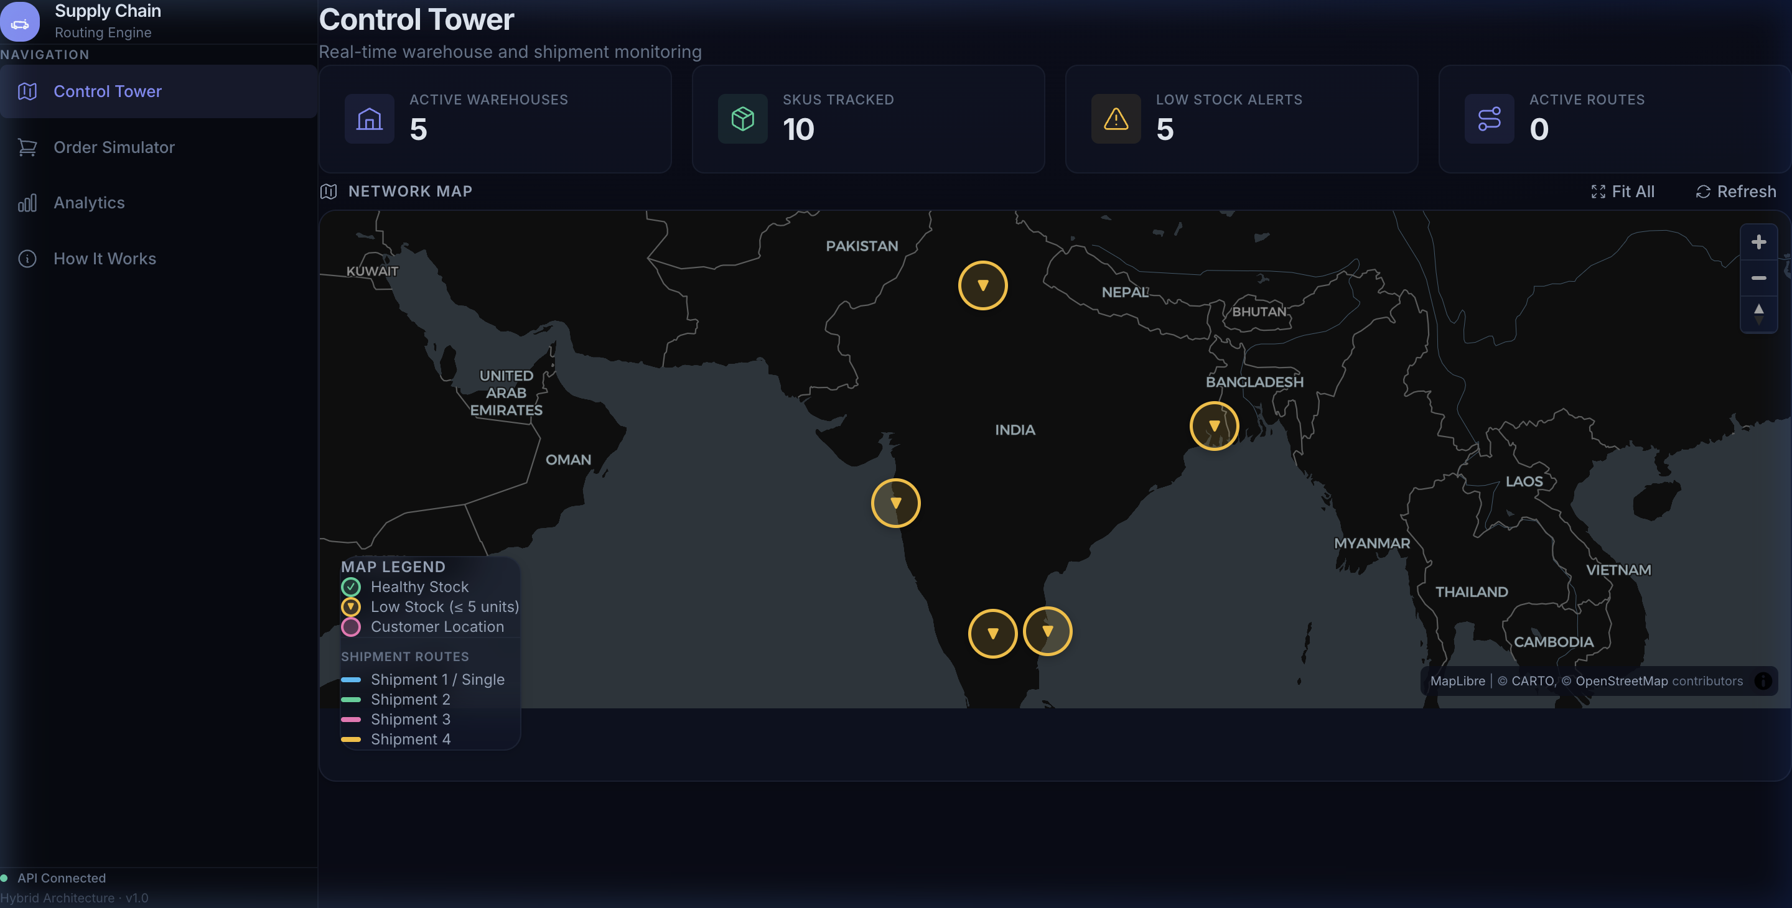
MEMBER 1 — CORE
Database Schema & Control Tower UI Foundation
DATABASE SCHEMA (PostgreSQL)
CONTROL TOWER UI FOUNDATION
users – Customer/Host accounts, roles
products – SKU, name, price, category
warehouses – Name, city, lat/lng, capacity
warehouse_inventory – Per-warehouse per-SKU stock
orders – Customer ID, status, total, address
order_items – Order → Product → quantity → price
shipments – Order → Warehouse → tracking
shipment_items – Shipment → SKU → quantity
routes – Order → GeoJSON, distance, cost
inventory_movements – Audit trail: type, qty, timestamp
✦ Enterprise dark navy design system
✦ MapLibre GL interactive map + CARTO basemap
✦ 4 real-time KPI cards
✦ Sidebar navigation + API health indicator
✦ Frontend architecture & reusable components
Notes:
Member 1 owns the database schema with 10+ tables and the Control Tower UI foundation. The database uses fully normalized PostgreSQL tables with ACID transactions. The Control Tower UI includes the enterprise design system, MapLibre map integration, KPI cards, and the application shell — all built as reusable components.

Slide 8
MEMBER 2 — BACKEND
Checkout Orchestration & Redis Concurrency
Member 2 — API, Logistics Orchestration & Checkout Lead
CHECKOUT FLOW (SINGLE ACID TRANSACTION)
REDIS CONCURRENCY PROTECTION
1. Validate Customer
2. Validate Cart
3. Read Current Inventory
4. Acquire Redis Lock (per-SKU)
5. Check Availability
6. Run Routing Algorithm [calls M1]
7. Allocate Inventory (-avail, +reserved)
8. Create Order + Order Items
9. Create Shipments + Shipment Items
10. Generate Route GeoJSON
11. Calculate Delivery Cost
12. COMMIT Transaction
✦ Per-SKU distributed locks: lock:sku:<ID>
✦ Lock TTL prevents deadlocks
✦ Rate limiting: 30 req/min per IP
(sliding window, configurable)
✦ Duplicate checkout prevention
✦ Idempotency keys
✦ Request validation & input guards
GUARANTEES:
✓ Zero overselling
✓ Zero negative inventory
✓ Zero duplicate orders
BUILT-IN STRESS TEST:
Flash-sale tool fires N concurrent
checkout requests to prove safety
ON FAILURE: ROLLBACK → Release Locks → Return Error
Notes:
Member 2 owns the entire checkout orchestration and Redis concurrency layer. The checkout is a single ACID transaction with 12 steps. Redis provides per-SKU distributed locks, rate limiting, and duplicate prevention. The built-in flash-sale stress test proves zero overselling under concurrent load.

Slide 9
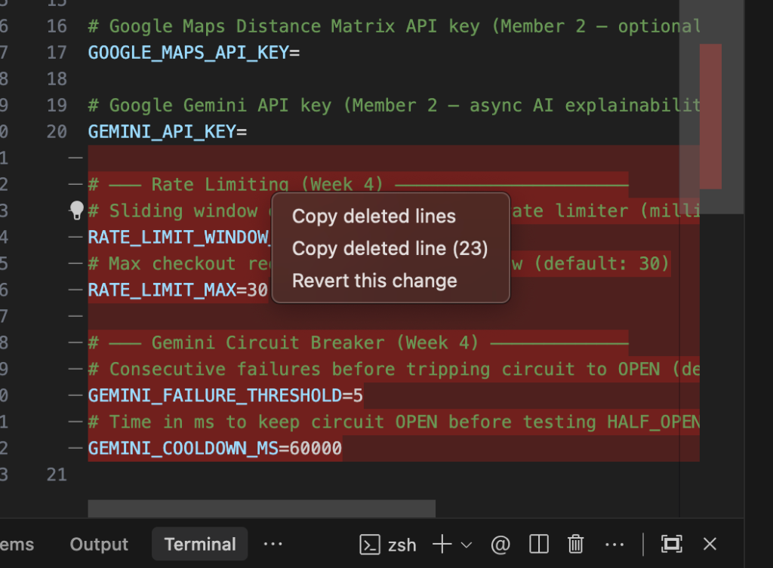
MEMBER 2 — BACKEND
Gemini AI Explainability & Order Simulator
GEMINI AI INTEGRATION
CUSTOMER ORDER SIMULATOR (Week 5)
✦ Google Gemini API generates plain-language
routing explanations
✦ Fully async — never blocks checkout path
✦ Host-only (customer never sees explanations)
CIRCUIT BREAKER PATTERN:
• 5 consecutive Gemini failures → circuit OPENS
• Deterministic fallback activates automatically
• 60-second cooldown, then retry (HALF_OPEN)
AI EXPLAINS:
• Why a warehouse was selected
• Why an order was split across warehouses
• Distance vs inventory tradeoffs
✦ 8 preset cities + custom coordinates
✦ 10 products with real-time stock
✦ Cart panel with quantity controls
✦ Full checkout triggers routing algorithm
Notes:
Member 2 also owns the Gemini AI integration with circuit breaker pattern and the Customer Order Simulator frontend. The circuit breaker trips after 5 consecutive Gemini failures and automatically falls back to deterministic template-based explanations. The Order Simulator was built in Week 5 and allows testing the full checkout flow.

Slide 10
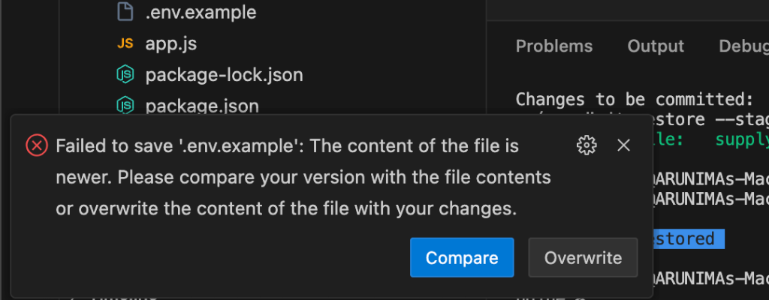
MEMBER 3 — FRONTEND
Control Tower Frontend Integration
Member 3 — Frontend, Analytics & Geospatial Visualization Lead
✦ MapLibre route visualization
✦ Warehouse markers (health-coded)
✦ Click marker → inventory popup
✦ Shipment route lines (color-coded)
POPUP DETAILS:
• Warehouse name & coordinates
• Stock status badge (Healthy/Low)
• SKU-level Available / Reserved
5 WAREHOUSES:
• Mumbai Central
• Bangalore Tech Park DC
• Chennai Port
• Kolkata East Hub
• Delhi NCR Fulfillment Hub
✦ Frontend API integration
✦ Responsive design & polish
Notes:
Member 3 integrated the Control Tower frontend — connecting Member 1's UI foundation with live backend data. This includes MapLibre route visualization, warehouse marker popups with SKU-level inventory, shipment route rendering, and responsive design polish. The popup shows live PostgreSQL data for each warehouse.

Slide 11
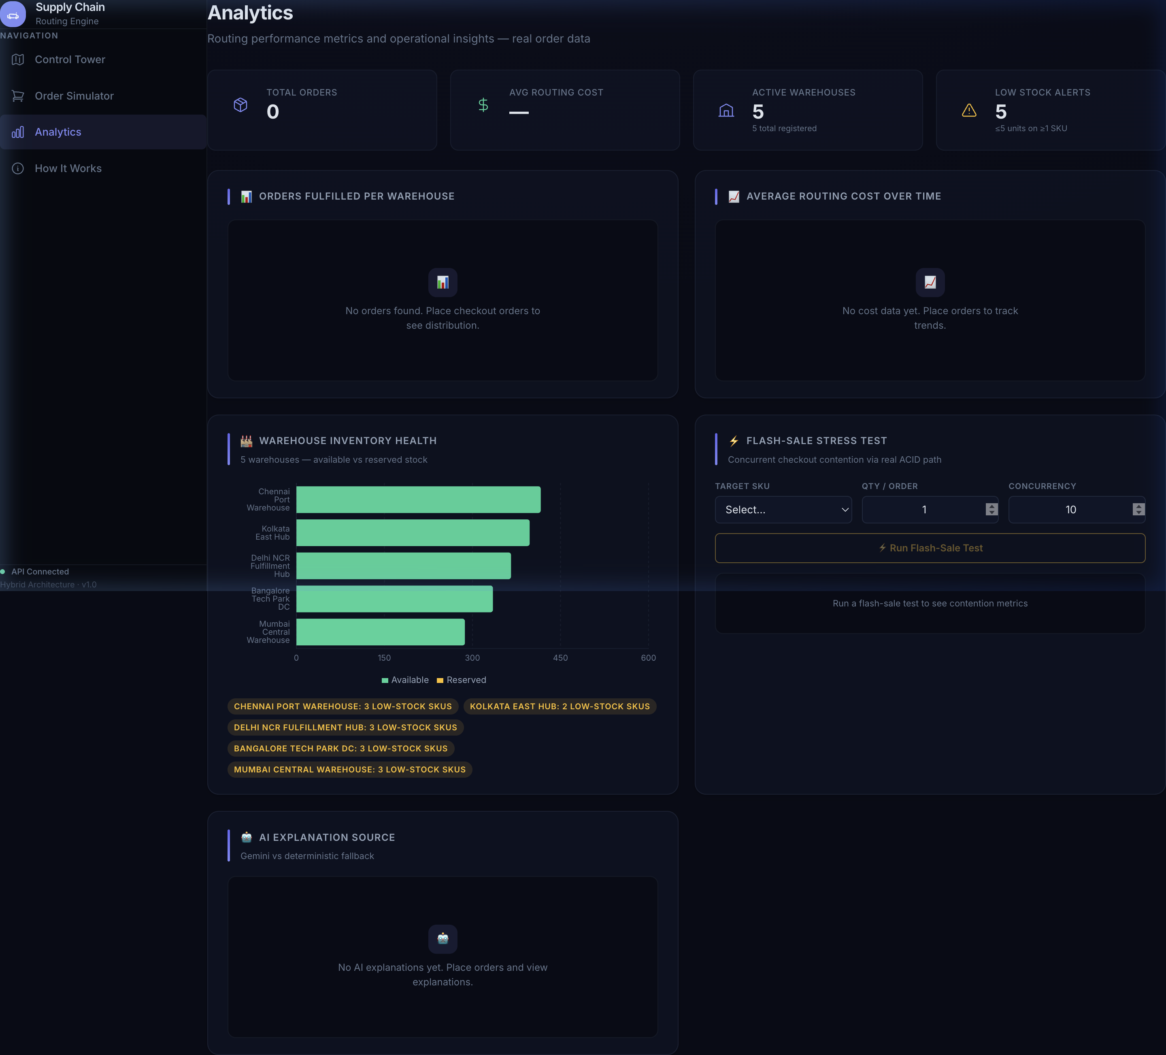
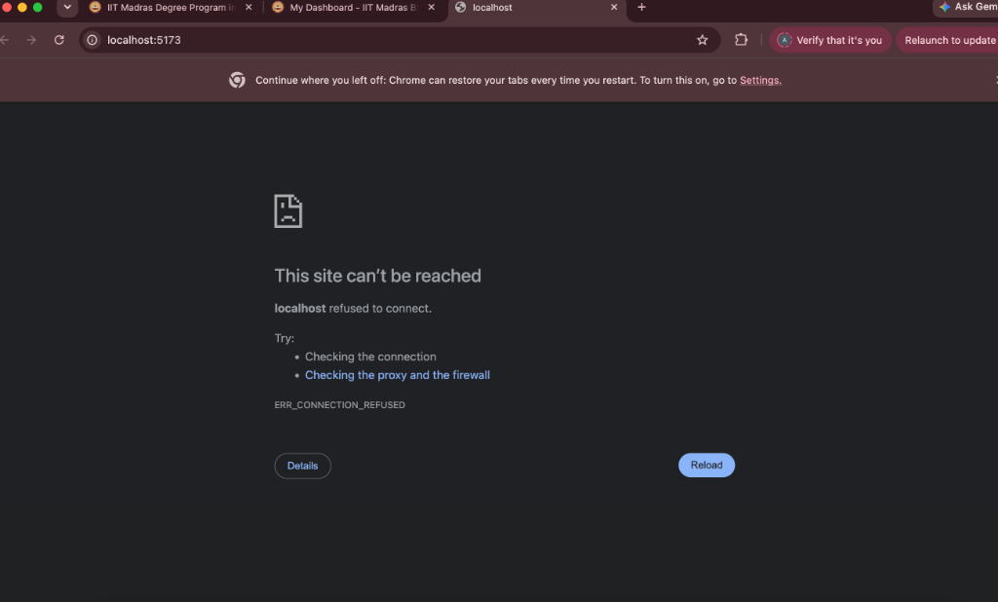
MEMBER 3 — FRONTEND
Analytics Dashboard & AI Explanation UI
ANALYTICS DASHBOARD (Recharts)
AI EXPLANATION UI
KPIs · Orders per warehouse · Routing cost trends · Warehouse inventory health · Low-stock badges
Gemini vs deterministic breakdown · AI explanation source · Flash-sale stress test panel
Notes:
Member 3 built the Analytics dashboard using Recharts — showing KPIs, orders fulfilled per warehouse, routing cost trends, warehouse inventory health charts, and low-stock alerts. They also built the AI explanation UI that displays Gemini vs deterministic fallback breakdowns.

Slide 12
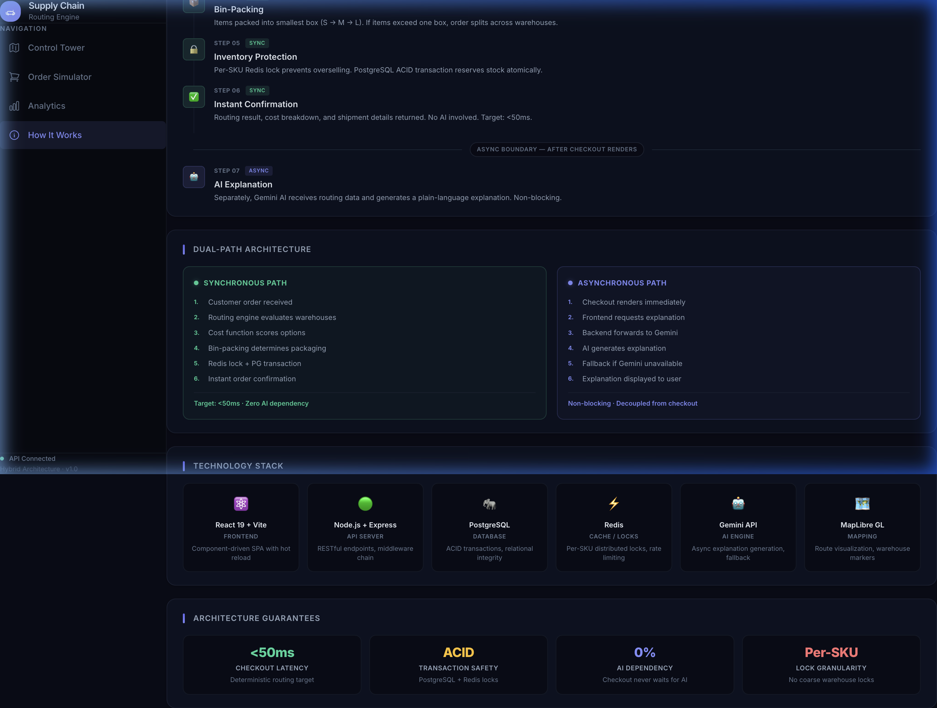
M1 + M3
How It Works — Interactive Architecture Guide
✦ 7-step visual walkthrough:
1. Customer Order
2. Warehouse Evaluation [M1]
3. Cost Scoring [M1]
4. Bin-Packing [M1]
5. Inventory Protection [M2]
6. Instant Confirmation [M2]
7. AI Explanation [M2+M3]
✦ SYNC/ASYNC step labels
✦ Async boundary marker
✦ Dual-path comparison
✦ Technology stack grid
✦ Architecture guarantees panel
✦ Designed for viva demo
Notes:
The How It Works page was built collaboratively — Member 1 designed the architecture flow and Member 3 handled the frontend integration. It walks through all 7 steps with SYNC/ASYNC labels, shows the dual-path architecture, technology stack, and architecture guarantees. This page serves as a comprehensive reference during viva.

Slide 13
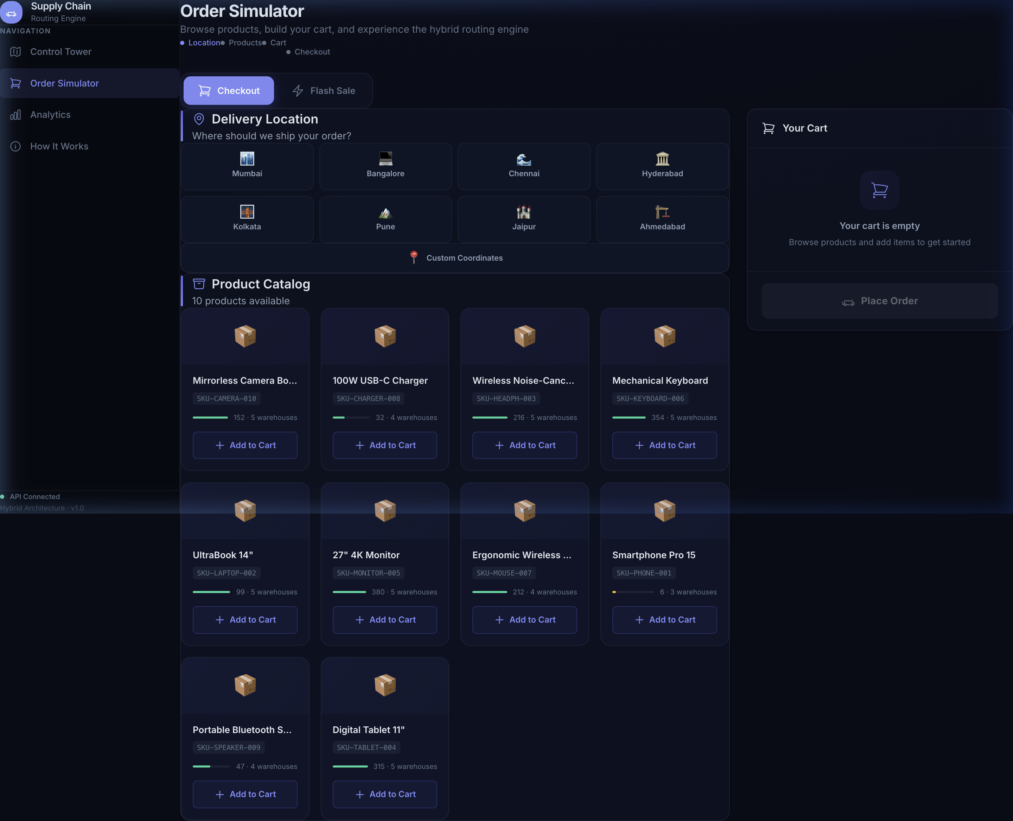
M2 + M3
Customer E-Commerce Experience
CUSTOMER SEES:
✓ 8 preset delivery cities
✓ Custom lat/lng entry
✓ 10 products with live stock
✓ Color-coded availability bars
✓ Cart with quantity controls
✓ Final price (includes delivery)
✓ Order confirmation
CUSTOMER DOES NOT SEE:
✗ Warehouse selection logic
✗ Routing algorithm scores
✗ AI explanation
✗ Inventory locks
✗ System analytics
PRINCIPLE:
Customer sees results.
Host sees analysis.
Notes:
The customer experience was built by Member 2 (Order Simulator frontend, Week 5) with Member 3 handling final integration and polish. The key principle is information asymmetry: the customer sees the shopping experience and final results, never the internal routing logic.

Slide 14
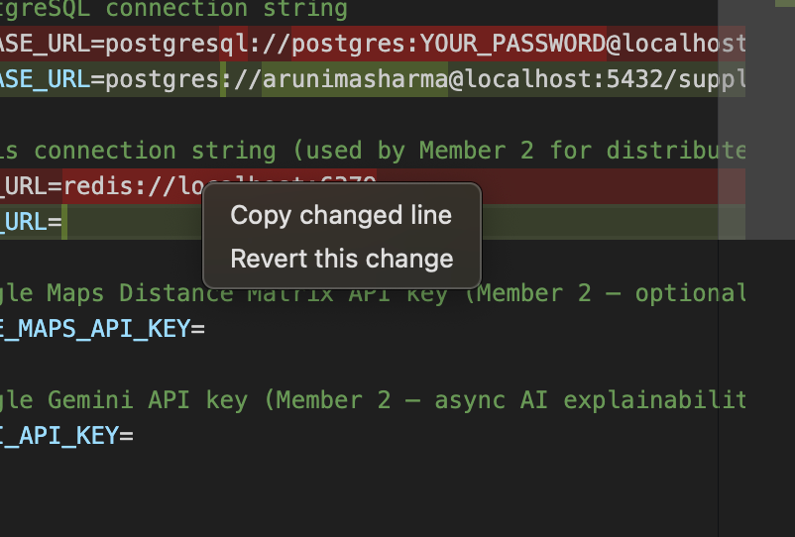
ALL MEMBERS
Live Demo & Test Results
DEMO FLOW
1. Control Tower — show 5 warehouses on map [M1+M3]
2. Click warehouse marker → inventory popup [M3]
3. Order Simulator — select Jaipur, add products [M2]
4. Place Order → routing algorithm runs [M1+M2]
5. Control Tower — new route on map [M3]
6. Analytics — updated charts [M3]
7. Flash-Sale Test — 10 concurrent → 0 overselling [M2]
TEST RESULTS
Single-warehouse checkout
✅ Pass
Multi-warehouse split
✅ Pass
Insufficient stock rejection
✅ Pass
Concurrent checkout (10 threads)
✅ 0 overselling
Gemini AI explanation
✅ Generated
Gemini fallback (circuit breaker)
✅ Deterministic fallback
Rate limiting (30 req/min)
✅ Enforced
Notes:
Live demo flow showing each member's contribution. Test results confirm all critical features work: single and multi-warehouse checkout, concurrent checkout with zero overselling, Gemini AI with fallback, and rate limiting.

Slide 15
ALL MEMBERS
Conclusion & Future Scope
WHAT WE BUILT
FUTURE SCOPE
✅ Multi-warehouse routing algorithm [M1]
✅ Split shipments & bin-packing [M1]
✅ PostgreSQL schema & performance [M1]
✅ Control Tower UI foundation [M1]
✅ Backend APIs & checkout orchestration [M2]
✅ Redis concurrency protection [M2]
✅ Gemini AI + circuit breaker [M2]
✅ Order Simulator frontend [M2]
✅ Analytics dashboards (Recharts) [M3]
✅ MapLibre route visualization [M3]
✅ AI explanation UI [M3]
✅ Responsive design & final polish [M3]
🔮 Customer authentication (JWT)
🔮 Host warehouse/product CRUD panels
🔮 Real-time order tracking (WebSocket)
🔮 Google Maps Distance Matrix API
(real road distances)
🔮 ML-based demand forecasting
🔮 Delivery partner assignment
🔮 Mobile-responsive customer app
🔮 Admin role management
🔮 Email/SMS order notifications
🔮 Advanced bin-packing optimization
Thank You
Notes:
In conclusion — Member 1 built the core routing algorithm, database, and UI foundation. Member 2 built the backend APIs, checkout orchestration, Redis concurrency, and Gemini AI. Member 3 built the analytics dashboards, MapLibre visualization, AI explanation UI, and final frontend polish. Thank you.

