Slide 1
CSAI 330 — DESIGN AND ANALYSIS OF ALGORITHMS
Construction and Visualization of
Densest Subgraphs in Graphs
Network category: Collaboration Networks (co-authorship graphs)
Charikar's Greedy Peeling · Greedy++ · Goldberg's Exact Max-Flow · Exact Triangle-Density
github.com/Amrkhattab123/algorithm

Slide 2
OVERVIEW
Agenda
— Problem definition — the Densest Subgraph Problem and why it matters
— Graph modelling — Collaboration Networks and how the raw data becomes a graph
— The four algorithms — two greedy-peeling, two exact max-flow-based
— Datasets — five real networks, 379 to 317,080 nodes
— Methodology — how a shrinking peel / a shrinking max-flow cut becomes a growth video
— Results — runtime growth, densities found, and cross-algorithm consistency
— Simulation demos — the incremental construction videos
— Limitations & conclusion
Construction & Visualization of Densest Subgraphs — Collaboration Networks
2

Slide 3
PROBLEM DEFINITION
The Densest Subgraph Problem
Given a graph G = (V, E), find the vertex subset S ⊆ V maximizing:
density(S) = |E(S)| / |S| (edge-density)
density△(S) = |Δ(S)| / |S| (triangle-density)
— Why it's hard: checking all 2^|V| subsets is infeasible; exact answers need a max-flow reduction, not brute force.
— Why it matters here: the densest subgraph of a co-authorship network is its most tightly-knit research community — collaborating far more with each other than with the rest of the field.
— Other applications: fraud/anomaly detection, web/social community detection, network summarization, recommendation seeding.
Construction & Visualization of Densest Subgraphs — Collaboration Networks
3

Slide 4
GRAPH MODELLING
Category: Collaboration Networks
— Nodes = authors, edges = co-authorship (two researchers who published together).
— Edge weight = number of shared papers (defaults to 1.0 for unweighted “pattern” files).
— Source: Network Repository (networkrepository.com), .mtx files mirrored on nrvis.com.
— Applications: surfacing active research clusters, flagging citation rings / coordinated authorship, collaboration recommendation, compact network summarization.
.mtx loader pipeline
%%MatrixMarket banner
↓
rows cols nnz (dimension line — may
itself be “%”-prefixed)
↓
u v [w] (edge; missing w → 1.0)
↓
networkx.Graph
(weighted, undirected,
self-loops dropped)
Construction & Visualization of Densest Subgraphs — Collaboration Networks
4

Slide 5
GRAPH MODELLING
Five Datasets — Small to Very-Large
Dataset | Nodes | Edges | Tier
ca-netscience | 379 | 914 | small
ca-CSphd | 1,882 | 1,740 | small-medium
ca-GrQc | 4,158 | 13,422 | medium
ca-HepTh | 11,204 | 117,619 | large
ca-dblp-2012 | 317,080 | 1,049,866 | very-large
All five satisfy the assignment's
size-spread rule and the ≥ half-
team-size dataset count.
Sizes shown are the real, verified
counts from the files actually
hosted today — three differ from
the course PDF's illustrative table
(documented in README.md).
Construction & Visualization of Densest Subgraphs — Collaboration Networks
5

Slide 6
ALGORITHMS — GREEDY PEELING
Charikar's Algorithm & Greedy++
CHARIKAR · 2000
BOOB ET AL. · WWW 2020
Greedy Peeling
Greedy++
O((n+m) log n) · 1/2-approximation
O(R · (n+m) log n) for R rounds
Repeatedly removes the currently lowest-weighted-
degree vertex, recording density after each removal.
Returns the densest subgraph seen anywhere in that
shrinking sequence.
On ca-netscience / ca-GrQc / ca-HepTh, this single
pass already finds the exact optimum — verified
against Goldberg's exact algorithm.
Repeats Charikar's peel across many rounds, but
ranks vertices by degree PLUS an accumulated “load”
carried over from every earlier round's peel — a
discretized multiplicative-weights scheme.
On ca-dblp-2012, 13 rounds close the small gap
Charikar's single pass leaves (56.500 → 56.565),
matching Goldberg's exact answer.
Construction & Visualization of Densest Subgraphs — Collaboration Networks
6

Slide 7
ALGORITHMS — EXACT, MAX-FLOW-BASED
Goldberg's Algorithm & Exact Triangle-Density
GOLDBERG · 1984
KHULLER & SAHA · 2009
Exact Max-Flow Algorithm
Exact Triangle-Density
O(log(1/ε) · MaxFlow(n, m))
O(log(1/ε) · MaxFlow(n+T, m))
Binary searches a candidate density g. Builds a flow
network: s→v capacity m, v→t capacity m+2g−deg(v),
u↔v capacity w(u,v). A subgraph of density ≥ g exists
iff the min-cut's source side is non-trivial.
Converges to the EXACT maximum density — the
ground truth all our correctness tests rely on.
Generalizes Goldberg's reduction to a 3-uniform
hypergraph term: one auxiliary flow node per
triangle Δ (s→Δ capacity 1, Δ→{u,v,w} capacity BIG),
v→t capacity g per vertex.
Finds a smaller, more clique-like core than edge-
density — confirmed the two objectives genuinely
optimize for different structures.
Construction & Visualization of Densest Subgraphs — Collaboration Networks
7

Slide 8
METHODOLOGY
Making a Shrinking Process Look Like Growth
Peeling removes vertices — but the videos must show the densest subgraph being GROWN.
peeling order (algorithm removes lowest-degree vertex, left → right)
|S|=6
|S|=5
|S|=4
|S|=3
S* (amber)
|S|=6
|S|=5
|S|=4
|S|=3
video replay order (frames play right → left through this same sequence: starts small, GROWS to S*)
Construction & Visualization of Densest Subgraphs — Collaboration Networks
8

Slide 9
METHODOLOGY
Sampling Policy — Documented, Never Silent
The exact algorithms don't scale for free — two real obstacles, both caught empirically:
3.36 MILLION triangles
11 GB and climbing
ca-HepTh's full graph has 3.36M triangles — the
triangle-density flow network would need millions
of auxiliary nodes. Confirmed intractable; solved
with a documented, reproducible BFS sample.
An early peeling implementation copied the full
remaining-node set at every step — O(n²) memory.
Caught mid-run on ca-dblp-2012 before it crashed;
fixed to an O(1)-per-step trace + lazy reconstruction.
Resulting policy: Charikar / Greedy++ always run at full size, including the 317K-node ca-dblp-2012.
Goldberg runs at full size on the 4 smaller datasets, BFS-sampled (~10,000 nodes) only on ca-dblp-2012.
Triangle-density runs at full size only where triangle counts are small (ca-netscience, ca-CSphd); every
other dataset uses a BFS sample sized to keep the triangle count in the low thousands. Every sampled row
is flagged in the results table — nothing is substituted without saying so.
Construction & Visualization of Densest Subgraphs — Collaboration Networks
9

Slide 10
RESULTS
Every (Dataset × Algorithm) Result
Dataset | Algorithm | Nodes run | Runtime (s) | Density | |S*|
ca-netscience | Charikar | 379 | 0.014 | 4.000 | 9
ca-CSphd | Charikar | 1,882 | 0.054 | 1.250 | 4
ca-CSphd | Greedy++ | 1,882 | 0.683 | 1.500 | 6
ca-GrQc | Goldberg | 4,158 | 26.057 | 22.391 | 46
ca-GrQc | TriangleDensity | 500 | 27.297 | 77.667 | 24 | sampled
ca-HepTh | Goldberg | 11,204 | 227.150 | 119.000 | 239
ca-HepTh | TriangleDensity | 250 | 27.486 | 100.000 | 26 | sampled
ca-dblp-2012 | Charikar | 317,080 | 24.231 | 56.500 | 114
ca-dblp-2012 | Greedy++ | 317,080 | 341.364 | 56.565 | 115
ca-dblp-2012 | Goldberg | 10,000 | 210.109 | 56.565 | 115 | sampled
Full 20-row table (all 4 algorithms × all 5 datasets): figures/benchmark_results.csv in the repo.
Construction & Visualization of Densest Subgraphs — Collaboration Networks
10

Slide 11
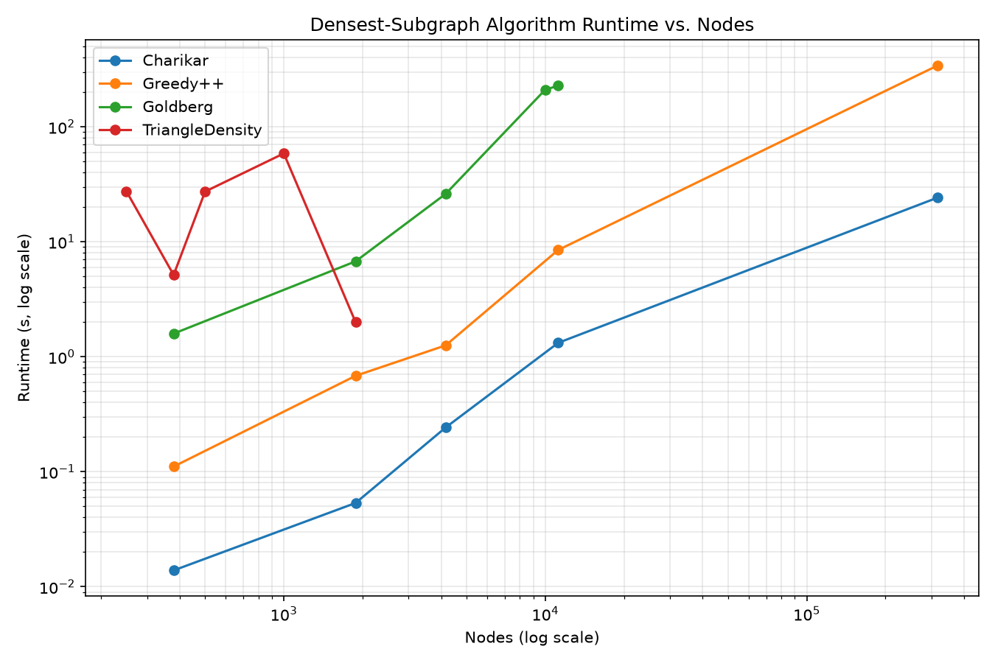
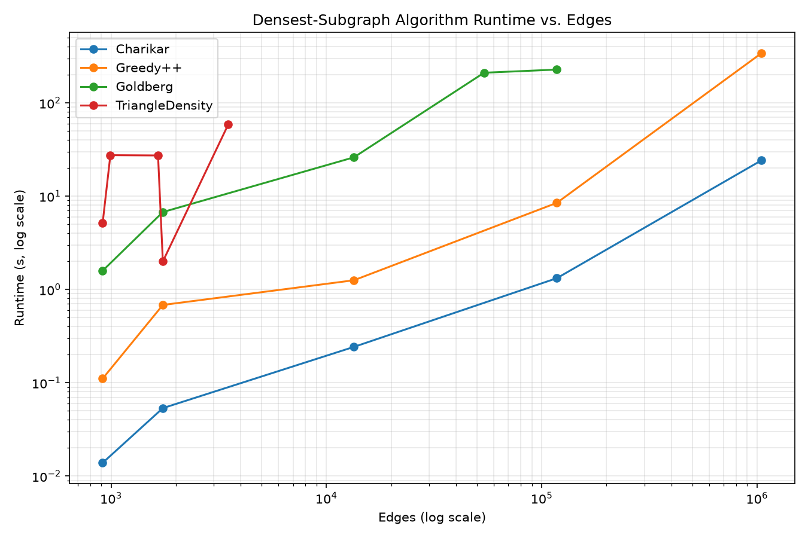
RESULTS
Runtime Growth — All Four Algorithms, One Legend
Log-log scale across a 379-to-317,080-node size range. Charikar/Greedy++ scale near-linearly; the exact
max-flow algorithms grow faster, motivating the documented sampling policy at very-large scale.
Construction & Visualization of Densest Subgraphs — Collaboration Networks
11

Slide 12
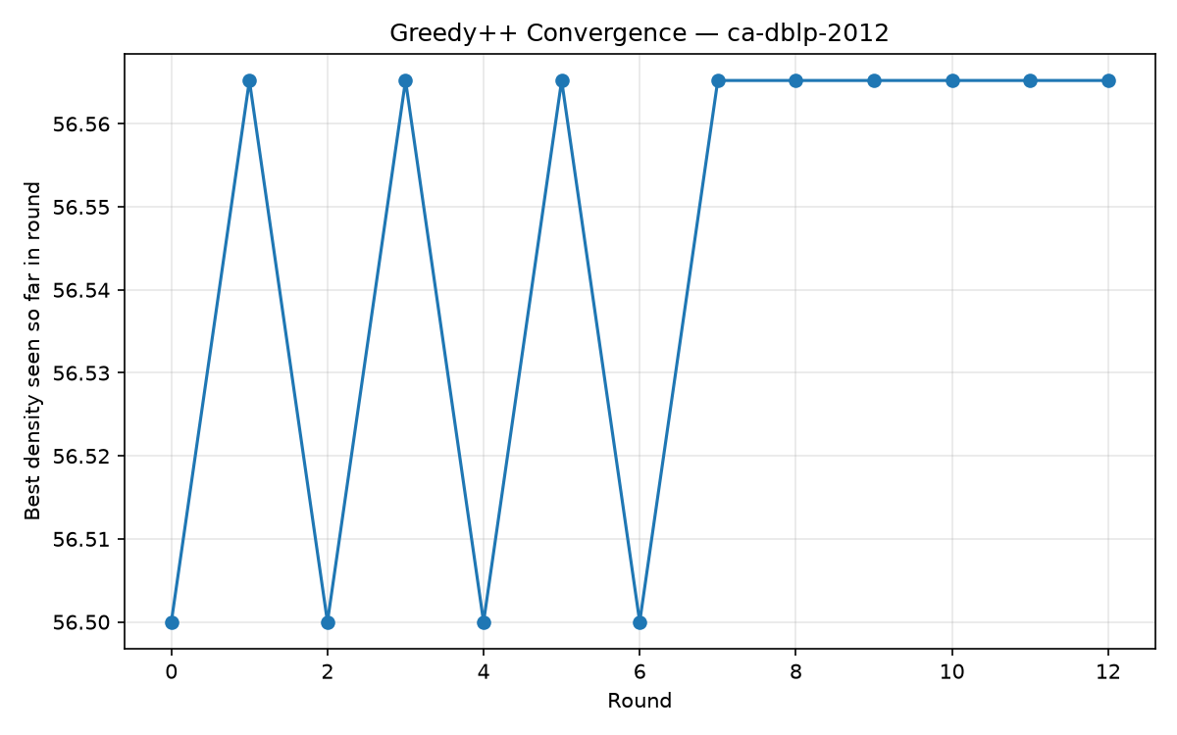
RESULTS
Greedy++ Convergence — ca-dblp-2012
— 13 rounds: oscillates between 56.500 and 56.565 through round 6, then stabilizes at Goldberg's exact 56.565 from round 7 onward.
Construction & Visualization of Densest Subgraphs — Collaboration Networks
12

Slide 13
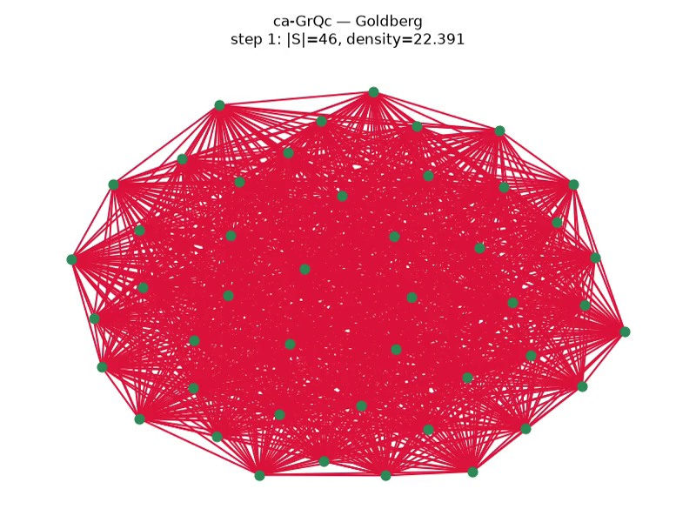
SIMULATION DEMOS
Incremental Construction — ca-GrQc, Goldberg's Algorithm
The general-relativity co-authorship network's densest subgraph: 46 authors, density 22.39 (~1,030
mutual co-authorship edges) — found identically by Charikar, Greedy++, and Goldberg's exact algorithm.
All 20 videos (5 datasets × 4 algorithms) are in videos/ in the repository.
Construction & Visualization of Densest Subgraphs — Collaboration Networks
13

Slide 14
RESULTS
Key Findings
— Goldberg never loses: on every dataset, the exact algorithm's density matches or exceeds both heuristics — the correctness cross-check the whole project rests on.
— Charikar is sometimes already optimal: on ca-netscience, ca-GrQc, and ca-HepTh, all three edge-density algorithms land on the identical density — a single peeling pass found the true global optimum.
— Sampling validated at scale: on ca-dblp-2012, Goldberg's 10,000-node BFS sample recovered the exact same 115-vertex optimum that Greedy++ found on the full 317,080-node graph.
— Triangle-density finds a genuinely different core: on ca-CSphd, the edge-optimal set (6 vertices, density 1.5) has triangle-density only 0.667 — the two objectives measure different structure, as the theory predicts.
— 39/39 tests passing: including exact agreement between Goldberg's algorithm and brute-force ground truth on every synthetic fixture.
Construction & Visualization of Densest Subgraphs — Collaboration Networks
14

Slide 15
CONCLUSION
Limitations & Conclusion
Limitations
Conclusion
— Three datasets' real, verified sizes differ from the course PDF's illustrative table (documented, not hidden).
— Exact algorithms use a documented BFS sample on the largest / most triangle-dense graphs — not full-scale.
— networkx's pure-Python preflow-push, not a hand-rolled Dinic's — chosen for correctness confidence over raw speed, since it also serves as ground truth for the test suite.
— All 4 algorithms implemented, tested, and cross-validated against each other and against brute-force ground truth.
— All 5 datasets processed, all 20 videos rendered, both required growth-curve plots produced.
— Full code, tests, notebook, videos, and this write-up are live at github.com/Amrkhattab123/algorithm.
Construction & Visualization of Densest Subgraphs — Collaboration Networks
15

