Slide 1
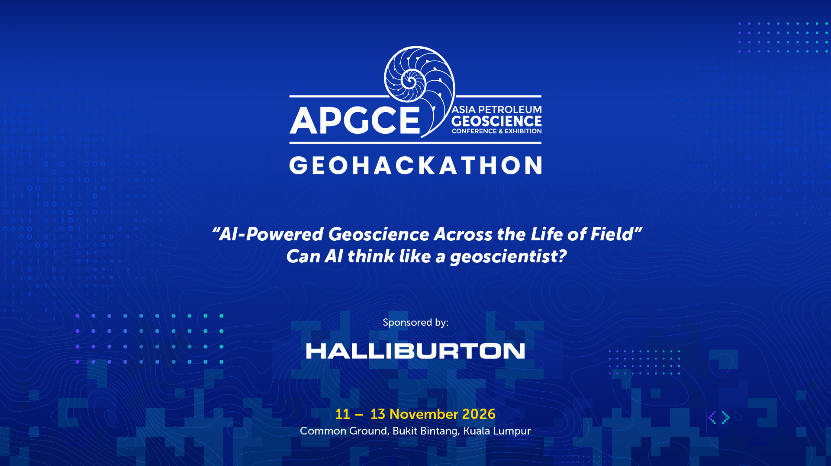
Kickstarter Briefing
“Geoscience Across Life of Field: From First Discovery to Last Recovery”
1 October 2026

Slide 2
Challenge 2 : Analog Explorer
Hydrocarbon Finder – Pakar AI Anda
Amr Abdelfattah – Principal Geoscientist Advisor
Haider Ali – Geoscience Principal Consultant
Davis Reza Siregar – Senior Geoscientist
Siti Syafiqah Binti Azman – Data Scientist
Erdiah Ashida Binti Nasirin – Geoscientist & RE

Slide 3
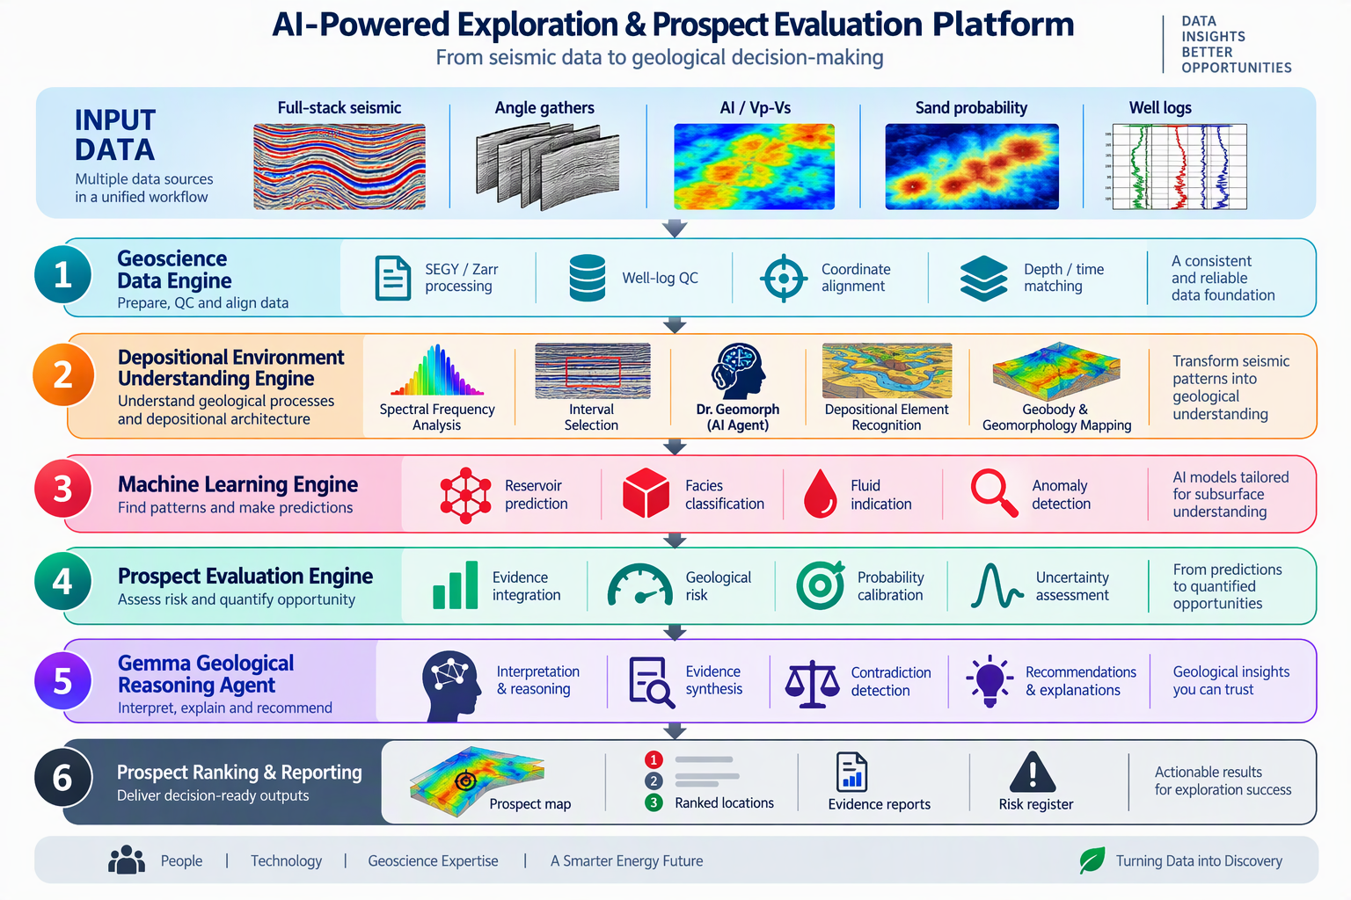
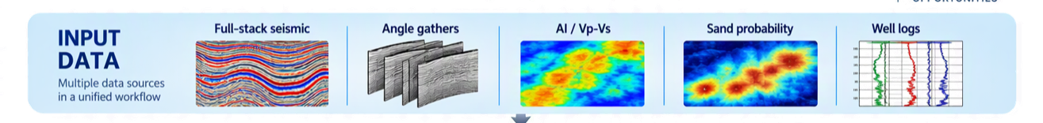
The Solution Design – Vision and Challenges
Solution Vision:
Create fast screening for oil and gas prospects that integrate different data and delineate potential prospective area for HILP
Data Challenges:
  Data in different formats & types ( well data, seismic data)
  No geological background
  A lot of data can not always be a good thing, it might give us different messages
  No software involved
  One login instance

Slide 4
The Solution Design
Solution Design Concepts
  Multi-layered solution
  Multi agents
  Data ingestion and pipeline
  Integrate machine learning with AI-Agents
  Minimum human interaction
Input data pipeline
Seismic Data
Angel Stacks
Sand_Prob
Well Data
Depositional Environment Engine
Spectral Analysis
Dr.GeoMorph
Machine Learning Engine
Porosity Prediction Model
Fluid Highlighting Model
Prospect Evaluation
Dataset Integration
Solution Design Tech Stack
  Python (numpy, pandas, Scikitlearn, Scipy)
  LLM (thinking layer)
  Ai Agents (Smart Employees)
  Front-End Design (Streamlit)
Geological Reasoning Evaluation
Prospect Researcher
Fluid Indicator
Dr.PI
Interpreter
Prospect Ranking & Reporting
Oil Finder UI

Slide 5
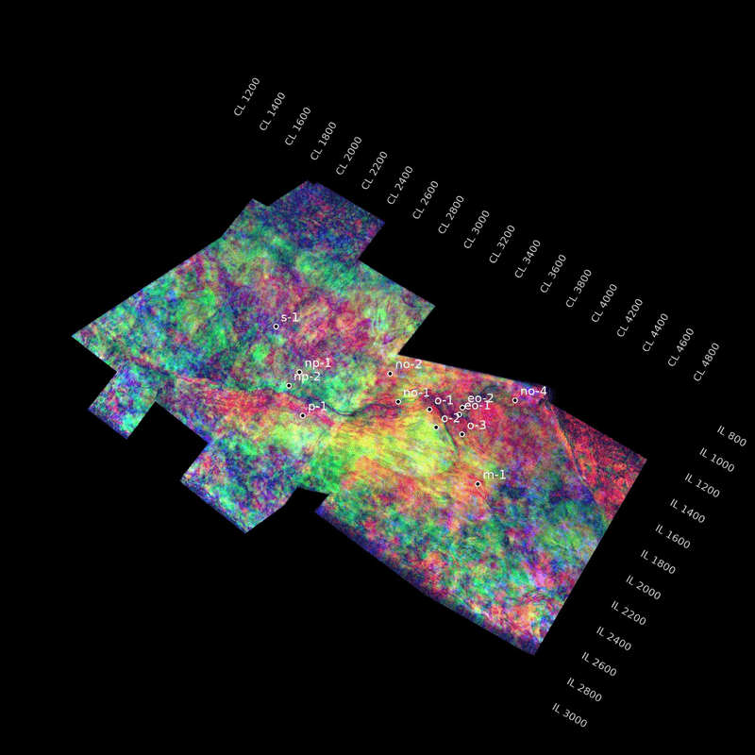
The Solution Workflow
Confirm the DHI with the potential Prospects
Scan the dataset for potential prospects
Seismic Data
Porosity Prediction Model
Fluid Indicator
Prospect Researcher
Angle Stacks
Input data pipeline
Dataset Integration
Spectral Analysis
Oil Finder UI
Sand_Prob
Dr.PI
Well Data
Interpreter
Dr.GeoMorph
Integrate all the data coming from all ai agents and give the final feedback to the UI
Depositional Environment
Geological features
DHI screening
Delineate using polygons
Calculate LamdaRho & MuRho
Calculate Rho
AVO Indicator (N-F)F

Slide 6
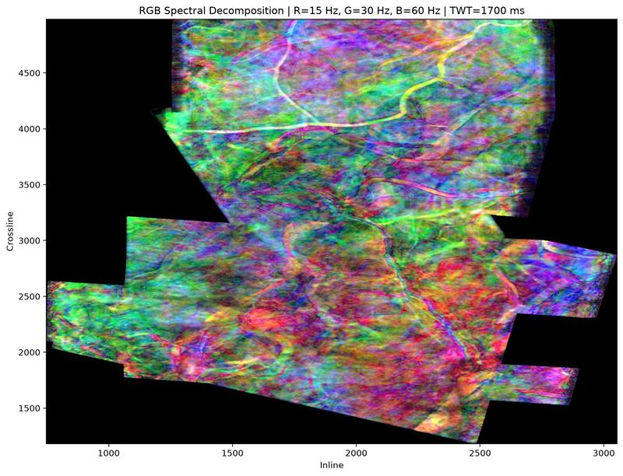
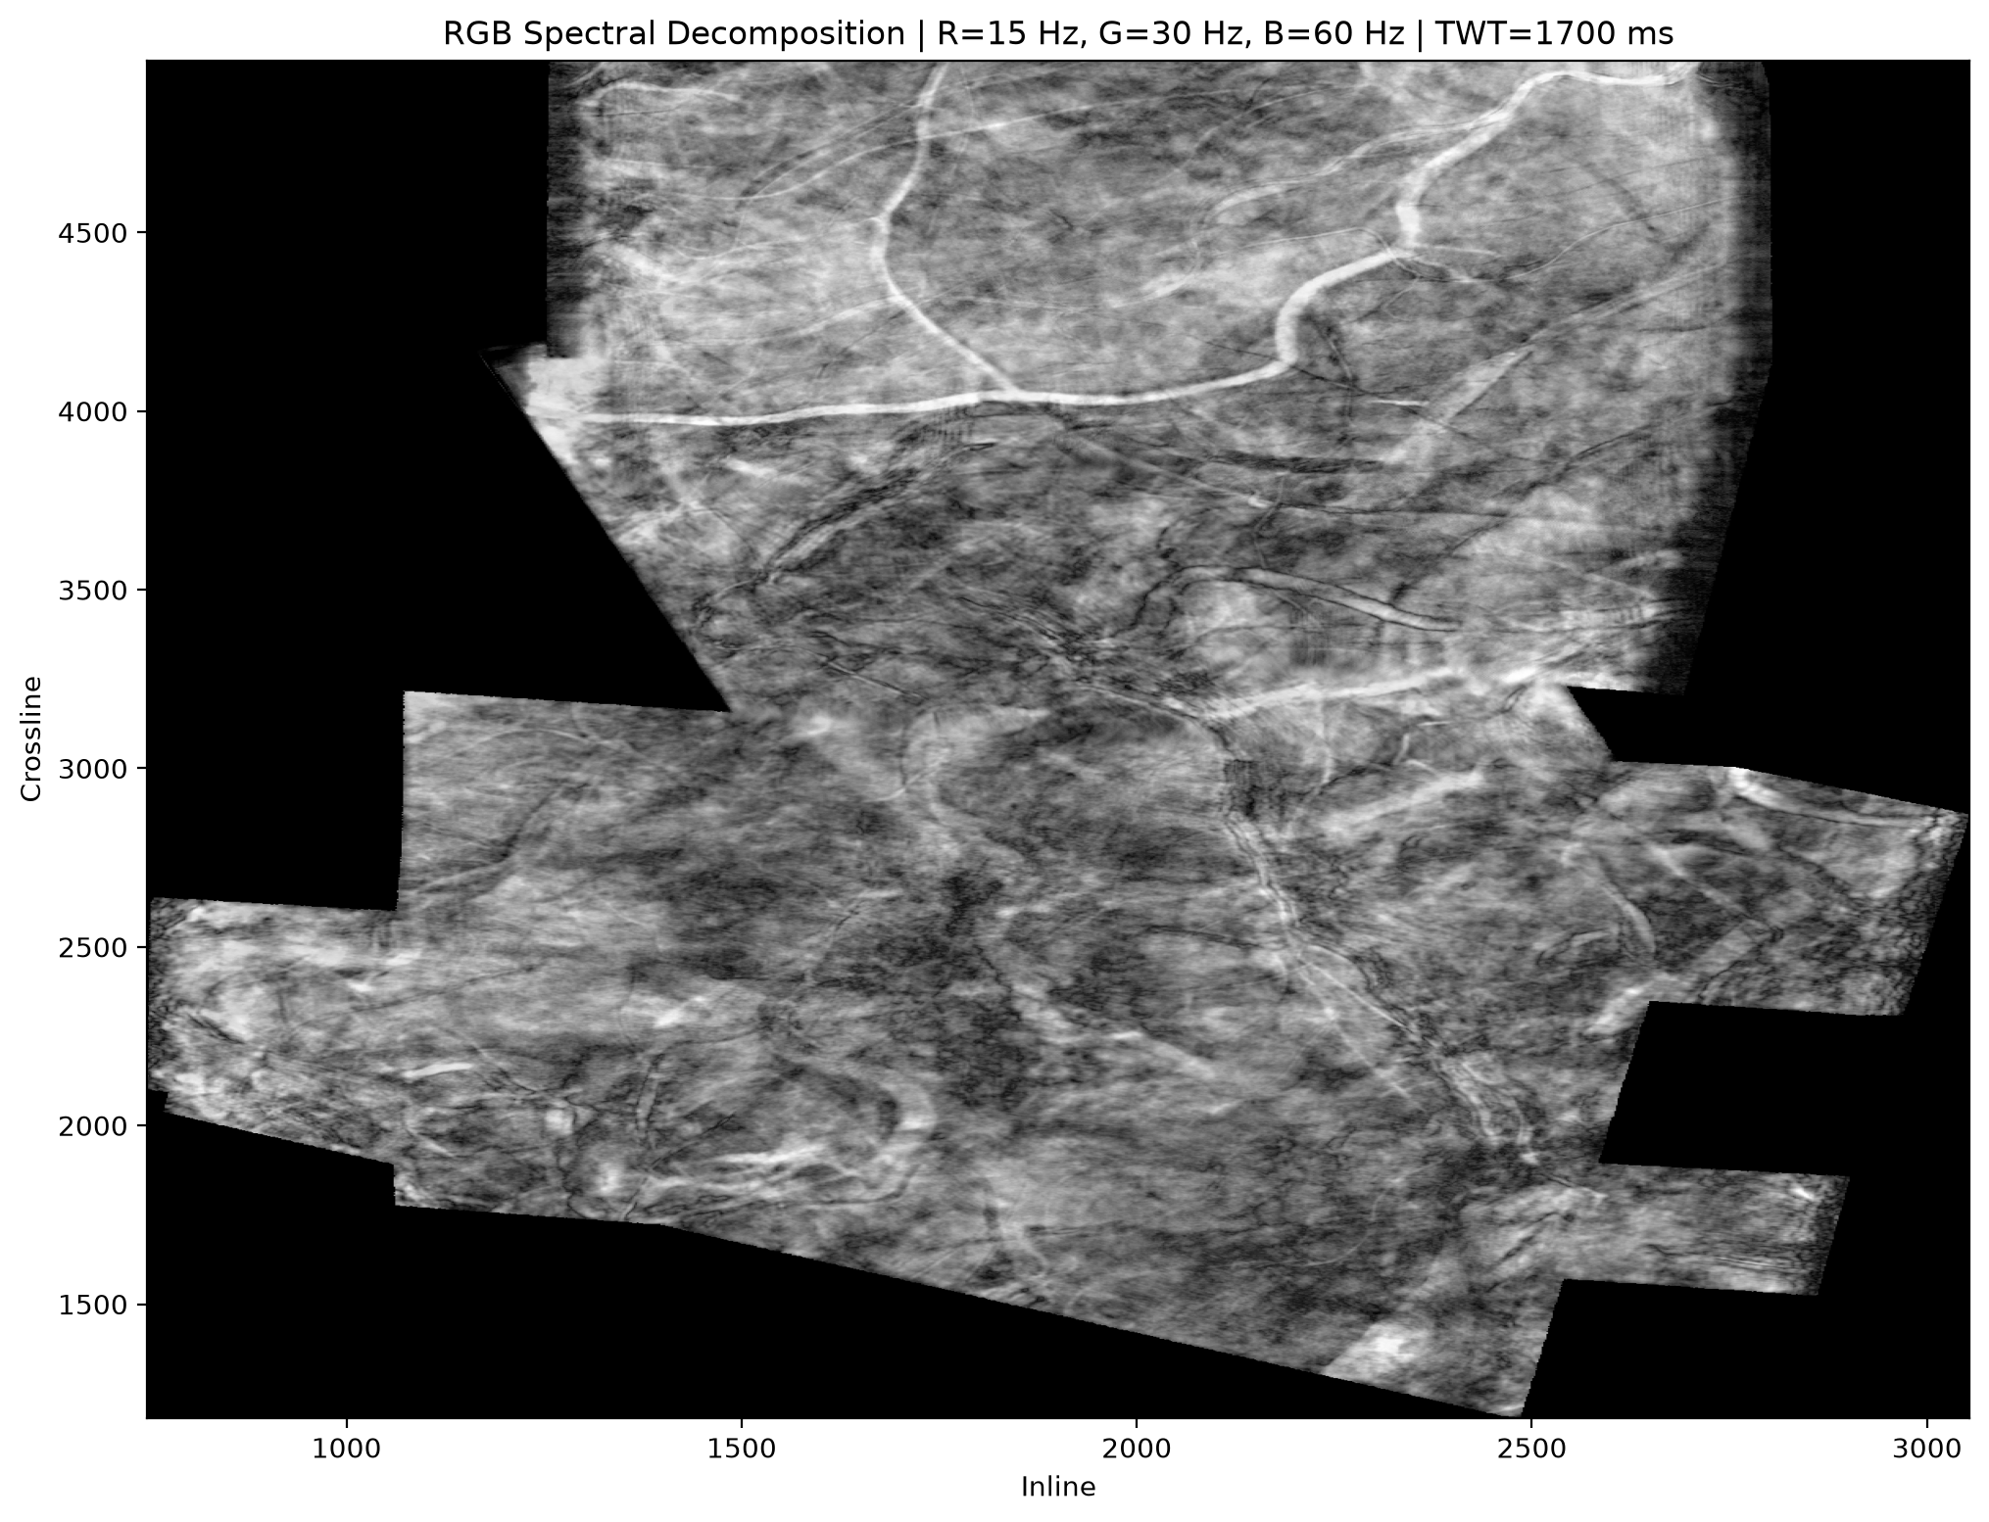
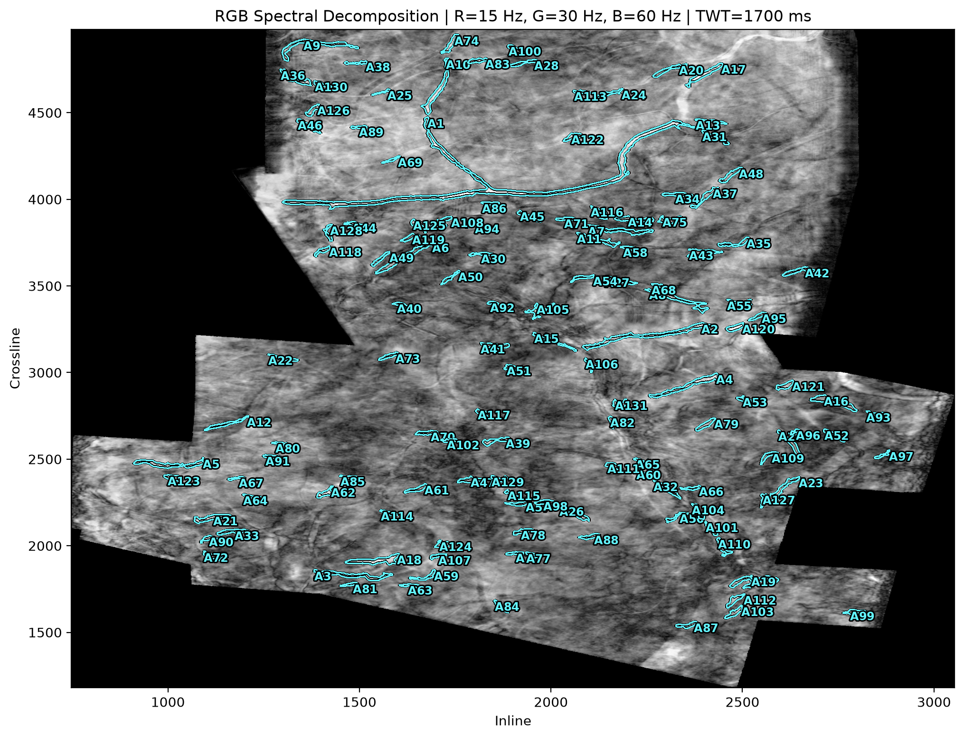
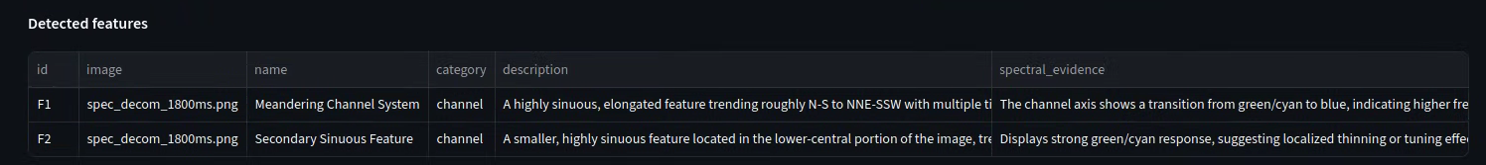
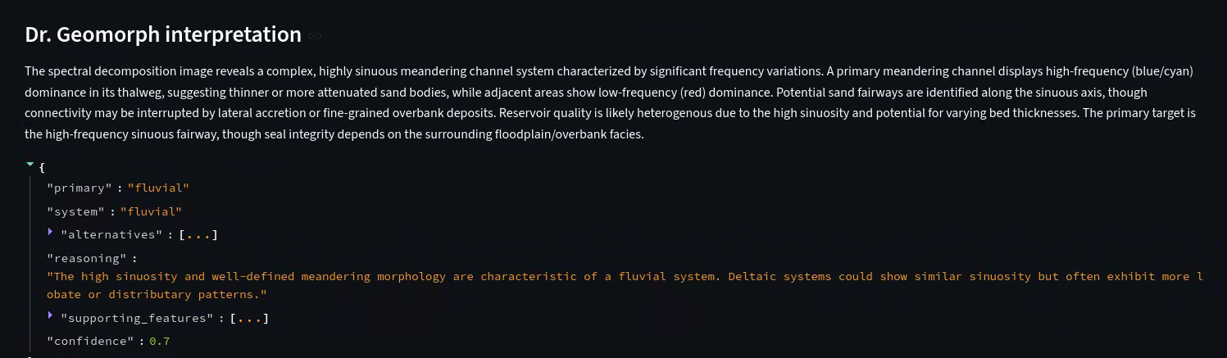
How Pakar AI finds new prospects

Slide 7
How Pakar AI finds new prospects
What makes it innovative?
  AI Agents working together to make our life easier
  It enables HILP
  few minutes prospect screening with evidence
  Simple to use
  It uses local LLM -> data privacy
Business Impact
  Cuts the interpretation cycle time
  Cuts the hidden cost
    Using Local LLM of tokenization
    3rd part studies
  From Data to Discovery -> no prospect left behind
  Removing human bias

Slide 8
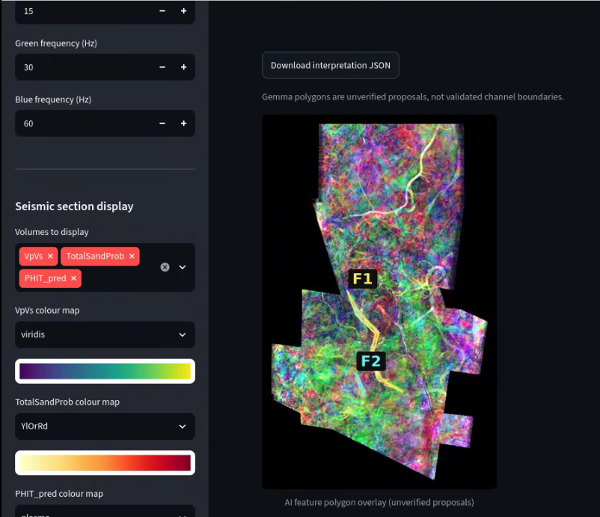
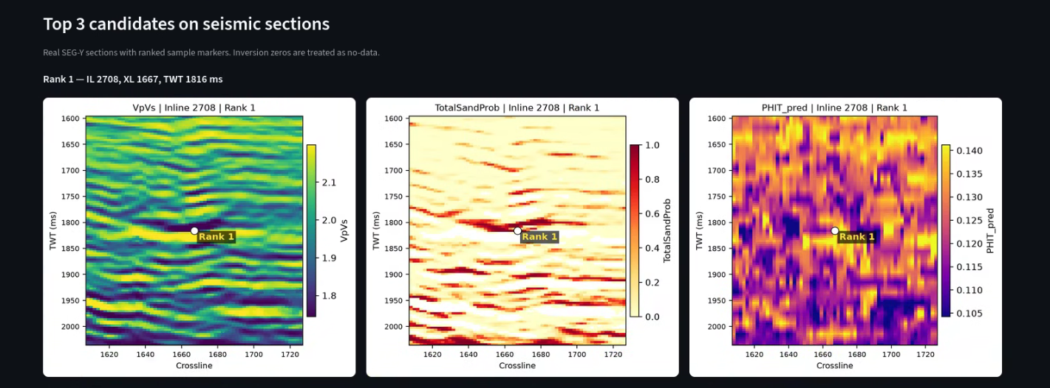
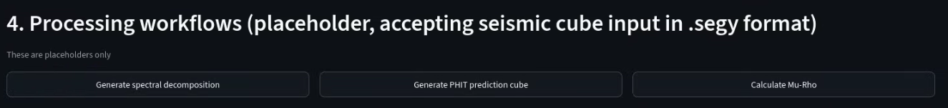
How Pakar AI finds new prospects
AI Agents working together to make our life easier
Modular approach
Minimum human Intervention

Slide 9
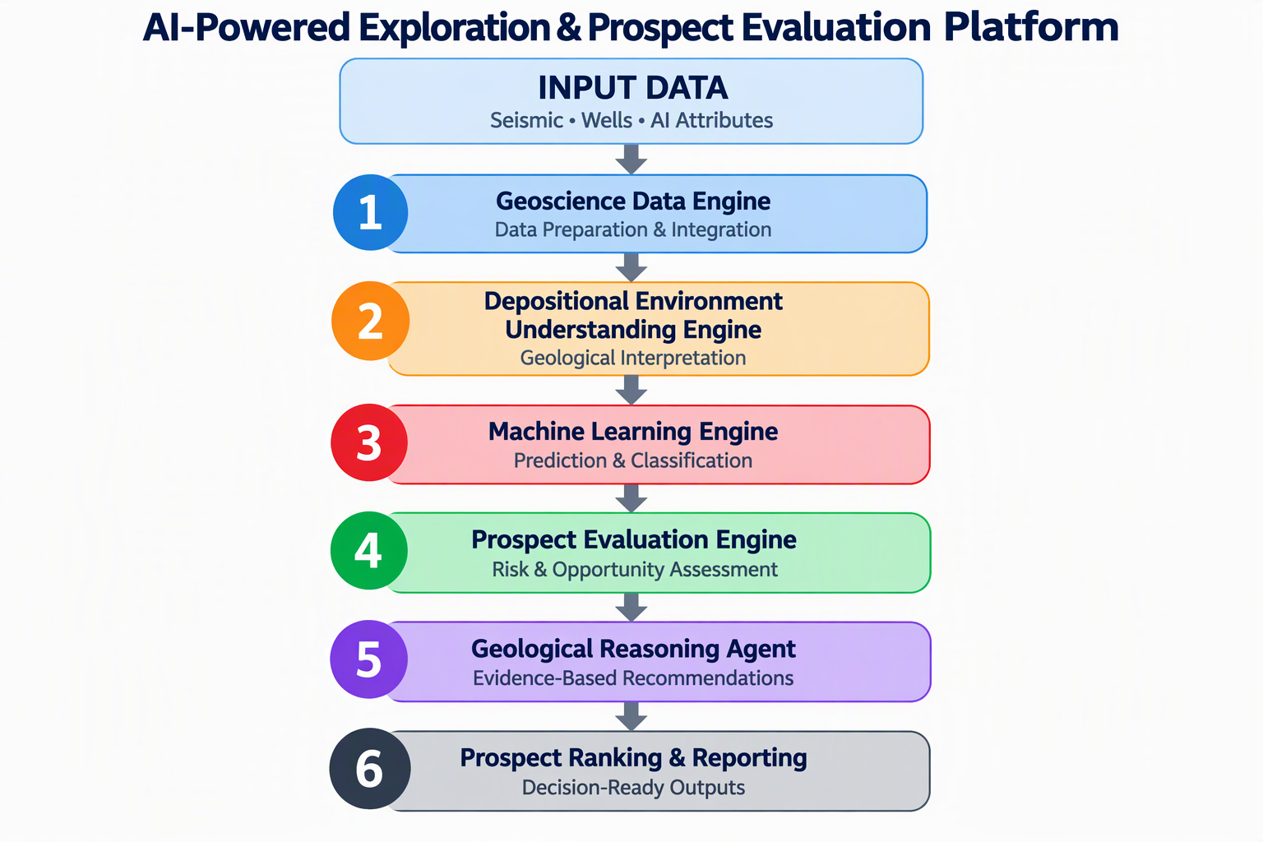
The Pakar AI steps SOON

Slide 10
Thank YOU
"In a world of shifting variables, the best strategy is a flexible mindset. Flexibility is the ultimate competitive advantage."
Amr Abdelfattah – Principal Geoscientist Advisor
Haider Ali – Geoscience Principal Consultant
Davis Reza Siregar – Senior Geoscientist
Siti Syafiqah Binti Azman – Data Scientist
Erdiah Ashida Binti Nasirin – Geoscientist & RE

Slide 11
The Solution Design
Solution Design Concepts
  Multi-layered solution
  Multi agents
  Data ingestion and pipeline
  Integrate machine learning with AI-Agents
  Minimum human interaction
Solution Design Tech Stack
  Python (numpy, pandas, Scikitlearn, Scipy)
  LLM (thinking layer)
  Ai Agents (Smart Employees)
  Front-End Design (Streamlit)

