Slide 1
Da Vinci Clinical Documentation Exchange (CDex) Track
May 2022 HL7 Connectathon
May 3-4, 2022
Lloyd McKenzie & Eric Haas

Slide 2
Agenda
Introduction
CDex Overview
Connectathon Activities
References
Notes:
Roadmap for supplemental example guides to flesh out specific use cases.

Slide 3
INTRODUCTION

Slide 4
Focus
This Da Vinci Track is Focused on Testing the Functionality of the CDex Implementation Guide.
Da Vinci Clinical Data Exchange (CDex) Implementation Guide 1.0.0 – STU R1
Currently in Ballot as 1.1.0-ballot - ballot the Draft parts of version 1.0.0
It covers provider to provider and provider to payer exchanges to help facilitate continuity of care.
Notes:
Roadmap for supplemental example guides to flesh out specific use cases.

Slide 5
Focus
Testing Will Focus on 3 Topics
1.
Using Task as a mechanism to asynchronously solicit clinical information from a remote system
2.
Invoking an operation to submit unsolicited attachments to claims and prior authorizations
3.
Use of signatures with:
Direct query-based retrieval
Task-based data requests
Attachments
Notes:
Roadmap for supplemental example guides to flesh out specific use cases.

Slide 6
CDex OVERVIEW

Slide 7
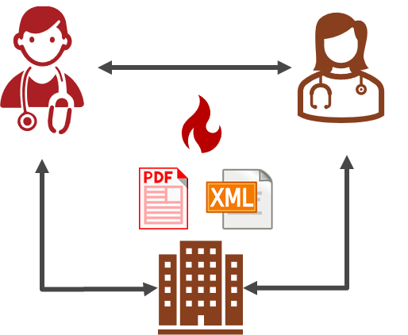
Clinical Data Exchange: Key Exchange Scenarios
Exchanging clinical data between referring providers
Requesting attachments to support claim submission, medical necessity and other reasons for attachments between payers and providers
Gathering additional information for Quality programs and Risk Adjustment between payers and providers
Sending attachments for claims management and prior authorization
Support for digital signatures with clinical data exchange

Slide 8




Clinical Data Exchange: Direct Query and Task Based
Benefits
Requestors can be explicit about the data they are requesting
e.g., FHIR Condition, Medication, Observation resources
Specific documents or labs identified by LOINC Document codes
Leverage widely implemented “Out of the Box” FHIR transactions for automated workflows
Provides mechanism for workflow that requires human intervention
Provides mechanism for automated completion of the request
e.g., What are the patient’s active conditions?
e.g., What are the patient’s HbA1C results after 2020-01-01?
e.g., Send the patient’s latest History & Physical
1. Payer or External Provider System Initiates Request
2. Provider System Retrieves Data
3. Practitioner Intervention (if required)
Direct Query or Task Based Approach
4. Provider System
Returns Data
Task Based Approach

Slide 9
Clinical Data Exchange: Direct Query and Task Based
eg, What are the patient’s active conditions?
Direct Query or Task Based Approach
Task Based Approach
eg, What are the patient’s HbA1C results after 2020-01-01?
eg, Send the patient’s latest History & Physical
1. Payer or External Provider System Initiates Request
2. Provider System Retrieves Data
3. Practitioner Intervention (if required)
4. Provider System
Returns Data
Notes:
Payer to Provider or Provider to Provider Interaction
3 transaction Patterns Described
Request/ Response pattern
Payer to Provider or Provider to Provider Interaction
Direct Query - aka US Core / FHIR RESTful queries synchronous.
Task Based Request: async, e.g. requires human intervention

Slide 10
Direct Query vs Task Based Approach
Direct Query
Synchronous
Client (e.g, Payer) executes the basic FHIR RESTful search on the FHIR Server (e.g. Provider ) to fetch patient data
The FHIR Server (e.g. Provider ) synchronously returns the patient data
Task Base Approach
Asynchronous
Client (e.g, Payer) creates a Task to request data and executes a basic FHIR RESTful create to POST it to the FHIR Server (e.g. Provider)
The FHIR asynchronously fetches the data and updates the Task. When the Task is complete, the Data Consumer reads the document referenced by the Task.

Slide 11

Clinical Data Exchange: Attachments for Claims and Prior Authorization
Patient’s latest History & Physical
1.
Provider Submits Attachments + Data Elements for re-association
2.
Payer Accepts Attachments
Notes:
Push pattern
Provider to Payer
FHIR Operation - $submit attachment
“Unsolicited” Claims attachment - essentially a pre-negotiated agreement to send claims information to Payer
“Solicited” Claims attachment - essentially an out of band response to an X12 request

Slide 12
Clinical Data Exchange: Attachments for Claims and Prior Authorization
Client (e.g., the Provider) invokes the 'process-attachment' operation on the FHIR Server (e.g., the Payer ) to “PUSH” attachments data to Server
“unsolicited” vs “solicited” business workflows for claims
In addition to the attachment data, payload contains data for reassociation to the Claim/Prior Authorization
Notes:
Push pattern
Provider to Payer
FHIR Operation - $submit attachment
“Unsolicited” Claims attachment - essentially a pre-negotiated agreement to send claims information to Payer
“Solicited” Claims attachment - essentially an out of band response to an X12 request

Slide 13
Profile Pyramid
Da Vinci CDex: Cdex use case specific profiles and guidance
Da Vinci HRex: Profiles and guidance across all Da Vinci IG’s
US Core: US Realm specific profiles and guidance
FHIR: Universal applicable resources and guidance

Slide 14

Signatures
 | Direct Query | Task Based | Attachments
Requirement for Signature | Pre-negotiated (out of band) | Task input parameter (in band) | Pre-negotiated (out of band)
What is signed | Search Bundle | Document Bundle | Document Bundle
Who sign it | Organization | Individual | Individual
JWS based specification
see implementation guide for details and examples

Slide 15
CONNECTATHON ACTIVITIES

Slide 16
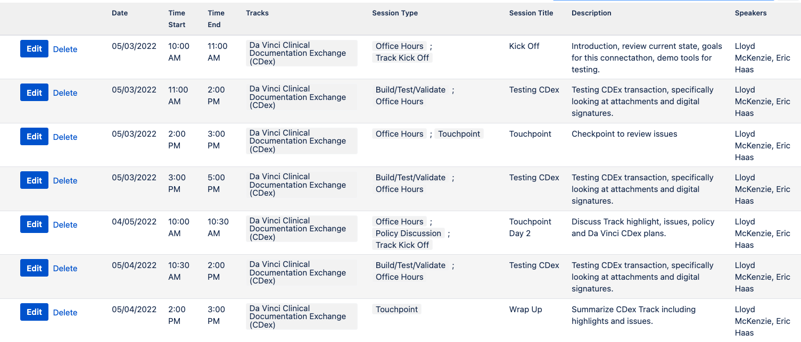
Schedule
Connectathon kick-off May 2, 2022 at 4:00 PM ET
Can still schedule ad-hoc sessions as desired by participants
Notes:
Breakout for discussion of adding a FHIR transaction for Data element analysis for what is needed from the Payer277 and Payer278 tx. – PIE workgroup
NOTE: Testing can happen outside scheduled hours

Slide 17
Communications
Track Details: https://confluence.hl7.org/pages/viewpage.action?pageId=90356723
Zulip Chat: https://chat.fhir.org/#narrow/stream/180805-Da-Vinci.20eCDx

Slide 18
Objectives and Roles
Objective is for participants to write/test code, give feedback on specification
Participants should review the specification and track and have an application or server ready to test prior to the connectathon (see system roles)
System roles:
Synchronous Data Source (Provider)
Synchronous Data Consumer (Payer or Provider)
Asynchronous Data Source (Provider)
Asynchronous Data Consumer (Payer or Provider
Attachments Data Source (Provider)
Attachments Data Consumer (Payer)

Slide 19
Sign Up for Track
Sign up for track using ConMan App: http://conman.clinfhir.com/?event=con30
Name
Organization
Sub-track(s)
What will you be bringing to test?
Endpoints
Special instructions to connect (e.g., email for authorization)

Slide 20


OTHER FEATURES
Signatures
Purpose of Use (Task only)
Work Queue Hints (Task only)

Slide 21
Use Case Focus Areas
Quality Improvement
Member Access
Clinical Data Exchange
Data Exchange for Quality Measures STU2
Clinical Data
Exchange
Payer Data
Exchange
Payer Data
Exchange
Payer Data Exchange: Formulary
Payer Data Exchange: Directory
Clinical Data
Exchange
Gaps in Care & Information
Payer Coverage Decision Exchange
Process Improvement
Patient Cost Transparency
Notifications
Coverage Requirements Discovery STU2
Coverage / Burden Reduction
Patient Data Exchange
Risk Based Contract Member Identification
Risk Based Coding
Documentation Templates and Rules
Performing Laboratory Reporting
Prior-Authorization Support
Published
Use Case
HL7 Standards Progress
Balloting
Build
Aligned with specific ONC or CMS rule or proposed rule
Future
Notes:
Where does it fit in to other Da Vinci Guides?

Slide 22



Proposed CMS Rules
Aligned with final ONC or CMS rule
Use Case Readiness
Clinical Data Exchange
Coverage, Transparency & Burden Reduction
Clinical Data
Exchange (CDex)t
Payer Data Exchange (PDex)*
Coverage Requirements Discovery (CRD)t
Documentation Templates and Rules (DTR)t
Prior-Authorization Support (PAS)t
Quality & Risk
Formulary*
Plan Net/Directory*
Patient Cost Transparency (PCT)t
Data Exchange for Quality Measures inc. Gaps In Care (DEQM/GIC)
Risk Adjustment (RA)
Foundational Assets
Member Attribution List
Notifications *
Health Record Exchange (HRex)
* Referenced in or supports Federal Regulation
Aligned with expected Federal Regulation
Dial denotes progress in current STU Phase
Overall Maturity: | Most Mature | Active Growth | Least Mature
Use Cases: https://confluence.hl7.org/display/DVP/Da+Vinci+Use+Cases
Notes:
Hrex Published – March 2022!
Cdex Published – March 2022!
Plan Net 1.1 published March 2022!

Slide 23
How Does CDEX fit into RA?
CDEX
DEQM
RA
Notes:
e.g. :
Payer requests patient health record information to support a HEDIS/Stars quality program.
Payer requests patient health record information to support their Risk Adjustment submissions to CMS.
Payer requests patient health record information to support their member records. (Some payers create a clinical record for each of their members to facilitate data exchange with providers. Payers use this clinical record to give providers the adequate information to execute care coordination decisions.)
Payers requests patient health record information to meet new regulatory requirements (e.g., promoting patient access)
Type of information needed by Payers includes:
Medical records - for example, a progress note or visit summary
C-CDA’s of various types
The other IG has not been or can not be implemented for the use case. For example, the Data Exchange For Quality Measures (DEQM) Implementation Guide provides a standard method for automating the reporting of Quality Measures. CDex can be used when:
The measure is not yet implementable using DEQM
A Provider has not implemented DEQM
Additional information is required for an audit of the Quality Measure.

Slide 24

What About Bulk?
Notes:
http://build.fhir.org/ig/HL7/davinci-ecdx/exchanging-clinical-data.html
For example, requesting all the information related to their members using POST [base]/Group/$export.
“here has not been enough implementation experience with this use case to provide specific guidance in this guide.”
Consider Task + Subscription may be best suited for this. Refer to discussions yesterday at connectathon.

Slide 25
Next Steps
Publication
Test at future Connectathons
Tentative next version in January 2022 Ballot for Community Input and Review
References
Notes:
Roadmap for supplemental example guides to flesh out specific use cases.

Slide 26
REFERENCES

Slide 27
Resources
Lloyd McKenzie Track Lead lloyd.mckenzie@accenture.com
Eric Haas (Track Lead) ehaas@healthedatainc.com
Vanessa Candelora (Project Manager) vanessa.candelora@pocp.com
Confluence Page
Conference Calls: Wednesdays at 2 pm Eastern
https://global.gotomeeting.com/join/514633709
Join us! All our Welcome!

Slide 28
Questions
For Questions Contact me at: ehaas@healthedatainc.com

